Slide 1

Code Metrics
Automation Server
Putne

Slide 2
Open source
Ruby
Code Metrics & Visualization
Automation Server
Putne

Slide 3
Putne
Code metrics
Automation server
(Visualization)
(Ruby / Git )

Slide 4
Metrics
Econometrics
Informetrics
Cinemetrics
Sabermetics
...

Slide 5
Code metrics
Index of code quality
Code coverage
Complexity
Duplication
Code smells
Churn / Bugspot
...

Slide 6
Ruby code metrics
There are many gems for code metrics
https://github.com/metricfu/metric_fu/wiki/Code-Tools

Slide 7
Ruby code metrics
metric_fu, saikuro-treemap, rcov, Simplecov, cane, code_metrics, mutant, turbulence, brakeman, holepicker, bugspots, Outlaw, Git statistics, Excellent, laser, discover unused partaials, flay, heckle, gauntlet, roodi, repodepot, rails indexes, consistency fail, rails-best_practices,appraisal, reek, hopper, metriks, rubocop, ruby-lint, flog, pelusa, rbx only, autometric video, Churn, old_yeller, tailor, PMD, rushcheck, saikuro, crap4r, dont_repeat_yourself, perftools.rb, devtools, sandi_meter, code_rippa, doc printer ....
https://github.com/metricfu/metric_fu/wiki/Code-Tools

Slide 8
metric_fu, saikuro-treemap, rcov, Simplecov, cane, code_metrics, mutant, turbulence, brakeman, holepicker, bugspots, Outlaw, Git statistics, Excellent, laser, discover unused partaials, flay, heckle, gauntlet, roodi, repodepot, rails indexes, consistency fail, rails-best_practices,appraisal, reek, hopper, metriks, rubocop, ruby-lint, flog, pelusa, rbx only, autometric video, Churn, old_yeller, tailor, PMD, rushcheck, saikuro, crap4r, dont_repeat_yourself, perftools.rb, devtools, sandi_meter, code_rippa, doc printer ....

Slide 9
Automation server
Web service
  Code climate
Continuous integration
  matric_fu
    cane, flog, reek, flay, saikuro, ...
Self-hosted
  Putne
    use push hook ( Just add your repo url! )

Slide 10
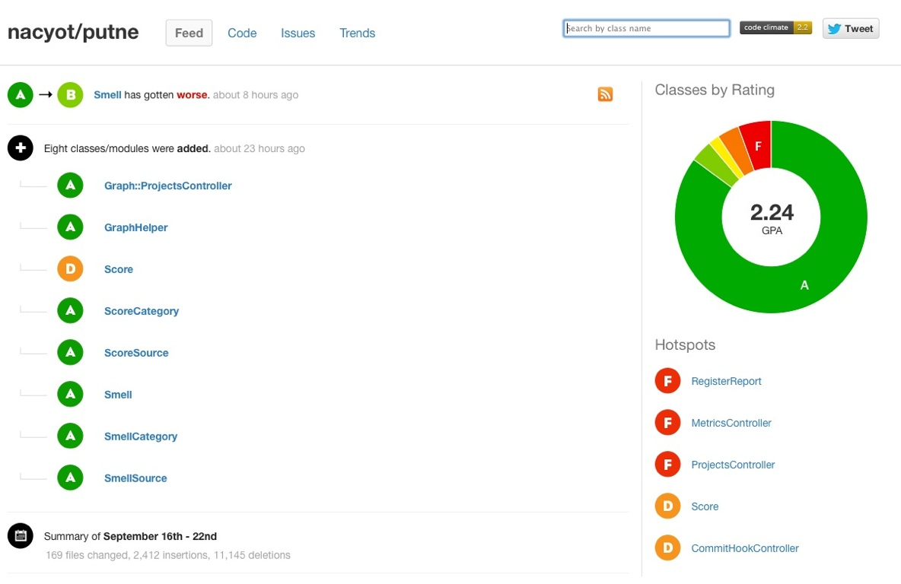
Code Climate

Slide 11
Putne vs Code climate
Putne
  is self-hosetd automation server
  is open source
  has extendability
Code climate
  is commercial
  is web service
  provides limited report on purpose
  web service

Slide 12
Visualization
is always starting point of statistical analysis.
provides exploratory report.
gives you bird-eye view of your projects.

Slide 13
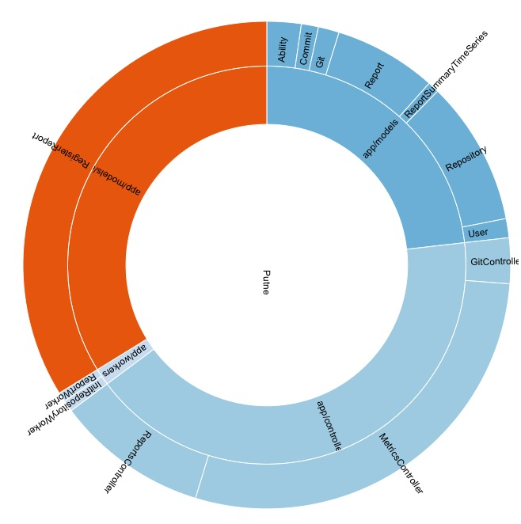
Putne complexity sunburst

Slide 14

Activity calendar

Slide 15
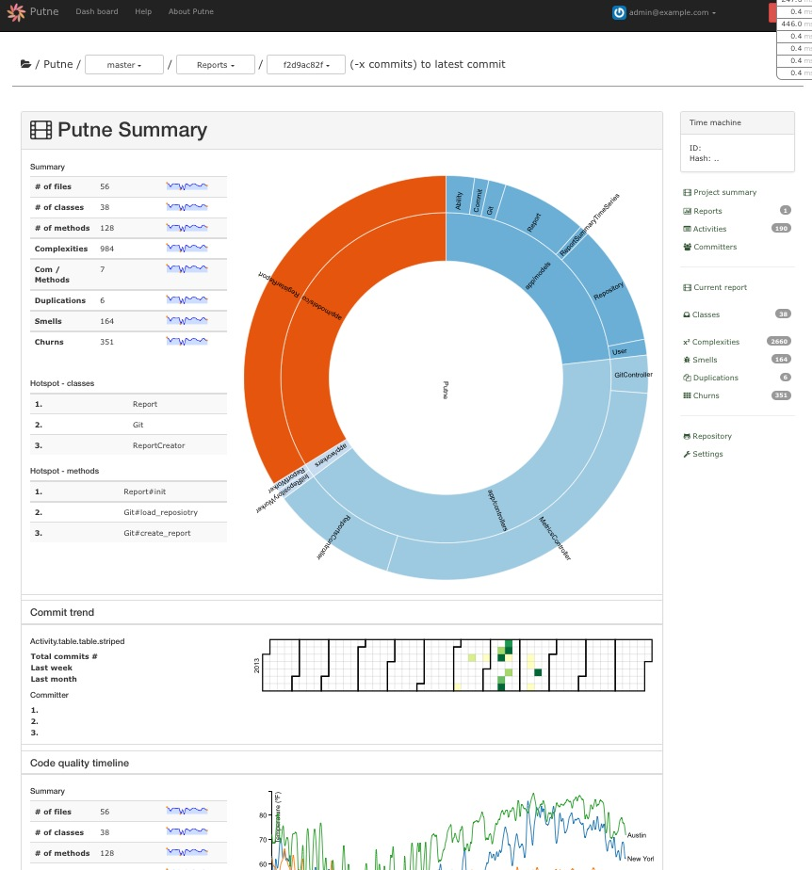

Slide 16
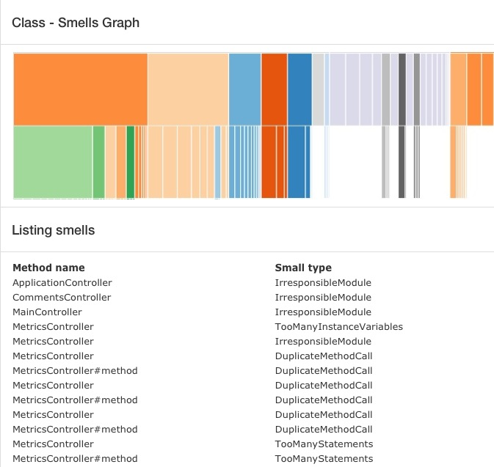

Slide 17
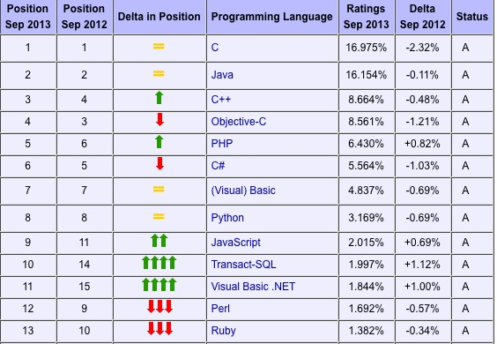
TOIBE Index
http://www.tiobe.com/index.php/content/paperinfo/tpci/index.html

Slide 18
Repository has >= 1 stars in github
Ruby | 147,451
Javascript | 126,887
Java | 93,303
Python | 73,940
PHP | 68,448
C | 39,800
Perl | 37,224
C++ | 35,870
Shell | 22,037
C# | 21,997

Slide 19
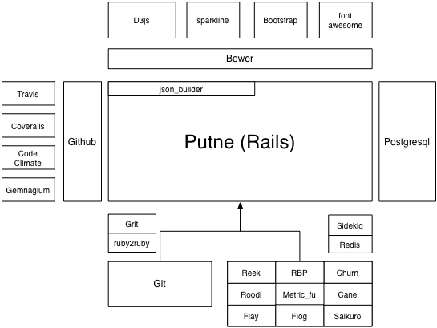
Architecture

Slide 20
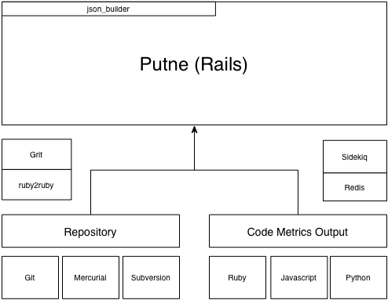
Todo #1

Slide 21
Todo #2
Other code metrics report
Notification
PDF export
Github API
Shell interface
And there are many issues on putne github repo.

Slide 22
Questions?

