Slide 1
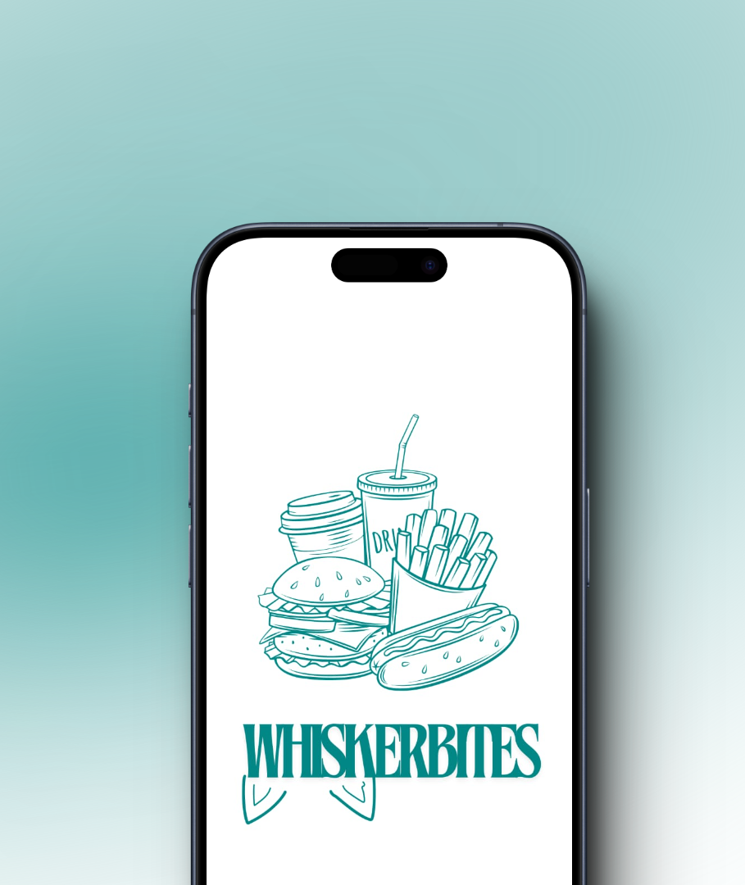

WhiskerBites: Food Ordering App
WhiskerBites is an innovative food ordering application that provides users with a seamless and efficient way to discover and order from a wide range of local restaurants. With advanced authentication, intuitive listings, and flexible fulfillment options, WhiskerBites delivers a delightful dining experience right at your fingertips.

Slide 2
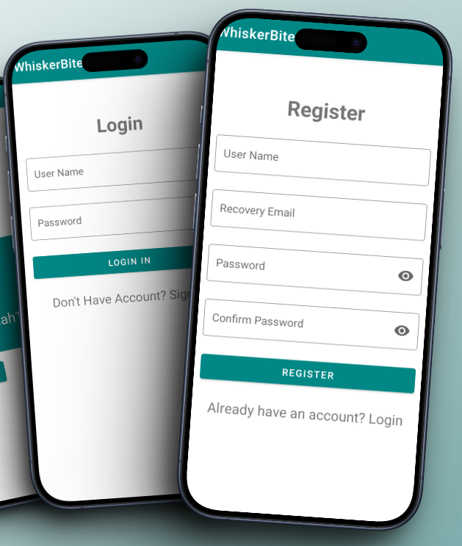
User Authentication and Login/Signup
1
Secure Login
2
Seamless Signup
3
Profile Management
WhiskerBites offers a secure and convenient login process, allowing users to sign in using their email, phone number, or social media accounts.
New users can quickly create an account and start ordering with just a few simple steps, ensuring a frictionless onboarding experience.
Users can easily update their personal information, payment details, and delivery preferences within the app, ensuring a personalized experience.

Slide 3
Restaurant and Menu Listings
Wide Variety
Detailed Menus
WhiskerBites offers an extensive selection of restaurants, covering a diverse range of cuisines to cater to diverse customer preferences.
Users can explore comprehensive menus for each restaurant, complete with detailed descriptions, high-quality images, and pricing information.
Personalized Recommendations
Reliable Information
The app's smart algorithms provide personalized meal suggestions based on user preferences.
Up-to-date restaurant details, including operating hours, help customers make informed decisions.

Slide 4
Comprehensive Cart Management
Flexible Order Customization
Delivery / Pickup Option
Seamless Checkout
The app stores users' previous orders, allowing them to select both pickup and delivery option
The intuitive checkout process guides users through the payment and order confirmation steps, ensuring a smooth and efficient transaction.
Users can easily customize their orders, adjusting quantities, selecting add-ons, for the restaurant.

Slide 5
Flexible Order Fulfillment
Delivery Options
Pickup Alternatives
WhiskerBites offers on-demand delivery, allowing users to track their order's progress in real-time and receive their meals quickly.
For those who prefer to pick up their orders, the app provides the option to select a convenient pickup location and time.
Estimated Arrival Times
Dynamic Tracking
Users can view estimated delivery or pickup times, ensuring they can plan their day accordingly and prepare for the arrival of their food.
The app's tracking capabilities allow customers to monitor the status of their orders and receive updates on the delivery progress.

Slide 6




Delivery and Pickup Options
On-Demand Delivery
Convenient Pickup
Estimated Arrival Times
Wide Coverage
Pickup your order from a nearby designated location.
Extensive delivery and pickup areas to serve your needs.
Fast and reliable delivery services to your doorstep.
Stay informed with real-time updates on your order status.

Slide 7
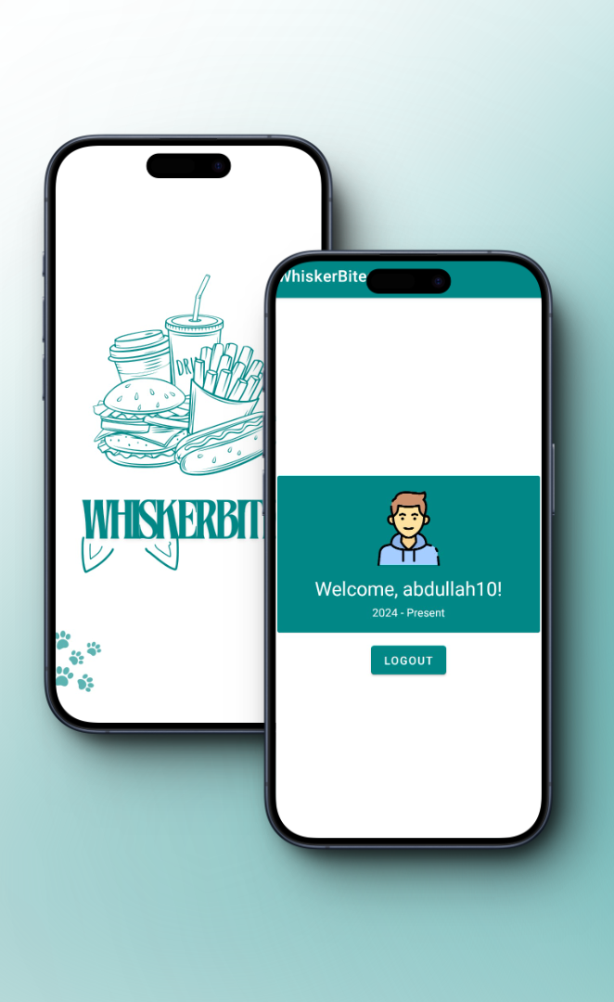



Seamless User Experience
Intuitive Navigation
The app's user-friendly interface makes it easy to browse, and order from your favorite restaurants.
Personalized Recommendations
Intelligent code suggest meals and restaurants tailored to your tastes, simplifying the decision-making process.
Seamless Checkout
A streamlined checkout experience with secure payment options and order tracking ensures a hassle-free transaction.

