Slide 1
USART
Universal Synchronous Asynchronous Receiver Transmitter

Slide 2
Outlines
USART main functions
USART Block diagram
USART Transmitter
USART Receiver
Use of separate transmitter/ receiver shift register.
2

Slide 3
USART main functions
Can be synchronous (with clock) or asynchronous (no clock signal).
Can be either transmitter or receiver.
Uses full duplex operation.
Serial interface.
Most commonly used in asynchronous operation with one pin used for transmission and another pin for reception .
3

Slide 4
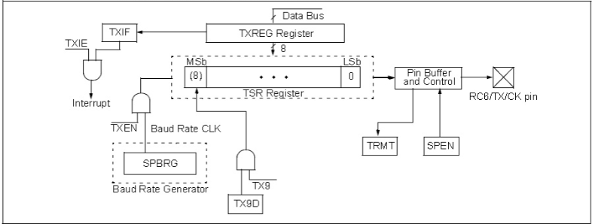
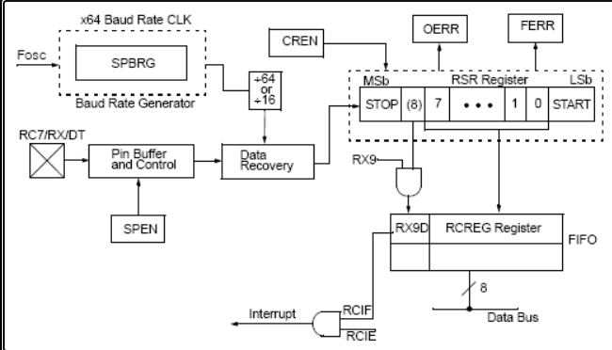
USART block diagram
Transmitter block diagram
Receiver block diagram
4

Slide 5
USART Transmitter
The USART can be configured to transmit eight or nine data bits by the TX9 bit in the TXSTA register.
If nine bits are to be transmitted, the ninth data bit must be placed in the TX9D bit of the TXSTA register before writing the other eight bits to the TXREG register.
Once data has been written to TXREG, the eight or nine bits are moved into the transmit shift register.
From there they are clocked out onto the TX pin preceded by a start bit and followed by a stop bit.
9/4/2021
A 100-MS/S 8-BIT 10-ENOB NOISE-SHAPING SAR ADC | Nada Mohamed
5

Slide 6
USART Receiver
The USART can be configured to receive eight or nine bits by the RX9 bit in the RCSTA register.
After the detection of a start bit, eight or nine bits of serial data are shifted from the RX pin into the receive shift register one bit at a time.
After the last bit has been shifted in, the stop bit is checked and the data is moved into the buffer which passes the data through to the RCREG register if it is empty. The buffer and RCREG register therefore form a two element FIFO.
If nine bit reception is enabled, the ninth bit is passed into the RX9D bit in the RCSTA register in the same way as the other eight bits of data are passed into the RCREG register.
9/4/2021
A 100-MS/S 8-BIT 10-ENOB NOISE-SHAPING SAR ADC | Nada Mohamed
6

