Slide 1
ANIMAL CLASSIFICATION USING CONVOLUTIONAL NEURAL NETWORKS (CNN)

Slide 2
Introduction :
The goal of this project is to build a deep learning model that can classify images of animals into four categories.
Categories: Buffalo, Elephant, Rhino, Zebra.
Importance: Helps automate animal recognition in images, useful in wildlife monitoring and research.

Slide 3
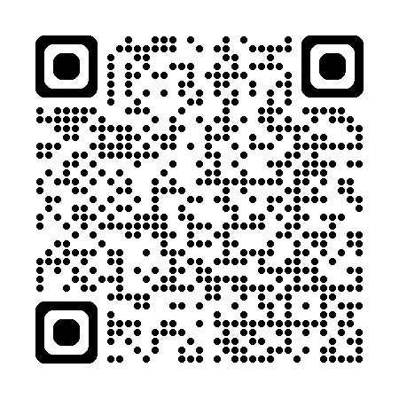
Dataset :
Image dataset organized by folders (one for each class).
Total images:
Training set: 3200 images Va lidation set: 800 images
Used Image DataGenerator to preprocess and augment images (rescaling, f lipping, rotating, etc.).
Link dataset : https://www.kaggle.com/datasets/ayushv322/animal-classification/data

Slide 4
Model Architecture :
Built using Sequential model from Keras.
Layers used:
Conv2D + MaxPooling2D Flatten
Dense with ReLU activation
Dropout for regularization Softmax for final classification
Optimizer: Adam, Loss Function: categorical_crossentropy

Slide 5
Training Results :
Trained for 25 epochs
Final training accuracy: 97.7% Final validation accuracy: 79.6%
Model saved as: animal_classifier_kaggle.h5

Slide 6
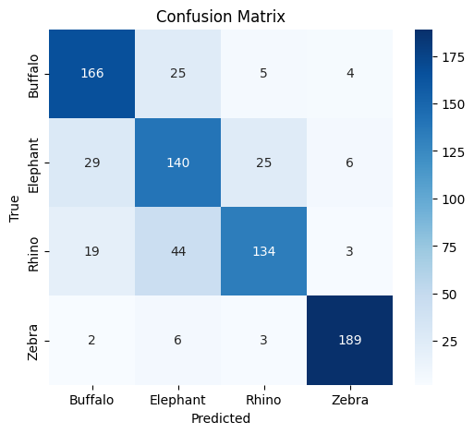
Evaluation :
Overall Accuracy on validation set: 79%
Classification Report: Zebra: 94% precision
Buffalo: 80% precision
Rhino: 73% precision
Elephant: 67% precision

Slide 7
Predictions :
Model tested on both dataset images and custom images.
Images were displayed with predicted labels.
Example: Zebra image predicted correctly with high confidence.

Slide 8
Conclusion :
CNN model successfully classifies animals with good accuracy.
Performance can be improved by:
Adding more training data Using deeper architectures
Useful for wildlife monitoring, research, and educational purposes.

Slide 9
THANK YOU
Nada Hesham Diab
202203904
Rania Mohamed Abd-elsameea 202203992

