Slide 1
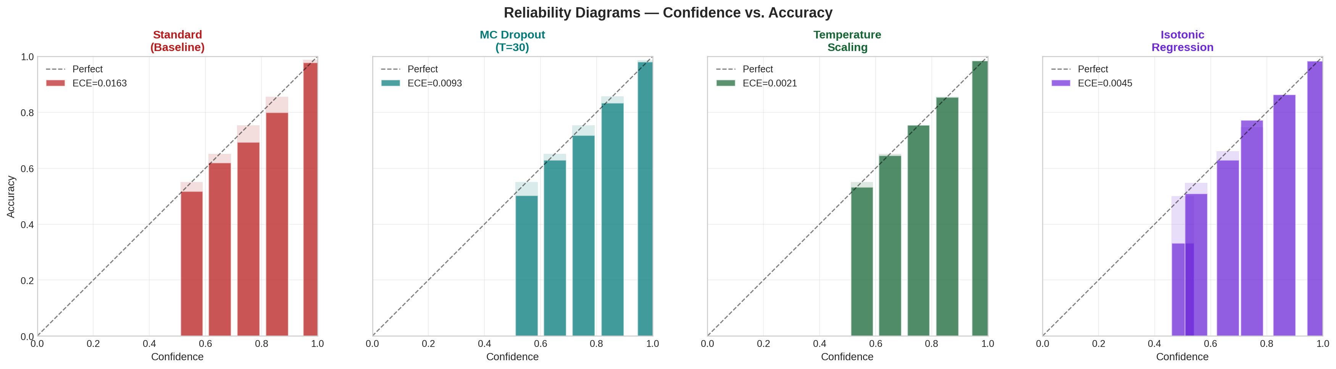
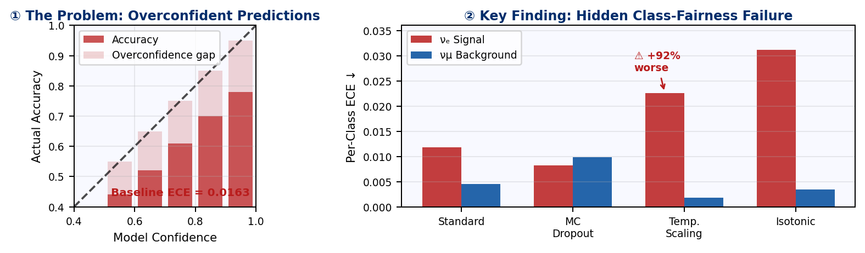

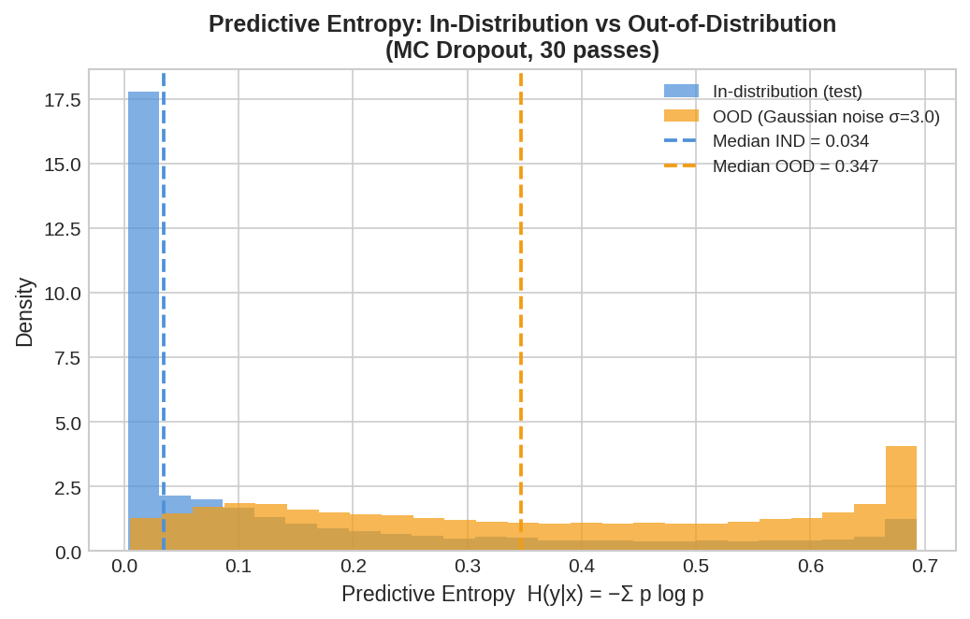
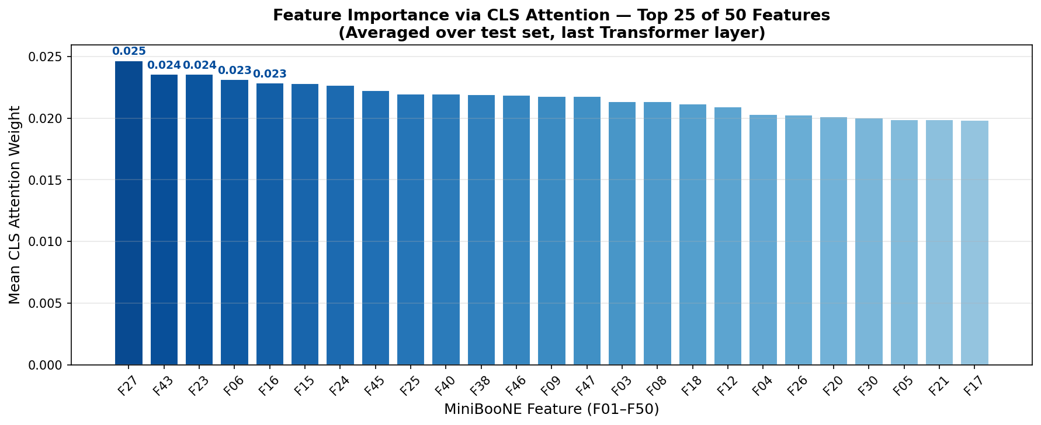
ICTP
Uni Messina
MAECI
Erasmus+
International Centre for
Theoretical Physics
ICTP Trieste · July 2026
Toward Robust Deep Learning: Evaluating Uncertainty in
Transformer-Based Architectures for Scientific Data
Nada Ibrahim Abdelrahman Elhassan · inada350@gmail.com · M.Sc. Data Science, University of Messina
Supervisor: Prof. [Advisor Name] · MAECI Scholar · Erasmus+ Grantee
① Abstract
② Methodology
③ Results
Why: Particle physics experiments depend on reliable model confidence scores for event selection and trigger decisions. A miscalibrated model silently distorts analyses — discarding genuine signal events or polluting samples with background.
A. FT-Transformer Architecture
Reliability Diagrams — Confidence vs. Accuracy (4 methods)
What: We evaluate epistemic uncertainty — model uncertainty arising from limited knowledge, not inherent data noise — in an FT-Transformer trained on MiniBooNE (Fermilab, 130k νₑ/νμ events, 50 kinematic features).
Input: 50 continuous kinematic features x₁ x₂ ··· x₅₀ ∈ ℝ
How: Four post-hoc UQ methods compared: Standard · MC Dropout (Bayesian approximation, epistemic) · Temperature Scaling · Isotonic Regression. Evaluated on ECE, NLL, Brier Score, and balanced accuracy.
Feature Tokenizer
Finding: Temperature Scaling reduces overall ECE by 87% — but worsens rare νₑ signal calibration by 92%, exposing a hidden class-fairness failure critical for physics applications.
50 independent Linear(1 → 64) — one per feature, NOT shared
★ Novel contribution: We characterise epistemic (model) uncertainty in FT-Transformer-based particle classification — revealing that global calibration methods systematically fail the rare νₑ signal class, a previously unexamined failure mode in imbalanced HEP data.
W₁
W₂
W₃
···
W₄₉
W₅₀
tᵢ = xᵢ · Wᵢ + bᵢ ∈ ℝ⁶⁴
MiniBooNE
Data
FT-
Transformer
4 UQ
Methods
Calibrated
Output
[CLS] t₁ t₂ ··· t₅₀ — 51 tokens ∈ ℝ⁶⁴
130k events
50 features
d=64, 2 layers
MC Dropout
Std·MC·TS·IR
ECE ↓87%
T=1.282
Transformer Encoder
× 2 layers
Expected Calibration Error (ECE) — All Four Methods
Multi-Head Self-Attention (4 heads, d_head=16)
α = softmax(QKᵀ/√d_head) · V
Q=TW_Q, K=TW_K, V=TW_V
Feed-Forward Network (d_ff = 256)
Dataset: MiniBooNE Particle Identification
Linear(64→256) → GELU → Linear(256→64)
130,064
50
28%
92.3%
d=64 · heads=4 · layers=2 · dropout=0.2 · d_ff=256
Events
Features
Signal νₑ
Bal. Acc.
Method
Bal.Acc
ECE
NLL
Brier
νₑ ECE ⚠
Standard
0.9229
0.0163
0.1696
0.0982
0.0118
MC Dropout (p=0.2) · ACTIVE at inference · T=30 stochastic passes → epistemic uncertainty
MC Dropout
0.9215
0.0092
0.1657
0.0972
0.0102
Temp. Scaling ★
0.9229
0.0021
0.1645
0.0970
0.0226
LayerNorm → Linear(64→2) → Softmax → p(νₑ|x), p(νμ|x)
Isotonic
0.9209
0.0045
0.1672
0.0971
0.0311
⚠ νₑ ECE: TS achieves best overall ECE (0.0021) but worsens signal ECE by 92% (0.0118→0.0226). Red cells show the class-fairness trade-off.
B. Uncertainty Quantification Metrics
★ KEY FINDING: Per-Class Calibration — νₑ Signal vs νμ Background
Epistemic uncertainty (model uncertainty, reducible) is captured by MC Dropout. Aleatoric uncertainty (inherent data noise, irreducible) is present in both classes but not separately modelled here.
▶ Fermilab MiniBooNE: νμ beam → 800t mineral oil → Cherenkov rings → 1,520 PMTs.
① Expected Calibration Error (ECE)
Best: 0.0021★
▶ 50 continuous kinematic features F01–F50. No categorical variables.
ECE = Σ (|Bₘ|/n) × |acc(Bₘ) − conf(Bₘ)|
▶ OOD set: σ=3.0 Gaussian noise on standardised features (synthetic, acknowledged limitation).
Raw
probs
Bin by
conf.
Gap:
conf−acc
ECE
sum
Code & Reproducibility
github.com/nadaibrahim-png/
Transformers_UQ
⚠ Trade-off: TS achieves best overall ECE (0.0021) but worsens νₑ signal calibration by 92% (0.0118→0.0226). It optimises NLL dominated by the majority class. MC Dropout improves both classes and captures epistemic uncertainty for OOD detection.
Full code · Colab notebook · Pre-trained weights · All figures reproducible
② Predictive Entropy — OOD Detection
Epistemic ★
④ Conclusions & Limitations
H = − Σ p̄(y|x) · log p̄(y|x)
✓ Temperature Scaling (T=1.282) achieves best overall ECE (0.0021, ↓87%) — zero retraining needed.
Acknowledgements
Input
x
×30 passes
Dropout ON
Mean
p̄(y|x)
Entropy
H(x)
⚠ TS worsens νₑ signal calibration by 92% — a class-fairness failure hidden by aggregate metrics.
This work was supported by the Italian Ministry of Foreign Affairs and International Cooperation (MAECI) through a scholarship for international students, and by the Erasmus+ Programme of the European Union. The author thanks the University of Messina and ICTP Trieste for hosting this research. Special thanks to Prof. Dario Bruneo for his guidance throughout this work.
IND: H≈0.034 lower entropy → certain
OOD: H≈0.347 higher entropy → uncertain
✓ MC Dropout quantifies epistemic uncertainty and enables OOD detection via predictive entropy.
★ Recommendation: TS for overall calibration · MC Dropout for signal-critical or OOD-aware decisions.
③ Temperature Scaling (T = 1.282)
Best ECE ★
◌ Limitation: single dataset/architecture, synthetic OOD. Future: class-conditional TS, multi-seed, physical OOD.
p̂(y|x) = softmax( z / T ) T fitted on val set
⑤ References
[1] Gal & Ghahramani 2016 · Dropout as Bayesian Approx. · arXiv:1506.02142
Logits
z
÷ T
1.282
Calibrated
softmax
[2] Gorishniy et al. 2021 · Revisiting DL for Tabular Data · arXiv:2106.05346
[3] Guo et al. 2017 · On Calibration of Modern NNs · arXiv:1706.04599
Before: overconfident (conf > acc)
After: calibrated (conf ≈ acc)
[4] Vaswani et al. 2017 · Attention Is All You Need · arXiv:1706.03762
[5] Zadrozny & Elkan 2002 · Calibrating Classifier Scores · KDD
Training: Adam lr=1e-3 · CosineAnnealingLR · 80 epochs · batch=256 · gradient clip 1.0 · 60/20/20 split

