Slide 1
FindMyDoc
A project for social change
By: Nada Laabid, Saad Lahrichi, Brahim Raiss

Slide 2
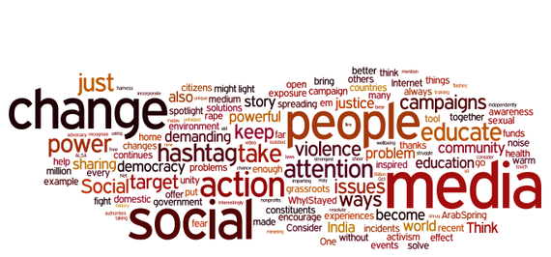

Slide 3
Summary
The problems we’re trying to solve.
The solution: our website.
How the website works?
The future plans and projections for this website.

Slide 4
The problems we’re trying to solve
Lack of communication between doctors and patients.
Long waiting time whenever we visit a doctor.
Development of more complex illnesses and death cases because of the unavailibility of some doctors.

Slide 5
To solve these problems
Create a way for the doctors to communicate with their patients and avoid the long waiting time
➔ Conception and production of FindMyDoc

Slide 6
What is FindMyDoc ?
It’s a website created by highschool students using different programming languages (HTML ,CSS and JavaScript) for web development.

Slide 7
How the website works?
Collects information about doctors in moroccan cities
Shows either the doctor is avaible or not, the estimated waiting time for patients depending on number of patients in waiting rooms.

Slide 8
How the website works?
This process depends on updates made by the secretary in the doctor’s office whenever a new patient visits the doctor or leaves.

Slide 9
The future plans for the project
Augment the numbers of cities from three cities (the current version) to all the moroccan cities.
Create an interface between the secretary and the program( add the real-time update option by the secretary)
Expand the numbers of doctors using the website.

Slide 10
Thank you!
Special acknowledgment to Doctor Cavalli, the e-nitiate team, all the volunteers and every single person who was involved in this program.

