Slide 1
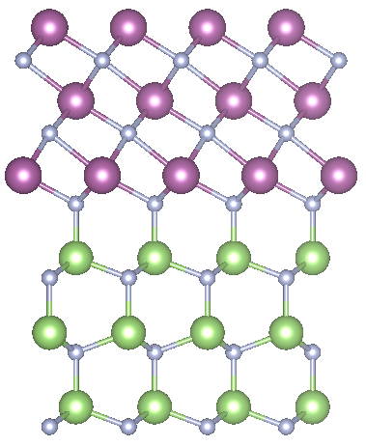
Giant polarization charge density at ScN/GaN interfaces
Nicholas L. Adamski
Department of Electrical and Computer Engineering, University of California, Santa Barbara
Cyrus E. Dreyer
Department of Physics and Astronomy,
Stony Brook University
Flatiron Institute,
A division of the Simons Foundation
Chris G. Van de Walle
Materials Department,
University of California, Santa Barbara
This work was supported by the Air Force Office of Scientific Research.

Slide 2
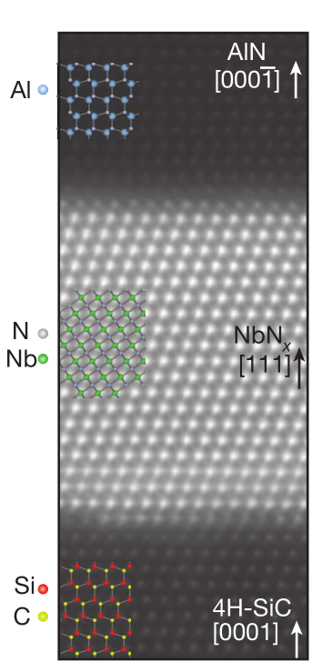
Rocksalt/Wurtzite Interfaces
NbN / AlN: metal/semiconductor
R. Yan et al., Nature 555, 183 (2018).
ScN / GaN can be grown by MBE
J. Casamento et al., Appl. Phys. Lett. 115, 172101 (2019).
ScN used as a buffer for GaN growth
M. A. Moram et al., J. Cryst. Growth 308, 302 (2007)
Alternating cations/anions
Asymmetric interfaces
Define polarization?

Slide 3
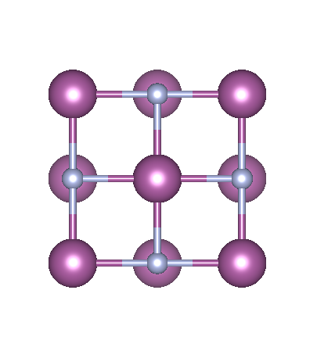
Nitride semiconductors
Wurtzite III-nitrides
Established materials system for optical and electronic devices
Wide range of band gaps (0.7 – 6.1 eV)
Strong spontaneous polarization
ScN
Rocksalt semiconductor (non-polar)
Indirect gap: 0.9 eV (Direct: 2.0eV)
Small lattice mismatch to GaN (1%) and AlN (2%)
Dopable n type and p type
B. Biswas and B. Saha Phys. Rev. Mater. 3, 020301 (2019).
ScN (rocksalt phase)

Slide 4
Nitride semiconductors
Wurtzite III-nitrides
Established materials system for optical and electronic devices
Wide range of band gaps (0.7 – 6.1 eV)
Strong spontaneous polarization
ScN
Rocksalt semiconductor (non-polar)
Indirect gap: 0.9 eV (Direct: 2.0eV)
Small lattice mismatch to GaN (1%) and AlN (2%)
Dopable n type and p type
B. Biswas and B. Saha Phys. Rev. Mater. 3, 020301 (2019).
ScN (rocksalt phase)

Slide 5
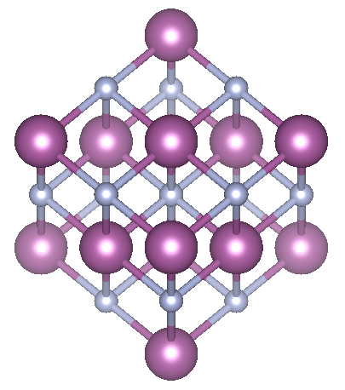
Nitride semiconductors
Wurtzite III-nitrides
Established materials system for optical and electronic devices
Wide range of band gaps (0.7 – 6.1 eV)
Strong spontaneous polarization
ScN
Rocksalt semiconductor (non-polar)
Indirect gap: 0.9 eV (Direct: 2.0eV)
Small lattice mismatch to GaN (1%) and AlN (2%)
Dopable n type and p type
B. Biswas and B. Saha Phys. Rev. Mater. 3, 020301 (2019).
ScN (rocksalt phase)

Slide 6
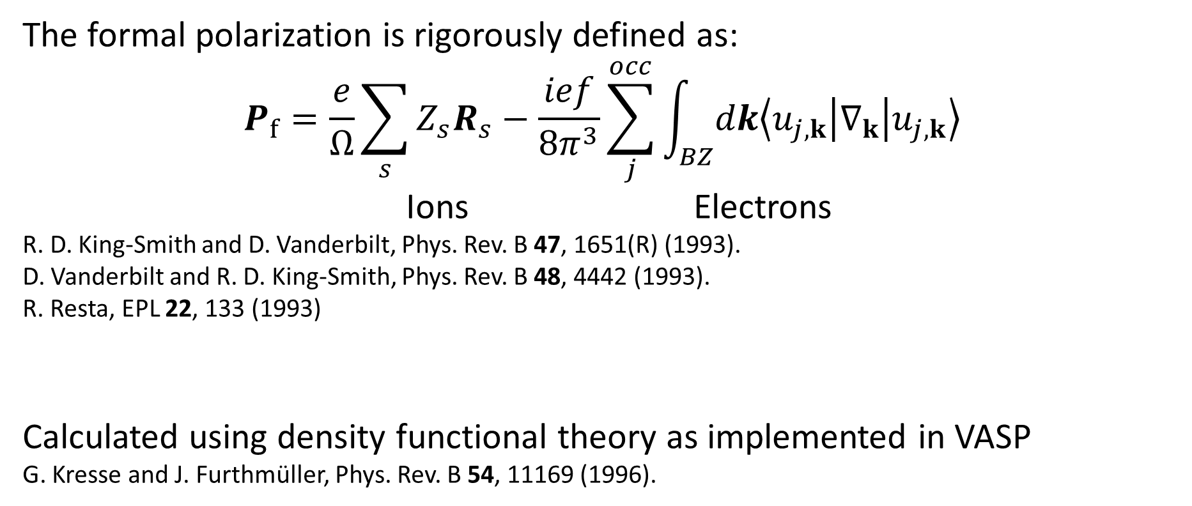
Modern Theory of Polarization
The formal polarization is rigorously defined as:
$$P_{f}=\frac{e}{Ω}\sum_{s}{Z_{s}R_{s}}−\frac{ief}{8π^{3}}\sum_{j}^{occ}{\int_{BZ}^{ }{dk\left\langle u_{j,k} | ∇_{k} | u_{j,k}\right\rangle }}$$
Ions Electrons
R. D. King-Smith and D. Vanderbilt, Phys. Rev. B 47, 1651(R) (1993).
D. Vanderbilt and R. D. King-Smith, Phys. Rev. B 48, 4442 (1993).
R. Resta, EPL 22, 133 (1993)
Calculated using density functional theory as implemented in VASP
G. Kresse and J. Furthmüller, Phys. Rev. B 54, 11169 (1996).

Slide 7
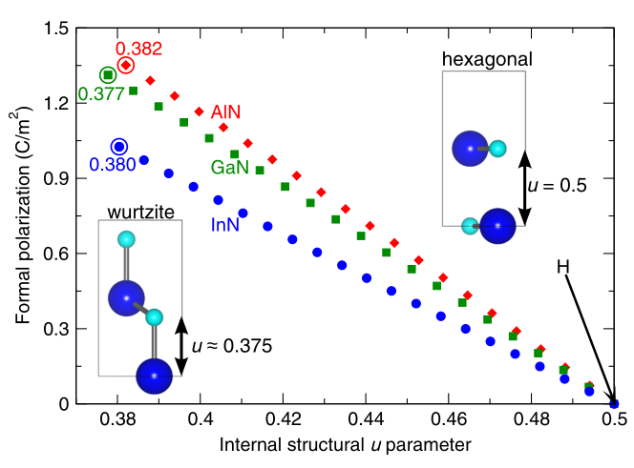
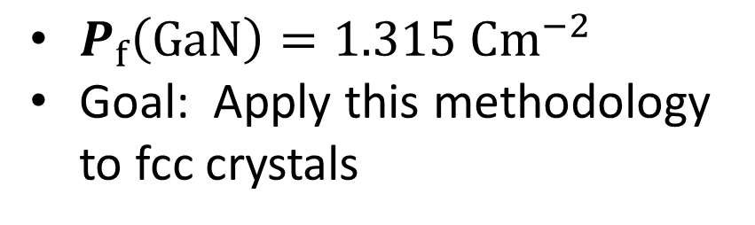
Polarization in wurtzite III-nitrides
Spontaneous polarization in wz-GaN is calculated relative to a h-GaN
Polarization is proportional to the separation between cation and anion layers along the c axis
$P_{f}\left(GaN\right)=1.315 {Cm}^{−2}$
Goal: Apply this methodology to fcc crystals
C. E. Dreyer et al. Phys. Rev. X 6, 021038 (2016).

Slide 8
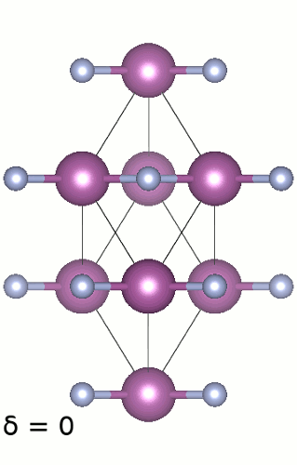
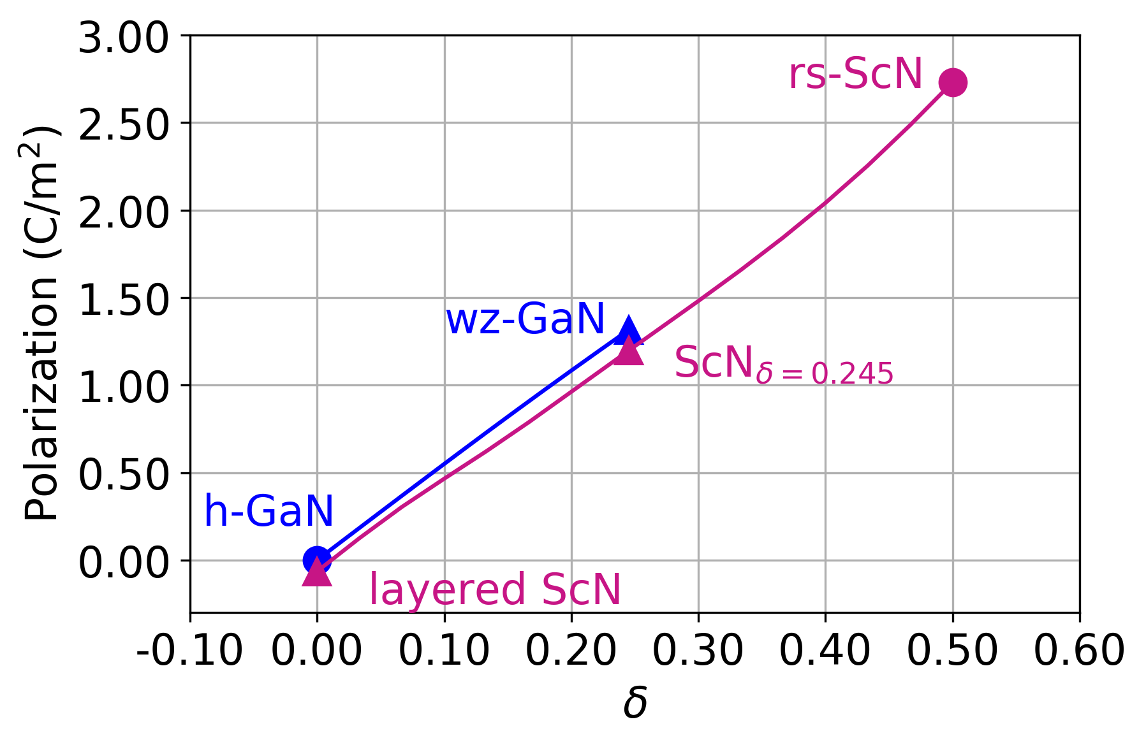


Formal polarization of rs-ScN
Compare rocksalt to a layered-ScN
Define $δ$: relative separation between cation and anion layers
$$δ={1−2u}_{wz}$$
N. L. Adamski et al., Appl. Phys. Lett. 115, 232103 (2019).

Slide 9
Formal polarization of rs-ScN
Compare rocksalt to a layered-ScN
Define $δ$: relative separation between cation and anion layers
$$δ={1−2u}_{wz}$$
N. L. Adamski et al., Appl. Phys. Lett. 115, 232103 (2019).

Slide 10
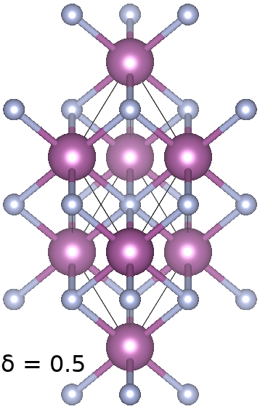
Formal polarization of rs-ScN
Compare rocksalt to a layered-ScN
Define $δ$: relative separation between cation and anion layers
$$δ={1−2u}_{wz}$$
N. L. Adamski et al., Appl. Phys. Lett. 115, 232103 (2019).

Slide 11
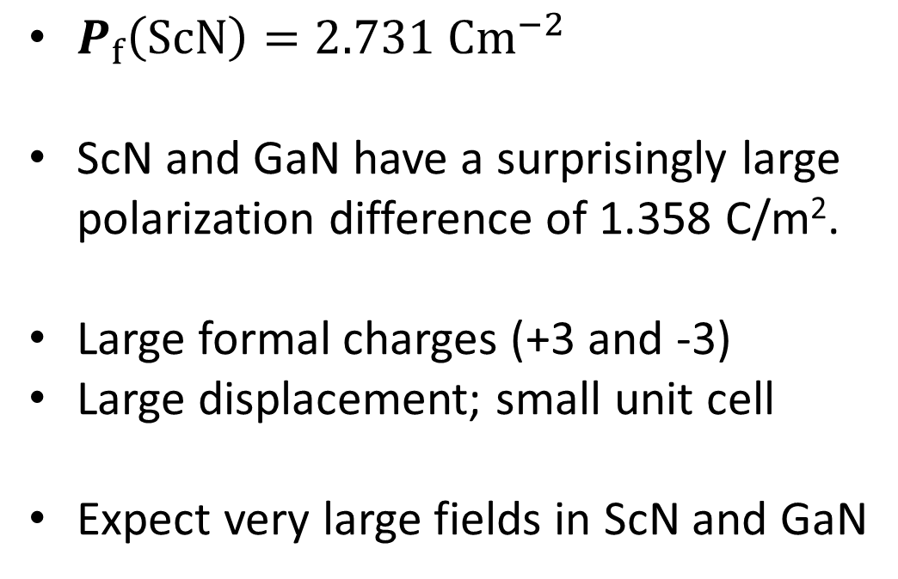
Polarization differences between ScN and GaN
$P_{f}\left(ScN\right)=2.731 {Cm}^{−2}$
ScN and GaN have a surprisingly large polarization difference of 1.358 C/m².
Large formal charges (+3 and -3)
Large displacement; small unit cell
Expect very large fields in ScN and GaN
Can confirm with explicit superlattice calculations

Slide 12
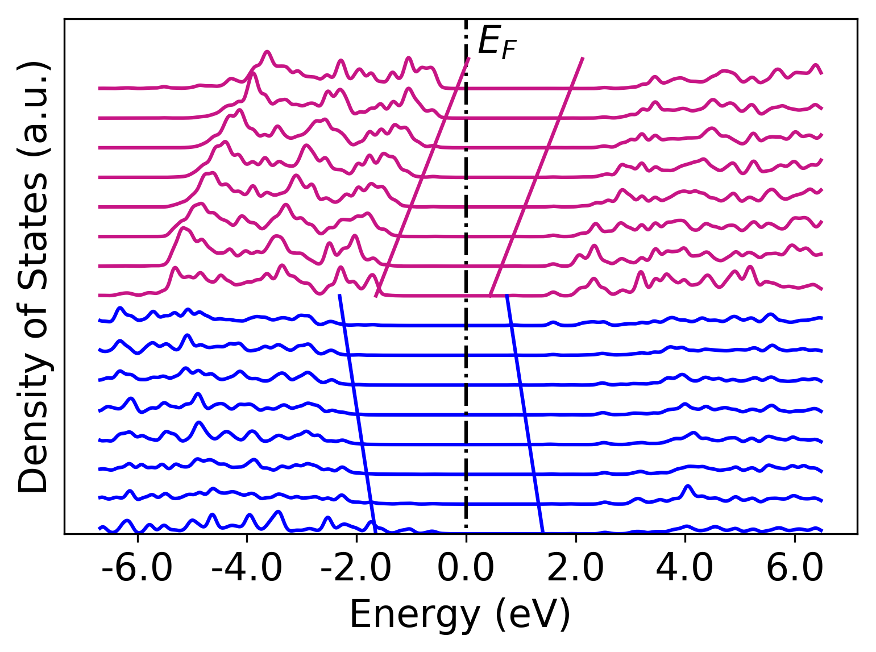
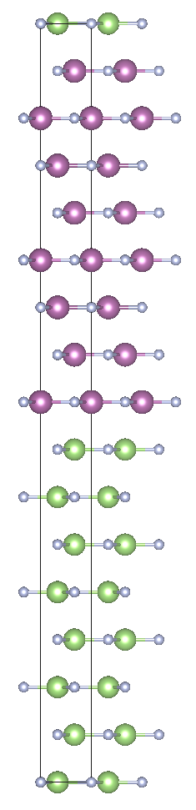
Quantitative test: h-GaN / Layered ScN
8 x 8 superlattice
h-GaN is centrosymmetric, layered ScN has lower symmetry
Small ΔP, no charge accumulation

Slide 13
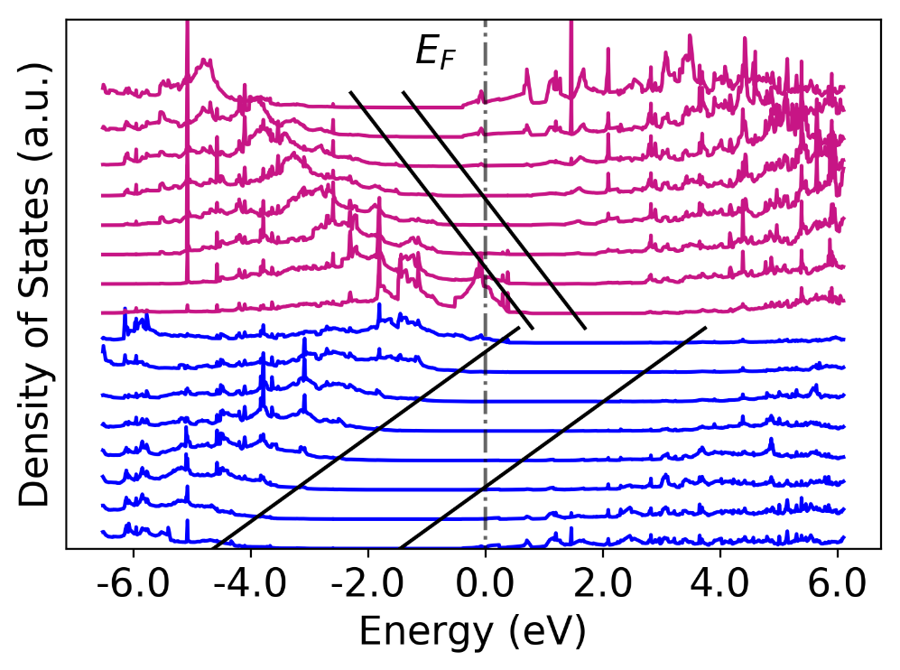
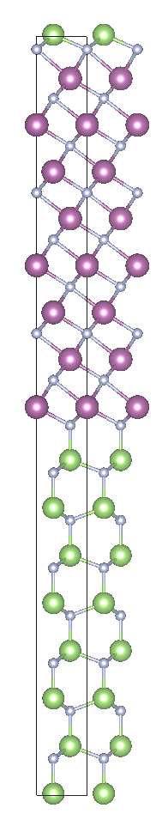
wz-GaN / rs-ScN
8 x ScN, 8 x GaN
Layer-resolved density of states shows a common band gap
Holes at Ga-polar interface
Electrons at N-polar interface
Much larger fields than AlN/GaN

Slide 14
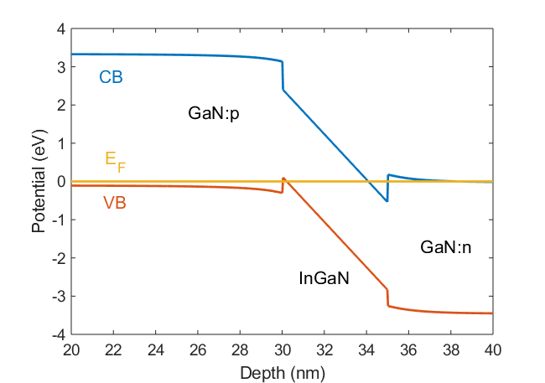
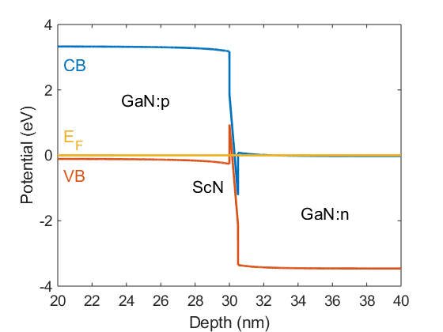
Implications of polarization charge
Polarization charge of 1.358 C/m²
Carrier concentrations up to 8.5 x 10¹⁴ cm⁻³
ScN could be used as an interlayer in tunnel junctions
Higher polarization fields than GaN and InGaN
Smaller lattice mismatch
Direct gap of ScN is over 2.0 eV
Carriers at the interfaces for contact layers or current spreading layers

Slide 15
Conclusions
Large polarization difference at rocksalt/wurtzite interface
Carrier concentrations up to 8.5 x 10¹⁴ cm⁻³
Applications in tunnel junctions and spreading layers

