Slide 1

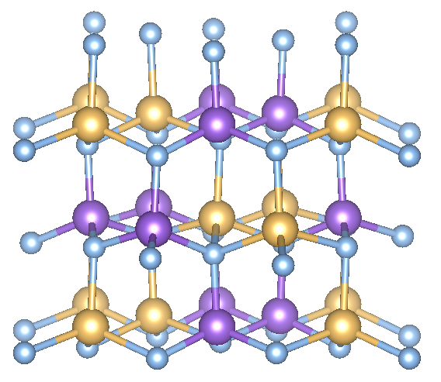
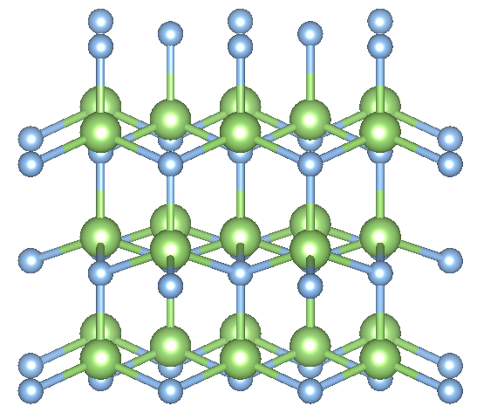
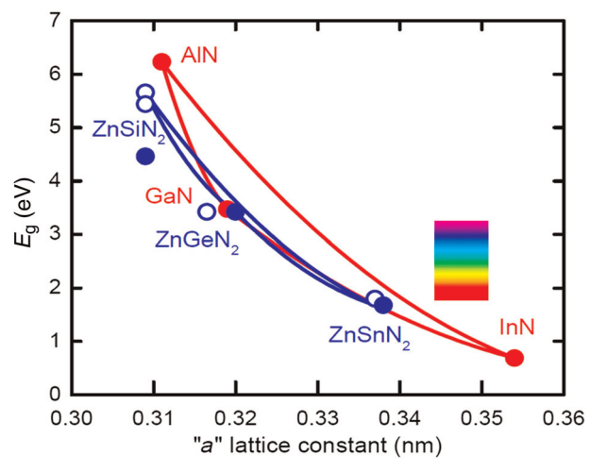
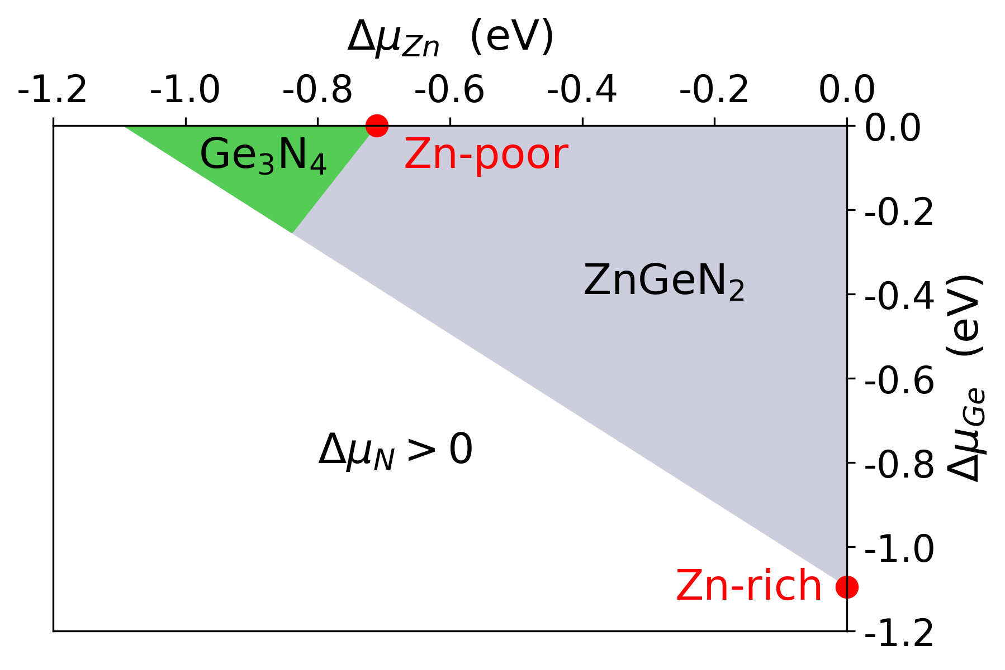
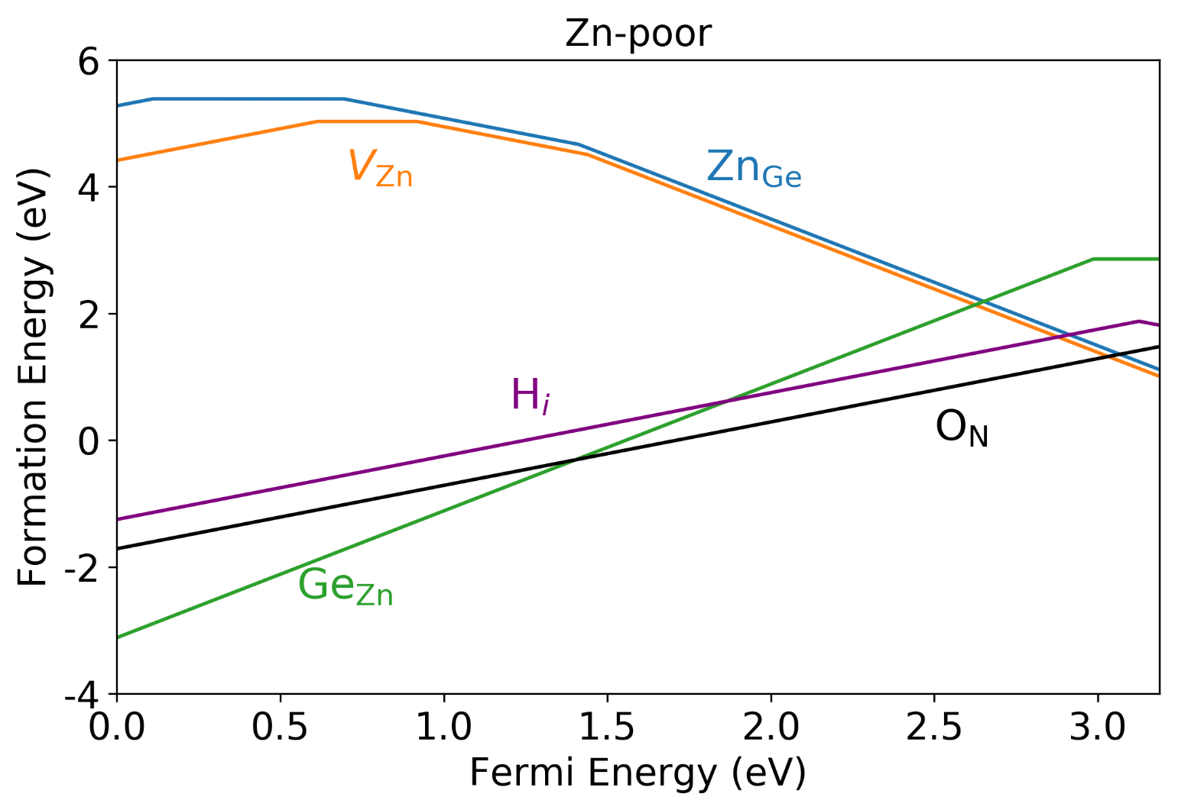
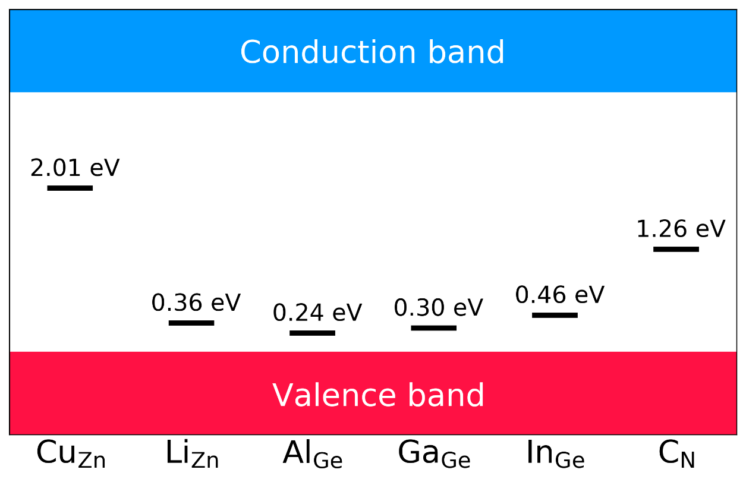
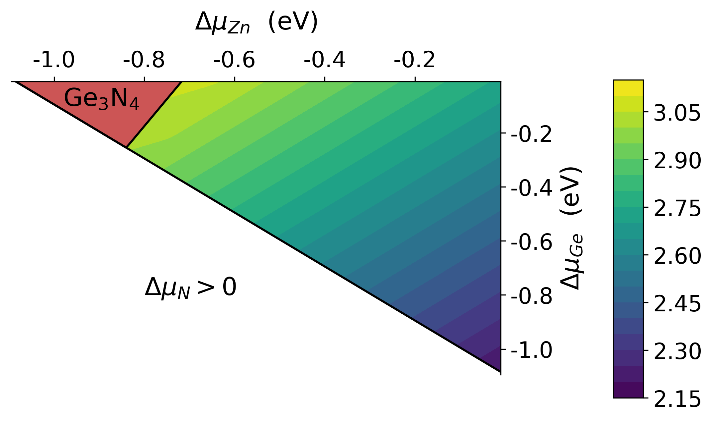
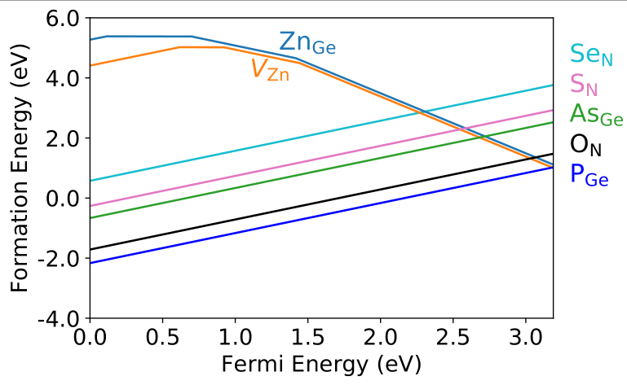
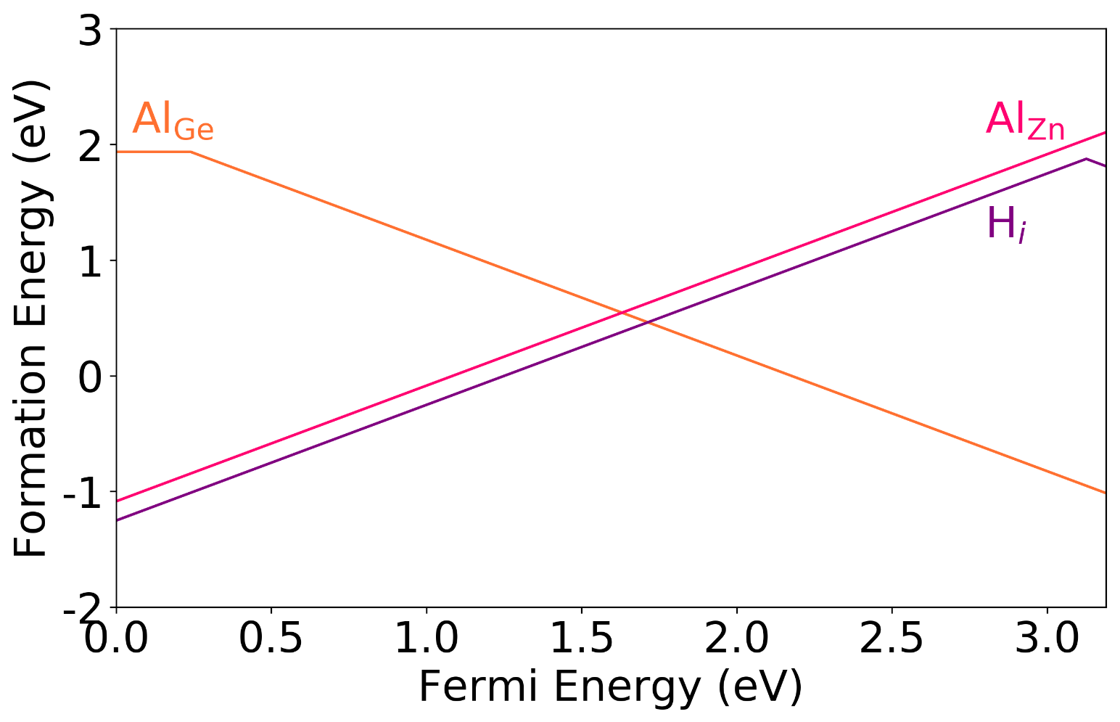
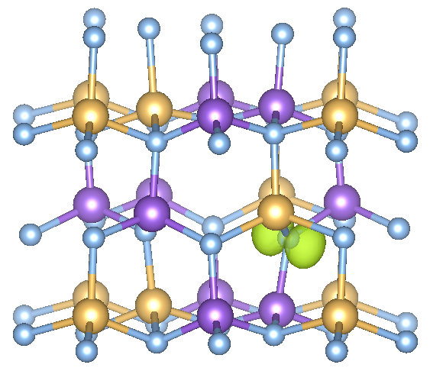
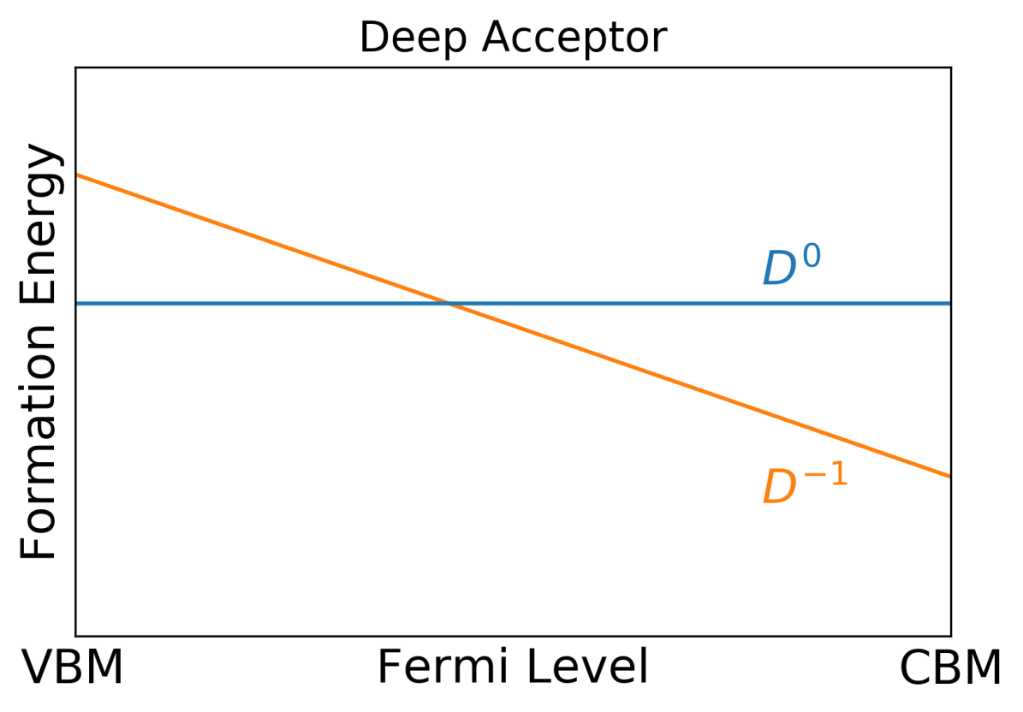
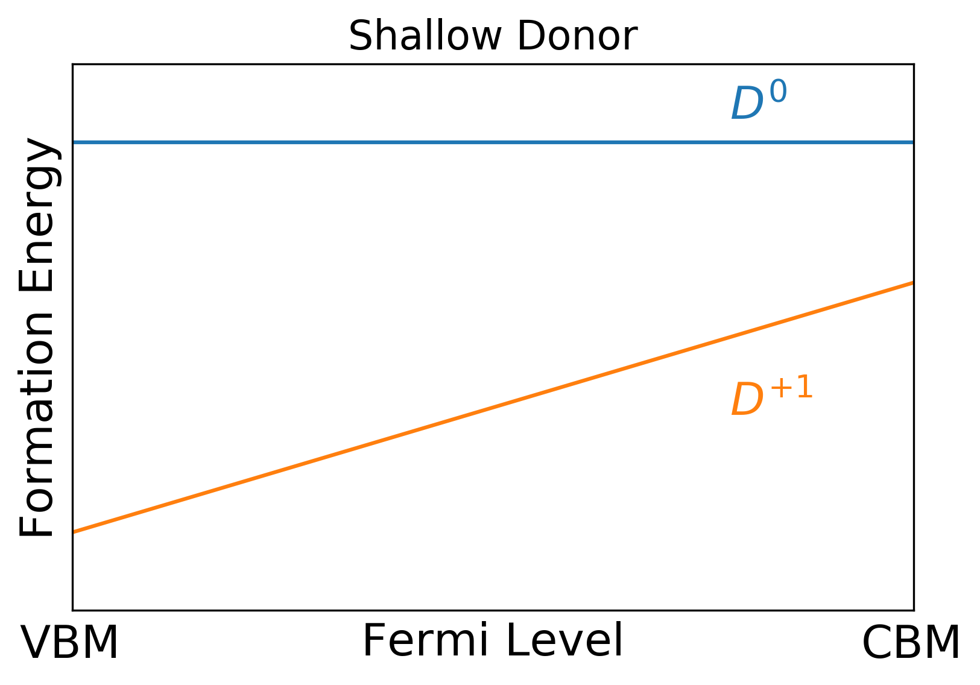
Defects and Doping in ZnGeN₂ Nicholas Adamski¹, Zhen Zhu², Darshana Wickramaratne², Chris G. Van de Walle² 1. Department of Electrical and Computer Engineering, UC Santa Barbara, 2. Materials Department, UC Santa Barbara
Motivation
Native point defects and impurities in ZnGeN₂
Candidate p-type and n-type dopants in ZnGeN₂
Defects and Impurities in ZnGeN₂
Defects and Impurities in ZnGeN₂
Acceptor levels due to substitution on Zn, Ge, and N sites
All candidate acceptors have transition levels within the band gap
Al_{Ge} has a transition level 0.24 eV from the VBM; similar to Mg in GaN
Orthorhombic ZnGeN₂
Wurtzite GaN
Quayle, P.C., et al., MRS Comm., 3(3), 135–138. (2013).
II-IV-nitrides are a promising class of materials formed from earth-abundant materials that exhibit a wide range of band gaps and spontaneous and piezoelectric polarization moments.
Potential for optoelectronic and electronic devices.
Orthorhombic II-IV-nitride unit cell derived from cation mutation of wurtzite III-nitrides: group III → group II + IV
What are the properties of defects and prospects for controlled doping in these materials?
Variation in Fermi-level pinning due to O_{N} and Zn_{Ge}
Oxygen and hydrogen are donors in ZnGeN₂, strong compensation by vacancies (V_{Zn}) and antisites (Zn_{Ge})
Fermi level is closest to the CBM (3.19 eV) under Zn-poor conditions.
Formation energy of candidate donors
All candidate donors are shallow
P_{Ge} has the lowest formation energy, and least risk of compensation
Methodology
Hydrogen-assisted p-type doping
Conclusions
Density functional theory with the Heyd-Scuseria-Ernzerhof^{[1]} functional implemented in VASP^{[2]} [1] J. Heyd, G. Scuseria, M. Ernzerhof, J. Chem. Phys. 124, 219906 (2006) [2] G. Kresse and J. Hafner, Phys. Rev. B 54, 11169 (1996)
Defect formation energies calculated using a 128-atom supercell with electronic corrections.
C. Freysoldt et al., Phys. Status Solidi B 248, 1067 (2011)
Al incorporates on Ge and Zn sites
→ strong compensation → limits p-type doping by Al_{Ge}
Al_{Ge} forms neutral complexes with H similar to Mg_{Ga} – H in GaN
Al_{Ge} – H binding energy calculated to be 0.55 eV
Diffusion barrier for H in ZnGeN₂ is 1.2 eV
H can be removed in a post-growth anneal
Native point defects in ZnGeN₂
lead to insulating material.
Al_{Ge} can lead to p-type doping in ZnGeN₂.
H-assisted doping increases Al substitution on the Ge site.
P_{Ge} is a promising n-type dopant.
Deep versus shallow defects
This work was supported by the Army Research Office (ARO) under grant number W911NF-16-1-0738. Computational resources were provided by CNSI/MRL, NERSC, and XSEDE.

