Slide 1
Sketchring – a dynamic sketch
Eiad Boulos, Nada Nusair
Supervised by Prof. Roy Friedman,
and Mrs. Rana Shahout

Slide 2
Project goals
Implementing the sketchring.
Performance analysis.

Slide 3
Project goals
High-performance stream processing is essential for many applications and asking questions in real-time about the incoming streams has become important, but the input of data streams usually come in huge volumes, and the memory is limited, therefore it is often not feasible to store the entire stream, and even linear algorithms are sometimes not efficient nor implementable. Therefore, stream processing algorithms often suggest an approximate data structures and algorithms, also known as sketches.

Slide 4
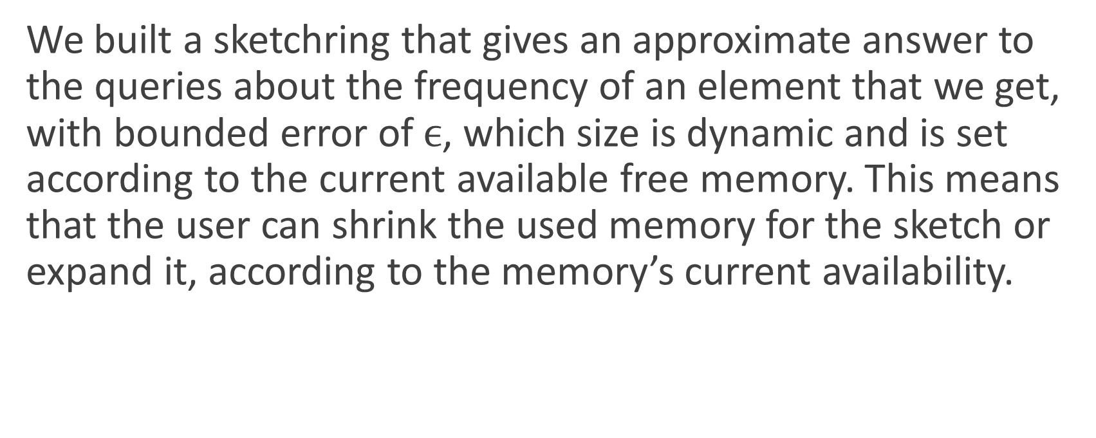
Project goals
We built a sketchring that gives an approximate answer to the queries about the frequency of an element that we get, with bounded error of $ϵ$, which size is dynamic and is set according to the current available free memory. This means that the user can shrink the used memory for the sketch or expand it, according to the memory’s current availability.

Slide 5
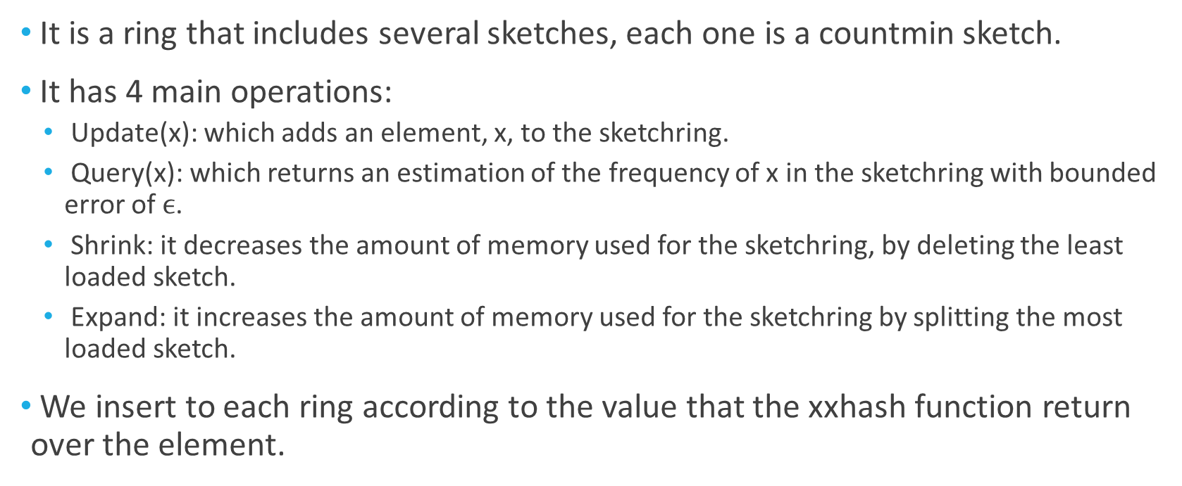
What is a sketchring?
It is a ring that includes several sketches, each one is a countmin sketch.
It has 4 main operations:
Update(x): which adds an element, x, to the sketchring.
Query(x): which returns an estimation of the frequency of x in the sketchring with bounded error of $ϵ$.
Shrink: it decreases the amount of memory used for the sketchring, by deleting the least loaded sketch.
Expand: it increases the amount of memory used for the sketchring by splitting the most loaded sketch.
We insert to each ring according to the value that the xxhash function return over the element.

Slide 6
Main challenges
Which data structure to use so that the performance of the sketchring would use little space and time.
It was a challenge to do expand and shrink without saving all the elements, while the main purpose of the sketch is not to save them because they need a huge amount of memory.

Slide 7
Project implementation
We implemented the project in C++ language.
We implemented a Union-Find data structure, that is built using a tree structure. Each node in the tree includes the numerical space of the numbers that this node, and its children include. It also includes the min-sketch that saves the elements.
The implementation is generic and not type specific.

Slide 8
Project implementation
We initialize the program with k separate trees, where k is the initial number of sketches. Each of them includes a different non-intersected bounds of numbers.
When shrink is called, we search for the least loaded leaf, and we mark it as inactive.
When expand is called, we search for the most loaded active leaf, and we expand it by adding two sons if there are no sons yet, or activate them if they exist and have been deactivated.
When query is called, we find the leaf that includes the element in its bounds and sum the value that the countmin sketch returns regarding this element on the path from this leaf to the root.
When update is called, we search for the deepest active node that includes this element in its bounds and we add it to its countmin sketch.

Slide 9
Add, Query, Shrink and Expand Demonstrations

Slide 10
Add x such as hash(x) = 20
isLastupper: false isLastlower: false
Field:0-100
Number of elements: 5
The field includes 20 but it’s not the deepest active leaf.
isLastupper: false isLastlower: false
isLastupper: true isLastlower: true
Field:0-50
Number of elements: 10
Field:51-100
Number of elements: 6
isLastupper: true isLastlower: true
isLastupper: true isLastlower: true
Field:0-25
Number of elements: 2
Field:26-50
Number of elements: 5

Slide 11
Add x such as hash(x) = 20
isLastupper: false isLastlower: false
Field:0-100
Number of elements: 5
isLastupper: false isLastlower: false
isLastupper: true isLastlower: true
The field includes 20 but it’s not the deepest active leaf.
Field:0-50
Number of elements: 10
Field:51-100
Number of elements: 6
isLastupper: true isLastlower: true
isLastupper: true isLastlower: true
Field:0-25
Number of elements: 2
Field:26-50
Number of elements: 5

Slide 12
Add x such as hash(x) = 20
isLastupper: false isLastlower: false
Field:0-100
Number of elements: 5
isLastupper: false isLastlower: false
isLastupper: true isLastlower: true
Field:0-50
Number of elements: 10
Field:51-100
Number of elements: 6
The field includes 20 and it’s the deepest active leaf. So we add it here.
isLastupper: true isLastlower: true
isLastupper: true isLastlower: true
Field:0-25
Number of elements: 3
Field:26-50
Number of elements: 5

Slide 13
Shrink
isLastupper: false isLastlower: false
Field:0-100
Number of elements: 5
isLastupper: false isLastlower: false
isLastupper: true isLastlower: true
Field:0-50
Number of elements: 10
Field:51-100
Number of elements: 6
isLastupper: true isLastlower: true
isLastupper: true isLastlower: true
Field:0-25
Number of elements: 3
Field:26-50
Number of elements: 5
Least loaded active leaf

Slide 14
Shrink
isLastupper: false isLastlower: false
Field:0-100
Number of elements: 5
isLastupper: false isLastlower: true
isLastupper: true isLastlower: true
Field:0-50
Number of elements: 10
Field:51-100
Number of elements: 6
X
isLastupper: false isLastlower: false
X
isLastupper: true isLastlower: true
Field:0-25
Number of elements: 3
Field:26-50
Number of elements: 5
Least loaded active leaf

Slide 15
Expand
isLastupper: false isLastlower: false
Field:0-100
Number of elements: 5
isLastupper: false isLastlower: true
isLastupper: true isLastlower: true
Field:0-50
Number of elements: 10
Field:51-100
Number of elements: 6
Most loaded active leaf
X
X
isLastupper: true isLastlower: true
isLastupper: false isLastlower: false
X
Field:0-25
Number of elements: 3
Field:26-50
Number of elements: 5

Slide 16
Expand
isLastupper: false isLastlower: false
Field:0-100
Number of elements: 5
isLastupper: false isLastlower: true
isLastupper: false isLastlower: false
Field:0-50
Number of elements: 10
Field:51-100
Number of elements: 6
Most loaded active leaf
X
isLastupper: true isLastlower: true
isLastupper: true isLastlower: true
isLastupper: true isLastlower: true
isLastupper: false isLastlower: false
Field:0-25
Number of elements: 3
Field:26-50
Number of elements: 5
Field:51-75
Number of elements: 6
Field:76-100
Number of elements: 6

Slide 17
Query x where hash(x) = 20
isLastupper: false isLastlower: false
Query on the sketch returns 1
Field:0-100
Number of elements: 5
Query on the sketch returns 4
isLastupper: false isLastlower: true
isLastupper: false isLastlower: false
Field:0-50
Number of elements: 10
Field:51-100
Number of elements: 6
Query on the sketch returns 2
X
isLastupper: true isLastlower: true
isLastupper: true isLastlower: true
isLastupper: true isLastlower: true
isLastupper: false isLastlower: false
Field:0-25
Number of elements: 3
Field:26-50
Number of elements: 5
Field:51-75
Number of elements: 6
Field:76-100
Number of elements: 6

Slide 18
Query x where hash(x) = 20
isLastupper: false isLastlower: false
Query on the sketch returns 1
Field:0-100
Number of elements: 5
Query(x) returns 7
Query on the sketch returns 4
isLastupper: false isLastlower: true
isLastupper: false isLastlower: false
Field:0-50
Number of elements: 10
Field:51-100
Number of elements: 6
Query on the sketch returns 2
X
isLastupper: true isLastlower: true
isLastupper: true isLastlower: true
isLastupper: true isLastlower: true
isLastupper: false isLastlower: false
Field:0-25
Number of elements: 3
Field:26-50
Number of elements: 5
Field:51-75
Number of elements: 6
Field:76-100
Number of elements: 6

Slide 19
Testing
We also implemented “test_generator.cpp” that generates random tests that includes update, shrink and expand in order to test the sketchring.
We implemented as well “test.h” that stores the real frequency of each element and at the end it compares the real frequency and the frequency that the sketchring returns in order to calculate the error and measure the performance of the sketchring.

Slide 20
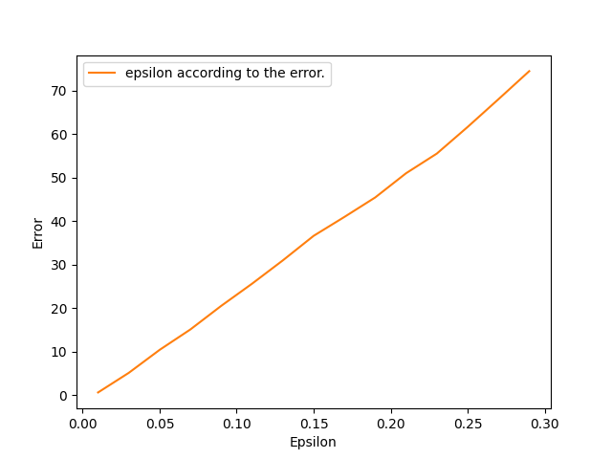
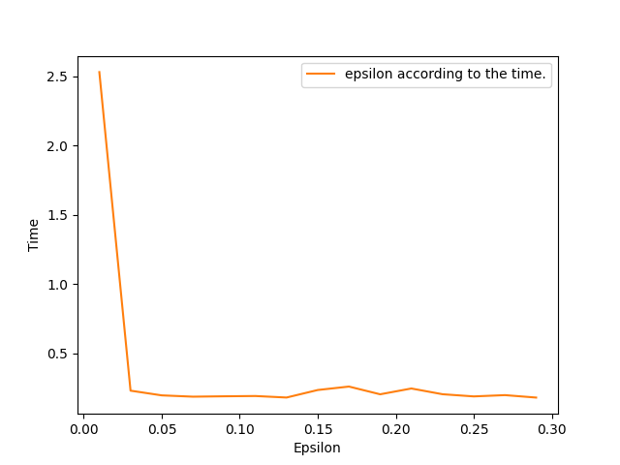
Performance
Input size: 5,000. Epsilon ranges between 0.01 and 0.3. delta: 0.01

Slide 21
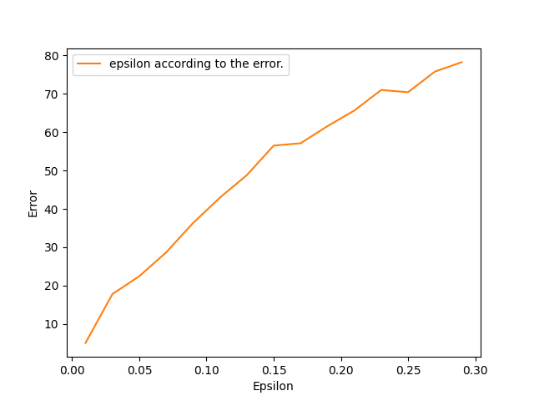
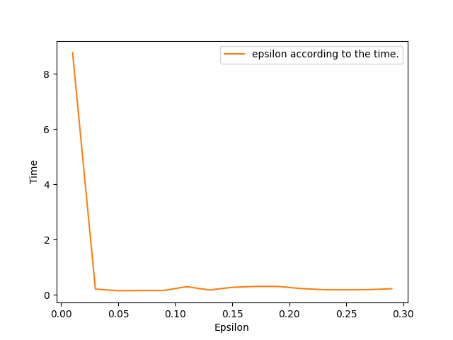
Performance
Input size: 10,000. Epsilon ranges between 0.01 and 0.3. delta: 0.01

Slide 22
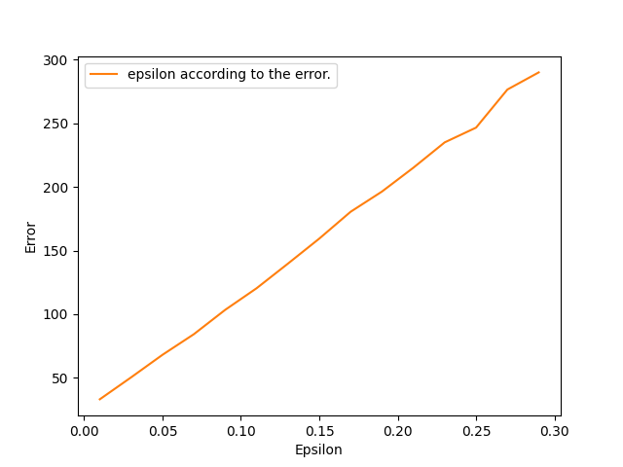
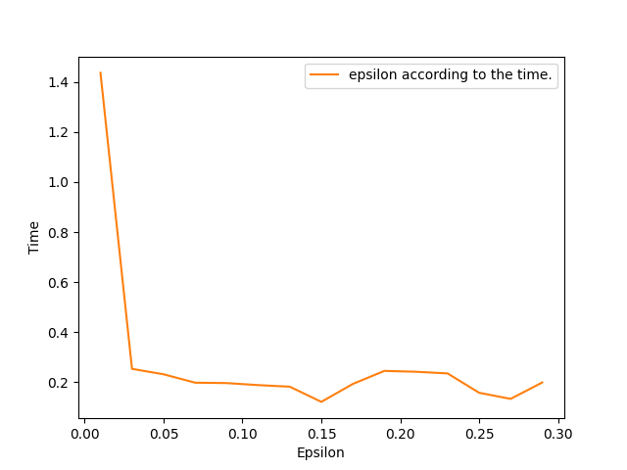
Performance
Input size: 20,000. Epsilon ranges between 0.01 and 0.3. delta: 0.01

Slide 23
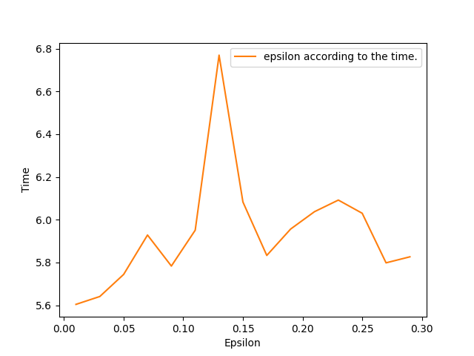
Performance
We noticed that when the script is running with another application in the background the graph of epsilon according to time doesn’t reflect the actual time and does not behave as expected.
For example, when were talking on zoom we got:

Slide 24
Conclusions
As we saw in the graphs earlier, the sketchring does return an error that is lower than epsilon multiplied by the number of elements in the input as specified in the stretch the sketch paper.
We can also see that the sketchring returns a good estimation to the real frequency, and with low values of epsilon it works very well.
When the epsilon is higher, the error is higher as expected.
When the epsilon is higher, the time needed to finish the process is lower.

Slide 25
Possible extensions
Functionality to undo the effects of a previous event on the sketch.
Concurrency in the functionality of the sketch.
The use of multiple hash functions in order to ensure better load balancing between the sketches in the sketch ring and to reduce the error.
The sketch can include data from more than one type, for example 3 sketches for data of type int, and another 3 for data of type string.

