Slide 1
BLACK FRIDAY SALES PREDICTION
SULIMAN RAHIMI - YIHENG ZHANG - AHMAD NADAR - GUILLAUME POISSONNET - VINCENT GABU

Slide 2
INTRODUCTION
Problem statement : “How can grocery stores prepare themselves for the Black Friday Sales in terms of supply ?”
Dataset : https://datahack.analyticsvidhya.com/contest/black-friday/

Slide 3



PROJECT MANAGEMENT
Communication Channel
Scrum methodology
Gantt chart

Slide 4
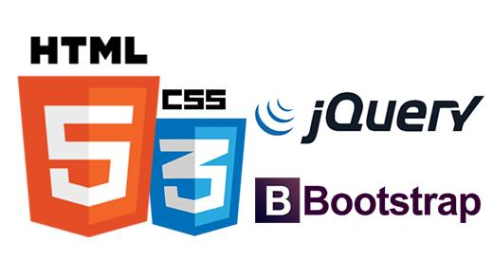
USER INTERFACE DESIGN
TECHNOLOGIES:
CSS 3
HTML 5
JAVASCRIPT
BOOTSTRAP v4 (front-end framework)

Slide 5
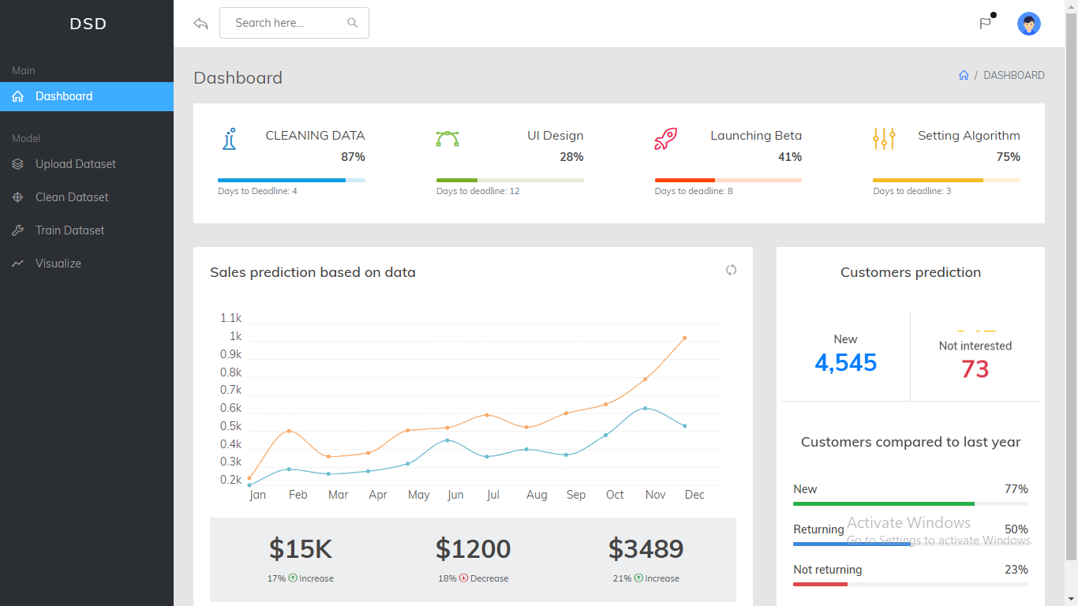
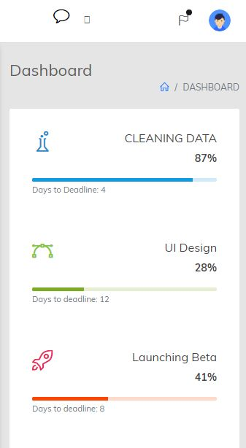
USER INTERFACE DESIGN
Responsiveness
Tested with Chrome Responsive Web Design Tester
Cross-browser compatibility
Tested on
Google Chrome
Mozilla Firefox
Microsoft Edge

Slide 6
API
- Django REST framework.
- Accepts POST requests from the GUI and returns our prediction for the data provided.

Slide 7
DATA & ML MODEL [GUILLAUME, ZHANG]
Two parts :
Analyzing Data
Preprocessing Data

Slide 8
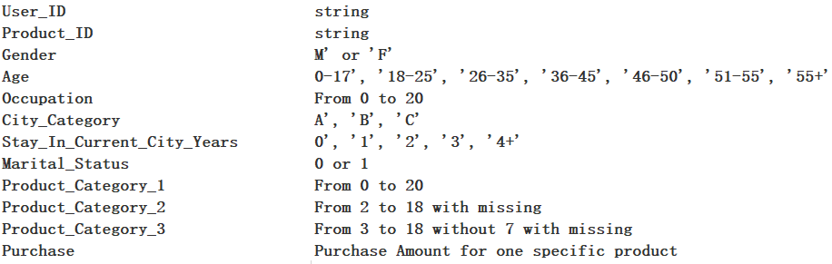
Data

Slide 9
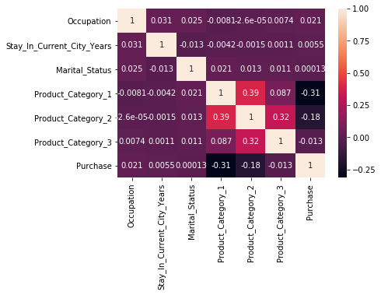
ANALYZING DATA AND SELECTED CATEGORIES
By correlation, three categories have positive values as a function of Purchase (city categories will be analyzed later)
We decided to focus on Occupation

Slide 10
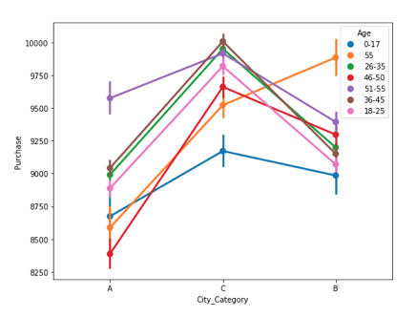
PREPROCESSING DATA & ONE HOT ENCODING
One hot encoding on categorical values (like City Category) to replace them by numerical values
Applied on Age, City Category, Stay & Occupation

Slide 11
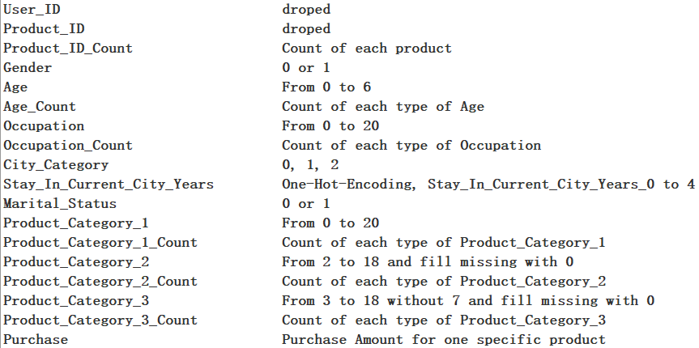
Pre-processing

Slide 12
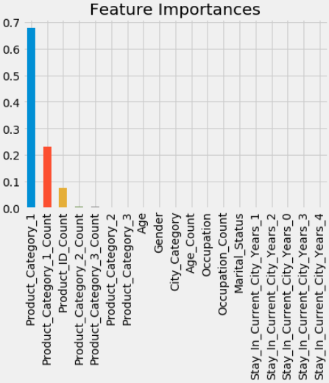
RFT
Random Forest algorithm gives the best results and is mainly based on the product category

Slide 13
SELECTING A MODEL FOR TRAINING
We chose a RandomForest algorithm that worked well with our previous one hot encoding.
RMSE : 1481 R2 : 0.9115

Slide 14

DOCKERIZATION
Container orchestration
Two services managed by Docker compose
GUI-service
API-service

Slide 15
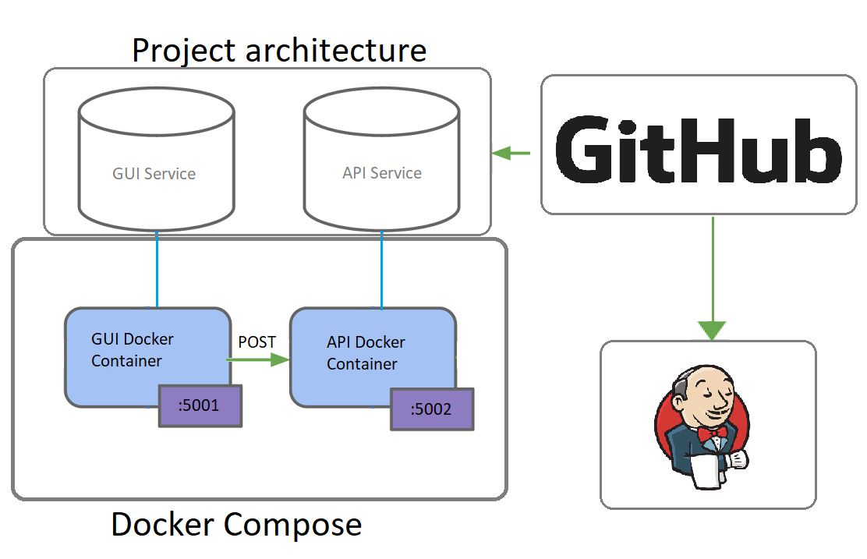

Slide 16
Work to be done
Re-training the model.
Asking our model more questions.
Setup a database for the data.

Slide 17
Demo

