Slide 1
BLACK FRIDAY SALES PREDICTION
SULIMAN RAHIMI - YIHENG ZHANG - AHMAD NADAR - GUILLAUME POISSONNET - VINCENT GABU

Slide 2
INTRODUCTION
Problem statement : “How can grocery stores prepare themselves for the Black Friday Sales in terms of supply ?”
Dataset : https://datahack.analyticsvidhya.com/contest/black-friday/

Slide 3



PROJECT MANAGEMENT
Communication Channel
Scrum methodology
Gantt chart

Slide 4

USER INTERFACE DESIGN
TECHNOLOGIES:
CSS 3
HTML 5
JAVASCRIPT
BOOTSTRAP v4 (front-end framework)

Slide 5
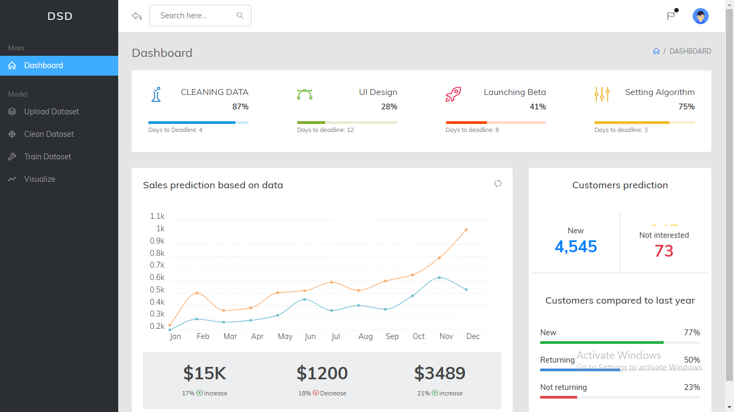
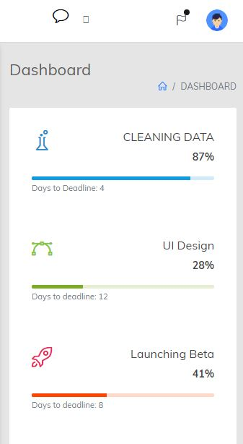
USER INTERFACE DESIGN
Responsiveness
Tested with Chrome Responsive Web Design Tester
Cross-browser compatibility
Tested on
Google Chrome
Mozilla Firefox
Microsoft Edge

Slide 6
API
- Django REST framework.
- Accepts POST requests from the GUI and returns our prediction for the data provided.

Slide 7
DATA & ML MODEL [GUILLAUME, ZHANG]
Two parts :
Analyzing Data
Preprocessing Data

Slide 8
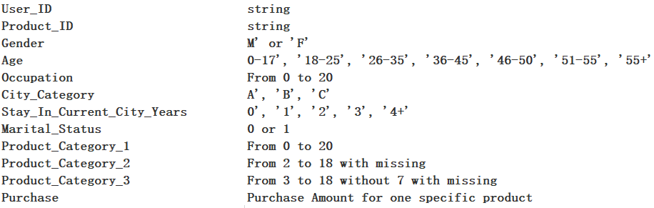
Data

Slide 9
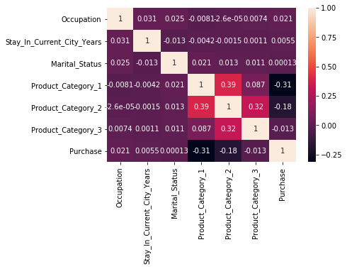
ANALYZING DATA AND SELECTED CATEGORIES
By correlation, three categories have positive values as a function of Purchase (city categories will be analyzed later)
We decided to focus on Occupation

Slide 10
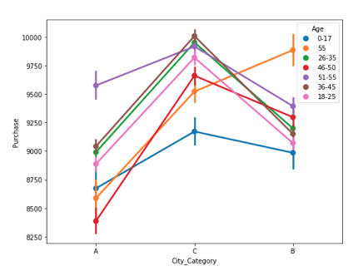
PREPROCESSING DATA & ONE HOT ENCODING
One hot encoding on categorical values (like City Category) to replace them by numerical values
Applied on Age, City Category, Stay & Occupation

Slide 11
Pre-processing
User_ID | droped
Gender | change to 0 or 1
Age | change from 0 to 6
Age_Count | create count of each range of age
Occupation | no change
Occupation_Count | create count of each type of occupation
Marital_Status | no change
City_Category | no change
Product_ID | droped
Product_ID_Count | create count of each product
Product_Category_1 | drop 19 and 20
Product_Category_1_Count | create count of each type of Product_Category_1
Product_Category_2 | fill missing with 0
Product_Category_2_Count | create count of each type of Product_Category_2
Product_Category_3 | fill missing with 0
Product_Category_3_Count | create count of each type of Product_Category_3
Purchase | no change

Slide 12
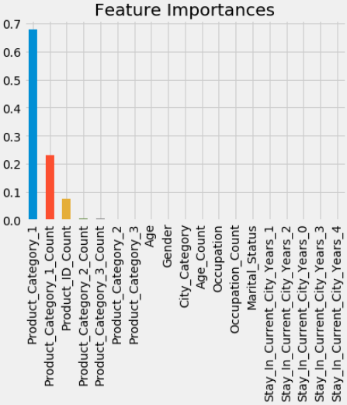
RFT
Random Forest algorithm gives the best results and is mainly based on the product category

Slide 13
SELECTING A MODEL FOR TRAINING
We chose a RandomForestRegression algorithm that worked well
R2 : 0.71

Slide 14

DOCKERIZATION
Container orchestration
Two services managed by Docker compose
GUI-service
API-service

Slide 15
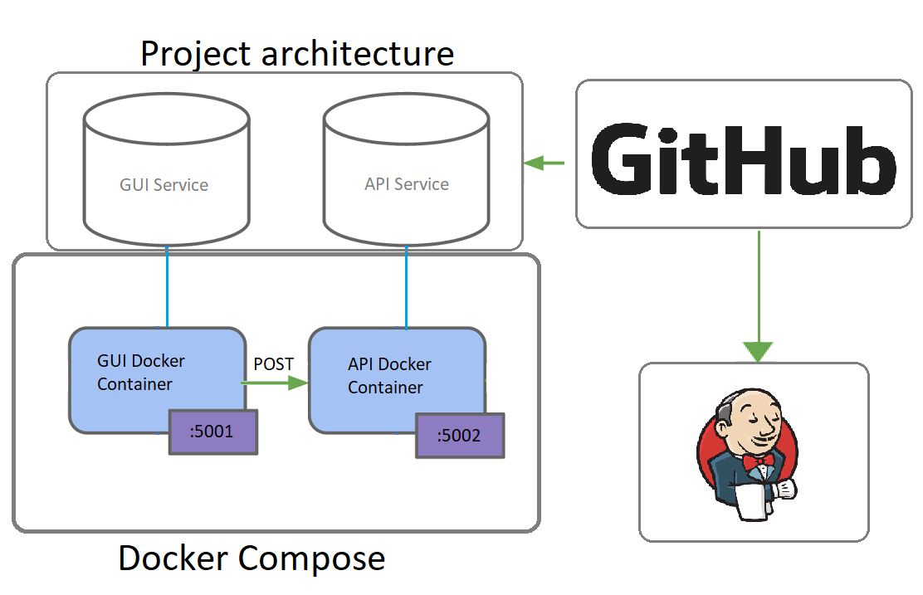

Slide 16
Work to be done
Re-training the model.
Asking our model more questions.
Setup a database for the data.

Slide 17
Demo

