Slide 1
Arabic sentiment Analysis Covid-19
Presented by:
Nada Abdul Rasoual
Prof.
Menoufia University
Department of Computer

Slide 2



Outlines
Project Overview
Used Dataset
Text Preprocessing
Sentiment Analysis: Tools and Models
Discussion/Conclusion

Slide 3
Overview
COVID-19 information has been exponentially increasing and spreading across various social media platforms.
With people heavily relying on social media platforms to share information more than ever, it is important to analyze their conversations to understand people’s sentiments and feelings.
Sentiment analysis is the identification of opinions from text to determine how the human feels.
Our goal is to analyze Covid-19 Twitter data and find out which is the better classification model for Arab world sentiment.

Slide 4
Used Dataset
Twitter dataset in CSV format:
Arabic tweets about Covid-19 collected by the Twitter API.
Dataset contains 13 columns X 341443 rows:
with columns’ names:
tweetID
tweetText
tweetRetweetCt
tweetFavoriteCt
tweetSource
tweetCreated
userID
userScreen
userName
userCreateDt
userDesc
userLocation

Slide 5
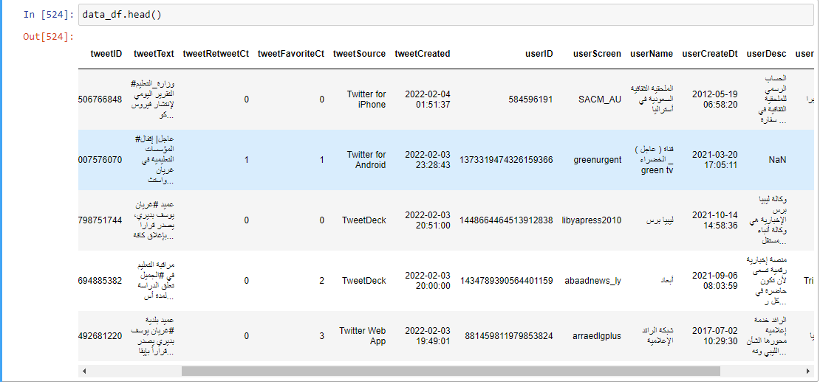
Snapshot of first collected data.

Slide 6
Text Preprocessing
To prepare the text data for the model building we perform text preprocessing. It is the very first step of NLP projects , Some of the preprocessing steps are:
Drop of duplicates.
Regular Expression ( re.sub function):
Removing punctuations like . , ! $( ) * % @
Removing URLs
Removing emotions , symbols & pictographs
Removing Stop words( Stop words are the commonly used words and are removed from the text as they do not add any value to the analysis.)
Tokenization (the text is split into smaller units).

Slide 7
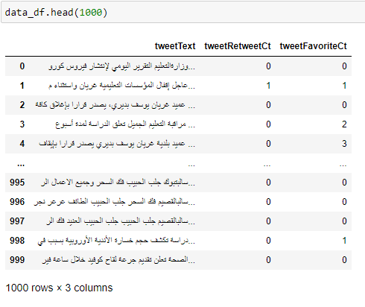
Snapshot of cleaned dataset

Slide 8
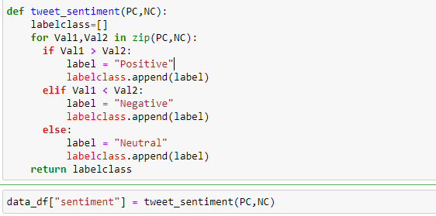
Sentiment Analysis: Tools & Models
Using a user-defined function tweet_sentiment()
We got the tweets sentiment:

Slide 9
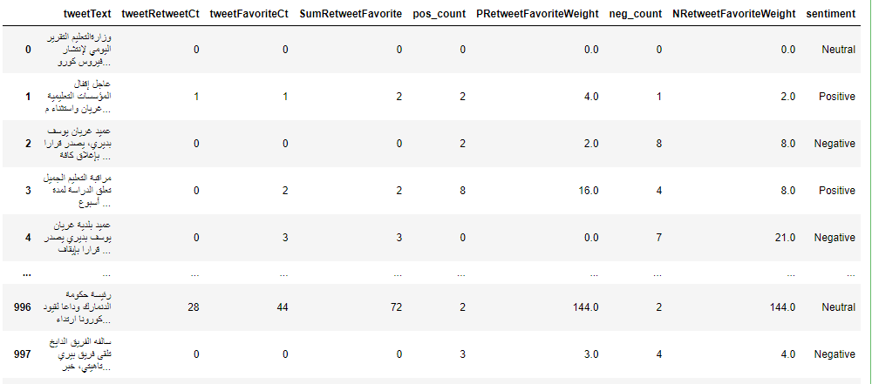
Snapshot of dataset with sentiment.

Slide 10
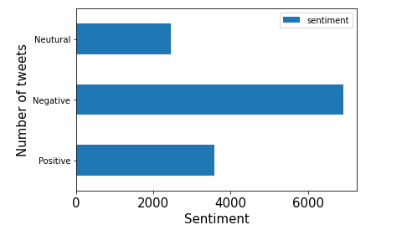
A Plot of resulted sentiment

Slide 11
It wasn’t enough to get the sentiment of tweets . we used the output dataset to train a collection of ML Classifiers to get the best one for predicting any new Arabic tweet’s sentiment (‘positive’ , ‘Negative’ , ‘Neutral’).
Before training a model , we should split the data so we will first discuss this point.

Slide 12
Splitting Balanced Dataset for Model Training
Splitting dataset is essential for evaluation of prediction performance. But, before splitting we made the dataset balanced for a better training.
Balanced Dataset of only ( ‘positive’ , ’negative’) tweets was splited randomly into three subsets:
train_data 80%
test_data 10%
val_data 10%

Slide 13
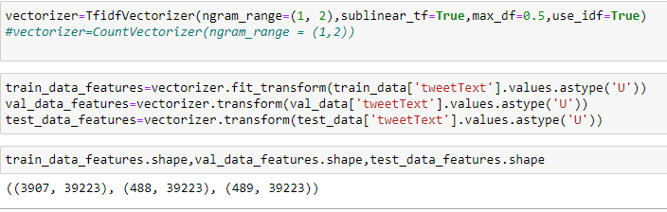
Text Vectorization & Features Extraction
To fit models on train_data, we first vectorized the text using ’ TF-IDF vectorizer ’ to extract features from each tweet.
Term frequency-inverse document frequency ( TF-IDF) gives a measure that takes the importance of a word into consideration depending on how frequently it occurs in a document and a corpus.

Slide 14
Ml classifires
Classifier | score on training | Accuracy | F1-Score
LogisticRegression | 0.9759406194 | 0.77049180 | 0.76696909
MultinomialNB | 0.978756078 | 0.7704918032 | 0.770244821
SVM (support vector machine) | 0.99488098285 | 0.81557377049 | 0.814777327
RandomForestClassifier | 1.0 | 0.7807377049 | 0.7790219852

Slide 15
Training Models with Unbalanced Data
Classifier | score on training | Accuracy | F1-Score
LogisticRegression | 0.886462460141 | 0.8941267387944 | 0.7815145520985
MultinomialNB | 0.876219924630 | 0.8717156105100 | 0.71172665539361
SVM (support vector machine) | 0.959899507198 | 0.9034003091190 | 0.8170486871051
RandomForestClassifier | 0.999903372306 | 0.8732612055641 | 0.7895893236034

Slide 16
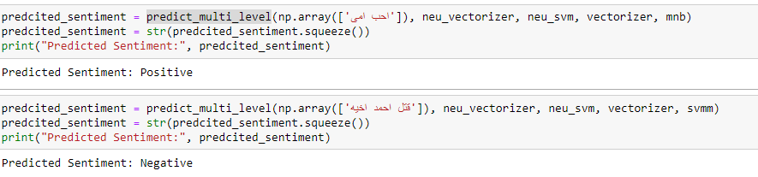
Conclusions
SVM had The best accuracy on Validating & predicting test_data.
Now, we have a trained model that can analyze
Any Arabic tweet with the function predict_multi_level().

Slide 17
Thanks

