Slide 1


Slide 2
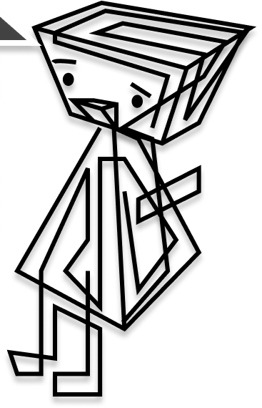
Our Story
As cs students, we have encountered a situation, that when applying for development position many companies required projects
Though we do love to program, we had a hard time producing project and managing them on our on.
After consulting with our classmates, we found it was a real problem, - and came up with the idea to develop a side project management platform
a survey we conducted indicated that over 60% of student ask wanted to join such a platform immediately .

Slide 3
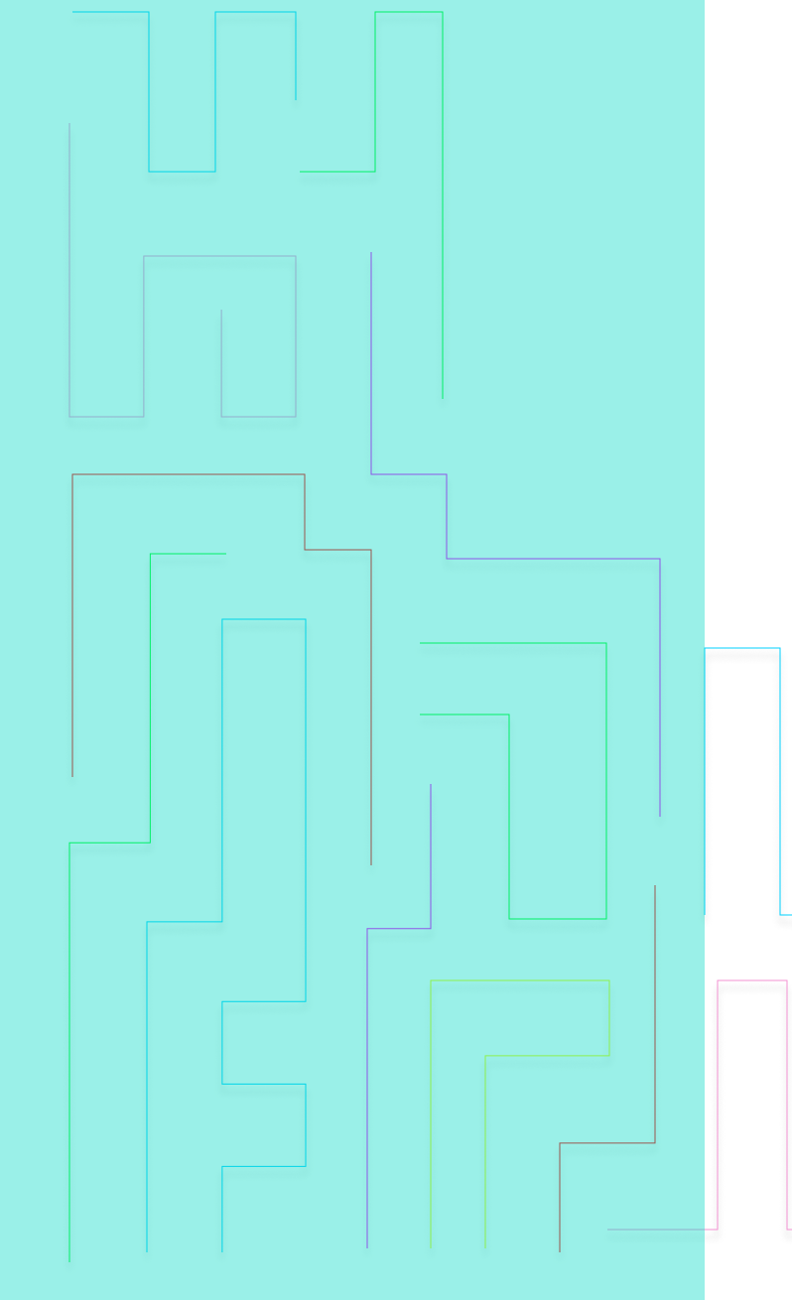
Covid & us
During covid a lot of companies has slowed or stopped all completely the recruitment of students for development positions
The few opening had fierce competition and we needed a way to set ourself out from the crowds.
Even more so when our grades became obsolete dough to the university policy
Our product enable students to gain experience and confidence those making the job-hunting process a little easier

Slide 4
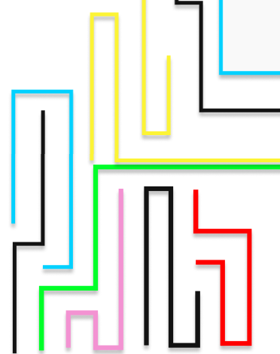
Our values:
Development using industry level – high standards platforms
Allowing us to continue development
Using elaborate design patterns – in order to be able to expand our activity
User friendly design
Encourages beginner programmers to use the platform
Game like experience

Slide 5
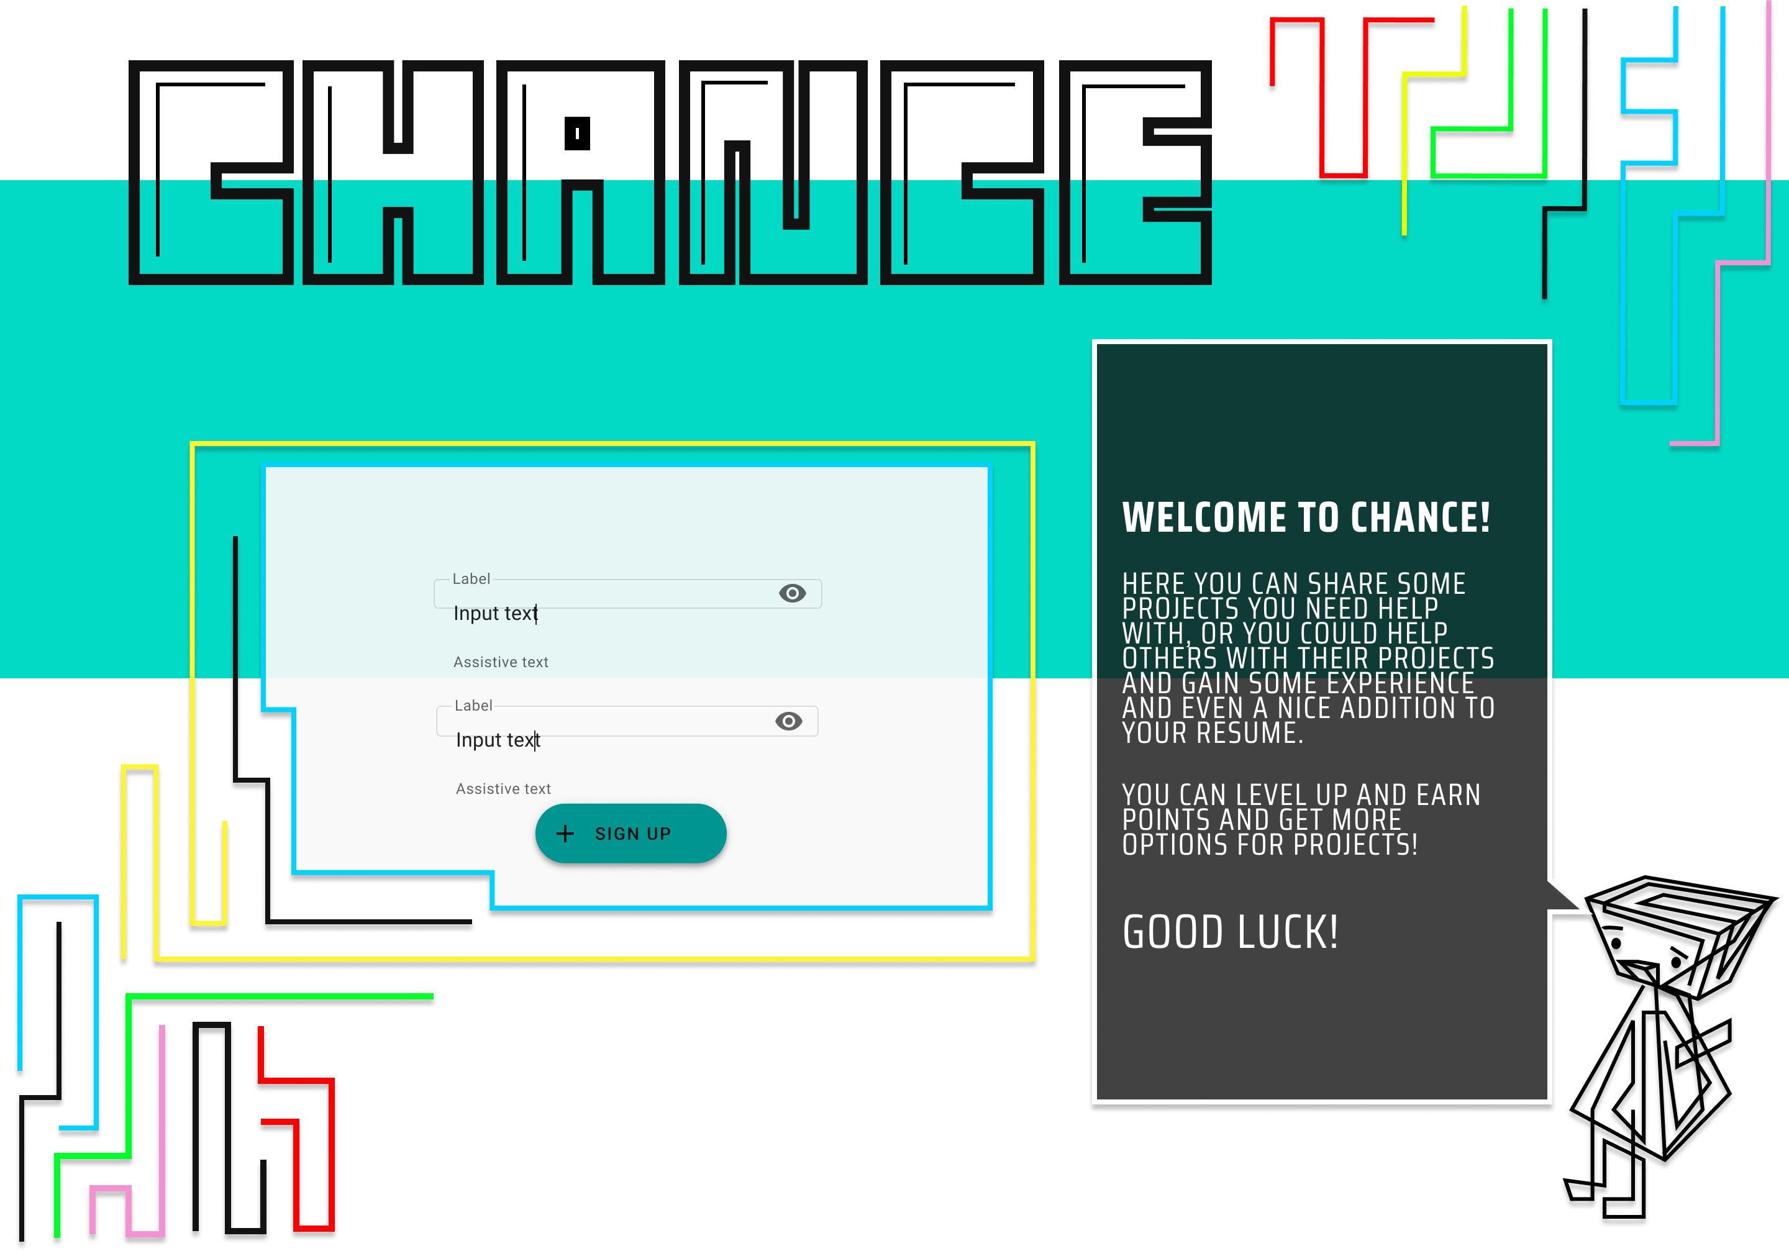

Slide 6
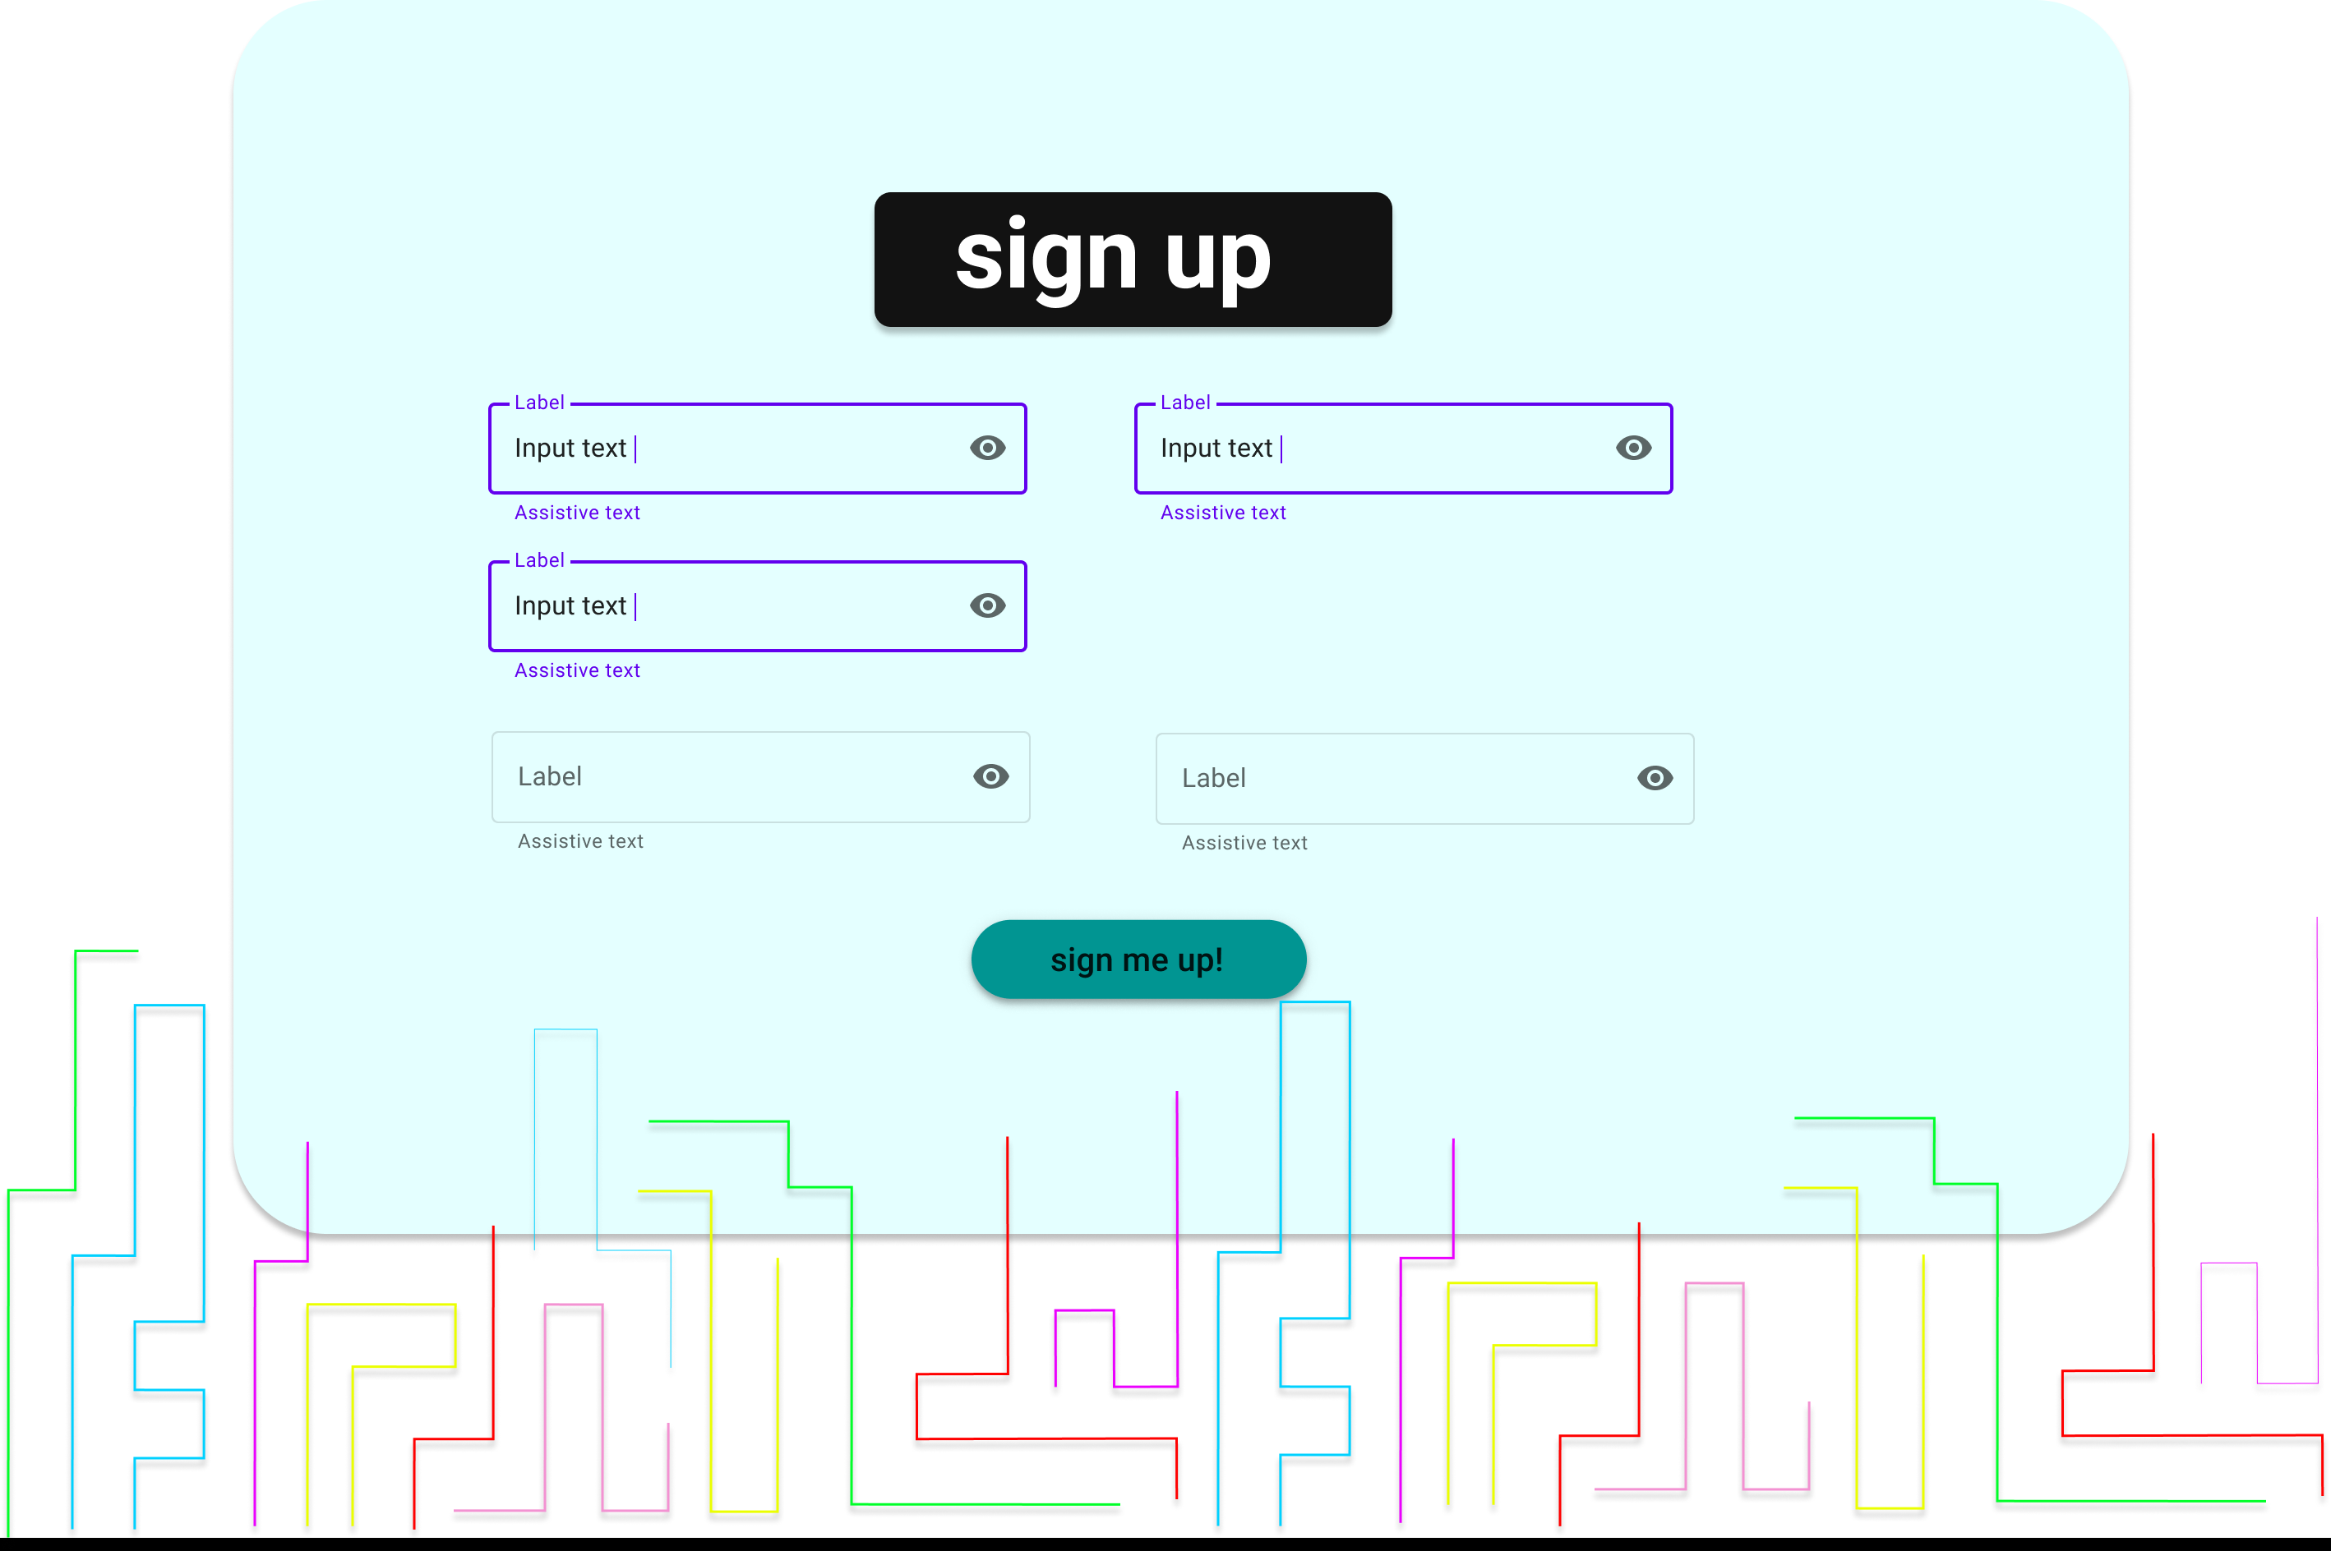

Slide 7
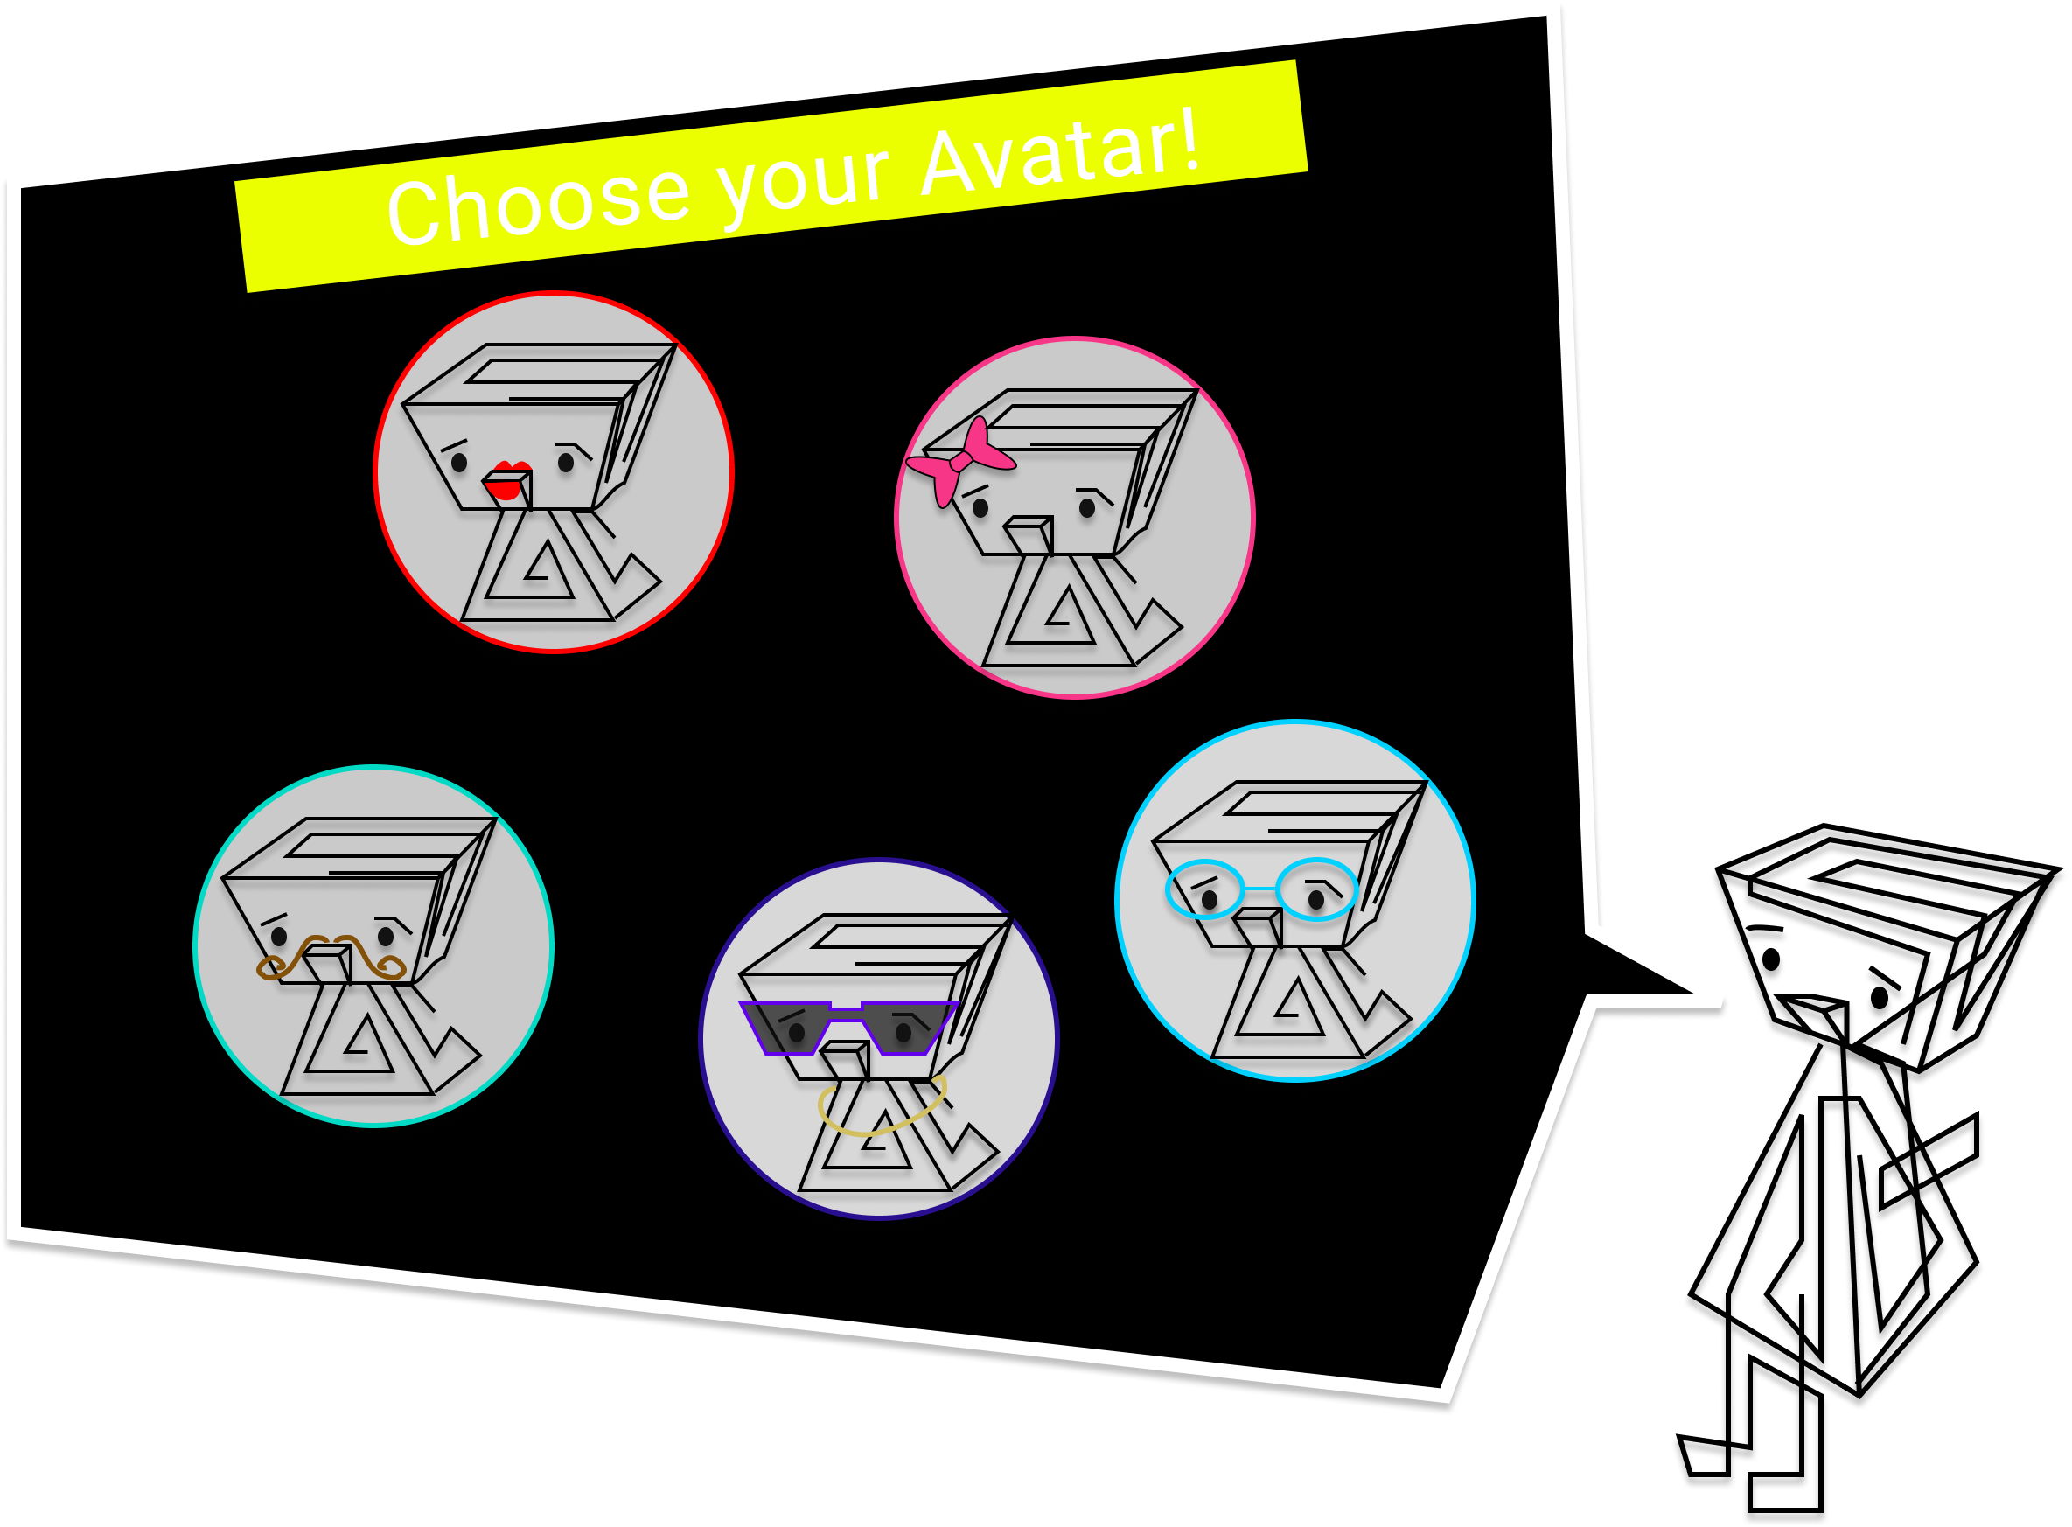

Slide 8
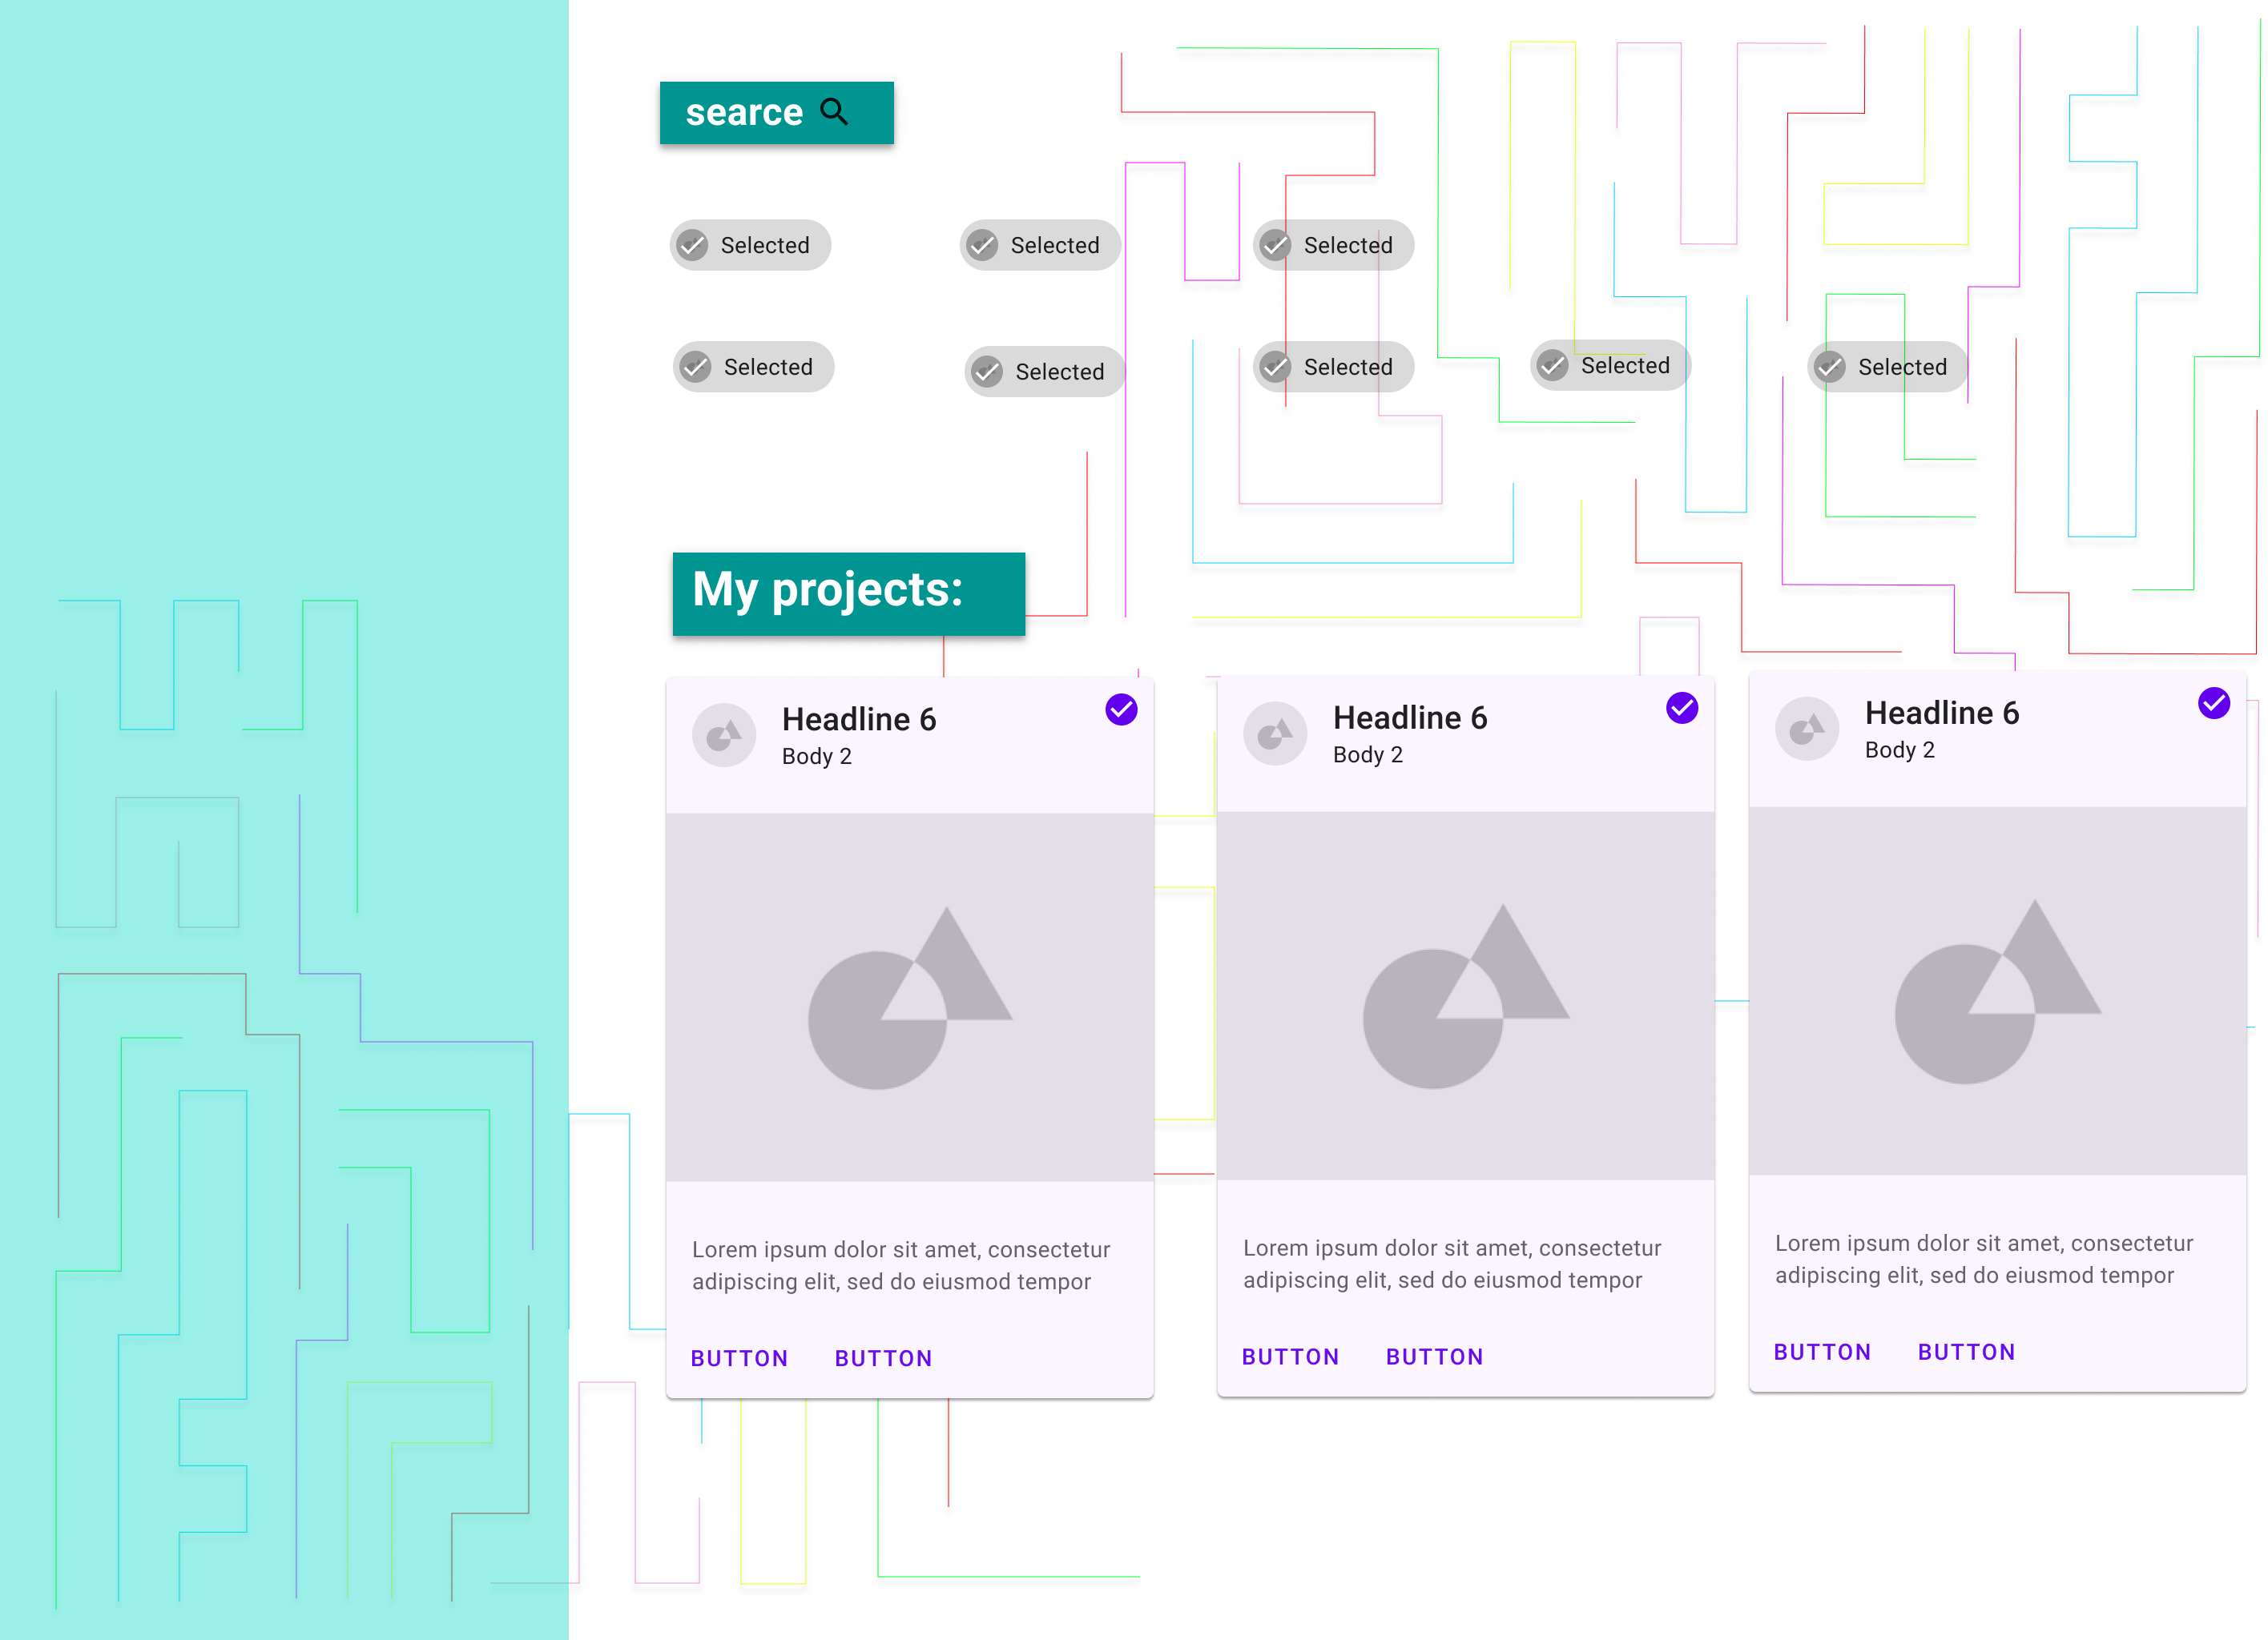

Slide 9
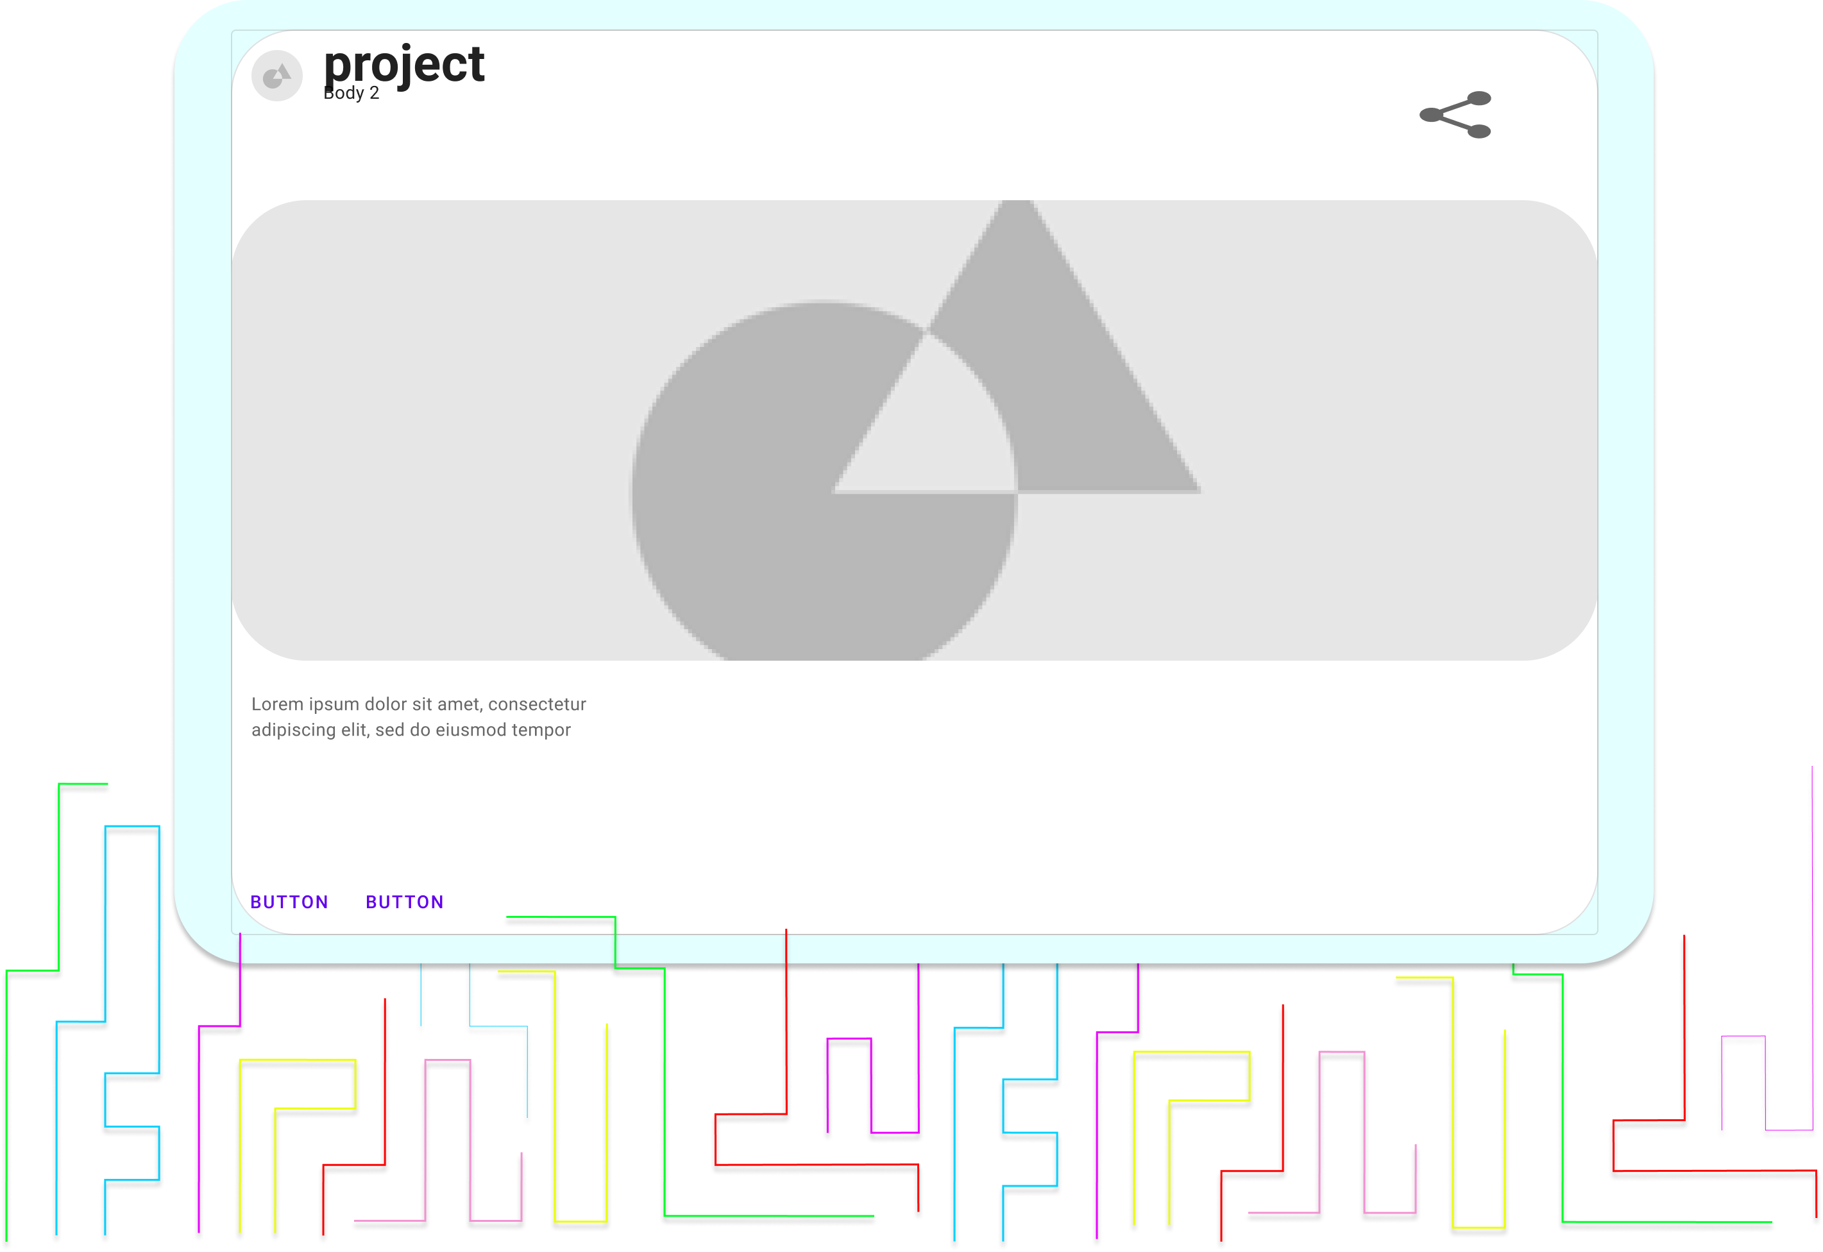

Slide 10
