Slide 1


Slide 2

Our Story
Today, many companies prefer students with an industry experience or projects over inexperienced students.
Evidentially, inexperienced students have harder time managing and executing projects.
We realized, many organizations can benefit from small effort projects for free or for small price by a third party
As a result, we produced the idea to develop a side project management platform

Slide 3
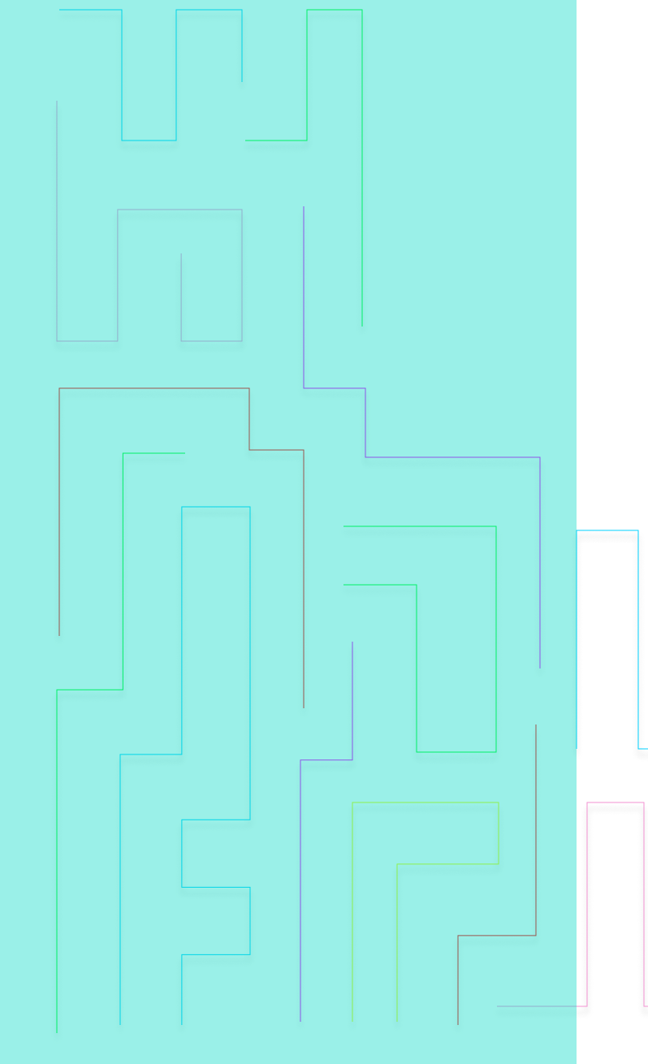
Covid & us
During covid a lot of companies has slowed or stopped all completely the recruitment of students for development positions
The few opening had fierce competition and we needed a way to set ourself out from the crowds.
Even more so when our grades became obsolete due to the university policy
Our product enables students to gain experience and confidence, thus making the job-hunting process a little easier

Slide 4
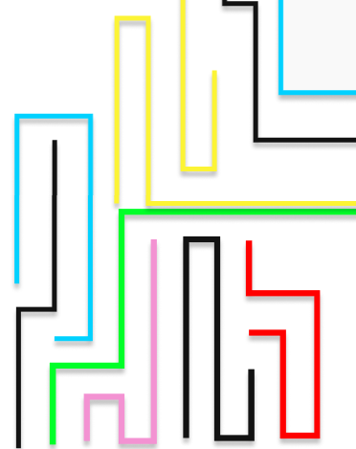
Our values:
Development using industry level – high standards platforms
Allowing us to continue development in the future
Community and collaboration
Allowing opurtunitues
Open source development
Encouraging inexperienced developers
User friendly platform

Slide 5
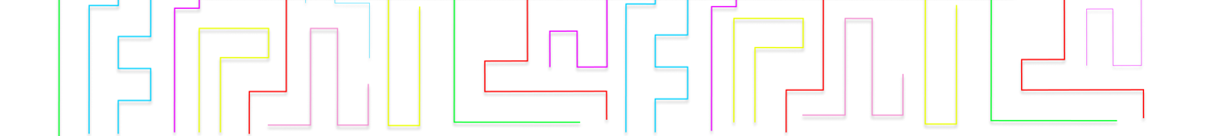
Our current product
Web application
Server side – with RESTful API (Implemented with python’s flask)
Database using MongoDB
Frontend – using react with TypeScript
Design – Using Figma and material design
Organizations – each organization can sign up and register projects
Students – each student can sign up and register to ongoing projects
Rewards – students get reward for projects they do

Slide 6
The next Stage
Better design – already designed
Promoted internship, and paid internship
Integration with PayPal and other payment solutions
GitHub integration
LinkedIn certificates
Allowing collaboration on projects – building a community of
Open-source development

Slide 7
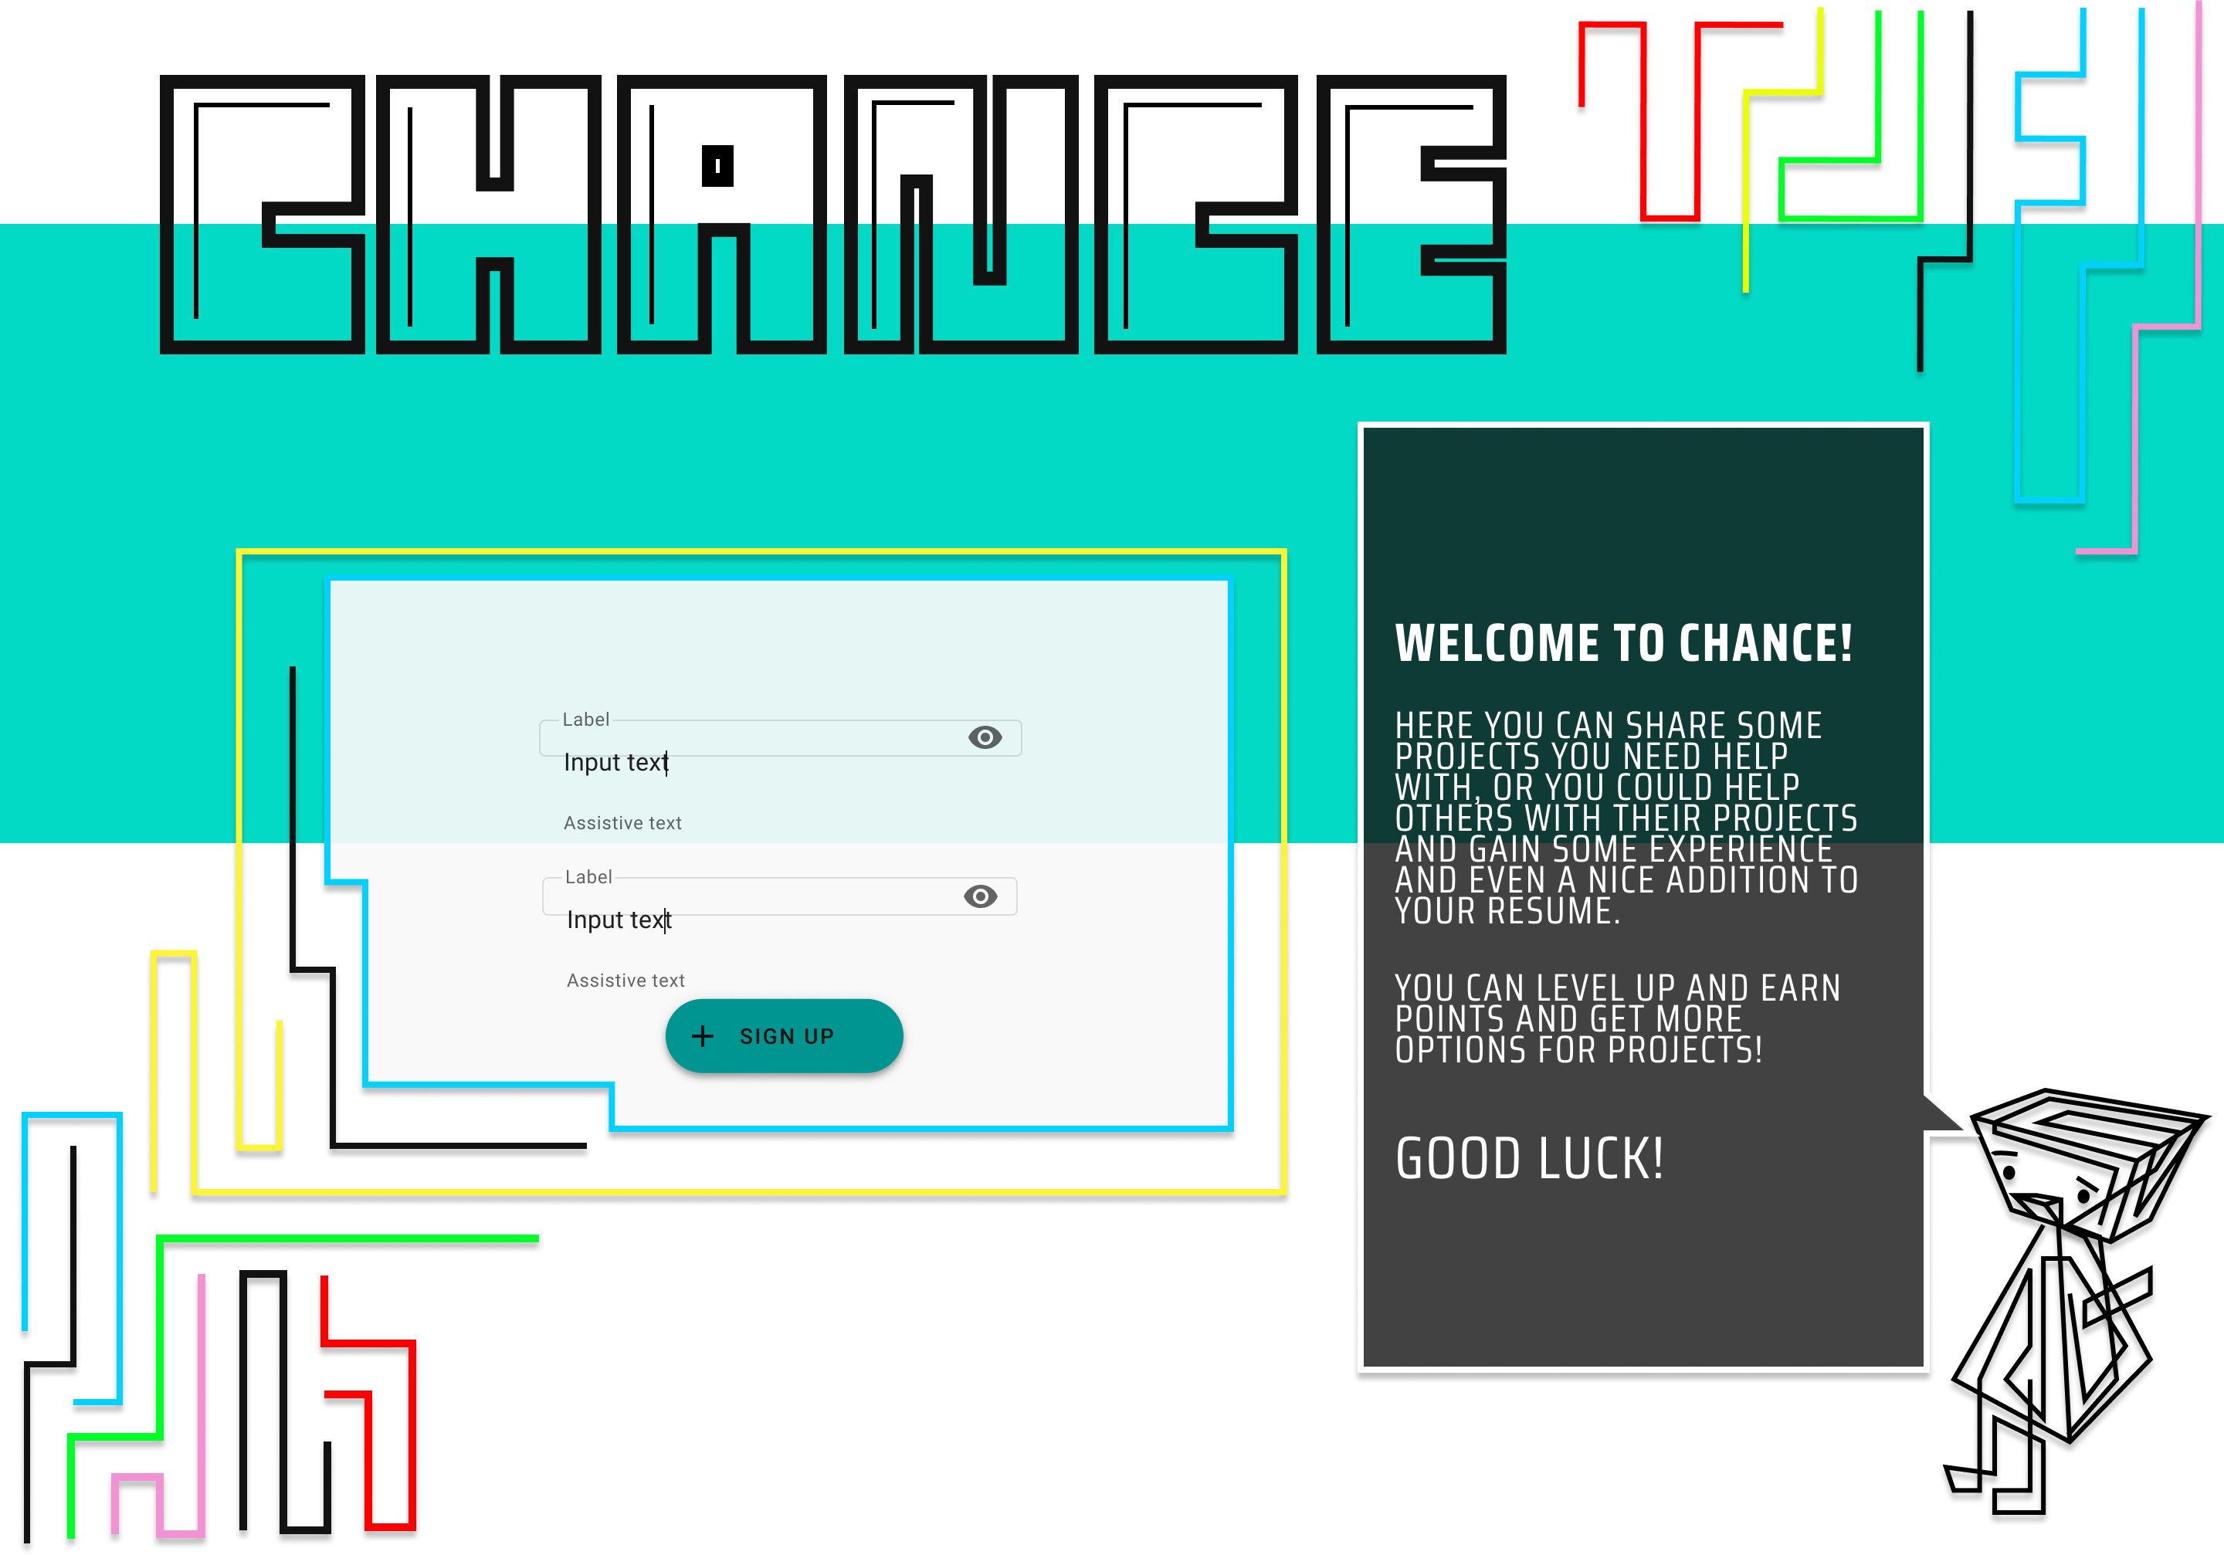

Slide 8
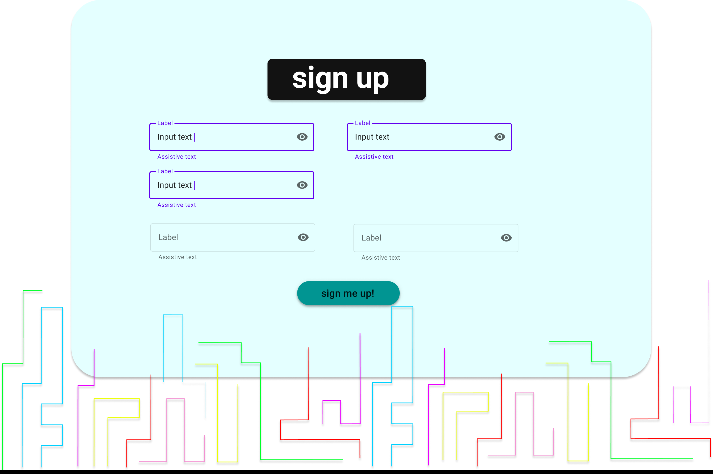

Slide 9
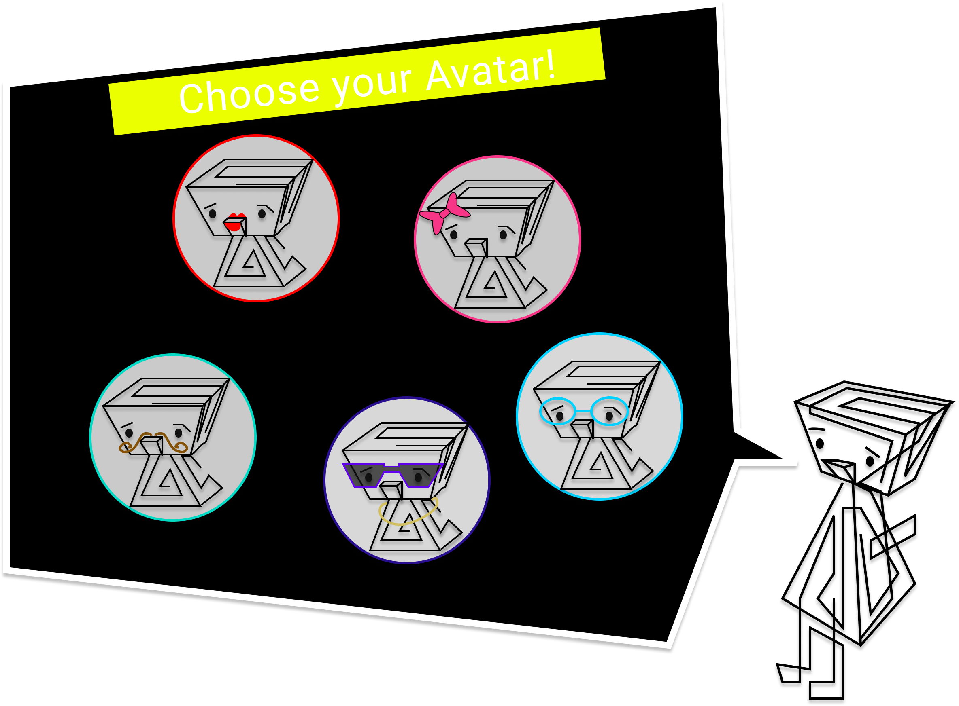

Slide 10
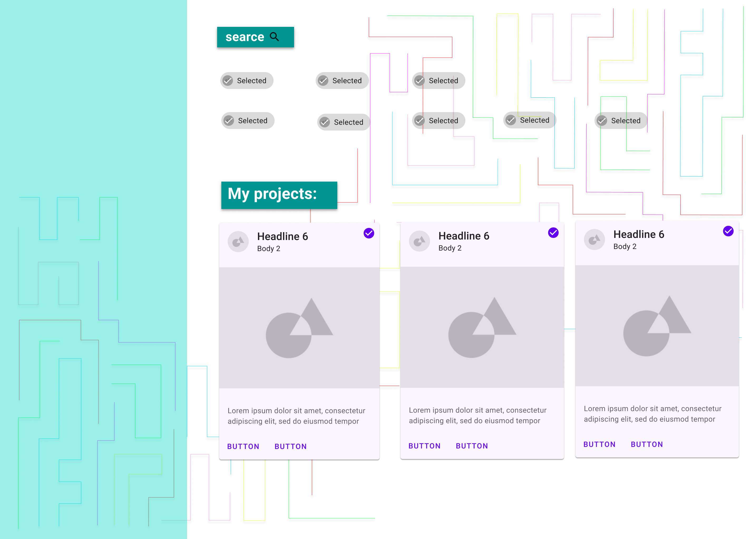

Slide 11
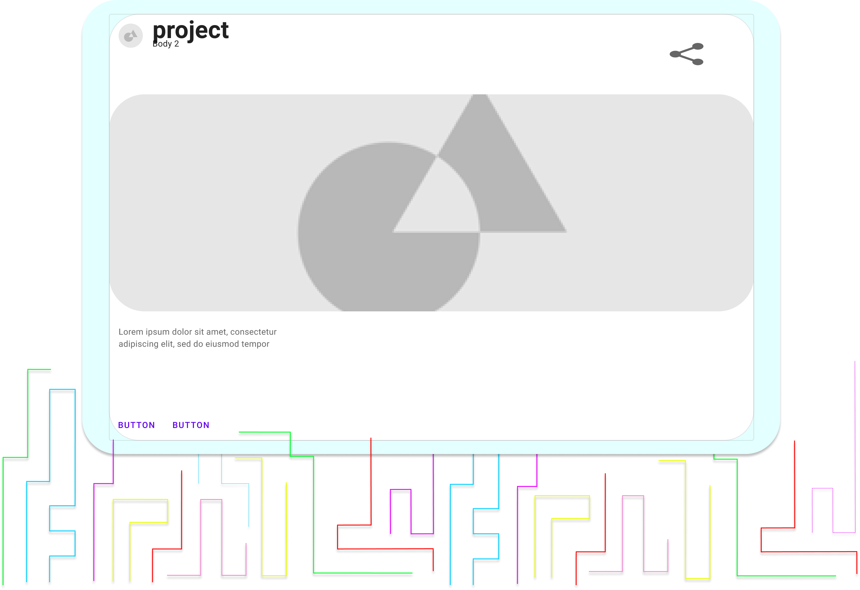

Slide 12
