Slide 1
Statistics for Graduate Students Lecture #4
Contrasts: Planned vs post-hoc
False-positive Psychology (and lessons)

Slide 2
Reminder: One- and two-way ANOVA
ANOVAs test for an effect of a categorical independent variable(s) on a numeric dependent variable.
One-way ANOVA: one categorical IV.
Two-way ANOVA: two categorical IV.
The mathematical basis: Compute two statistics which under H0 estimate the same variance (the population variance). Look at their ratio – F distributed under H0.
As always, if too extreme – reject H0.
Evidence for an effect: The effect of the independent variable.
One-way ANOVA: testing for the effect of one variable.
Two-way ANOVA: testing for effects of variable A, variable B, and their interaction.

Slide 3
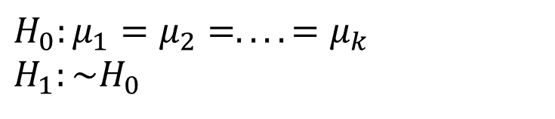
Reminder: One- and two-way ANOVA
The conclusion from an ANOVA is for an overall effect of an IV on a DV (or an interaction between two variables)
E.g., in one-way ANOVA: If we found an effect - evidence that the population means are not the same in all groups; some effect of the manipulation.
But: where does this effect come from?
To answer that question, we run contrasts.
Can be applied in both one- and two-way ANOVAs (and beyond); for simplicity we will focus on the one-way case.
Two types: Planned contrasts and post-hoc contrasts.
$$H_{0}:μ_{1}=μ_{2}=....=μ_{k} \\ H_{1}:\sim H_{0}$$

Slide 4

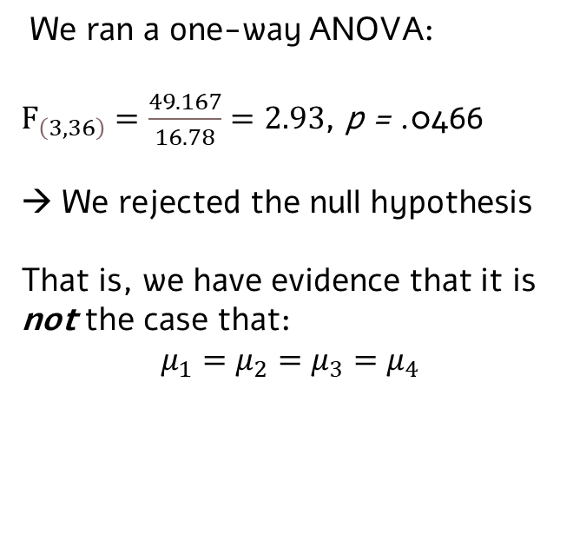








An example: City of residence and depression
We ran a one-way ANOVA:
$F_{\left(3,36\right)}=\frac{49.167}{16.78}=2.93$, p = .0466
We rejected the null hypothesis
That is, we have evidence that it is not the case that:
$$μ_{1}=μ_{2}=μ_{3}=μ_{4}$$
Nashville (4) | Seattle (3) | Los Angeles (2) | New York City (1)
1 3 6 1 8 4 0 12 8 7 | 12 14 4 10 15 8 7 5 9 16 | 3 4 6 8 12 14 5 9 6 3 | 6 7 11 12 7 9 13 4 18 3
${\overline{x}}_{1}$= 9
${\overline{x}}_{2}$= 7
${\overline{x}}_{3}$= 10
${\overline{x}}_{4}$= 5
$n_{1}$= 10
$n_{2}$= 10
$n_{3}$= 10
$n_{4}$= 10
$\overset{̿}{x}$= 7.75

Slide 5
Contrasts Planned comparisons

Slide 6
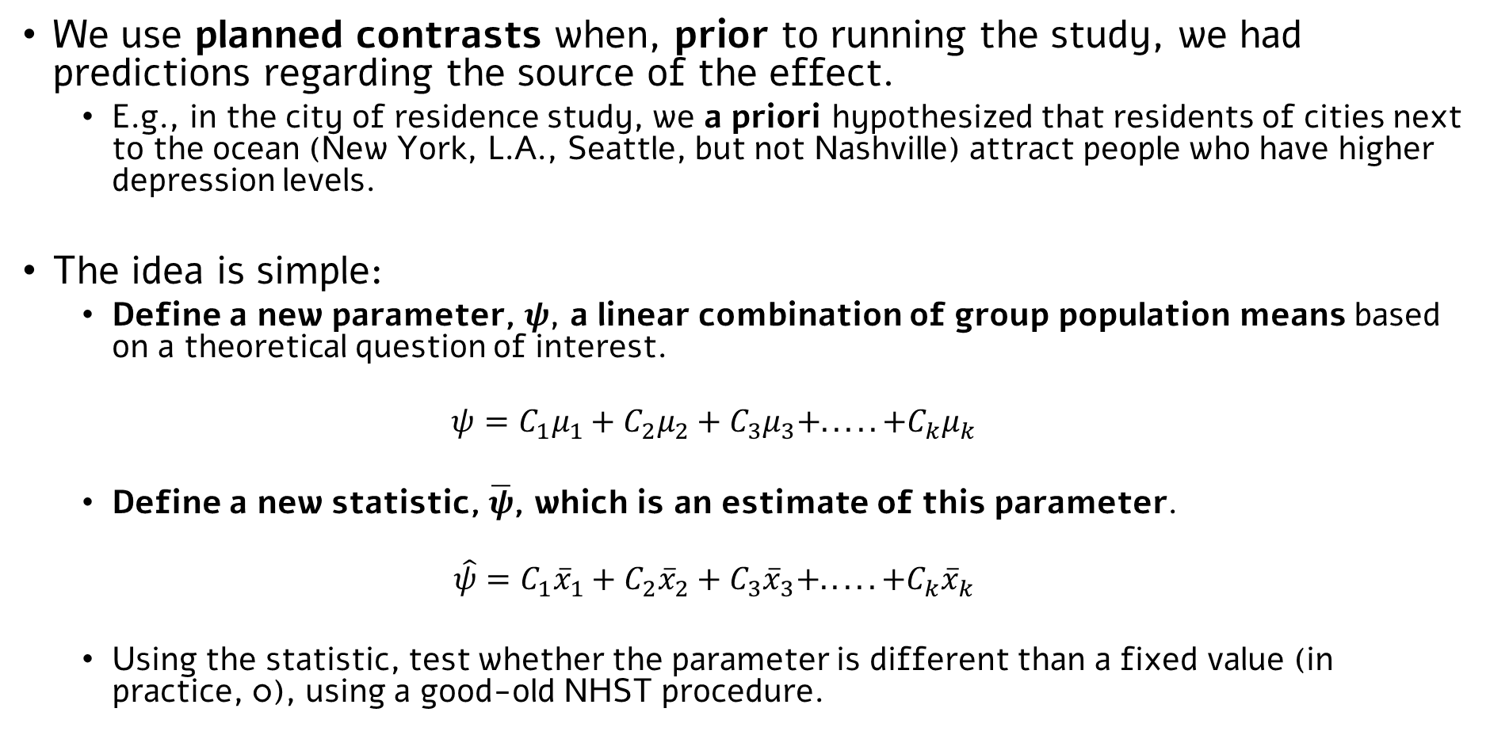
Planned contrasts
We use planned contrasts when, prior to running the study, we had predictions regarding the source of the effect.
E.g., in the city of residence study, we a priori hypothesized that residents of cities next to the ocean (New York, L.A., Seattle, but not Nashville) attract people who have higher depression levels.
The idea is simple:
Define a new parameter, $ψ$, a linear combination of group population means based on a theoretical question of interest.
$$ψ=C_{1}μ_{1}+C_{2}μ_{2}+C_{3}μ_{3}+.....+C_{k}μ_{k}$$
Define a new statistic, $\overline{ψ}$, which is an estimate of this parameter.
$$\hat{ψ}=C_{1}{\overline{x}}_{1}+C_{2}{\overline{x}}_{2}+C_{3}{\overline{x}}_{3}+.....+C_{k}{\overline{x}}_{k}$$
Using the statistic, test whether the parameter is different than a fixed value (in practice, 0), using a good-old NHST procedure.

Slide 7

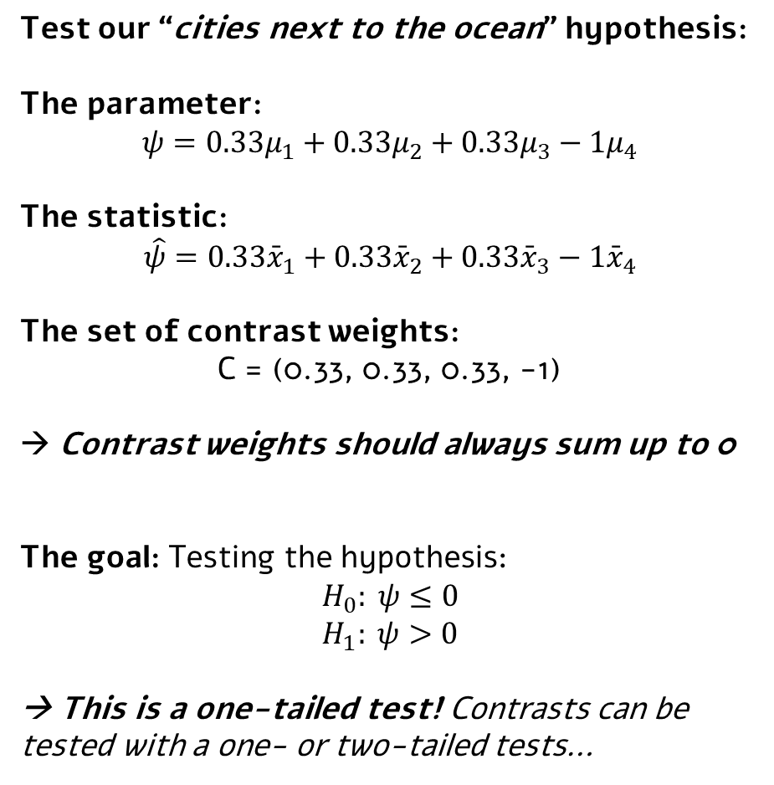








Setting up contrasts
Test our “cities next to the ocean” hypothesis:
The parameter:
$$ψ=0.33μ_{1}+0.33μ_{2}+0.33μ_{3}−1μ_{4}$$
The statistic:
$$\hat{ψ}=0.33{\bar{x}}_{1}+0.33{\bar{x}}_{2}+0.33{\bar{x}}_{3}−1{\bar{x}}_{4}$$
The set of contrast weights:
C = (0.33, 0.33, 0.33, -1)
Contrast weights should always sum up to 0
The goal: Testing the hypothesis:
$$H_{0}: ψ≤0$$
$$H_{1}: ψ>0$$
→ This is a one-tailed test! Contrasts can be tested with a one- or two-tailed tests…
Nashville (4) | Seattle (3) | Los Angeles (2) | New York City (1)
1 3 6 1 8 4 0 12 8 7 | 12 14 4 10 15 8 7 5 9 16 | 3 4 6 8 12 14 5 9 6 3 | 6 7 11 12 7 9 13 4 18 3
${\overline{x}}_{1}$= 9
${\overline{x}}_{2}$= 7
${\overline{x}}_{3}$= 10
${\overline{x}}_{4}$= 5
$n_{1}$= 10
$n_{2}$= 10
$n_{3}$= 10
$n_{4}$= 10
$\overset{̿}{x}$= 7.75

Slide 8

A blast from the past! Three questions
Same three questions from Z- and t-tests about the sampling distribution of $\hat{ψ}$:
What is the expected value of the sampling distribution of $\hat{ψ}$?
What is the variance/SD of the sampling distribution of $\hat{ψ}$?
What is the shape of the sampling distribution of$\hat{ψ}$?

Slide 9



A blast from the past! Three questions
Same three questions from Z- and t-tests about the sampling distribution of $\hat{ψ}$:
What is the expected value of the sampling distribution of $\hat{ψ}$?
What is the variance/SD of the sampling distribution of $\hat{ψ}$?
What is the shape of the sampling distribution of$\hat{ψ}$?
$$E\left(\hat{ψ}\right)=E\left(C_{1}{\bar{x}}_{1}+C_{2}{\bar{x}}_{2}+C_{3}{\bar{x}}_{3}+.....+C_{k}{\bar{x}}_{k}\right)$$
$$=E\left(C_{1}{\bar{x}}_{1})+E(C_{2}{\bar{x}}_{2})+E(C_{3}{\bar{x}}_{3})+.....+E(C_{k}{\bar{x}}_{k}\right)$$
[independent samples in groups 1…n]
$${=C}_{1}E\left({\bar{x}}_{1})+C_{2}E({\bar{x}}_{2})+C_{3}E({\bar{x}}_{3})+.....+C_{k}E({\bar{x}}_{k}\right)$$
[C1…Ck are constants]
${=C}_{1}μ_{1}+C_{2}μ_{2}+C_{3}μ_{3}+.....$+ $C_{k}μ_{k}=ψ$
[E(${\bar{x}}_{1}$)…E(${\bar{x}}_{k}$) are $μ_{1}…μ_{k}$]
*end result is unsurprising, otherwise we wouldn’t have used $\hat{ψ}$

Slide 10
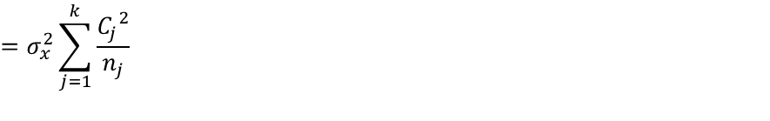

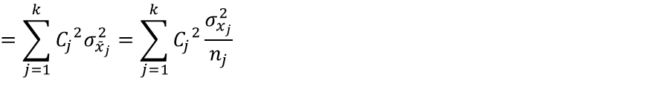
A blast from the past! Three questions
Same three questions from Z- and t-tests about the sampling distribution of $\hat{ψ}$:
What is the expected value of the sampling distribution of $\hat{ψ}$?
What is the variance/SD of the sampling distribution of $\hat{ψ}$?
What is the shape of the sampling distribution of$\hat{ψ}$?
$$Var\left(\hat{ψ}\right)=V(C_{1}{\bar{x}}_{1}+C_{2}{\bar{x}}_{2}+C_{3}{\bar{x}}_{3}+.....+C_{k}{\bar{x}}_{k})$$
$$=V\left(C_{1}{\bar{x}}_{1})+V(C_{2}{\bar{x}}_{2})+V(C_{3}{\bar{x}}_{3})+.....+V(C_{k}{\bar{x}}_{k}\right)$$
[independent samples in groups 1…n]
$${=C}_{1}^{2}V\left({\bar{x}}_{1})+C_{2}^{2}V({\bar{x}}_{2})+C_{3}^{2}V({\bar{x}}_{3})+.....+C_{k}^{2}V({\bar{x}}_{k}\right)$$
[C1…Ck are constants]
$$=\sum_{j=1}^{k}{{C_{j}}^{2}σ_{{\bar{x}}_{j}}^{2}}=\sum_{j=1}^{k}{{C_{j}}^{2}\frac{σ_{x_{j}}^{2}}{n_{j}}}$$
[algebra + variance of mean’s sampling dist.]
$$=σ_{x}^{2}\sum_{j=1}^{k}{\frac{{C_{j}}^{2}}{n_{j}}}$$
[assuming homogeneity of variance ]

Slide 11



A blast from the past! Three questions
Same three questions from Z- and t-tests about the sampling distribution of $\hat{ψ}$:
What is the expected value of the sampling distribution of $\hat{ψ}$?
What is the variance/SD of the sampling distribution of $\hat{ψ}$?
What is the shape of the sampling distribution of$\hat{ψ}$?
Since x is assumed to be normally distributed, if $σ_{x}^{2}$ was known, then:
$$\hat{ψ}\sim _{H_{0}}Normal(ψ_{H_{0}}, \sqrt{σ_{x}^{2}\sum_{j=1}^{k}{\frac{{C_{j}}^{2}}{n_{j}}}})$$
And after standardization we could say that:
$$\frac{\hat{Ψ}−ψ_{H_{0}}}{\sqrt{σ_{x}^{2}\sum_{j=1}^{k}{\frac{{C_{j}}^{2}}{n_{j}}}}}\sim Z$$
Because the variance is unknown, we’ll estimate it.
How? via MSW*:
$$\frac{\hat{Ψ}−ψ_{H_{0}}}{\sqrt{MSW\sum_{j=1}^{k}{\frac{{C_{j}}^{2}}{n_{j}}}}}\sim t_{N−K}$$
→ And voila! This is our statistical test
*in a two-way ANOVA, we use MSE

Slide 12

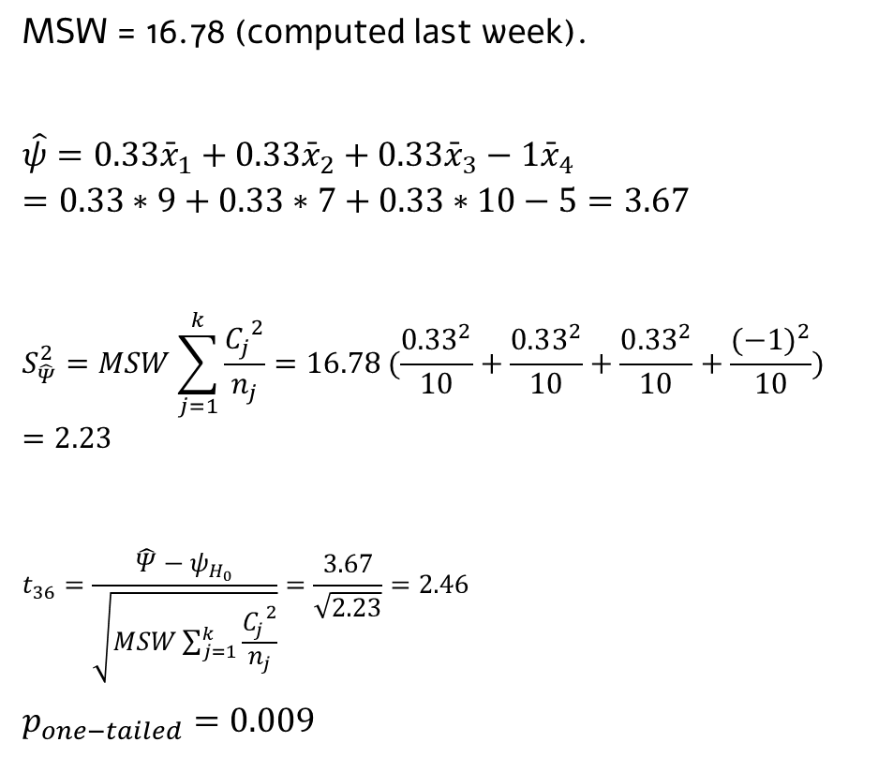








Back to our example
MSW = 16.78 (computed last week).
$$\hat{ψ}=0.33{\bar{x}}_{1}+0.33{\bar{x}}_{2}+0.33{\bar{x}}_{3}−1{\bar{x}}_{4}=0.33∗9+0.33∗7+0.33∗10−5=3.67$$
$$S_{\hat{Ψ}}^{2}=MSW\sum_{j=1}^{k}{\frac{{C_{j}}^{2}}{n_{j}}=16.78}(\frac{0.33^{2}}{10}+\frac{0.33^{2}}{10}+\frac{0.33^{2}}{10}+\frac{(−1)^{2}}{10})=2.23$$
$$t_{36}=\frac{\hat{Ψ}−ψ_{H_{0}}}{\sqrt{MSW\sum_{j=1}^{k}{\frac{{C_{j}}^{2}}{n_{j}}}}}=\frac{3.67}{\sqrt{2.23}}=2.46$$
$$p_{one−tailed}=0.009$$
Nashville (4) | Seattle (3) | Los Angeles (2) | New York City (1)
1 3 6 1 8 4 0 12 8 7 | 12 14 4 10 15 8 7 5 9 16 | 3 4 6 8 12 14 5 9 6 3 | 6 7 11 12 7 9 13 4 18 3
${\overline{x}}_{1}$= 9
${\overline{x}}_{2}$= 7
${\overline{x}}_{3}$= 10
${\overline{x}}_{4}$= 5
$n_{1}$= 10
$n_{2}$= 10
$n_{3}$= 10
$n_{4}$= 10
$\overset{̿}{x}$= 7.75
What can be concluded?

Slide 13
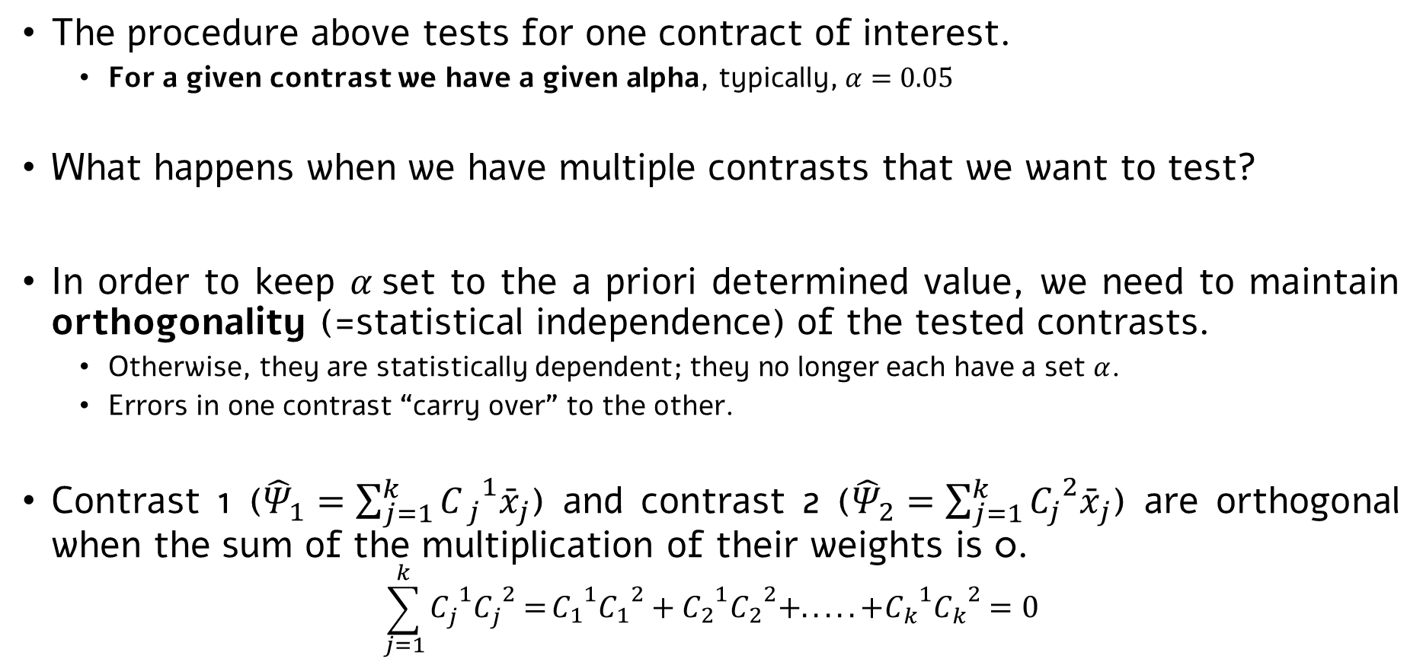
Planned contrasts: Orthogonality of contrasts
The procedure above tests for one contract of interest.
For a given contrast we have a given alpha, typically, $α=0.05$
What happens when we have multiple contrasts that we want to test?
In order to keep $α$set to the a priori determined value, we need to maintain orthogonality (=statistical independence) of the tested contrasts.
Otherwise, they are statistically dependent; they no longer each have a set $α$.
Errors in one contrast “carry over” to the other.
Contrast 1 (${\hat{Ψ}}_{1}=\sum_{j=1}^{k}{{C_{ j}}^{1}{\bar{x}}_{j}}$) and contrast 2 (${\hat{Ψ}}_{2}=\sum_{j=1}^{k}{{C_{j}}^{2}{\bar{x}}_{j}}$) are orthogonal when the sum of the multiplication of their weights is 0.
$$\sum_{j=1}^{k}{{C_{j}}^{1}{C_{j}}^{2}=}{C_{1}}^{1}{C_{1}}^{2}+{C_{2}}^{1}{C_{2}}^{2}+.....+{C_{k}}^{1}{C_{k}}^{2}=0$$

Slide 14




Planned contrasts: Orthogonality of contrasts
Orthogonal contrasts:
Non-orthogonal (statistical dependent) contrasts:
SS$ψ_{2}$
SS$ψ_{2}$
SSB
SS$ψ_{1}$
SSB
SS$ψ_{1}$
SSW
SSW
SST
SST
No overlap between variance explained by each contrasts
Some Overlap between variance explained by each contrasts

Slide 15
Planned contrasts: orthogonality of contrasts
Nashville (4) | Seattle (3) | Los Angeles (2) | New York City (1)
1 3 6 1 8 4 0 12 8 7 | 12 14 4 10 15 8 7 5 9 16 | 3 4 6 8 12 14 5 9 6 3 | 6 7 11 12 7 9 13 4 18 3
Contrasts 1 and 2 are orthogonal:
(1/3)*1 + (1/3)*(-1/2) + (1/3)*(-1/2) + (-1)*0 = 0
Similarly, contrasts 2 and 3, and 1 and 3 are orthogonal.
Contrasts 1-3 are an orthogonal set of contrasts.
But, contrast 4 is non-orthogonal with, e.g., contrast 1; it’s not part of the orthogonal set.
 |  | C1 | C2 | C3 | C4
Contrast 1 | “proximity to ocean” | 1/3 | 1/3 | 1/3 | -1
Contrast 2 | “east vs west coast” | 1 | -1/2 | -1/2 | 0
Contrast 3 | “south west vs north west” | 0 | 1 | -1 | 0
Contrast 4 | “east coast vs rest” | 1 | -1/3 | -1/3 | -1/3

Slide 16



Planned contrasts: orthogonality of contrasts
Generally speaking, for a categorical independent variable with k levels, there is a maximum of k-1 orthogonal contrasts (“a set of orthogonal contrasts”).
An orthogonal set of contrasts: (k=4)
SSB
SS$ψ_{1}$
SS$ψ_{2}$
SS$ψ_{3}$
SSW
SST
An orthogonal set of size k-1 contrast cover the full SSB

Slide 17
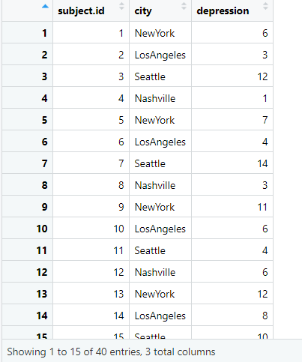
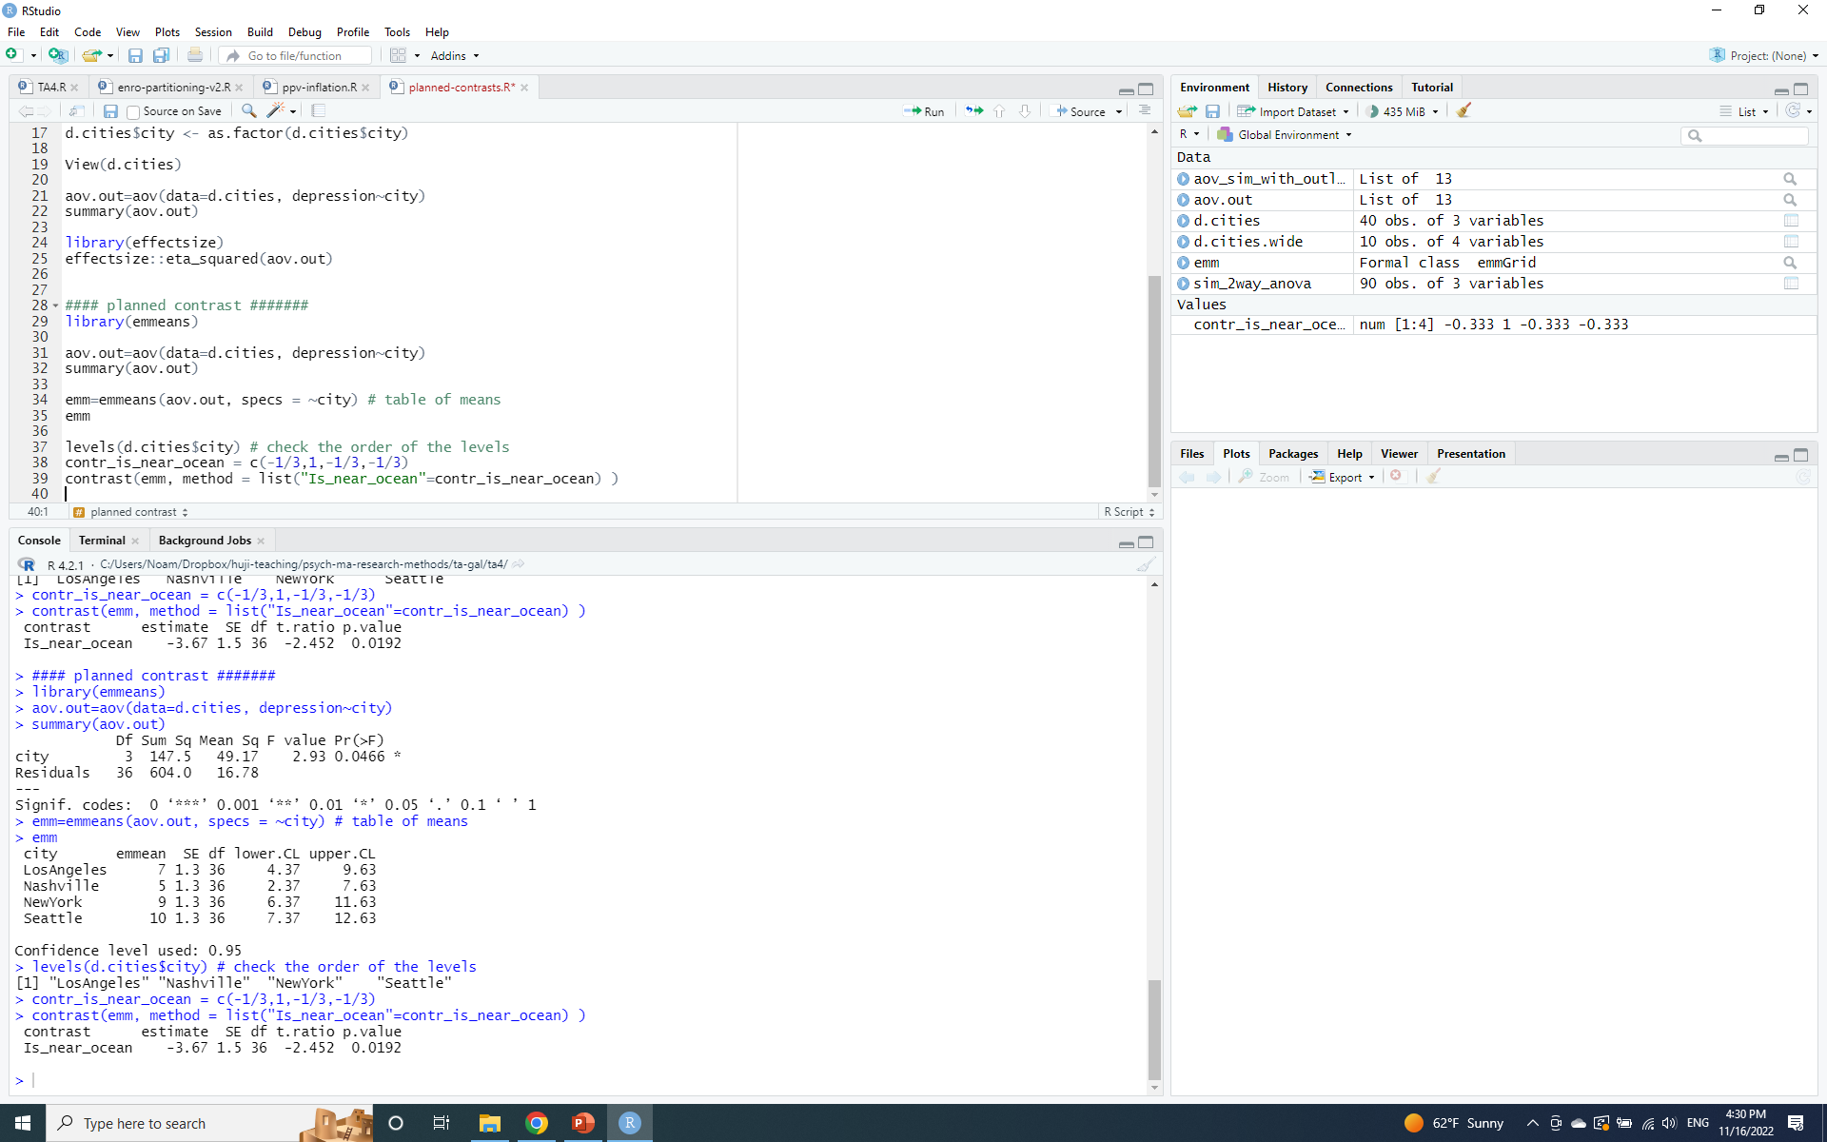
Planned contrasts in R
* Remember – R’s default is a two-tailed p-value
* Additional implementations (e.g., here) will become clearer and intuitive after we learn about linear models

Slide 18
Contrasts Post-hoc comparisons

Slide 19
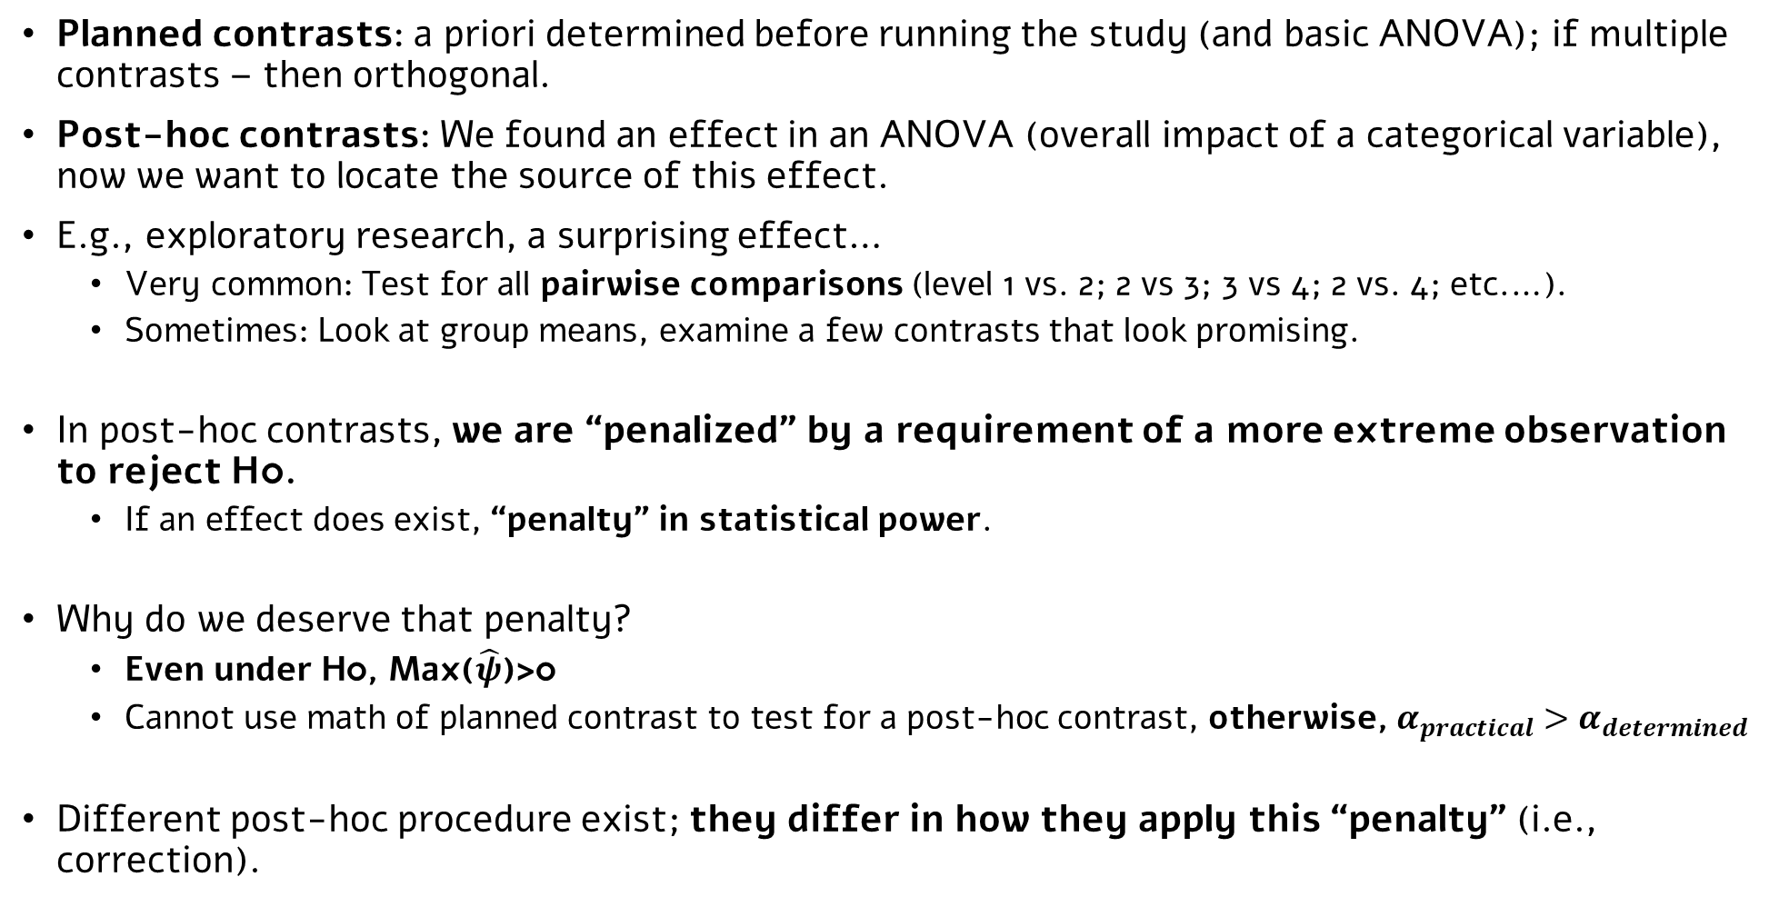
Post-hoc contrasts
Planned contrasts: a priori determined before running the study (and basic ANOVA); if multiple contrasts – then orthogonal.
Post-hoc contrasts: We found an effect in an ANOVA (overall impact of a categorical variable), now we want to locate the source of this effect.
E.g., exploratory research, a surprising effect…
Very common: Test for all pairwise comparisons (level 1 vs. 2; 2 vs 3; 3 vs 4; 2 vs. 4; etc.…).
Sometimes: Look at group means, examine a few contrasts that look promising.
In post-hoc contrasts, we are “penalized” by a requirement of a more extreme observation to reject H0.
If an effect does exist, “penalty” in statistical power.
Why do we deserve that penalty?
Even under H0, Max($\hat{ψ}$)>0
Cannot use math of planned contrast to test for a post-hoc contrast, otherwise, $α_{practical}>α_{determined}$
Different post-hoc procedure exist; they differ in how they apply this “penalty” (i.e., correction).

Slide 20
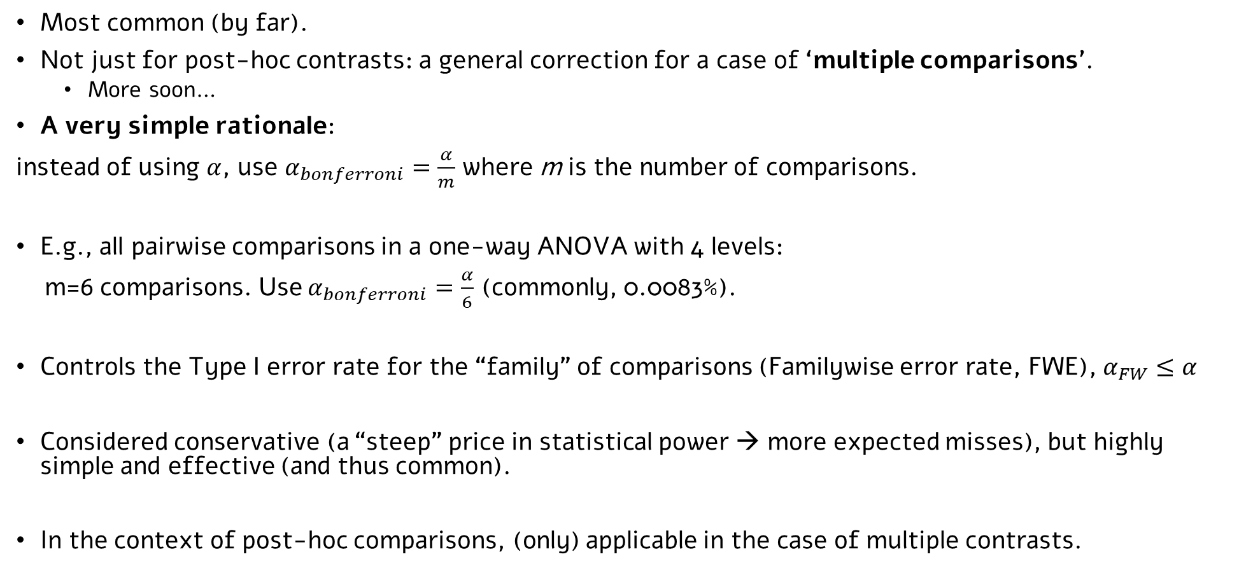
Bonferroni correction
Most common (by far).
Not just for post-hoc contrasts: a general correction for a case of ‘multiple comparisons’.
More soon…
A very simple rationale:
instead of using $α$, use $α_{bonferroni}=\frac{α}{m}$ where m is the number of comparisons.
E.g., all pairwise comparisons in a one-way ANOVA with 4 levels:
m=6 comparisons. Use $α_{bonferroni}=\frac{α}{6}$ (commonly, 0.0083%).
Controls the Type I error rate for the “family” of comparisons (Familywise error rate, FWE), $α_{FW}≤$ $α$
Considered conservative (a “steep” price in statistical power → more expected misses), but highly simple and effective (and thus common).
In the context of post-hoc comparisons, (only) applicable in the case of multiple contrasts.

Slide 21
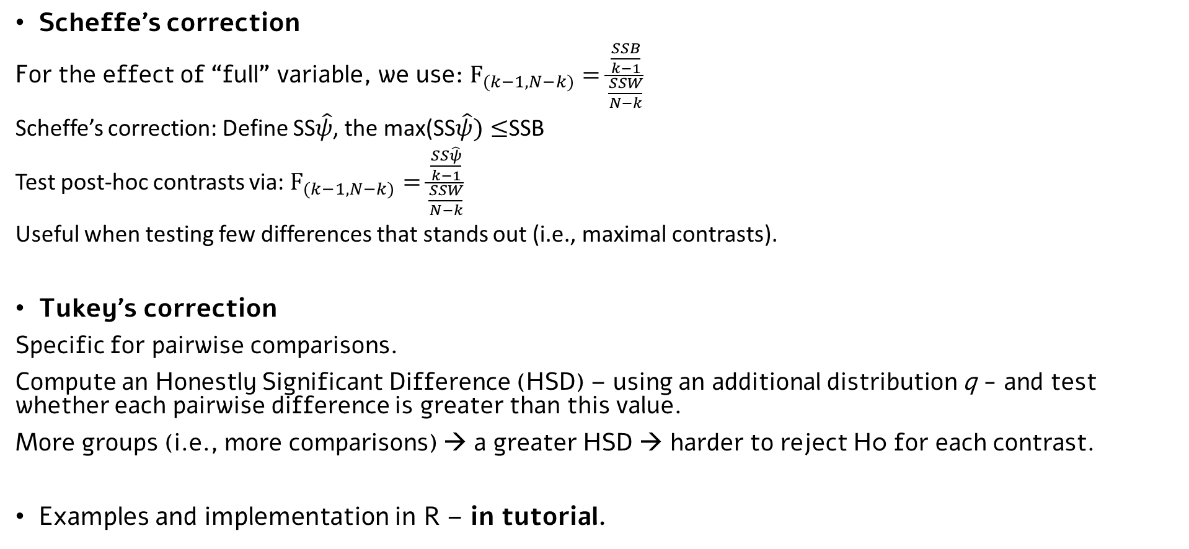

Other corrections: Specific for post-hoc contrasts
Scheffe’s correction
For the effect of “full” variable, we use: $F_{(k−1, N−k)}=\frac{\frac{SSB}{k−1}}{\frac{SSW}{N−k}}$
Scheffe’s correction: Define SS$\hat{ψ}$, the max(SS$\hat{ψ})≤$SSB
Test post-hoc contrasts via: $F_{(k−1, N−k)}=\frac{\frac{SS\hat{ψ}}{k−1}}{\frac{SSW}{N−k}}$
Useful when testing few differences that stands out (i.e., maximal contrasts).
Tukey’s correction
Specific for pairwise comparisons.
Compute an Honestly Significant Difference (HSD) – using an additional distribution q - and test whether each pairwise difference is greater than this value.
More groups (i.e., more comparisons) → a greater HSD → harder to reject H0 for each contrast.
Examples and implementation in R – in tutorial.
SS$\hat{ψ}$
SSB
SSW

Slide 22
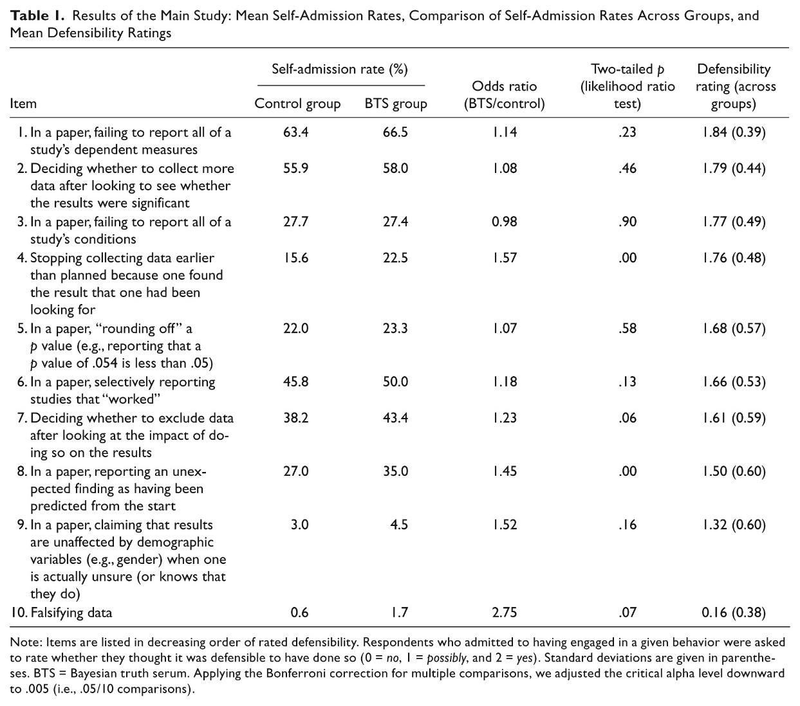
Planned vs. Post-hoc contrasts
Planned contrasts: A priori determined, a “standard” process with no further corrections.
Post-hoc contrasts: No specific a priori predictions, incorporate a “penalty” that ensures we do not inflate Type I error rate.
As a consequence, statistical power is lower
In practice, unfortunately, nothing stops us from presenting post-hoc as planned.
Most likely, a pretty common practice.
If we were to do that, reproducibility would take a hit.
An instantiation of a larger phenomenon: “False-Positive Psychology” (aka QPRs).
John et al., 2012, Psychological Science

Slide 23
False-positive Psychology What NOT to do (and what can we learn from these rather common bad practices)

Slide 24
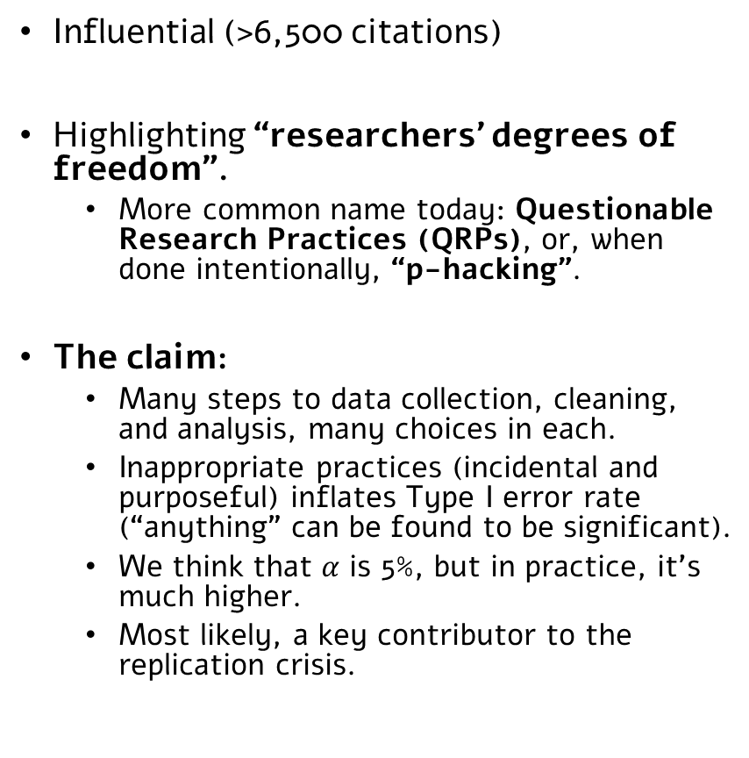
False-Positive Psychology paper
Influential (>6,500 citations)
Highlighting “researchers' degrees of freedom”.
More common name today: Questionable Research Practices (QRPs), or, when done intentionally, “p-hacking”.
The claim:
Many steps to data collection, cleaning, and analysis, many choices in each.
Inappropriate practices (incidental and purposeful) inflates Type I error rate (“anything” can be found to be significant).
We think that $α$ is 5%, but in practice, it’s much higher.
Most likely, a key contributor to the replication crisis.

Slide 25
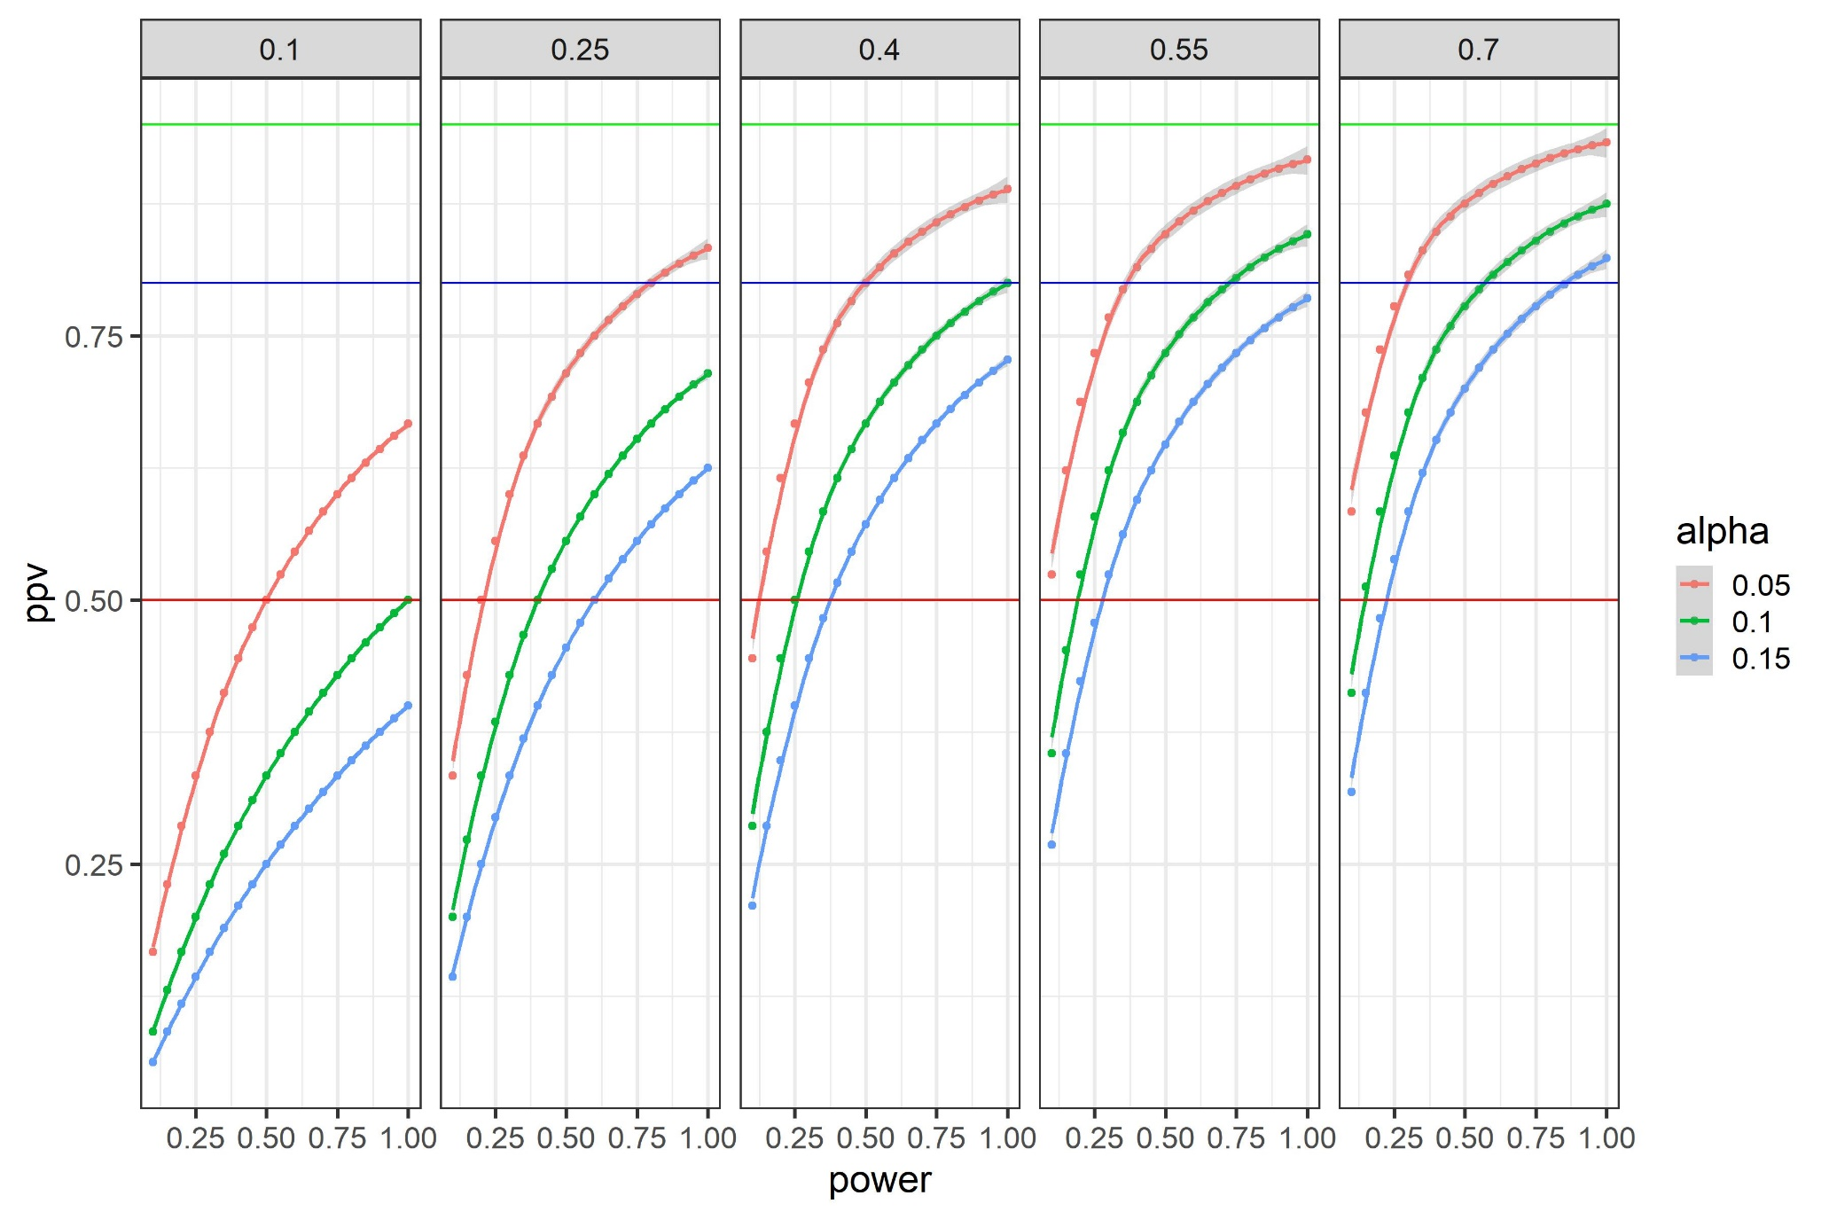
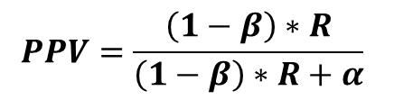
Impact on PPV (remember last time?)
$$PPV=\frac{\left(1−β\right)∗R}{\left(1−β\right)∗R+α}$$
Panels: R (odds)
PPV=0.95
PPV=0.8
PPV=0.5

Slide 26
False-Positive Psychology
Simmons et al. highlight 5 common “researchers’ degrees of freedom” (QPRs) that substantially inflate Type I error rate:
Flexible treatment of outliers.
Gradual increase of sample size.
Analysis of multiple dependent variables (and partial reporting).
Omission of experimental conditions.
Problematic choices regarding statistical controls.
Today: For each QPR, why is it bad, and how to do it right.

Slide 27
False-Positive Psychology
Simmons et al. highlight 5 common “researchers’ degrees of freedom” (QPRs) that substantially inflate Type I error rate:
Flexible treatment of outliers.
Gradual increase of sample size.
Analysis of multiple dependent variables (and partial reporting).
Omission of experimental conditions.
Problematic choices regarding statistical controls.
Today: For each QPR, why is it bad, and how to do it right.
Both related to multiple comparisons

Slide 28
Before we start: How bad could it be?
Really bad!

Slide 29
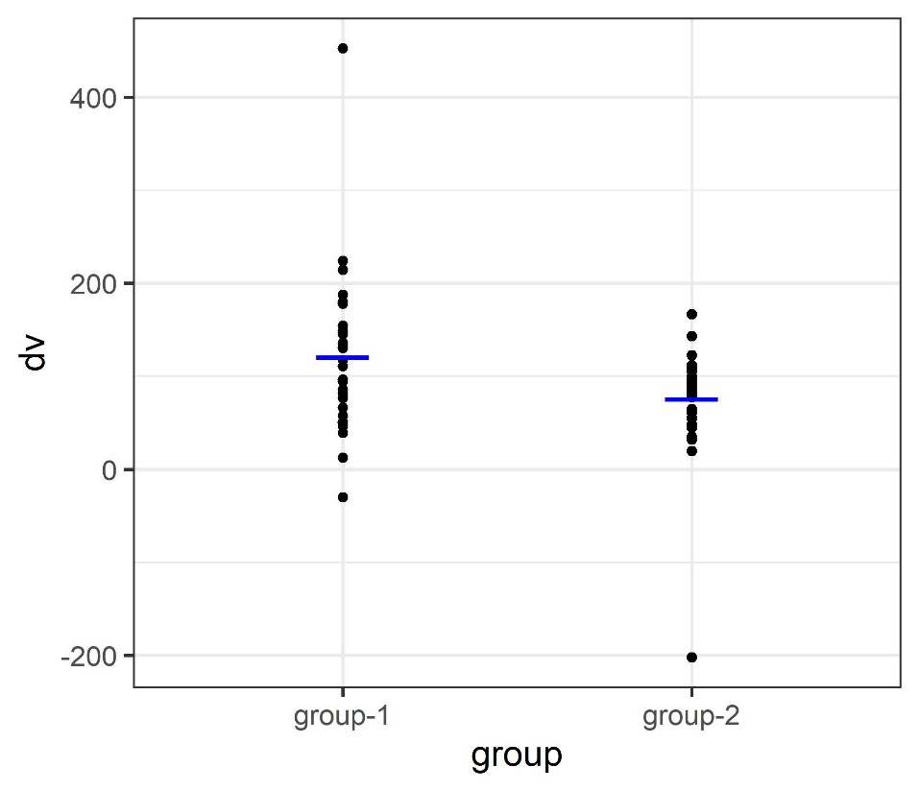
1. Treatment of outliers
Some treatment of outliers is very common and sensible.
At the subject-level: Exclude/trim participants with extreme (mean) values. (lack of motivation? Not belonging to the same population?)
At the trial-level: Exclude/trim trials (within-participants) with extreme values. (measurement error? Technical failure? Momentarily diversion?)
The rationale behind outlier exclusion: We don’t want a small number of extreme observations (subjects and/or trials) to mask an existing effect or ‘create’ a non-existent effect.
Example: Two groups of subjects (n=30), t-test found a significant difference (M_{x} = 120.65, SD_{x} = 86.08; M_{y} = 75.50, SD_{y} = 61.68; t(58)=2.34, p = 0.02)… But is it, though?

Slide 30
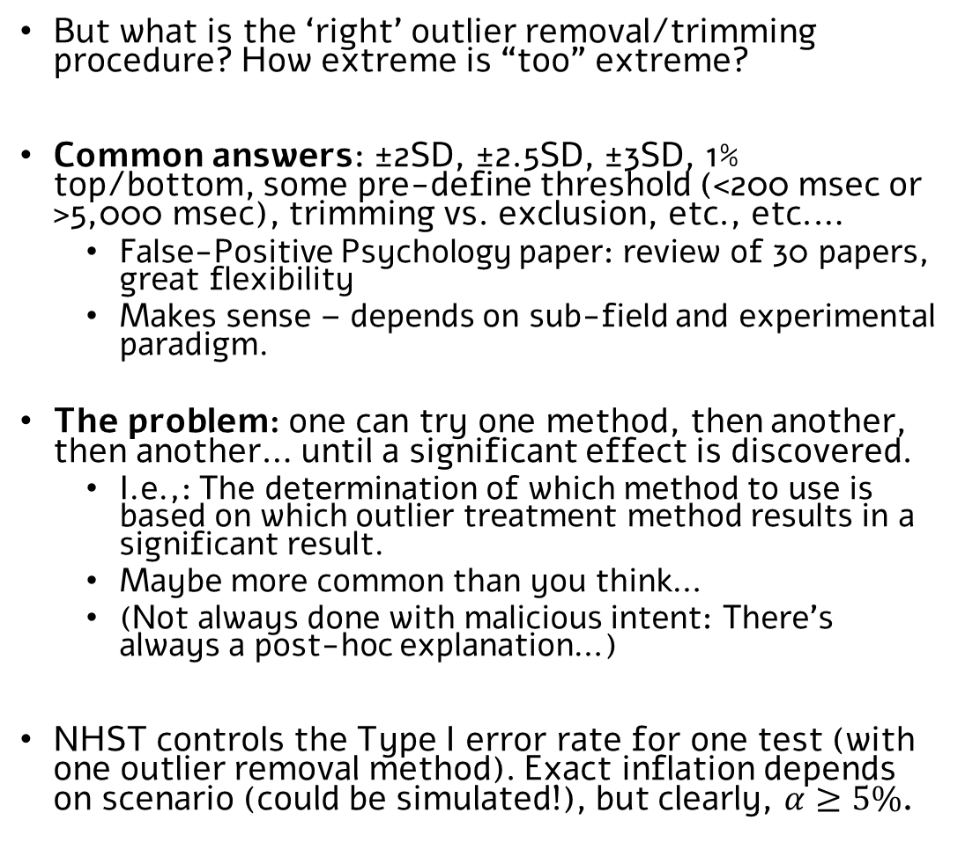
Treatment of outliers
But what is the ‘right’ outlier removal/trimming procedure? How extreme is “too” extreme?
Common answers: ±2SD, ±2.5SD, ±3SD, 1% top/bottom, some pre-define threshold (<200 msec or >5,000 msec), trimming vs. exclusion, etc., etc.…
False-Positive Psychology paper: review of 30 papers, great flexibility
Makes sense – depends on sub-field and experimental paradigm.
The problem: one can try one method, then another, then another… until a significant effect is discovered.
I.e.,: The determination of which method to use is based on which outlier treatment method results in a significant result.
Maybe more common than you think…
(Not always done with malicious intent: There’s always a post-hoc explanation…)
NHST controls the Type I error rate for one test (with one outlier removal method). Exact inflation depends on scenario (could be simulated!), but clearly, $α≥5\%$.
John et al., 2012, Psychological Science

Slide 31
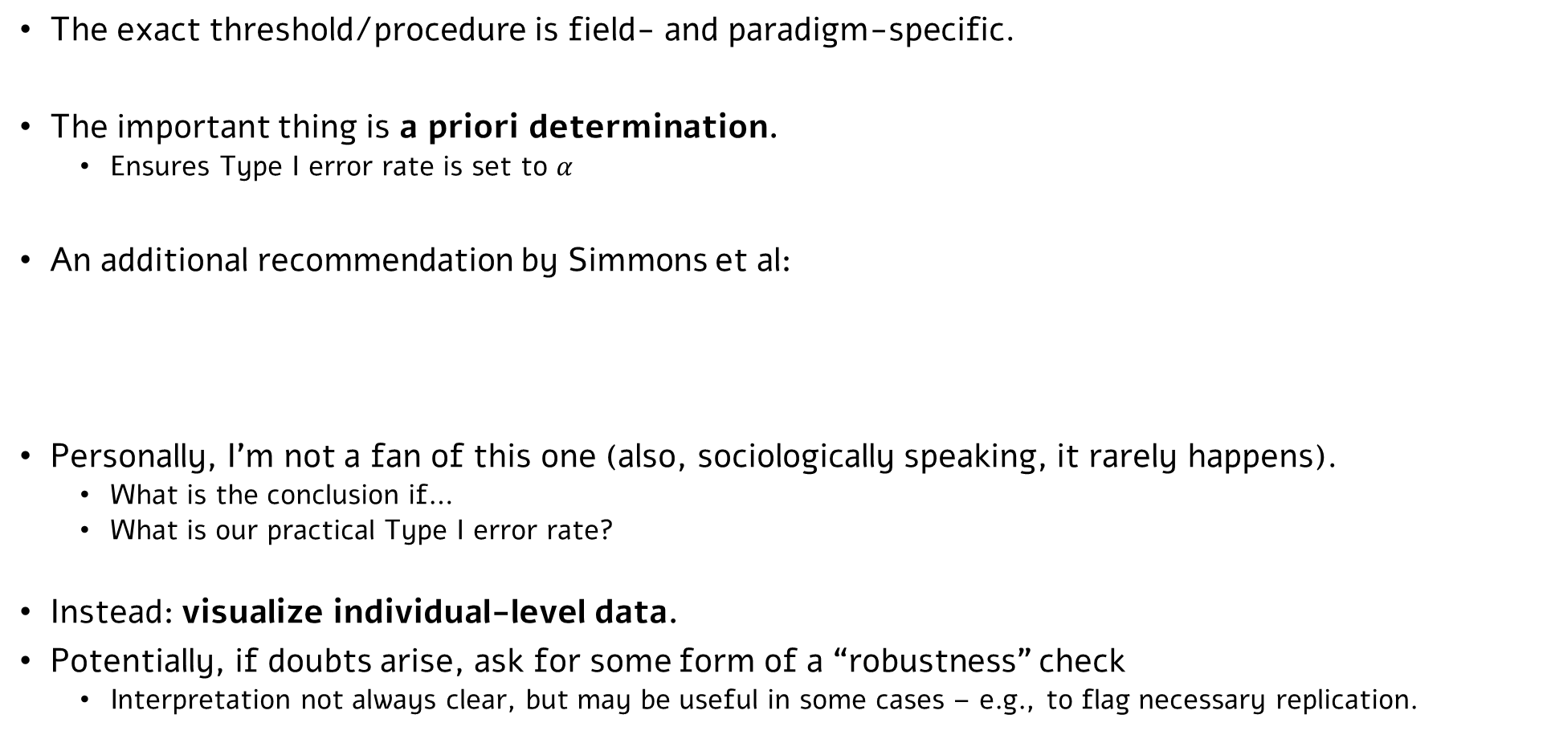
Outlier removal: How to do it right?
The exact threshold/procedure is field- and paradigm-specific.
The important thing is a priori determination.
Ensures Type I error rate is set to $α$
An additional recommendation by Simmons et al:
Personally, I’m not a fan of this one (also, sociologically speaking, it rarely happens).
What is the conclusion if…
What is our practical Type I error rate?
Instead: visualize individual-level data.
Potentially, if doubts arise, ask for some form of a “robustness” check
Interpretation not always clear, but may be useful in some cases – e.g., to flag necessary replication.

Slide 32
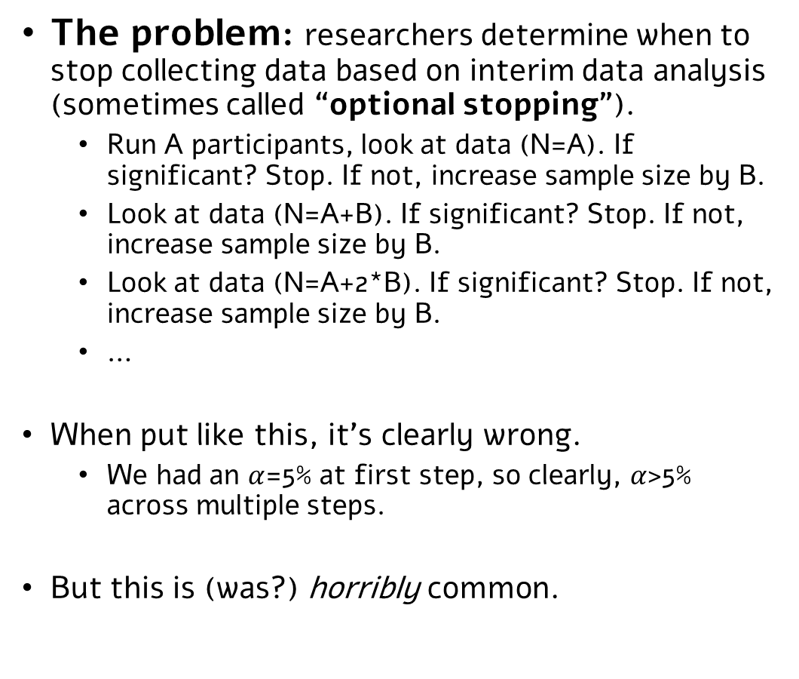
2. Gradual increase in sample size
The problem: researchers determine when to stop collecting data based on interim data analysis (sometimes called “optional stopping”).
Run A participants, look at data (N=A). If significant? Stop. If not, increase sample size by B.
Look at data (N=A+B). If significant? Stop. If not, increase sample size by B.
Look at data (N=A+2*B). If significant? Stop. If not, increase sample size by B.
…
When put like this, it’s clearly wrong.
We had an $α$=5% at first step, so clearly, $α$>5% across multiple steps.
But this is (was?) horribly common.
John et al., 2012, Psychological Science

Slide 33
2. Gradual increase in sample size
Inflation of Type I error rate:
Can get really bad…

Slide 34
Determination of sample size: How to do it right?
Optimally: Run a power analysis.
Reminder: set a power level, set a minimal effect size → find number of participants needed.
Determine minimal effect size either based on rules of thumb (e.g., ‘small’ effect of d = 0.2), or ideally, based on previous studies and meta-analysis.
Less than optimal but still more than fine: Follow previous studies.
“We ran N=XXX participants because YYY did”.
May be useful in cases where power estimates are hard to obtain (e.g., very complex statistical models).
Not optimal but better than optional stopping: Arbitrarily decide when to stop.
E.g., “all participants that we were able to recruit by the end of the semester”.
The most important thing: A priori determination.
Methods above may differ in the statistical power they provide (which is important; remember, e.g., PPV) but they all avoid the issue of optional stopping, i.e., inflation of Type I error.
Plus, be honest about it:

Slide 35
3. Multiple dependent variables + partial reporting 4. Omission of experimental conditions
Problem (3) – Collect multiple DVs, run analysis with each, report only significant results.
E.g., in paper, collect both ‘real age’ and ‘how old they feel’
Problem (4) – assign participants to multiple conditions, check multiple contrasts, report only significant comparisons (and omit those which are not significant).
E.g., in paper, assign participants to three conditions, find a (spurious) effect between two of them, omit the third.
(again, not always done with an attempt to cheat – there’s always a post-hoc justification…).
Both are an instantiation of the same issue: Multiple comparisons (without full reporting/statistical correction).
John et al., 2012, Psychological Science
* Why is one so much common than the other? No idea…

Slide 36
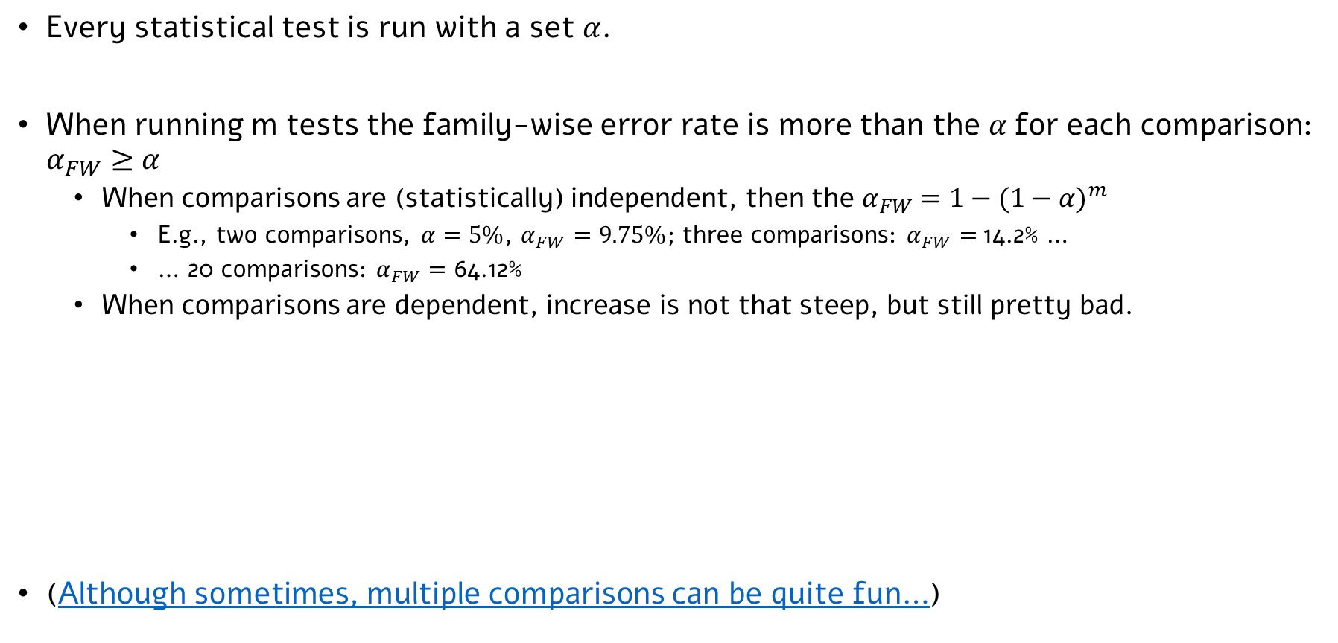
Multiple comparisons
Every statistical test is run with a set $α$.
When running m tests the family-wise error rate is more than the $α$for each comparison: $α_{FW}≥$ $α$
When comparisons are (statistically) independent, then the $α_{FW}=1−{(1−α)}^{m}$
E.g., two comparisons, $α=5\%$, $α_{FW}=9.75\%$; three comparisons: $α_{FW}=$14.2% …
… 20 comparisons: $α_{FW}=$ 64.12%
When comparisons are dependent, increase is not that steep, but still pretty bad.
(Although sometimes, multiple comparisons can be quite fun…)

Slide 37
Multiple comparisons: How to do it right?
First, be honest.
Report all comparisons conducted: Don’t hide conditions, don’t hide DVs.
If you really think there was a good reason for an effect in one condition/DV but not another – replicate!
Don’t present post-hoc comparisons as planned.
Second, correct for multiple comparisons when needed.
E.g., Bonferroni. But also check out other options (some less conservative): False Discovery Rate (FDR).
Sometimes a correction is clearly needed.
Sometimes, things are less clear.

Slide 38
Taking it a step further
Simmons et al.’s suggested requirements from authors:
Details can be argued about. But the bottom line is: full and honest reporting.
There’s room for exploratory (“hypothesis generating”) AND confirmatory (“hypothesis testing”) research. But exploratory research should never be presented as confirmatory.

Slide 39
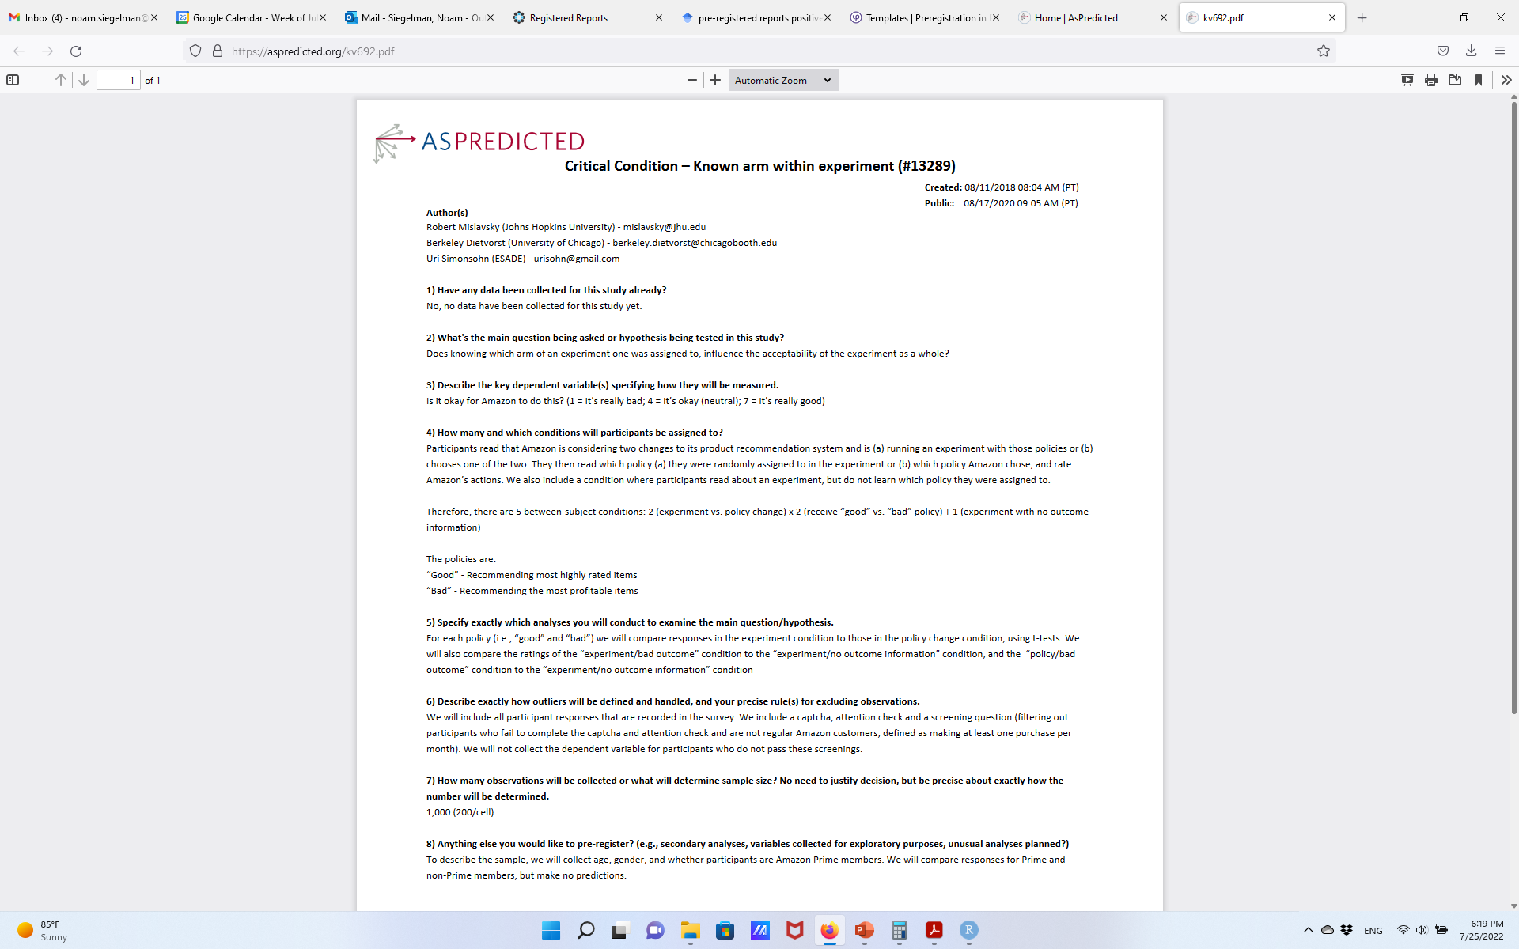
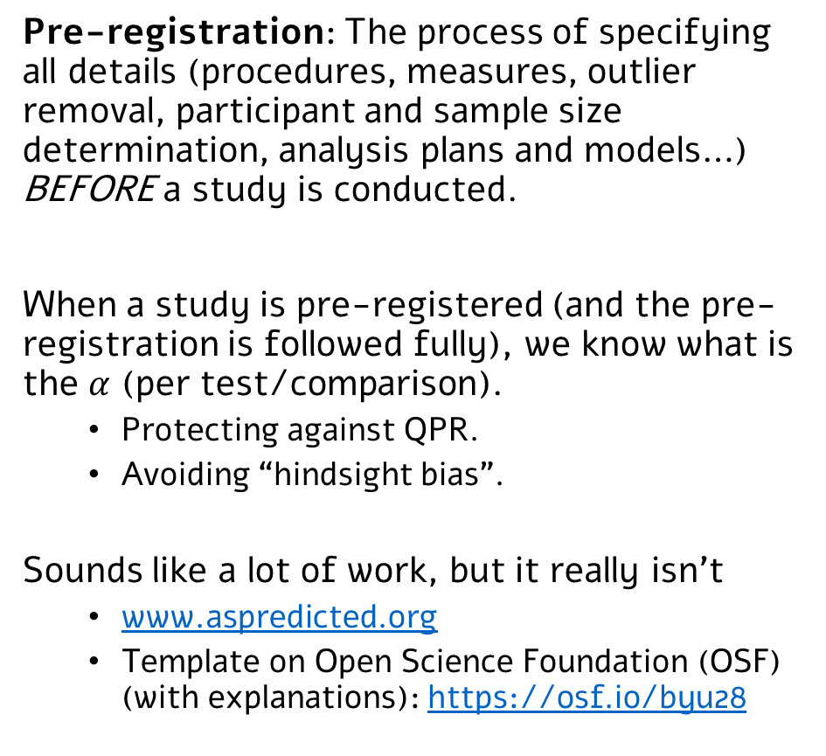
Taking it a step further II: Pre-registration, registered reports
Pre-registration: The process of specifying all details (procedures, measures, outlier removal, participant and sample size determination, analysis plans and models…) BEFORE a study is conducted.
When a study is pre-registered (and the pre-registration is followed fully), we know what is the $α$ (per test/comparison).
Protecting against QPR.
Avoiding “hindsight bias”.
Sounds like a lot of work, but it really isn’t
www.aspredicted.org
Template on Open Science Foundation (OSF) (with explanations): https://osf.io/byu28

Slide 40
Taking it a step further II: Pre-registration, registered reports
A step further: A registered report.
A paper with two submission stages: Stage A – intro and methods. If accepted than: Stage B (results and discussion). Guaranteed publication (if done in line with Stage A).
Still a place for exploratory analyses, but must be presented as such.
Minimizing the “file drawer problem” – the fact that only “positive” (i.e., significant) results are published
Due to NHST structure, a null result is not informative – we cannot “prove” a null finding, hence null results get buried “in a drawer”
Facilitates better accumulation of knowledge and meta-analysis.
Common now in many (some top-tier) journals: see list here.
Impact on prevalence of null vs. positive findings is still being explored.
Interested in Registered Reports? Read this great paper by Chambers & Tzavella, 2022

Slide 41
More things you can do to avoid QPR and increase reproducibility
Be honest, open, and collaborative.
Publish your raw data and materials.
Use, e.g., Open Science Foundation (OSF)
Promotes resource sharing, allow secondary analyses, protect from human errors, facilitate meta-analysis.
Run (and read) meta-analysis.
Useful for accumulation of evidence.
Be aware of, and strive to minimize, confirmation and hindsight bias.
Replicate yourself, and others.

Slide 42
Things sound easy, until they aren’t *my two cents, take with a grain of salt
Honesty – easy. Full reporting – easy. A priori determination of measures, samples, and procedures – easy.
Still, there are some cases that raise interesting and non-trivial questions.
E.g., using very large-scale databases; computational simulations: So many hypotheses being tested – how to correct for that?
NHST procedures – made for “classic” research. We live in a world where some research is vastly different than these classic cases.
Remember what NHST does, and what it doesn’t. Don’t misuse, don’t misinterpret.
Acknowledge limitations, and when needed, use other tools.
Go learn Bayesian inference, too!

Slide 43
Where are we? Where are we going?
Class # | Class: Topics | Tutorial # | Tutorial: Topics
1 | Replication crisis in psychology Hypothesis testing: An intro; One-sample Z and t-tests | 1 | Intro to R I
 | (No class – elections) | 1b | Intro to R II: Basic tests, simulations
2 | Statistical errors I: Refresher Two-sample t-test (independent + paired) Beyond dichotomous inference | 2 | Assumption violation and statistical errors – simulations.
3 | Statistical errors II: How many findings are false?; power analysis One-way and two-way ANOVA | 3 | Power analysis in R One-way ANOVA in R
4 | Contrasts (Planned vs. posthoc) Statistical errors III: False-positive psychology | 4 | Contrasts False-positive psychology simulations
5 | ANOVAs: within-subject and beyond. Correlation, regression, intro to multiple regression | 5 | Repeated measures ANOVA Simple linear models in R
6 | Multiple regression I: Control variables, (Multi)collinearity, Mediation, categorical predictors | 6 | Multiple regression in R I
7 | Multiple regression II: Interactions, centering & Transformation of variables, logistic models | 7 | Multiple regression in R II
 | Vacation |  | Vacation
8 | Mixed-effect models I: Fixed vs. random effects, significance testing | 8 | Mixed-effect models in R I
9 | Mixed-effect models II: Coding, interactions, centering & Transformations, Logistic LMM | 9 | Mixed-effect models in R II
10 | Mixed-effect models III: Determining random effect structure | 10 | Mixed-effect models in R III
11 | Summary so far Introduction to multivariate, non-parametric, and Bayesian inference | 11 | Multiple DVs (multivariate)
12 | Student presentations | 12 | Multiple DVs (multivariate)
13 | Student presentations *two weeks into break
More familiar (but: more advanced discussions,
Must-read papers,
R inc. simulations)
More novel

Slide 44
Unrelated to stats, but important

Slide 45

Notes from the Academic Administration Unit & Commission for the Prevention of Sexual Harassment

Slide 46

Notes from the Academic Administration Unit & Commission for the Prevention of Sexual Harassment

