Slide 1

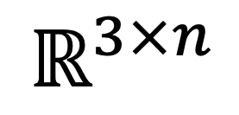



Lifted
representation
Input
Output
$$f_{feat }$$
$$\hat{Λ}$$
$$ℝ^{3×n}$$
$$W_{feat}^{n}$$
$$W_{T}^{n}$$

Slide 2

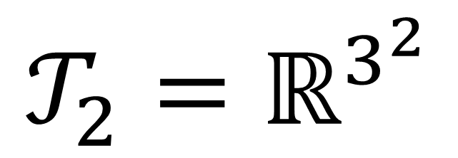

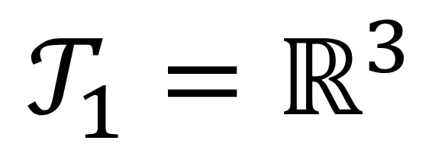


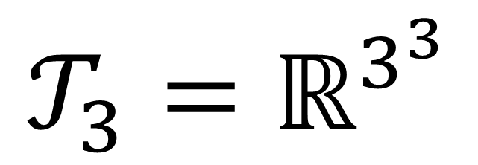
$$R$$
$$R$$
$$R$$
$$R$$
$$R$$
$$R$$
$$𝒯_{1}=ℝ^{3}$$
$${𝒯_{2}=ℝ}^{3^{2}}$$
$${𝒯_{3}=ℝ}^{3^{3}}$$

