Slide 1
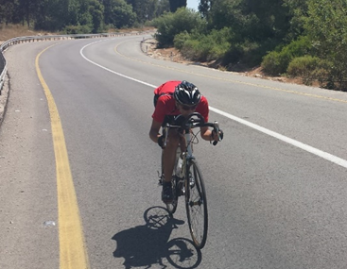
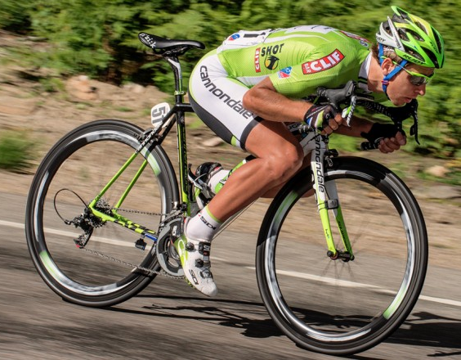
Descending cyclist’s speed
Notes:
Today I will talk to you about a project I have done about descending cyclist’s speed as an example of the usage of differential equations. Different cyclists use different positions in order to reach maximum aerodynamics. It’s reflected mostly in downhills.

Slide 2




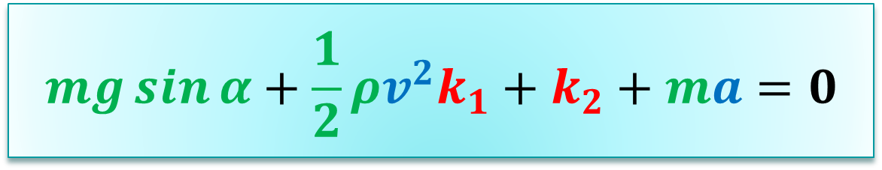
Theory
Permanent
resistance
Air resistance
Gravitation
$$F_{2}=\frac{1}{2}ρv^{2}k_{1}$$
$$F_{1}=mg\sin{α}$$
$$F_{3}=k_{2}$$
$$mg\sin{α}+\frac{1}{2}ρv^{2}k_{1}+k_{2}+ma=0$$
Notes:
This equation is the power equation of the cyclist. While descending, the cyclist’s power is 0, so I can remove the velocity from the equation and get this equation. This is a differential equation, because acceleration is the derivative of velocity. In the green color, these are parameters I know, as cyclist’s mass, road incline, air density. In the blue color these are variables and in the red color these are parameters I had to find.

Slide 3
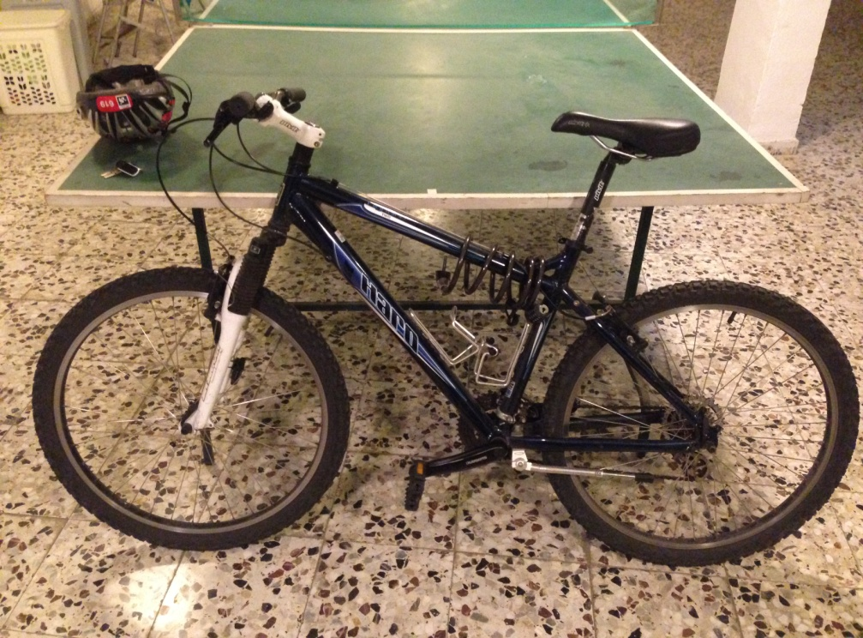

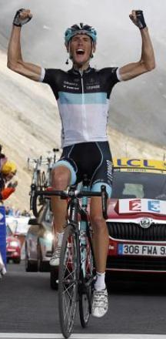
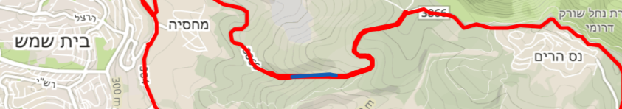
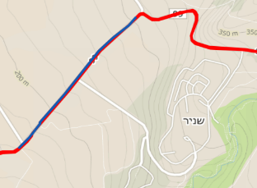
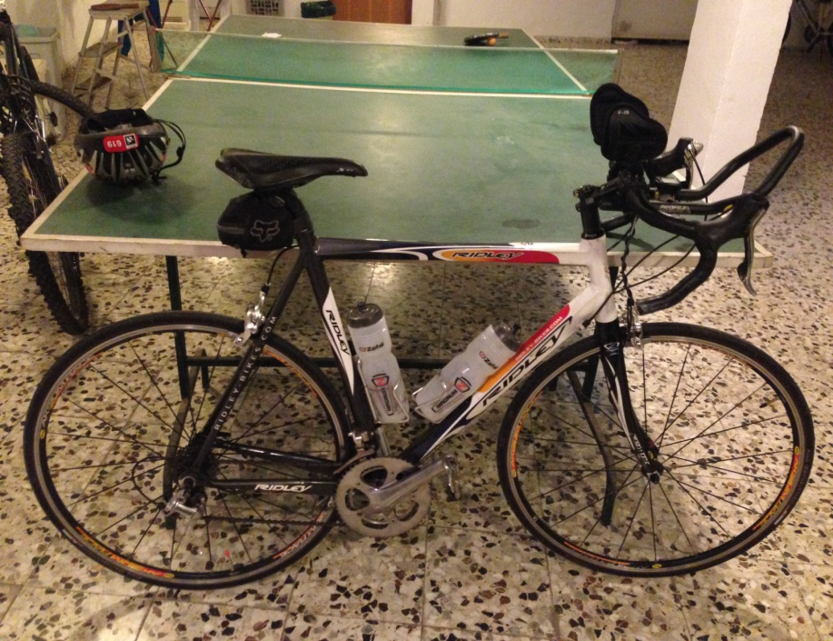

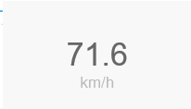

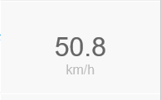
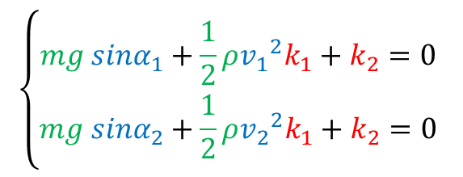
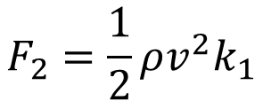

Finding k1 and k2
$$F_{2}=\frac{1}{2}ρv^{2}k_{1}$$
$$F_{3}=k_{2}$$
$$\left\{\begin{aligned}mg {sinα}_{1}+\frac{1}{2}ρ{v_{1}}^{2}k_{1}+k_{2}=0 \\ mg {sinα}_{2}+\frac{1}{2}ρ{v_{2}}^{2}k_{1}+k_{2}=0 \end{aligned}\right.$$
Notes:
In order to solve the differential equation I had to first find k1 and k2. In order to do so I created a set of equations of two equations in two variables. One equation represents a part of the Hermon mountain downhill, and the second one is a part of Nes Harim downhill, near Bet Shemesh.

Slide 4
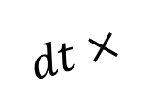
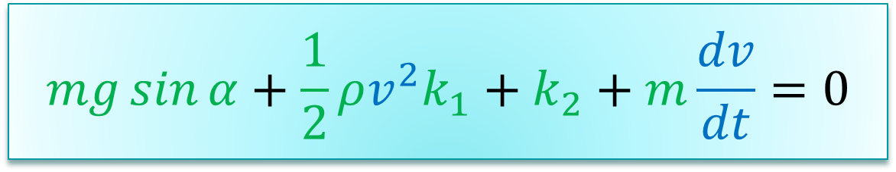







Solving the differential equation
$$mg\sin{α}+\frac{1}{2}ρv^{2}k_{1}+k_{2}+m\frac{dv}{dt}=0$$
$$v_{0}$$
$$v_{1}$$
$$v_{2}$$
$$a_{1}$$
$$a_{0}$$
$${dv}_{0}$$
$$dt×$$
$${dv}_{1}$$
Notes:
Now I can solve the differential equation. We will pick an initial speed, v0, and will use it to find the acceleration, dv to dt. The result will be multiplied by a short period of time so that I can find the difference in speed. I will add this difference to v0 and get the next speed, v1. Repeating this procedure will sequence of velocities. This method is called Euler method for solving differential equations.

Slide 5
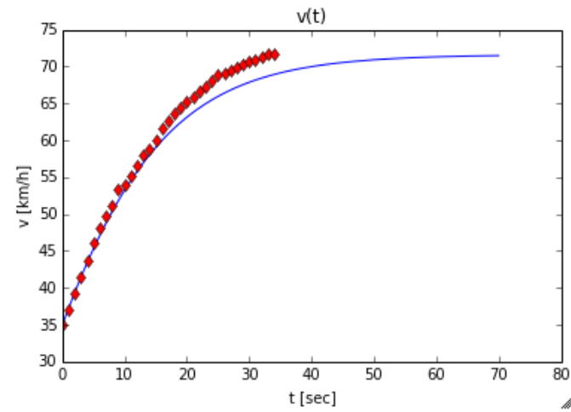
Result
Measured speed
Calculated speed
Notes:
And these are the results. The red graph is the speed measured in Nes Harim downhill, and the blue one is the solution of the differential equation. As you can see, these graphs are very similar, and almost identical until the velocity of 60 km/h.
As you could see in both graphs, cyclist’s speed is going to a permanent value, the maximum value. In order to increase this speed, the cyclist can change his position, or gain some weight of some wind in the right direction.

Slide 6
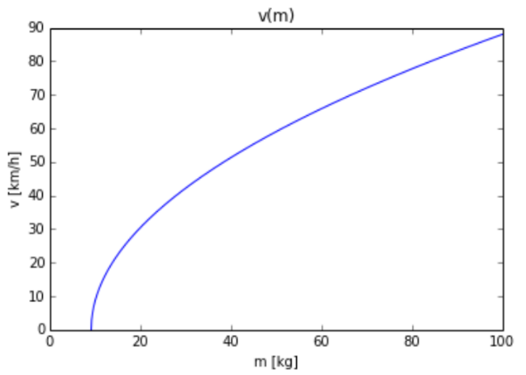
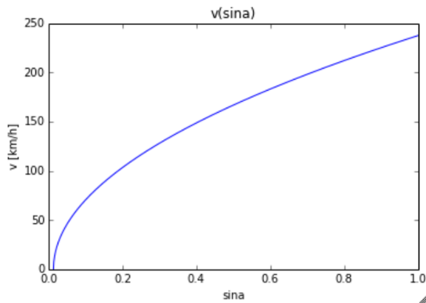
For further research
Notes:
Using this project I can research how cyclist’s mass or road incline affects the maximum speed, as you can see in there graphs. These are only estimated graphs, it should be pretty accurate but I haven’t done an experiment yet, so I can’t know.

