Slide 1
Calendar Analysis Tutorial
Watch a tutorial video
Export calendar from Microsoft Outlook (see slide 2)
Run Calendar Analysis.EXE
Loading....
Press to start
Open newly written excel file “output.xslx” and “plot.PNG” to view the analysis results

Slide 2
How to export Microsoft Outlook calendar to csv file?
Open “file” tab
Open “ Open & Export”
Choose “Import/Export”
Choose “Export to a file” and then “Comma Separated Values”
Choose the calendar that you want to analyze, export to the location of the script and choose “finish”
Enter the wanted period (3 months)

Slide 3
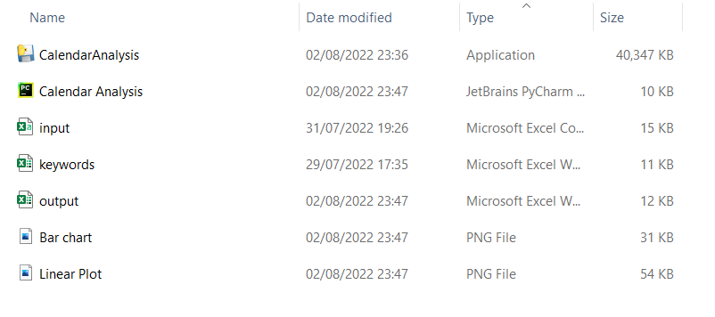
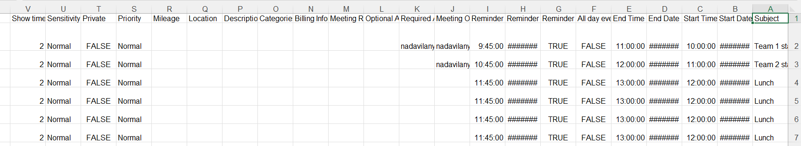
Input.csv is the exported calendar from outlook. It must be in the same location as the script/exe
Input.csv

Slide 4
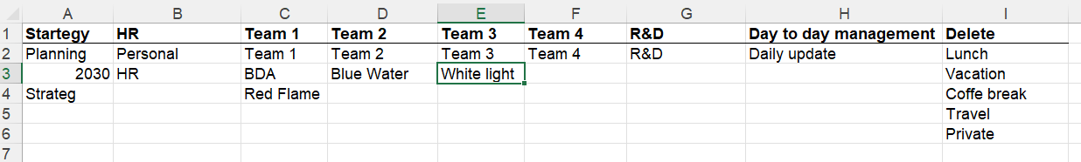
keywords.xslx is the file that we use to determine the sorting process by the proper key words. It must be in the same location as the script/exe
Keywords.xslx

Slide 5
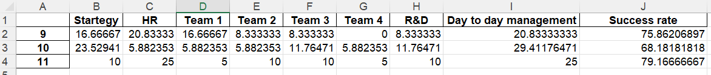
output.xslx is the a that the script writes to the destination. Its first sheet shows the results of the script.
Output.xslx - results sheet

Slide 6
output.xslx is the a that the script writes to the destination. Its second sheet shows how the tool sorted each of the meetings. Users can continue or correct their own manual sorting.
Output.xslx – draft for manual sorting sheet

Slide 7
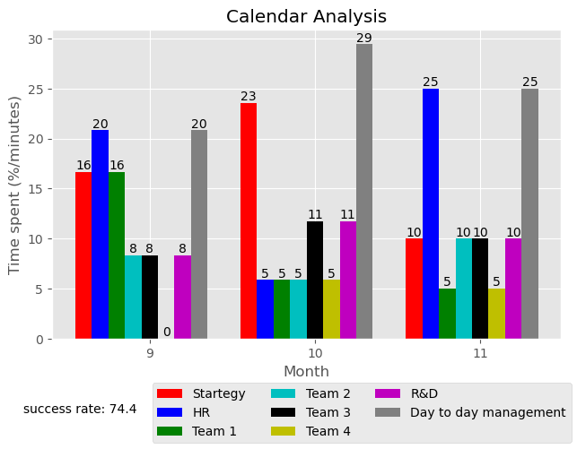
Bar Chart.png is a file that the script writes to the destination. It shows a comparison by categories for each month
Bar Chart.png

Slide 8
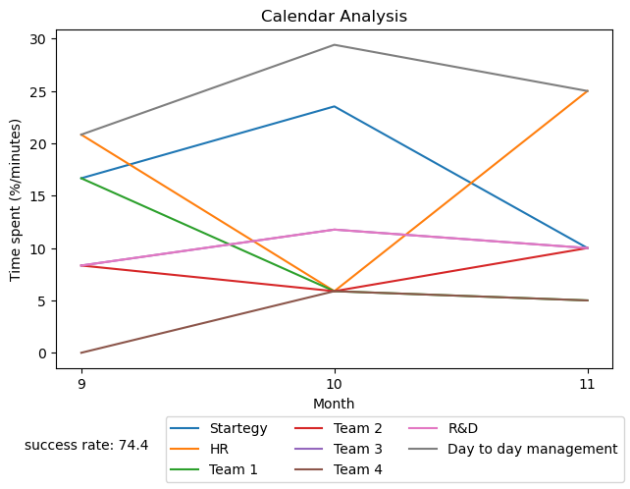
Linear plot.png is a file that the script writes to the destination. It shows a comparison by months for each category
Linear Plot.png

Slide 9
Troubleshooting
Fix | Reason | Error
Exporting input as instructed in slide 2 | Input file is not saved correctly | Output file and the plot are empty
Saving Keywords as instructed in slide 3 | Keywords file is not saved correctly | Output file and the plot are empty
Switching the language of Microsoft Outlook to English | Usage of Microsoft Outlook with different language than English | Very low success rate (0-15%)
Exporting 3 months of calendar, and repeating the process again for another 3 months | Exported more than 3 months of calendar. The tool only works for 3 months | Expected analysis over 1 year span but ended up with only the starting 3 months
Re-run the application, only once | Ran the application twice | Plot that contains 2 legends
Exploring your calendar and updating the proper key words. | Keywords file is not updated to the calendar | Low success rate (40-70%)

