Slide 1





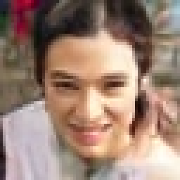


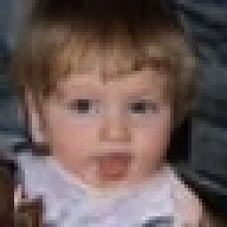



Frequency-AR image generation: what have we learned?
EXECUTIVE SUMMARY · FFHQ-64 · STATUS 19 OCT 2026
A1 (ours, 11.1M) · 250k EMA · UniPC [20,10,8,8] · std seeds 0–11, uncurated — seed 9 shows the rare single-token G3 checkerboard (slide 10)
THE MODEL
A1 freq-AR
R0 DCTdiff
NOT YET WON
p(X) = ∏_{k} p(G_{k} | G_{<k})
9.46
8.68
46 vs 15 serial evaluations
1.84× latency, 1.36× GPU-s (H100)
1.72× training H100-h for this FID
Recall gap grows G1→G3
G0 DC
UniPC 20 calls
FID-50K
FID-50K
G1 (0,1) (1,0)
UniPC 10 calls
params 11.1M
recall 0.413
46 serial calls
train 5.77 H100-h
params 44.2M
recall 0.440
15 serial calls
train 3.34 H100-h
G2 (2,0) (1,1) (0,2)
UniPC 8 calls
G3 (0,3) (1,2) (2,1)
UniPC 8 calls
Both: validated UniPC samplers, same q90 evaluator
Outer: AR over 4 groups of 4×4 block-DCT coefficients. Inner: a conditional diffusion ODE samples each group’s whole 8×8 field (one axial transformer, exact prefix cache).
Open question Is explicit frequency causality a distinct, useful inductive bias — and can its per-field generator be made cheap enough to win the quality–compute frontier, not just the parameter count?
FFHQ64-q90 (70k), EDM Inception FID-50K + k=3 P/R; A1 a1_d256 250k EMA, R0 our DCTdiff port 250k EMA; latency: isolated H100 NVL bench (bs 500 / bs 16). efficiency/phase2_verdict.json, bench*.json
Notes:
Purpose: a one-slide state of the project.
Claim: on FFHQ-64, our frequency-autoregressive model A1 (11.1M parameters) reaches FID-50K 9.46 with recall 0.413 using a validated UniPC schedule of 46 serial network evaluations. Our own DCTdiff port R0 (44.2M) with the same solver family reaches 8.68 / 0.440 at 15 evaluations. Both are measured with the same q90 reference and EDM Inception evaluator on 50k samples.
What is genuinely promising: 4x fewer parameters at ~1.09x the FID; on FFHQ the causal model beats its own joint control (slide 7).
What is weak: serial depth (46 vs 15), 1.84x latency at batch 16, and 1.72x the training H100-hours to get there. The sample strip is uncurated: seed 9 shows the single-token G3 checkerboard tail artifact, which we diagnose on slide 10.
Likely objection: "the UniPC gain is just a solver" — correct, and we applied it to R0 too; the gap persists.
Sources: reports/dct_causal/efficiency/phase2_verdict.json, bench.json, bench_r0.json; reports/dct_causal/efficiency/baseline.json.

Slide 2

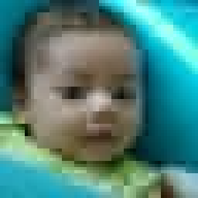



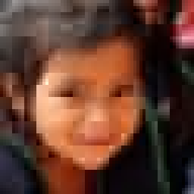










Why order image generation by frequency?
MOTIVATION
Joint diffusion
Spatial autoregression
Frequency autoregression (ours)
noise level t
shared by all
raster
order
G0, G1 fixed
G2 being sampled
G3 next
p(X) via one reverse-time ODE over all of X
p(X) = ∏_{i} p(x_{i} | x_{<i})
p(X) = ∏_{k} p(G_{k} | G_{<k})
every position and every frequency is denoised together; coarse-to-fine emerges only implicitly
pixels / patches in raster order; long serial chains, global layout decided late
a whole spatial field per step, low → high frequency; each field sampled stochastically
Real FFHQ-64 images rebuilt by cumulative frequency groups (data, not model)
What the factorization offers
A different causal order: layout (G0) is decided first, detail conditioned on it
Explicit, inspectable separation of global vs fine information
Questions, not assumptions: does it improve quality, conditional diversity, training or sampling cost?
No computational advantage is assumed; it is measured (slides 9, 12).
G0
+G1
+G2
all
G0
+G1
+G2
all
Real images: FFHQ64-q90 cache (real10k.pt, dataset index 7i), decoded with DCTdiff DCT_to_RGB after zeroing later groups. Group = u+v of the 4×4 zig-zag coefficient.
Notes:
Purpose: position the factorization against the two standard ones.
Joint diffusion (DCTdiff, EDM...) denoises everything at a shared noise level; spectral coarse-to-fine behaviour is emergent (DCTdiff even argues diffusion is implicitly spectral AR). Spatial AR generates pixels/patches serially. Ours makes frequency the explicit causal axis: four groups of block-DCT coefficients, each generated as an entire 8x8 spatial field, conditioned on all lower groups.
The bottom row is real data, not model output: decoding a real FFHQ-64 image with only G0 gives the 16x16 luma / 8x8 chroma block means; adding G1 gives edges; G2 and G3 add detail.
Important honesty point: we do not assume frequency causality is superior. The interesting questions are whether it helps quality, conditional diversity, training efficiency or sampling efficiency. The rest of the deck answers each separately.
Source: reports/dct_causal/efficiency real10k cache; lsb/dct_causal/ffhq64_eff.py lowpass convention.

Slide 3
A1: one axial transformer, causal across frequency
ARCHITECTURE · third_party/DCTdiff/libs/axial_freqk.py (FFHQ-64, a1_d256)
1 · REPRESENTATION
2 · TRUNK (TRAINING, ONE PASS)
3 · SAMPLING (OUTER × INNER)
x ∈ ℝ^(64×64×3)
clean G0
t
…
G0
G0 ~ p(G0)
YCbCr 4:2:0 → 4×4 block DCT → keep 9 zig-zag coefficients
clean G1
t
…
INNER: UniPC ODE, 20 calls
clean G2
t
…
G1 ~ p(G1 | G<1)
G1
v →
noisy G0 @ t0
t
…
INNER: UniPC ODE, 10 calls · prefix K/V cached once
u
00
01
02
03
group = u + v
(3,0) and u+v ≥ 4 dropped
noisy G1 @ t1
t
…
OUTER AR LOOP k = 0 … 3
10
11
12
G2
G2 ~ p(G2 | G<2)
noisy G2 @ t2
t
…
INNER: UniPC ODE, 8 calls · prefix K/V cached once
20
21
token = 8×8 px = 4 Y + Cb + Cr blocks × 9 coef = 54 ch; 64 tokens on an 8×8 grid
noisy G3 @ t3
t
…
G3
G3 ~ p(G3 | G<3)
spatial heads (3/4): dense, bidirectional over the 64 + 1 tokens of one slot
INNER: UniPC ODE, 8 calls · prefix K/V cached once
G0
6 ch / token · 384 values / image
frequency head (1/4): same position across slots, masked →
G1
12 ch / token · 768 values / image
frequency mask (row → column)
13 axial blocks (6·mid·6, long skips), D 256, 4×64 heads
Shared: all blocks, position + time embeddings
Per stage: adapters ℝ^Cₖ ↔ ℝ^256, stage embedding
[B, 7, 65, 256] · 11.09M params · ε-MSE
c0
reassemble 54 ch → inverse 4×4 DCT → RGB
G2
18 ch / token · 1152 values / image
c1
c2
G3
18 ch / token · 1152 values / image
n0
Inner diffusion acts only on the current field (64 × Cₖ); the outer chain never revisits earlier groups.
n1
field Gₖ ∈ ℝ^(64 × Cₖ): 3456 values / image
n2
n3
c0
c1
c2
n0
n1
n2
n3
Masks/shapes verified: verify_axial*.json (clean Gₖ → ε̂(Gₖ) Jacobian exactly 0; cached vs training ε̂ ≤ 1e-6). Training: 3 clean + 4 noisy slots, one t per stage. Sampler: efficiency/phase2_verdict.json.
Notes:
Purpose: the exact model, from the code (libs/axial_freqk.py, AxialFreqK with rep dct4x4k9; config ffhq64_exp.py:a1_d256).
Representation: DCTdiff's own FFHQ representation ported to 64x64: YCbCr 4:2:0, 4x4 block DCT, first 9 zig-zag coefficients; one token = an 8x8-pixel area = 4 luma blocks + Cb + Cr, 6 blocks x 9 = 54 channels, 64 tokens. Groups are u+v of the zig-zag position: G0 = DC; G1 = (0,1),(1,0); G2 = (2,0),(1,1),(0,2); G3 = (0,3),(1,2),(2,1). Note (3,0) is not in the 9 retained coefficients, so G3 is not orientation-symmetric.
Trunk: the state is [batch, slots, 1+64 tokens, 256]. Each block does split-head axial attention with one shared QKV: 3 spatial heads attend densely over the 65 tokens within a slot (no spatial order), 1 frequency head attends across slots at the same spatial position under the mask on the right. Training packs clean G0..G2 (teacher forcing) and noisy G0..G3 (independent t per stage) into one forward; noisy G_k sees clean G_<k and itself only, so all four conditionals are trained per example.
Parameter sharing: all 13 blocks, positional and time embeddings are shared across stages; only the per-stage input/output linear adapters and the stage embedding are stage-specific.
Sampling: an outer loop over k; for each k an inner UniPC ODE (20/10/8/8 calls) integrates the noisy field while the clean prefix's per-layer frequency-head keys/values are computed once and cached (exact: clean slots never depend on noisy slots or on t).
Do not confuse: the outer autoregression is over frequency groups; the inner process is a standard diffusion ODE over one spatial field.

Slide 4









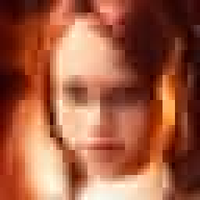






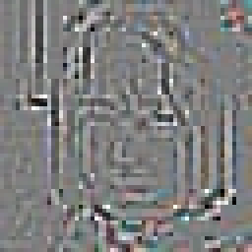







Next-frequency generation, stage by stage (real samples)
WHAT GENERATION LOOKS LIKE
G0
What each group alone contributes
(0,0) DC
band-only decodes (other groups zeroed), seeds 0–1
+6 ch · 384 values
≤ G1
+ (0,1) (1,0)
+12 ch · 768
≤ G2
+ (2,0) (1,1) (0,2)
+18 ch · 1152
G0
G1 ×1.5
G2 ×2.8
G3 ×5
all
Re-sampling one group’s noise (others fixed): share of image variation it controls
+ (0,3) (1,2) (2,1)
+18 ch · 1152
G0
pixel 98.2% · Inception 99%
A1 250k EMA, UniPC [20,10,8,8]; each row decodes the generated coefficients of the groups so far; std seeds 0–5, uncurated
G1
pixel 2.8% · Inception 31%
G2
pixel 0.8% · Inception 19%
G3
pixel 0.4% · Inception 12%
Samples: H100 run j20_10_8_8 (s0_coef.pt), decoded with DCT_to_RGB. Noise shares: efficiency/phase1_verdict.json (A1 250k, Euler, resample one stage’s noise; Inception = mean sq. feature change vs independent draw).
Notes:
Purpose: make "next-frequency prediction" concrete with genuine samples.
Left: six uncurated samples (std seeds 0-5) from A1 at 250k with the UniPC [20,10,8,8] sampler. Row 1 shows only G0 - the DC of every 4x4 block, i.e. a 16x16 luma / 8x8 chroma mosaic: it already fixes identity-level layout, pose, colour. G1 adds first-order gradients (edges), G2 and G3 add texture and sharpness.
Right: what each group contributes on its own (contrast-stretched; G1-G3 have very different energies). The bar chart is the measured noise influence: re-sampling only G0's noise changes 98% of pixel variance and 99% of the Inception-feature change of a fully independent draw; G1 noise moves 31% of the features but under 3% of pixels; G3 only 12%.
So G0 decides the layout almost completely. This is why a G0 error is so consequential, and why our efficient sampler gives G0 the most solver calls.
Source: decoded from /dev/shm/nadavo_dct/eff/runs/j20_10_8_8/s0_coef.pt; phase1_verdict.json noise_pixel_share / noise_feature_share.

Slide 5
Three references isolate what frequency causality does
EXPERIMENTAL DESIGN
R0 · DCTdiff (our port)
A0 · joint axial
A1 · frequency-AR axial
Joint denoising of all retained DCT coefficients
Our axial network, all groups noisy at one shared t
Same network, clean prefix + causal frequency mask
G0 @ t
t
0
c G0
t
1
c G1
t
G1 @ t
t
2
c G2
t
G2 @ t
t
G0 @ t0
t
each of 64 tokens carries all 54 ch, noisy at one t
G3 @ t
t
3
G1 @ t1
t
0
G2 @ t2
t
1
2
U-ViT, D 512, 13 blocks (official FFHQ “small” recipe)
one joint ODE: UniPC-15 or Euler-100
17.6 GFLOP / training image
3
G3 @ t3
t
bidirectional frequency attention
one joint ODE (UniPC-15 best)
17.8 GFLOP / training image
causal frequency mask, t per stage
4 conditional ODEs (UniPC 46 calls)
31.1 GFLOP / training image
A1 − A0 the matched architectural test
identical blocks and parameter count; only slot set, mask and per-stage objective differ → effect of causal frequency factorization
A1 − R0 practical competitiveness
confounded by 4× parameters, a different backbone and token design → never read as an architectural effect
Earlier spatial-causal, 256-token staged and channel-mask designs were dropped (appendix A5).
Configs: third_party/DCTdiff/configs/ffhq64_exp.py (r0, a0_d256, a1_d256). Training FLOPs: FlopCounterMode, ffhq64/mature/summary.json.
Notes:
Purpose: make clear which comparison answers which question.
R0 is DCTdiff's official FFHQ-128 "small" U-ViT recipe ported to 64x64, run in our environment with our evaluator (44.2M parameters). It reproduces the authors' released CIFAR checkpoint (FID-10K 8.50 vs 8.54), so we trust the port.
A0 and A1 are the same 11.09M-parameter axial network. A0 makes all four groups noisy at one shared t with bidirectional frequency attention: it is a joint diffusion model with our backbone. A1 adds the clean prefix slots, independent noise levels per stage, and the causal mask.
So A1 - A0 is the clean test of the factorization. A1 - R0 asks whether the whole package is competitive, but mixes backbone, capacity and token design.
Likely objection: A1 does 1.75x A0's training FLOPs per image (31.1 vs 17.8 GFLOP) because the clean prefix is re-encoded. We therefore report matched steps, matched H100-hours and matched FLOPs separately (slide 7).
Earlier designs (spatial-causal U-ViT - wrong axis; 256-token block-causal staging - 4.18x FLOPs; channel-lane causality - capacity confounded) are in appendix A5.

Slide 6
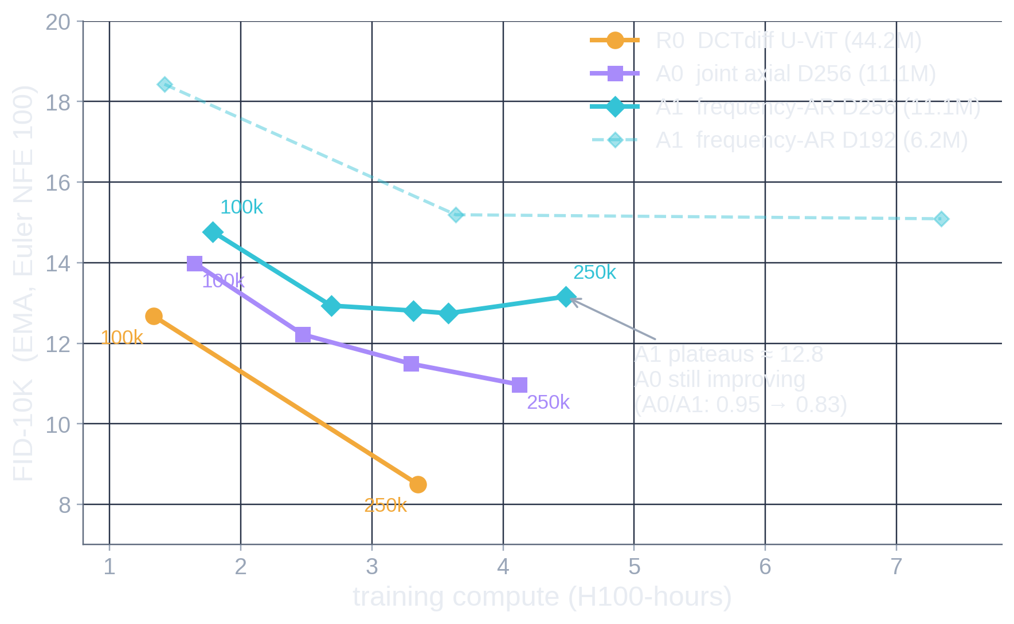
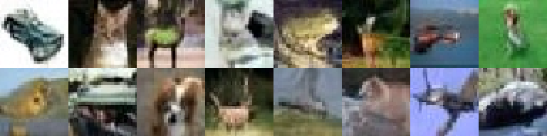
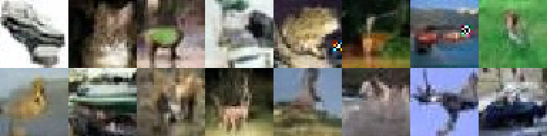
CIFAR-10: causality looked nearly free, then plateaued
CIFAR-10 · 32×32, 2×2 block DCT, 3 groups
Early: A1 ≈ A0
A1/A0 = 1.05 at 100k (D192), recall −0.023
Mature: A0 kept improving
D256: A0/A1 0.95 → 0.83 at 250k; A1 plateau ≈ 12.8
Width helped
D192 → D256: 18.43 → 14.77 at 100k
More stages ≠ better
4×4 DCT K3 → K7: 0.95× FID at 2.06× H100-h
Full-image DCT overfit
early global bands memorise: FID 51.6, recall 0.25
G₋₁ context, stage noise
neutral (1.07×, 1.02× FID)
same seeds · official released DCTdiff 500k (left) vs A1 D192 500k (right): note single-token checkerboards
Takeaway on CIFAR, strict low→high ordering costs a growing share of quality at maturity, and the joint axial backbone is itself 1.35× R0 at equal H100-h. Does this generalize to aligned faces?
CIFAR-10 (DCTdiff’s JPEG-q75 statistics), FID-10K, EMA, Euler NFE 100 per stage. scaling/summary.json (d256_maturity, arms, verdicts). EMA before 100k mostly measures lag, so curves start at 100k.
Notes:
Purpose: the first evidence, including the part that went against us.
On CIFAR-10 at D192, A1 looked almost free relative to its joint control (A1/A0 = 1.05 at 100k). With the wider D256 network trained to 250k, A0 kept improving (13.99 -> 10.98) while A1 flattened near 12.8, so A0/A1 went 0.95 -> 0.83: the causal penalty grows with training. The early comparison was misleading.
Single-axis screens (all 100k, pre-registered rules): width is the only clear win; more spectral stages in the same 4x4 DCT (K3 -> K7) gave 0.95x FID at 2.06x compute; the full-image DCT with 8 bands overfit badly - each early global band has ~12 degrees of freedom per image so the next band becomes a lookup (train loss falls, held-out loss rises); a persistent Gaussian context G_-1 and stage-noise jitter were neutral.
The sample rows show the single-token checkerboard already on CIFAR (frog, car).
Do not compare these FIDs with FFHQ numbers: different dataset, representation (2x2 DCT, 3 groups) and reference statistics.
Source: reports/dct_causal/scaling/summary.json; narrative SCALING_SUMMARY and D256_NOTE.

Slide 7
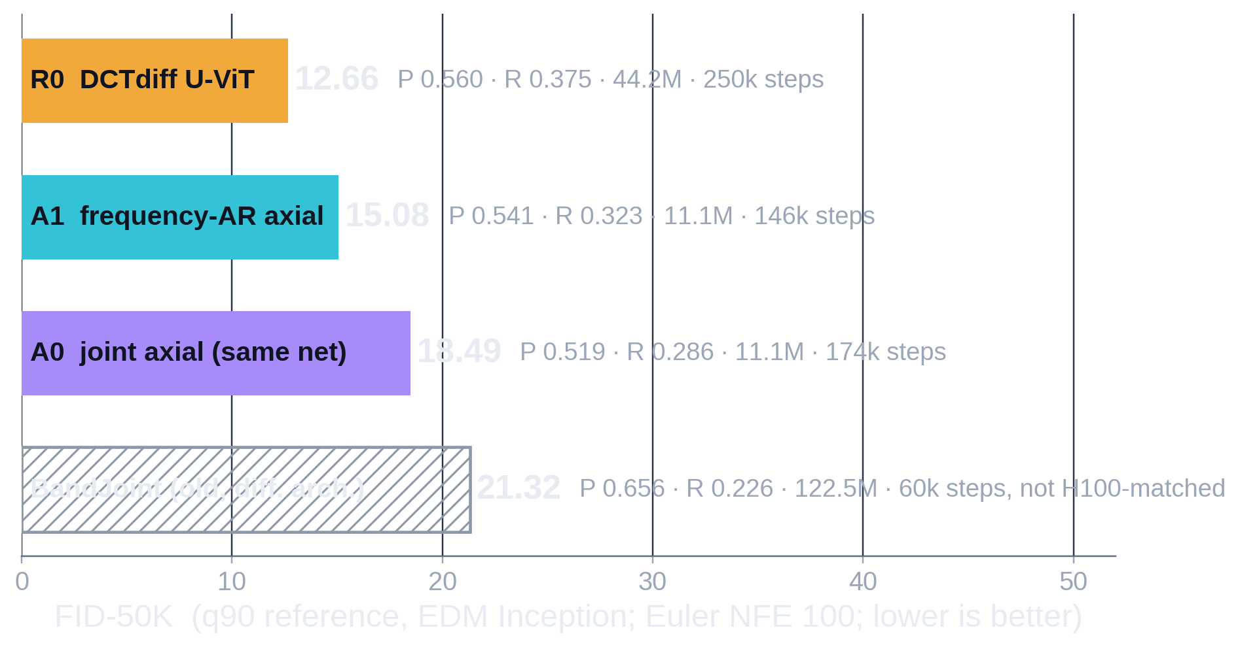












FFHQ-64: frequency AR beats its joint control
FFHQ-64 · EQUAL TRAINING BUDGET (3.34 H100-h EACH) · EULER [100]×K
R0 250k
A1 146k
A0 174k
same std seeds 0–3 for every arm, Euler, uncurated
A1 > A0 on every matched axis but FLOPs
The CIFAR ranking reversed
Not yet competitive with R0
steps (FID-10K 20.09 vs 25.17 @100k) · H100-h (15.08 vs 18.49) · recall (.323 vs .286); per training FLOP ≈ tie (31.1 vs 17.8 GFLOP/img)
CIFAR: A0/A1 = 0.83 at 250k. FFHQ: A1/A0 = 0.82 at equal hours. Aligned faces may favour layout-first generation — one dataset, one seed per arm.
A1 = 1.19× R0 FID-50K (pre-registered target ≤ 1.10×), still improving fast at 146k; sampling 1.80× R0’s GPU-s at Euler.
FFHQ64-q90 (jpeg-ar q90, 70k), EDM Inception FID-50K, P/R k=3 at n=50k; EMA; Euler [100] per stage (A1 400 calls, R0/A0 100). ffhq64/summary.json · BandJoint winner: jpeg-ar campaign, same evaluator, 122.5M, its own sampler.
Notes:
Purpose: the result that made the project interesting again.
Protocol (PREREG_FFHQ64.md): jpeg-ar's q90 FFHQ-64 (all 70k images), NVlabs EDM Inception FID against the q90 reference; every arm gets 3.34 H100-hours, R0's measured time to 250k. Throughput probes set A1 to 146k steps and A0 to 174k. Final checkpoints scored with FID-50K and precision/recall at n=50k; all with the original matched Euler sampler (100 calls per stage).
Result: R0 12.66, A1 15.08 (1.19x R0), A0 18.49. On FFHQ the frequency-AR model beats its joint control at matched steps, matched H100-hours and recall - the reverse of CIFAR. Per training FLOP it is roughly a tie, because A1 does 1.75x A0's FLOPs per image; A1's hour advantage partly comes from better GPU utilisation.
BandJoint (our older design, 122.5M parameters, different architecture and training budget) is shown only as a historical point under the same evaluator: A1 is 1.41x better with 11x fewer parameters.
Caveats to say out loud: one training seed per arm; all arms short of maturity; this is not proof that low-to-high frequency order is universally better (slide 11 has the reverse-order control).

Slide 8
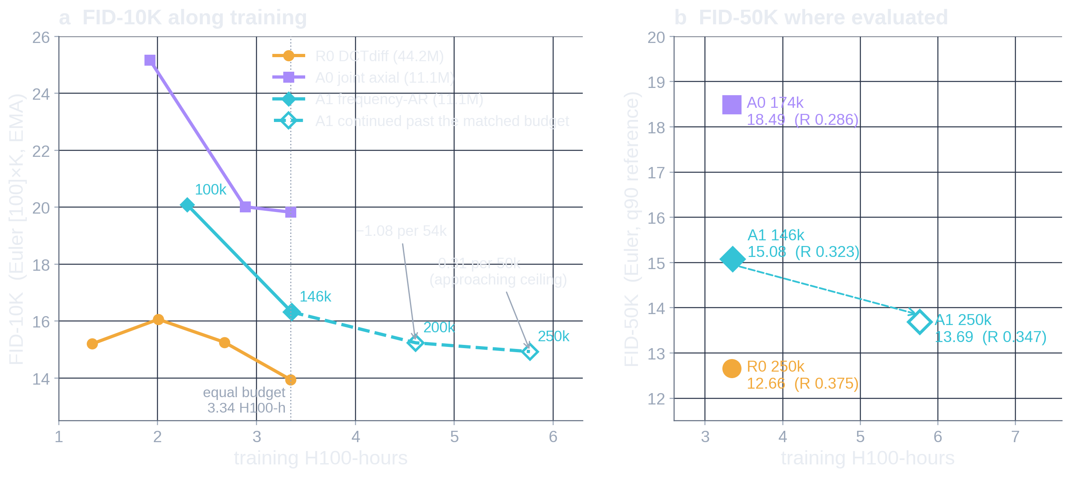
More training brought A1 close to R0, at higher cost
FFHQ-64 · A1 MATURITY (BEFORE SOLVER OPTIMIZATION)
Undertrained at 146k
Approaching a ceiling
No further extension
pre-registered 200k gate passed: FID-10K 16.32 → 15.24, recall .367 → .385, memorisation 0.03%
200k → 250k: −0.31 FID-10K for 1.16 H100-h; FID-50K 13.69 = 1.08× R0 (inside the 1.10× band)
5.77 H100-h = 1.72× R0, recall .347 vs .375, G3 tail rate 2.9 → 3.6%: more exposure was not the lever
Euler [100]×K, EMA, q90 ref. a: FID-10K (A1 146k/200k on std seeds; R0/A0 finals = first 10k of their 50k runs). b: FID-50K only where run. ffhq64/summary.json, ffhq64/mature/summary.json, efficiency/baseline.json.
Notes:
Purpose: what more training buys, and why we stopped.
The compute-matched A1 (146k) was resumed from its full state (weights, EMA, AdamW moments, scheduler) with everything frozen except the step count (PREREG_A1_FFHQ64_MATURITY.md). The pre-registered 200k gate passed; the 200k->250k leg was a weak improvement (-0.31 FID-10K). The FID-50K rule then triggered: 13.69 at 250k, 1.08x R0's 12.66.
That is quality proximity, not efficiency: it took 5.77 H100-hours (1.72x R0) and 1.77x R0's training FLOPs, and recall stays below R0 (.347 vs .375). The G3 tail outlier rate also grows with training (2.9% -> 3.6%).
Panel (a) mixes nothing: all FID-10K, all Euler. Panel (b) is FID-50K only at the checkpoints where it was evaluated. FID-10K is systematically ~1.2-1.3 higher than FID-50K here, which is why we never place them on one axis.
Important framing: this was our conclusion before solver optimization - the next slide changes the sampling picture, not the training picture.

Slide 9
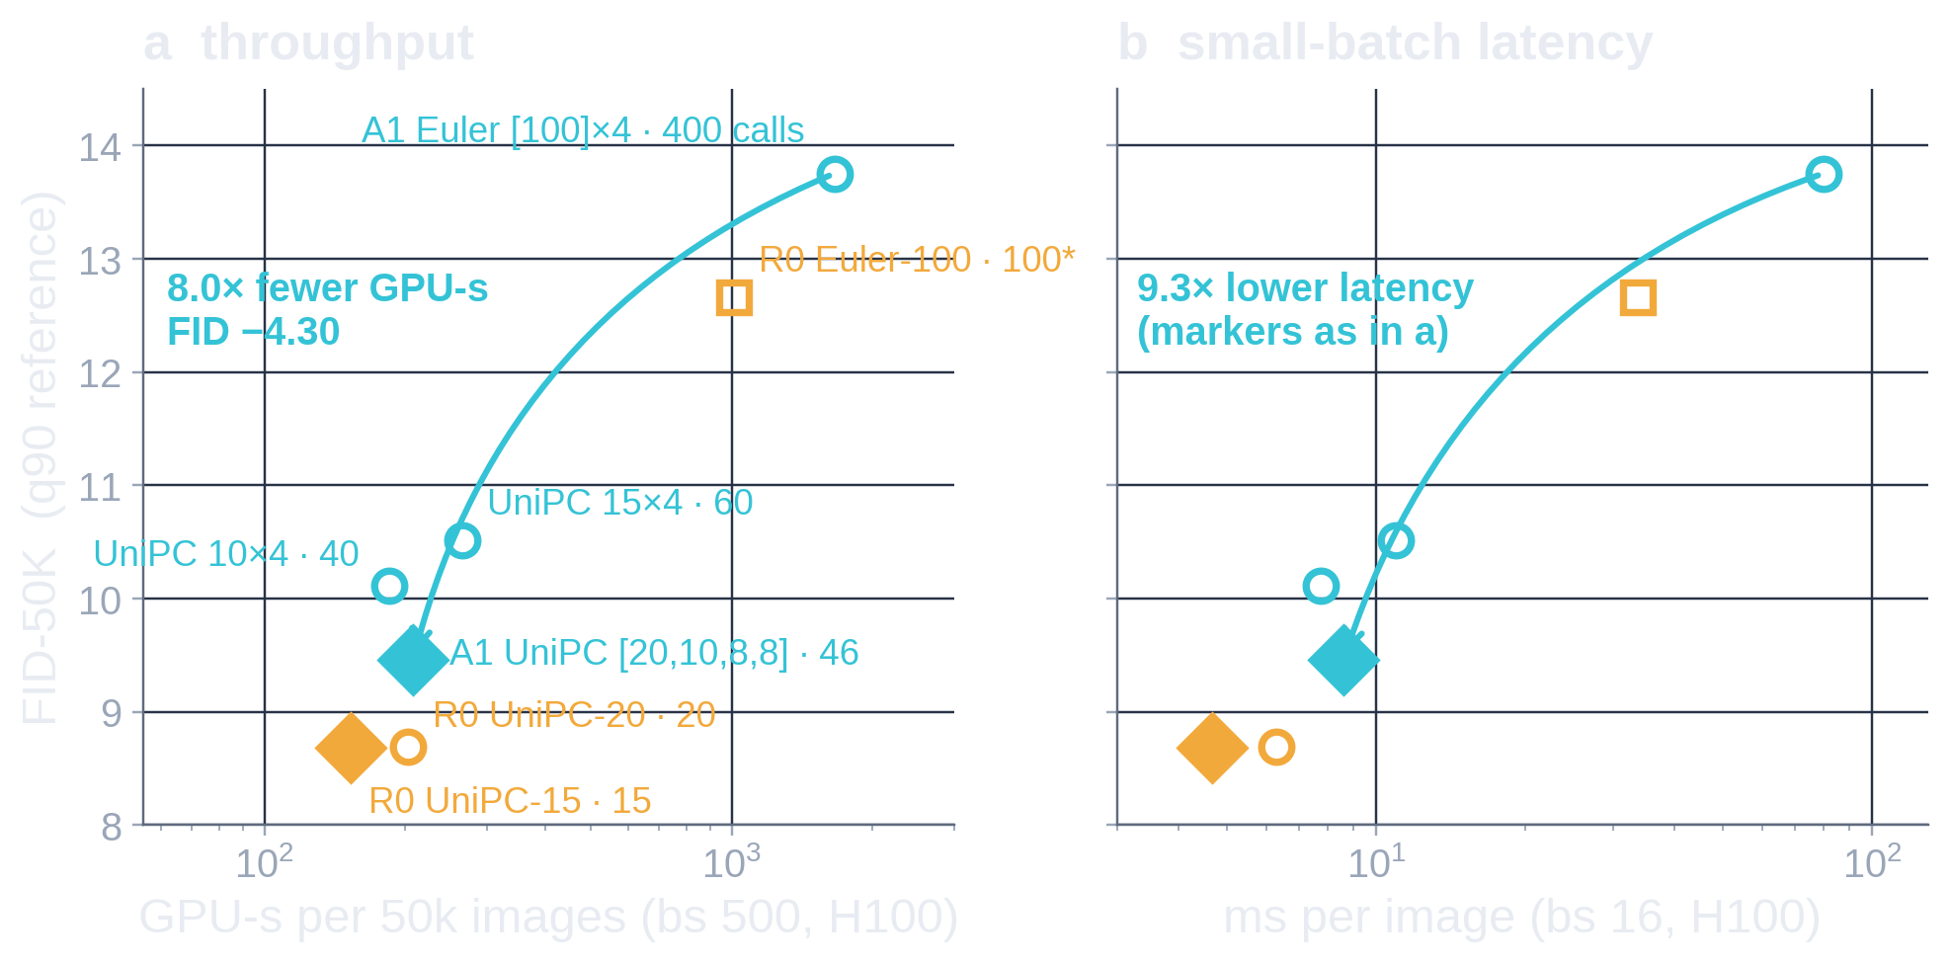
UniPC: 400 → 46 evaluations, FID-50K 13.75 → 9.46
SAMPLER · SAME FROZEN A1 250k WEIGHTS, PAIRED NOISE
Euler
[100, 100, 100, 100] → 400
UniPC
[ 20, 10, 8, 8] → 46
calls for G0, G1, G2, G3 · UniPC-2 bh2, logSNR grid, terminal Euler step
FID-50K
recall
9.46
0.413
from 13.75 · −31%
from 0.349 · +0.064
GPU-s / 50k
ms / image
208
8.6
Fairness control: the same solver on R0
from 1662 · 8.0×
from 79.9 · 9.3×
R0 UniPC-15: FID-50K 8.68, recall 0.440, 153 GPU-s / 50k, 4.7 ms / image
A1 stays 1.09× R0 FID, with 46 vs 15 serial calls, 1.36× GPU-s, 1.84× latency
UniPC is not our contribution, and fewer sampling calls do not make training cheaper
Allocation matters: G0 needs ≥ 15–20 calls (8 → FID-10K 13.8), G2/G3 tolerate 8; G0 errors amplify 3–4× downstream. Cuts compound non-additively.
FID-50K on paired H100 std seeds (A1 Euler 13.75 here vs 13.69 on A5000 seeds). Latency: isolated H100 NVL, compiled A1 noisy pass + exact prefix cache, R0 eager. *R0 Euler FID from its A5000 run. efficiency/phase2_verdict.json, bench*.json, runs.json
Notes:
Purpose: the largest single improvement, stated with its fairness control.
Phase 2 of the efficiency campaign kept A1's 250k weights frozen and only changed the sampler. The original Euler sampler (100 calls per stage, 400 serial calls) was both under-converged and badly allocated. Per-stage allocation curves showed G0 needs 15-20 UniPC calls (its errors amplify 3-4x into later bands) while G2/G3 tolerate 8. The winning joint schedule [20,10,8,8] = 46 calls gives FID-50K 9.46 vs 13.75 (paired seeds, -31%) and recall +0.064, at 8.0x lower batch-500 GPU-seconds and 9.3x lower batch-16 latency.
The fairness control is essential: the same UniPC applied to R0 gives FID-50K 8.68 at 15 calls (8.69 at 20). So A1/R0 stays ~1.09 and A1 remains 1.4-1.8x slower to sample. Distilling G2/G3 to 1-2 calls would save at most 12 of 46 calls and cannot close the serial-depth gap, so it was not run.
Likely objection: "you tuned A1's schedule more than R0's" - R0 was swept over UniPC 10/15/20/30/50, with 15 and 20 confirmed on a second seed set; both give FID-50K ~8.7.
Source: efficiency/phase2_verdict.json, bench.json, bench_r0.json, runs.json (f50_*).

Slide 10
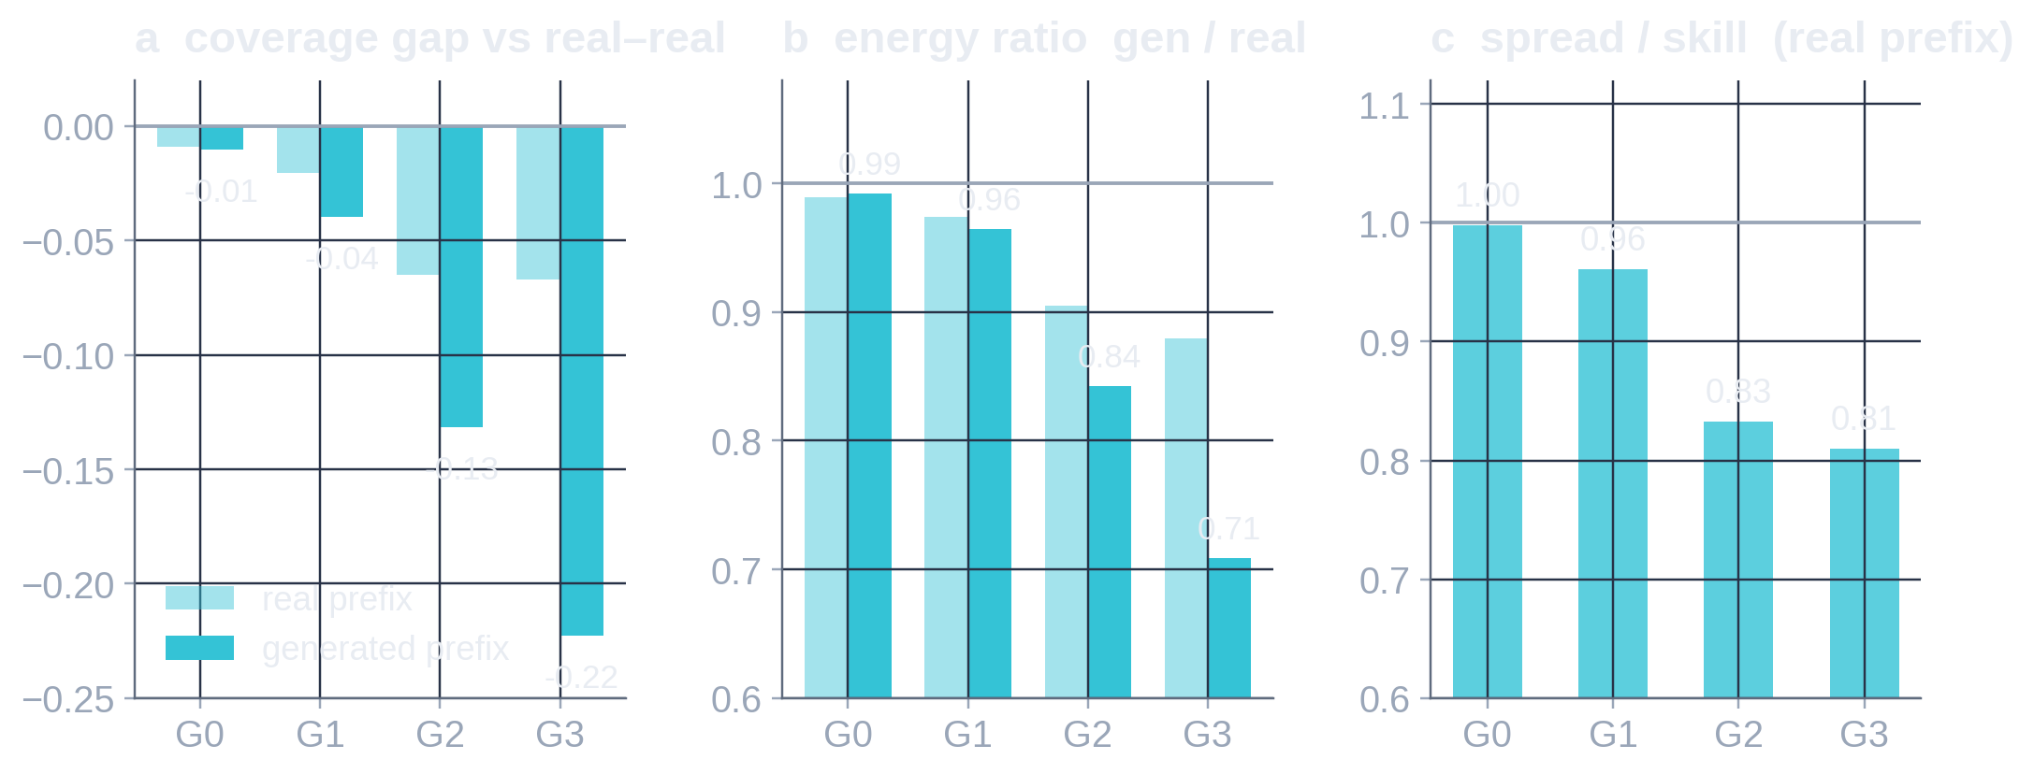
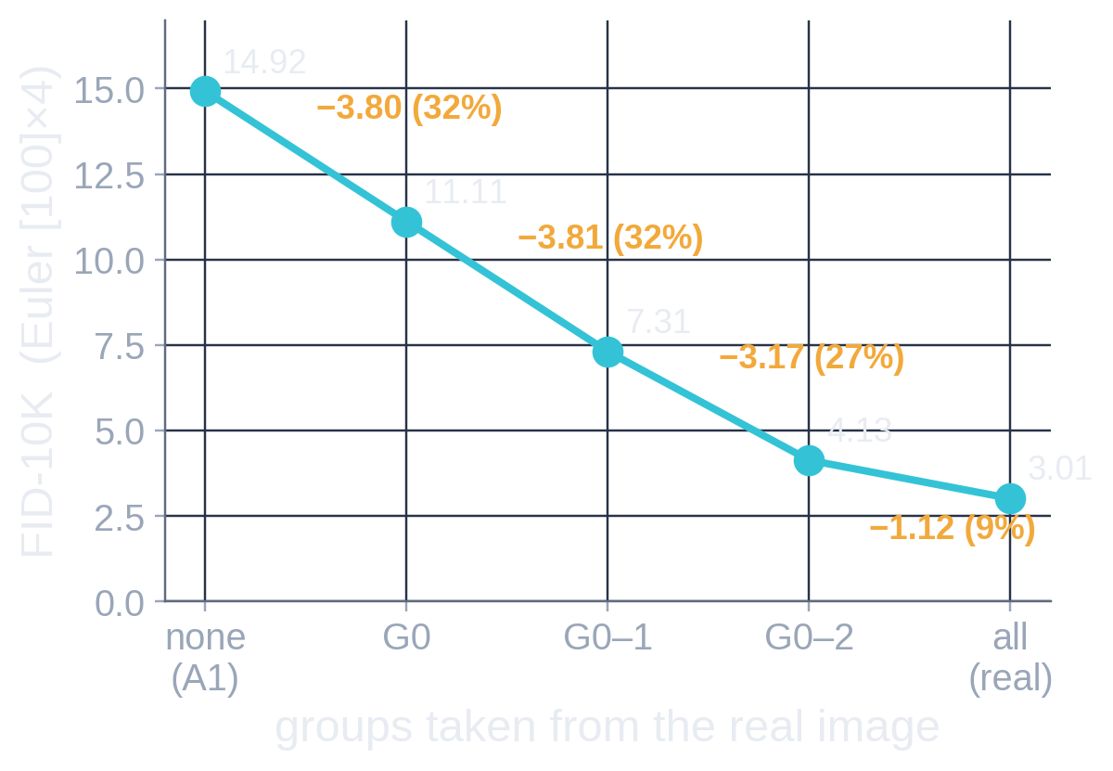

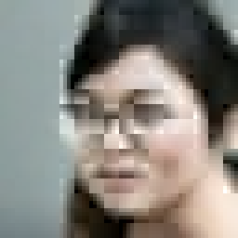




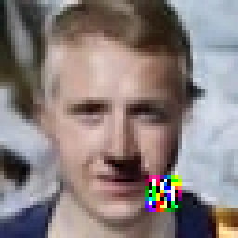
Where A1 fails: later groups lose conditional diversity
DIAGNOSIS · A1 250k
real-prefix oracle (Euler sampler)
Tail failure appears exactly when G3 is added (worst of 5k)
G0 decides layout (98% of pixel variance) but is adequately modelled: coverage ≈ real–real, spread/skill 0.99
Not G0 alone: the real-prefix oracle splits the gap G0 32 / G1 32 / G2 27 / G3 9% (cumulative, path-dependent — not additive attribution)
Later groups are under-dispersed even with a real prefix (spread/skill .83/.81, energy .90/.88) and it compounds along the chain (energy .84/.71)
Inference variance probe: FID-10K 10.77 → 10.50, recall +0.015 → supports H1 (variance under-estimation)
G0
≤G1
≤G2
all
other failing seeds
2.6% of UniPC samples have a G3 coefficient > 5× the data max (113–153× in these); R0 0.5%, A0 0.6%. The trigger is the token’s own noise norm (≈3σ), not the prefix.
a–c: efficiency/diag2.json (UniPC [20,10,8,8], std+31M seeds, PCA-64 k=3 recall vs real–real). Oracle: phase1_verdict.json (Euler; real prefixes are also FID-reference images). Incidence: my recount on 5k paired samples (samples_meta.json).
Notes:
Purpose: locate the remaining deficit, carefully distinguishing interventions from attribution.
(1) G0 is the most influential group (its noise controls 98% of pixel variance and perturbations amplify 3-4x downstream) but is adequately modelled: its PCA-64 coverage matches the real-vs-real reference and spread/skill is 0.99.
(2) The real-prefix oracle (an intervention): replacing G0 with the real image's coefficients drops FID-10K 14.92 -> 11.11; adding real G1 -> 7.31; G2 -> 4.13; all real -> 3.01 (the representation floor). Shares 32/32/27/9%. These are cumulative increments along one path, not additive causal attributions; and real prefixes are training images that are also in the FID reference.
(3) The deficit grows with frequency and is a diversity/scale problem: with a REAL prefix, G2/G3 already have spread/skill 0.83/0.81 and energy 0.90/0.88 (under-dispersed conditionals); with the model's own prefix the coverage gap widens to -0.13/-0.22 and energy to 0.84/0.71. The pre-registered rules make H1 (conditional variance under-estimation compounding through the chain) primary, H2 (spatial capacity) marginal; H3 (exposure bias) fails its rule.
(4) A zero-training probe that rescales each generated group about the data mean (alpha fitted on a separate calibration set) improves FID-10K 10.77 -> 10.50 and recall +0.015 - consistent with H1, and the motivation for the running candidate A.
(5) The tail artifact: one token's G3 coefficients explode when that token's own Gaussian noise has norm beyond ~3 sigma; the network under-predicts extreme input noise at t=1, and sigma/alpha amplifies it. It is visible in ~2-3% of images but costs nothing measurable in FID (truncating the noise tail changes FID by +0.05 on CIFAR).

Slide 11
Only width helped clearly; finer serialization never did
STRUCTURAL ABLATIONS
 | Lever | Question | Result vs reference | Cost | Verdict
CIFAR | Width D192 → D256 / D320 | Is A1 capacity-limited? | FID-10K 18.43 → 14.77 / 14.27 @100k | 1.27× / 1.62× H100-h | GAIN
 | Groups K3 → K7 (same 4×4 DCT) | Do easier transitions help? | 22.07 → 21.01 (0.95×) | 2.06× H100-h, 700 calls | NEUTRAL
 | Full-image DCT, 8 bands | Are global bands better? | 51.57 (2.8× A1), P/R .74/.25 — memorises | 2.4× H100-h | REGRESSION
 | Gaussian G₋₁ context (OT) | Does a shared latent help G0? | 19.67 (1.07×) | 1.24× H100-h | NEUTRAL
 | Context noise σ 0.005 | Robustness to own prefix? | EMA 1.02×; raw-weight FID 28.4 → 21.5 | ≈ 1.0× | NEUTRAL
 | A0 refines A1 (no training) | Can joint refinement repair order? | 12.59 → 11.64 (~70% of gap); never below A0 | +10 calls | PARTIAL
FFHQ | Depth 13 → 9 blocks | Cheaper calls at equal quality? | raw FID-10K 27.09 → 30.25, recall −.066 @50k | 0.74× per step | REGRESSION
 | 6 radial rings (same 9 coef) | Finer serialization? | raw 27.09 → 38.58 (+42%), +16 calls | 1.44× per step | REGRESSION
 | 8×8 blocks, 36 coef (= 3456) | Fewer, richer tokens? | FID-10K 72 / 83 vs 29 / 27 (EMA / raw); blur | 0.43× per step | REGRESSION
 | Edit earlier groups (no training) | Can later bands fix layout? | 16.13 → 16.04; random edit of equal norm as good | 1.04× sampling | NEGATIVE
 | Per-group variance rescale | Late groups too narrow? | FID-10K 10.77 → 10.50, recall +.015 | 0 | SMALL GAIN
 | Reverse order G3 → G0 | Does the order matter? | FID-10K 46.8 vs 13.7 @100k (each own sampler) | same | ORDER MATTERS
 | Per-group data-std precond. | Fix late-group dispersion? | EMA 28.81 → 25.41, raw 26.80 → 26.96; recall +.08 / +.07 @50k | same | BORDERLINE*
 | UniPC + per-stage allocation | Was sampling the limit? | FID-50K 13.75 → 9.46, recall +.064 | 8.0× fewer GPU-s | NOT ARCH.
CIFAR: 100k steps, EMA FID-10K, Euler NFE 100 (scaling/summary.json; refine/results.json). FFHQ screens: 50k, canonical UniPC (efficiency/screens.json); edit: ffhq64/edit; probe & reverse: efficiency/runs.json. Reverse order = 100k screen, stagewise-loss write-up pending. *Candidate A pilot evaluated 11:22 IDT today; not yet adjudicated by the campaign.
Notes:
Purpose: one dashboard of the screens that changed our interpretation. Green = clear gain, grey = neutral, red = regression/negative, yellow = partial or important-but-provisional, cyan = gain that is not architectural.
CIFAR (100k, pre-registered helps <= 0.90x / hurts >= 1.10x): width is the only single-axis win. Finer spectral serialization buys little at large cost. The full-image DCT construction memorises (on 50k images, early global bands carry ~12 numbers per image). Refinement by the joint model recovers ~70% of the A1->A0 gap but never beats A0.
FFHQ (50k screens, canonical UniPC sampler, raw and EMA): shallower, more finely serialized (6 Euclidean rings) or less spatial (8x8 blocks, 16 tokens) variants all regress; editing earlier groups at inference through the frozen model's own loss does nothing beyond random edits.
Two FFHQ results matter most for the paper question:
- Reverse order (G3 -> G2 -> G1 -> G0, same parameters, verified leakage-free) is catastrophic at 100k: FID-10K 46.8 vs 13.7 with each direction's best sampler, 48.9 vs 17.4 at equal calls (UniPC-15 per stage). Low-to-high order matters for this architecture. Caveat: the prereg requires inspecting stagewise teacher-forced losses before attributing a >2x failure purely to ordering; that write-up is pending, and other orders (e.g. interleaved) were not tested.
- The variance probe is small but directional evidence for the H1 diagnosis.
Newest row (evaluated 11:22 IDT today): per-group data-std preconditioning, the training-time version of the variance probe. Paired over two seed sets it improves EMA FID-10K by 11.8% and recall by +0.07-0.08, but raw-weight FID is 0.6% worse (within seed noise), so under the strict pre-registered survivor rule it is borderline. Not yet adjudicated by the campaign - present it as early evidence only.
The UniPC row is included only so the dashboard is complete; it is a sampler, not an architecture change.

Slide 12
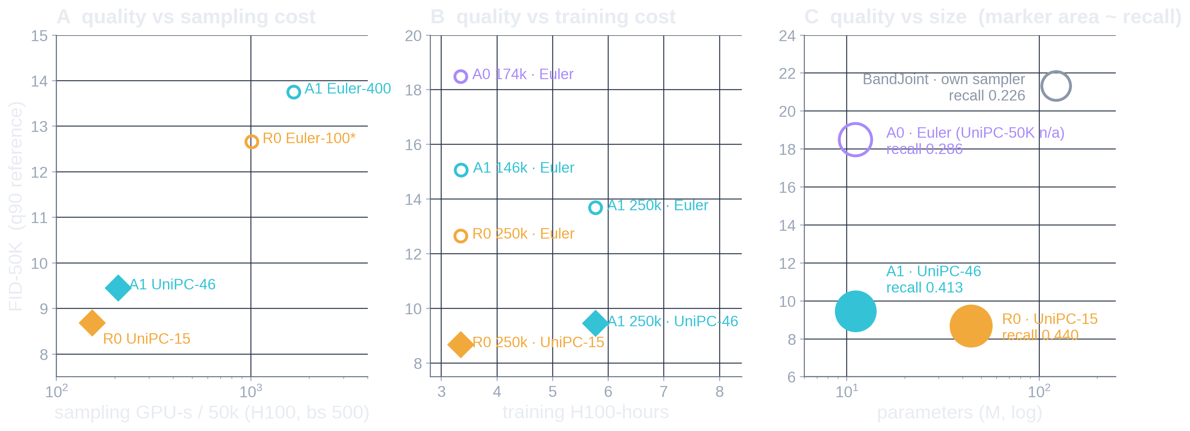
Our present frontier: small and close, not cheaper
WHERE WE STAND · FFHQ-64, FID-50K, BEST VALIDATED SAMPLERS
A Sampling
B Training
C Size
R0 UniPC-15 has lower FID and lower GPU-s than every A1 point: no A1 sampler is on this frontier.
At R0’s 3.34 H100-h A1 has no UniPC FID-50K; at 5.77 h it is 9.46 vs R0 8.68 at 3.34 h. R0 dominates.
A1 and R0 are both non-dominated: 4.0× fewer parameters for +0.77 FID and −0.027 recall.
Conclusion we are parameter-efficient and close in FID, but not yet training- or latency-efficient against optimized DCTdiff.
Filled = UniPC (validated per model), hollow = Euler. A0 has FID-10K 15.00 with UniPC-15 but no UniPC FID-50K, so it appears only with Euler. BandJoint: different architecture and hardware budget, shown only in C. phase2_verdict.json, bench*.json, ffhq64/summary.json
Notes:
Purpose: the honest frontier, with three separately labelled axes.
A (quality vs sampling GPU-seconds, isolated H100 benchmark): R0 with UniPC-15 is better and cheaper than any A1 configuration. A1's UniPC point is 1.36x R0's GPU-seconds (and 1.84x its batch-16 latency).
B (quality vs training H100-hours): R0 reached 8.68 with 3.34 h; A1 needed 5.77 h for 9.46. We do not have a UniPC FID-50K for A1 at 146k (the equal-hours checkpoint), so we do not claim one.
C (quality vs parameters, marker area = recall): A1 and R0 are both on the frontier - neither dominates. This is the one axis where A1 wins: 11.1M vs 44.2M parameters.
I verified Pareto status only among the points plotted. A0 appears only with Euler because its UniPC result is FID-10K only (15.00, vs A1 at 250k 10.77 on the same protocol). BandJoint is a different architecture trained on A5000s; it appears only in the size plot and is clearly dominated.
Conclusion sentence is the requested one, and it is what the data support.

Slide 13
Prior art: what we cannot claim to be new
PRIOR ART · ALL ENTRIES CHECKED AGAINST THE PAPER (APPENDIX A10)
Method | Tokens / representation | What is autoregressed | Within-step spatial model | Stochastic generator
DCTransformer (Nash+ ICML’21) | quantized 8×8 DCT, sparse triples | every non-zero coefficient, low→high | none (one scalar / step) | categorical
JPEG-LM (Han+ 2024) | JPEG file bytes | bytes in codec order | none | categorical (LLM)
DCTdiff (Ning+ ICML’25) | block DCT (we reuse it) | nothing — joint | joint over all tokens | diffusion
GDM (Lee+ 2023) | pixels, frequency groups | groups diffused in sequence | joint | one diffusion process
FAR (Yu+ 2025) | continuous VAE latents, low-pass levels | frequency levels | parallel, per-token head | per-token diffusion MLP
NFIG (Huang+ 2025) | FFT-band-guided residual VQ | frequency / scale stages | parallel per stage (VAR-like) | categorical
SpectralAR (Huang+ ICCV’25) | nested spectral tokens | one spectral token / step | sequential | categorical
MAR · GIVT · JetFormer | continuous latents (+ flow) | spatial tokens | per-token head | diffusion MLP / GMM
Wavelet Flow (Yu+ NeurIPS’20) | Haar wavelet levels | resolution levels | conditional flow per level | normalizing flow
BandJoint (ours, Sep 2026) | JPEG-q90 8×8 DCT, radial bands | 5 bands; summed re-encoded prefix | joint per band | per-band diffusion
A1 (ours) | analytic 4×4 DCT, 9 coef, 4 groups | 4 coefficient groups | joint 64-position field, causal freq axis | conditional diffusion (46 calls)
Cannot claim
Potentially defensible (needs controls)
Missing evidence
frequency / coarse-to-fine AR (Nash, FAR, NFIG, SpectralAR, VAR)
per-stage diffusion over frequency groups (GDM, FAR, BandJoint)
DCT-space diffusion (DCTdiff); UniPC
causal frequency axis inside one axial net with exact prefix cache
jointly modelled spatial field per group (vs per-token heads)
measured per-band evaluation allocation
written-up reverse-order mechanism (100k screen only)
a frontier win vs optimized DCTdiff
diffusion-free field head (F1) result; 2nd dataset / resolution
Primary sources verified 19 Oct 2026 (arXiv / CVF / PMLR). Closest concept: FAR-Yu (next-frequency + diffusion head); closest to F1: Wavelet Flow, JetFormer, GIVT. Audit: reports/dct_causal/PRIOR_ART_AUDIT.md
Notes:
Purpose: an accurate novelty map, so we do not overclaim.
Categories: explicit coefficient AR (DCTransformer: quantized sparse DCT triples, one scalar per step; JPEG-LM: an LLM over JPEG bytes); joint diffusion in DCT space (DCTdiff - our R0 and our representation); groupwise sequential diffusion over frequency (GDM); frequency/scale-level AR with tokenizers (FAR-Yu with continuous latents and a per-token diffusion MLP; NFIG with frequency-guided residual VQ; SpectralAR with nested spectral tokens; VAR with scales); continuous-token AR with non-diffusion heads (GIVT GMM, JetFormer flow+GMM, MAR diffusion MLP); multi-scale conditional flows (Wavelet Flow).
What we cannot claim: frequency-ordered AR, per-stage diffusion over frequency groups, DCT diffusion, or the solver.
What might be defensible, if supported by controls: making frequency an explicit causal axis inside one axial network with an exact prefix cache, and generating each group as a jointly modelled spatial field (FAR-Yu and MAR use per-token heads; Nash is per-scalar). The reverse-order result and the measured per-band evaluation allocation are candidate findings, not yet mechanisms.
Missing: a written-up order mechanism, any frontier win against optimized DCTdiff, the F1 diffusion-free result, and a second dataset/resolution.
All rows were checked against the papers (links in appendix A10).

Slide 14
Next experiments, and what each outcome would imply
NEXT EXPERIMENTS · PREREG_DIFFPP.md (18 H100-h CEILING)
A · Does low→high order matter?
B · Is diffusion needed per field?
C · Coefficient-plane AR (K = 9)
D · Fix late-group dispersion
SCREEN DONE
GATES PASSED · QUEUED
AUTHORIZED · NOT RUN
A EVALUATED · B TRAINING
Reverse order, 100k: FID-10K 46.8 vs 13.7 (own samplers), recall .055 vs .43. Next: stagewise-loss write-up; interleaved order if budget.
F1: axial trunk + conditional affine-coupling flow over each 64×Cₖ field (11.66M); 1 trunk + 8 couplings / stage. Strong if ≤ +10% FID at ≥ 2× speed.
One stage per DCT coordinate, same 3456 values; generator held fixed. Priors are weak: CIFAR K7 neutral, FFHQ K6 rings −42%.
A (per-group data-std preconditioning, 50k): EMA FID −12%, raw +0.6%, recall +.07–.08 → borderline; verdict pending. B (depthwise 3×3 + 1×1 control) training now.
Decision tree
yes → mature to 200k + seed replicate; re-test vs R0 at equal H100-h
strong (≤ +10% FID, ≥ 2× faster) → “diffusion-free frequency AR” is the paper
D pilot survives? (50k, paired seeds, calls unchanged)
F1 flow viable? (≤ 1.5× A1 FID at 50k)
no → late-group deficit is not a scale issue; budget returns
viable only → reuse as head for C (K9); else keep diffusion, write the mechanism paper
Order (A) already says the factorization is not arbitrary for this model; whether that makes a contribution depends on B–D beating optimized DCTdiff on some axis other than parameters.
Status at 11:35 IDT 19 Oct from campaign branch 050f9dc + H100: a1_vp done & scored (scr_a1_vp_50000_*, paired std/31M); a1_dw training; f1_flow gate-verified (verify_flow.json), queued; a1_k9 configured. No B or C results.
Notes:
Purpose: what we will run, its status, and how outcomes map to claims.
A (order): completed as a 100k screen - reverse order is catastrophic, recall collapses to 0.055. Remaining: the pre-registered inspection of stagewise teacher-forced losses before we attribute the failure purely to order; an interleaved order would make the claim sharper.
B (diffusion-free head): the prior-art audit chose a conditional affine-coupling flow over each whole field (GMM-per-location discards within-field spatial dependence; MaskGIT needs quantization). All seven pre-training gates pass (round trip 1.3e-5, exact log-det, synthetic density gap 0.007 nats/dim, zero leakage, spatially coupled samples). The 50k pilot is queued, not run.
C (coefficient-plane K=9): authorized only. Our own evidence (CIFAR K7 neutral at 2x compute; FFHQ 6-ring K6 -42% raw FID) makes a positive outcome unlikely; if run, generator family is held fixed so granularity is the only change.
D (late-group dispersion): candidate A (per-stage data-std preconditioning, motivated by the H1 diagnosis and the variance probe) finished its 50k pilot this morning. Paired FID-10K (mean of std and 31M seeds) vs the A1 50k control: EMA 28.81 -> 25.41 (-11.8%), raw 26.80 -> 26.96 (+0.6%, within ~0.2 seed noise); recall +0.077 (EMA) / +0.070 (raw). Strictly, the FID clause fails on raw and the recall clause needs 'FID not worse', which raw misses by 0.16 - borderline. The campaign has not adjudicated it; I report it as early and unadjudicated. Candidate B (depthwise 3x3 mixer with an equal-parameter 1x1 control) started training at ~11:22 IDT.
Survivor rule (pre-registered): >=5% better paired FID-10K in raw AND EMA at 50k, or +0.02 recall without FID loss, with serial calls unchanged and <=10% per-call latency growth.

Slide 15
What is the actual paper contribution?
FOR DISCUSSION
Strongest supported claim
Main novelty threat
Missing decisive evidence
With a matched backbone, explicit low→high frequency causality beats joint generation on FFHQ-64 (A1 15.08 vs A0 18.49 at equal H100-h), and reversing the order collapses it — at 4× fewer parameters than DCTdiff for 1.09× its FID.
Next-frequency AR with a diffusion head already exists (FAR-Yu; GDM, NFIG, SpectralAR; Nash for DCT). Our differences — analytic block DCT, joint spatial field, causal axis in one axial net — are design combinations until a controlled mechanism is shown.
A frontier win over optimized DCTdiff on training or latency; a written-up order mechanism; one more dataset or resolution; a cheaper per-field generator (F1).
Three questions
1
Is explicit frequency autoregression a sufficiently distinct and useful inductive bias — and what would convince a reviewer it is not just a coarse-to-fine schedule?
2
What is the simplest stochastic spatial-field generator that preserves diversity without diffusion’s serial cost?
3
Which single experiment would make the architecture both competitive and clearly differentiated from FAR / DCTdiff?
We have promising FFHQ results and a coherent architectural hypothesis, but we have not yet demonstrated a superior overall quality–compute frontier or established a definitive novel mechanism.
Numbers: slides 7, 9, 11, 12. Prior art: slide 13 / appendix A10.
Notes:
Purpose: invite a decision, not applause.
Strongest claim we can defend today: on FFHQ-64, with the backbone held fixed, explicit causal frequency generation beats joint generation at equal compute, and the reverse order is catastrophic - so the order is not arbitrary for this model. Practically, A1 matches DCTdiff to within 9% FID with a quarter of the parameters.
Main threat: FAR (Yu et al. 2025) already does next-frequency AR with a diffusion head on continuous tokens; GDM sequentially diffuses frequency groups; Nash et al. did low-to-high DCT AR. Our distinctions are real but are design combinations.
Missing: anything that beats optimized DCTdiff on training or latency, a written-up mechanism for why order matters, a second dataset/resolution, and the diffusion-free head.
Questions for Shai: (1) is frequency causality a distinct inductive bias or just a schedule; (2) what is the simplest stochastic field generator that keeps diversity; (3) which single experiment would make the work both competitive and differentiated.

Slide 16
Technical appendix
A1 packing · A2 masks & causality · A3 samplers · A4 evaluation protocol · A5 abandoned designs · A6 throughput & FLOPs · A7 tail artifact · A8 full screen table · A9 paired samples · A10 bibliography
Notes:
Reference material for questions. Every slide carries its source file.

Slide 17
DCT packing: 54 channels, 4 radial groups
A1 · REPRESENTATION
k | (u,v) | group
0 | (0,0) | G0
1 | (0,1) | G1
2 | (1,0) | G1
3 | (2,0) | G2
4 | (1,1) | G2
5 | (0,2) | G2
6 | (0,3) | G3
7 | (1,2) | G3
8 | (2,1) | G3
Image 64×64 RGB → YCbCr, chroma 4:2:0 → 4×4 block DCT (DCTdiff’s own transform, Y_bound η = 480.25, per-coefficient std reweighting, SNR scale 4.0)
Token = 8×8-pixel area: Y0, Y1, Y2, Y3 (four 4×4 luma blocks) + Cb + Cr (one 4×4 block each) → 6 blocks × 9 coefficients, channel c = block · 9 + k
Group of coefficient k = u + v of its zig-zag position (u = row / vertical, v = column / horizontal). G0 6 ch, G1 12, G2 18, G3 18 per token
The 9 retained coefficients include (0,3) but not (3,0): G3 is not orientation-symmetric (zig-zag truncation)
Coefficients are continuous (mean fractional part 0.247 vs 0.25 uniform; 126,593 of 128,000 values distinct) → no dequantization needed for the flow
Representation floor: real images through encode/decode give FID-10K 3.01 (“all real” oracle)
DCT_utils.zigzag_order(4)[:9]; libs/axial_freqk.local_dct_stages; PRIOR_ART_AUDIT.md (dequantization check); efficiency/phase1_verdict.json (real_all).
Notes:
Exact packing from the code. The zig-zag truncation at 9 coefficients means G3 contains (0,3),(1,2),(2,1) but not (3,0); this asymmetry is inherited from DCTdiff and is the reason the F2 coefficient-plane order needs an explicit tie-break convention.

Slide 18
Attention masks and causality checks
A2 · CAUSALITY
A1 training mask (frequency head; rows attend columns)
Jacobian tests (C–G), two attention backends, at init and after 200 AdamW steps: ∂ε̂(Gₖ)/∂ clean Gₖ = 0 exactly; noisy slots never see each other; later stages never reach earlier outputs
Exact prefix cache: clean slots depend only on lower clean slots and t = 0, so their per-layer frequency K/V are computed once per stage; cached vs training-path ε̂ differ ≤ 1e-6
Edit probe: gradients of stage-3 loss into G3’s own band are exactly 0
Reverse model a1_rev: leakage test passes; parameter count identical (adapters permuted)
BandJoint differs: it sums the prefix into one token per position and re-runs its encoder per stage; there is no frequency axis inside its transformer
clean G0
clean G1
clean G2
noisy G0
noisy G1
noisy G2
noisy G3
c0
c1
c2
n0
n1
n2
n3
clean Gₖ ← clean G≤ₖ
noisy Gₖ ← clean G<ₖ and itself
A0: 4 noisy slots, all-true mask. Spatial heads never masked (no spatial order).
axial/verify_axial_D192.json (B: fmask, inference_vs_training_eps; CDEFG), ffhq64/edit/preflight.json, verify_diffpp.py; report “Implementation audit”.
Notes:
The mask shown is generated by the same rule as libs/axial_freq.slot_mask. The verification JSON stores the actual mask used in a traced forward, and the Jacobian tests are numerical, not by construction.

Slide 19
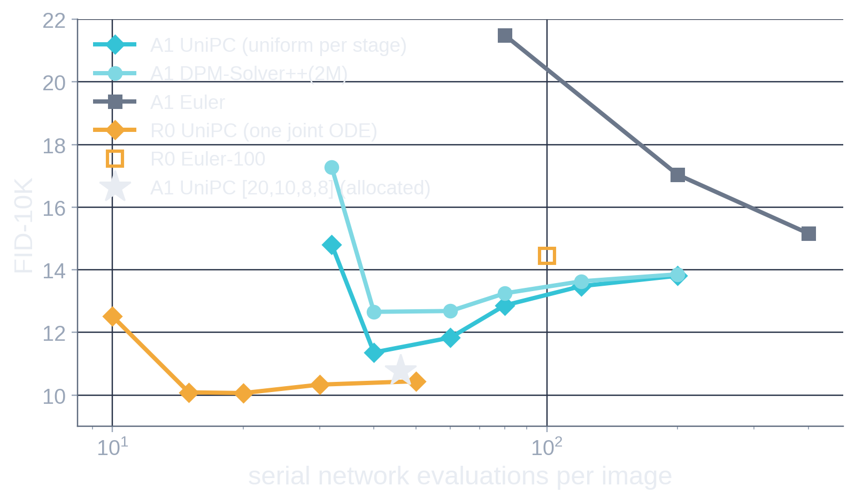
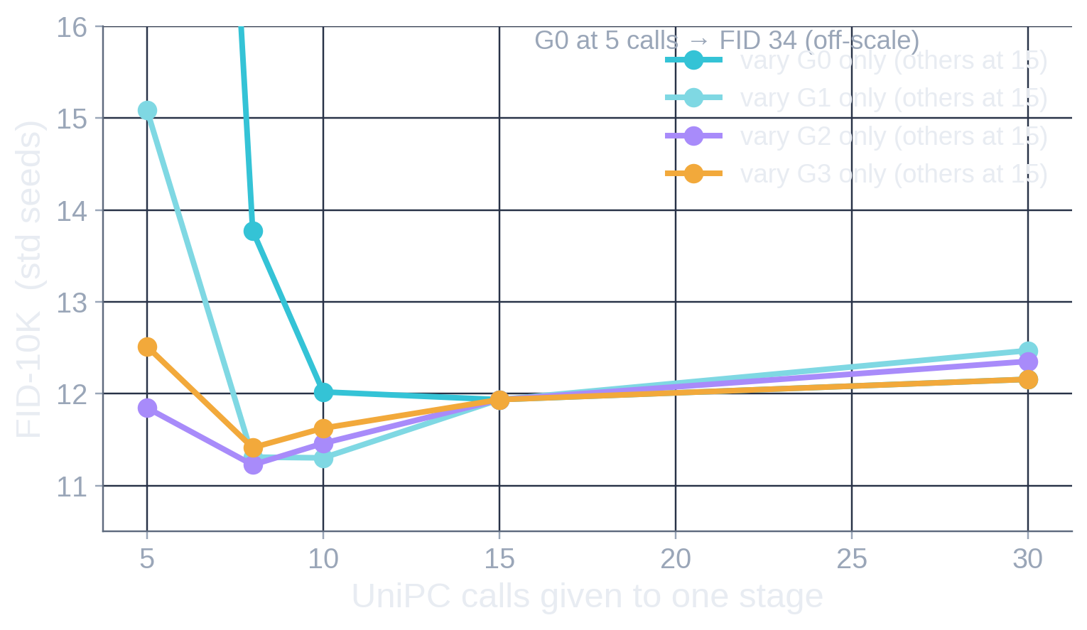
Samplers: equations and evaluation accounting
A3 · SAMPLERS & NFE ACCOUNTING
ODE: VP probability flow of DCTdiff’s SDE (SNR scale 4.0); data prediction x̂₀ = (xₜ − σₜ ε̂)/αₜ; t: 1 → 10⁻³
UniPC-2 bh2 (predictor + UniC corrector reusing the next evaluation), uniform-logSNR grid, final reference Euler step 10⁻³ → 0
A1 calls = Σₖ nₖ (one noisy-slot pass each) + one prefix-cache pass per stage k ≥ 1; GFLOP/image: Euler-400 599, UniPC-46 77; R0 UniPC-15 ≈ 88
Allocation curves vary one stage with the others at 15; joint schedules are not additive ([12,8,6,6] 12.75 vs [20,10,8,8] 10.77)
lsb/dct_causal/ffhq64_eff.py (solvers), efficiency/runs.json (uni_*, fs_*, r0_unipc_*), baseline.json (GFLOP/call 1.47, prefix cache), phase2_verdict.json. FID-10K = mean of std & 31M seed sets where both exist.
Notes:
Solver curves: UniPC beats DPM-Solver++(2M) and Euler for A1 at every budget; A1 FID rises with more uniform calls (UniPC-10 better than UniPC-50), i.e. a mildly over-dispersed fine solve trades precision for recall. R0 is flat from 15 calls on. The allocation figure is the evidence for giving G0 the most calls.

Slide 20
Evaluation protocol: q90 reference, FID-10K vs 50K
A4 · EVALUATION
Primary (FFHQ) | EDM Inception FID vs real_q90_pool: all 70k jpeg-ar q90 FFHQ-64 images (thumbnails128 → LANCZOS 64 → JPEG q90 4:2:0 → decode), exported losslessly; floor FID 1.4e-5
Secondary | FID vs the official EDM FFHQ-64 reference: includes the q90 codec floor (10.77) → R0 35.20, A1-146k 37.27, A1-250k 35.01 · never mixed with primary
Precision / recall | Kynkäänniemi k = 3, Inception pool3, at n = 50k for decisive numbers (at n = 10k real-vs-real recall is only 0.74)
FID-10K vs 50K | FID-10K is biased upward: A1 146k 16.43 (first 10k) vs 15.08 (50k); R0 13.95 vs 12.66 → separate axes, never one plot
Seeds | std = generator 20261017 + shard (paired across samplers); 31M = second independent set. H100 and A5000 CUDA noise streams differ for the same seed
CIFAR-10 | DCTdiff’s own statistics, which match JPEG-q75 re-encoded images; our R0 250k FID-10K 8.50 vs released checkpoint 8.54 (reproduction OK)
Not comparable | DCTdiff’s reported FFHQ-128 6.25 (its q75 stats, pytorch-fid); BandJoint training hours (A5000); any FID-10K against FID-50K
PREREG_FFHQ64.md, PREREG_EFFICIENCY_FFHQ64.md, ffhq64/summary.json, efficiency/baseline.json (note on H100 vs A5000 streams), report “Reproduction and evaluator”.
Notes:
If asked why q90: the BandJoint campaign trained on q90-decoded images, and to compare against its 21.32 winner we kept its protocol. The official-reference FID is reported separately because it includes the codec floor.

Slide 21
Early architectures we abandoned
A5 · HISTORY
Spatial-causal DCTdiff | WRONG AXIS | causality over token positions, not frequency; seams at every token boundary at 50k
256-token block-causal staging | TOO COSTLY | 4 stages × 64 positions as one sequence: correct but 4.18× R0 FLOPs; stopped at 5.7k
Prefix-causal E0 / E1 | OBJECTIVE PROBLEM | one sampled target group per example; E1 needed 3 calls per solver step
Channel-causal C0 / C1 | CONFOUNDED | trunk split into 128|256|128 lanes; C1 2.02× worse (recall −0.13), DC output reached 1/16 of weights
Depth-staged P0 / P1 | PAUSED | groups injected at blocks 6/10/13; frozen at 9.8k when we switched to the axial design
BandJoint (jpeg-ar, Sep 2026) | SUPERSEDED | 5 radial bands of JPEG-q90 8×8 DCT, summed prefix re-encoded per stage, 122.5M; FID-50K 21.32
Lesson: put frequency on its own axis (slots) instead of serializing tokens or splitting channels — the axial design keeps attention cost at slots·(S+1)² + (S+1)·slots² and lets one forward train every conditional.
report.html “Archived 1–4b”; reports/dct_causal/PREREG_CHAN.md, PREREG_DEPTH.md, PREREG_FREQSTAGE.md; jpeg-ar BandJoint campaign memory.
Notes:
These are kept for completeness; none produced a model we compare against. The spatial-causal run was a specification error (wrong axis); the others were correct but either too costly or confounded by capacity.

Slide 22
Training throughput and FLOP accounting
A6 · COST
 | params | H100 steps/s (bs 256) | train GFLOP / image | H100-h to final | sampling GFLOP / image | serial calls
R0 DCTdiff | 44.2M | 21.05 | 17.6 | 3.34 (250k) | ≈ 88 (UniPC-15) | 15
A0 joint axial | 11.09M | 14.50 | 17.8 | 3.34 (174k) | — | 15 (UniPC best)
A1 frequency-AR | 11.09M | 12.16 | 31.1 | 3.36 (146k) · 5.77 (250k) | 77 (UniPC-46) · 599 (Euler-400) | 46
A1 trains 4 conditionals per image in one forward over 7 slots × 65 tokens, so 1.75× A0’s FLOPs per image; its H100 utilization is higher, which is why A1 wins per hour but only ties per FLOP
Per call A1 costs 1.47 GFLOP (noisy slot only) vs ≈ 5.9 for R0, but narrow D256 calls are latency/memory-bound: 4× fewer FLOPs per call did not give 4× faster calls
Evaluation GPU time (A5000 / H100 sampling) is not included in training H100-hours
ffhq64/summary.json (probe_steps_per_s, r0_h100_hours), ffhq64/mature/summary.json (FlopCounterMode, fwd+bwd), efficiency/baseline.json (GFLOP per call / prefix cache), phase2_verdict.json.
Notes:
FLOPs come from torch FlopCounterMode (matmul/conv/attention, forward+backward; elementwise ops not counted). The CIFAR profile showed the same pattern: A1 at D192 used 0.72x R0 FLOPs but 1.55x GEMM time because 192-wide matmuls underuse tensor cores.

Slide 23


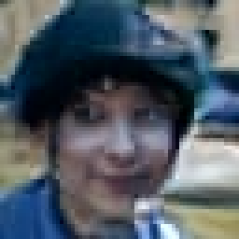



The single-token tail artifact
A7 · ROBUSTNESS
What: one token’s highest group (G2 on CIFAR, G3 on FFHQ) reaches 2–150× the largest value in 10k real images; all 6 blocks of that token, chroma worst
Trigger: that token’s own stage noise norm: 0 failures below 4.5 (of ~255k tokens), 77% at 5–5.25, 100% above 5.25 (CIFAR A1 500k); prefix swaps do nothing
Mechanism: at t = 1 the ε-network under-predicts extreme input noise (ε̂/x 1.00 up to 2.5σ, 0.91 at 3σ, 0.55 at 5σ); σ/α amplifies the miss; the deterministic ODE locks on
Not caused by frequency AR: CIFAR 100k rates A1 0.85%, A0 0.70%, R0 0.10% — a property of per-stage noise tokens in the axial design
Cost: none measurable in FID (redraw all tokens with norm > 4.5: 15.088 → 15.140). Grows with training. FFHQ UniPC 5k: > 5× data max in 2.6% (A1) vs 0.5% (R0)
Fixes (not applied): truncate per-token noise norm; dynamic x̂₀ thresholding; v- or x₀-prediction for noisy slots
G0
≤G1
≤G2
all
narrative G2_DIAG (CIFAR, A1 D192 500k); g2/tail.json, swap_*.json; FFHQ incidence recounted on efficiency j20_10_8_8 / r0_unipc_15 / a0_unipc_15 coefficient arrays (samples_meta.json).
Notes:
The three rows of tiles are the three worst FFHQ UniPC samples by max |coef|/data-max, decoded cumulatively: the artifact is absent until G3 is added. On CIFAR the diagnosis was done by noise/prefix swaps at a fixed token.

Slide 24
Full screen table (raw numbers)
A8 · ALL SCREENS
run | data | steps | params | H100-h | FID-10K EMA | FID-10K raw | recall EMA / raw | sampler
A1 D192 | CIFAR | 100k / 250k / 500k | 6.24M | 1.42 / 3.64 / 7.34 | 18.43 / 15.19 / 15.09 | 28.44 (100k) | .494 (100k) | Euler 100/stage
A1 D256 | CIFAR | 100k / 185k / 250k | 11.08M | 1.80 / 3.32 / 4.48 | 14.77 / 12.81 / 13.16 | 18.18 / 19.70 / 21.40 | .537 / .564 / .560 | Euler 100/stage
A0 D256 | CIFAR | 100k / 200k / 250k | 11.08M | 1.65 / 3.30 / 4.12 | 13.99 / 11.49 / 10.97 | 17.04 / 16.81 / 17.30 | .557 / .575 / .589 | Euler 100
R0 (ours) | CIFAR | 100k / 250k | 44.2M | 1.34 / 3.35 | 12.67 / 8.50 | 16.05 / 18.31 | .565 / .600 | Euler 100
A1 D320 | CIFAR | 100k | 17.29M | 2.30 | 14.27 | 21.52 | .550 | Euler
4×4 K3 / K7 | CIFAR | 100k | 6.24M | 1.40 / 2.88 | 22.07 / 21.01 | 25.88 / 25.31 | .472 / .473 | Euler
full-image K8 | CIFAR | 100k | 6.31M | 3.43 | 51.57 | 59.12 | .246 | Euler
G₋₁ / σ 0.005 | CIFAR | 100k | 6.24M | 1.76 / 1.48 | 19.67 / 18.75 | 30.61 / 21.48 | .500 / .497 | Euler
A1 D256 (ctrl) | FFHQ | 50k | 11.09M | ≈1.15 | 28.84 | 27.09 | .204 / .315 | UniPC 46
L8 · K6 · 8×8 k36 | FFHQ | 50k | 7.67 / — / 11.14M | 0.85 / — / 0.52 | 48.43 / 52.08 / 72.41 | 30.25 / 38.58 / 82.67 | .053 / .053 / .011 (EMA) | UniPC
A1 vs reverse | FFHQ | 100k | 11.09M | ≈2.3 | 13.69 vs 46.77 | 22.94 vs 69.87 | .428 vs .055 | own best
A0 D256 | FFHQ | 174k | 11.09M | 3.34 | 15.00 (UniPC-15) | — | .393 | UniPC 15
scaling/summary.json (arms, d256_maturity, a1), efficiency/screens.json, efficiency/runs.json (rev100_*, a1100_*, a0_unipc_*). FFHQ 100k reverse comparison: FID-10K mean of std/31M where both exist; reverse std only.
Notes:
Raw numbers behind slides 6 and 11. CIFAR FIDs and FFHQ FIDs are on different scales and must not be compared across the two blocks.

Slide 25





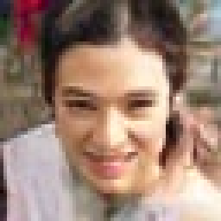


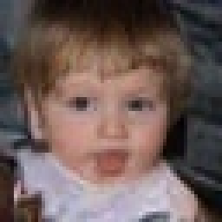





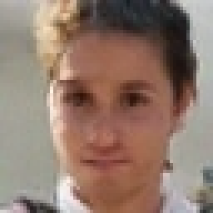





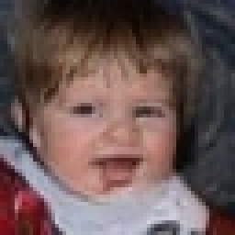








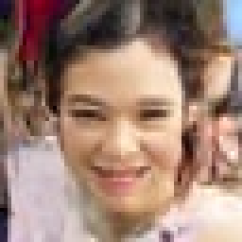


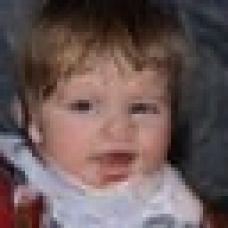











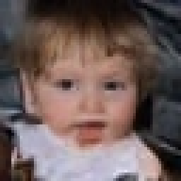













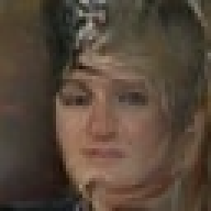
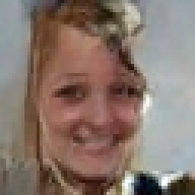
Same initial noise, different samplers and models
A9 · SAME NOISE
A1 250k · Euler 400
A1 250k · UniPC 46
R0 250k · UniPC-15
A0 174k · UniPC-15
A1 100k · UniPC 46
reverse 100k · UniPC
Std seeds 0–11, H100, uncurated. Euler → UniPC keeps identity and sharpens. The two joint models (R0, A0) map the same noise to nearly the same face; A1 diverges more, consistent with its layout being set by the G0 noise slice alone. Reverse order keeps faces but loses colour and diversity.
Notes:
All rows share the same initial noise tensor for each column (generator 20261017, shard 0). This is a qualitative cross-check of the quantitative claims: UniPC is the same model with a better solve; R0 and A0, both joint ODEs, learn nearly the same noise-to-image map.

Slide 26
Bibliography
A10 · REFERENCES (VERIFIED 19 OCT 2026)
Nash, Menick, Dieleman, Battaglia. Generating Images with Sparse Representations (DCTransformer). ICML 2021. arxiv.org/abs/2103.03841
Han, Ghazvininejad, Koh, Tsvetkov. JPEG-LM: LLMs as Image Generators with Canonical Codec Representations. 2024. arxiv.org/abs/2408.08459
Ning et al. DCTdiff: Intriguing Properties of Image Generative Modeling in the DCT Space. ICML 2025. arxiv.org/abs/2412.15032
Lee, Lee, Kim, Kim, Uh. Sequential Data Generation with Groupwise Diffusion Process (GDM). 2023. arxiv.org/abs/2310.01400
Yu, Luo, Yuan, Rong, Huang, Zhao. Frequency Autoregressive Image Generation with Continuous Tokens (FAR). 2025. arxiv.org/abs/2503.05305
Huang et al. NFIG: Autoregressive Image Generation with Next-Frequency Prediction (later: Multi-Scale … via Frequency Ordering). 2025. arxiv.org/abs/2503.07076
Huang, Chen, Zheng, Duan, Zhou, Lu. SpectralAR: Spectral Autoregressive Visual Generation. ICCV 2025. arxiv.org/abs/2506.10962
Tian et al. Visual Autoregressive Modeling: Scalable Image Generation via Next-Scale Prediction (VAR). 2024. arxiv.org/abs/2404.02905
Li, Tian, Li, Deng, He. Autoregressive Image Generation without Vector Quantization (MAR). 2024. arxiv.org/abs/2406.11838
Tschannen, Eastwood, Mentzer. GIVT: Generative Infinite-Vocabulary Transformers. ECCV 2024. arxiv.org/abs/2312.02116
Tschannen, Pinto, Kolesnikov. JetFormer: An Autoregressive Generative Model of Raw Images and Text. 2024. arxiv.org/abs/2411.19722
Yu, Derpanis, Brubaker. Wavelet Flow: Fast Training of High Resolution Normalizing Flows. NeurIPS 2020. arxiv.org/abs/2010.13821
Hang, Bao, Wei, Chen. Fast Autoregressive Models for Continuous Latent Generation (FAR, shortcut head). 2025. arxiv.org/abs/2504.18391
Ma, Wei, Wang, Zhang, Tian. DeCo: Frequency-Decoupled Pixel Diffusion for End-to-End Image Generation. 2025. arxiv.org/abs/2511.19365
Zhao et al. UniPC: A Unified Predictor-Corrector Framework for Fast Sampling of Diffusion Models. 2023. arxiv.org/abs/2302.04867
Notes:
Every entry was opened on arXiv (abstract page) on 19 Oct 2026; venue info from CVF/PMLR/ECVA where listed. FAR appears twice in the literature under the same acronym (Yu et al. frequency AR; Hang et al. fast AR) - they are different papers.

