Slide 1
Summary statistics
How the energy sector compares to the information technology sector in 2016 ?

Slide 2
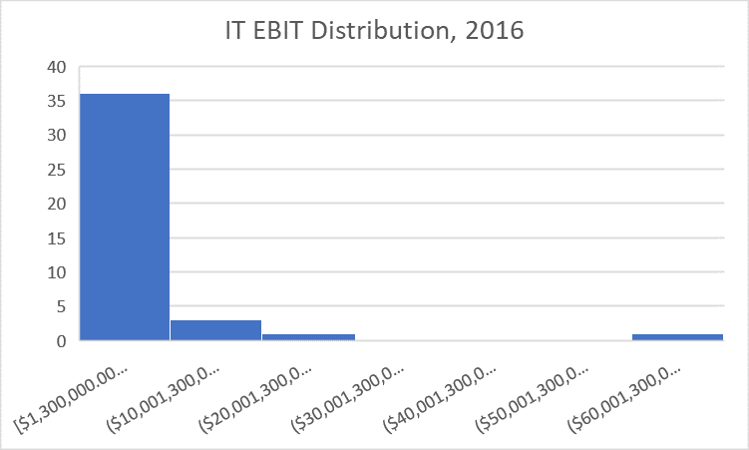
Key Takeaways:
The average revenue for IT companies was higher by more than 10B$ in 2016.
By looking at the median of the energy sector’s R&D expenses, it can be learned that most companies within this sector don’t spend money on research. In contrast, in the IT sector, the median expenses of R&D was almost 1B$.
Both sectors’ EBIT range is between 70-80[Billion $] . It means that theirs is little difference between the sector’s operating income in terms of minimum – maximum gap.
When taking into consideration the standard deviation of EBIT per company in both sectors in 2016, there is a notable difference: the deviation of the energy sector is 1.7B$, while the deviation of the IT sector is 10B$. It can be inferred that the EBITs within the IT sector are way more diverse and spread out:
Interestingly, by looking at the histogram, this large standard deviation is caused by an outlier, which is the EBIT of Apple, which makes sense, as it is a leading IT company.

Slide 3
Overall analysis
The following charts provide different perspective on EBIT distribution within the market as of 2016.

Slide 4
