Slide 1
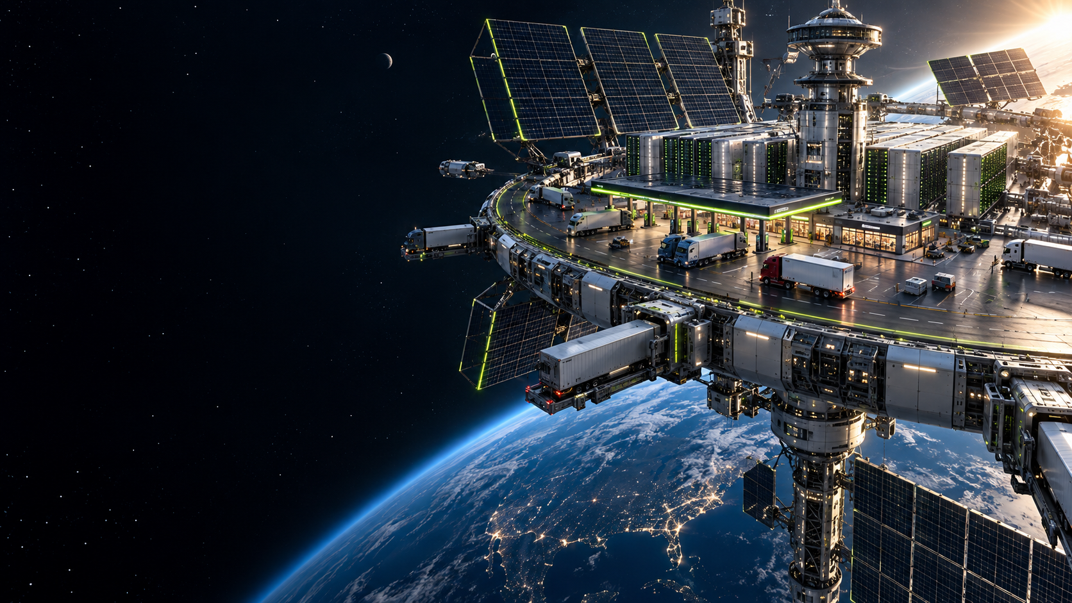
LOW ORBIT,
HIGH STATUS
Orbital compute. Interstate ambition.
A FICTIONAL RETREAT PITCH
Notes:
Fictional company for the Starship Ventures retreat pitch competition. Speaker 1 / CEO. Opening: The future of compute is orbital. The future of distribution is Exit 147. We are bringing sovereign AI infrastructure to the most overlooked node in the American economy: the truck stop. Generated concept illustration, not real infrastructure.

Slide 2
CUSTOMER DISCOVERY
“We want
cleaner showers.”
We heard orbital infrastructure.
Notes:
CEO: We asked truckers what they needed. They said cleaner showers, cheaper diesel, and Wi-Fi that works. We heard orbital infrastructure. Say the first two sentences seriously, then pause before the last. These customer interviews are fictional parody.

Slide 3
OUR ARCHITECTURE
400 km
from the customer
Orbital GPUs / Truck-stop ground stations / Shower queue
We solved the last mile by adding 250 miles vertically.
Notes:
Speaker 2 / CTO: Our orbital GPUs beam AI to ground stations at truck stops. This powers the most advanced shower queue in human history. AWS has availability zones. We have loading zones. The last-mile metric is fictional pitch logic, not an engineering claim.

Slide 4
TECHNICAL RISK
WILL.
Will Heltsley
He can get it into orbit.
Nobody can explain why it belongs there.
Advisor status: within earshot.
Notes:
CTO: Our entire technical diligence is Will. Will can get it into orbit. Nobody can explain why it belongs there. Source for real professional background only: https://www.starship.vc/team identifies Will Heltsley as an advisor and former SpaceX VP of Propulsion. Advisory relationship to our fictional company is a joke, not a real endorsement. Patrick reports Will is present.

Slide 5
THE PRODUCT
Diesel. Gold.
Platinum. Divorced.
Airline miles on every fill-up
Priority shower boarding. Complimentary lounge taquitos.
Notes:
CTO: Each purchase earns airline miles and status. We have four tiers: Diesel, Gold, Platinum, and Divorced. Platinum gets priority shower boarding and complimentary lounge taquitos. Divorced gets twice the miles because now you can finally go somewhere. Handoff to Speaker 3 / Chief Loyalty Officer: But that is only the feature. Here is the business. All benefits are invented.

Slide 6
THE BUSINESS MODEL
The satellites are
a customer
acquisition cost.
Sell miles. Collect fees. Monetize status anxiety.
Notes:
Speaker 3 / Chief Loyalty Officer: The satellites are a customer acquisition cost. Pause. We sell miles to our fictional co-branded card partner. Drivers buy status. Redemption is subject to blackout dates, a 97-page rewards policy, and the heat death of the universe. Compute is the demo. The airline loyalty program is the whole business. This is a fictional business model, with no real airline or bank partner.

Slide 7
WHY STARSHIP
LP = Loyalty Points
Your capital is locked up for ten years.
Your shower credits expire Friday.
Frontier technology. Frontier redemption policies.
Notes:
Chief Loyalty Officer: Why Starship? Sean backs frontier technology, and there is absolutely no civilization anywhere near this business model. Hugo is our Chief Orbital Officer, pending his learning about it right now. To the LPs: we can offer liquidity immediately; there is a soda fountain next to pump seven. Source for names and actual roles: https://www.starship.vc/team. All fictional titles and investment relationships are jokes.

Slide 8
THE ASK
$69M
1% engineering
99% convincing people they’re Platinum
Exit strategy: Exit 147.
Notes:
Chief Loyalty Officer: We are raising 69 million dollars, because apparently saying nice counts as investment committee approval. One percent goes to engineering. Ninety-nine percent goes to convincing people they are Platinum. Judge asks about your exit? Exit 147. End immediately. Every number is fictional satire. Suggested total delivery time 3–5 minutes, to be adjusted to competition rules.

