Slide 1

Notes:
[Sources]
- app/page.tsx
- docs/service/value-proposition.md

Slide 2
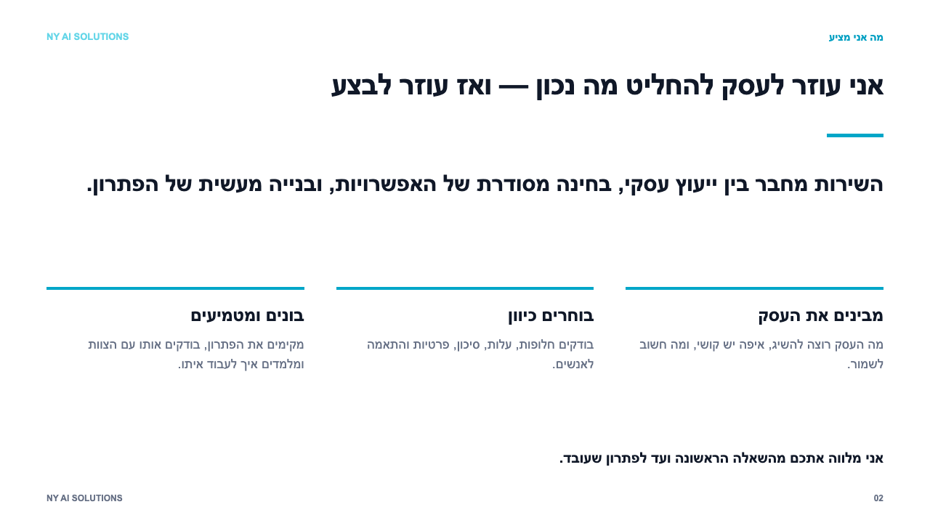
Notes:
[Sources]
- app/page.tsx
- Builder OS: 2026-08-11-ny-ai-consulting-launch.md

Slide 3
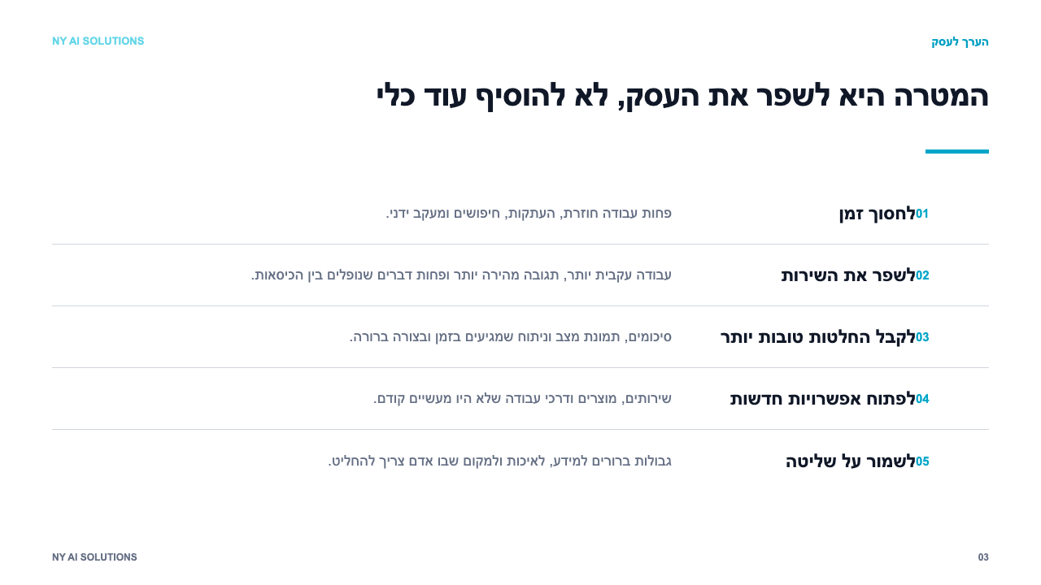
Notes:
[Sources]
- app/benefits/page.tsx
- docs/service/value-proposition.md

Slide 4
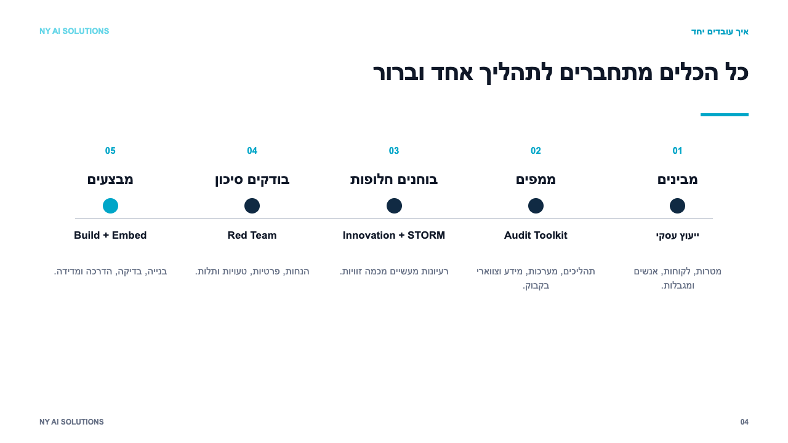
Notes:
[Sources]
- docs/toolkit/README.md
- Builder OS: thinking-tools-guide.md
- Builder OS: IDEATION v0.2.md

Slide 5
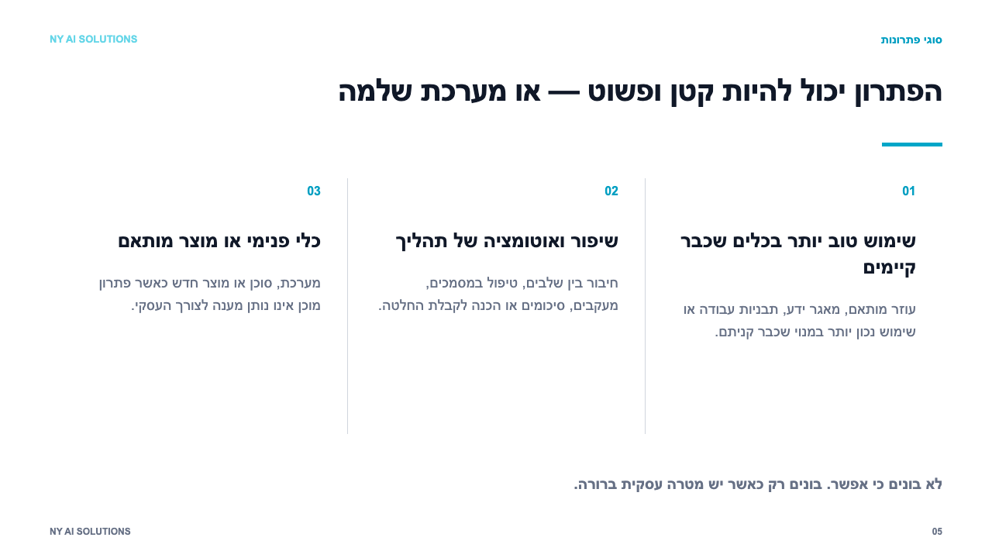
Notes:
[Sources]
- app/page.tsx
- docs/service/delivery-workflow.md

Slide 6
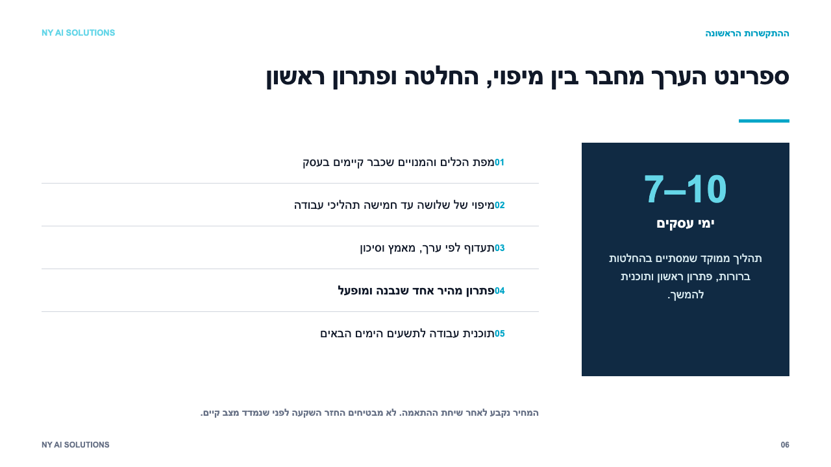
Notes:
[Sources]
- docs/service/offer.md
- docs/service/delivery-workflow.md

Slide 7
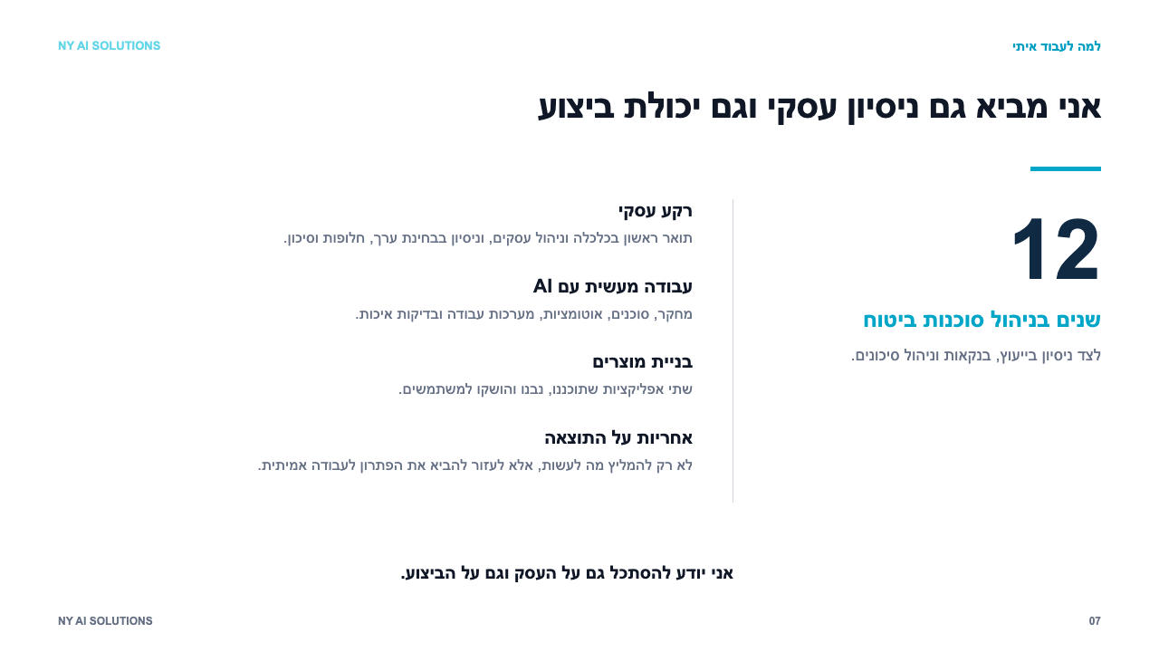
Notes:
[Sources]
- app/page.tsx
- docs/service/value-proposition.md

Slide 8
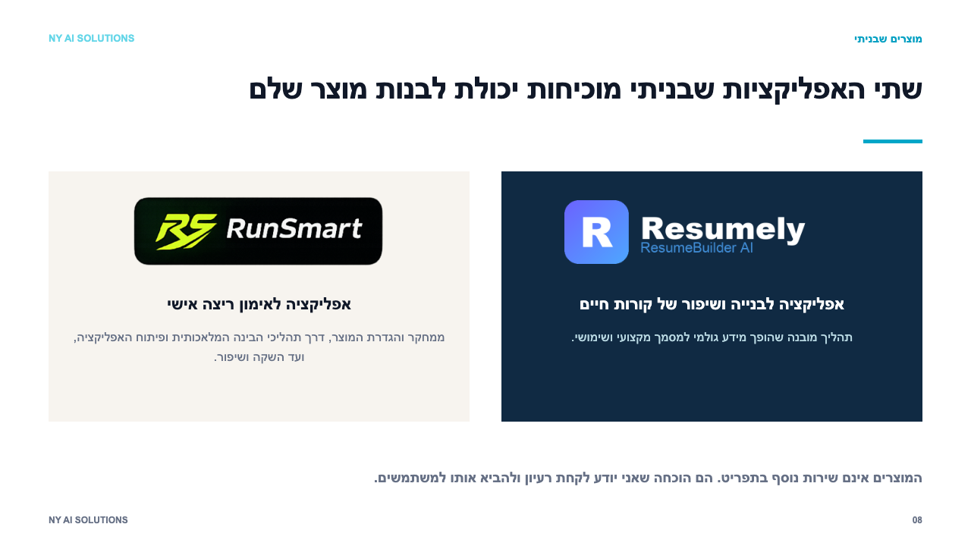
Notes:
[Sources]
- app/page.tsx
- docs/service/value-proposition.md

Slide 9
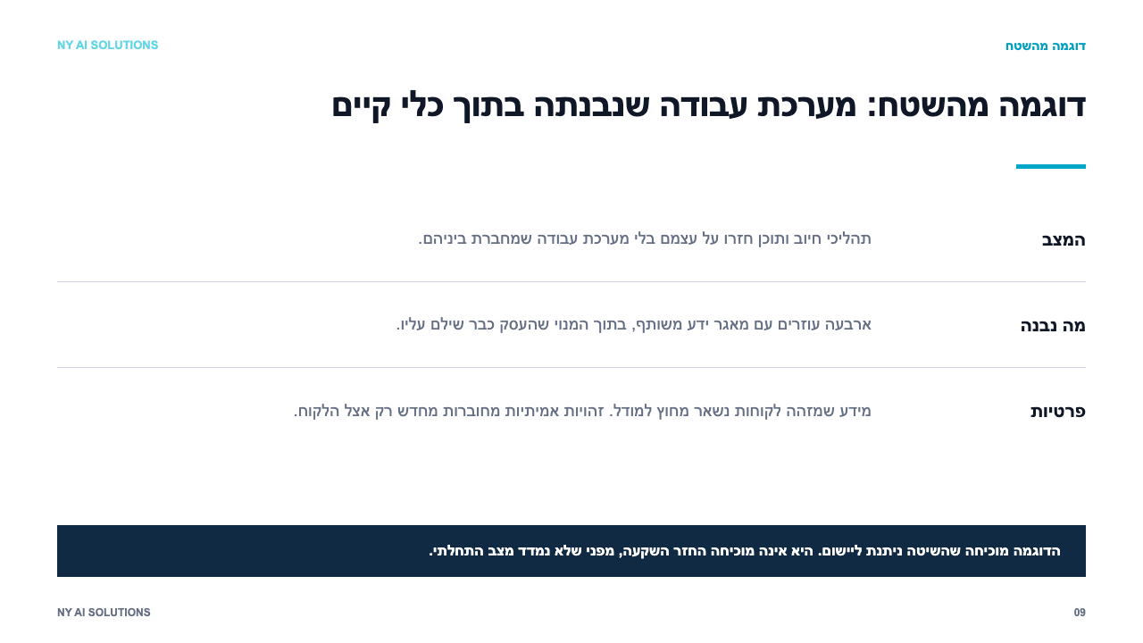
Notes:
[Sources]
- docs/clients/2026-08-30-michal-engagement-retro.md

Slide 10
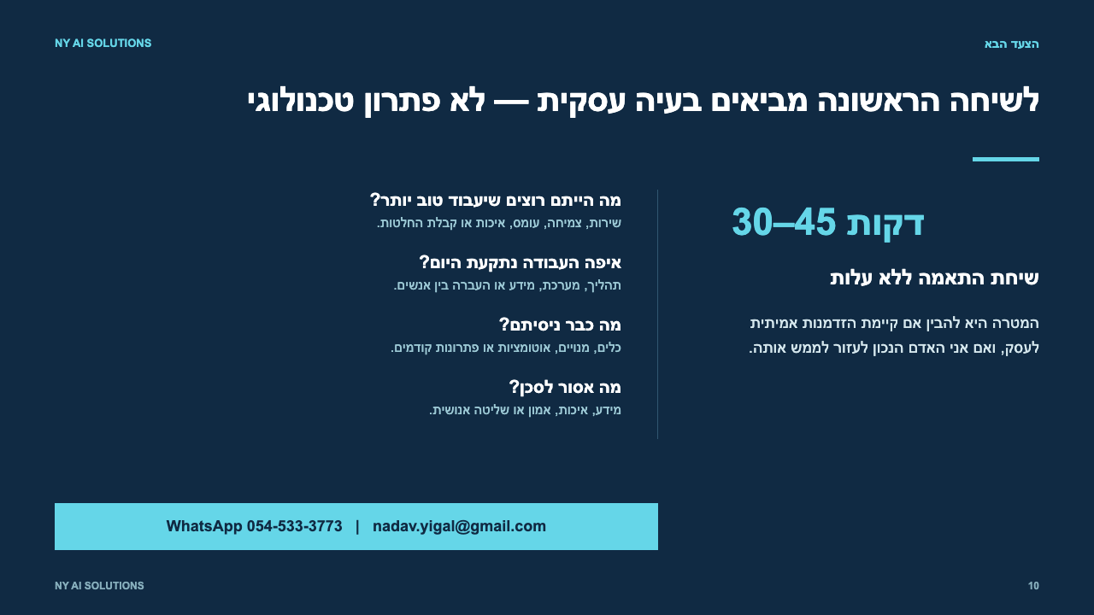
Notes:
[Sources]
- docs/service/offer.md
- docs/toolkit/01-intake.md

