Slide 1

Notes:
[Sources]
- docs/service/offer.md
- app/journey.ts

Slide 2

Notes:
[Sources]
- docs/service/offer.md

Slide 3
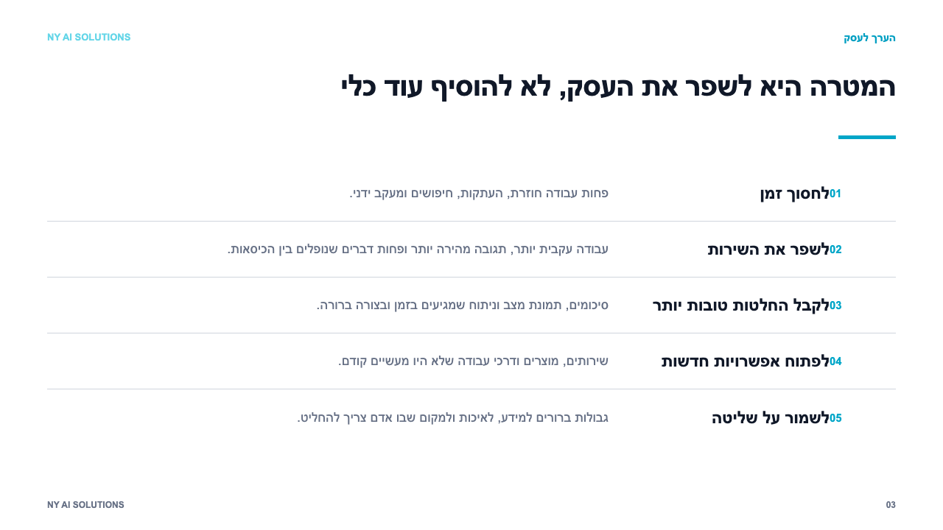
Notes:
[Sources]
- app/benefits/page.tsx
- docs/service/value-proposition.md

Slide 4
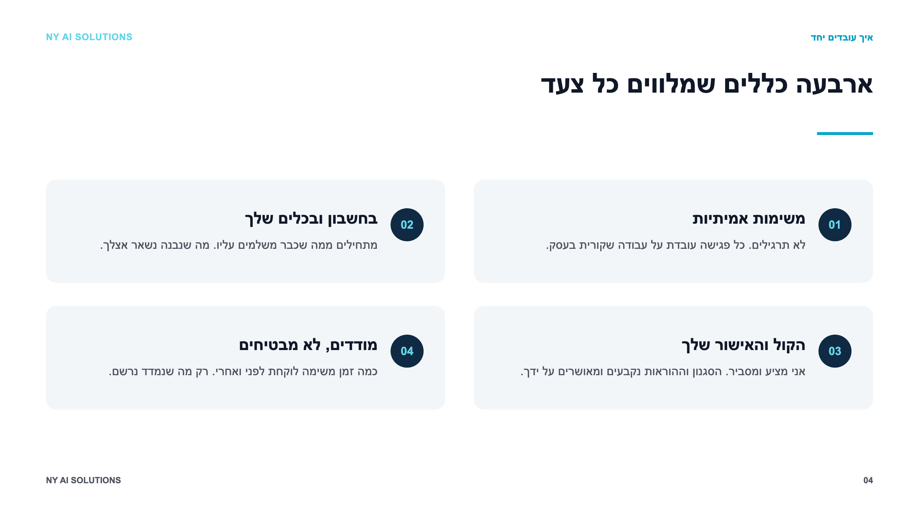
Notes:
[Sources]
- docs/service/offer.md

Slide 5
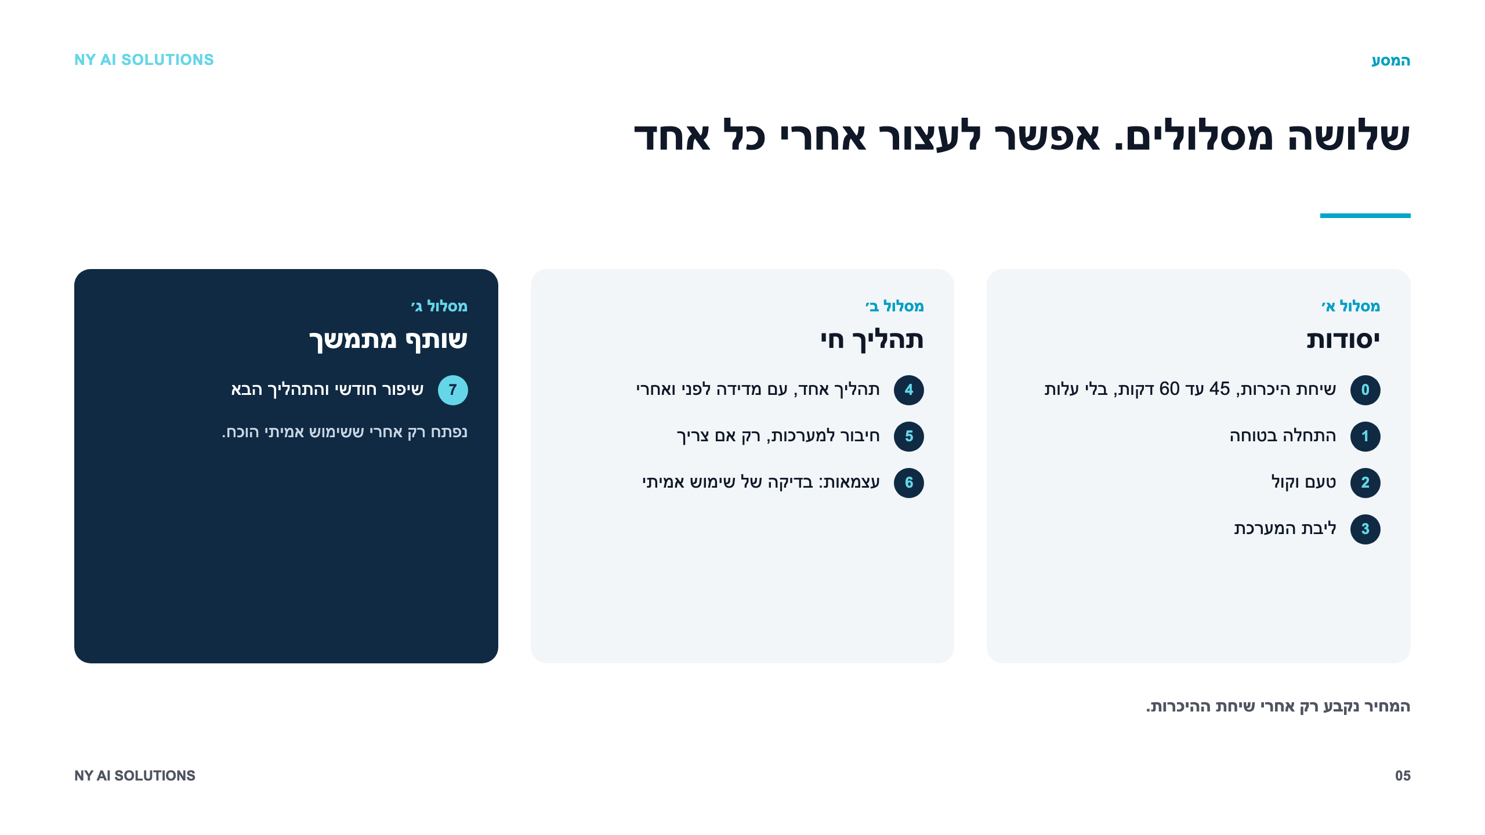
Notes:
[Sources]
- docs/service/offer.md
- app/journey.ts

Slide 6
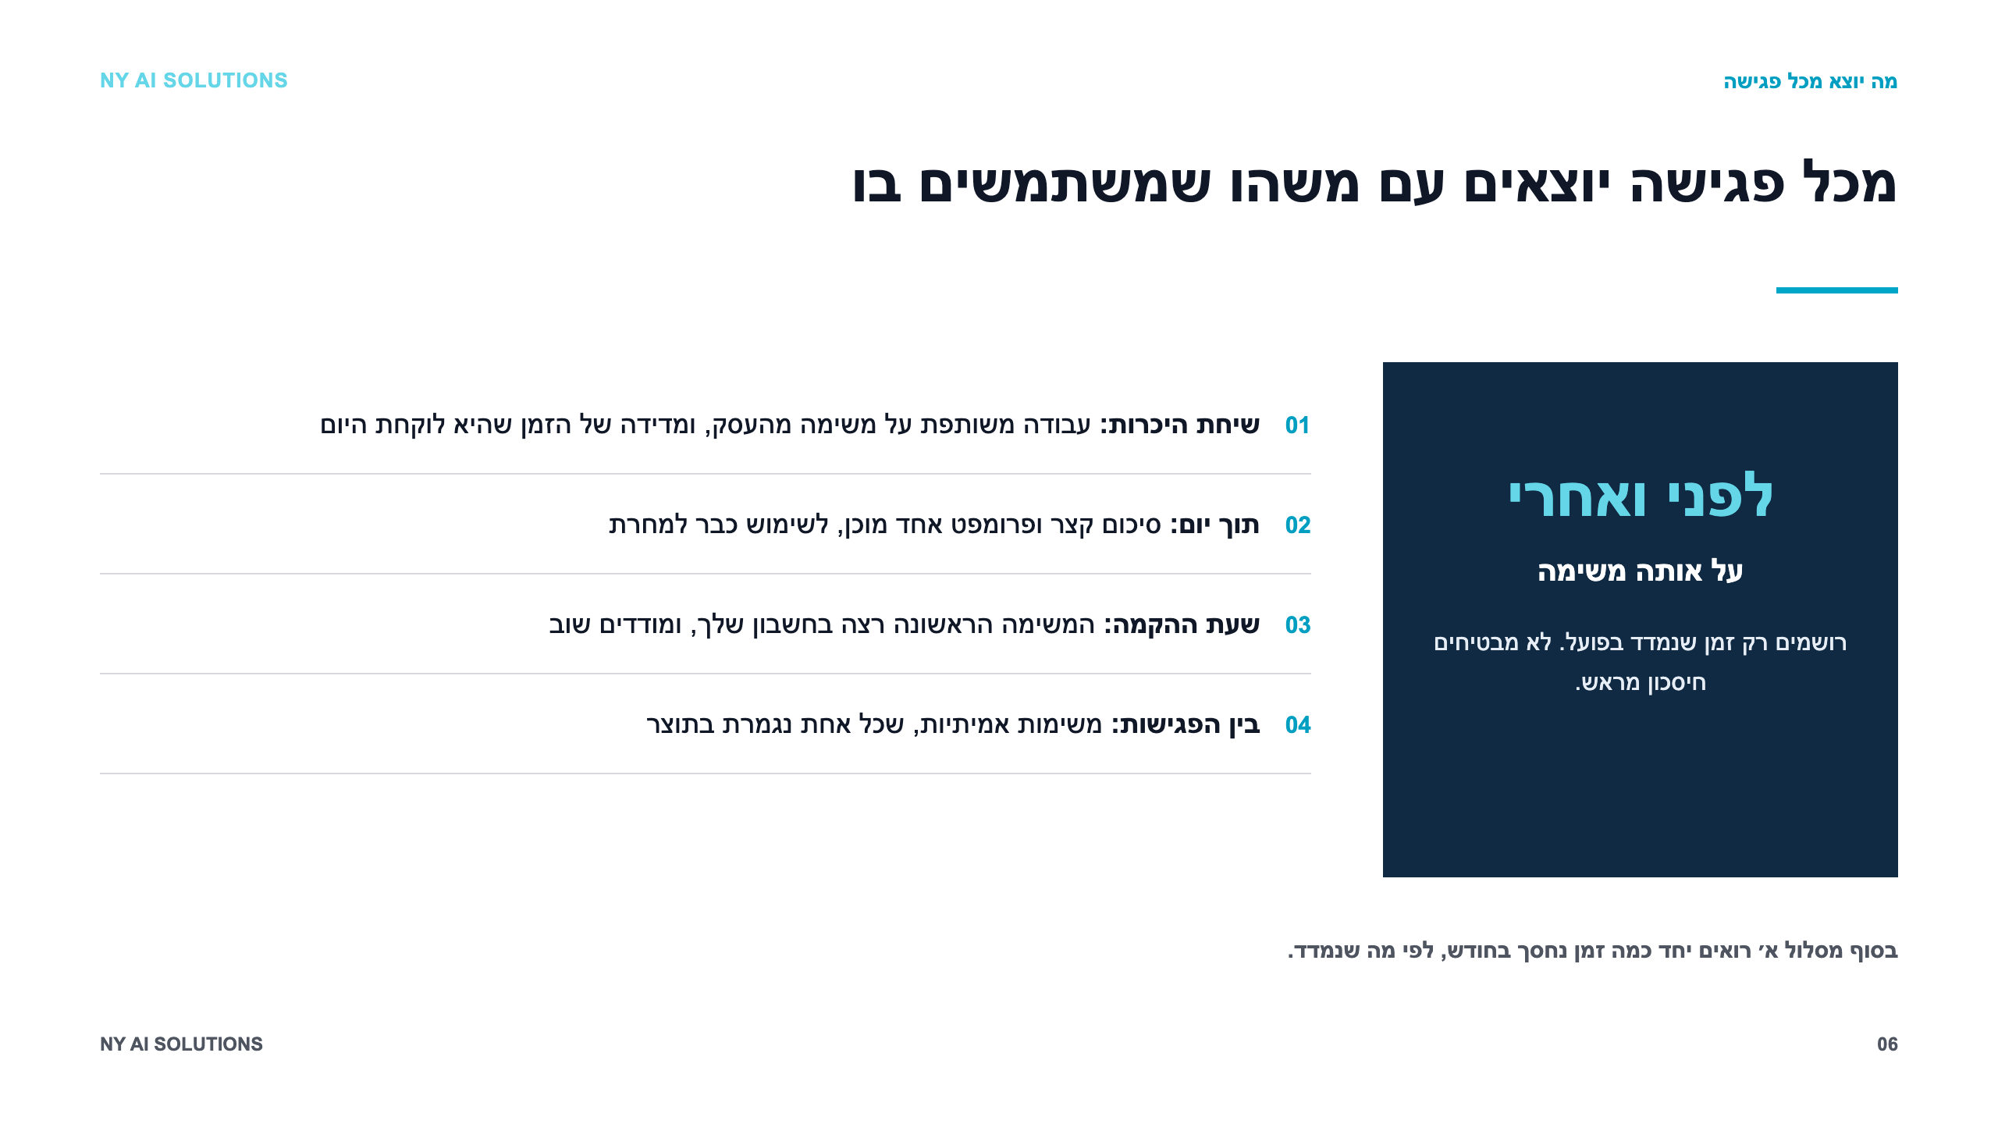
Notes:
[Sources]
- docs/service/offer.md
- docs/sales/NY-AI-Solutions-Service-Pitch-Hebrew-v6.md

Slide 7

Notes:
[Sources]
- app/page.tsx
- docs/service/value-proposition.md

Slide 8
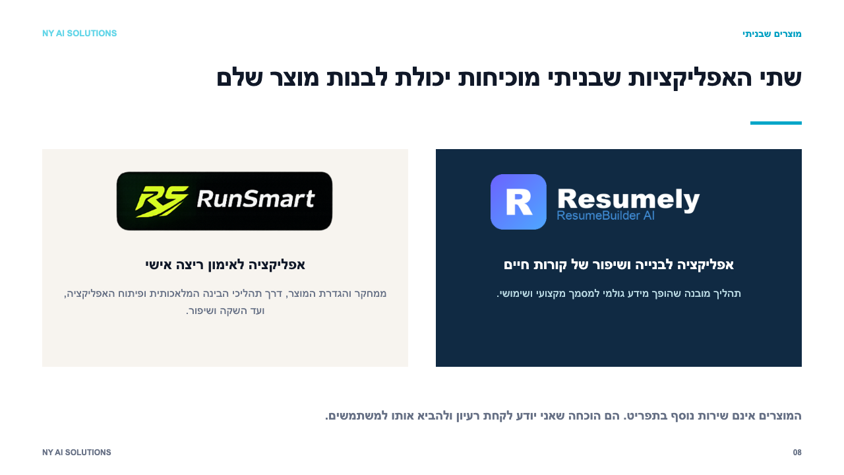
Notes:
[Sources]
- app/page.tsx
- docs/service/value-proposition.md

Slide 9
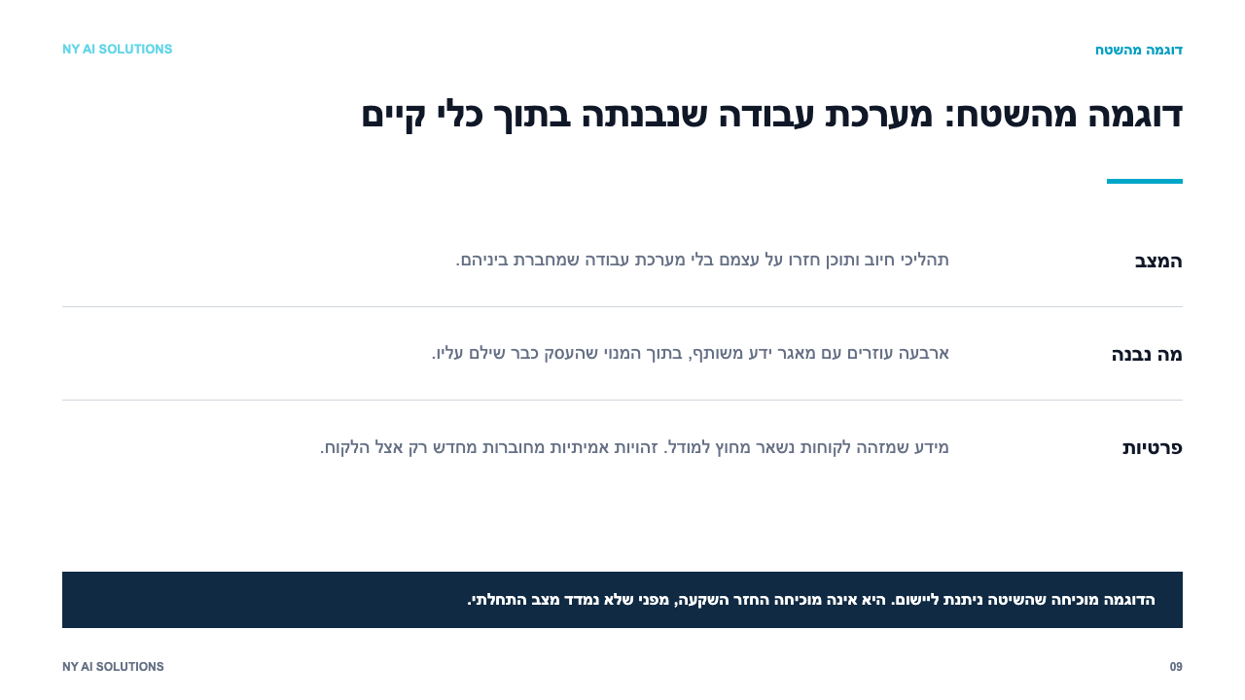
Notes:
[Sources]
- docs/clients/2026-08-30-michal-engagement-retro.md

Slide 10

Notes:
[Sources]
- docs/service/offer.md
- docs/sales/NY-AI-Solutions-Service-Pitch-Hebrew-v6.md

