Slide 1
ERASURE CODING HW ACCELERATOR
project mid-semester presentation
Or Dadush
Nadav Zaharia

Slide 2
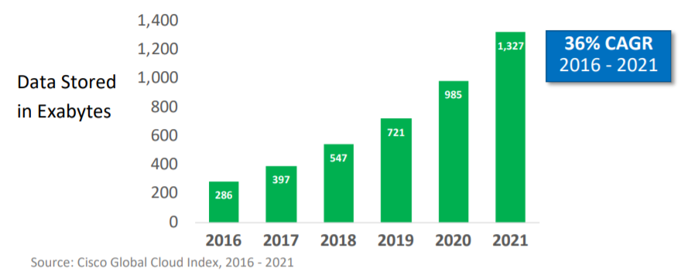
Booming of Data
The booming of data makes storage overhead of replication considerable
Notes:
הקדמה על גדילת המידע והיחלשות חוק מור
הגדרת הפרוייקט ואיך הגענו לEC

Slide 3
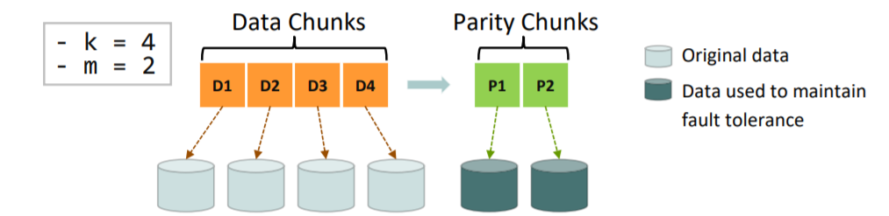
Fault Tolerance & Replication
Fault tolerance is a critical requirement for distributed storages
Availability
Durability
Erasure coding:
Takes in k data chunks and generates m parity chunks
Distributes (k + m) chunks to (k + m) independent nodes
Notes:
זמינות – המידע עדיין זמין לאחר נפילות
עמידות – המידע בר שחזור לאחר נפילות
פתרון טריוויאלי – שכפול X3
RAID 6\5
4. EC – גמישה -> יעילות והתאמה לכל מקרה (מערכת אחסון)
Availability: data is still accessible under failures
Durability: no data corruptions under failures
data is stored in physical devices
the devices fail randomly hence fault tolerance is needed
EC is efficient in storage overhead but inefficient computation wise.
K is the granularity of restoration
M gives tradeoff between availability and storage overhead (bc we can lose M shards simu)

Slide 4
Definition and Goals
Design and implement a generic hardware accelerator for efficient encoding of data blocks using erasure coding.
Goals:
- Maximal genericity
- cpu offloading
- Compatibility to existing solutions.
- Power consumption.
- Minimal on-chip memory.
- Area efficiency
- Real time performance.

Slide 5
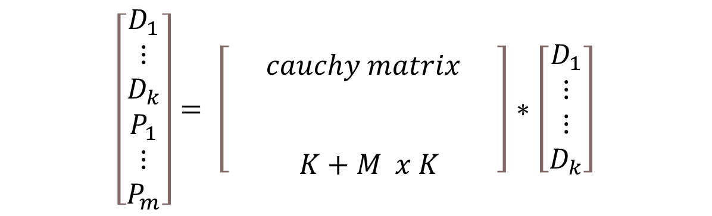
Cauchy Reed-Solomon Codes
matrix multiplication on finite Galois field
$$\left[\begin{matrix}\begin{matrix}D_{1} \\ ⋮ \\ D_{k}\end{matrix} \\ \begin{matrix}P_{1} \\ ⋮ \\ P_{m}\end{matrix}\end{matrix}\right]= \left[\begin{matrix} & & \\ & \begin{matrix}cauchy matrix \\ \\ \end{matrix} & \\ & K+M x K & \end{matrix}\right]∗\left[\begin{matrix}D_{1} \\ \begin{matrix}⋮ \\ ⋮ \\ D_{k}\end{matrix}\end{matrix}\right]$$
Notes:
we want to have an equation so that a reversable matrix ties between the original k shards and the k+m shards.
the matrix should be reversable for every set of remaining shards between K + M -1 to K shards
the solution is Cauchy matrix that is reversable for every submatrix of itself
the mult and addition is on GF
matrix mult is computational heavy but highly parallel

Slide 6
Alternative solutions:
alternative solutions:
software: Jerasure, Intel ISA-L, Gibraltar (gpu)
NIC: Mellanox-EC
FPGA: SoftIron, Academic paper. (*)
alternative implementations:
No known generic EC implementations in ASIC
GF operations using LUT
(*) Mian Qin, et al “A Generic FPGA Accelerator for Minimum Storage Regenerating Codes”
Notes:
hardware alternatives – FPGA is generic by default. LUT is available

Slide 7
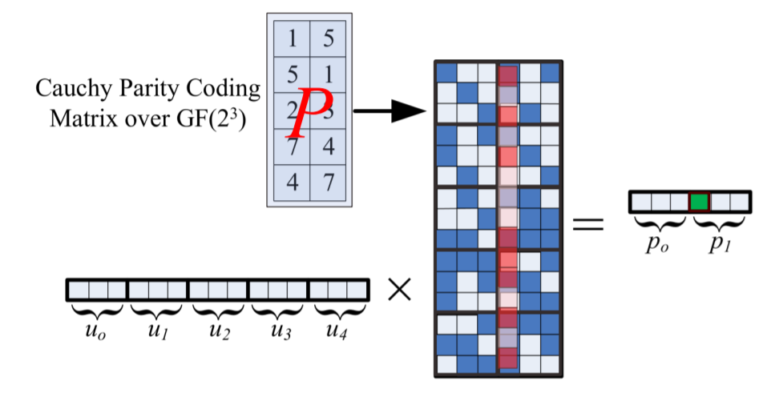
Fast GF Ops – Binary Representation
Notes:
explanation on the method
turn the matrix numbers to W x W bitmatrix
turn the data numbers to W bits vector
mult just like a regular matrix mult but in W = 1
why this over LUT:
AREA – each look up table will be 2^W and we’ll need
easy to implement in ASIC -> simple control and design
3. POWER

Slide 8
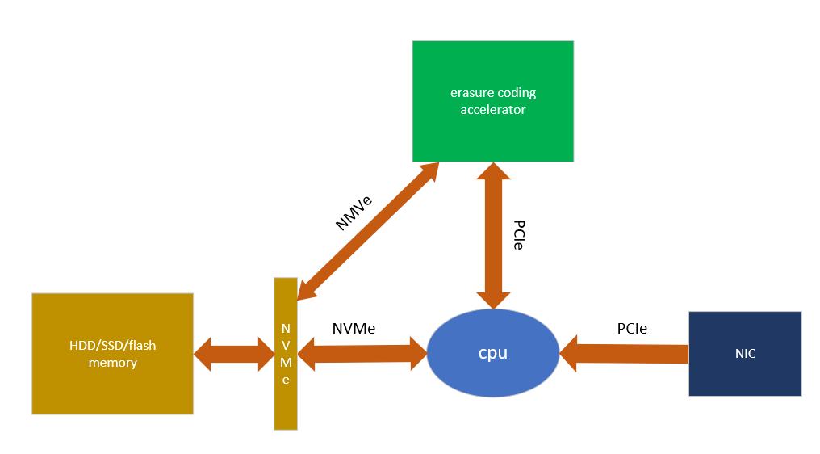
Architecture - overview
CPU only involved in setup and data transmission
Notes:
CPU only sends data and where to store once to the acc - > offloading
we focused on the engine and not the IF as Bnya instructed

Slide 9
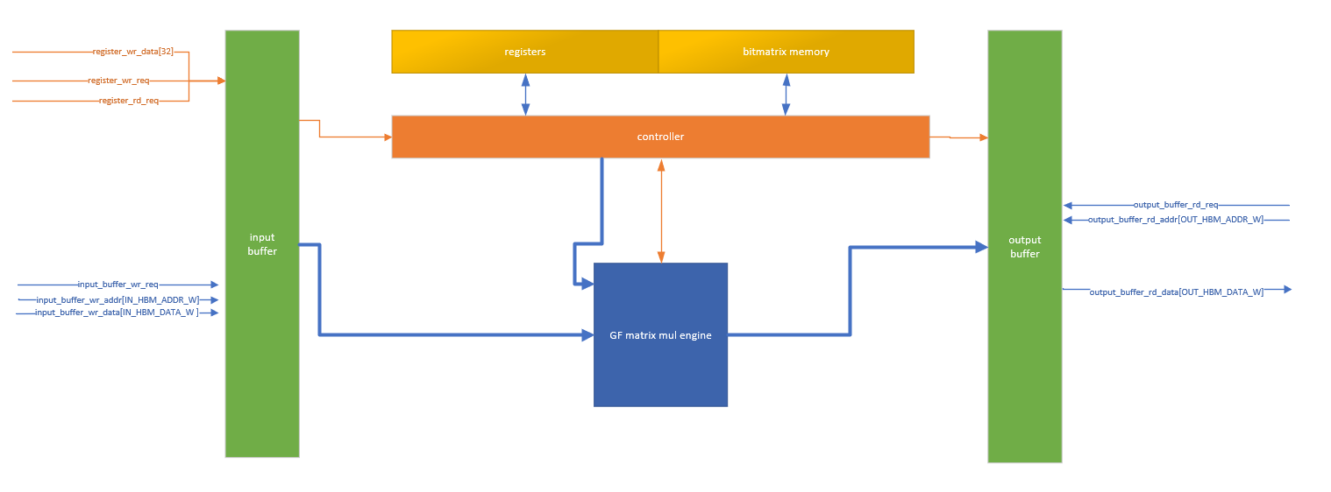
Architecture – Block Diagram
Notes:
ASK BNYA if to drop this

Slide 10
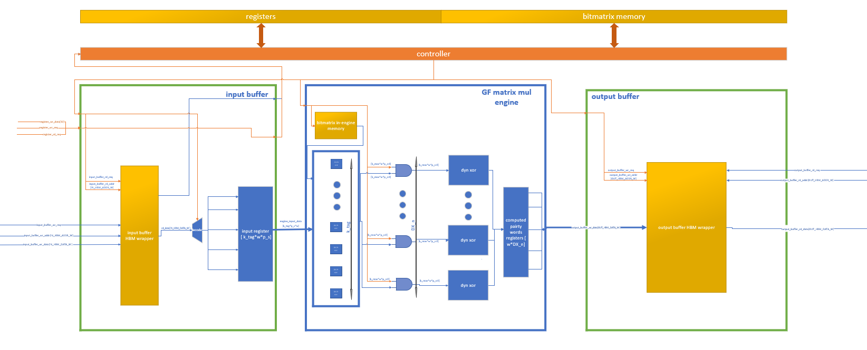
Micro-Architecture
Notes:
explain data movement – only read once

Slide 11
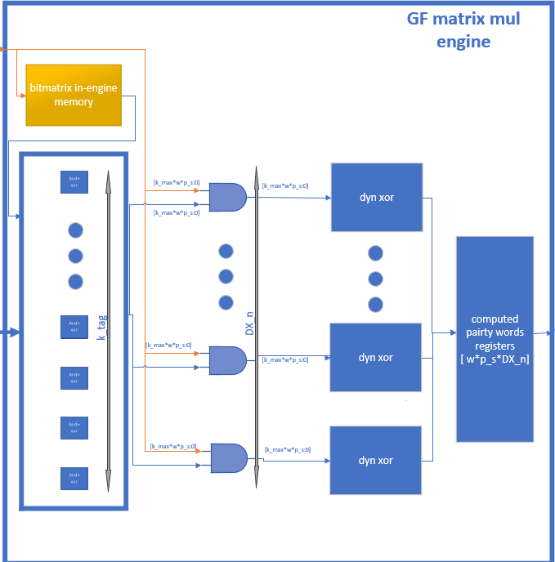
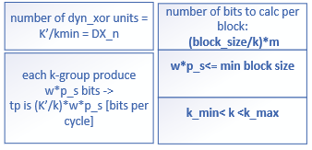
Micro-Architecture - Engine
Main parameters:
K - a coded data block is divided to k shards.
M - number of redundant produced shards.
K_TAG – number of basic processing units.
K_min
K_max
Packet = W * packet_length
Notes:
and+xor units – they do the w^2 bitmatrix product
dyn xor does the xor between the bitmatrixes products
ASK BNYA – how much should we talk about micro ARCH of genericty (dyn xor ect)
explain k min/max and packet parameters and how they effect

Slide 12
Fast GF Ops – Binary Representation
Notes:
explanation on the method
turn the matrix numbers to W x W bitmatrix
turn the data numbers to W bits vector
mult just like a regular matrix mult but in W = 1
why this over LUT:
AREA – each look up table will be 2^W and we’ll need
easy to implement in ASIC -> simple control and design
3. POWER

Slide 13
Status
So far:
survey of computation-heavy challenges in the distributed data storage area.
Examination of a wide range of erasure coding solutions and implementations.
Architectural and micro-architectural design
Software simulator implementation
To be done:
RTL implementation and verification
Performance analyze
Synthesis + Layout

Slide 14
Schedule
Gantt Chart:
stage\week | 1 | 2 | 3 | 4 | 5 | 6 | 7 | 8 | 9 | 10 | 11 | 12 | 13 | 14 | 15 | 16 | 17
Exploring problems in data storage area
Erasure Coding solutions examination
Architectural and micro-architectural design
Software Simulation
RTL Implementation
Functional simulation
Synthesis
Layout Design
Report

