Slide 1
What does determine the insurance charges?
Final Project Probability Course – Sekolah Data Pacmann
Nada Wahyu

Slide 2
Outline
Introduction
Dataset
Descriptive statistical analysis
Categorical variable analysis
Continuous variable analysis
Variable correlation
Hypothesis testing
Conclusion

Slide 3
Introduction
Premium of health insurance is affected by multiple factors
Assessment of the risk profile of the insured users
Analysis of the variables involved/correlated with the premium, e.g., sex, age, region, smoker status, number of children insured altogether
Descriptive, categorical, continuous variable analysis, variable correlation, hypothesis testing
Carried in Python using NumPy, Pandas, Scipy, Matplotlib and Seaborn packages

Slide 4
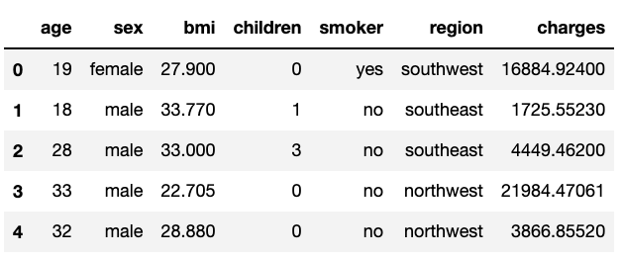
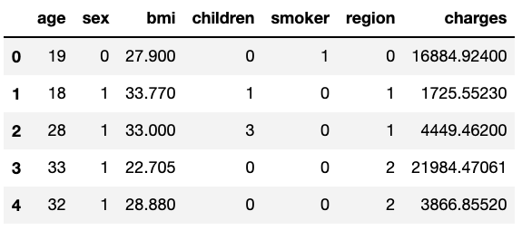
Dataset
Insurance data in the United States
Age, sex, BMI, number of children, smoker status, region of living, insurance charges

Slide 5
Encoding
Sex, smoker, and region was encoded to make correlation calculation easier
Sex
Female: 0
Male: 1
Smoker:
No: 0
Yes: 1
Region:
Southwest: 0
Southeast: 1
Northwest: 2
Northeast: 3

Slide 6
Descriptive statistical analysis

Slide 7

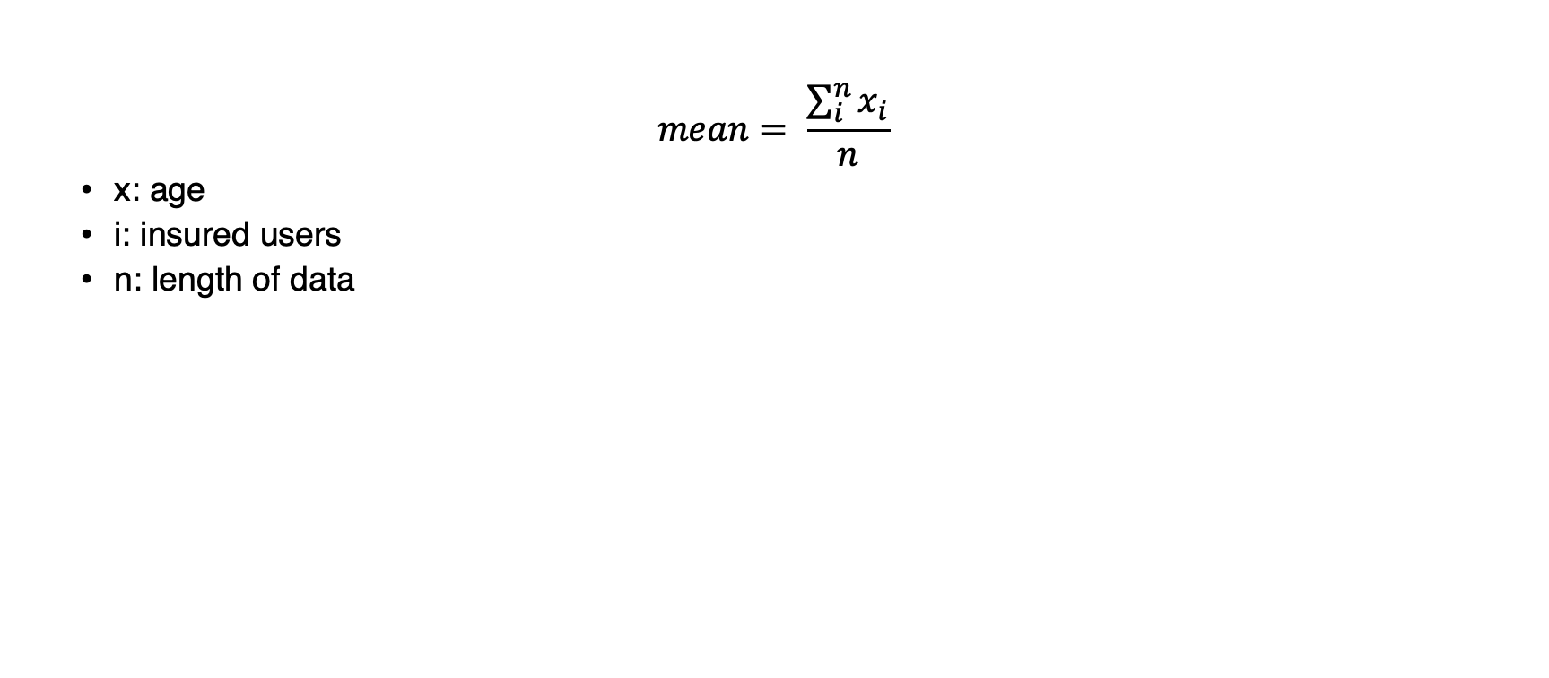
Mean of age
$$mean= \frac{\sum_{i}^{n}{x_{i}}}{n}$$
x: age
i: insured users
n: length of data
Notes:
Calculated the mean of age from all insured users in the dataset

Slide 8

Mean BMI of smokers
Notes:
Dataset was filtered, so that we only have the data of insured users who registered as smokers
Calculated the mean using the exact same approach

Slide 9
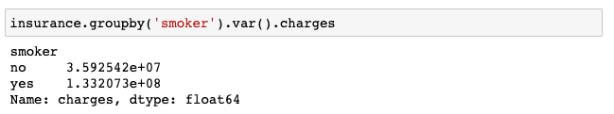
Charges’ variance by smoker status
Notes:
Dataset was filtered by smoker status, and each of them was calculated using the corresponding filtered dataset

Slide 10
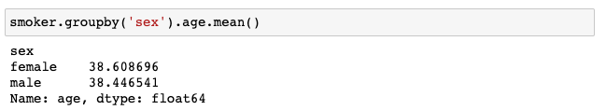
Mean age of smokers by sex
Notes:
(Previously filtered smoker) dataset was filtered based on the sex of the insured users, and the mean of age was calculated using the corresponding filtered datasets.

Slide 11
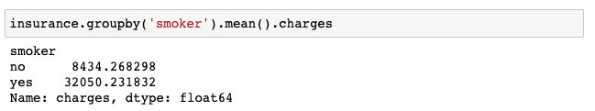
Mean of charge by smoker status
Notes:
The mean of charge was calculated using filtered datasets

Slide 12
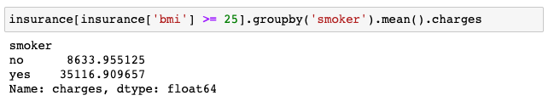
Mean of charge of BMI > 25 by smoker status

Slide 13
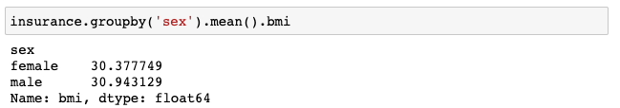
BMI by sex

Slide 14
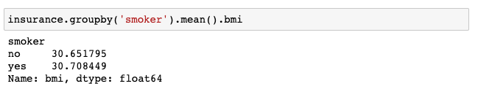
BMI by smoker status

Slide 15
Analysis
Smoker and non-smoker users are in a similar age range
Huge gap between premium of smokers & non-smokers (almost 4x as big)
BMI by sex and smoker status are similar
Notes:
Mean age of the insured users is 39 and mean age of smoker users of both sex are 38.61 for female and 38.45 for male, which means that non-smoker users are in a similar age range
Variance in charges between smokers and non-smokers is big, which indicates that there is also a big difference in the charges between both groups
The statement can be verified with the average premium of the smoker vs non-smoker group, which is almost almost 4x as big
BMI by sex and smoker status are similar

Slide 16
Categorical Variable Analysis

Slide 17
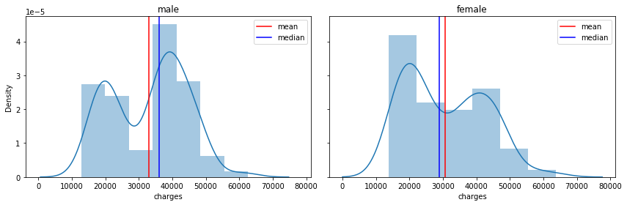
Higher Charges by Sex
Notes:
Med for male is 9412
Female 9369

Slide 18
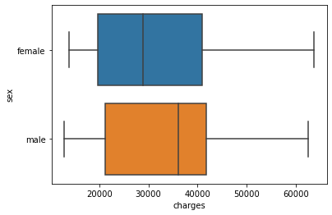
Higher Charges by Sex

Slide 19
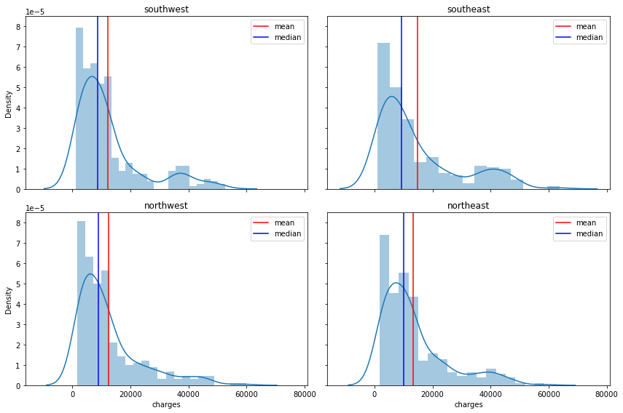
Premium Distribution by Region
Notes:
Sw 8799
Se 9294
Nw 10057
Ne 8965

Slide 20
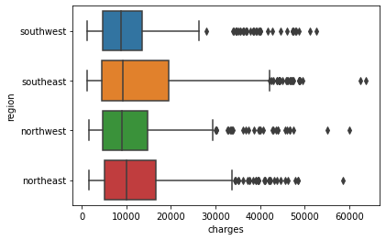
Premium Distribution by Region
Notes:
Sw 8799
Se 9294
Nw 10057
Ne 8965

Slide 21
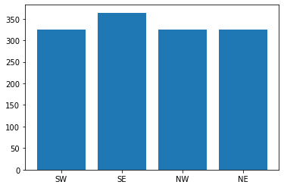
Data Proportion in Each Region

Slide 22
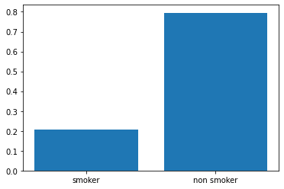
Data Proportion of Smoker and Non-Smoker

Slide 23

Probability of someone is a female, given that they are smokers
$$P\left(female | smoker\right)=\frac{P(female ∩smoker)}{P(smoker)}$$
$$P\left(female | smoker\right)=41.97\%$$

Slide 24

Probability of someone is a male, given that they are smoker
$$P\left(male | smoker\right)=\frac{P(male ∩smoker)}{P(smoker)}$$
$$P\left(male | smoker\right)=58.03\%$$

Slide 25
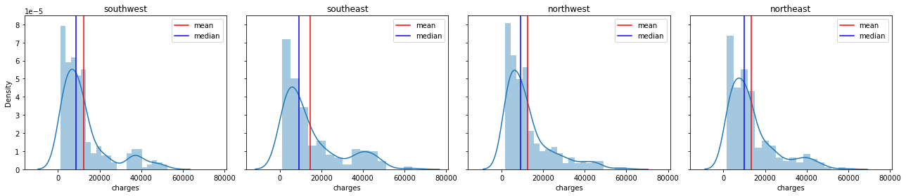
Premium Distribution in Each Region

Slide 26
Analysis
Almost
charge

Slide 27
Continuous Variable Analysis

Slide 28
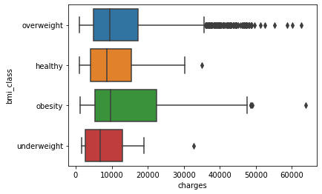
Probability of Charges based on BMI
Added a column to define the class of the BMI of each insured user

Slide 29

Probability of smoker with BMI > 25 getting charged > $16,700
$$P\left(smoker \right| charge>16700,BMI>25)=\frac{P(smoker ∩ charge>16700, BMI>25)}{P(BMI>25)} =98.17\%$$

Slide 30

Probability of someone getting charged $16,700 given that they are smokers
$$P\left(charge>16,700 | smoker\right)=\frac{P(charge>16,700 ∩smoker)}{P(smoker)}=92.70\%$$

Slide 31
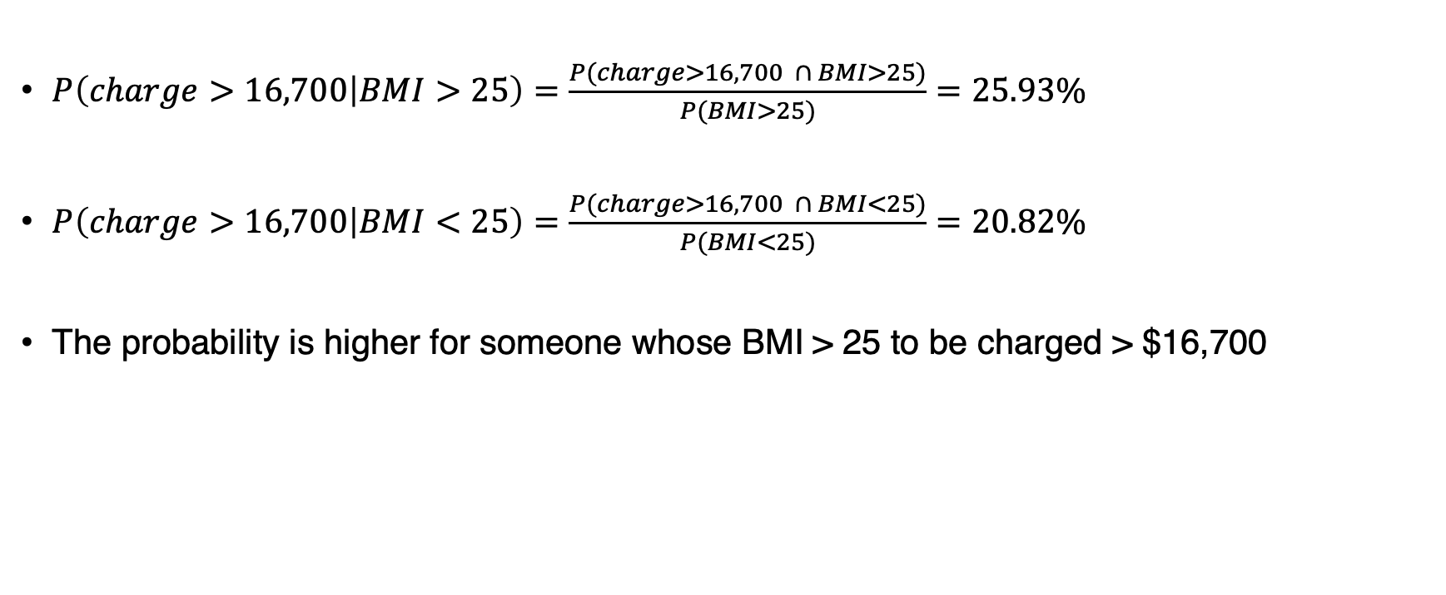
Probability of getting charged above $16,700 for BMI higher or lower than 25
$P\left(charge>16,700 | BMI>25\right)=\frac{P(charge>16,700 ∩ BMI>25)}{P(BMI>25)}=25.93\%$
$P\left(charge>16,700 | BMI<25\right)=\frac{P(charge>16,700 ∩ BMI<25)}{P(BMI<25)}=20.82\%$
The probability is higher for someone whose BMI > 25 to be charged > $16,700

Slide 32
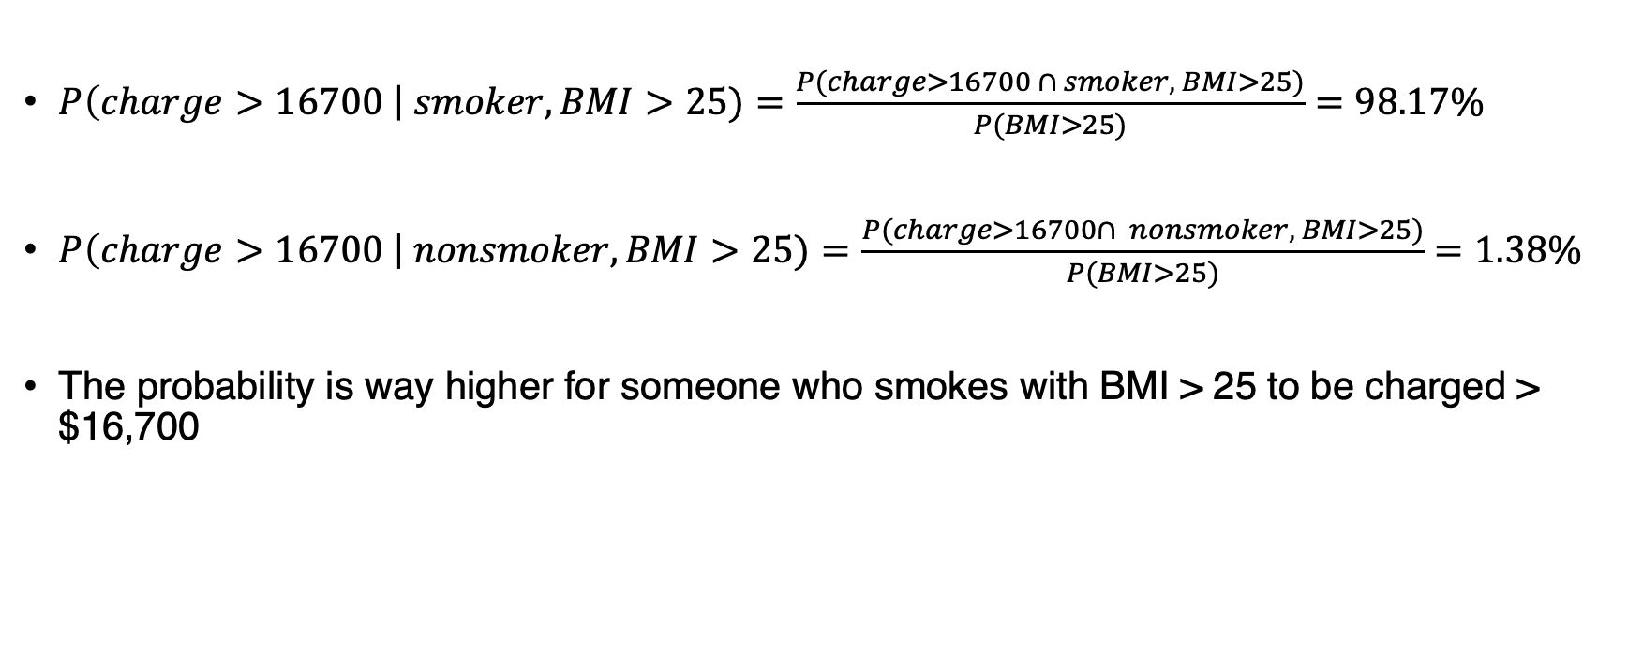
Probability of getting charged above $16,700 and BMI > 25 by smoker status
$P\left(charge>16700 \right| smoker, BMI>25)=\frac{P(charge>16700 ∩ smoker, BMI>25)}{P(BMI>25)}=98.17\%$
$P\left(charge>16700 \right| nonsmoker, BMI>25)=\frac{P(charge>16700∩ nonsmoker, BMI>25)}{P(BMI>25)}=1.38\%$
The probability is way higher for someone who smokes with BMI > 25 to be charged > $16,700

Slide 33
Analysis
People who are obese have a higher chance to be charged highly than those who are underweight
Probability of smokers being charged highly is very high, and it gets higher if their BMI > 25
Probability of being charged highly for people whose BMI > 25 is higher than those who don’t
People who smoke with BMI > 25 have a higher chance to be charged highly

Slide 34
Correlation Variable Analysis

Slide 35
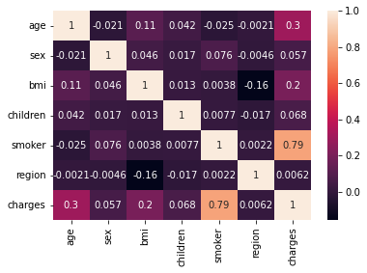
General Correlation
Correlation with charges:
Age, sex, BMI, number of children and region are weakly correlated with charges
One strongly, possitively correlated is whether they are smoker or not

Slide 36
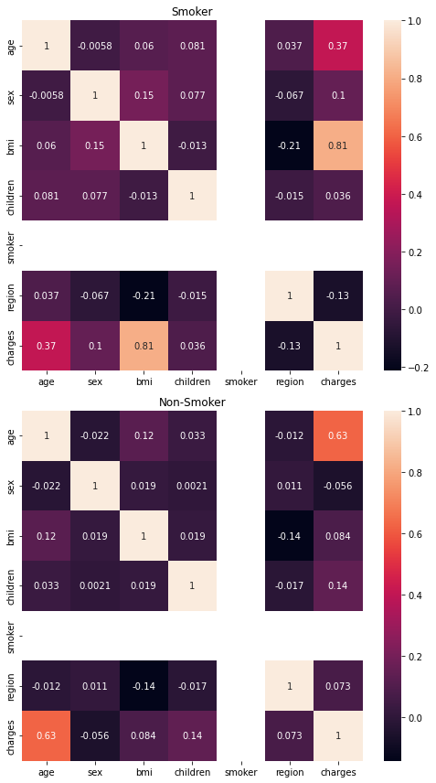
Smoker vs Non-Smoker
Smoker:
Charge is strongly, positively correlated with BMI
Non-smoker:
Charge is moderately, positively correlated with age

Slide 37
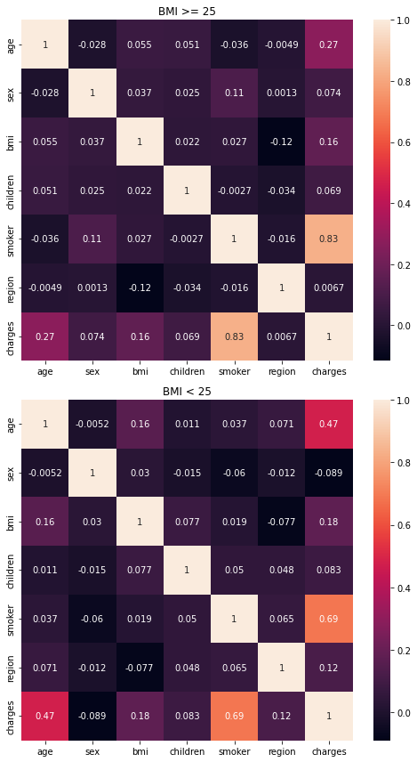
BMI > 25 and BMI < 25
BMI > 25: smoking status strongly correlated with charges
BMI < 25: smoking status only moderately correlated with charges

Slide 38
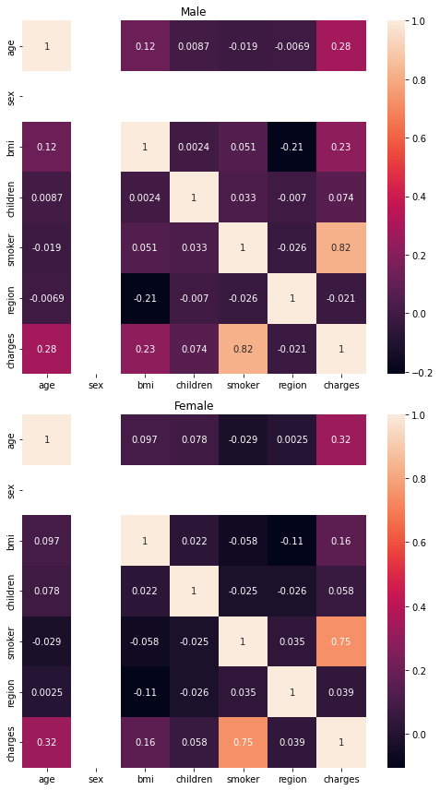
Male vs Female
Male:
Charges is strongly correlated with the smoker status
Female:
Charges is strongly correlated with the smoker status

Slide 39
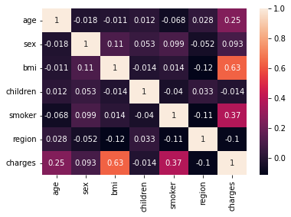
High Charges ( > 16,700)
For the charges above $16,700 can be seen that BMI and the insurance charge are moderately positively correlated

Slide 40
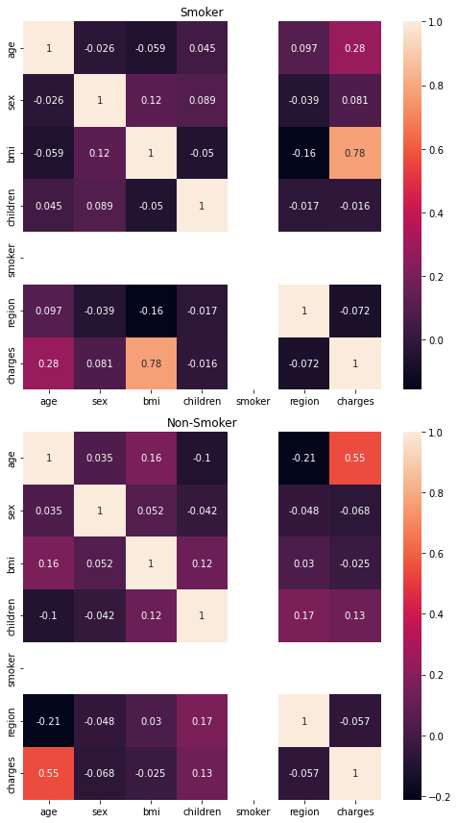
Smoker Status & High Charges
Smoker:
BMI and charges are strongly correlated
Non-smoker:
Age and charges are moderately correlated

Slide 41
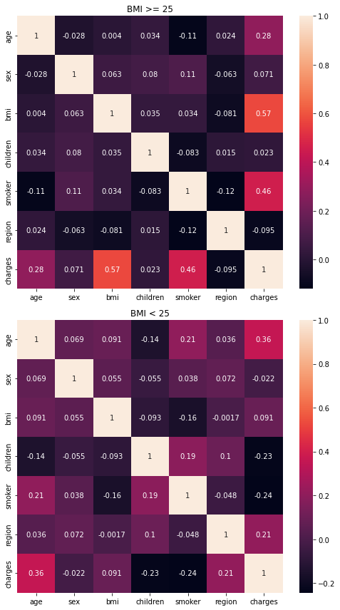
BMI above & below 25, high charges
BMI > 25:
Moderate positive correlation between BMI and charges
Low positive correlation between smoker status and charges
BMI < 25:
Negligible correlation between BMI, smoker status and charges

Slide 42
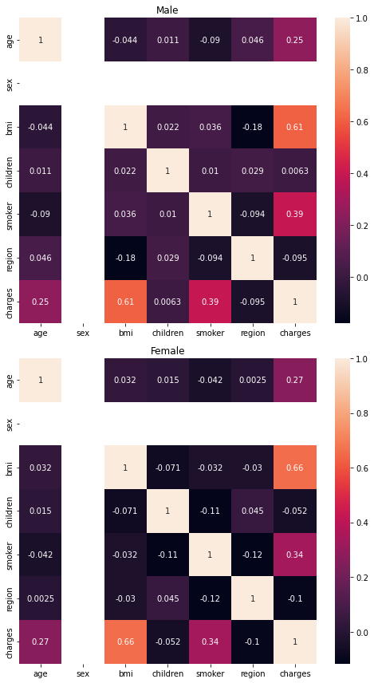
Sex & High Charges
Male:
BMI moderately correlated with charges
Smoker status only slightly correlated with charges
Female:
BMI moderately correlated with the charges, yet it has a higher correlation value than male

Slide 43
Analysis
BMI, smoker status and charge seem to be correlated with each other
Generally only smoker status correlate strongly with the charges
Charges strongly correlated with smoking status: BMI > 25 and for both sex
High charge (> $16,700):
Smokers: BMI & charges

Slide 44
Hypothesis Testing

Slide 45
Is It True: Smokers’ charges higher than non-smokers’?
H₀: Smokers’ charges are lower than non-smokers’.
H₁: Smokers’ charges are higher than non-smokers’.
Using t-test, the result returns p-value of 0.00
Null hypothesis is rejected
The mean of insured users who smoke is higher ($32,050) than those who don’t ($8,434)
There is a significant difference between the insurance charge of smokers and non-smoker

Slide 46
Do people with BMI > 25 really have higher insurance charges than those below it?
H₀: People whose BMI > 25 does not have higher insurance charges than those whose BMI > 25.
H₁: People whose BMI > 25 have higher insurance charges than those whose BMI < 25.
Using t-test, the returned p-value is 0.0001
Null hypothesis is rejected
The mean insurance charges of insured users with BMI > 25 is higher ($13,946) than people with BMI < 25 ($10,284), and with statistically significant difference (p < 0.05)

Slide 47
Insurance Charges of male is higher than female
H₀: Male insurance charges is lower than female.
H₁: Male insurance charges is greater than female.
Using t-test, the returned p-value is 0.0253
Null hypothesis is rejected
The mean insurance charges of insured male users is greater than female users and the difference is statistically significant

Slide 48
Conclusion

Slide 49
Conclusion
3 moderate-strongly correlated variables: smoker status, bmi and charges
3 proven statistically signiificant hypotheses:
Smokers’ charges is higher than non-smokers’
People with BMI > 25 have higher insurance charges than those below it
Insurance charge of male users is higher than female

