Slide 1



Premiere of the UPGRADED
MIDUS-Colectica Portal
This research project is supported by a grant from the National Institute on Aging (R03-AG046312).
NADDI 2016 - Edmonton

Slide 2
Overview of Presentation
Background on MIDUS study design
Description MIDUS use of DDI
Demonstration of Portal’s new functionality
Future challenges and goals

Slide 3


Background on
Baseline: 1995-96
Harvard University
MacArthur Foundation
N=7,108
Ages 25-74
Satellite studies of stress, cognition

Slide 4
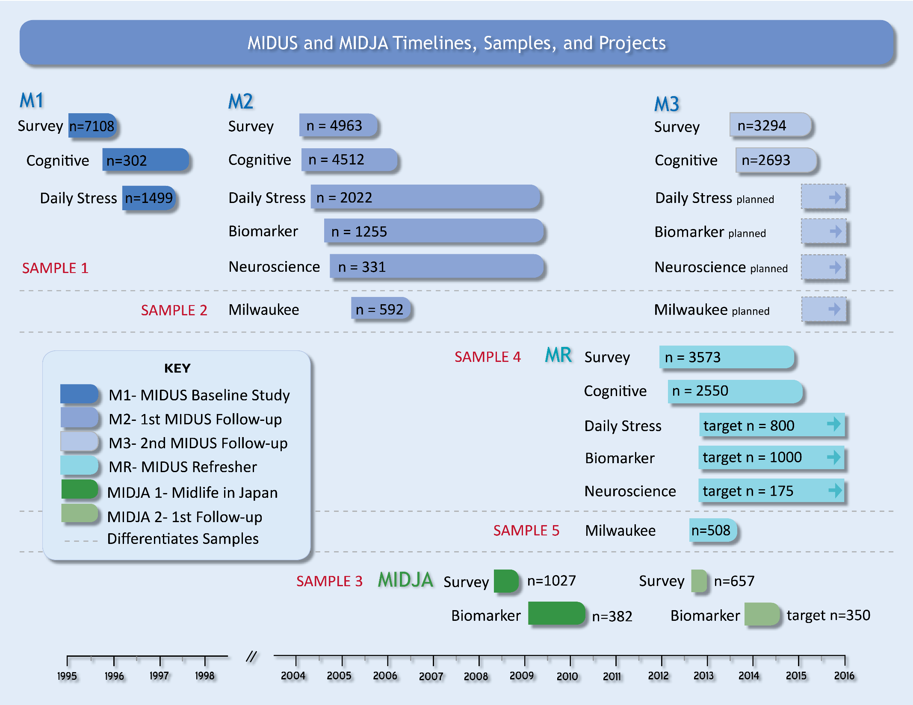

Slide 5
MIDUS Design: Required Details
Multiple waves with 9-10 year interval
Multiple longitudinal samples
Multidisciplinary design
Products:
  N<13,000
  25,000 variables
  20 datasets

Slide 6
MIDUS: Unique Characteristics
Multiple waves with 9-10 year interval
Multiple longitudinal samples
Multidisciplinary design
Many data products
Popular usage of data
  Open Data philosophy
  #1 data download at NACDA
  63k data downloads; 24k users
  700+ publications

Slide 7
MIDUS DDI2 Codebooks
http://midus1-project1.ssc.wisc.edu/
http://midus2-project1.ssc.wisc.edu/
http://midus2-project2.ssc.wisc.edu/
http://midus2-project3.ssc.wisc.edu/
http://midus2-project4.ssc.wisc.edu/
http://midus2-project5.ssc.wisc.edu/
http://midus2-project1.ssc.wisc.edu/milwaukee/
http://midus2-project1.ssc.wisc.edu/midja/

Slide 8
Goals for MIDUS-Colectica Portal
Under a DDI 3.2 rubric, perform…
1. Harmonization (internal, post-hoc)
  Clarify related nature of longitudinal and cross-cohort survey variables
    Concordance tables and RepresentedVariable
  Provide information/procedures for reconciliation
2. Custom Data Extract (CDE)
  Allow researchers to focus on variables of interest
  Facilitate accurate merges across numerous datasets

Slide 9
MIDUS DDI3 Portal
http://midus.colectica.org/
requires login

Slide 10
Future Challenges - MIDUS and DDI
Ongoing improvements
  More information about related variables
    Derived variables (constructed scales)
    Searching via Concept
  Visualization and display
  Funds!
Non-survey Projects
  Create concordance tables across projects
  Better document non-survey data captures

Slide 11
Barry Radler – UW-Madison (bradler@wisc.edu)
Dan Smith – Colectica (dan@colectica.com)
Jeremy Iverson – Colectica (jeremy@colectica.com)
midus.wisc.edu
www.colectica.com

