Slide 1
Community Based Train Locating System (CBTLS)
Final Report
D.N.H Senevirathna- 139180A
Supervised by: Mr. Saminda Premaratne
Faculty of Information Technology
University of Moratuwa

Slide 2
Content
CBTLS - Introduction
Background and Motivation
Aims and Objectives of the CBTLS
Current approaches available
Research Plan
Technologies Adapted
Design Considerations
Future Work

Slide 3
CBTLS - Introduction
A real time train tracking system based on GPS, named Community Based Train Locating System (CBTLS),
For the benefit of train passengers and train transportation of Sri Lanka.
A native Android mobile application and a Web application.
Smart mobile device or a computer would be able to access the system through internet
Only the master data would be inserted into the system initially
Rest of the data required are inserted by the train passengers
Hence the system is community based.

Slide 4
Introduction – Cont.
update the train locations, compartment details, and view current and/or last known locations of a train, view analysis, predictions on train schedules.
a location aware alarm clock
for the use of passengers to indicate when their destination has been reached
analytical component available in web application
to allow a selected set of users to view the patterns of train schedules – to detect occurrences of delays.
location-aware android mobile application
to allow the system to gather information regarding train’s location through passenger.
The location would be gathered through GPS and the Network Location Provider of Android

Slide 5
Background and Motivation
heavy traffic congestion could be observed daily in city areas, especially around and in city of Colombo
valuable man hours and other resources are wasted on roads
School students, University Students, Government and public sector employees, and general public
has become one of the major concerns in country
Possible solutions –
introducing proper alternative methods of transportation
enhancing the efficiency, reliability and quality of currently available public transport systems.
A main mode of currently available public transportation in Sri Lanka – Rail transportation
it is very important to support and enhance railway transportation as an alternative method of transportation

Slide 6
Background and Motivation – Cont.
The common issues could be observed in Sri Lanka train transportation are;
Delay of Trains
Cancellation of trains without prior notification
Train Schedule available for public – not updating frequently
One approach to solve these issues – make train passengers aware of the situation beforehand
Allow to make a better decision on their method and time of transportation
For Railway administration, to collect data on each schedule daily
could be used to analyse the existing issues in the system
the reasons for the train delays,
locations where trains gets delayed
find solutions for them and finally enhance the service.
For passengers, analyzed data could be used
when deciding which train to travel on

Slide 7
Aims and Objectives of the CBTLS
The expected outcome of this research is to provide a comprehensive software application solution - named as Community Based Train Locating System (CBTLS),
For the train passengers in Sri Lanka
To aid for an efficient usage of current train transportation service.
For Railway administration
the collected data on each schedule daily, along the entire route
could be used to analyse the existing issues in the system
the reasons for the train delays,
locations where trains gets delayed
find solutions for them and finally enhance the service.

Slide 8
Aims and Objectives – Cont.
New features of CBTLS, which are not available in current systems
Facility for the passengers to update train’s current location actively or passively
Searching and locating trains in real time
Providing information about the passenger density in each compartment of the selected train
Predicting and suggesting most suitable train to take based on destination, and time of arrival at destination desired by the passenger.
Analysis of data collected over a period on a given train, and indicate more accurate travelling times.
Location based alarm to indicate if the passenger has reached the destination.

Slide 9
Aims and Objectives – Cont.
CBTLS will be an enhancement and combination over the features available in currently available systems for the same purpose.
Facilitate the storage and analysis of historical data related with each train by storing them in a centralized database.
Authorized users are allowed analyze patterns of train travelling daily.
Registered users are allowed to post their comments, criticisms and suggestions regarding a selected train.
Authorized users are allowed to view these comments, criticisms or suggestions by the passengers.

Slide 10
Current approaches available
Currently Available Systems for general public in railway transportation services
eService by The Department of Railways
http://www.eservices.railway.gov.lk/schedule
Drawbacks as observed
only the static schedule data is displayed
Can’t confirm if the train is available or not in real time.
Can’t view train delays.
Can’t locate the trains in real time.
Android Mobile Applications available in the Google Play marketplace
Sri Lanka Train Schedule - https://play.google.com/store/apps/details?id=lk.icta.mobile.apps.railway

Slide 11
Current approaches available – Contd.
Train Schedules of Sri Lanka - https://play.google.com/store/apps/details?id=com.aselalee.trainschedule
Train Guide - Sri Lanka - https://play.google.com/store/apps/details?id=k.dw.timetable
For all above andorid mobile applications, in common, drawbacks as observed;
only the static schedule data is displayed
Can’t confirm if the train is available or not in real time.
Can’t view train delays.
Can’t locate the trains in real time.

Slide 12
Current approaches available – Contd.
GPS based train movement tracking system by Sri Lanka Railway with University of Colombo
http://www.slrail.info/
System Features
Implemented only for Coastal Line,
Current location of the train could be seen on a map.
An enquiry can be placed by providing start position and destination stations.
Only available system to show current location of trains in Sri Lanka to date.
Drawbacks as observed
Implemented only for Coastal Line
Currently the system does not show the live train details
System maintainace is not properly in place as it is observed.

Slide 13
Current approaches available – Contd.
A proposed system - GPS/GSM based train tracking system – utilizing mobile networks to support public transportation
The paper presents a solution to be implemented in Sri Lanka
To provide an intelligent train tracking and management system to improve the existing railway transport service.
Based on combination of following technologies and software
mobile computing,
Global System for Mobile Communication (GSM) - transfers the location information to the central system via GSM
Global Positioning System (GPS) - identifies the train location with a highest accuracy
Geographical Information System (GIS)

Slide 14
Current approaches available – Contd.
Features of the system
Availability of real time train location information allows the Train Controller to take accurate decisions.
Visual positioning using maps granting a wholesome view on train location.
to identify the possible safety issues and react to them effectively
to facilitate accurate scheduling with regard to train arrival and departure on each station.
Drawbacks
Mainly focuses on train administrative staff rather than the passengers
Cost of implementation and infrastructure cost will be large.
This system should be implemented within the railway department itself.

Slide 15
Research Plan
CBTLS consists of a web application and a mobile application
Web application consists of all the mobile application’s functionality and additional administrative functionalities
Web applications host as the backend service for mobile application.
A proper database structure is defined to store data
Master data - available static train schedule details from Sri Lanka Railways
Data received from passengers on each occurrence of this train schedule
The collected data from application will be processed using data mining techniques for prediction/analysis purposes

Slide 16
Technologies Adapted
Mobile application - a native android application
GPS and the Network Location Provider of Android – collect location data
Web application - based on Java EE.
Spring Framework – Security, Web MVC, IOC, REST controllers
Hibernate Framework – ORM
Bootstrap, JQuery, CSS3 – UI
MySQL – database
Weka – Data mining purposes
Google Maps API – for location based services
Web and mobile application communicate through a REST (Representational State Transfer) API (Application Program Interface)

Slide 17
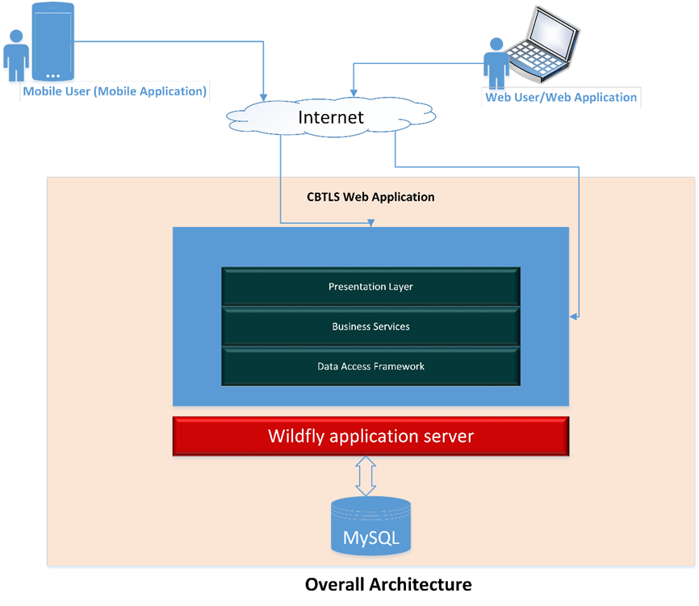
Detailed Software Architecture

Slide 18
Detailed Software Architecture - explained
Component | Description
CBTLS Web application | Used by the general public through web clients and as well as mobile clients
Wildfly Application Server | Application server which hosts the CBTLS Web application
MySQL | Relational database to store CBTLS data
Mobile User/Mobile Application | Native android application which would communicate with the web application
Web user/Web application | Web application as the client itself

Slide 19
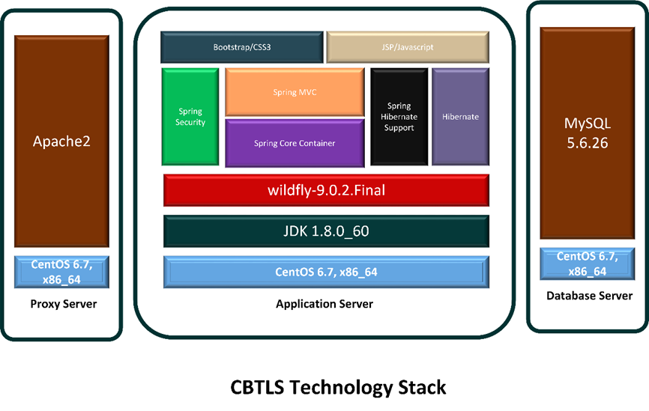
Technology Stack

Slide 20
Component | Description
Proxy Server | The physical server dedicated to handle requests from client and do load balancing, which is crucial in systems like CBTLS
CentOS 6.7,x86_64 | 64 bit CentOS- a linux operating system as the OS in servers
Apache2 | To be used as the proxy server
Application Server | The dedicated physical server/servers to handle application server - WildFly
JDK 1.8.0_60 | Java framework version 8, on top which CBTLS is implemented and will execute,.
Wildfly Application Server | Application server which hosts the CBTLS Web application
Spring security | A component in Spring framework, integrated to CBTLS to handle user authentication related security tasks easily

Slide 21
Component | Description
Spring Core container | Included in CBTLS to handle Inversion of Control and dependency Injection and for the integration of Spring MVC, spring security and spring hibernate support.
Spring MVC | Included in CBTLS to separate presentation layer from business logic, so it will be able to cater both mobile and web clients, or any other client
Spring hibernate support | Used to integrate Hibernate ORM mapping framework into spring context, and also to handle database transactions automatically
Hibernate | Used as an ORM tool and database access
Bootstrap/CSS | To style the UI and maintain consistent look and feel across different browsers
JSP/Javascript/jQuery | To view and modify data from client’s web browser
MySQL | Relational database to store CBTLS data

Slide 22
Design Considerations
UI Considerations
For the web application –
Model View Controller (MVC) Pattern – The Spring MVC
To cater both mobile and web clients using same services
User Language Preference - labels shall support all three languages, linguistic issues.
Internet Browser Support – all the main browsers and their latest versions.
UI framework bootstrap is used.
JQuery based AJAX framework – partially update pages
Segregate Look and Theme – CSS (cascaded style sheet) for storing font, colour, table styles etc.
Mobile application –
support earliest possible android version
Support for standard screen sizes

Slide 23
Design Considerations – Cont.
Data Model Design
The physical data model is done considering MySQL database.
The model has assumed soft deletion of entities compared to hard delete.
Relational database model is selected for the convenient of data analysis using weka
Transaction and rollback
Connections will be fetched from connection pool in Business layer and passed as parameter to DAO layer.
Concurrent access
optimistic locking of database records.
Clustering support
Business classes are stateless and singleton to support session affinity capabilities of the load-balancer.
Logging Facilities
Log4j logging framework is integrated to capture log into file system

Slide 24
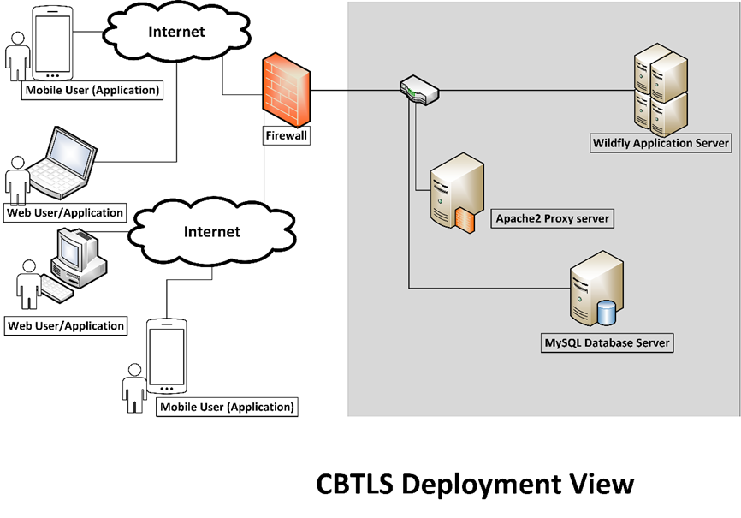

Slide 25
CBTLS Web Application Deployment Diagram
Apache2 – Proxy Server running as the load balancer
Wildfly Application Server – Hosts the CBTLS application
MySQL database – Database service which stores the CBTLS application data.

Slide 26
Future Work – To be implemented
Integrate available components with backend service
Design Andorid Mobile Application Ui s and connect with Web application REST services
Generate data provided by train passengers for simulation
Use weka data classification for prediction of train schedules on generated data

Slide 27
System Demonstration

Slide 28
References - Cont
[1] A. Kumarage, “Urban traffic congestion. the problem and its solutions,” 2002.
[2] A. B. Jayasinghe and N. Pathiranage, “Centrality measures’ as a tool to identify the transist demand at railway stations: the case of railway network, Sri Lanka,” 2015.
[3] “Economic and social infrastructure - Central Bank of Sri Lanka - ANNUAL REPORT 2012,” CENTRAL BANK OF SRI LANKA, ANNUAL REPORT 2012, Mar. 2013.
[4] “Statistics, Ministry of Internal Transport,” Ministry of Transport and Civil Aviation - Sri Lanka, 28-Oct-2015. [Online]. Available: http://www.transport.gov.lk/web/index.php?option=com_content&view=article&id=141&Itemid=113&lang=en. [Accessed: 13-Mar-2016].
[5] G. Bradley, International Association for Development of the Information Society, and Albert-Ludwigs-Universität Freiburg, Eds., Proceedings of the IADIS International Conference ICT, Society and Human Beings 2010: part of the IADIS Multi Conference on Computer Science and Information Systems 2010 ; Freiburg, Germany, July 29 - 31, 2010. Lisboa: IADIS Press, 2010.
[6] S. Rainford, “e-Sri Lanka: An integrated approach to e-government case study,” Reg. Dev. Dialogue, vol. 27, no. 2, pp. 209–218, 2006.
[7] ICTA, “Sri Lanka Railways - Train Schedule,” Sri Lanka Railways, 2011. [Online]. Available: http://eservices.railway.gov.lk/schedule. [Accessed: 13-Mar-2016].
[8] G. Bhashitha Nadun, “Sri Lanka Train Schedule - Android Apps on Google Play,” Google Play, 04-Mar-2014. [Online]. Available: https://play.google.com/store/apps/details?id=lk.icta.mobile.apps.railway. [Accessed: 13-Mar-2016].
[9] Leelaratne, “Train Schedules of Sri Lanka - Android Apps on Google Play,” Google Play, 14-Oct-2014. [Online]. Available: https://play.google.com/store/apps/details?id=com.aselalee.trainschedule. [Accessed: 13-Mar-2016].

Slide 29
References
[10] K. Mobiles, “Train Guide - Sri Lanka,” Google Play, 30-Jul-2014. [Online]. Available: https://play.google.com/store/apps/details?id=k.dw.timetable. [Accessed: 13-Mar-2016].
[11] “Railway Traffic Optimisation System,” Sri Lanka Railways, 01-Aug-2014. [Online]. Available: www.slrail.info/tracking/timetable.php. [Accessed: 22-Nov-2015].
[12] Prasanna, “How to search where the train is in Sri lanka (system to keep track of trains),” Synergy Y, 17-Jul-2014.
[13] D. Jayakody, M. Gunawardana, N. W. Surendra, D. G. Jayasekara, C. Upendra, and R. De Silva, “GPS/GSM based train tracking system – utilizing mobile networks to support public transportation,” 2011.
[14] N. S. Gunasekara, “GPS based tracking system for trains in Sri Lanka.” 07-Jan-2006.
[15] ICTA, “Future Plans - Information Technology,” Sri Lanka Railways, 11-Sep-2011. [Online]. Available: http://www.railway.gov.lk/web/index.php?option=com_content&view=article&id=126&Itemid=180&lang=en#IT. [Accessed: 13-Mar-2016].
[16] B. Coifman, D. Beymer, P. McLauchlan, and J. Malik, “A real-time computer vision system for vehicle tracking and traffic surveillance,” Transp. Res. Part C Emerg. Technol., vol. 6, no. 4, pp. 271–288, 1998.
[17] D. J. Dailey, L. Li, T. Northwest, and others, “Video image processing to create a speed sensor,” Washington State Department of Transportation, 2000.
[18] N. Chadil, A. Russameesawang, and P. Keeratiwintakorn, “Real-time tracking management system using GPS, GPRS and Google earth,” 2008, pp. 393–396.

Slide 30
Thank you!

