Slide 1
Community Based Train Locating System (CBTLS)
Final Report
D.N.H Senevirathna- 139180A
Supervised by: Mr. Saminda Premaratne
Faculty of Information Technology
University of Moratuwa

Slide 2
Content
CBTLS - Introduction
Background and Motivation
Aims and Objectives of the CBTLS
Current approaches available
Research Plan
Technologies Adapted
Design Considerations
Analysis and Design of CBTLS
Implementing CBTLS for real time information
System Evaluation
Conclusion and further work
System Demonstration

Slide 3
CBTLS - Introduction
A real time train tracking system based on GPS, named Community Based Train Locating System (CBTLS),
For the benefit of train passengers and train transportation of Sri Lanka.
A native Android mobile application and a Web application.
Smart mobile device or a computer would be able to access the system through internet
Only the master data would be inserted into the system initially
Rest of the data required are inserted by the train passengers
Hence the system is community based.

Slide 4
Introduction – Cont.
update the train locations, compartment details, and view current and/or last known locations of a train, view analysis on train schedules.
a location aware alarm clock
for the use of passengers to indicate when their destination has been reached
analytical component available in web application
to allow a selected set of users to view the patterns of train schedules – to detect occurrences of delays.
location-aware android mobile application
to allow the system to gather information regarding train’s location through passenger.
The location would be gathered through GPS and the Network Location Provider of Android

Slide 5
Background and Motivation
heavy traffic congestion could be observed daily in city areas, especially around and in city of Colombo
valuable man hours and other resources are wasted on roads
School students, University Students, Government and public sector employees, and general public
has become one of the major concerns in country
Possible solutions –
introducing proper alternative methods of transportation
enhancing the efficiency, reliability and quality of currently available public transport systems.
A main mode of currently available public transportation in Sri Lanka – Rail transportation
it is very important to support and enhance railway transportation as an alternative method of transportation

Slide 6
Background and Motivation – Cont.
The common issues could be observed in Sri Lanka train transportation are;
Delay of Trains
Cancellation of trains without prior notification
Train Schedule available for public – not updating frequently
One approach to solve these issues – make train passengers aware of the situation beforehand
Allow to make a better decision on their method and time of transportation
For Railway administration, to collect data on each schedule daily
could be used to analyse the existing issues in the system
the reasons for the train delays,
locations where trains gets delayed
find solutions for them and finally enhance the service.
For passengers, analyzed data could be used
when deciding which train to travel on

Slide 7
Aims and Objectives of the CBTLS
The expected outcome of this research is to provide a comprehensive software application solution - named as Community Based Train Locating System (CBTLS),
For the train passengers in Sri Lanka
To aid for an efficient usage of current train transportation service.
For Railway administration
the collected data on each schedule daily, along the entire route
could be used to analyse the existing issues in the system
the reasons for the train delays,
locations where trains gets delayed
find solutions for them and finally enhance the service.

Slide 8
Aims and Objectives – Cont.
New features of CBTLS, which are not available in current systems
Facility for the passengers to update train’s current location actively or passively
Searching and locating trains in real time
Providing information about the passenger density in each compartment of the selected train
Analysis of data collected over a period on a given train, and indicate more accurate travelling times.
Location based alarm to indicate if the passenger has reached the destination.
Provide feedback on selected train schedules

Slide 9
Aims and Objectives – Cont.
CBTLS will be an enhancement and combination over the features available in currently available systems for the same purpose.
Facilitate the storage and analysis of historical data related with each train by storing them in a centralized database.
Authorized users are allowed analyze patterns of train travelling daily.
Users are allowed to post their comments, criticisms and suggestions regarding a selected train.
Authorized users are allowed to view these comments, criticisms or suggestions by the passengers.

Slide 10
Current approaches available
Currently Available Systems for general public in railway transportation services
eService by The Department of Railways
http://www.eservices.railway.gov.lk/schedule
Drawbacks as observed
only the static schedule data is displayed
Can’t confirm if the train is available or not in real time.
Can’t view train delays.
Can’t locate the trains in real time.
Android Mobile Applications available in the Google Play marketplace
Sri Lanka Train Schedule - https://play.google.com/store/apps/details?id=lk.icta.mobile.apps.railway

Slide 11
Current approaches available – Contd.
Train Schedules of Sri Lanka - https://play.google.com/store/apps/details?id=com.aselalee.trainschedule
Train Guide - Sri Lanka - https://play.google.com/store/apps/details?id=k.dw.timetable
For all above andorid mobile applications, in common, drawbacks as observed;
only the static schedule data is displayed
Can’t confirm if the train is available or not in real time.
Can’t view train delays.
Can’t locate the trains in real time.

Slide 12
Current approaches available – Contd.
GPS based train movement tracking system by Sri Lanka Railway with University of Colombo
http://www.slrail.info/
System Features
Implemented only for Coastal Line,
Current location of the train could be seen on a map.
An enquiry can be placed by providing start position and destination stations.
Only available system to show current location of trains in Sri Lanka to date.
Drawbacks as observed
Implemented only for Coastal Line
Currently the system does not show the live train details
System maintainace is not properly in place as it is observed.

Slide 13
Current approaches available – Contd.
A proposed system - GPS/GSM based train tracking system – utilizing mobile networks to support public transportation
The paper presents a solution to be implemented in Sri Lanka
To provide an intelligent train tracking and management system to improve the existing railway transport service.
Based on combination of following technologies and software
mobile computing,
Global System for Mobile Communication (GSM) - transfers the location information to the central system via GSM
Global Positioning System (GPS) - identifies the train location with a highest accuracy
Geographical Information System (GIS)

Slide 14
Current approaches available – Contd.
Features of the system
Availability of real time train location information allows the Train Controller to take accurate decisions.
Visual positioning using maps granting a wholesome view on train location.
to identify the possible safety issues and react to them effectively
to facilitate accurate scheduling with regard to train arrival and departure on each station.
Drawbacks
Mainly focuses on train administrative staff rather than the passengers
Cost of implementation and infrastructure cost will be large.
This system should be implemented within the railway department itself.

Slide 15
Research Plan
CBTLS consists of a web application and a mobile application
Web application consists of all the mobile application’s functionality and additional administrative functionalities
Web applications host as the backend service for mobile application.
A proper database structure is defined to store data
Master data - available static train schedule details from Sri Lanka Railways
Data received from passengers on each occurrence of this train schedule
The collected data from application will be processed and analysed.

Slide 16
Technologies Adapted
Mobile application - a native android application
GPS and the Network Location Provider of Android – collect location data
Web application - based on Java EE.
Spring Framework – Security, Web MVC, IOC, REST controllers
Hibernate Framework – ORM
Bootstrap, JQuery, CSS3 – UI
MySQL – database
Weka – Data mining purposes
Google Maps API – for location based services
Web and mobile application communicate through a REST (Representational State Transfer) API (Application Program Interface)

Slide 17
Design Considerations
Usage of MVC pattern
both mobile and web client should be catered using same services, the presentation layer is separated from the business layer.
Integrating localization to the system
to address the difficulties faced by train passengers due to linguistic issues3.3.1.3 Supporting major browsers available
User interface framework like bootstrap, and JavaScript framework like JQuery
to be accessed by a large variety of users - support the main browsers and their latest versions.
Variety of Mobile device support -catering large number of users
Programming considerations
to increase the reusability and maintainability at the code level
in every possible location, design patterns were be used.
already available with the integration of spring and hibernate frameworks.

Slide 18
Design Considerations – Cont.
Data model- done considering MySQL database.
RDBMS (Relational Database management system) used to maintain the relationships of data for the easy analysis later.
Connection Pooling
to cater the simultaneous usage of the system by large number of users.
Database Transaction and rollback handling
transaction layer has been moved to the service layer of the application - ensures no partially committed transactions are available.
Support and Facilitating Concurrent access of database - optimistic locking
Support concurrent accesses in a very high frequency.
Clustering support for scaling up
designed to support clustering, to facilitate scaling up when required.
Logging Facilities for debugging
Log4j logging framework is integrated. Get details of issues and fix the bugs raising after the systems launch.
Security- secured with Spring security framework

Slide 19
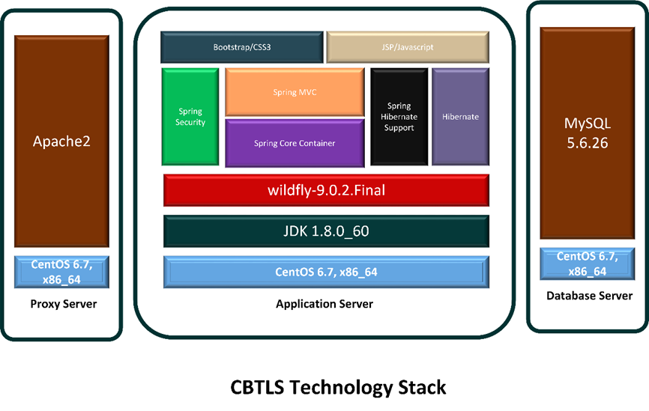
Technology Stack

Slide 20
Analysis and Design of CBTLS
CBTLS consist of a mobile application and a web application.
The web application caters as the backend for the mobile application.
The mobile application connect to the backend system hosted through internet.
In the same way, the web client component of the web application is to be connected to the backend through internet.
the backend of the CBTLS is layered and separated the presentation layer, business layer and the database layer.
to facilitate high flexibility, maintainability, and scalability of the system.
The web application is designed to be hosted in wildly application server, and the system is to connect to MySQL database through data access layer of the application.

Slide 21
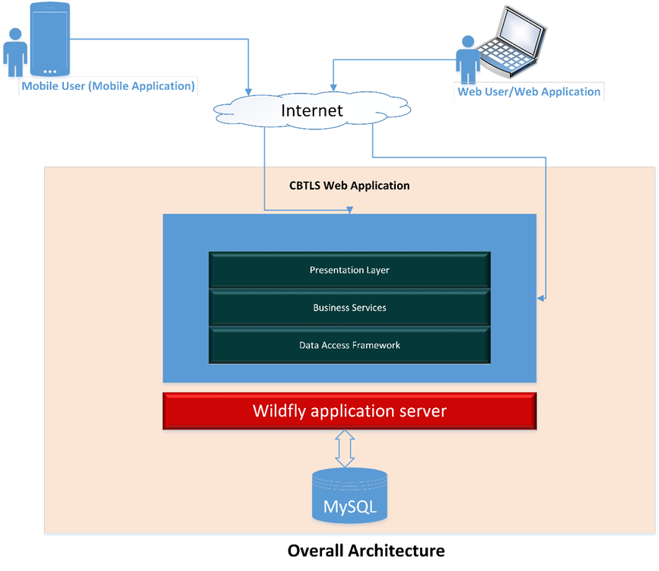
Detailed Software Architecture

Slide 22
Detailed Software Architecture - explained
Component | Description
CBTLS Web application | Used by the general public through web clients and as well as mobile clients
Wildfly Application Server | Application server which hosts the CBTLS Web application
MySQL | Relational database to store CBTLS data
Mobile User/Mobile Application | Native android application which would communicate with the web application
Web user/Web application | Web application as the client itself

Slide 23
Implementing CBTLS for real time information
Implementation Plan for demonstration purpose
Master Data Integration –
A separate module was added to the system to integrate master data in to the system, by accessing the remote web service provided by ICTA
Periodic synchronization (every Sunday at 12 midnight) is enabled to ensure data remains up to date, using scheduled task
User data generation –
Since the system is required to be updated by general public, till the system goes online, data is not available
For the demonstration purposes, data was generated by the system

Slide 24
Implementing CBTLS for real time information
User data generation cont.–
For the demonstration purpose, all train schedules available from Colombo Fort station to Ja-Ela station were selected - 20 available
All the stations in between were taken – 13 stations
The geo coordinates of the stations were taken
The average duration of reaching each station from Colombo Fort Station was taken
Along the rail route, at 6 additional random points, geo coordinates were taken in between each station

Slide 25
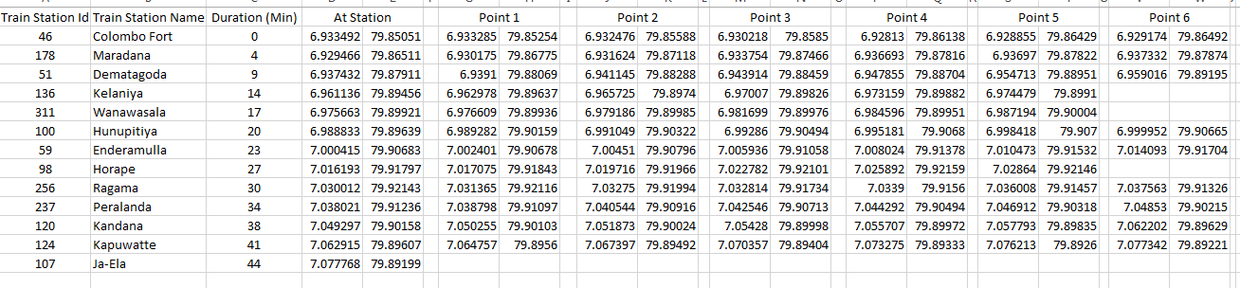
Implementing CBTLS for real time information

Slide 26
Implementing CBTLS for real time information
Using above data, for the 20 train schedules available between Colombo Fort station to Ja-Ela station, system generated data which should be input by user
To generate information – 156 random user accounts were used
Data was generated for period of 2016-03-01 to 2016-04-04
Data was generated as if user actively updated train location, for 20 selected schedules for all the selected points of train route
No of train schedule turns generated :- 700
No of train schedule turn location updates generated :- 58806

Slide 27
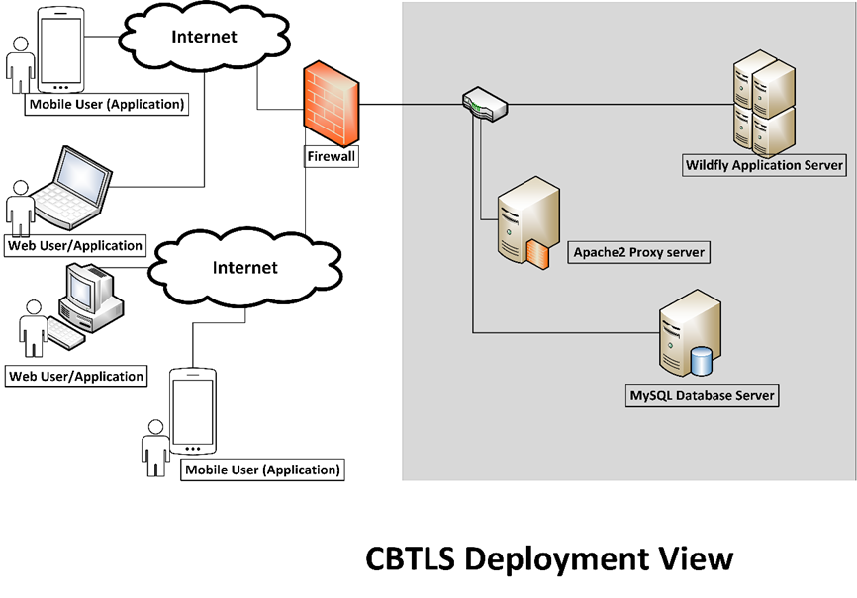

Slide 28
CBTLS Web Application Deployment Diagram
Apache2 – Proxy Server running as the load balancer
Wildfly Application Server – Hosts the CBTLS application
MySQL database – Database service which stores the CBTLS application data.

Slide 29
System Evaluation
The methodology used here is to allow a set of selected users to use and give a feedback on system using a predefined set of question in a questionnaire.
Total number of users who provided their feedback: - 17
For this evaluation purpose, the system was deployed in a local environment.
Since CBTLS consists of a mobile and a web based application, both systems were evaluated separately, using the same set of questions.
The following areas were evaluated in the system evaluation.
Web Application Evaluation
In terms of system functionality (5 questions)
In terms of Usability (5 questions)
In terms of Overall Impression (5 questions)
Mobile Application Evaluation
In terms of system functionality (5 questions)
In terms of Usability (5 questions)
In terms of Overall Impression (5 questions)

Slide 30
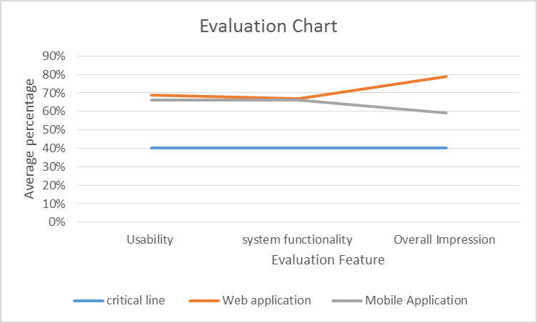
System Evaluation
For each question on system evaluation sections, following evaluation factors were assigned.
1 - Very poor (1), 2 – Poor (3), 3 – Average (6), 4 - Good (8), 5 - Excellent (10)
The critical line = 40%
Figure – Evaluation Chart

Slide 31
Conclusion and further work
This new system will provide the following information to a passenger, regarding a selected train.
Indication if the train is available or not.
The current position of the desired train.
The crowd density in each compartment.
Facility to provide the passenger’s suggestions, comments and criticisms regarding a selected train
A location aware alarm to indicate when the desired destination is reached
Facility to add train schedules in to a “Favorites List” for easy access
Analysis of a train schedule for administrators

Slide 32
Conclusion and further work
The above features would allow passengers
to save the waiting time at the stations for a train.
to select an alternative method of transportation
to use train service without hesitation – alarm clock
To conveniently use train service
analyzed patterns of train transportation can be used to identify the points where delays occur
hence to enhance the service
This can save many productive man hours for the country.

Slide 33
Conclusion and further work
Concerns of CBTLS
Reliability of gathered data - crowdsourced
eliminated by using feedbacks from other users and data validation.
Location awareness of the mobile application for passengers require GPS or Android's Network Location Provider activated in the mobile application.
Both features are power consuming
An active internet connection is required to use this application.
Certain parts of Sri Lanka – still no complete coverage
To cater many simultaneous users, a powerful server infrastructure is required for production deployment

Slide 34
Conclusion and further work
Data collected regarding each train daily by CBTLS would be a new set of data
could be used to generate new knowledge.
For an official implementation for Railway Department,
could be done at a minimal cost - only requirement would be to place a smart mobile device inside the train.
To analyses and study the pattern of train transportation varying with the factor of weather conditions
another dimension could be integrated in to CBTLS as to collect weather information along with train location updates.
For this purpose, a third party service could be easily integrated with the system.

Slide 35
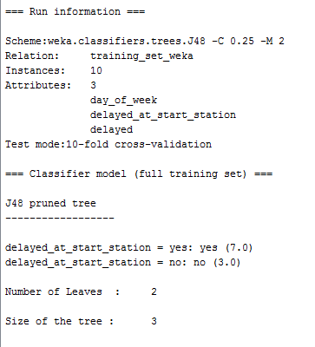
Conclusion and further work
Comments and feedbacks from passengers could be used by some responsible authority to get to know the feedback of general public on their services.
Use WEKA tool for prediction of train schedules
Considering the factors like day of week, if it’s a holiday or not, weather conditions, if it got delayed at start station
Using a decision tree like J48, it would be easy to predict if the train will get delayed

Slide 36
System Demonstration

Slide 37
References - Cont
[1] A. Kumarage, “Urban traffic congestion. the problem and its solutions,” 2002.
[2] A. B. Jayasinghe and N. Pathiranage, “Centrality measures’ as a tool to identify the transist demand at railway stations: the case of railway network, Sri Lanka,” 2015.
[3] “Economic and social infrastructure - Central Bank of Sri Lanka - ANNUAL REPORT 2012,” CENTRAL BANK OF SRI LANKA, ANNUAL REPORT 2012, Mar. 2013.
[4] “Statistics, Ministry of Internal Transport,” Ministry of Transport and Civil Aviation - Sri Lanka, 28-Oct-2015. [Online]. Available: http://www.transport.gov.lk/web/index.php?option=com_content&view=article&id=141&Itemid=113&lang=en. [Accessed: 13-Mar-2016].
[5] G. Bradley, International Association for Development of the Information Society, and Albert-Ludwigs-Universität Freiburg, Eds., Proceedings of the IADIS International Conference ICT, Society and Human Beings 2010: part of the IADIS Multi Conference on Computer Science and Information Systems 2010 ; Freiburg, Germany, July 29 - 31, 2010. Lisboa: IADIS Press, 2010.
[6] S. Rainford, “e-Sri Lanka: An integrated approach to e-government case study,” Reg. Dev. Dialogue, vol. 27, no. 2, pp. 209–218, 2006.
[7] ICTA, “Sri Lanka Railways - Train Schedule,” Sri Lanka Railways, 2011. [Online]. Available: http://eservices.railway.gov.lk/schedule. [Accessed: 13-Mar-2016].
[8] G. Bhashitha Nadun, “Sri Lanka Train Schedule - Android Apps on Google Play,” Google Play, 04-Mar-2014. [Online]. Available: https://play.google.com/store/apps/details?id=lk.icta.mobile.apps.railway. [Accessed: 13-Mar-2016].
[9] Leelaratne, “Train Schedules of Sri Lanka - Android Apps on Google Play,” Google Play, 14-Oct-2014. [Online]. Available: https://play.google.com/store/apps/details?id=com.aselalee.trainschedule. [Accessed: 13-Mar-2016].

Slide 38
References
[10] K. Mobiles, “Train Guide - Sri Lanka,” Google Play, 30-Jul-2014. [Online]. Available: https://play.google.com/store/apps/details?id=k.dw.timetable. [Accessed: 13-Mar-2016].
[11] “Railway Traffic Optimisation System,” Sri Lanka Railways, 01-Aug-2014. [Online]. Available: www.slrail.info/tracking/timetable.php. [Accessed: 22-Nov-2015].
[12] Prasanna, “How to search where the train is in Sri lanka (system to keep track of trains),” Synergy Y, 17-Jul-2014.
[13] D. Jayakody, M. Gunawardana, N. W. Surendra, D. G. Jayasekara, C. Upendra, and R. De Silva, “GPS/GSM based train tracking system – utilizing mobile networks to support public transportation,” 2011.
[14] N. S. Gunasekara, “GPS based tracking system for trains in Sri Lanka.” 07-Jan-2006.
[15] ICTA, “Future Plans - Information Technology,” Sri Lanka Railways, 11-Sep-2011. [Online]. Available: http://www.railway.gov.lk/web/index.php?option=com_content&view=article&id=126&Itemid=180&lang=en#IT. [Accessed: 13-Mar-2016].
[16] B. Coifman, D. Beymer, P. McLauchlan, and J. Malik, “A real-time computer vision system for vehicle tracking and traffic surveillance,” Transp. Res. Part C Emerg. Technol., vol. 6, no. 4, pp. 271–288, 1998.
[17] D. J. Dailey, L. Li, T. Northwest, and others, “Video image processing to create a speed sensor,” Washington State Department of Transportation, 2000.
[18] N. Chadil, A. Russameesawang, and P. Keeratiwintakorn, “Real-time tracking management system using GPS, GPRS and Google earth,” 2008, pp. 393–396.

Slide 39
Thank you!

