Slide 1
Scrum Process Framework
Training Session
2018/05/22

Slide 2
Three Simple Truths
There are three simple truths that, once accepted, dispense with much of the drama and dysfunction we typically see on software projects.
It is impossible to gather all the requirements at the beginning of a project!
Whatever Requirements could be gathered are guaranteed to change!
There will always be more to do than time and money will allow!

Slide 3
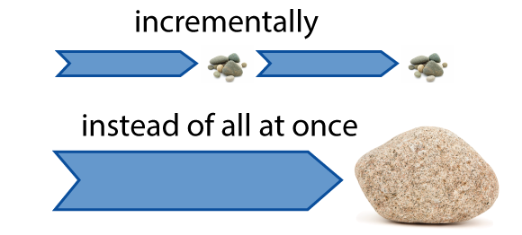
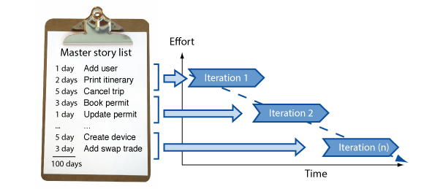
What is Agile
Agile is a time boxed, iterative approach to software delivery
Builds software incrementally from the start of the project
In Agile,
Projects are broken down into components of user functionality - called User Stories
User Stories are prioritized
User Stories are Continuously Delivered in short cycles - called Iterations.

Slide 4
What is Scrum
Scrum and Agile are not the same
It is one of the most popular frameworks for implementing agile methodology
- co-creators Ken Schwaber and Jeff Sutherland
Many frameworks can be used to implement agile. Eg:- kanban
Scrum is an agile way to manage a project, usually software development.
Scrum facilitates
- addressing complex adaptive problems,
- while productively and creatively delivering products,
- of the highest possible value.
Scrum is: Lightweight, Simple to understand, Difficult to master

Slide 5
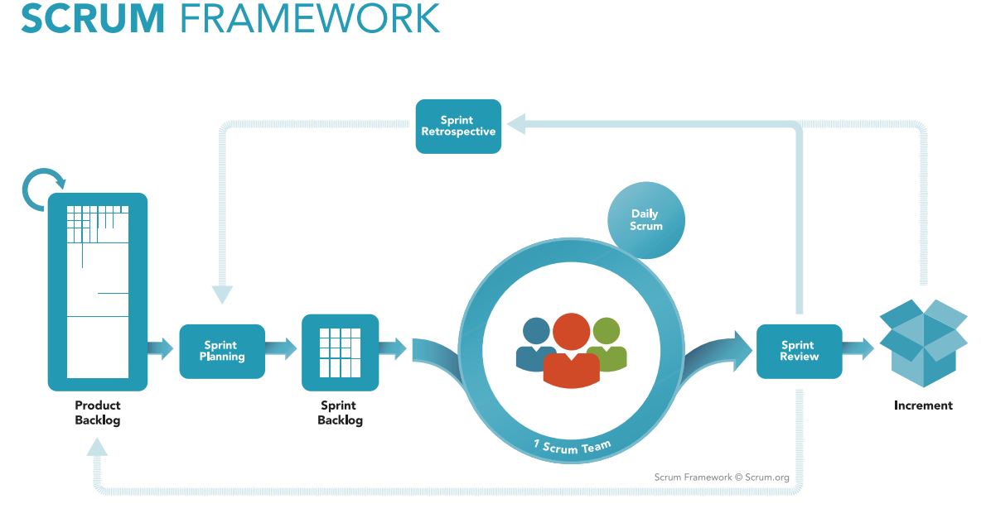

Slide 6
The Scrum framework in action
A product owner creates a prioritized wish list called a product backlog.
During sprint planning, the team pulls a small chunk from the top of that wish list, a sprint backlog, and decides how to implement those pieces.
The team has a certain amount of time — a sprint (usually two to four weeks) — to complete its work, but it meets each day to assess its progress (daily Scrum).
Along the way, the ScrumMaster keeps the team focused on its goal.
At the end of the sprint, the work should be potentially shippable: ready to hand to a customer, put on a store shelf, or show to a stakeholder.
The sprint ends with a sprint review and retrospective.
As the next sprint begins, the team chooses another chunk of the product backlog and begins working again.

Slide 7
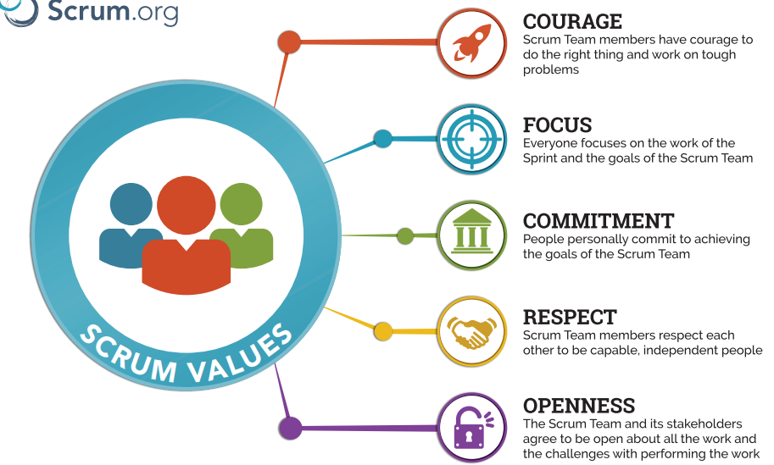
The Scrum Values

Slide 8
Roles of the Scrum Team
Scrum Teams are self-organizing and cross-functional.
Self-organizing teams choose how best to accomplish their work, rather than being directed by others outside the team.
Cross-functional teams have all competencies needed to accomplish the work without depending on others not part of the team
The team model in Scrum is designed to optimize flexibility, creativity, and productivity.
The Scrum Team consists of a
Product Owner,
The Development Team, and a
Scrum Master.

Slide 9
Product Owner
Is the sole person responsible for managing the Product Backlog, which includes:
Build and manage the product backlog
Closely partner with the business and the team to ensure everyone understands the work items in the product backlog
Optimizing the value of the work the Development Team performs.
Ensuring that the Product Backlog is visible, transparent, and clear to all, a
shows what the Scrum Team will work on next.
Decide when to ship the product with the predisposition towards more frequent delivery
The Product Owner is one person, but may represent the desires of a committee.
To succeed, the entire organization must respect his or her decisions.
A product owner is not a project manager, do not manage the status of the program.
.

Slide 10
The scrum master
Acts as a facilitator for the Product Owner and the team.
The Scrum Master does not manage the team.
Works to remove any obstacles that are obstructing the team from achieving its sprint goals.
Helps the team remain creative and productive while making sure its successes are visible to the Product Owner.
The Scrum Master also works to advise the Product Owner about how to maximize ROI for the team.

Slide 11
Four ceremonies of Scrum
Sprint planning:
A team planning meeting that determines what to complete in the coming sprint.
Daily stand-up:
Also known as a daily scrum, a 15-minute mini-meeting for the software team to sync.
Sprint demo:
A sharing meeting where the team shows what they've shipped in that sprint.
Sprint retrospective:
A review of what did and didn't go well with actions to make the next sprint better.

Slide 12
Sprint Planning
Attendees: development team, scrum master, product owner
When: At the beginning of a sprint.
Duration: Usually an hour per week of iteration–e.g. a two-week sprint kicks off with a two-hour planning meeting.
Purpose:
Sprint planning sets up the entire team for success throughout the sprint.
Coming into the meeting, the product owner will have a prioritized product backlog.
They discuss each item with the development team, and the group collectively estimates the effort involved.
The development team will then make a sprint forecast outlining how much work the team can complete from the product backlog.
That body of work then becomes the sprint backlog.

Slide 13
Daily Stand-up
Attendees: development team, scrum master, product owner
When: Once per day, typically in the morning.
Duration: No more than 15 minutes. Don't book a conference room and conduct the stand up sitting down. Standing up helps keep the meeting short!
Purpose: Stand-up is designed to quickly inform everyone of what's going on across the team. It's not a detailed status meeting. The tone should be light and fun, but informative. Have each team member answer the following questions:
What did I complete yesterday?
What will I work on today?
Am I blocked by anything?
There's an implicit accountability in reporting what work you completed yesterday in front of your peers. No one wants to be the team member who is constantly doing the same thing and not making progress.

Slide 14
Iteration review
Attendees: Required: development team, scrum master, product owner
Optional: project stakeholders
When: At the end of a sprint or milestone.
Duration: 30-60 minutes.
Purpose: Iteration review is a time to showcase the work of the team. They can be in a casual format like "demo Fridays", or in a more formal meeting structure. This is the time for the team to celebrate their accomplishments, demonstrate work finished within the iteration, and get immediate feedback from project stakeholders. Remember, work should be fully demonstrable and meet the team's quality bar to be considered complete and ready to showcase in the review.

Slide 15
Retrospective
Attendees: development team, scrum master, product owner
When: At the end of an iteration.
Duration: 60 minutes.
Purpose: Agile is about getting rapid feedback to make the product and development culture better. Retrospectives help the team understand what worked well–and what didn't.
Retrospectives aren't just a time for complaints without action. Use retrospectives to find out what's working so the team can continue to focus on those areas. Also, find out what's not working and use the time to find creative solutions and develop an action plan. Continuous improvement is what sustains and drives development within an agile team, and retrospectives are a key part of that.

Slide 16
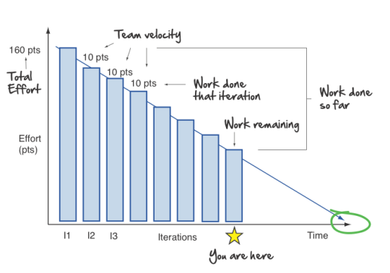
Burndown Charts
A chart that shows how quickly the team is burning through the customer's user stories.
Shows the total effort against the amount of work delivered in each iteration.
The total effort is on the left,
The team velocity on the right.
Other information from this simple graph,
Work done each iteration
Work remaining
Work done so far
When it is expected to be done

Slide 17
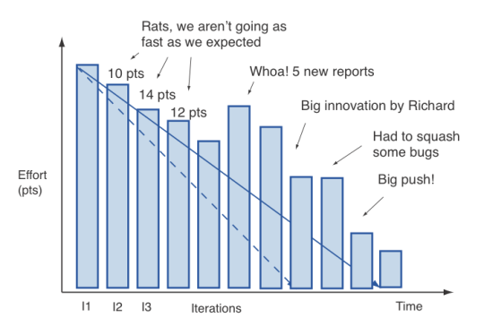
More realistic burndown chart

Slide 18
Reference/Further Readings
https://www.scrum.org/resources/what-is-scrum
http://agilemanifesto.org/
https://www.cprime.com/resources/what-is-agile-what-is-scrum/
http://www.mountaingoatsoftware.com/agile/scrum
https://www.cprime.com/2015/03/5-tips-to-manage-scrum-processes-in-the-real-world/
https://www.scrumguides.org/docs/scrumguide/v2017/2017-Scrum-Guide-US.pdf#zoom=100
https://www.atlassian.com/agile/scrum
http://www.agilenutshell.com/what_is_agile
User Stories:- https://www.youtube.com/watch?v=LvRVnFmLpSA
Estimation :- https://www.youtube.com/watch?v=sCCUEtjCpCs
http://www.agilenutshell.com

