Slide 1
Scrum Process Framework
Training Session
2018/05/22

Slide 2
Three Simple Truths
There are three simple truths that, once accepted, dispense with much of the drama and dysfunction we typically see on software projects.
It is impossible to gather all the requirements at the beginning of a project!
Whatever Requirements could be gathered are guaranteed to change!
There will always be more to do than time and money will allow!

Slide 3
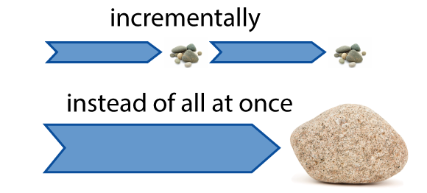
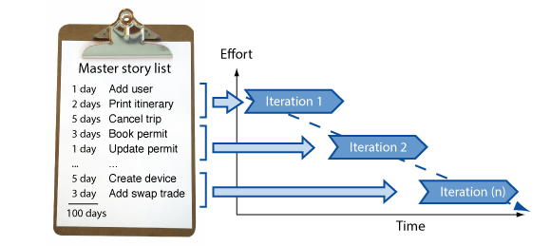
What is Agile
Agile is a time boxed, iterative approach to software delivery
Builds software incrementally from the start of the project
In Agile,
Projects are broken down into components of user functionality - called User Stories
User Stories are prioritized
User Stories are Continuously Delivered in short cycles - called Iterations.

Slide 4
What is Scrum
Scrum and Agile are not the same
It is one of the most popular frameworks for implementing agile methodology
- co-creators Ken Schwaber and Jeff Sutherland
Many frameworks can be used to implement agile. Eg:- kanban
Scrum is an agile way to manage a project, usually software development.
Scrum facilitates
addressing complex adaptive problems,
while productively and creatively delivering products,
of the highest possible value.
Scrum is: Lightweight, Simple to understand, Difficult to master

Slide 5
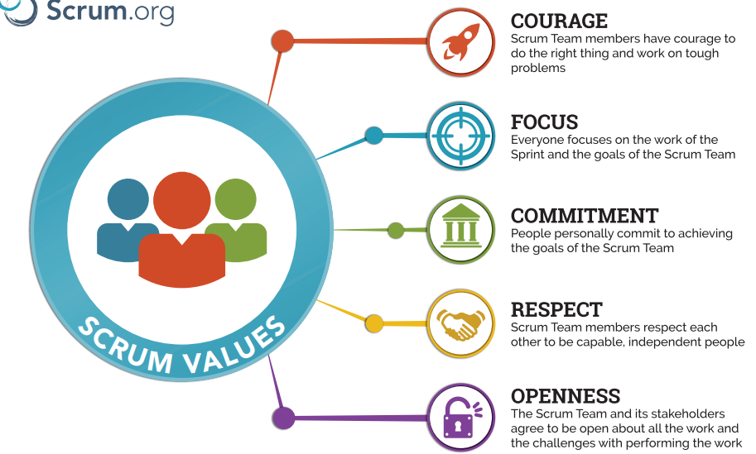
The Scrum Values

Slide 6
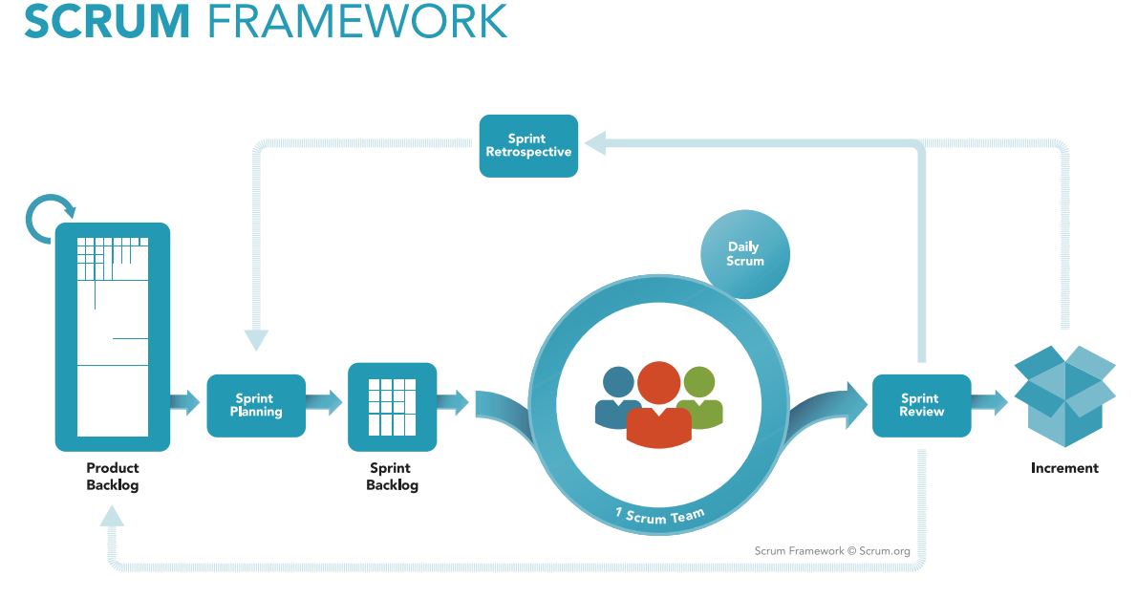

Slide 7
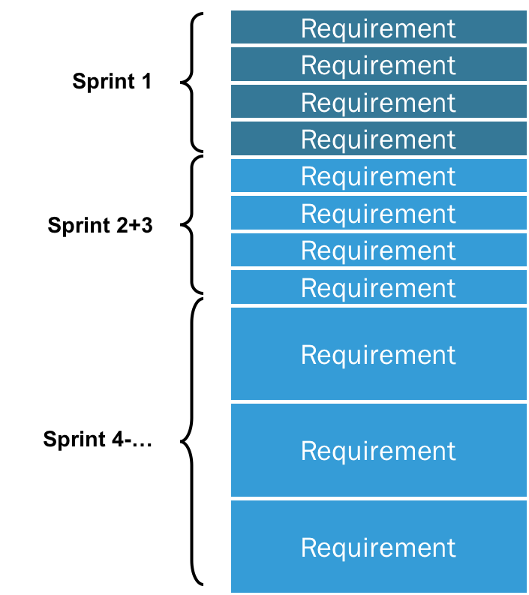
The Scrum Product Backlog
is a prioritized features list,
contains short descriptions of all functionality desired in the product.
user stories have emerged as the best and most popular form of product backlog items
it can be whatever the team desires (eg:- use case)
is allowed to grow and change as more is learned about the product and its customers.
May comprises the following different types of items:
Features
Bugs
Technical work
Knowledge acquisition

Slide 8
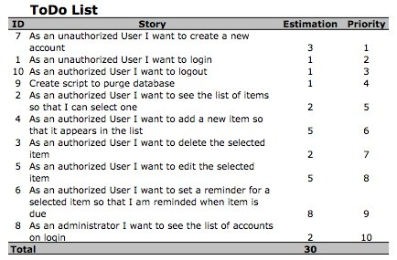
Example Scrum Product Backlog

Slide 9
Sprint Backlog
is a list of tasks identified by the Scrum team to be completed during the Scrum sprint.
During the sprint planning meeting,
the team selects some number of product backlog items,
usually in the form of user stories,
identifies the tasks necessary to complete each user story.
estimate how many hours each task will take someone on the team to complete.
It's critical that the team selects the items and size of the sprint backlog.
they are the people committing to completing the tasks,
they must be the people to choose what they are committing to during the Scrum sprint.
The sprint backlog is commonly maintained as a spreadsheet, but custom software also available

Slide 10
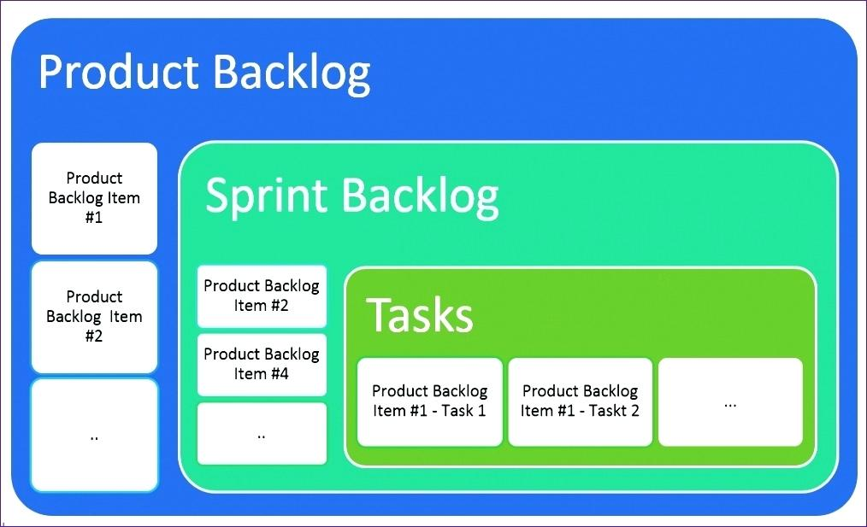

Slide 11
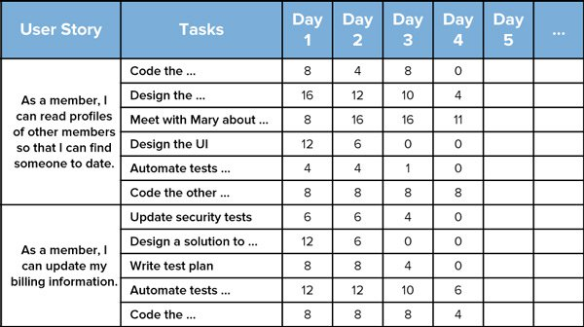
Example Sprint Backlog

Slide 12
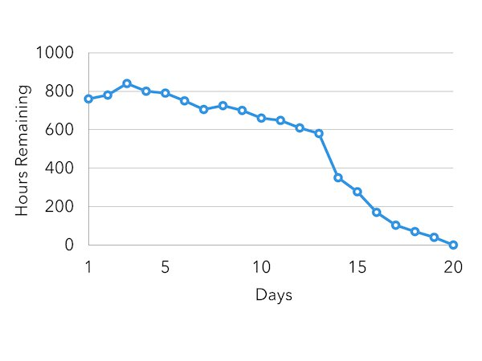
Sprint Backlog cont.
team members are expected to update the sprint backlog as new information is available during sprint,
minimally once per day.
usually teams will do this during the daily scrum.
Once each day, the estimated work remaining in the sprint is calculated and graphed by the ScrumMaster,
resulting in a sprint burndown chart.
The team does its best to pull the right amount of work into the Scrum sprint,
but sometimes too much or too little work is pulled in during planning.
In this case, the team needs to add or remove tasks.

Slide 13
Sprint
Input for sprint :- entries taken from Product Backlog
all activities needed for the implementation of entries are performed within Sprints
also called 'Iterations'
always short: normally about 2-4 weeks.
Each Sprint start with two planning sessions to define the content of the Sprint:
the WHAT-Meeting - Scrum Team commits to the User Stories from the Scrum Product Backlog
the HOW-Meeting - break the committed User Stories into smaller and concrete tasks
The combination of these two meeting are also defined as Sprint Planning Meeting.
Output from Sprint:- Sprint Backlog

Slide 14
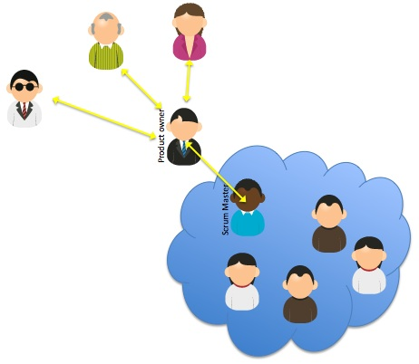
Roles of the Scrum Team
Scrum Teams are self-organizing and cross-functional.
Self-organizing teams choose how best to accomplish their work, rather than being directed by others outside the team.
Cross-functional teams have all competencies needed to accomplish the work without depending on others not part of the team
The team model in Scrum is designed to optimize flexibility, creativity, and productivity.
The Scrum Team consists of a
Product Owner,
The Development Team, and a
Scrum Master.

Slide 15
Product Owner
Is the sole person responsible for managing the Product Backlog, which includes:
Build and manage the product backlog
Closely partner with the business and the team
to ensure everyone understands the work items in the product backlog
Optimizing the value of the work the Development Team performs.
Ensuring that the Product Backlog is visible, transparent, and clear to all, a
shows what the Scrum Team will work on next.
Decide when to ship the product with the predisposition towards more frequent delivery
The Product Owner is one person, but may represent the desires of a committee.
To succeed, the entire organization must respect his or her decisions.
A product owner is not a project manager, do not manage the status of the program.
.

Slide 16
The ScrumMaster
Acts as a facilitator for the Product Owner and the team.
The ScrumMaster does not manage the team, but schedules meetings, runs the daily standups
The ScrumMaster is responsible for:
Helping the team to reach an agreement;
for what can be achieved during a specific period of time.
Helping the team to reach agreement during the daily scrum.
Helping the team to stay focused and follow the agreed-upon rules for daily scrums.
Removing obstacles that are obstructing the team's progress.
Protecting the team from outside distractions.
ensures the entire team works as effectively as possible throughout each sprint.

Slide 17
The Scrum Development Team – “we're all in this together”
Team is a collection of individuals working together to deliver the requested and committed product increments. (preferably 3-9)
Optimal Development Team size is small enough to remain agile and large enough to complete significant work within a Sprint.
Often includes people with traditional software engineering titles such as programmer, designer, tester, or architect.
To work effectively it is important that everyone within the team
follows a common goal
adheres the same norms and rules
shows respect to each other
Everyone on the project works together to complete the set of work they have collectively committed to complete within a sprint, regardless of their official title or preferred job tasks.

Slide 18
Characteristics of Scrum Development Teams
They are self-organizing.
No one (not even the Scrum Master) tells the Development Team how to turn Product Backlog into Increments of potentially releasable functionality;
Development Teams are cross-functional,
with all the skills as a team necessary to create a product Increment;
Scrum recognizes no titles for Development Team members,
regardless of the work being performed by the person;
Scrum recognizes no sub-teams in the Development Team,
regardless of domains that need to be addressed like testing, architecture, operations or business analysis;
Individual Development Team members may have specialized skills and areas of focus, but accountability belongs to the Development Team as a whole.

Slide 19
Four ceremonies of Scrum
Sprint planning:
A team planning meeting that determines what to complete in the coming sprint.
Daily stand-up:
Also known as a daily scrum, a 15-minute mini-meeting for the software team to sync.
Sprint demo:
A sharing meeting where the team shows what they've shipped in that sprint.
Sprint retrospective:
A review of what did and didn't go well with actions to make the next sprint better.

Slide 20
Sprint Planning
Attendees: development team, scrum master, product owner
When: At the beginning of a sprint.
Duration: Usually an hour per week of iteration
e.g. a two-week sprint kicks off with a two-hour planning meeting.
Purpose:
Sprint planning sets up the entire team for success throughout the sprint.
Coming into the meeting, the product owner will have a prioritized product backlog.
They discuss each item with the development team, and the group collectively estimates the effort involved.
The development team will then make a sprint forecast outlining how much work the team can complete from the product backlog.
That body of work then becomes the sprint backlog.

Slide 21
Daily Stand-up
Attendees: development team, scrum master, product owner
When: Once per day, typically in the morning.
Duration: No more than 15 minutes. Don't book a conference room and conduct the stand up sitting down. Standing up helps keep the meeting short!
Purpose: Stand-up is designed to quickly inform everyone of what's going on across the team. It's not a detailed status meeting. The tone should be light and fun, but informative. Have each team member answer the following questions:
What did I complete yesterday?
What will I work on today?
Am I blocked by anything?
There's an implicit accountability in reporting what work you completed yesterday in front of your peers.
No one wants to be the team member who is constantly doing the same thing and not making progress.

Slide 22
Iteration review
Attendees: Required: development team, scrum master, product owner
Optional: project stakeholders
When: At the end of a sprint or milestone.
Duration: 30-60 minutes.
Purpose:
Is a time to showcase the work of the team.
Time for the team
to celebrate their accomplishments,
demonstrate work finished within the iteration,
and get immediate feedback from project stakeholders.
Remember, work should be fully demonstrable and meet the team's quality bar to be considered complete and ready to showcase in the review.

Slide 23
Retrospective
Attendees: development team, scrum master, product owner
When: At the end of an iteration.
Duration: 60 minutes.
Purpose:
Retrospectives help the team understand what worked well–and what didn't.
Retrospectives aren't just a time for complaints without action.
find out what's working so the team can continue to focus on those areas.
find out what's not working and use the time to find creative solutions and develop an action plan.
Continuous improvement is what sustains and drives development within an agile team, and retrospectives are a key part of that.

Slide 24
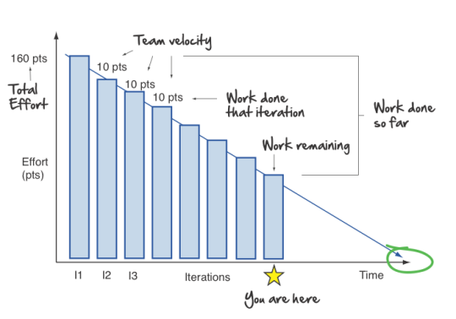
Burndown Charts
A chart that shows how quickly the team is burning through the customer's user stories.
Shows the total effort against the amount of work delivered in each iteration.
The total effort is on the left,
The team velocity on the right.
Other information from this simple graph,
Work done each iteration
Work remaining
Work done so far
When it is expected to be done

Slide 25
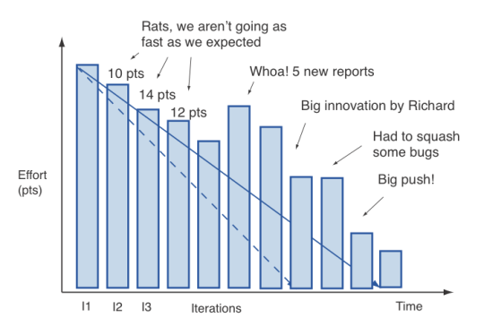
More realistic burndown chart

Slide 26
User Stories
are short, simple descriptions of a feature
told from the perspective of the person who desires the new capability,
usually a user or customer of the system.
They typically follow a simple template:
As a < type of user >, I want < some goal > so that < some reason >.
often written on index cards or sticky notes,
stored in a shoe box,
arranged on walls or tables to facilitate planning and discussion.
they strongly shift the focus from writing about features to discussing them.
these discussions are more important than whatever text is written.

Slide 27
User Stories cont.
they can be written at varying levels of detail.
a user story could be written to cover large amounts of functionality.
generally known as epics.
Example epic agile user story from a desktop backup product;
As a user, I can backup my entire hard drive.
an epic is generally too large for an agile team to complete in one iteration,
it is split into multiple smaller user stories before it is worked on.
The epic above could be split into many, including these two:
As a power user, I can specify files or folders to backup based on file size, date created and date modified.
As a user, I can indicate folders not to backup so that my backup drive isn't filled up with things I don't need saved.

Slide 28
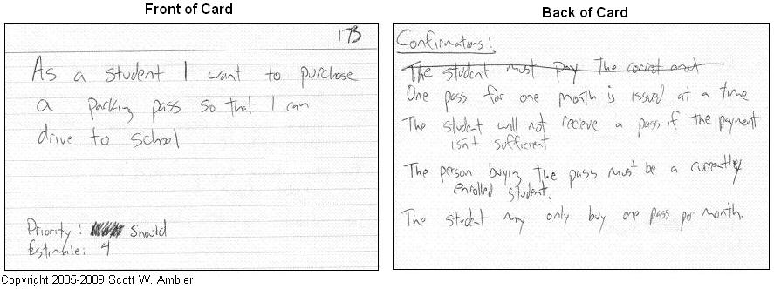

Slide 30
The Scrum framework in action
A product owner creates a prioritized wish list called a product backlog containing user stories.
During sprint planning, the team pulls a small chunk from the top of that wish list, a sprint backlog, and decides how to implement those pieces.
The development team has a certain amount of time — a sprint (usually two to four weeks) — to complete its work, but it meets each day to assess its progress (daily Scrum).
Along the way, the ScrumMaster keeps the team focused on its goal.
At the end of the sprint, the work should be potentially shippable: ready to hand to a customer, put on a store shelf, or show to a stakeholder.
The sprint ends with a sprint review and retrospective.
As the next sprint begins, the team chooses another chunk of the product backlog and begins working again.

Slide 31
5 Tips to Manage Scrum Processes in the Real World
Be Dedicated to the Daily Scrum Meeting
Even if only a few team members are able to attend on any given day, NEVER cancel a daily Scrum meeting.
Once you cancel one, it becomes easier to cancel the next
Enlist a Strong Scrum Master
The Scrum Master (similar to a Project Manager) acts as the day-to-day lead for the team.
Make Scrum and Agile training a high priority
training the team on Scrum and Agile development is key to ensure each member understands how to play a role
Obtain complete buy-in
if the organizational culture does not change to accept and support a full transition to an agile way of working, the transformation will fail.
Record, Report and Rejoice Result
Agile is not just a theory. Its success can be validated. rejoice with the team and celebrate the accomplishments.

Slide 32
Practice Makes Perfect
To successfully manage Scrum processes, there is no substitute for practice.
The more you do it, the better you will become.

Slide 33
Reference/Further Readings
https://www.scrum.org/resources/what-is-scrum
http://agilemanifesto.org/
https://www.cprime.com/resources/what-is-agile-what-is-scrum/
http://www.mountaingoatsoftware.com/agile/scrum
https://www.cprime.com/2015/03/5-tips-to-manage-scrum-processes-in-the-real-world/
https://www.scrumguides.org/docs/scrumguide/v2017/2017-Scrum-Guide-US.pdf#zoom=100
https://www.atlassian.com/agile/scrum
http://www.agilenutshell.com/what_is_agile
User Stories:- https://www.youtube.com/watch?v=LvRVnFmLpSA
Estimation :- https://www.youtube.com/watch?v=sCCUEtjCpCs
http://www.agilenutshell.com
http://www.agilenutshell.com/agile_vs_waterfall

