Slide 1
GMO Environment and Risk Assessments
An evidence-based university course on the environmental risk assessment of genetically modified organisms
Evidence, not advocacy - for BS/MS molecular biology, biotechnology, environmental science, agriculture & biosafety
Instructor: Dr. Saira Azam · Assistant Professor · Centre of Excellence in Molecular Biology · University of the Punjab, Lahore

Slide 2
1 · Introduction
Modules 1-2 - why assess, and the hazard/risk distinction

Slide 3
Why assess GMO environmental risk?
• Traits, organisms and receiving environments differ - no blanket judgments
• Assessment quantifies: what could go wrong, how likely, how serious, how certain
• Informs regulation - but is not itself the decision
• Course motto: Trait + Organism + Environment + Exposure + Evidence + Uncertainty
Key takeaway: Case-by-case is not a slogan - it is the epistemology of the field.
Notes:
Open by contrasting a Bt crop, a vitamin-biofortified crop and a GM microorganism: same word 'GMO', entirely different assessment questions.

Slide 4
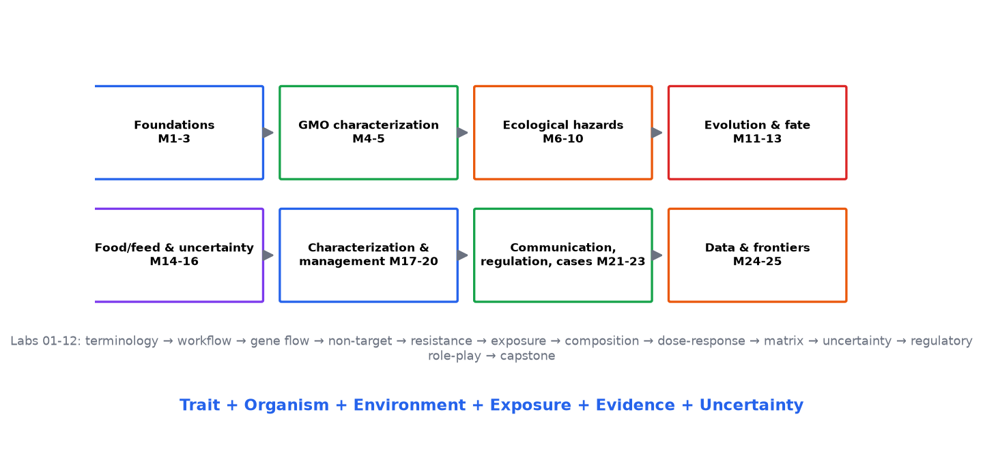
The teaching journey
• Foundations (M1-3): terminology, hazard vs risk, the framework
• Characterization (M4-5): molecular and phenotypic/compositional
• Ecological hazards (M6-10): gene flow, persistence, non-targets, soil, webs
• Evolution & fate (M11-13): resistance, herbicide systems, exposure
• Food/feed & uncertainty (M14-16); characterization & management (M17-20)
• Communication, regulation, cases, data, frontiers (M21-25)
Notes:
Emphasize that labs 01-12 shadow the modules; the capstone synthesizes everything.

Slide 5
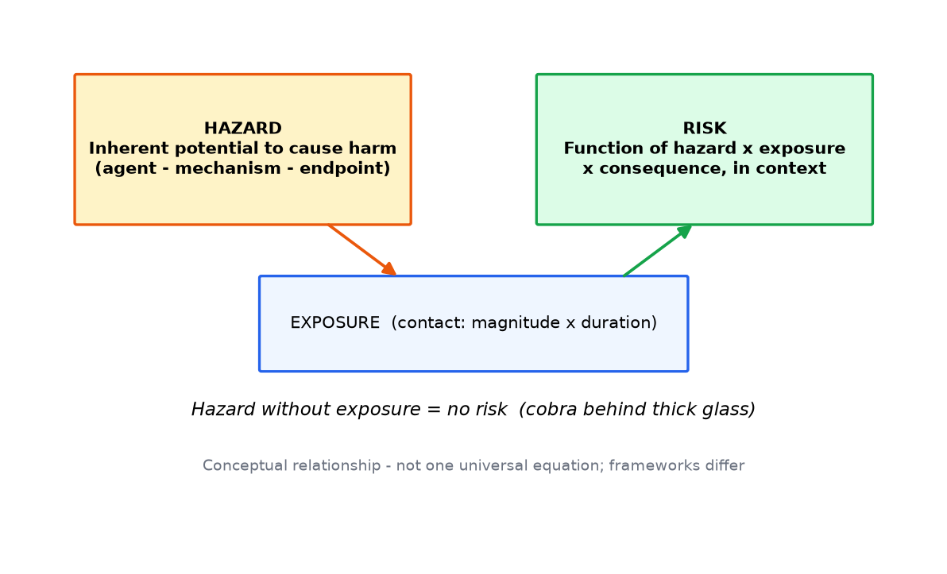
Hazard vs risk - the distinction everything rests on
• Hazard: inherent potential to cause harm (agent-mechanism-endpoint)
• Exposure: contact between hazard and receptor - magnitude x duration
• Risk: hazard + exposure + dose-response + context (conceptual, not one formula)
• Cobra behind thick glass: a hazard at near-zero risk
Key takeaway: Hazard without exposure is not risk - the monarch case will prove this empirically.
Notes:
Drill the three-part hazard statement: agent, mechanism, endpoint. Anything less is not assessable.

Slide 6
2 · Risk fundamentals
Framework stages and their inputs, outputs, limits

Slide 7
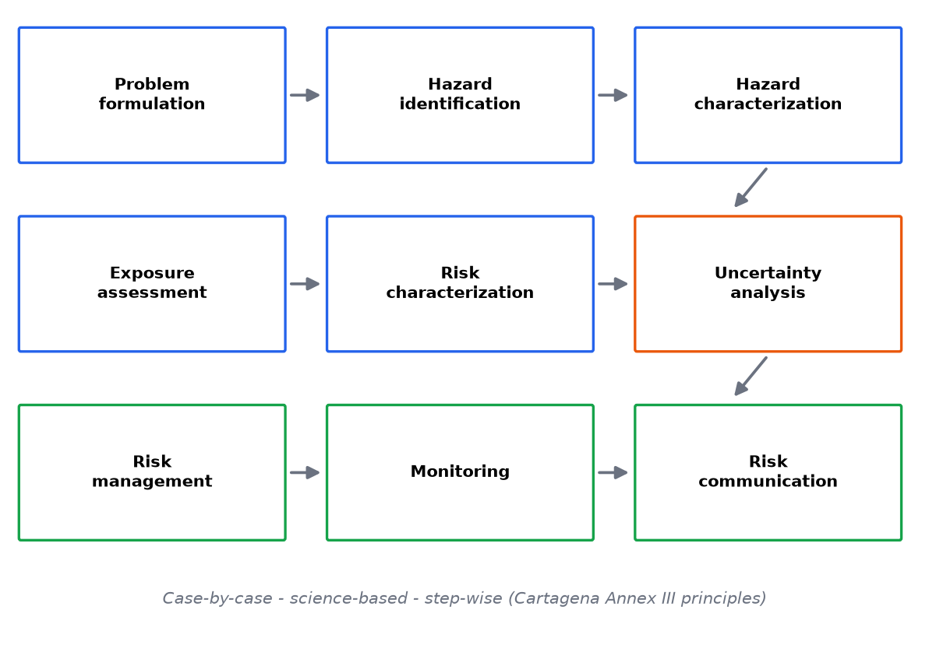
The ERA framework - memorize the spine
• Problem formulation → hazard identification → hazard characterization
• → exposure assessment → risk characterization → uncertainty analysis
• → risk management → monitoring → risk communication
• Cartagena Annex III principles: case-by-case, science-based, step-wise
Key takeaway: Problem formulation defines what 'relevant' means - everything downstream inherits it.
Notes:
For every stage know: inputs, questions, data, methods, outputs, limitations, example.

Slide 8
Problem formulation
• Define protection goals and assessment endpoints
• Specify the receiving environment (species, climate, practices)
• List plausible hazard pathways and analysis plan
• Output: a scoping document that bounds the entire assessment
Key takeaway: Scope determines which evidence counts - set it before data collection.
Notes:
Weak problem formulation is the most common root cause of contested assessments.

Slide 9
Hazard identification vs characterization
• Identification: agent-mechanism-endpoint statements, from construct biology
• Characterization: dose-response, tiers, severity/survival parameters
• Methods: forced-dose lab, semi-field, field - escalation criteria matter
• Every hazard statement must be falsifiable
Key takeaway: If no data could refute it, it is advocacy - not a hazard statement.

Slide 10
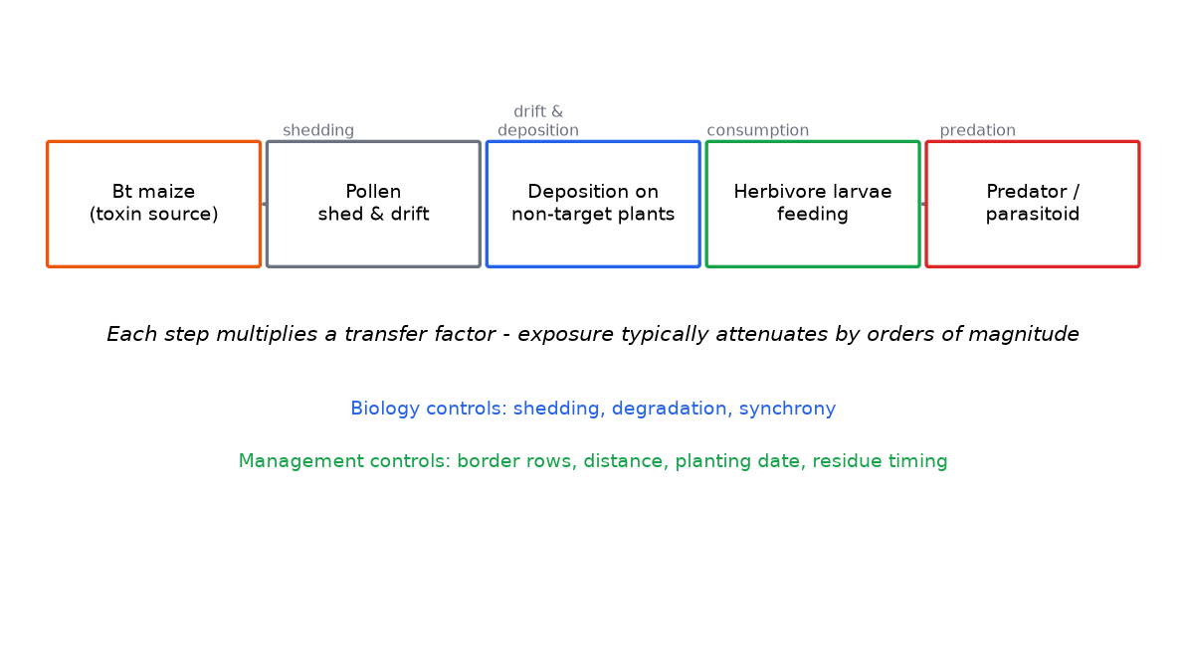
Exposure assessment
• Pathway mapping: source → transfer → attenuation → receptor
• Magnitude and duration at each step; biology vs management controls
• Outputs: receptor doses with uncertainty intervals
• Typical finding: orders-of-magnitude attenuation along the chain
Key takeaway: Exposure is where most 'scary hazard' stories die - and where management intervenes.
Notes:
Walk the five-box chain; each arrow is a transfer factor students compute in Lab 06.

Slide 11
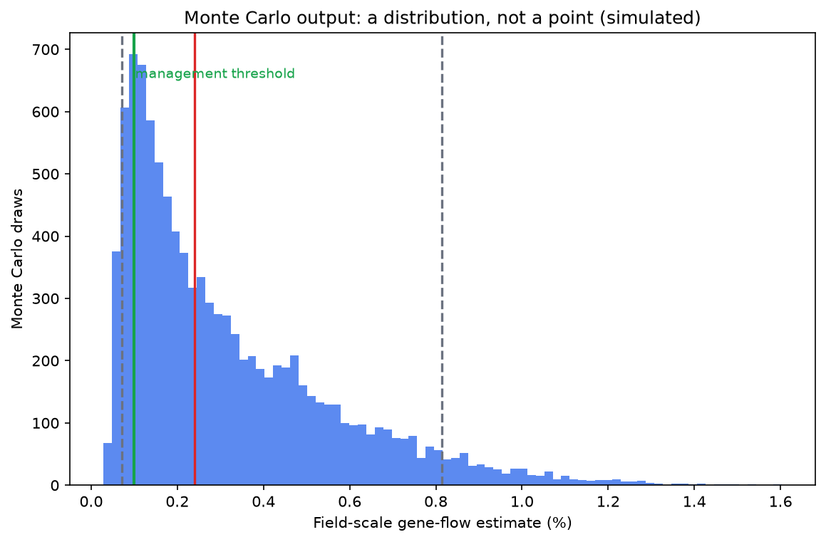
Risk characterization & uncertainty
• Integrate hazard + exposure + dose-response + ecological context
• Qualitative (matrix) and quantitative (Monte Carlo) modes
• Uncertainty types: measurement, model, sampling, extrapolation, variability
• Output: risk statement WITH intervals - never bare adjectives
Key takeaway: 'Safe' and 'unsafe' are not assessment outputs - characterized risk statements are.
Notes:
Preview the Monte Carlo figure: a distribution, not a point. Lab 10 builds exactly this.

Slide 12
Three different jobs
• Assessment: characterize risk and uncertainty - science-led
• Management: accept, mitigate, contain, monitor - policy-laden
• Communication: exchange information with stakeholders
• Conflating them corrupts all three
Key takeaway: Keep the jobs separate and each becomes defensible; merge them and all three become contestable.
Notes:
Use the salmon example: assessors characterize escapement; managers choose containment; communicators explain triple-barrier facilities - three different products.

Slide 13
Exposure has three dimensions
• Magnitude: concentration at the receptor
• Duration: how long contact persists (seasons? decades?)
• Frequency: how often across the landscape
• Different hazards are dominated by different dimensions
Key takeaway: Name which dimension drives your hazard before choosing study designs.
Notes:
Pollen exposure: high-magnitude, short-duration. Soil protein: low-magnitude, long-duration. Gene flow: rare, potentially irreversible. Each demands different data.

Slide 14
Uncertainty is communicated, not hidden
• Intervals over adjectives - quantify, then speak
• Name the dominant driver and what would narrow the interval
• Precaution is a policy response to uncertainty - not a substitute for data
• False certainty is the most expensive communication error
Key takeaway: An honest 'unknown' with a measurement plan beats a confident guess every time.

Slide 15
3 · GMO characterization
Modules 4-5 - molecular and comparative biology

Slide 16
Molecular characterization for ERA
• Construct and insert: copy number, site, integrity, stability
• Expression profile: where, when, how much protein
• Protein identity and mode of action
• Genome-edited organisms: intended edit + potential off-targets
Key takeaway: Molecular data turn 'a GMO' into a specific, assessable object.
Notes:
Links directly to hazard identification: what is expressed, where, how much determines exposure biology.

Slide 17
Phenotypic and compositional comparison
• Near-isogenic comparator + commercial reference ranges
• Proximates, key nutrients, anti-nutrients, toxicants
• Intended differences separated from unintended flags
• Equivalence margins pre-declared - TOST, not bare t-tests
Key takeaway: Substantial equivalence is a starting framework, not a verdict - teach its limits.
Notes:
Preview Lab 07: one analyte among 50 will 'differ' by chance alone - multiplicity discipline.

Slide 18
Biology sets the gene-flow baseline
• Mating system: selfing (soybean) vs outcrossing (maize, OSR)
• Pollen: size, viability window, vector (wind/insect)
• Wild relatives: presence, compatibility, phenology overlap
• OECD biology consensus documents: the standard baseline source
Key takeaway: Read the biology dossier first - the assessment inherits its facts.
Notes:
Crop identity dominates: same trait, different crop = entirely different gene-flow assessment.

Slide 19
Coexistence: crop-to-crop gene flow
• Seed-purity thresholds drive isolation distances
• Volunteers and seed banks extend the problem across seasons
• Machinery hygiene and harvest sequencing
• A management/coexistence question - not automatically ecological harm
Key takeaway: Crop-to-crop flow is quantified and managed routinely - treat it as logistics, not catastrophe.

Slide 20
Gene flow in the local context
• Map compatible relatives before siting trials or releases
• Local flowering calendars decide overlap windows
• Sentinel plants quantify realized flow
• Verify local wild-relative status from national biodiversity sources
Key takeaway: Local ecology turns generic gene-flow theory into a specific, measurable exposure.
Notes:
Encourage students to build local flowering-calendar overlays - it converts an abstract hazard into a testable seasonal window.

Slide 21
4 · Gene flow
Module 6 - the most quantified ecological hazard

Slide 22
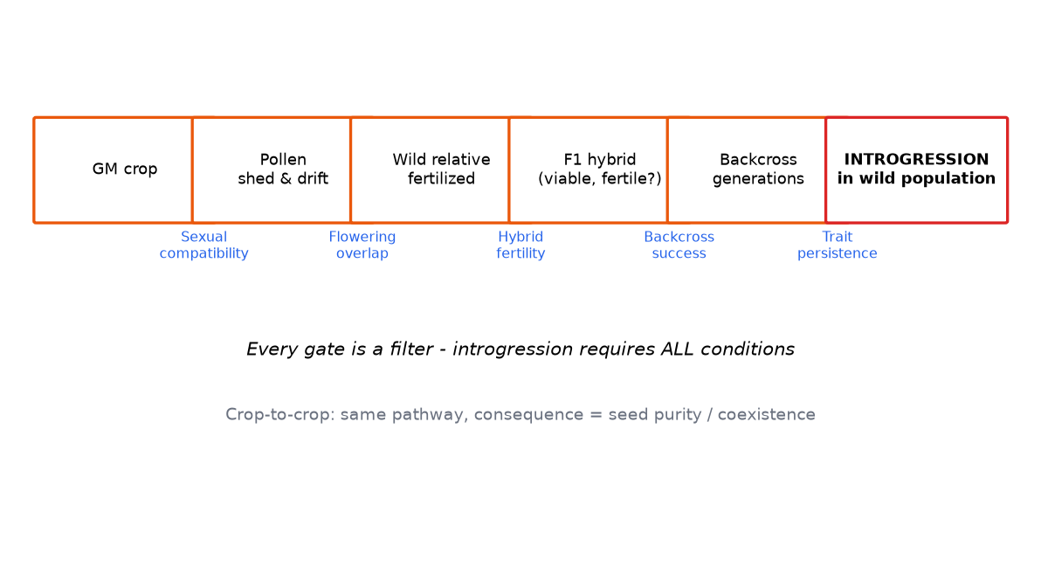
Gene flow: routes and gates
• Pollen (distance-decaying), seed (machinery, spillage), volunteers
• Crop-to-crop = coexistence/seed-purity issue
• Crop-to-wild = ecological issue - requires ALL introgression gates
• Compatibility, overlap, hybrid fertility, backcross persistence
Key takeaway: Crop identity determines the route: oilseed rape vs soybean are different worlds.
Notes:
Each gate is a filter; introgression needs all of them - that is why it is often rare.

Slide 23
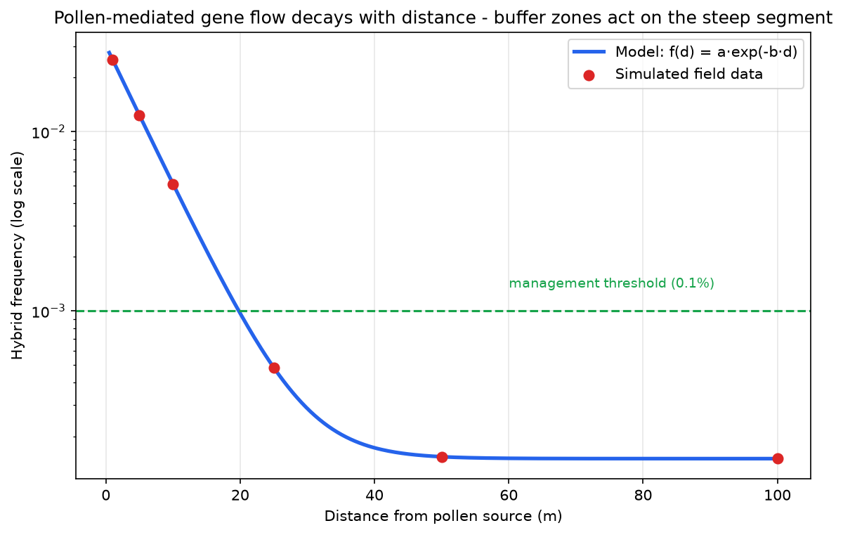
Quantifying gene flow
• f(d) = a·exp(-b·d): edge frequency and decay constant
• Threshold logic: d* = ln(a/threshold)/b
• Buffer zones act on the steep segment - the tail never reaches zero
• Report point-estimate AND upper-confidence distances
Key takeaway: 'Acceptable frequency' is a management judgment informed by the curve - not a detection limit.
Notes:
Lab 03 walks the fit; the management sentence students must produce is threshold-based.

Slide 24
Managing gene flow
• Isolation distances and border rows (dilution)
• Flowering-time management (synchrony gates the whole pathway)
• Machinery hygiene and harvest sequencing (seed route)
• Monitoring sentinels where wild relatives persist
Key takeaway: Every instrument maps to a specific pathway step - name the step.

Slide 25
5 · Persistence, weediness, invasiveness
Module 7 - demography of escaped traits

Slide 26
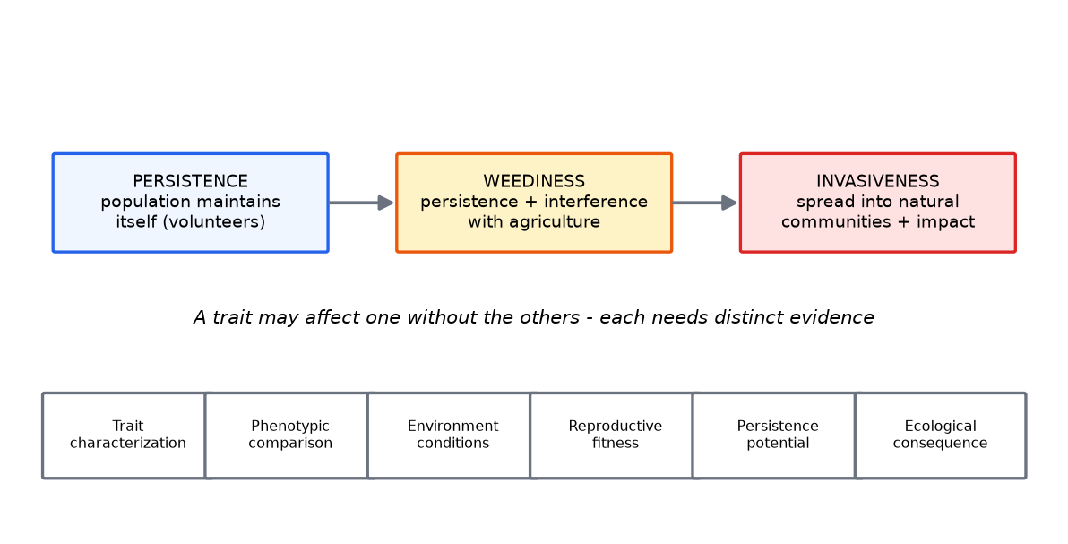
Three different concepts
• Persistence: population maintains itself (volunteers, seed bank)
• Weediness: persistence + interference with agriculture
• Invasiveness: spread into natural communities + ecological impact
• A trait may affect one without the others
Key takeaway: Evidence differs per concept: seed-bank data vs control-cost data vs community-spread data.
Notes:
HT volunteers are typically a management problem, not an invasiveness problem - keep categories clean.

Slide 27
Assessment workflow for persistence
• Trait characterization → phenotypic comparison vs conventional
• Environmental conditions → reproductive fitness components
• Persistence potential → ecological consequence
• Conclude only at the level of evidence gathered
Key takeaway: Fitness is measured in components (survival, fecundity, dormancy) - not asserted.

Slide 28
Volunteer dynamics
• Seed shed at harvest → dormancy → multi-season emergence
• Seed banks: oilseed rape volunteers persist for years
• Management: stale seedbeds, rotations, selective chemistry
• Trait-carrying volunteers narrow options - the practical risk
Key takeaway: Volunteer risk is measured in seed-bank halves and control windows - both measurable.

Slide 29
Invasiveness: the highest bar
• Requires spread BEYOND habitats of origin + ecological impact
• Most GM crops lack the trait portfolio for wildland invasiveness
• Domestication baggage: dependency on managed environments
• Assess per trait: stress tolerance shifts the question
Key takeaway: Invasiveness is not the default assumption - it is a claim requiring its own evidence.
Notes:
Drought-tolerance traits deserve sharper invasiveness scrutiny in water-limited landscapes - trait-specific, not generic.

Slide 30
6 · Non-target organisms
Module 8 - tiered testing and the monarch lesson

Slide 31
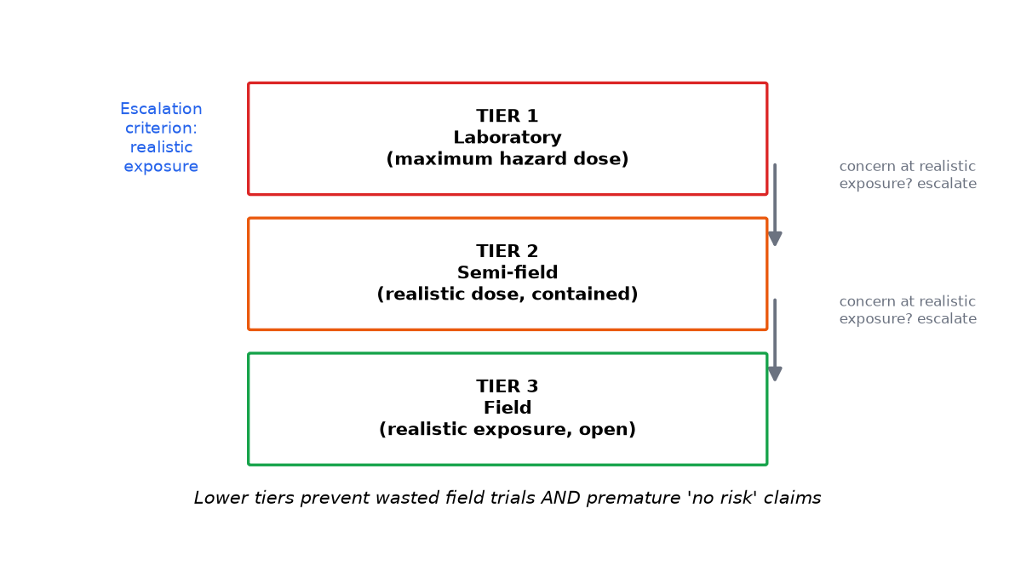
Non-target assessment
• Groups: pollinators, predators, parasitoids, soil fauna, aquatic insects
• Routes: direct (pollen/tissue), tritrophic (via prey), residue
• Tiered testing: lab max-dose → semi-field → field
• Escalation only on concern at REALISTIC exposure
Key takeaway: The escalation criterion - realistic exposure - is the entire logic of the pyramid.
Notes:
Tier 1 is a hazard screen; tiers 2-3 are where risk lives. Lab 04 trains the analysis.

Slide 32
The monarch butterfly case
• 1999: lab note - Bt pollen harms monarch larvae (hazard)
• Multi-group response: pollen densities, per-event toxicity, phenology
• Landscape exposure far below effect doses → negligible risk
• Communication lesson: hazard headlines outrun exposure data
Key takeaway: A hazard finding is the start of assessment, never its end.
Notes:
Perfect for discussing how one laboratory result became a global narrative before exposure analysis existed.

Slide 33
Comparators decide non-target conclusions
• Compare against the regime REPLACED (sprayed conventional)
• Unsprayed isolines inflate apparent Bt harm
• Bt vs sprayed regimes usually favors Bt for natural enemies
• Always state the comparator explicitly
Key takeaway: No comparator, no conclusion.
Notes:
This is the most common analytical bias in public literature - Lab 04 quantifies it.

Slide 34
Design pitfalls in non-target studies
• Pseudoreplication: cages vs fields as the replicate
• Dose without route: forced feeding vs natural exposure
• Single life-stage testing - mismatch with field phenology
• Power: many published studies cannot detect 20% effects
Key takeaway: Study design, not toxin chemistry, explains most literature conflicts.
Notes:
These four pitfalls explain most contradictions between published non-target studies - students can now read that literature critically.

Slide 35
Pollinator assessment specifics
• Adults: pollen/nectar route, foraging ranges, hive-level effects
• Larvae: pollen-provisioned brood - a different window
• Semi-field tunnel studies bridge lab and landscape
• Colony-level endpoints beat single-bee mortality
Key takeaway: Match life stage to exposure route - adult feeding tests cannot see brood effects.

Slide 36
7 · Soil, biodiversity, food webs
Modules 9-10 - community-level assessment

Slide 37
Soil ecosystems
• Exposure: exudates, residues, DNA/protein persistence
• Methods: community profiling, functional assays, decomposition
• Findings: generally small/transient - but study-dependent
• Interpretation: difference → relevance → adverse? chain
Key takeaway: Soil conclusions are the most over-claimed in both directions - discipline required.
Notes:
Natural spatial/temporal variability dominates soil noise; multi-season designs are essential.

Slide 38
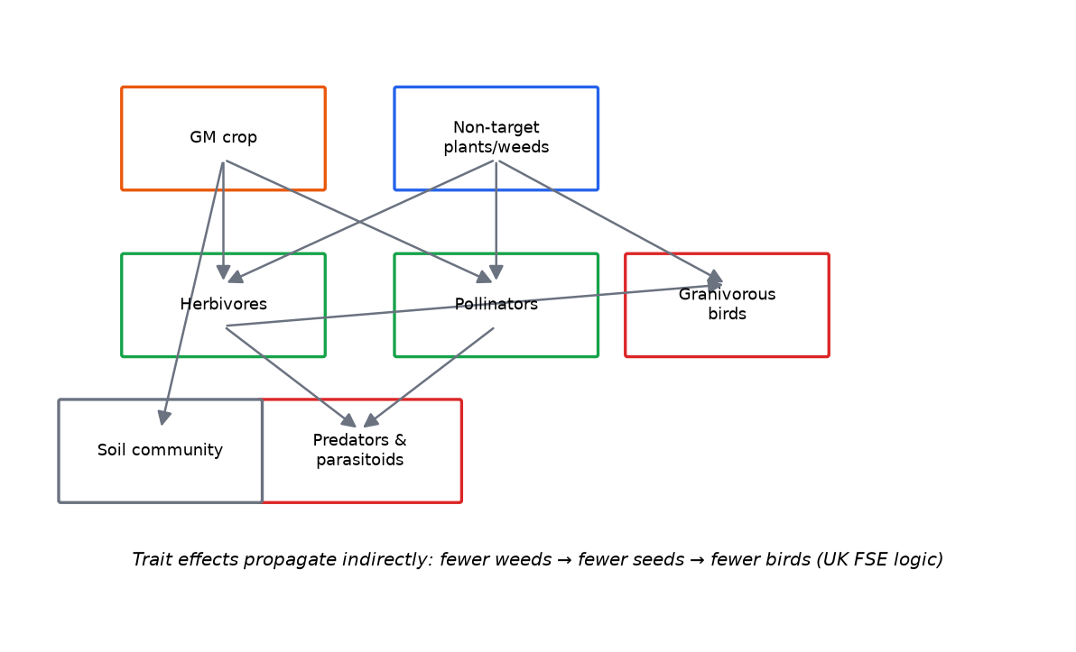
Biodiversity and food webs
• Direct vs indirect (trophic) effects; buffering and amplification
• UK Farm-Scale Evaluations: herbicide REGIME, not trait alone
• Different HT systems produced opposite community outcomes
• Assess management systems - not traits in isolation
Key takeaway: Trait-only thinking misses the actual exposure pathway: the regime.
Notes:
The weed-seed → bird pathway makes indirect effects tangible for students.

Slide 39
Ecosystem services as assessment endpoints
• Pollination, biological control, nutrient cycling, soil fertility
• Services link community ecology to societal protection goals
• Trait effects priced in service terms are policy-relevant
• Endpoint choice declared in problem formulation
Key takeaway: Services convert 'biodiversity' from a slogan into measurable endpoints.
Notes:
Bridging slide: ecosystem-service framing makes the Module 3 protection-goal language concrete.

Slide 40
8 · Resistance evolution
Modules 11-12 - the dominant realized risk

Slide 41
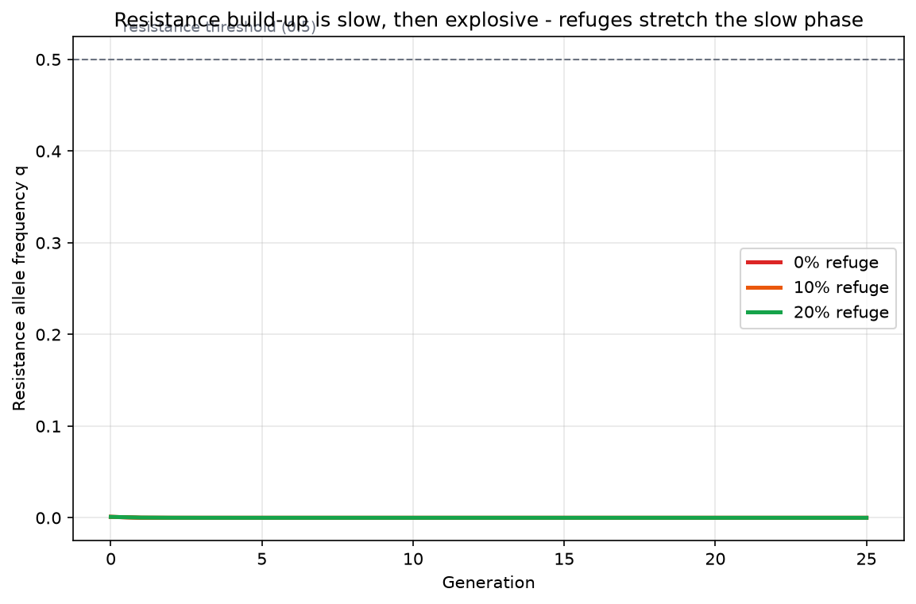
Resistance genetics
• Constant selection from season-long toxin expression
• Rare-recessive dynamics: slow-then-explosive S-curve
• High-dose/refuge: susceptible alleles dilute resistance when rare
• Refuges must produce in-space/in-time susceptible mating
Key takeaway: Refuges work only while resistance is RARE - which is why monitoring is load-bearing.
Notes:
Lab 05 builds this recursion; the refuge effect is dramatic and compliance-dependent.

Slide 42
Resistance management in practice
• Pyramids/stacks: multiple toxins, distinct receptors, no cross-resistance
• Monitoring: diagnostic-dose bioassays, damage reports, F2 screens
• Pre-agreed trigger thresholds → defined responses
• Binding constraint is grower compliance, not laboratory science
Key takeaway: The strategy's weakest link is behavioral - build instruments accordingly.
Notes:
Bt cotton: resistance risk is manageable with effective refuges - the constraint is enforcement.

Slide 43
Herbicide-resistant weeds - the system-level risk
• Selection comes from the herbicide REGIME, not the trait molecule
• Repeated glyphosate selected resistant weed biotypes across the Americas
• Responses: rotations, mixtures, integrated weed management
• Trait-enabled practice → system-level consequence
Key takeaway: Assess the agronomic system the trait enables - that is where selection lives.
Notes:
Avoid the 'superweeds' shorthand - the accurate statement is selection under the management system.

Slide 44
Resistance monitoring in practice
• Diagnostic-dose bioassays: survivors above the discriminating dose
• F2 screens detect rare alleles conventional bioassays miss
• Unexpected-damage reports: the free early-warning system
• Data feed pre-agreed triggers - not annual reports that nobody reads
Key takeaway: Monitoring design determines whether resistance is managed or merely documented.
Notes:
Pink bollworm case: monitoring with pre-agreed triggers enabled region-scale eradication programs.

Slide 45
9 · Environmental fate & exposure
Module 13 - what happens after release

Slide 46
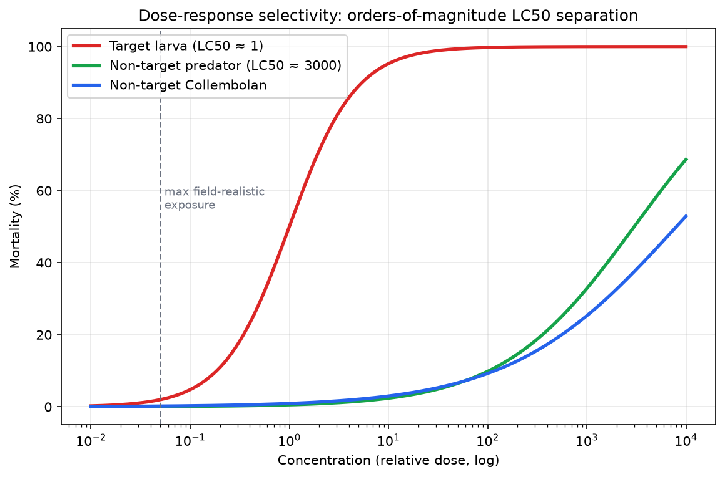
Environmental fate
• Release pathways: pollen, residue, exudates, debris, water
• Degradation (half-lives), transport, persistence
• Protein fate in soil; DNA persistence debates
• Fate parameters feed exposure assessment directly
Key takeaway: Fate + pathway + dose-response = the quantitative tripod of environmental risk.
Notes:
Link to the dose-response figure: fate determines realized exposure against LC50s.

Slide 47
Quantitative exposure logic
• Chain: C_source x transfer factors x attenuation
• Hazard quotient = receptor dose / effect threshold
• HQ << 1 under worst-case assumptions → pathway negligible
• HQ near 1 → measure the dominant parameter better
Key takeaway: An HQ near 1 flags what to measure - not necessarily a risk.
Notes:
Lab 06 computes the full chain; worst-case framing is a screening device, not a field estimate.

Slide 48
Exposure scenarios: central vs conservative
• Central estimate: best-estimate parameters - the likely case
• Conservative: plausible-worst-case - the screening basis
• Worst-case: physically possible - rarely informative alone
• State which scenario every number belongs to
Key takeaway: Scenario discipline is communication discipline - label everything.
Notes:
Mixing scenario types is a classic dossier defect - one table mixing central and worst-case values is unreadable.

Slide 49
10 · Food & feed safety
Modules 14-15 - composition, toxicity, allergenicity

Slide 50
Food/feed safety assessment
• Compositional comparison: analytes vs comparator + reference ranges
• New protein: identity, mode of action, acute toxicity, digestibility
• Feed performance: target-animal studies where warranted
• Intended differences separated; unintended flags followed up
Key takeaway: Composition is one evidence line - necessary, never sufficient alone.
Notes:
Codex principles structure this worldwide; Lab 07 trains the table-reading.

Slide 51
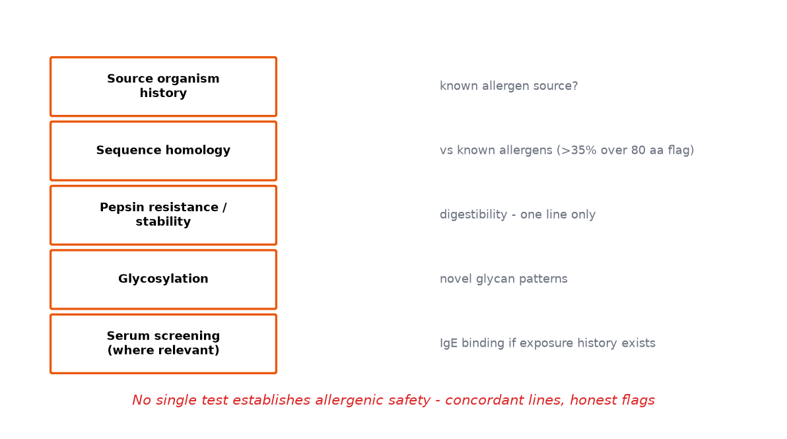
Allergenicity - weight of evidence
• Source-organism history; sequence homology to known allergens
• Pepsin resistance/stability - one line among several
• Glycosylation; serum screening where exposure history exists
• NO single test establishes allergenic safety
Key takeaway: Concordant lines support safety; any flag demands targeted follow-up.
Notes:
StarLink: unresolved allergenicity + feed-only approval + commingling = regulatory failure case.

Slide 52
Toxicity assessment
• Hazard identification: mode of action first
• Acute oral studies; margins of exposure vs realistic intake
• Chronic considerations handled via composition + protein biology
• Do not invent toxicity values - cite and scope honestly
Key takeaway: MOE ratios >> 1 with stated uncertainty - that is the professional output.

Slide 53
Animal feeding studies - role and limits
• Target-animal performance: feed-efficiency endpoint
• 90-day rodent studies: where warranted by molecular/compositional flags
• Sensitivity limits acknowledged in the literature - interpret honestly
• They complement - never replace - composition and protein work
Key takeaway: Feeding studies are one line of evidence with known limits - position them accordingly.
Notes:
The debate over feeding-study sensitivity is itself teachable: what power do these designs actually have for what endpoints?

Slide 54
11 · Unintended effects & uncertainty
Modules 16 - interpretation discipline

Slide 55
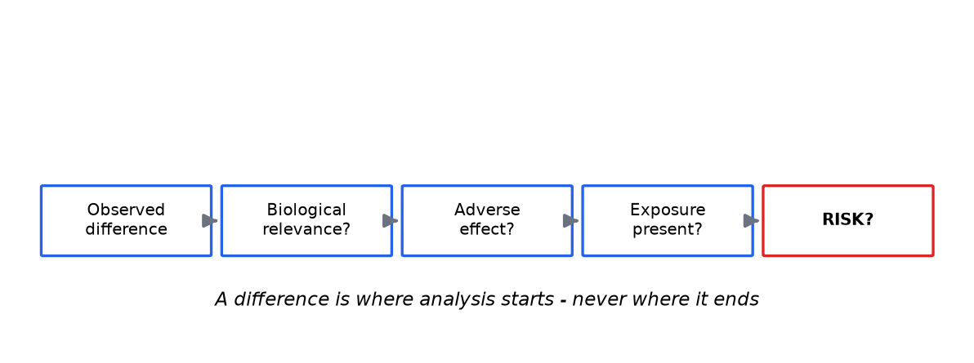
Unintended effects
• Mechanisms: position effects, pleiotropy, insertional variation
• Detection via molecular + phenotypic + compositional screening
• Difference ≠ automatically harm - run the chain
• Environmental interaction can reveal latent phenotypes
Key takeaway: A difference is where analysis starts - never where it ends.
Notes:
The chain: difference → relevance → adverse? → exposure? → risk? - course interpretive core.

Slide 56
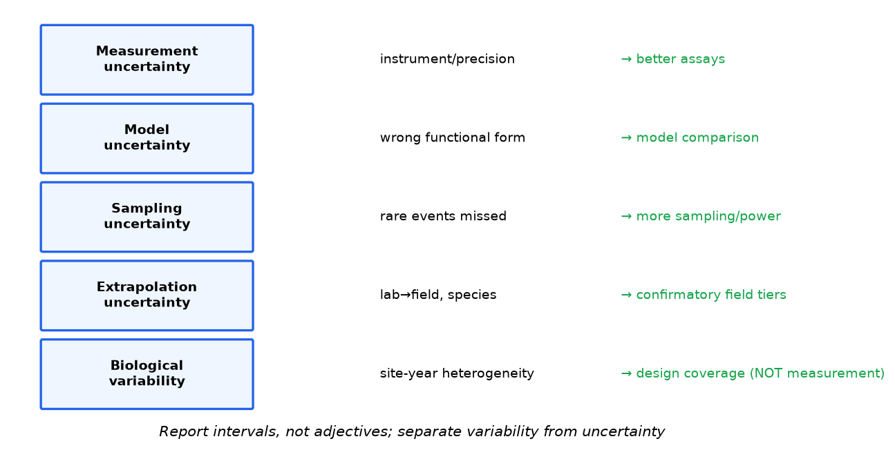
Uncertainty - taxonomy and treatment
• Measurement, model, sampling, extrapolation, biological variability
• Quantify: CIs, Monte Carlo, model comparison
• Separate variability (design) from uncertainty (measurement)
• Sensitivity ranking → what to measure next
Key takeaway: Uncertainty is quantified and carried - never hidden, never used as an excuse to stop deciding.
Notes:
Lab 10 converts 'we are uncertain' into a measurement campaign - the practical payoff.

Slide 57
The uncertainty matrix
• Rows: key parameters; columns: type, impact, trend, response
• Impact = effect on the risk statement, not on the parameter
• Trend: more data will narrow / will not narrow this
• Response: measure better, manage conservatively, or accept and monitor
Key takeaway: An uncertainty matrix converts hedging into a decision table.
Notes:
The matrix is the regulatory-summary format for Module 16 - students produce one in Lab 10.

Slide 58
12 · Risk characterization & management
Modules 17-18 - integration into decisions

Slide 59
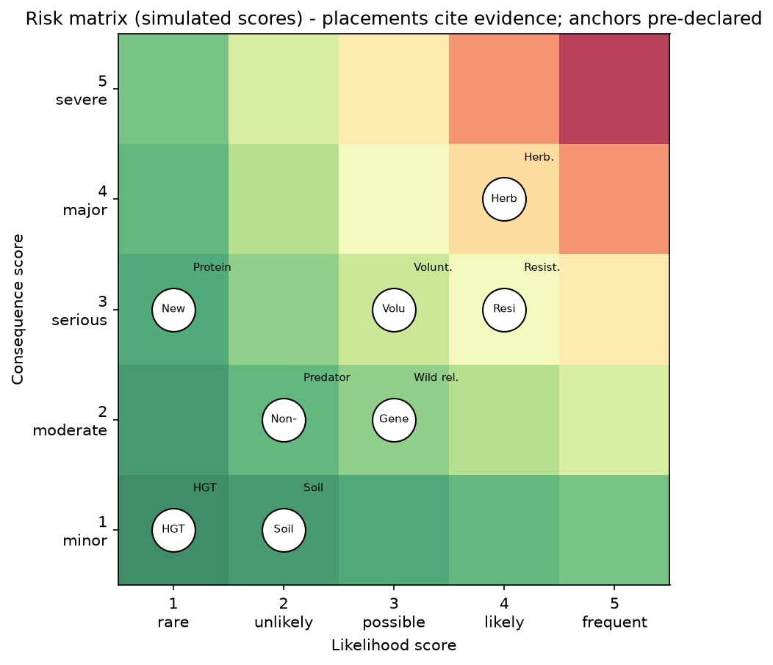
Risk characterization
• Integrate: hazard + exposure + dose-response + context + uncertainty
• Qualitative: matrices with PRE-DECLARED anchors
• Quantitative: distributions, exceedance probabilities
• Statement format: estimate + interval + driver + response options
Key takeaway: The matrix is presentation; the assessment is the reasoning behind each placement.
Notes:
Lab 09: placements cite evidence; cross-group divergence traces to anchors, not logic.

Slide 60
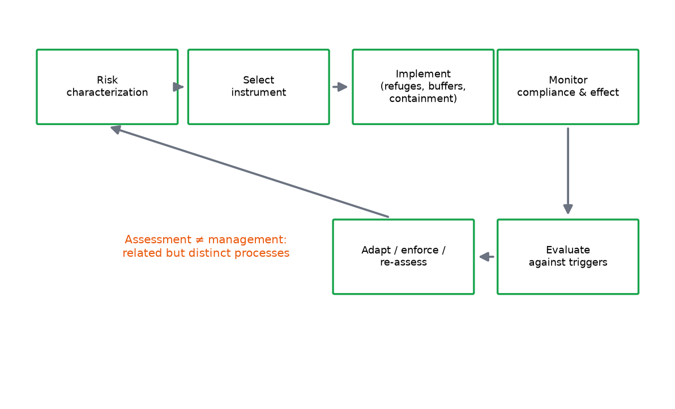
Risk management instruments
• Avoidance/containment (exposure engineered away - GM salmon logic)
• Mitigation: refuges, rotations, mixtures, buffer zones
• Stewardship programs with compliance enforcement
• Every characterized risk needs an instrument and an owner
Key takeaway: A top-ranked risk without an instrument is an unmanaged risk - say so in the report.
Notes:
Assessment and management are related but distinct - Lab 11 role-play enforces the boundary.

Slide 61
Instruments matched to characterized risks
• Resistance → refuges + monitoring triggers + stewardship
• Gene flow → isolation, borders, timing, hygiene
• Volunteers → rotation design, alternative chemistry
• Unanticipated effects → PMEM with response owners
Key takeaway: Match instrument to mechanism - generic conditions are compliance theater.
Notes:
The mapping table is the core of Module 18; students reproduce it for their capstone GMO.

Slide 62
13 · Monitoring
Modules 19-20 - adaptive management in practice

Slide 63
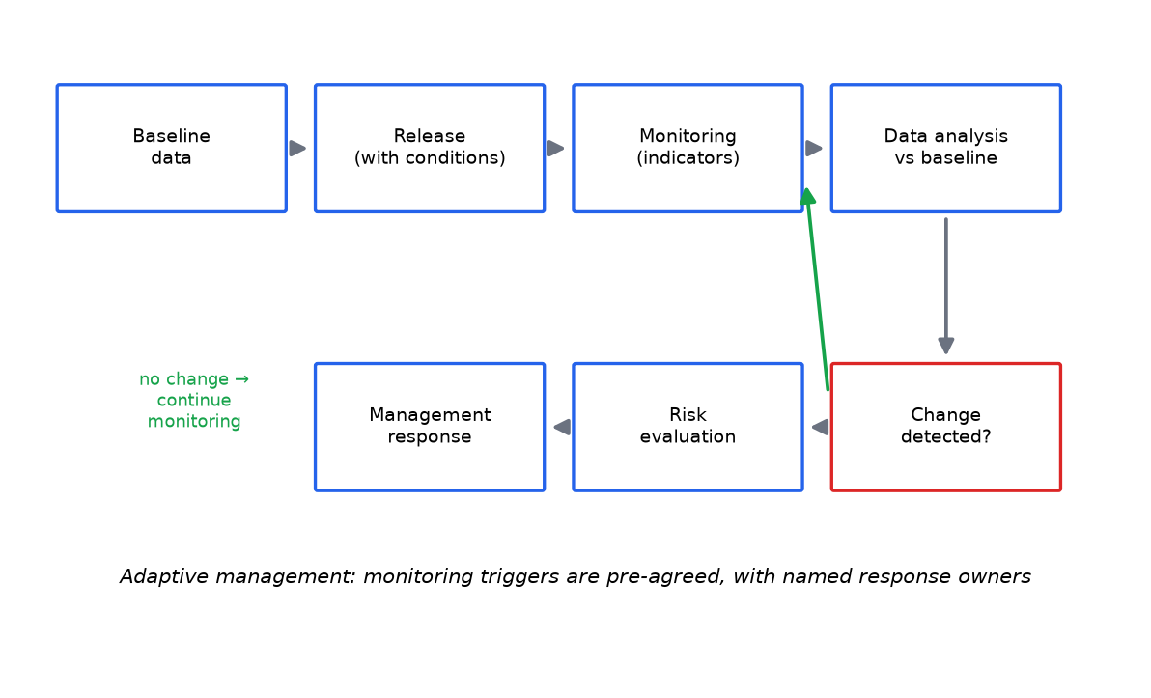
Environmental monitoring
• Baseline data pre-release - the non-negotiable
• Indicators: resistance frequencies, gene-flow sentinels, non-targets
• Pre-agreed trigger thresholds with named response owners
• Adaptive management: monitor → evaluate → adjust
Key takeaway: Monitoring without triggers is decoration; with triggers it is control.
Notes:
Pink bollworm case: monitoring with triggers enabled eradication - monitoring as active management.

Slide 64
Baselines: the non-negotiable
• Pre-release reference data across representative sites and seasons
• Power matched to the trigger thresholds agreed later
• Without baselines, monitoring cannot attribute change
• The weakest link of post-market systems worldwide
Key takeaway: Monitoring design is decided BEFORE release - retrofitting baselines is impossible.
Notes:
Ask students: what would you sample for two years before a Bt chickpea release in Punjab? Indicators become concrete instantly.

Slide 65
Post-market environmental monitoring (PMEM)
• Case-specific monitoring: ERA-identified hazards
• General surveillance: broad, unanticipated-effect watch
• Reporting obligations; time-limited authorizations in some systems
• Weak link worldwide: maintained long-term baselines
Key takeaway: Detecting slow change needs decades of baselines - the honest global gap.

Slide 66
14 · Risk communication
Module 21 - the discipline of honest framing

Slide 67
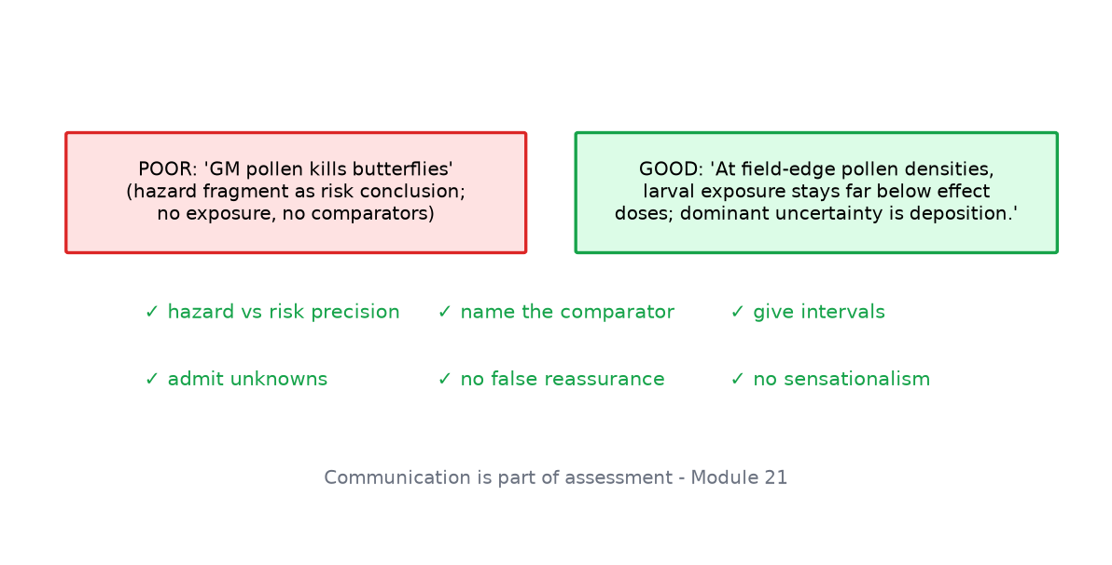
Communicating risk
• Hazard vs risk precision in every statement
• Name comparators; give intervals; admit unknowns
• Avoid sensationalism AND false reassurance - both are advocacy
• Stakeholder input informs decisions - not hazard tables
Key takeaway: Communication is part of assessment - treat it with the same rigor as the statistics.
Notes:
Drill the poor vs good example pairs; students write their own for their capstone GMO.

Slide 68
Communicating probabilities
• Natural frequencies beat percentages for lay audiences
• Exceedance statements: 'threshold crossed in 5% of scenarios'
• Visualize the distribution - not just a line
• Test comprehension: communication that is not understood did not occur
Key takeaway: A probability the audience cannot repeat back is not communicated.

Slide 69
15 · Regulatory frameworks
Module 22 - assessment vs decision

Slide 70
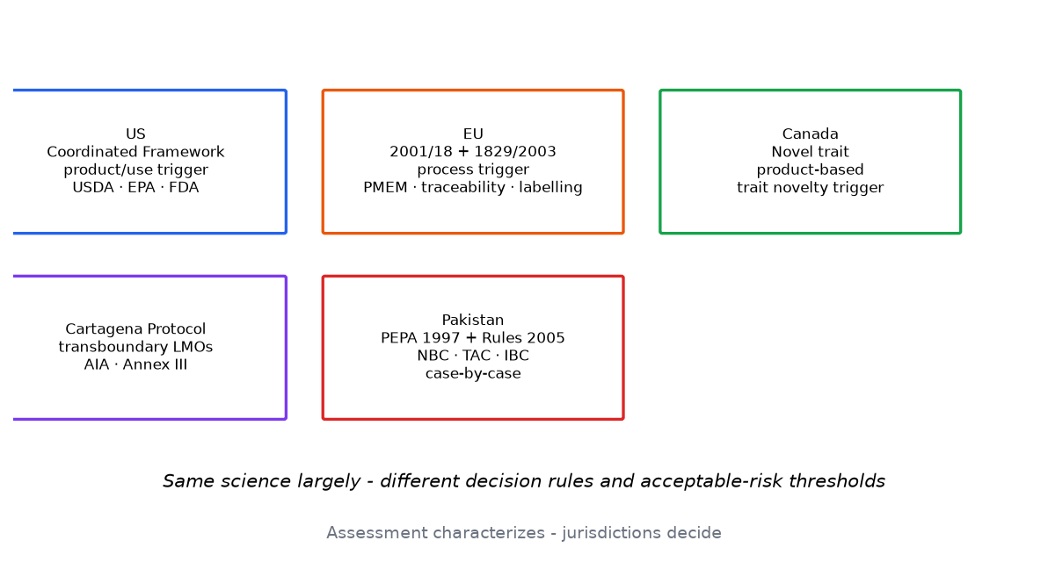
The regulatory landscape
• Cartagena Protocol: transboundary LMOs, AIA, Annex III principles
• Codex: food-safety assessment principles; comparator; WoE allergenicity
• OECD: biology consensus documents; familiarity concept
• EFSA assesses; Commission and member states decide
Key takeaway: Assessment characterizes - jurisdictions decide; the boundary is the profession's core discipline.
Notes:
US product/use trigger vs EU process trigger vs Canada novel trait - same science, different rules.

Slide 71
Pakistan's framework
• PEPA 1997 + Pakistan Biosafety Rules 2005
• NBC (approvals) · TAC (technical review) · IBCs (institutional oversight)
• Bt cotton approved; other cases case-by-case (verify current notifications)
• Cartagena Party since 2009
Key takeaway: National frameworks implement international principles - capacity and enforcement are the live questions.
Notes:
Direct students to current NBC notifications - rules and approval lists update periodically.

Slide 72
The assessment/decision boundary in one slide
• Assessment outputs: hazard list, characterized risks, uncertainty flags
• Decision inputs: those outputs + thresholds, values, alternatives
• Same assessment, different decisions across jurisdictions - legitimately
• Violations run both directions: assessors must not decide; regulators must not edit hazard tables
Key takeaway: Guard the boundary: it is what makes both roles defensible.
Notes:
This slide is the course's regulatory thesis - Lab 11 role-play tests whether students can hold the boundary in real time.

Slide 73
16 · Case studies
Module 23 - fifteen documented trajectories

Slide 74
Case-study spectrum
• Bt cotton (resistance dominant) · Monarch (exposure decisive)
• HT crops (system-level change) · OSR gene flow (low frequency ≠ no consequence)
• StarLink (segregation failure) · Golden Rice (benefit ≠ safety argument)
• Papaya (low exposure) · GMMs (reversibility) · Salmon (containment)
Key takeaway: Fifteen cases, fifteen different risk profiles - the anti-lottery lesson.
Notes:
Outcomes genuinely differ - because traits, organisms, environments and management differ.

Slide 75
Three cases that teach the boundary
• Monarch: hazard headline → exposure quantification → negligible risk
• StarLink: feed-only approval failed on commingling - traceability is real
• Bt brinjal: same evidence, different national decisions - science vs policy
Key takeaway: Controversy often encodes value differences - identify them explicitly.
Notes:
Use these three for the assessment/decision discussion; students defend positions from the evidence only.

Slide 76
Three more cases that teach method
• UK FSE: measure the regime - community effects followed management, not molecules
• Pink bollworm: monitoring with triggers enabled eradication
• GM salmon: containment substituted for hazard characterization
• Method lessons transfer to every future GMO
Key takeaway: Cases are method teachers - each one upgrades a specific assessment skill.

Slide 77
17 · Quantitative analysis
Module 24 + Labs 03-10 - the working toolkit

Slide 78
The ten-dataset toolkit
• Gene-flow decay & thresholds · Non-target survival (Wilson CIs)
• Resistance recursion with refuges · Weed-resistance counts
• Soil communities · Composition (TOST) · Exposure chains (HQ)
• Dose-response (LC50, MOE) · Risk matrices · Monte Carlo + sensitivity
Key takeaway: Five certifiable skills: proportions, decay, recursion, dose-response, uncertainty propagation.
Notes:
All datasets simulated and labeled; analysis_demo.py reproduces every documented answer.

Slide 79
Reading numbers like an assessor
• Effect size + interval + comparator - never a bare p-value
• 'Not detected' ≠ 'absent' - state detection limits
• Multiplicity: 1-in-20 analytes differ by chance at α=0.05
• Sensitivity analysis converts uncertainty into measurement priorities
Key takeaway: Precision comes from design and n - not from decimal places.
Notes:
These four disciplines separate professional from amateur readings of identical data.

Slide 80
From data to dossier language
• Statistics → characterization sentence → uncertainty flag → instrument
• Every table feeds a paragraph; every paragraph feeds a decision element
• Orphan numbers (no interpretation) are defects, not depth
• Practice: convert Lab 03 output into dossier prose
Key takeaway: The deliverable is not the analysis - it is the characterized, actionable sentence.
Notes:
A short exercise with outsized professional value - most scientists can compute, few can convert computation into assessable prose.

Slide 81
18 · Advanced topics
Module 25 - research frontiers

Slide 82
Frontier topics and their maturity
• Population genetics & landscape gene-flow modeling
• Bayesian/probabilistic ERA; multi-criteria decision analysis
• Stacked traits; gene-edited organisms (NGTs)
• Synthetic biology releases; gene drives (conceptual - no releases approved)
Key takeaway: Gene drives break introgression-rate assumptions - reversibility becomes the controlling question.
Notes:
Flag maturity explicitly: model-to-data ratio rises with topic novelty.

Slide 83
Probabilistic and Bayesian ERA
• Monte Carlo propagation: risk distributions, not points
• Bayesian hierarchical models: pooling sparse field data
• Expert elicitation: formalized, disclosed, sensitivity-tested priors
• Separate variability from uncertainty in every output
Key takeaway: Bayesian methods quantify uncertainty - they do not eliminate it; priors must be disclosed.
Notes:
Conceptual level only - students should recognize the vocabulary and demand disclosure of priors.

Slide 84
Climate interactions and long-term monitoring
• Shifting pest ranges change selection landscapes
• Flowering-time shifts alter gene-flow windows
• Drought modifies trait expression and exposure
• Treat as scenario inputs - not computable predictions
Key takeaway: Frontier topics demand uncertainty disclosure as a professional ethic.

Slide 85
19 · Review & assessment
Capstone and exam preparation

Slide 86
The capstone ERA
• Choose a real GMO + specified receiving environment
• Full workflow: problem formulation → characterization → management → monitoring
• ≥4 quantitative elements from the course toolkit
• Defense: 15-minute presentation + viva from the question bank
Key takeaway: There is no single correct conclusion - there are correct disciplines.
Notes:
Lab 12 template and rubric; conclusion must be falsifiable - what monitoring would change it?

Slide 87
Exam-critical distinctions
• Hazard ≠ risk · assessment ≠ decision · difference ≠ harm
• 'Not detected' ≠ 'absent' · approved ≠ zero risk · banned ≠ proven harmful
• Comparator choice changes conclusions
• Every risk statement: evidence + uncertainty + instrument + trigger
Key takeaway: If you can defend these four lines with cases, you have learned the course.

Slide 88
Assessment package
• 60 MCQs (Bloom's-graded) · 30 short · 20 long · 40 viva
• 15 case-based · 15 data-interpretation questions
• Instructor answer key with rubrics
• 67 FAQs + 4-page cheat sheet for revision
Key takeaway: Assessment mirrors the course: structured reasoning, not recall alone.

Slide 89
Trait + Organism + Environment + Exposure + Evidence + Uncertainty
The course motto - evaluate every GMO as its own case; advocate nothing, hide nothing.
Dr. Saira Azam · CEMB · University of the Punjab, Lahore - Thank you.

