Slide 1
GMOs, Cloning Techniques & Developmental and Spatial Gene Expression
A university teaching module for BS/MS molecular biology, biotechnology, genetics & bioinformatics
Theory → Mechanism → Workflow → Data → Lab → Case studies → Assessment
Instructor: Dr. Saira Azam · Assistant Professor · Centre of Excellence in Molecular Biology · University of the Punjab, Lahore

Slide 2
1 · Introduction to Genetic Engineering
From classical genetics to spatial genomics (Module 1)

Slide 3
What is genetic engineering?
• Direct, deliberate modification of genetic material using laboratory techniques
• Recombinant DNA technology: join DNA from >1 source → propagate in a host
• Molecular cloning = building the blueprint; expression engineering = making it work
• Sits inside biotechnology, alongside classical uses and analytical omics
Key takeaway: Genetic engineering = designed molecular change + a way to propagate or deliver it.
Notes:
Emphasize precision of intent: the change is designed before the experiment. The 1973 Cohen–Boyer experiment is the canonical demonstration of cut → join → propagate → select.

Slide 4
The vocabulary — use it precisely
• GMO — umbrella term; the definition is REGULATORY and varies by country
• Transgenic — foreign (cross-species) DNA · Cisgenic — same-species DNA
• Gene-edited — change made by a targeted editor; may add no foreign DNA
• Stable (inherited) vs transient (fades over hours–days)
• The reagent can be transient while the consequence (edit) is stable
Key takeaway: Scientific descriptors are unambiguous; regulatory labels are not.
Notes:
Students routinely conflate these. Give the Bt-corn and base-edited crop examples: same scientific descriptors, different regulatory labels in different jurisdictions.

Slide 5
Why modify organisms?
• Research: assign function, build models, visualize biology (most GM work worldwide)
• Medicine: recombinant insulin (1982 — first rDNA drug), gene/cell therapy, mRNA vaccines
• Agriculture: Bt crops, virus-resistant papaya, Golden Rice, gene-edited crops
• Industry: enzymes, bio-based materials, engineered biosensors
Key takeaway: Every engineered organism answers a question — research, product, or both.
Notes:
Stress that basic research dominates the volume of genetic engineering; products are the visible minority.

Slide 6
Historical milestones I — foundations
• 1865–1900s: Mendel → chromosome theory
• 1928–1944: Griffith's transforming principle → Avery: DNA is the genetic material
• 1953: double helix (Watson, Crick, Franklin, Wilkins)
• 1968–70: restriction enzymes (Arber, Smith, Nathans; EcoRI purification) — Nobel 1978
• 1972–73: Berg's first in-vitro rDNA; Cohen–Boyer functional recombinant plasmids
Key takeaway: Each era supplied the tool the next era needed.
Notes:
The arc is: inheritance becomes chemistry, chemistry becomes cuttable, cuttable DNA becomes clonable.

Slide 7
Historical milestones II — the modern era
• 1975: Asilomar — scientists self-regulate; origin of biosafety frameworks
• 1977–82: Sanger sequencing; recombinant insulin approved (Humulin, 1982)
• 1981–83: transgenic mice; Agrobacterium plant transformation; PCR (Mullis)
• 1994: GFP as a genetically encoded reporter (Chalfie) — Nobel 2008
• 2012–13: CRISPR–Cas9 editing (Jinek; Cong/Mali/Zhang) — Nobel 2020
• 2009–2026: single-cell then spatial transcriptomics — expression read in place
Key takeaway: Read → copy → add → edit → watch: each capability built on the last.
Notes:
Two revolutions to keep separate: rDNA (1970s–90s, ADD DNA anywhere) vs genome editing (2010s–, CHANGE DNA at a chosen address).

Slide 8
2 · Molecular Cloning Fundamentals
Parts, plasmids and the eleven-stage workflow (Modules 2–3)

Slide 9
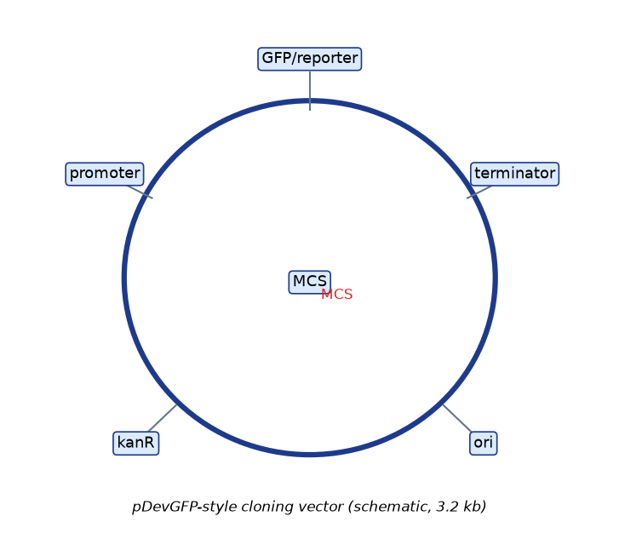
Anatomy of a cloning project
• Insert — the DNA you want · Vector — the vehicle · Backbone — vector minus insert
• Every vector component has a job; every job can fail
Key takeaway: A vector is not 'a circle with a hole' — it is a machine with parts.
Notes:
Walk the map: ori, marker, MCS, promoter cassette. Ask students what breaks when each is missing.

Slide 10
Vector components and failure modes
• ori → copy number (high pUC-class ~500; low pSC101 ~5; BAC single-copy)
• Selectable marker → without it you cannot recover transformants
• MCS / assembly architecture → where DNA enters
• Promoter + RBS/Kozak + terminator → expression or silence
• Reporter / tags → visibility and purification
Key takeaway: Design-stage attention to each component saves weeks at the bench.
Notes:
High-copy for yield; low-copy for burden-sensitive inserts. Ask: which component would you change to reduce toxicity of expression?

Slide 11
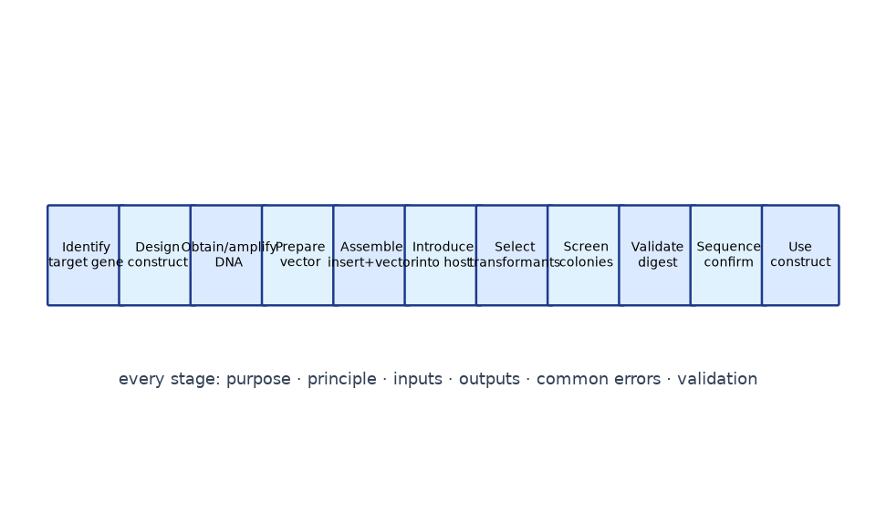
The eleven-stage cloning workflow
• Identify target → design construct → obtain/amplify DNA → prepare vector
• Assemble insert+vector → introduce into host → select → screen
• Validate (digest) → sequence-confirm → USE the construct
Key takeaway: Design decisions cascade; sequencing is the last gate before use.
Notes:
Module 2 details purpose/inputs/outputs/errors/validation for each stage — this slide is the map of the territory.

Slide 12
Copy number, capacity, host range
• High copy: more DNA per prep; more burden on unstable/toxic inserts
• Low copy: gentler, better for large or unstable DNA
• Plasmids 1–15 kb · BACs 100–300 kb (F-factor, single-copy, stable) · YACs up to ~1 Mb
• Shuttle vectors: two origins + two markers → build in E. coli, use elsewhere
Key takeaway: Match capacity to the question: cassette vs locus vs genome region.
Notes:
BACs matter for loci with full regulatory context (Hox, atonal-class clusters). YACs enabled megabase-scale genomics but are chimerism-prone.

Slide 13
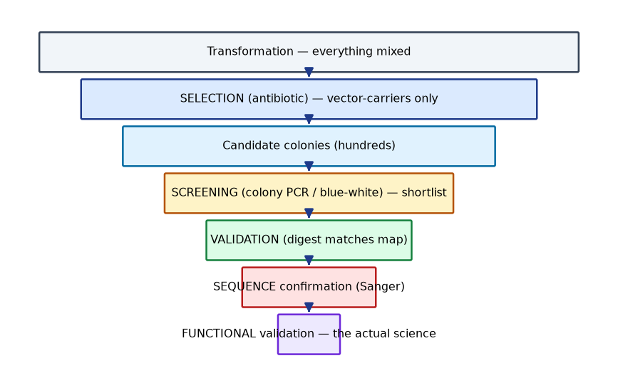
Selection vs screening vs validation
• SELECTION: undesired cells cannot grow (antibiotic, auxotrophy) — population level
• SCREENING: per-candidate test (blue-white, colony PCR, digest) — clone level
• VALIDATION: definitive proof (Sanger; then function) — molecule level
Key takeaway: Selection enriches populations; screening classifies individuals; validation proves identity.
Notes:
The funnel is the point: each stage removes a different class of wrong answer. A colony count is not a correct-clone count.

Slide 14
Blue-white screening — mechanism and limits
• Host strain carries lacZ α-deletion; vector supplies lacZα
• Empty vector → functional β-galactosidase → BLUE colonies on X-gal
• Insert disrupting lacZα → WHITE colonies — candidates, not proof
• Anomalies exist: PCR-positive blue colonies happen (lacZα-sparing insertions)
Key takeaway: Screening shortlists; validation settles.
Notes:
Use the Lab-04 anomaly as a teaching hook: screening readouts are probabilistic evidence, not verdicts.

Slide 15
Reading a plasmid map — the 7-point checklist
• ori and copy-number class
• Selectable marker(s) — and whether bacterial vs mammalian parts differ
• MCS / assembly-scar architecture — which sites are unique?
• Promoter(s) and DIRECTION (arrow)
• Insert position and orientation — explicitly stated?
• Total size — expected band on a digest gel
• Priming sites — where can sequencing primers bind?
Key takeaway: Map-reading is a skill with a checklist — practice it.
Notes:
Exam tip to repeat: a map without orientation arrows is ambiguous; always state orientation relative to the promoter.

Slide 16
Why every validation stage exists
• Selection alone: 500 colonies could ALL be empty vector
• Screening alone: PCR can't see point mutations or rearrangements
• Digest alone: uninformative if enzyme choice is poor (single band)
• Sequencing alone (without function): sequence-correct ≠ expressing
• The chain: selection → screen → digest → Sanger → functional assay
Key takeaway: Each stage removes a different class of wrong answer — skip one and it survives.
Notes:
Use the Lab-03/Lab-04 storyline: high colony counts with 85% empty clones (condition L3) make the point vividly.

Slide 17
3 · Cloning Techniques
Restriction · TA · blunt · Gibson · Golden Gate · Gateway (Module 4)

Slide 18
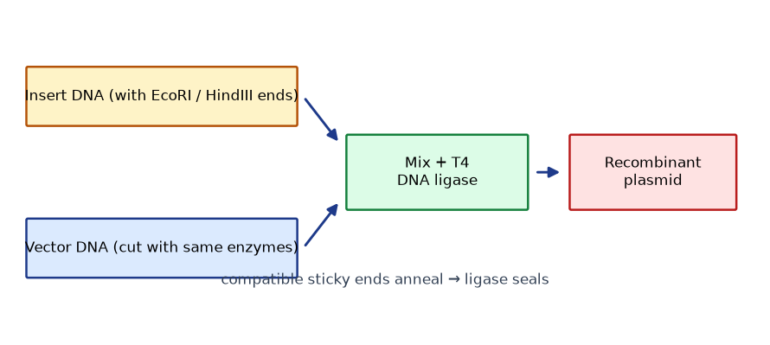
Restriction enzyme cloning
• Recognition sites 4–8 bp, usually palindromic: EcoRI G^AATTC, HindIII A^AGCTT
• Sticky (5′/3′ overhangs) vs blunt ends; compatible ends (BamHI/BglII → GATC)
• Directional cloning: two different enzymes force one orientation
• Dephosphorylate vector → blocks self-ligation; insert restores phosphates
• Insert:vector molar ratio ~3:1 as a starting point (kinetics, not law)
Key takeaway: Cut → anneal → ligate: simple, cheap, background-prone.
Notes:
Methylation sensitivity can block sites in common lab E. coli DNA — a real design consideration.

Slide 19
TA cloning and blunt-end cloning
• TA: Taq adds 3′-A overhangs; T-vector carries 3′-T — fast PCR-product capture
• TA limits: no orientation control; high-fidelity polymerases give blunt ends (A-tail first)
• Blunt: universal — any flush fragment ligates to any other
• Blunt limits: low efficiency, no directionality → dephosphorylation essentially mandatory
Key takeaway: Convenience vs control: TA is fast, blunt is universal, neither is directional.
Notes:
Ask students when blunt is the ONLY option: no convenient sites and non-PCR input (e.g., sheared/adaptor fragments).

Slide 20
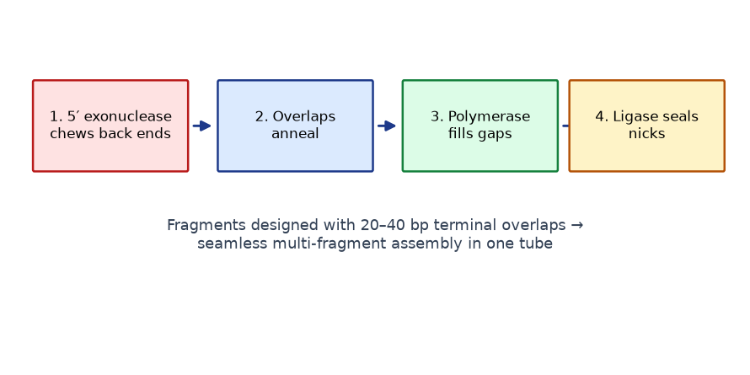
Gibson Assembly — overlaps do the addressing
• Fragments carry 20–40 bp terminal overlaps
• 5′ exonuclease chews back → overlaps anneal → polymerase fills → ligase seals
• Seamless; multi-fragment; no restriction sites needed
• Limits: repeat-driven misassembly; overlap design burden
Key takeaway: Design-level addressing: sequence, not restriction sites, defines the product.
Notes:
The overlap IS the addressing scheme — jigsaw edges. Repeats confuse the jigsaw.

Slide 21
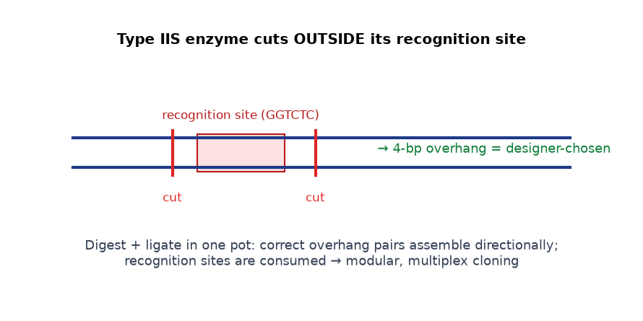
Golden Gate — programmable overhangs
• Type IIS enzymes (BsaI, BsmBI, SapI…) cut OUTSIDE the recognition site
• 4-bp overhang bases are designer-chosen → each junction has an address
• One-pot digest+ligation; correct products consumed their recognition sites → self-selecting
• Basis of modular cloning hierarchies (MoClo-style level-0 parts → units → multigene)
Key takeaway: Scars are 4 bp; efficiency and modularity are unmatched.
Notes:
Domestication: internal Type IIS sites must be removed or silently mutated. Note temperature-cycling for BsaI-class enzymes.

Slide 22
Gateway — recombination-based transfer
• attB/P → attL (entry clone) via BP; attL/R → attB (expression clone) via LR
• One sequence-verified entry clone feeds many destination vectors
• Strength: parallel expression testing across backbones
• Limits: att scars; proprietary mixes; counter-selection background (ccdB-type)
Key takeaway: Archive once, deploy everywhere — at the cost of fixed recombination scars.
Notes:
Conceptual level only; vendor systems evolve — consult current documentation before lab use.

Slide 23
Choosing a technique — decision guide
• Multi-fragment, seamless? → Gibson (≤ ~6–8) or Golden Gate (many, modular)
• Single insert with good unique sites? → restriction–ligation (directional)
• Quick PCR capture? → TA. No sites at all? → blunt
• One gene → many backbones in parallel? → Gateway
Key takeaway: The technique choice is a design decision, not a habit.
Notes:
Run the Lab-01 scenario live: internal BamHI forces EcoRI+HindIII.

Slide 24
4 · Expression Constructs & Reporters
Regulatory parts and measurable outputs (Module 5)

Slide 25
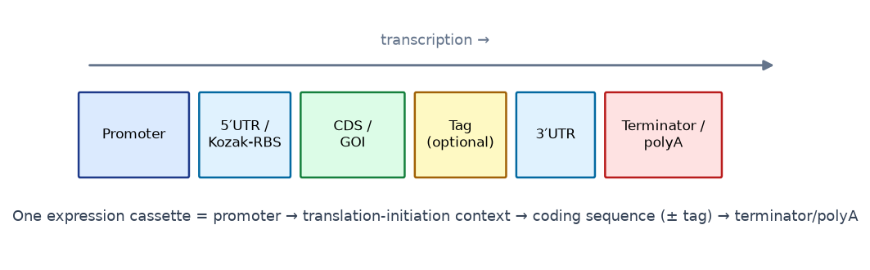
Anatomy of an expression cassette
• Promoter → 5′ UTR / RBS (Shine–Dalgarno) or Kozak context → CDS ± tag
• 3′ UTR → terminator (bacteria) or polyadenylation signal (eukaryotes)
• Enhancers/silencers: distal, orientation-flexible modulators
• Operators (prokaryotes): repressor/activator binding → inducibility
Key takeaway: The cassette, not just the gene, encodes the experiment.
Notes:
Same CDS + different regulatory parts = different experiments entirely. This is the lever students most often under-use.

Slide 26
Expression modes — four dials
• Constitutive: always on — production, housekeeping studies
• Inducible: signal-gated (lac/IPTG, Tet/doxycycline, Gal4-ER) — toxicity, timing
• Tissue-specific: spatial restriction — reporters, cell-type biology
• Developmentally regulated: staged activation — patterning studies
Key takeaway: Changing one regulatory element changes the question the construct answers.
Notes:
Swap-the-promoter thought experiment: same GFP, four different questions.

Slide 27
Reporter genes — the cast
• GFP: autocatalytic chromophore, needs only O2 → live spatial imaging (Nobel 2008)
• RFP/mCherry: red shift → tissue penetration + dual-color with GFP
• lacZ: X-gal histochemistry — vivid fixed-tissue maps, enzyme-amplified
• Luciferase: luciferin+ATP → photons; quantitative dynamic range; dual-luciferase normalization
Key takeaway: Reporters convert invisible regulatory states into measurable signals.
Notes:
Fluorescence = spatial detail; luminescence = quantitation. Choose by question.

Slide 28
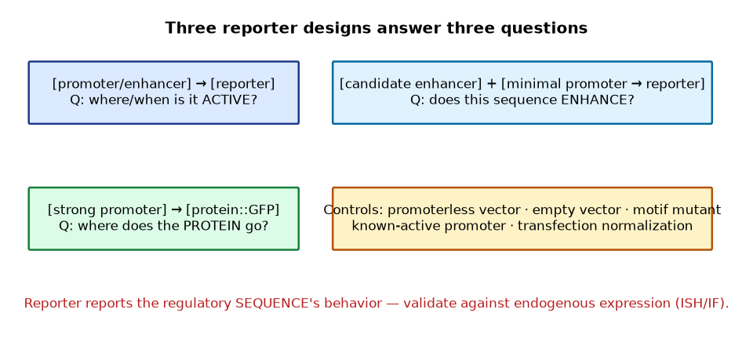
Reporter design patterns and controls
• Promoter-reporter: 'where is this promoter active?'
• Enhancer-reporter: minimal promoter + candidate enhancer (test both orientations)
• Fusion reporter: where does the PROTEIN go? (frame, linker, termini matter)
• Controls: promoterless + empty vectors, motif mutant, known-active promoter, normalization
Key takeaway: A reporter is sufficiency evidence — not an endogenous-expression verdict.
Notes:
Reporter reports the SEQUENCE's behavior — chromatin context can be missing. Always pair with endogenous validation (ISH/IF) for strong claims.

Slide 29
Landmark: GFP goes live (1994)
• Chalfie et al. expressed GFP in C. elegans touch neurons and E. coli
• No substrate, no cofactors beyond O2 → genetically encoded fluorescence
• Tsien-engineered variants: brightness, folding, color palette
• Consequence: live developmental imaging became routine
Key takeaway: One jellyfish protein joined genetic engineering to developmental biology.
Notes:
Bridge slide: cloning technology (Module 2–4) becomes developmental observation (Module 8–9).

Slide 30
Cloning techniques — the comparison table
• Restriction–ligation: cheap, directional possible; needs unique sites; self-ligation background
• TA: fast PCR capture; no orientation; A-tailing needed for high-fidelity products
• Blunt: universal; low efficiency; heavy background
• Gibson: seamless, multi-fragment; overlap design; repeat misassembly
• Golden Gate: one-pot, modular, multiplex; domestication of internal sites; 4-bp scars
• Gateway: one entry → many destinations; att scars; counter-selection background
Key takeaway: No universal technique: the constraint set picks the method.
Notes:
Have students reproduce this table from memory — it is the Module-4 anchor. Each row: mechanism → strength → limitation → scenario.

Slide 31
Worked design — the Lab-01 construct
• Goal: 850-bp zebrafish shha promoter → GFP in a 3.2-kb vector
• Scan insert: internal BamHI site → BamHI pair ELIMINATED
• Choice: EcoRI + HindIII (unique in vector, absent in insert, directional)
• Primers: 5′ clamp + site + gene-specific sequence (frame/termini checked)
• Ligation: 50 ng vector at 3:1 → ~31.5 ng insert (molar math)
• Diagnostic digest: EcoRI+BamHI → 1.9 + 2.15 kb (empty vector: 3.2 kb single)
• Screening: white colonies → colony PCR (Set A + B) → mini-prep → Sanger
Key takeaway: Design is decision-making under constraints — document every choice.
Notes:
Run this live with the design_check.py script on the simulated insert — students see the internal-site scan that forces the enzyme decision.

Slide 32
Fusion proteins — in-frame matters
• Insert must join the tag without frameshift → single continuous ORF
• Linkers (Gly-Ser repeats) preserve independent folding of both parts
• N-terminal fusions: tag's start codon dominates; C-terminal: no premature stop
• Fusions can perturb localization/function — always validate against endogenous
• Common tags: His6 (purification), FLAG/HA (detection), GFP (imaging), GST (solubility)
Key takeaway: A fusion is a new protein — verify it still behaves.
Notes:
The aggregation case: a mispositioned tag can bury a signal peptide or block an active site — three design causes, three fixes.

Slide 33
Transformation and selection — the plating logic
• Chemical transformation (heat shock) or electroporation — per institutional SOP
• Positive control (known plasmid) and negative control (no DNA) are mandatory
• Selection marker must match the vector — check concentration classes
• Colony number ≠ correct-clone number; controls calibrate the background
• Electroporation: salt in DNA prep → arcing → dead cells
Key takeaway: Controls turn colony counts into interpretable data.
Notes:
The positive control is the diagnostic: if it fails, the cells/buffer are the problem, not your ligation.

Slide 34
Promoter selection — matching promoter to purpose
• Prokaryotic: T7-class (expression strains), lac/tac/trc (tunable), constitutive housekeeping
• Mammalian: CMV (strong, broad), EF1α (stable), PGK/UbC (moderate) — silencing varies
• Plant: 35S (constitutive), ubiquitin-class, tissue/development-specific promoters
• Developmental: endogenous/tissue-specific promoters for spatial questions
• Inducible systems: Tet-On/Off, Gal4-ER, heat-shock — temporal control
Key takeaway: The promoter is the experimental design, encoded in DNA.
Notes:
CMV-driven expression of a gene that is normally tissue-restricted answers a different question than the endogenous promoter — make students articulate which.

Slide 35
Reporter fusions vs promoter reporters — choosing the readout
• Promoter-reporter: regulatory ELEMENT activity (transcriptional readout)
• Fusion reporter: protein localization/dynamics (post-transcriptional readout)
• They can disagree — post-transcriptional regulation is real biology
• Destabilized reporters (degron-tagged GFP): read CURRENT expression, not history
• For quantitation over time: luciferase wins; for spatial detail: fluorescence wins
Key takeaway: Match the reporter's biological level (RNA vs protein) to the question.
Notes:
Case: a protein whose mRNA is everywhere but protein is nuclear-only — the two reporter designs tell different true stories.

Slide 36
5 · GMO Generation
Bacteria, plants, animals — shared spine, different biology (Module 6)

Slide 37
What makes an organism 'modified'?
• Laboratory-altered genetic material in a defined, designed way
• Transgenic / cisgenic / gene-edited / knockout / knock-in / reporter
• Stable = inherited (integration, maintained plasmid) vs transient = fading
• In embryos: reagents transient, edits stable — the distinction that confuses everyone
Key takeaway: Category determines interpretation — and often regulation.
Notes:
Anchor with the five example classes; ask students to classify Golden Rice, an apoE knockout mouse, and a plasmid-transfected culture.

Slide 38
Bacteria — the fast lane
• Construct → transformation/electroporation → selection → screen → validate → phenotype
• Landmark: recombinant insulin (Humulin, 1982 — first rDNA drug)
• Industrial enzymes (amylases, chymosin); engineered metabolism (artemisinic acid)
• Colony = organism: days, not months
Key takeaway: Microbes trade complexity for speed.
Notes:
Note host choice: insulin is non-glycosylated — E. coli/yeast fine; glycoproteins need CHO-class hosts.

Slide 39
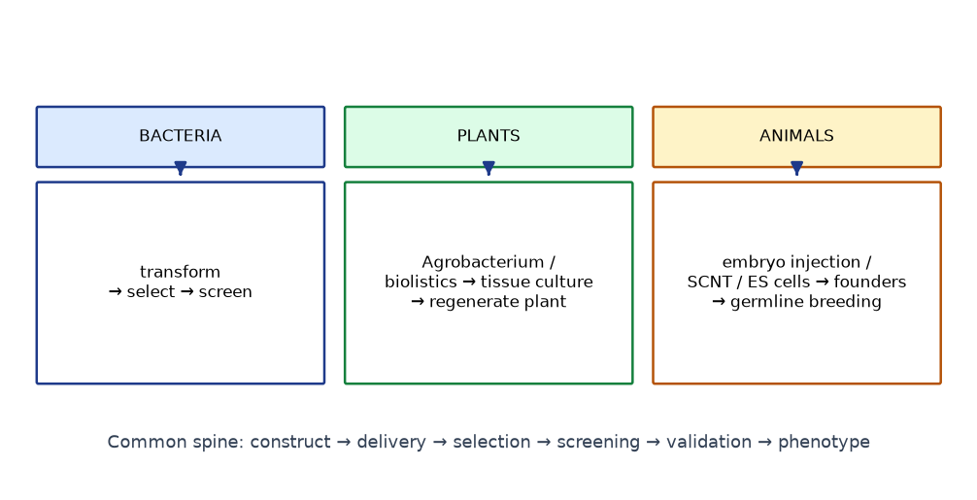
Plants — totipotency does the heavy lifting
• Agrobacterium: natural T-DNA transfer (Ti plasmid, border repeats, vir genes)
• Disarmed systems + binary vectors: cassette between borders; vir in trans
• Biolistics: DNA-coated particles — for recalcitrant species, chloroplast targets
• Tissue culture → regeneration → selection → molecular confirmation → field trials under permit
Key takeaway: The plant regenerates itself; engineering is delivery + selection.
Notes:
Totipotency: one modified somatic cell regenerates a whole plant — conceptually simpler than embryo-by-embryo animal work.

Slide 40
Landmark crops — history to present
• Bt cotton/corn (1996→): Cry proteins; resistance managed by refuges/pyramids
• Herbicide-tolerant soybean/corn: CP4 EPSPS; weed-resistance drove trait evolution
• PRSV-resistant 'Rainbow' papaya: saved the Hawaiian industry (public sector)
• Golden Rice: psy+crtI → provitamin A; GR2E food-safety approvals (2021→, verify current status)
• Gene-edited crops: waxy corn, MLO-edited wheat, non-browning mushroom — status varies by country
Key takeaway: Traits succeed or fail as agronomy + policy, not just molecular biology.
Notes:
Statuses change — mechanisms are stable, regulations are not. Flag re-verification for any commercial claim.

Slide 41
Animals — embryo routes and founder logic
• Pronuclear microinjection (classic transgenesis, 1981–82 'supermouse')
• ES-cell knockouts (Capecchi/Smithies/Evans, Nobel 2007) — targeted mammalian genetics
• SCNT: Dolly (1996/97) — cloning ≠ transgenesis; reprogramming in vivo
• CRISPR era: cytoplasmic editing reagents → F0 screening (species-dependent)
• Founder identification → germline transmission → breeding → phenotyping under animal-care approval
Key takeaway: Mosaic founders and slow breeding shape every animal-engineering design.
Notes:
No operational animal parameters in this course — species/jurisdiction-specific, under animal-care protocols.

Slide 42
6 · Genome Editing & CRISPR
Programmable changes at chosen addresses (Module 7)

Slide 43
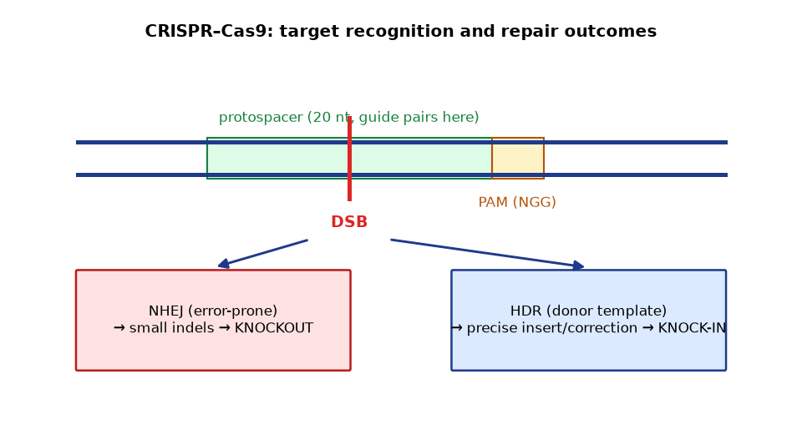
CRISPR–Cas9 in one picture
• Bacterial adaptive immunity → laboratory programmability
• sgRNA (~20-nt guide) + Cas9 + PAM (SpCas9: NGG)
• Guide-target pairing → R-loop → HNH/RuvC cleavage → blunt DSB ~3 bp from PAM
• The cell's repair choice writes the edit
Key takeaway: CRISPR does not edit; it creates the break. REPAIR does the editing.
Notes:
PAM is required for initiation — that's why it constrains targetable space and contributes to specificity.

Slide 44
Repair pathways decide the outcome
• NHEJ: active through the cell cycle; error-prone → indels → KNOCKOUT
• HDR: S/G2-biased, needs donor → precise correction/KNOCK-IN
• Knock-ins are hard: HDR-inefficiency in primary cells; alternatives: HITI, editors
• In-frame indels can escape knockouts — screen alleles, validate protein
Key takeaway: Design for the repair pathway you need — not the one you get by default.
Notes:
The Ma et al. 2017 MYBPC3 embryo work and its follow-up literature illustrate why repair-mechanism context matters.

Slide 45
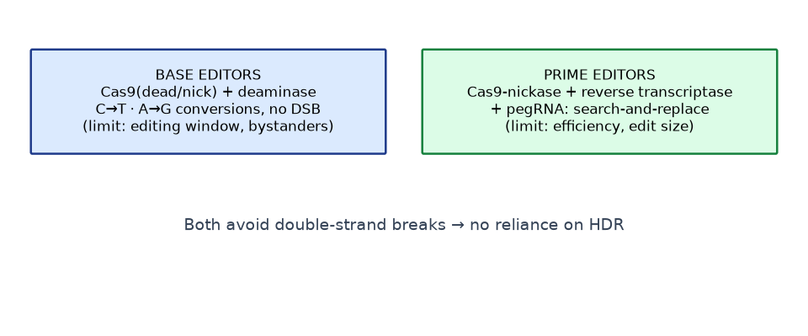
Beyond nucleases — base and prime editing
• Base editors: dead/nickase Cas9 + deaminase → C→T, A→G (no DSB; bystander risk)
• Prime editors: nickase + reverse transcriptase + pegRNA → all base swaps + small indels
• dCas9 chassis → CRISPRa (sufficiency) / CRISPRi (necessity) without genome change
• Cas12a (staggered cuts, multiplexing), Cas13 (RNA targets)
Key takeaway: No-DSB editors solve the HDR problem and create their own.
Notes:
Editors trade HDR-dependence for window/bystander/efficiency constraints — honest comparison on the slide.

Slide 46
Transgenesis vs genome editing — the honest table
• Transgenesis ADDS a designed unit; editing CHANGES an endogenous sequence
• Random vs defined locus; positional effects vs native context
• Multiplexing: each construct vs several sgRNAs in one experiment
• Big cargo (BACs/transposons) vs size-limited delivery
• Modern projects often use both: edited allele + transgenic reporter
Key takeaway: Pick by goal: add a program or change a letter.
Notes:
Ask the class: which approach for (a) a loss-of-function allele, (b) a lineage reporter with full enhancer context?

Slide 47
Off-targets, mosaicism, validation
• Off-targets: partial-match sites; mitigate by guide design, hi-fi variants, RNP delivery — and EMPIRICAL checks
• Mosaicism: post-one-cell editing → different alleles per tissue → genotype multiple tissues
• Validation: bulk genotyping → isolate → zygosity → off-target screen → outcross → line
• F0 screens (zebrafish crispants) ≠ founder genetics (mouse) — timing of germline differs
Key takeaway: The edit is not done until the line is genotyped and the protein checked.
Notes:
Genotyping depth and tissue choice are where editing projects quietly fail.

Slide 48
CRISPR workflow — design to genotyped line
• Design: guide choice (on-target + off-target scoring), donor if knock-in
• Delivery: RNP / mRNA / plasmid — transient expression limits exposure
• Bulk genotyping: amplicon sequencing or Sanger-deconvolution (ICE-class)
• Isolate founders/colonies → zygosity → off-target screen → outcross → line
• Protein/function validation: Western, activity, phenotype rescue
Key takeaway: Editing projects are genotyping projects with a biology question at the end.
Notes:
RNP delivery reduces off-target exposure because the nuclease degrades quickly — a design lever students should connect to the mosaicism slide.

Slide 49
CRISPR screens — loss-of-function at scale
• Genome-wide sgRNA libraries → pooled cell populations
• Dropout/enrichment analysis → essential genes, drug-resistance factors
• Landmark: Shalem/Wang 2014 genome-wide knockout screens
• CRISPRa/i screens: gain-of-function and repression coverage
• Analysis discipline: multiple guides per gene, FDR, copy-number correction
Key takeaway: Pooled genetics with programmable guides rewired functional genomics.
Notes:
Screens moved CRISPR from 'one gene at a time' to systematic discovery — connect to Module 10's network-inference loop.

Slide 50
Editing vs classical genetics — timing compared
• Classical mouse KO: ES-cell targeting → chimeras → breeding: 1–2 years
• CRISPR mouse F0: weeks — but mosaicism and off-targets to manage
• Zebrafish crispants: days for loss-of-function phenotypes (F0, transient mosaic)
• Arabidopsis: floral-dip transformation + edited lines via segregation
• The trade: speed vs cleanliness — know which your question needs
Key takeaway: Editing compressed genetics from years to weeks — with new QC duties.
Notes:
F0 zebrafish phenotyping is powerful but mosaic — confirm with stable lines for publication-grade claims.

Slide 51
7 · Developmental Gene Expression
Differential expression, morphogens, GRNs (Modules 8–10)

Slide 52
Development = differential gene expression
• One genome; different transcriptional programs per cell
• Cell fate → determination (fixed despite transplantation) → differentiation
• Potency narrows: totipotent → pluripotent → multipotent → unipotent
• Master regulators: sufficiency demonstrated (myoD) — endogenous mechanisms are multi-input
Key takeaway: Developmental biology = which genes are on, where, when, and why.
Notes:
The myoD caveat matters: 'master' describes the experimental result, not the whole in-vivo mechanism (Pax3/7 + signaling + chromatin).

Slide 53
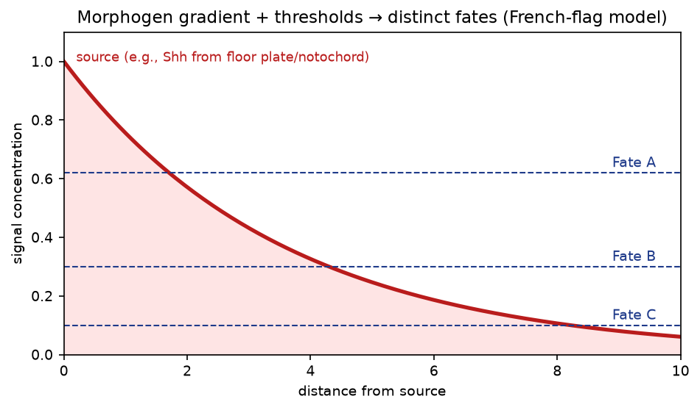
Morphogens — the French-flag logic
• Localized source → diffusion + degradation → concentration gradient
• Cells respond to thresholds → distinct fates at distinct distances
• Mechanisms vary (diffusion, transcytosis, cytonemes) — threshold logic is shared
Key takeaway: A gradient is positional information; interpretation is thresholded.
Notes:
Turing 1952; Wolpert 1969. Duration of exposure matters as much as concentration in the neural tube.

Slide 54
The recurring signaling cast
• Wnt/β-catenin — axis, stem compartments, organizer (dorsal zebrafish)
• Hedgehog/Shh — neural-tube DV, limb A–P (ZPA), sclerotome
• TGF-β/BMP/Nodal — mesoderm induction, neural induction via BMP inhibition
• Notch — lateral inhibition, boundaries (Delta/Jagged → NICD)
• FGF — outgrowth (AER), mesoderm migration; Retinoic acid — hindbrain/limb PD
Key takeaway: Seven pathways, endlessly recombined, pattern most of the embryo.
Notes:
Pathway outputs converge on cis-regulatory elements — a cell's combination of active pathways is its positional address.

Slide 55
Model organisms — who does what best
• Drosophila: forward genetics; segmentation hierarchy (Nüsslein-Volhard/Wieschaus, Nobel 1995)
• C. elegans: invariant lineage (Sulston); apoptosis, miRNA (lin-4/let-7)
• Zebrafish: transparent external development; live imaging; F0 screens
• Mouse: mammalian genetics; ES-cell/conditional alleles (Cre-lox)
• Arabidopsis: plant development; WUS/CLV stem-cell niche; ABC floral model
Key takeaway: The model is a tool chosen by the question, not by habit.
Notes:
Match organism to question: lineage precision vs live vertebrate imaging vs mammalian relevance vs plant cell biology.

Slide 56
Hox genes and body-plan identity
• Conserved clusters specifying A–P identity (Lewis 1978; McGinnis/Krumlauf)
• Colinearity: 3′ = anterior/early; 5′ = posterior/late
• Ectopic expression → homeotic transformations (Antennapedia legs-for-antennae)
• Colinearity implies shared chromatin/regulatory architecture
Key takeaway: One regulatory architecture, deployed along the axis, in nearly all animals.
Notes:
Enhancer deletions shift domain boundaries — link to Module 10 CRM logic.

Slide 57
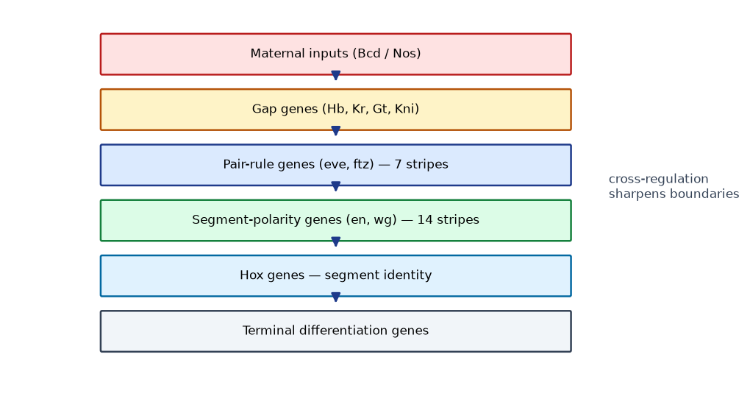
Drosophila segmentation — the first GRN
• Maternal gradients (Bicoid/Nanos) → gap genes → pair-rule (7 stripes) → segment-polarity (14) → Hox
• Cross-regulation sharpens every boundary (mutual repression, e.g., Gt/Kni)
• Each layer is more spatially precise AND later in time — refinement cascade
Key takeaway: Patterning is a temporal refinement cascade over spatial information.
Notes:
The 1980 saturation screen found zygotic genes — maternal ones needed separate genetics. Ask why (embryo lethality of mothers).

Slide 58
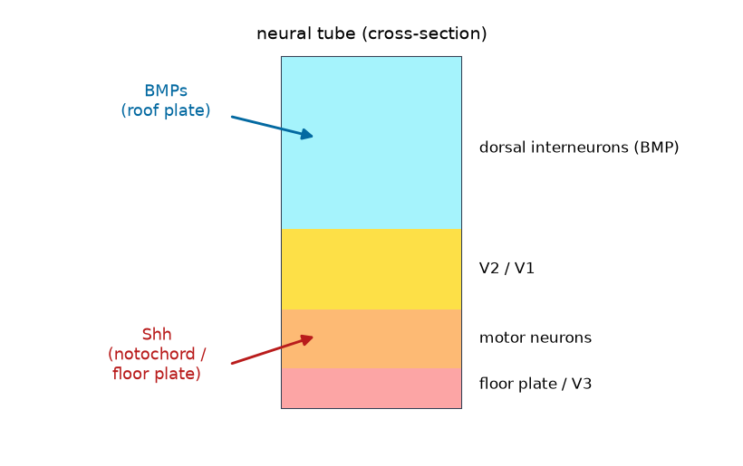
Neural tube — the Shh textbook case
• Shh from notochord/floor plate; BMPs from roof plate — opposing gradients
• Concentration AND duration of Shh → V3 → motor → V2 → V1 ventral classes
• Ectopic Shh induces ventral fates dorsally — sufficiency demonstrated
• Domains (nkx2.2, pax6, olfm-class boundaries) execute what gradients inform
Key takeaway: Gradients inform; domains execute; cross-repression sharpens.
Notes:
Ask: why do domains sharpen beyond the gradient shape? Cross-repression (Module 10 motifs).

Slide 59
8 · Spatial & Temporal Expression
Where, when — and the methods that resolve each (Module 9)

Slide 60
Three axes of every expression statement
• SPATIAL — where in organism/tissue/cell?
• TEMPORAL — when in development/response?
• QUANTITATIVE — how much, relative to what control?
• Bulk measurements integrate all three away — resolution is a design choice
Key takeaway: State the axis before choosing the method.
Notes:
The zebrafish example: bulk RNA-seq says 'gene X peaks at 24 hpf'; ISH says 'in the notochord from 10-somite stage'. Different claims, different tools.

Slide 61
Spatial concepts — gradient vs domain
• Gradient: continuous concentration change (Bicoid A–P; Shh D–V)
• Domain: sharply bounded expression region (eve stripe 2; nkx2.2)
• Tissue- vs cell-type- vs stage-specificity — nested restrictions
• Gradients usually inform; domains usually execute
Key takeaway: Gradient geometry carries information; domain geometry records decisions.
Notes:
Zebrafish somitogenesis is the cleanest two-axis example: her1/7 oscillations (time) freeze at the determination front (space) — clock-and-wavefront.

Slide 62
Spatiotemporal case studies
• Drosophila A–P: maternal gradient → zygotic stripes — refinement cascade
• Zebrafish somitogenesis: clock (Notch-linked oscillations) + wavefront (FGF/Wnt)
• Neural tube: gradient × duration → fate classes
• Arabidopsis flower: concentric ABC classes × staged identity (LFY/AP1 first)
Key takeaway: Every developmental pattern is an intersection of space and time.
Notes:
Each case pairs one spatial mechanism with one temporal mechanism — have students name both axes explicitly.

Slide 63
Method fit — resolving space and time
• ISH / RNA-FISH: endogenous mRNA, spatial (endpoint)
• IHC/IF: protein spatial map (endpoint; antibody-dependent)
• Reporters (GFP/luc): LIVE dynamics of a regulatory element
• RT-qPCR: magnitude over time (no space)
• scRNA-seq: cell types (no coordinates); Spatial transcriptomics: cells + coordinates
Key takeaway: Each method buys resolution on one axis by spending it on another.
Notes:
The decision matrix from Module 9 §4 — students should reproduce it from memory in the exam.

Slide 64
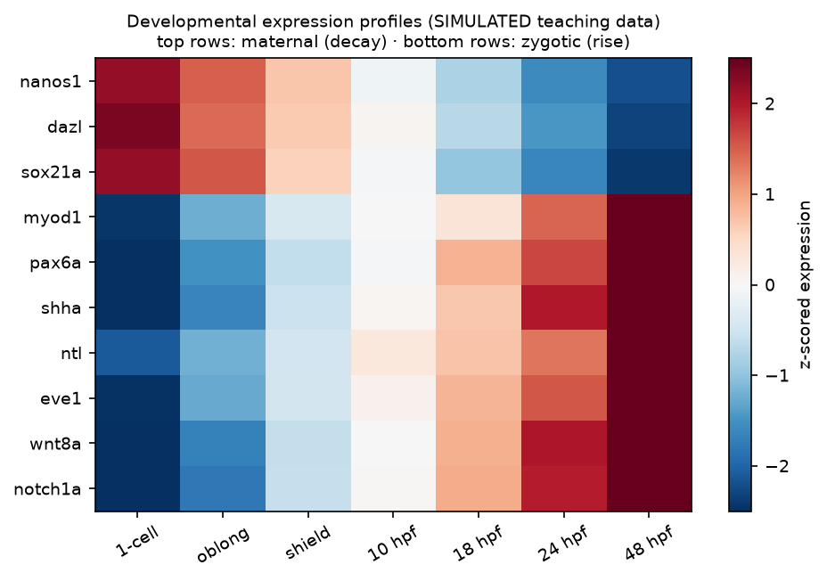
Temporal expression — developmental timing
• Stage-specific genes: windows of activity (hunchback early; myod1 at commitment)
• Maternal → zygotic transition: maternal mRNAs decay, zygotic genome activates
• Oscillating genes: segmentation clocks (her1/7 in zebrafish PSM)
• Staging rigor: hpf/somite counts/E-days — the temporal variable must be controlled
• Heatmap reading: decaying rows = maternal; rising rows = zygotic
Key takeaway: Temporal patterns have signatures — learn to read decay vs rise vs oscillation.
Notes:
The heatmap is the simulated developmental timecourse from DATA/ — the single most transferable visualization in developmental transcriptomics.

Slide 65
Expression gradients — case gallery
• Bicoid (Drosophila): maternal mRNA → A–P protein gradient → hunchback activation
• Shh (vertebrates): notochord/floor-plate source → DV neural tube + limb ZPA
• BMP (dorsal ectoderm): opposing Shh — dorsal fates
• Wnt: axis elongation, organizer, stem niches
• Retinoic acid: RALDH-synthesis vs CYP26-degradation gradients — hindbrain/limb
Key takeaway: Gradients are built by production AND destruction — both are regulatory.
Notes:
Each gradient pairs a source and a sink/mechanism — synthesis and degradation enzymes shape RA, not simple diffusion alone.

Slide 66
Expression domains — case gallery
• eve stripe 2 (Drosophila): the classic enhancer-dissection textbook case
• engrailed stripes: segment-polarity maintenance via wg/hh feedback
• nkx2.2 / pax6 boundary (neural tube): cross-repression sharpens the edge
• ABC-class MADS genes (Arabidopsis): concentric whorl domains
• Domains often sit ON gradients — the readout is binary, the input is analog
Key takeaway: Domains are the writable output of gradient-reading circuits.
Notes:
eve stripe 2: multiple activator/repressor sites in one CRM integrate maternal and gap-gene inputs — connect to Module 10.

Slide 67
Designing a spatiotemporal study — the 7-point checklist
• State the question on BOTH axes (where AND when)
• Choose resolution: cell type vs region vs whole embryo
• Choose method(s): endpoint (ISH/IF) vs live (reporter) vs snapshot omics
• Staging control: define the temporal variable rigorously
• Replicates: biological (clutches/litters) — not just technical
• Controls: sense/no-probe, known marker, reporter controls
• Quantification plan BEFORE imaging: area, intensity, counts
Key takeaway: Spatial studies fail on staging and quantification planning, not on stains.
Notes:
Have students apply this checklist to their capstone designs — it is the grading rubric for Lab-09.

Slide 68
9 · Experimental Methods
From probe design to spatial matrices (Module 11)

Slide 69
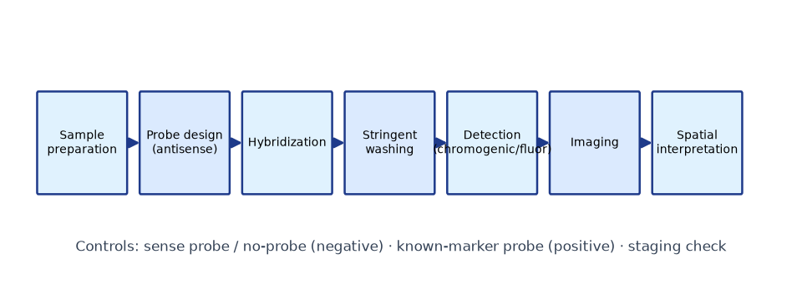
In situ hybridization — endogenous spatial mapping
• Fix/permeabilize → antisense labeled probe → hybridize → stringent wash → detect → image
• Antisense = true signal; sense probe = CANNOT pair → the clean negative control
• Controls: no-probe, known-marker (positive + staging), replicates
• Semi-quantitative: pattern is trustworthy; absolute amount is not
Key takeaway: ISH answers 'where, endogenously' — at the cost of being an endpoint.
Notes:
Probe design must mask repeats; low-abundance targets need amplification-based approaches (RNAscope-class).

Slide 70
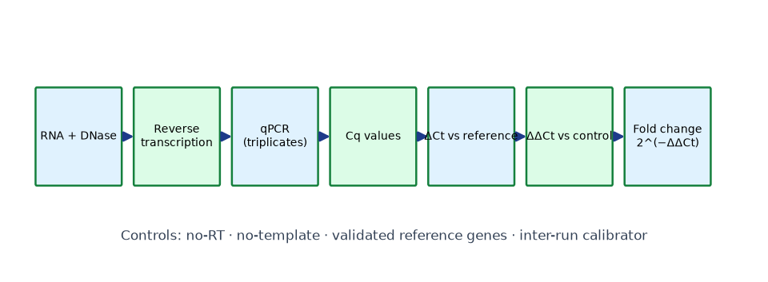
RNA-based quantitation — RT-qPCR and RNA-seq
• RT-qPCR: RT → real-time amplification → Cq → ΔΔCt vs validated references
• Controls: no-RT (genomic DNA), no-template (contamination), reference stability
• Bulk RNA-seq: library → sequence → count matrix → normalize → model → FDR
• Bulk = average over cells: heterogeneity and small hot regions vanish
Key takeaway: Quantitation needs validated references — and honest averages.
Notes:
Statistics on ΔCt, not fold change. For RNA-seq: n≥3 biological, balanced batches, negative-binomial modeling in research practice.

Slide 71
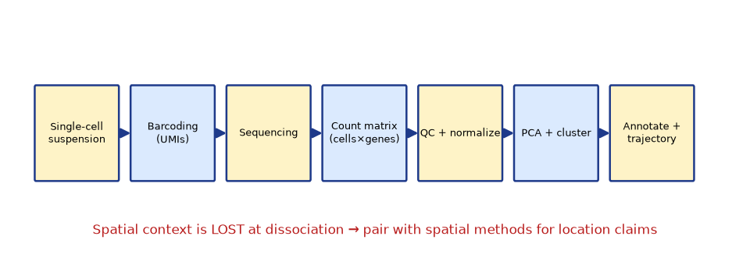
Single-cell RNA-seq — types without places
• Dissociate → barcode (UMIs) → sequence → cells × genes matrix
• QC (library size, genes/cell, doublets) → normalize → PCA/UMAP → cluster → marker annotation
• Trajectories/pseudotime: transcriptional order, NOT clock time
• Dropout: absence of a low transcript ≠ absence of biology
Key takeaway: scRNA-seq resolves WHAT cells are — not WHERE they are.
Notes:
Spatial context is severed at dissociation — the motivation for spatial methods. Cell-type discovery is the superpower; coordinates are the cost.

Slide 72
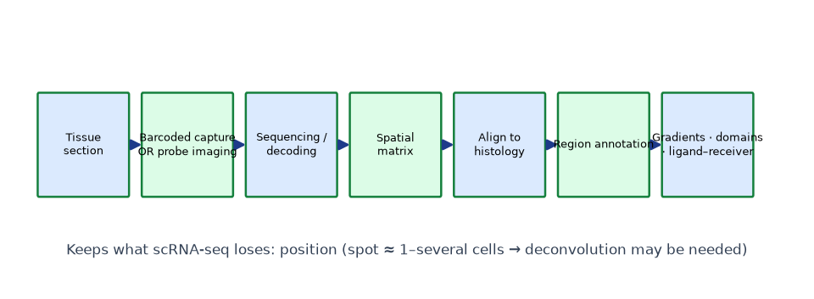
Spatial transcriptomics — expression in place
• Array-based: tissue on barcoded spots (~55 µm; spot = several cells → deconvolution)
• Imaging-based (MERFISH/seqFISH-class): barcoded probes decoded in situ — hundreds of genes, single cell
• Output: expression matrix WITH coordinates, aligned to histology
• Enables: region markers, gradients, ligand–receiver neighborhood logic
Key takeaway: Spatial transcriptomics reconnects molecular state to anatomy.
Notes:
Nature Methods 'Method of the Year 2020'. Trade-off: plex vs resolution vs throughput.

Slide 73
smFISH and multiplexed imaging — single molecules in place
• Many short oligos per transcript → diffraction-limited spots = single mRNAs
• Absolute counts per cell; nascent transcription sites visible
• Subcellular localization: mRNA transport, granules, cortical enrichment
• MERFISH/seqFISH-class: barcoded sequential imaging → hundreds–thousands of genes
• The bridge between classical ISH and spatial transcriptomics
Key takeaway: Counting molecules in place turns expression into measurable distributions.
Notes:
Absolute quantitation is the superpower: burst-size and frequency inference comes from these distributions (Module 15).

Slide 74
Immunohistochemistry / immunofluorescence — the protein layer
• Antibody binding → chromogenic or fluorescent detection of PROTEIN
• Controls: no-primary, isotype, knockout tissue, secondary-only
• Specificity must be validated — antibodies are the field's known weak point
• IHC/ISH disagreement = post-transcriptional regulation — real biology, not error
Key takeaway: Protein maps complete mRNA maps — disagreement is information.
Notes:
Knockout-tissue control is the gold standard for antibody specificity — much stronger than vendor claims.

Slide 75
Method choice — the one-slide decision guide
• WHERE, one/few genes, endogenous? → ISH / RNA-FISH / IF
• WHERE + DYNAMICS? → reporter (validated element) + ISH confirmation
• WHICH GENES define a cell type/region? → scRNA-seq or spatial transcriptomics
• HOW MUCH over time, few genes? → RT-qPCR time course
• GENOME-WIDE across stages? → bulk RNA-seq + targeted validation
Key takeaway: Discover broadly → validate spatially and functionally.
Notes:
The Module-11 decision guide verbatim — students reproduce this in the exam.

Slide 76
10 · Computational Analysis
Reading gels, Cqs and count matrices (Module 12)

Slide 77
Cloning data — the diagnostic logic
• Gel: migration ∝ log(size); interpolate against a ladder
• Colony PCR: flanking primers = size; vector+insert primers = orientation
• Diagnostic digest: fragments must match the map AND sum to plasmid size
• Sum > map size → rearrangement — the check everyone skips
Key takeaway: Two rules: interpolate against the ladder; always sum the fragments.
Notes:
Work the Lab-02 examples: A correct, B empty, C rearranged (2.3+1.7+0.9 = 4.9 kb ≠ 3.2 kb).

Slide 78
qPCR — ΔΔCt done right
• ΔCt = Cq(target) − Cq(reference) · ΔΔCt vs calibrator · FC = 2^(−ΔΔCt)
• Assumes ~100% efficiency; otherwise efficiency-corrected (Pfaffl)
• Statistics on ΔCt (normal-ish), never on fold changes (skewed)
• Geometric-mean references; report n, references, test, effect size
Key takeaway: Validated references are the difference between data and noise.
Notes:
Lab-05 numbers: myod1 18 hpf ≈ 7.5× vs 10 hpf — then validate spatially (ISH).

Slide 79
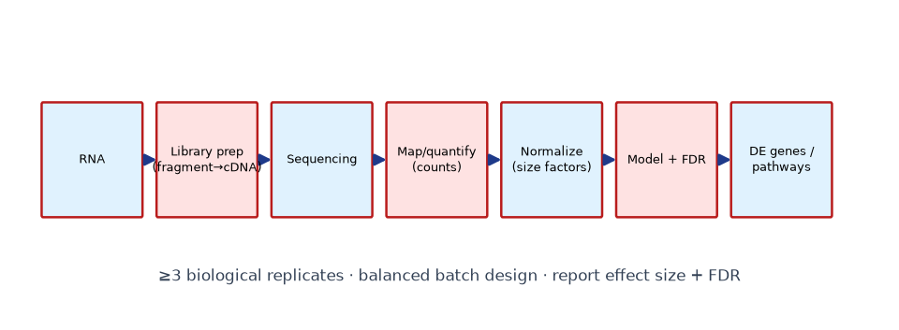
Bulk RNA-seq analysis
• Filter low counts → normalize (size factors/CPM) → model → Benjamini–Hochberg FDR
• Sort by effect size (|log2FC|), filter by FDR — never p alone
• 20,000 tests at 5% FDR ≈ 1,000 expected false calls — that's what FDR means
• Batch must not confound condition — check PCA BEFORE interpreting
Key takeaway: Design and multiple-testing discipline precede any gene list.
Notes:
Mini-workflow on the simulated 500×6 dataset; research practice = DESeq2/edgeR-class negative-binomial models.

Slide 80
Single-cell analysis
• QC: library size, detected genes, doublets → normalize/log → PCA → cluster
• Annotate clusters with marker genes (pax6a-neural; myod1-muscle; hbbe1-blood)
• Subclusters reveal transitions (low-myod1 differentiating precursors)
• Pseudotime orders transcriptional states — developmental sequence, not time
Key takeaway: Clusters are hypotheses; markers and validation turn them into cell types.
Notes:
Lab-08 dataset: 600 cells → 3 clean clusters + a k=4 transition subcluster. Absence (dropout) is not evidence of absence.

Slide 81
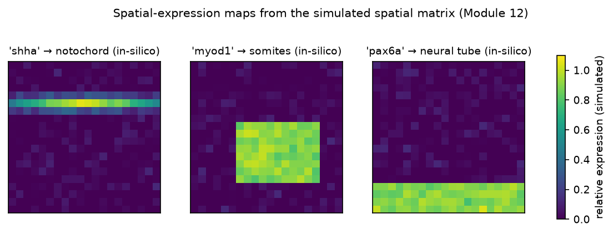
Spatial data analysis
• Join matrix + coordinates + (training) region labels
• Region-mean expression → top marker per region → in-silico in situ (x,y plots)
• Gradient test: correlate expression with distance (r ≈ −0.6 edge-gene example)
• Ligand in region A neighboring receptor in region B = hypothesis to validate
Key takeaway: Spatial matrices generate spatial hypotheses; ISH and perturbation confirm them.
Notes:
End every spatial finding with its independent check: ISH for the gradient gene, reporter or perturbation for the axis.

Slide 82
RNA-seq quality discipline
• Biological replicates: n≥3 is the floor — technical reps never substitute
• Batch balance: randomize/interleave conditions across processing batches
• Strandedness, polyA vs total RNA — declare and record library choices
• QC before interpretation: mapping rate, duplication, 3′ bias, PCA
• Report: n, normalization, test, FDR, effect size — every time
Key takeaway: RNA-seq credibility is decided at design time, not analysis time.
Notes:
The PCA-first rule: if batch explains the data, no downstream gene list is interpretable.

Slide 83
Volcano plots and honest gene lists
• x = log2FC (effect), y = −log10 p (evidence) — read both, filter by FDR
• The 1,800-gene-no-effect trap: near-zero FCs at scale = design artifact
• Low-count genes: unstable FCs — filter before testing
• Annotate gene lists with what you KNOW (pathway membership) — interpret, don't just rank
Key takeaway: Effect size + FDR + biology = an interpretable gene list.
Notes:
Demo on the simulated 500×6 dataset: 18 genes pass FDR<0.05 & |log2FC|>1, including a coherent 5-gene module.

Slide 84
11 · Case Studies
Twelve cases linking tools to biology (Module 13)

Slide 85
Agricultural GMOs — three arcs
• Bt crops: Cry toxins; pesticide-use reductions; resistance evolution → refuges/pyramids
• Golden Rice: endosperm provitamin A (psy+crtI); approvals 2021→; deployment debates
• Gene-edited crops: native-locus knockouts (waxy corn, MLO wheat) — product vs process regulation
Key takeaway: Traits live or die on evidence AND governance.
Notes:
All three: mechanism is settled; deployment is agronomy + regulation + acceptance. Keep the Module-14 layering when discussing.

Slide 86
Medical and research classics
• Recombinant insulin (1982): rDNA's clinical proof — small, non-glycosylated protein
• GFP organisms (1994→): live imaging revolution — promoter vs fusion logic
• Disease models: apoE−/−, mdx, SOD1-G93A — face/content/predictive validity; partial replication
• CRISPR knockouts/screens (2014→): loss-of-function genetics democratized
Key takeaway: Models are tools with known failure modes — state them.
Notes:
Use SOD1 as the model-limit discussion: why some trial successes in mice failed clinically.

Slide 87
Developmental case studies
• Hox regulation: colinear clusters; enhancer deletions shift boundaries
• Drosophila patterning: the first fully-worked GRN cascade
• Shh spatial signaling: gradient → threshold fates (V3→V1); duration matters
• Single-cell atlases: cell-type catalogs far richer than histology suggested
• Spatial transcriptomics: molecular anatomy — Method of the Year 2020
Key takeaway: Developmental cases show WHY the tools matter.
Notes:
Each case is a cloning + expression + data-analysis story — the course in miniature.

Slide 88
Case study — PRSV-resistant papaya
• Biological question: can pathogen-derived resistance save a devastated industry?
• Strategy: viral coat-protein gene expressed in papaya ('Rainbow', 1998)
• Mechanism: coat-protein-mediated resistance against Papaya Ringspot Virus
• Result: Hawaiian papaya production recovered; classic public-sector GMO
• Lesson: trait design from the pathogen's own biology
Key takeaway: Resistance can be engineered FROM the pathogen itself.
Notes:
Contrast with Bt (toxin-based) and Golden Rice (metabolic) — three different mechanism classes in agriculture.

Slide 89
Case study — single-cell atlas of development
• Question: how many cell types exist, and how do they arise?
• Strategy: scRNA-seq across stages (organogenesis atlases; zebrafish embryogenesis)
• Result: cell-type catalogs far richer than histology suggested; trajectory structure
• Interpretation: development as a branching transcriptional landscape
• Limits: no coordinates (motivates spatial methods); dropout; snapshots
Key takeaway: scRNA-seq redefined the unit of developmental biology: the cell type.
Notes:
Ask: which claims REQUIRE spatial validation? (anything about WHERE cells are or how they contact each other.)

Slide 90
12 · Ethics, Biosafety & Regulation
Four layers, kept distinct (Module 14)

Slide 91
The four-layer framework
• Scientific evidence — what we can measure (gene flow, resistance, safety studies)
• Risk assessment — structured hazard × exposure × consequence, vs baseline practice
• Ethical considerations — autonomy, justice, animal welfare, germline consent
• Policy/regulation — process-based (EU) vs product-based (US) framings
Key takeaway: Separate the layers — then argue explicitly.
Notes:
Conclusions at one layer are not evidence at another. Labeling debates are ethics/policy, not food-safety data.

Slide 92
Biosafety in practice
• Containment levels by organism/system; institutional IBC/ETH approval governs
• Teaching labs: disabled strains, instructor-approved materials, institutional SOPs
• This course: conceptual workflows + simulations; no operational animal/viral parameters
• DURC and gain-of-function research: dedicated oversight frameworks
Key takeaway: Biosafety is a practice, not a paragraph.
Notes:
Reinforce: students never self-assign biosafety levels. Approved SOPs only.

Slide 93
Editing humans — the bright line
• 2018 He Jiankui CCR5 case: condemned broadly — oversight, consent, transparency failures
• WHO 2021 governance framework: strict limits on heritable human editing
• Somatic vs germline distinction: therapy for a patient vs changes to future persons
• Technical possibility ≠ ethical readiness
Key takeaway: Some lines are drawn by governance capacity, not by technique.
Notes:
Keep this evidence-first: what happened, what frameworks now say, what remains contested.

Slide 94
Gene flow and environmental questions
• Pollen-mediated outcrossing: documented for canola, maize (low frequencies)
• Depends on species, distance, sexual compatibility with wild relatives
• Horizontal gene transfer mechanisms exist — assessed case-by-case
• Resistance evolution: documented in Bt target pests; refuge/pyramid management
• Herbicide-tolerance weeds: selection pressure — a management, not gene-flow, issue
Key takeaway: Environmental risk assessment is quantitative, not categorical.
Notes:
Keep claims product- and trait-specific: 'gene flow happens' is a mechanism, not a risk magnitude — exposure and consequence vary.

Slide 95
Food safety assessment frameworks
• Codex Alimentarius: the international reference for GM food safety assessment
• Compositional equivalence: targeted comparison with conventional counterparts
• Novel protein screening: digestibility, homology to allergens/toxins
• Feeding studies where indicated — case-by-case, not universal
• Decades of consumption through major regulatory systems + documented challenges
Key takeaway: Safety is assessed per product — the category label settles nothing.
Notes:
Both truths held together: reassuring assessments for products evaluated through major systems, AND real documented issues (resistance, IP concentration).

Slide 96
13 · Advanced Concepts
Chromatin, circuits, and the editing frontier (Module 15)

Slide 97
Regulatory chromatin
• H3K4me1+H3K27ac = active enhancer · H3K27me3 = Polycomb · bivalency = poised lineage genes
• ATAC-seq: open chromatin + TF footprints; ChIP/CUT&Tag: occupancy maps
• Pioneer factors open nucleosomal DNA — why some TFs reprogram identity
• DNA methylation: stable repression; imprinting; developmental dynamics
Key takeaway: Chromatin is the cell's memory and its option book.
Notes:
Bivalency is the developmental punchline: stem cells hold lineage genes ready for either direction.

Slide 98
3D genome and super-enhancers
• TADs constrain enhancer search space (CTCF/cohesin boundaries)
• Loops and condensate models — active research debate, present as such
• Super-enhancers: dense H3K27ac/Mediator/BRD4 clusters controlling identity genes
• Enhancer hijacking: structural variants relocate enhancers near oncogenes
Key takeaway: Who contacts whom is regulatory information.
Notes:
CRISPRi of a candidate enhancer + PRO-seq nascent readout = clean student-level entry experiment.

Slide 99
Synthetic circuits and conditional systems
• Motifs → circuits: toggles, repressilators, AND-gates, band-pass filters
• Conditional toolkits: Cre-lox, Flp-FRT, Dre-rox; Tet-On/Off; Gal4/UAS (fly, fish)
• Intersectional strategies: Cre+Flp overlaps → precision expression
• SynNotch: custom ligand → transcriptional program (cell-therapy logic)
Key takeaway: The motifs developmental biology discovered became engineering parts.
Notes:
Bridge from Module 8's GRN motifs to engineering the same motifs.

Slide 100
CRISPR frontier — multiplex and epigenome
• Multiplexing: Cas12a arrays, tRNA/ribozyme-flanked guides — pathways, polygenic traits
• CRISPRa/i: targeted up/down-regulation — sufficiency/necessity without DNA change
• Epigenome editing: dCas9-DNMT3A/TET1 — targeted methylation (memory varies)
• Prime editing: search-and-replace without donors — locus- and cell-dependent efficiency
Key takeaway: The editing frontier is about control precision, not just cutting.
Notes:
Have students map each tool to necessity vs sufficiency testing.

Slide 101
Advanced — gene regulatory network inference
• Inputs: expression (scRNA/time-course) + chromatin (ATAC/ChIP) + motifs
• Edge inference: co-expression, motif enrichment, perturbation signatures
• Prioritize → perturb (KO/CRISPRi) → reporter test → validate downstream fates
• Co-expression is not causation — perturbation is the gold standard
Key takeaway: Inferred edges are hypotheses; perturbation is the referee.
Notes:
The myogenic network example: every edge (Pax3/7 → Myf5/Myod → myogenin) was established by perturbation, not correlation.

Slide 102
Advanced — developmental trajectories and lineage
• Pseudotime: order cells by transcriptional similarity along a trajectory
• RNA velocity: spliced/unspliced ratios add directionality (assumptions apply)
• Lineage tracing: barcode-based phylogenies reconstruct fate decisions
• States vs types: continuous variation within a type; cell-cycle confounds
• Pseudotime ≠ chronological time — anchor with real timepoints where possible
Key takeaway: Trajectories reconstruct sequence from snapshots — carefully.
Notes:
Velocity assumptions (stationary splicing kinetics) can break in developmental samples — state them when interpreting.

Slide 103
Advanced — transcriptional bursting and noise
• RNAPII transcription is intermittent: bursts separated by refractory periods
• Consequences: cell-to-cell variability in isogenic populations
• Measurement: MS2/MCP live stem-loop imaging; smFISH distributions
• Burst size vs frequency: promoter kinetics from count distributions
• Noise is developmental material: robustness mechanisms exist because noise exists
Key takeaway: Gene expression is stochastic — regulation means shaping distributions.
Notes:
Connect to feedback motifs (Module 10): negative feedback suppresses noise, positive feedback amplifies commitment.

Slide 104
14 · Review & Assessment
Consolidate and test (Assessment package)

Slide 105
The course in one slide
• Tools: cloning (restriction → Gibson/Golden Gate/Gateway) → constructs → reporters
• Delivery: transformation / Agrobacterium / embryo editing → GMOs
• Editing: CRISPR → NHEJ/HDR → base/prime editors
• Biology: differential expression → morphogens → GRNs → spatial-temporal maps
• Reading data: gels → ΔΔCt → RNA-seq FDR → clusters → spatial gradients
• Responsibility: evidence → risk → ethics → policy
Key takeaway: One coherent pipeline: build → deliver → measure → interpret → justify.
Notes:
Run as an oral review: students supply the example for each line.

Slide 106
Cheat-sheet highlights — the exam's favorite traps
• Dolly = cloning, not transgenesis · PAM is on the genomic side
• White colony = candidate, not proof · PCR counts ≠ correct-clone counts
• Statistics on ΔCt, not fold change · dropout ≠ absence
• Reporter = sufficiency; ISH = endogenous; perturbation = necessity
• Gradient (continuous) vs domain (bounded); sum digest fragments!
Key takeaway: Most lost marks are category errors — fixable by terminology discipline.
Notes:
These twelve traps map to the cheat sheet's 'common exam mistakes' section.

Slide 107
Assessment map
• 50 MCQs (recall → evaluation) with explained key
• 30 short · 20 long · 40 viva questions with model answers
• 12 case-based + 10 data-interpretation questions
• 9 labs with workbook keys · capstone project with rubric
• Everything cross-linked: labs ↔ modules ↔ datasets ↔ cheat sheet
Key takeaway: Assessment mirrors the course: every tool tested in context.
Notes:
Point instructors to BUILD_REPORT.md for counts and to the Answer Key for distribution of cognitive levels.

