Slide 1
Infty Software - Assistive Tools to Access STEM -
Katsuhito Yamaguchi and Toshihiro Kanahori

Slide 2
Infty Project and NPO: Science Accessibility Net

Slide 3
Infty Project
Masakazu Suzuki who was a professor at Kyushu University undertook academic counselling of a blind student in 1995.
←Keenly realized how difficult accessing math was for visually disabled people.
To remove that impediment, started studies on math accessibility.
Organized a research group: "Infty Project " in the end 1990s.

Slide 4
NPO: Science Accessibility Net (sAccessNet)
Founded in August 2005
Has been working on the development of assistive tools and social activities to enable print-disabled people to access STEM contents.

Slide 5
Infty Assistive Tools (1): InftyReader

Slide 6
What is InftyReader?
InftyReader is Optical Character Recognition (OCR) software that recognizes image-based STEM content automatically, and can then convert it into LaTeX, MathML, or other accessible formats.

Slide 7
InftyReader: Target Documents
Scanned-page images of a printed book or PDF files including math formulas and other technical symbols/notations.
←Cuts out math parts automatically and recognizes them with a special OCR engine for math.

Slide 8
Example: Simple Layout Document
Automatic conversion of simple layout documents is easy with InftyReader. For example:

Slide 9
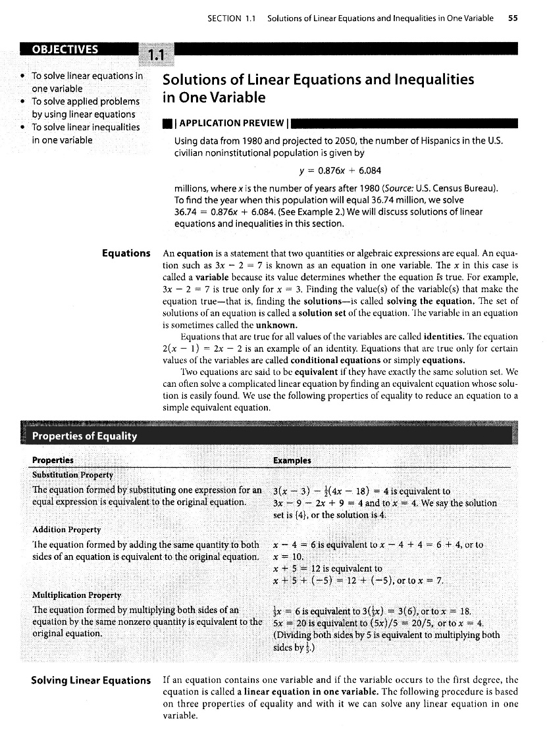
Example: Complex Layout Document.
For the layout like below, combination of automatic and manual actions will be required.

Slide 10
InftyReader: Minimum Requirements
The software recognizes only images carefully scanned, with minimum noise, in either 600 DPI or 400 DPI.
Image files have to be prepared in either TIF, PNG or PDF format. Gif files are not accepted.

Slide 11
Examples of Images That do not Meet InftyReader’s Minimum Requirements

Slide 12
Peripheral Dark Frame

Slide 13

Touched Characters

Slide 14


Broken Characters

Slide 15
InftyReader3: New Features

Slide 16
Cut-and-Paste Conversion
Using "Snapshot" function in AcrobatReader, one can cut out a math image in 600DPI from PDF STEM contents.
It is converted into an accessible form automatically and can be pasted into a Microsoft-Word/ChattyInfty document.
InftyReader recognizes it in the background, and a user can use this function in a similar manner to the ordinary cut and paste.

Slide 17
E-Born PDF
Originally produced in an electronical way such as LaTeX, Microsoft Word, etc.
Character information is embedded in it.

Slide 18
Recognition of STEM Contents in E-Born PDF
By making Use of character information analyzed by a PDF parsor, the current version of InftyReader can get a better recognition result.

Slide 19
Infty Assistive Tools (2): ChattyInfty3

Slide 20
What is ChattyInfty 3?
ChattyInfty 3 is a talking STEM editor. It can be used to edit the files processed (OCR’d) by InftyReader.
Once editing is complete, ChattyInfty 3 can export files into a wide range of accessible formats.

Slide 21
ChattyInfty 3: File Export Formats (1)
LaTeX
HTML
MathML
Microsoft Word XML
Spoken Text

Slide 22
ChattyInfty 3: File Export Formats (2)
DAISY 2.02 multimedia
DAISY 2.02 audio
DAISY 3 multimedia
DAISY 3 text (with audio for math)
DAISY 3 text-only
EPUB3 media overlays
EPUB3 no audio
EPUB3 iBooks media overlays

Slide 23
ChattyInfty3: Accessibility
Not only can read but also author STEM contents with speech.
Can share the same contents with sighted people.

Slide 24
ChattyInfty3: Multilingual Support

Slide 25
Multilingual Support in ChattyInfty3
English and Japanese versions have been developed since the very beginning of its release.
To release both versions efficiently/systematically, the definition of aloud reading, names of menu items, etc. are given independent on the main program.
←In principle, possible to develop other-language versions without reforming the main program, but there still remained some problems.

Slide 26
Multilingual-Support-Related Improvement
Unicode can be used on its main window.
The definition file for reading aloud math symbols and formulas, "ReadSetting.txt," is also represented in Unicode.
STEM terminology in menu items in "resource.xml" and "CodeMenu.tbl" can be replaced with local names.
Any SAPI5 voices can be selected for speech output.

Slide 27
New Localization Scheme
We have recently compiled a build tool for end-users to incorporate ReadSetting.txt and the other necessary files efficiently/systematically into ChattyInfty3 without our help.
←Allows themselves to customize ChattyInfty so that it can treat their local language.

Slide 28
A Model Case of ChattyInfty3 Localization: Vietnamese (1)
Situation in Vietnamese
Represented in alphabet with various (different eight types) accent marks, all included in Unicode.
Can be input with the ordinary keyboard by using an application, "Unikey."
Vietnamese SAPI5 TTS engines are rather of low quality, but available, anyhow.

Slide 29
A Model Case of ChattyInfty3 Localization: Vietnamese (2)
Supported by Japan International Cooperation System (JICS), "JICS NGO" Program.
Assistive Technology Developing Organization (ATDO) and our organization, sAccessNet have worked on developing the Vietnamese version of ChattyInfty3 in 2017 to provide with accessible STEM contents in DAISY.

Slide 30
New Features in the Next Version
Corresponds to languages using so-called "Grapheme Cluster“ such as Hindi, Nepali, etc.
Will be demonstrated at the EMPOWER 2018 Conference held in Sonipat, 25 – 27 Oct. 2018.

Slide 31
Contact Information
Infty Project:
URL: http://www.inftyproject.org/en/ and
NPO: Science Accessibility Net
URL: http://www.sciaccess.net/en/
E-mail: office@mail.sciaccess.net

