Slide 1

Concept & Practice of Inclusive Education at Ashoka University
Team: Reena Gupta heads the office along with Aditya Sen as a Deputy Manager.

Slide 2
About Ashoka University
Liberal arts education - literature, philosophy, mathematics, and social and physical sciences,
overall studies in a liberal arts degree program
A multidisciplinary education program with various choices of subjects across diverse disciplines
Pioneer in its focus on providing a liberal education at par with the best in the world
Offers a 3 years degree program with a choice of additional 4th year to help students apply abroad for higher education.
The pool of professors are from the best of the universities with plethora of knowledge, experience and expertise.
Encourages diverse learners and provides a supporting framework to accommodate the special needs for the students.
Various offices and centers are established to cater to socio emotional needs along with language related specific learning support.
Believes in providing opportunity to the deserving students and accommodates specific learning needs required to foster learning.

Slide 3
Office of Learning Support – How it Started?
Idea was New and Revolutionary
much needed change in higher education system
Beyond School – next to nothing
Support system should be extended throughout the education process
Multiple discussions and brainstorming sessions with the management
Management and the Founders believed in the idea – very strong backing from the then Dean of Academic Affairs

Slide 4
WHAT WE STARTED WITH in 2016
Objective of Inclusion
Widen student base
Social responsibility
Manage existing cases
Scope
Learning disabilities
Physical disabilities
Autism, Others?
Prepare for Inclusion
Culture
Policies
Practices

Slide 5
IN 2 YEARS …………..
Established in 2016
Was named as a “learning support” for the very fact that we realized academic guidance is for everyone who feels the need of it and not only for disabilities.
Academic support system for students with special needs
Has supported a significant number of students of which some have graduated from the University
Shifted gears and now acts as academic case manager for students with or without any special needs and support them through their academic journey at Ashoka
Organized various talks and guest sessions by eminent personalities on disability and challenges for students

Slide 6
How does OLS provide support?
Informal and Formal assessments
Recommend interventions
Provide Accommodations
Become Case Managers/Academic Coaches
Provide one-on-one remedial instruction

Slide 7
Student Engagement Journey
Outreach
Admissions
First year
Second year & beyond
Employability/Connect with the Industry

Slide 8
Challenges We Face
Required visibility of the office amongst students
Some areas still remain as reactive support than proactive – both students and the office
Regularity in interaction with students
Have more students use resources made available to them
Getting more students to apply to Ashoka

Slide 9
Statistical Review
2017-18
Types of Disability | Number of Students
Learning Disabilities | 8
Visual Impairment | 1
Hearing Impairment | 1
Loco-motor disability | --
Possibly Autism Spectrum | 1
Others (mental health concerns/temporary anxiety phases) | 19
TOTAL | 30

Slide 10
Way Forward
Collaborate with Outreach & Media:
Include Ashoka’s policy of inclusion in the outreach and media agenda.
Reach out to schools & organizations, have press releases and spread the word in every possible way.
Develop a Resource Hub for Curriculum Access:
Build an audio book library
Create course books in accessible format
Research and implementation of various assistive technology and pedagogical system
New initiatives for Accessibility
Physical accessibility: Infrastructure of the campus to be made accessible and barrier-free
Academic Accessibility: Assistive technology tools, Latest Test batteries, etc.

Slide 11
Resources
In-house
Conversion of academic content into following accessible formats:
LaTex
Audio Books
Daisy (in progress)
ePub (in progress)
Provision for scribes, audio recording and transcription
Support in classroom by T.As/T.Fs
In person time with professors, T.As/T.Fs, & tutors
Various assistive software repository with learning modules
Outsourced
Tactile graphs and maps
Braille prints of books and notes

Slide 12
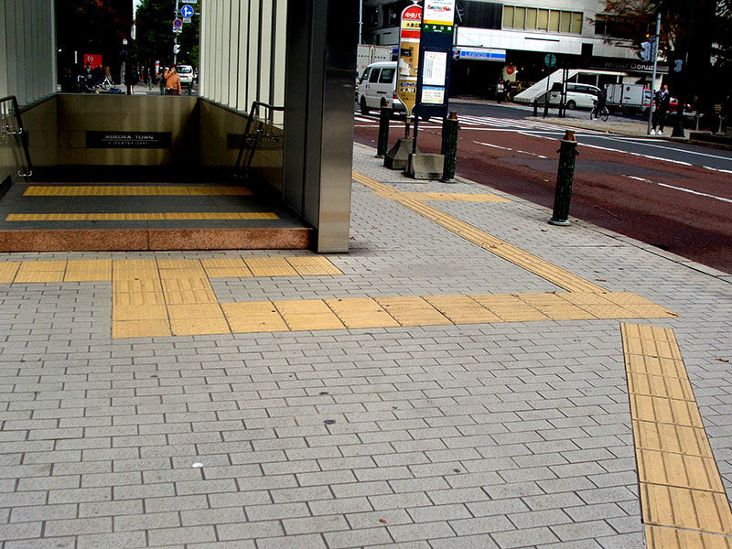
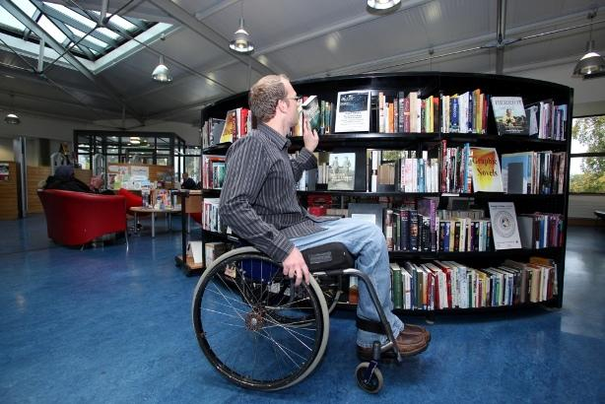
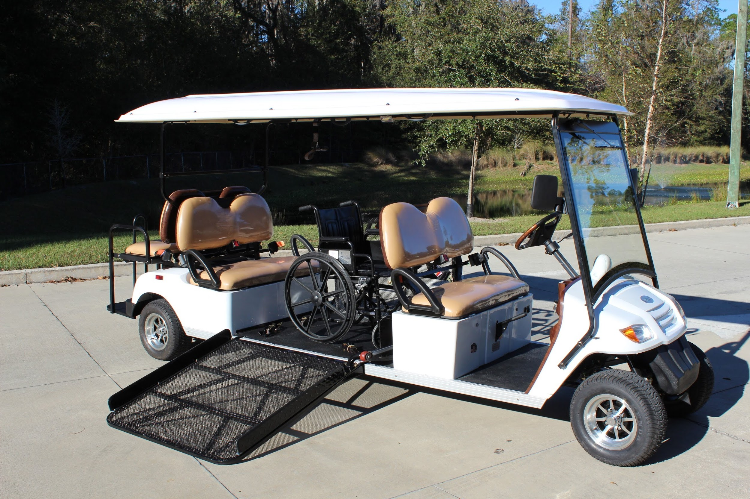
Physical Accessibility: In Plan
The infrastructure of the campus needs to be made accessible for visually impaired and wheelchair users.
Ramps provided on campus needs modifications to meet the recommended standards. Washrooms, library and common areas to be made accessible
Ashoka shuttle service and golf cart on campus to be made accessible

Slide 13
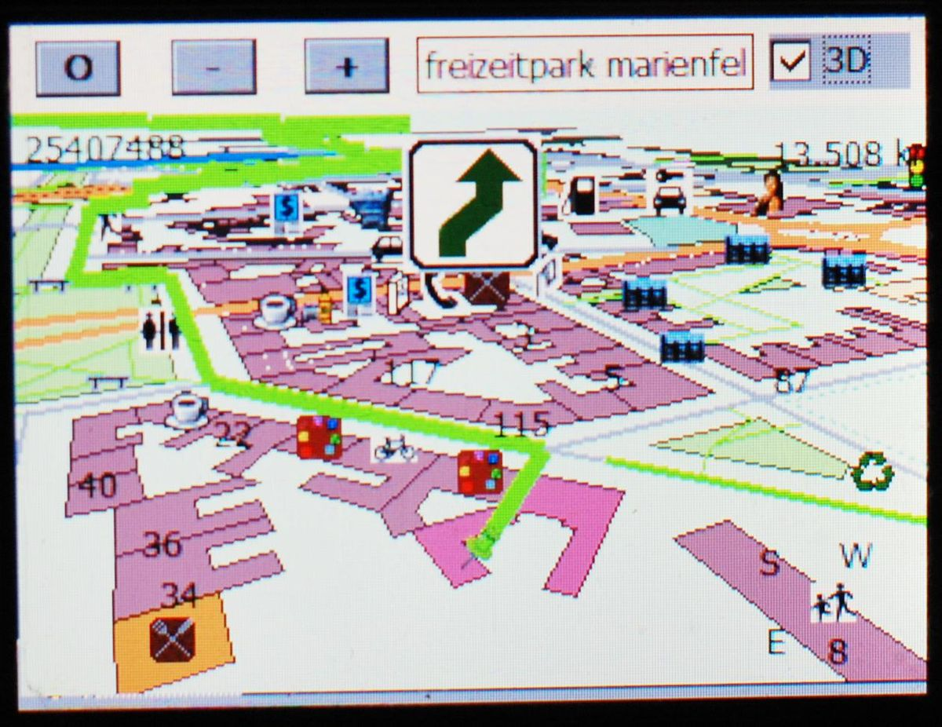
Digital Mapping: In Plan
Digital Maps can help visually impaired people navigate from one place to another without any dependency.
At Ashoka University, navigating from residence to classrooms and other student areas would be really easy with help of digital map of the campus.
As maps find out the shortest route, a barrier free pathway can be created for easy mobility.
This would also reduce a lot of retro fitting of tactile paths as we can only use them in direction of the map.

Slide 14
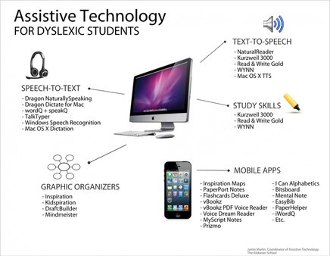
Academic Accessibility

Slide 15
Journey in a Glimpse….
Planned Outreach & Admissions
Visual and Hearing Impairment,
ESL support
Structured Framework
Physical Accessibility
Academic Accessibility - Assistive technologies
Volunteer support
Developing Collaborations/ Ecosystem
Include other disabilties including Autism/Asperger’s, loco-motor disabilities
Setup a center of excellence – a role model for university system in India
Only LD and ADD/ADHD
Support to other non-LD students
Provide classrrom & exam accommodations
Where we can be
Next steps
Where we have reached
Our original plan

Slide 16
Questions/Comments/Discussion?
Write to us on:
ols@ashoka.edu.in
Reena Gupta
reena.gupta@ashoka.edu.in
Aditya Sen
aditya.sen@ashoka.edu.in
Website: https://www.ashoka.edu.in/page/ols-68

