Slide 1
TOPIC: USE OF ELECTRONICS IN AGRICULTURE TO FIND SOIL FERTILITY
BY : NADEEM KHAN

Slide 2
CONTENT
LITTLE ABOUT AGRICULTURE.
CHEMISTRY OF COMPOUND.
PHYSICS OF EXPERIMENT.
INSTRUMENTATION.
ELECTRONICS OF EXPERIMENT.
HOW THE EXPERIMENT WILL BE PERFOMED

Slide 3
WHAT IS FERTILITY?
Soil fertility refers to the ability of a soil to sustain plant growth, i.e. to provide plant habitat and result in lasting constant yields of high quality. A fertile soil has the following properties:
It is rich in nutrients necessary for basic plant nutrition, including nitrogen, phosphorus and potassium
It contains sufficient minerals (trace elements) for plant nutrition, including boron, chlorine, cobalt, copper, iron, manganese, magnesium, molybdenum, sulphur, and zinc.
It contains soil organic matter that improves soil structure and soil moisture retention.
Soil pH is in the range 6.0 to 6.8 for most plants but some prefer acid or alkaline conditions.
Good soil structure, creating well drained soil, but some soils are wetter (as for producing rice) or drier (as for producing plants susceptible to fungi or rot, such as agave).
A range of microorganisms that support plant growth.

Slide 4
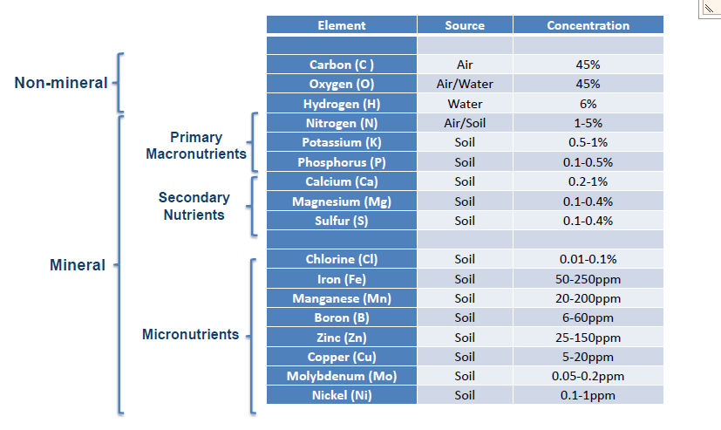

Slide 5
CONVENTIONAL METHOD TO CHECK MINERALS IN SOIL AND OTHER FACTORS
NITROGEN- KJENDAHL METHOD
PHOSPHOUS- BRAY’S METHOD
POTTASIUM- AMMONIUM ACETATE METHOD
pH- pH METER
WATER CONTENT- MOISTURE SENSOR

Slide 6
DRAWBACK OF CONVENTIONAL
METHOD
SKILLED PROFESSIONALS ARE REQUIRED.
TIME CONSUMING.
NOT VERY ACCURATE.
REQUIRE MUCH WORK.
EXPENSIVE.
THEY CAN’T MEASURE THE GRADIENT OF CONCENTRAION.

Slide 7
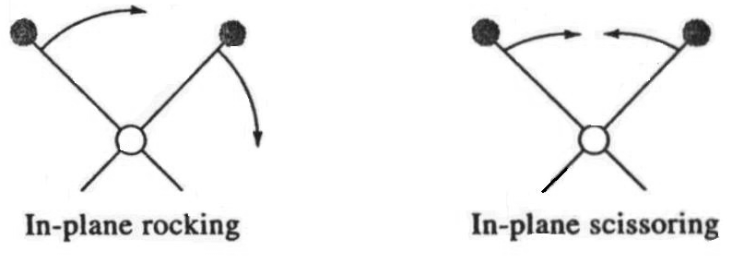
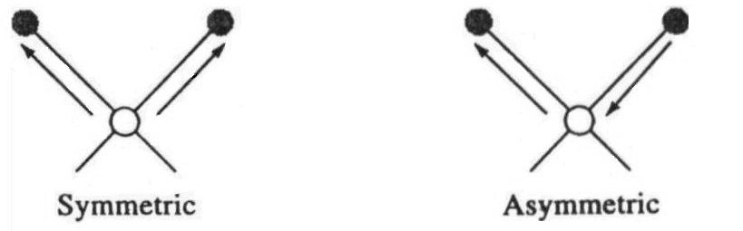
CHEMISTRY OF COMPOUND
TYPE OF VIBRATION
STRECTHING
BENDING
SYMMETRIC
ASYMMETRIC
SYMMETRIC
ASYMMETRIC

Slide 8
MOLECULE ALWAYS VIBRATE.
MOLECULE ABSORB ENERGY IN DICRETE FORM CALLED QUANTA.
ENERGY OF MOLECULE= ELECTRONIC ENERGY+ VIBRATIONAL ENEGRY+ ROTATIONAL ENERGY.
NON HARMONIC MOTION OCCUR DURING VIBRATION OF MOLECULE.

Slide 9
WHAT IS NIR SPECTROSCOPY
Spectrophotometric method using near infrared radiation.
Wavelength varies from 750nm to 2500nm.
Wavelength are measured in wavenumbers.

Slide 10
POINTS REGARDING NEAR INFRARED
IR ONLY MAKE THE TRANSITION IN VIBRATIONAL STATE OF MOLECULE.
ALL MOLECULE EXCEPT SYMMETRIC MOLECULE ABSORB NIR.
WHENEVER A MOLECULE ABSORB NIR, AMPLITUDE OF VIBRATION OF MOLECULE INCREASES.
DIFFERENT FUNCTIONAL GROUP ABSORB DIFFERENT FREQUENCY OF RADIATION.
BOND OF THE MOLECULE DOESN’T BREAK DURING ABSORPTION OF IR RADIATION.
MOLECULE ABSORB RADIATION BUT DOES NOT EMITT RADIATION BECAUSE ENERGY ABSORBED IS USED IN CHANGING THE DIPOLEE MOMENT OF THE MOLECULE.
TWO TYPE OF SPECTRAL BAND OCCUR DURING ABSORPTION OF IR RADIATION AND THAT ARE OVERTONE AND COMBINATIONAL BAND.

Slide 11
CRITERIA FOR ABSORPTION OF NIR
CORRECT WAVELENGTH OF RADIATION.
ONLY THOSE FREQUENCY ARE ABSORB WHICH MATCHES THE FREQUENCY OF VIBRATION.
CHANGE IN DIPOLE MOMENT
ONLY THOSE MOLECULE ABSORB RADIATION WHICH RESULTS IN CHANGE IN DIPOLE MOMENT.

Slide 12
ABSORPTION OF WAVELENGTH BY VARIOUS GROUPS

Slide 14
INSTRUMENTATION
NIR SOURCE: TUNGSTEN-HALOGEN SOURCE.
ANTENNA: TO DETECT THE TRANSMITTED WAVELENGTH. FOR THIS MOM(METAL OXIDE METAL) JUNCTION DIODE COUPLED TO A DIPOLE ANTENNA WILL BE USED.
TEMPRATURE SENSOR: TO MEASURE THE TEMPRATURE OF SOIL. FOR THIS LM35 WILL BE USED.
MOISTURE SENSOR: TO MEASURE THE WATER CONTENT SOIL.
pH SENSOR: TO MEASURE THE pH VALUE OF SOIL.
WIFI SENSOR: TO SEND THE DATA TO THE SERVER WHERE IT WILL BE MONITORED AND CORRESPONDING CONCENTRAION WILL BE CALCULATED.

Slide 15
METAL OXIDE METAL DIODE
IN THIS OXIDE LAYER IS SANDWITCH BETWEEN TWO METAL ELECTRODE CREATES A POTENTIAL BARRIER THROUGH WHICH ELECTRON TUNNELS.
THIS TUNNELING MECHANISM CAUSE THE RECTIFICATION OF APPLIED VOLTAGE.
ANTENNA COUPLED MOM DIODE WERE USED TO DETECT AND MIX THE SIGNAL OF 300GHz IN 1965 AND THE SIGNAL OF 36GHz IN 1981.
USED IN TWO CONFIGURATION: POINT CONTACT AND THIN FILM.
FOR LARGE APPLIED BIAS VOLTAGE, TUNNEL CURRENT DENSITY IS GIVEN BY:
V-I CHARACTERSTICS OF MOM DIODE:

Slide 16
ANTENNA USED FOR DETECTION OF NIR
METAL OXIDE METAL JUNCTION IS FABRICATED ON SILICON WAFER USING SINGLE ELECTRON LITHOGRAPHY.
SENSORS ARE FREQUENCY SELECTIVE AND CMOS COMPATIBLE.
QUANTUM TUNNELING OCCUR IN MOM DIODE.
THEY RECTIFIES THE HIGH FREQUENCY CURRENT INDUCED BY THE RADIATION.
DUE TO NON LINEAR RELATIONSHIP BETWEEN TUNNELING CURRENT AND APPLIED BIASED VOLTAGE, ANTENNA COUPLED AC VOLTAGE IS RECTIFED.

Slide 19
NIR SOURCE
SAMPLE
MONOCHROMATOR
MOM DIODE
ADC
SERVER
AT SERVER DIGITAL DATA FROM ADC WILL BE CONVERTED INTO CORRESPONDING CONCECNTRATION OF NUTRIENT.
SAMPLE LIBRARY OF NUTRIENT CAN ALSO BE CREATED IN SERVER FROM WHICH ADC VALUE IS COMPARED AND GIVES THE CORRESPONDING CONCENTRATION OF NUTREINT.

