Slide 1
Introduction to Data Analysis
Data Measurement
  Measurement of the data is the first step in the process that ultimately guides the final analysis.
  Consideration of sampling, controls, errors (random and systematic) and the required precision all influence the final analysis.
  Validation: Instruments and methods used to measure the data must be validated for accuracy.
    Precision and accuracy…Determination of error
    Social vs. Physical Sciences

Slide 2
Introduction to Data Analysis
Types of data
  Univariate/Multivariate
    Univariate: When we use one variable to describe a person, place, or thing.
    Multivariate: When we use two or more variables to measure a person, place or thing. Variables may or may not be dependent on each other.
  Cross-sectional data/Time-ordered data (business, social sciences)
    Cross-Sectional: Measurements taken at one time period
    Time-Ordered: Measurements taken over time in chronological sequence.
The type of data will dictate (in part) the appropriate data-analysis method.

Slide 3
Introduction to Data Analysis
Measurement Scales
  Nominal or Categorical Scale
    Classification of people, places, or things into categories (e.g. age ranges, colors, etc.).
    Classifications must be mutually exclusive (every element should belong to one category with no ambiguity).
    Weakest of the four scales. No category is greater than or less (better or worse) than the others. They are just different.
  Ordinal or Ranking Scale
    Classification of people, places, or things into a ranking such that the data is arranged into a meaningful order (e.g. poor, fair, good, excellent).
    Qualitative classification only

Slide 4
Introduction to Data Analysis
Measurement Scales (business, social sciences)
  Interval Scale
    Data classified by ranking.
    Quantitative classification (time, temperature, etc).
    Zero point of scale is arbitrary (differences are meaningful).
  Ratio Scale
    Data classified as the ratio of two numbers.
    Quantitative classification (height, weight, distance, etc).
    Zero point of scale is real (data can be added, subtracted, multiplied, and divided).

Slide 5
Univariate Analysis/Descriptive Statistics
Descriptive Statistics
  The Range
  Min/Max
  Average
  Median
  Mode
  Variance
  Standard Deviation
  Histograms and Normal Distributions

Slide 6
Univariate Analysis/Histograms
Distributions
  Descriptive statistics are easier to interpret when graphically illustrated.
  However, charting each data element can lead to very busy and confusing charts that do not help interpret the data.
  Grouping the data elements into categories and charting the frequency within these categories yields a graphical illustration of how the data is distributed throughout its range.

Slide 7
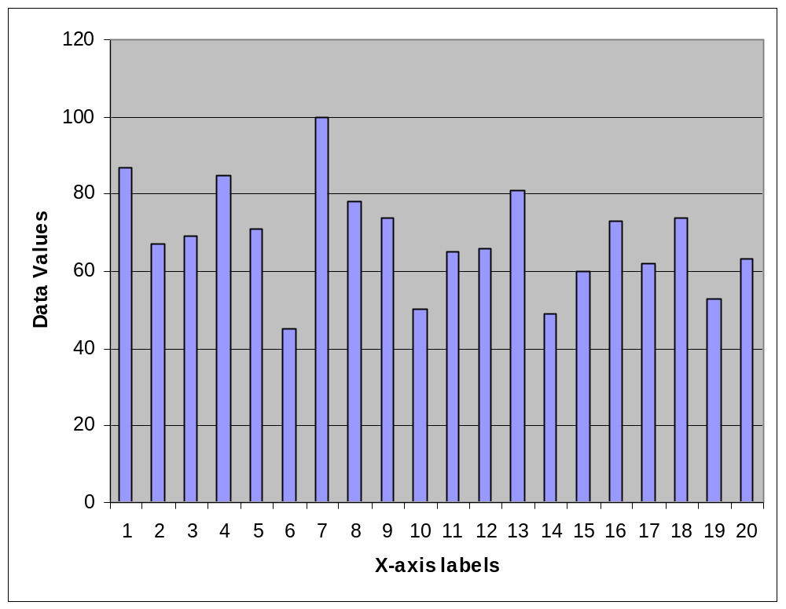
Univariate Analysis/Histograms
With just a few columns this chart is difficult to interpret. It tells you very little about the data set. Even finding the Min and Max can be difficult.
The data can be presented such that more statistical parameters can be estimated from the chart (average, standard deviation).

Slide 8
Univariate Analysis/Histograms
Frequency Table
  The first step is to decide on the categories and group the data appropriately.
  (45, 49, 50, 53, 60, 62, 63, 65, 66, 67, 69, 71, 73, 74, 74, 78, 81, 85, 87, 100)
Category Labels | Frequency
0-50 | 3
51-60 | 2
61-70 | 6
71-80 | 5
81-90 | 3
>90 | 1

Slide 9
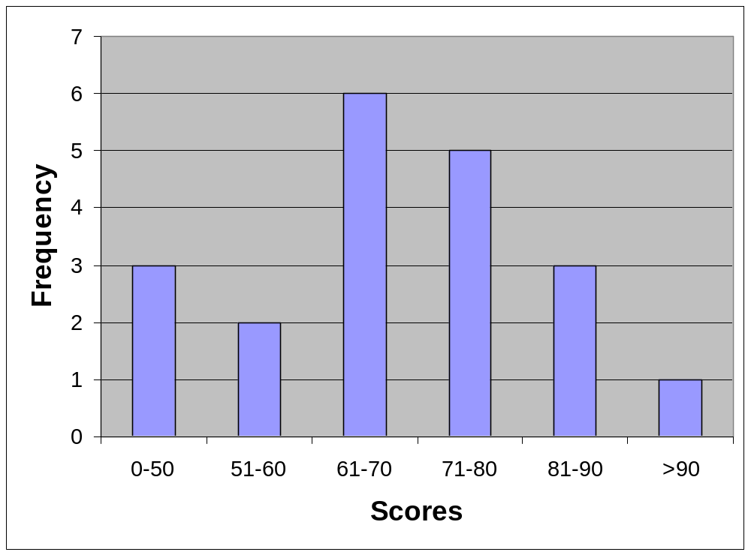
Univariate Analysis/Histograms
Histogram
  A histogram is simply a column chart of the frequency table.
Category Labels | Frequency
0-50 | 3
51-60 | 2
61-70 | 6
71-80 | 5
81-90 | 3
>90 | 1

Slide 10
Univariate Analysis/Histograms
Average (68.6) and Median (68)
Histogram
Mode (74)
-1SD
+1SD

Slide 11
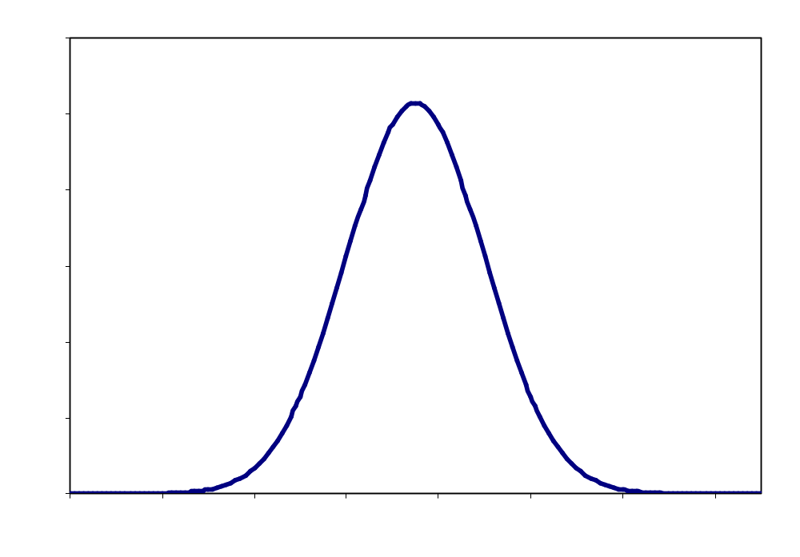
Univariate Analysis/Normal Distributions
Distributions that can be described mathematically as Gaussian are also called Normal
The Bell curve
  Symmetrical
  Mean ≈ Median
Mean, Median, Mode

Slide 12
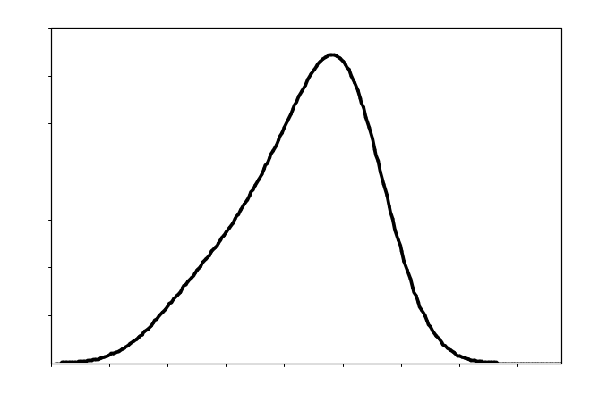
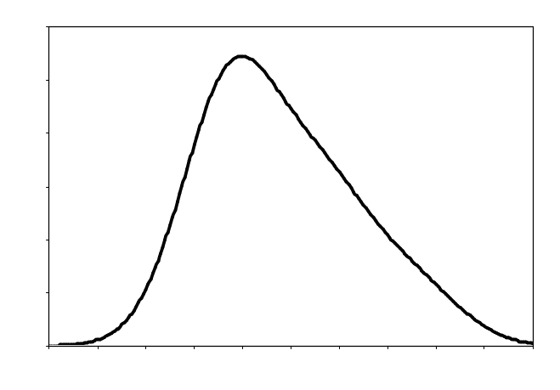
Univariate Analysis/Skewed Distributions
When data are skewed, the mean and SD can be misleading
Skewness
  sk= 3(mean-median)/SD
  If sk>|1| then distribution is non-symetrical
Negatively skewed
  Mean<Median
  Sk is negative
Positively Skewed
  Mean>Median
  Sk is positive

Slide 13
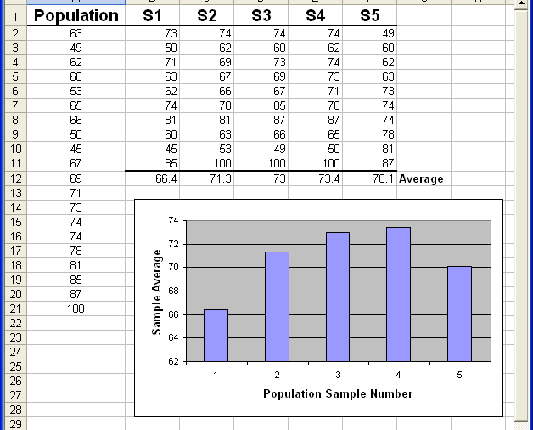
Central Limit Theorem
Regardless of the shape of a distribution, the distribution of the sample mean based on samples of size N approaches a normal curve as N increases.
  N must be less than the entire sample
        N=10

Slide 14
Univariate Analysis/Descriptive Statistics
The Range
  Difference between minimum and maximum values in a data set
  Larger range usually (but not always) indicates a large spread or deviation in the values of the data set.
  (73, 66, 69, 67, 49, 60, 81, 71, 78, 62, 53, 87, 74, 65, 74, 50, 85, 45, 63, 100)

Slide 15
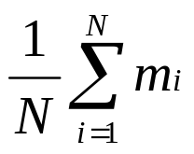
Univariate Analysis/Descriptive Statistics
The Average (Mean)
  Sum of all values divided by the number of values in the data set.
  One measure of central location in the data set.
  Average =
  Average=(73+66+69+67+49+60+81+71+78+62+53+87+74+65+74+50+85+45+63+100)/20 = 68.6
  Excel function: AVERAGE()

Slide 16
Univariate Analysis/Descriptive Statistics
0
2.5
7.5
10
The data may or may not be symmetrical around its average value
4.8
0
2.5
7.5
10
4.8

Slide 17
Univariate Analysis/Descriptive Statistics
The Median
  The middle value in a sorted data set. Half the values are greater and half are less than the median.
  Another measure of central location in the data set.
  (45, 49, 50, 53, 60, 62, 63, 65, 66, 67, 69, 71, 73, 74, 74, 78, 81, 85, 87, 100)
  Median: 68
  (1, 2, 4, 7, 8, 9, 9)
  Excel function: MEDIAN()

Slide 18
Univariate Analysis/Descriptive Statistics
The Median
  May or may not be close to the mean.
  Combination of mean and median are used to define the skewness of a distribution.
0
2.5
7.5
10
6.25

Slide 19
Univariate Analysis/Descriptive Statistics
The Mode
  Most frequently occurring value.
  Another measure of central location in the data set.
  (45, 49, 50, 53, 60, 62, 63, 65, 66, 67, 69, 71, 73, 74, 74, 78, 81, 85, 87, 100)
  Mode: 74
  Generally not all that meaningful unless a larger percentage of the values are the same number.

Slide 20
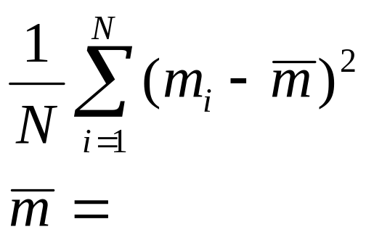
Univariate Analysis/Descriptive Statistics
Variance
  One measure of dispersion (deviation from the mean) of a data set. The larger the variance, the greater is the average deviation of each datum from the average value.
Variance =
Average value of the data set
Variance = [(45 – 68.6)² + (49 – 68.6)² + (50 – 68.6)² + (53 – 68.6)² + …]/20 = 181
Excel Functions: VARP(), VAR()

Slide 21
Univariate Analysis/Descriptive Statistics
Standard Deviation
  Square root of the variance. Can be thought of as the average deviation from the mean of a data set.
  The magnitude of the number is more in line with the values in the data set.
Standard Deviation = ([(45 – 68.6)² + (49 – 68.6)² + (50 – 68.6)² + (53 – 68.6)² + …]/20)^{1/2} = 13.5
Excel Functions: STDEVP(), STDEV()

