Slide 1
Creative Computing
Week 2

Slide 2
“FAVORITE SKETCHES”

Slide 3
Code Elements

Slide 4
call
argument
(or, parameter)

Slide 5
Anatomy of a Function Call Statement
ellipse( 50, 50, 80, 30 );
Arguments
Function name
Statement
terminator
Parentheses

Slide 6
What’s wrong?
size(200 200);
Background(102)
ellipse( 25,
30, 90
, 150 ,
150 ) ;

Slide 7
What’s wrong?
size(200, 200);
background(102);
ellipse( 25,
30, 90
, 150 ,
150 ) ;

Slide 8
Processing Canvas
size( width, height );
Set the size of the canvas
background( [0..255] );
Set the background grayscale color

Slide 9
Basic Shapes

Slide 12
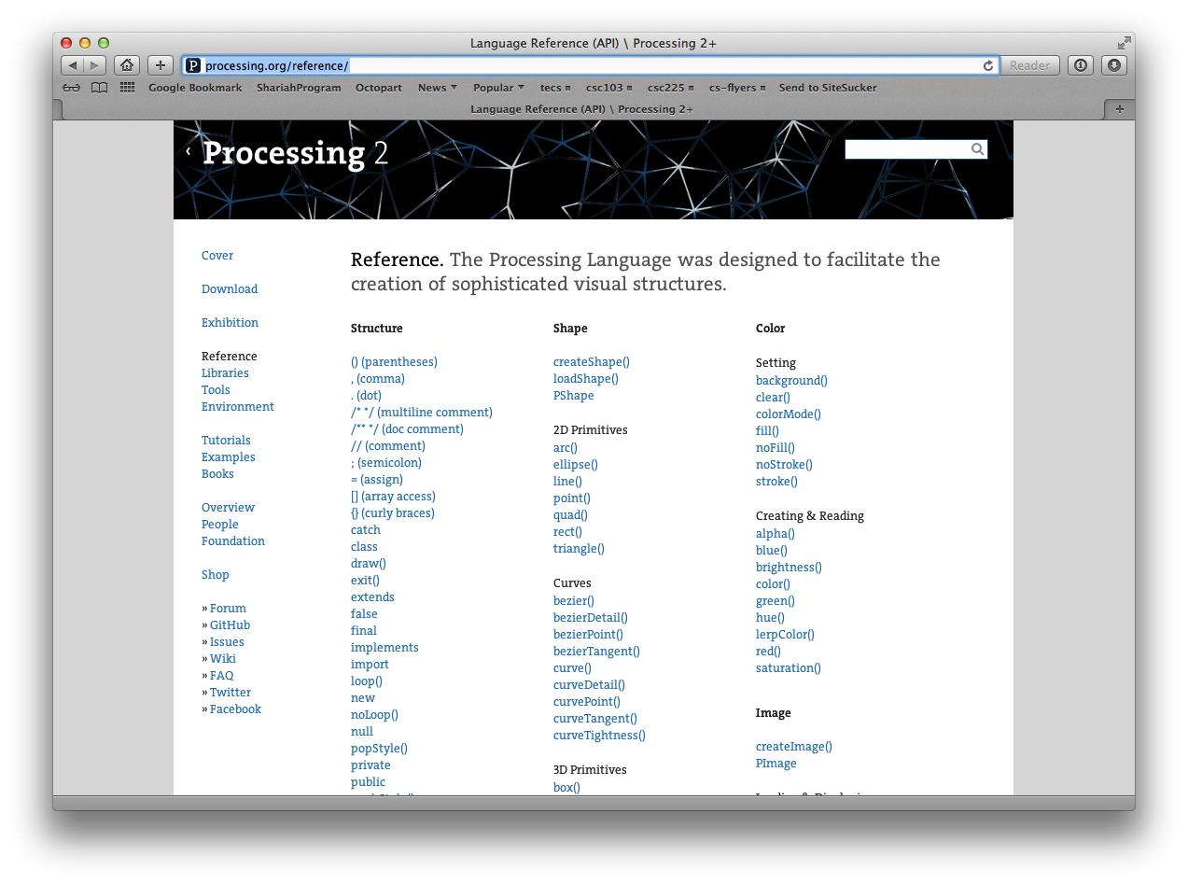
http://processing.org/reference

Slide 14

Colors
Image source: http://www.sxc.hu/assets/61/600129/palette-1135507-m.jpg

Slide 15
Fill Color
fill( gray );
fill( gray, alpha );
fill( red, green, blue );
fill( red, green, blue, alpha);
noFill();

Slide 16
Stroke (Line) Color
stroke( gray );
stroke( gray, alpha );
stroke( red, green, blue );
stroke( red, green, blue, alpha);
noStroke();

Slide 17
Why 0 … 255 ?
See 01.zip code (bits sketch)

Slide 18
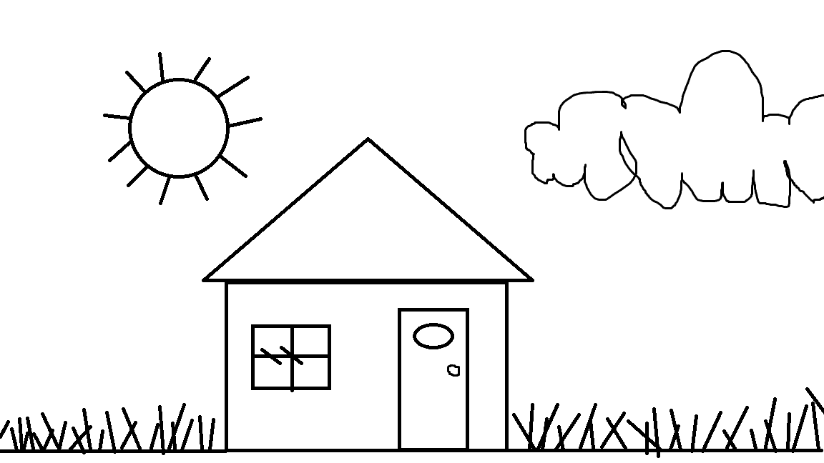
Exercise (Use http://processing.org/reference for reference)

Slide 19
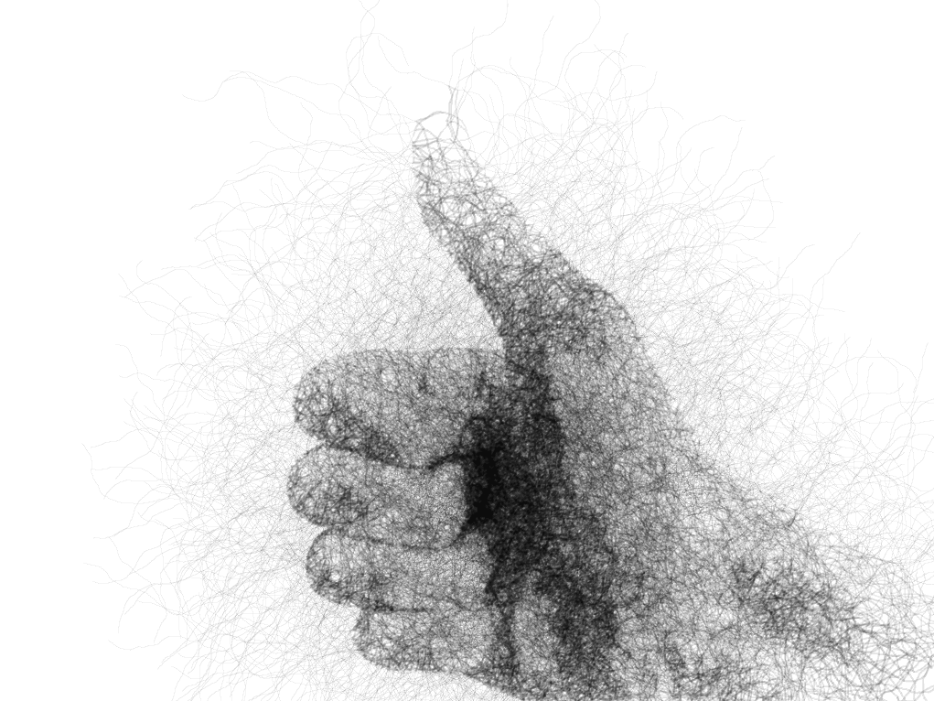

Slide 20
More SHapes

