Slide 1
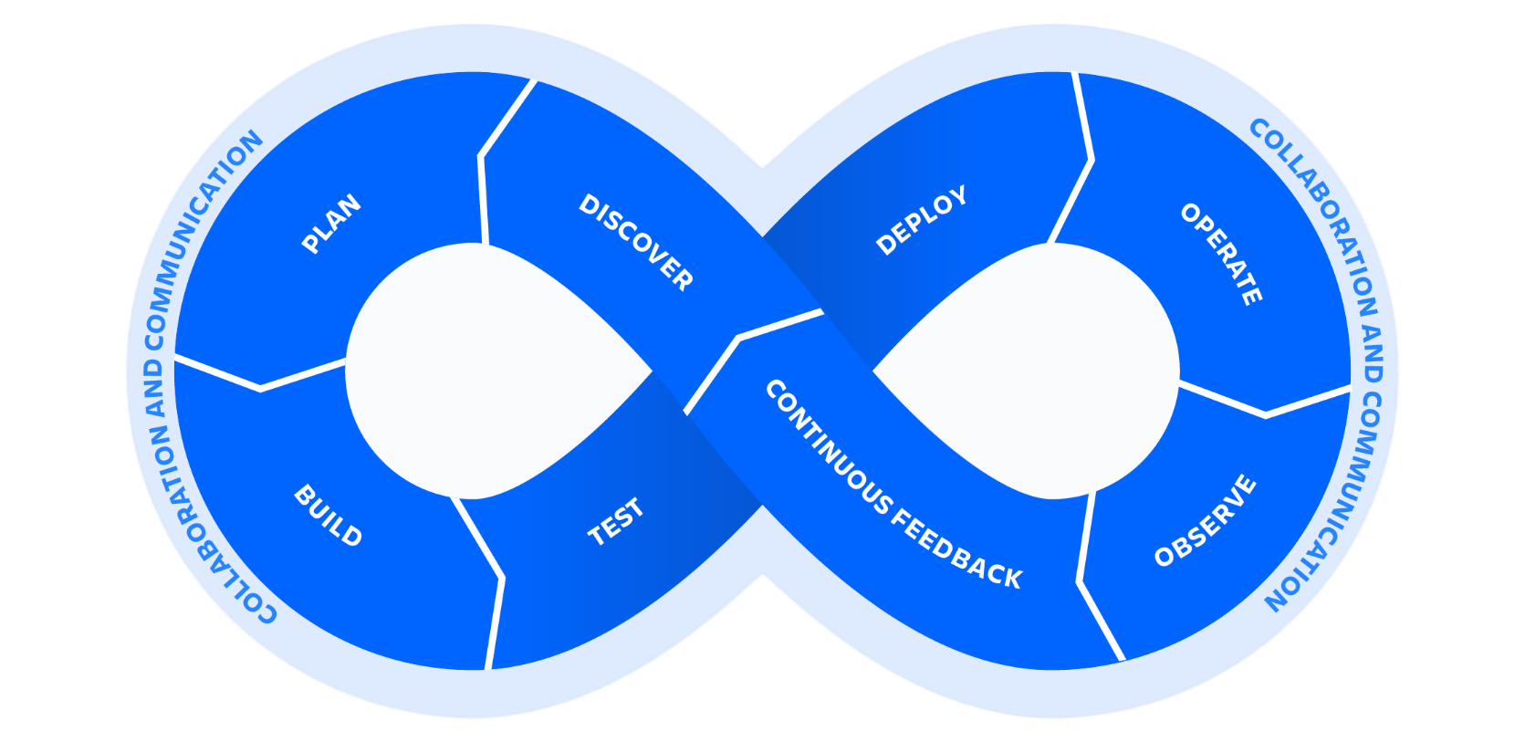

DevOps

Slide 2


What is DevOps ?

Slide 3

DevOps
Lets understand from Business perspective

Slide 4
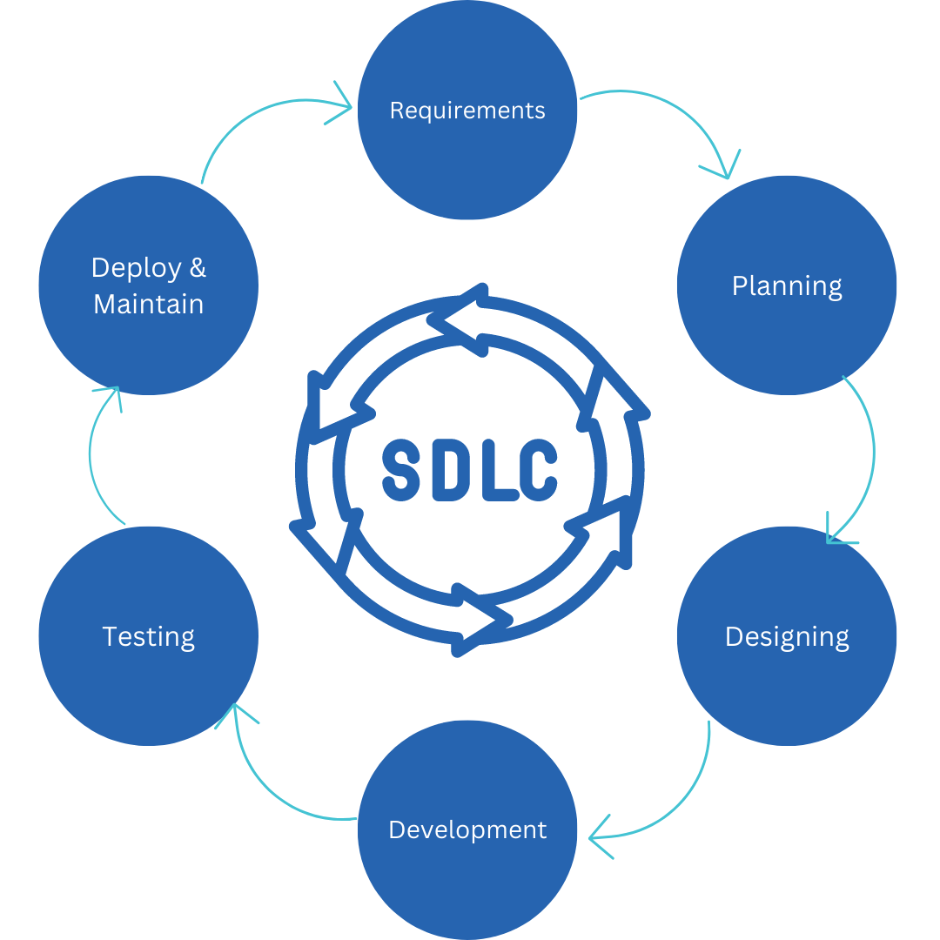
Software Development Lifecycle - SDLC

Slide 5
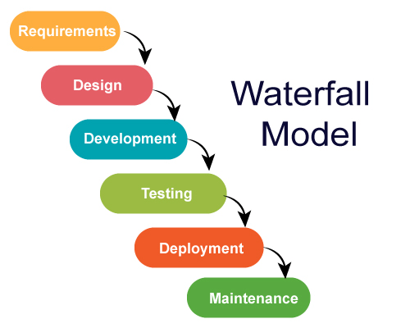
SDLC Models

Slide 6
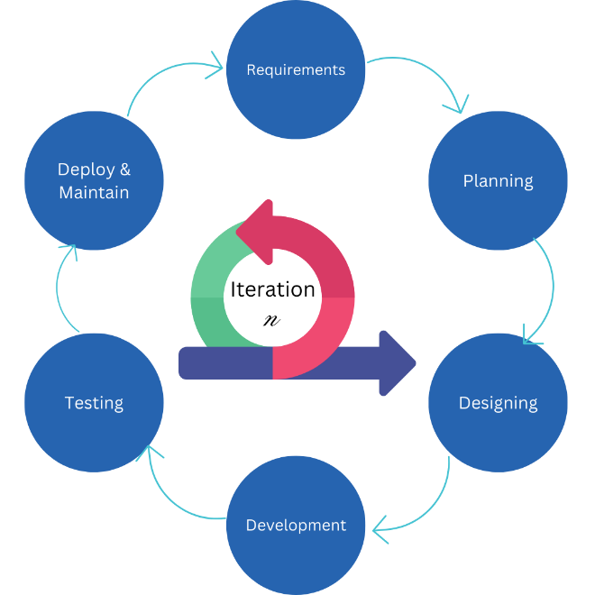
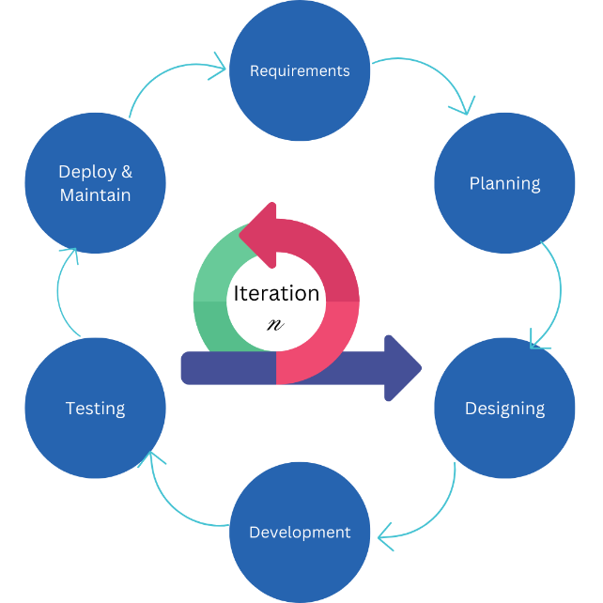
SDLC Models - Agile

Slide 7
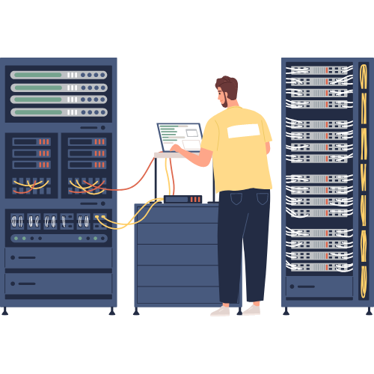
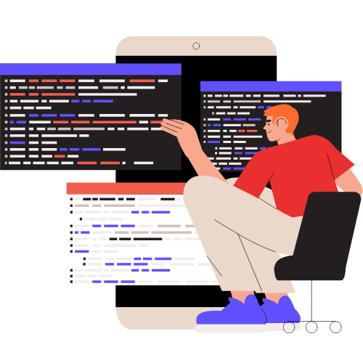
Dev vs Ops
“It works fine on my machine”
“Worked fine in DEV, its OPS problem now”
“Push code and pray”
“Its not the server it’s the code”

Slide 8
Dev vs Ops - Goals
Development
I want change
I want to add/modify features
Doesn’t deploy consistent software
Operations
I want stability
I want to create / enhance services
Motivation to resist change
ITIL driven
Security & Uptime

Slide 9
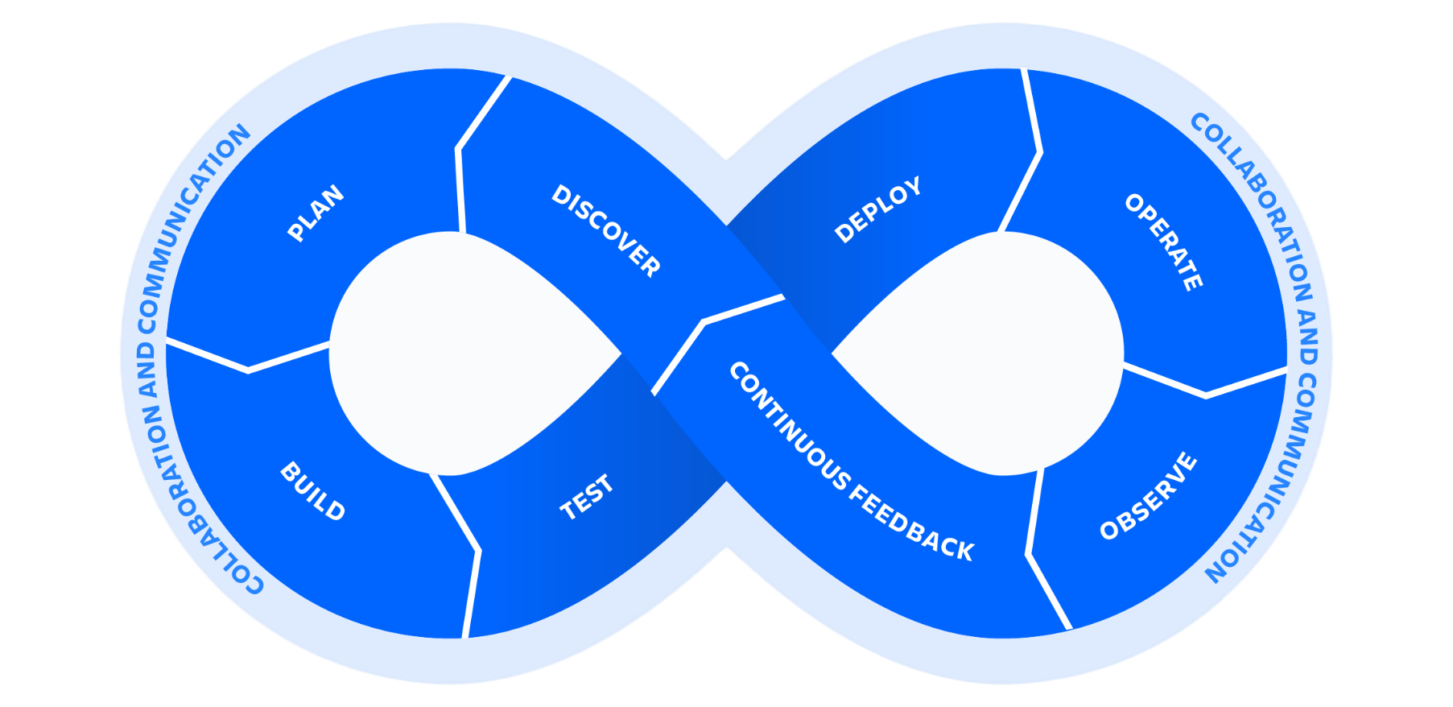
DevOps to business rescue

Slide 10
DevOps ?
DevOps is an approach to bridge the gap between Development and Operations
Its not a technology problem, but a business and cultural problem
DevOps is a grassroots movement, by practitioner, for practitioners
Aims to deliver software and services faster
DevOps is NOT tools, but TOOLS are essential for success in DevOps
DevOps is not a product
DevOps is not a Job Title

Slide 11
Understanding CI/CD
Use case scenario

Slide 12
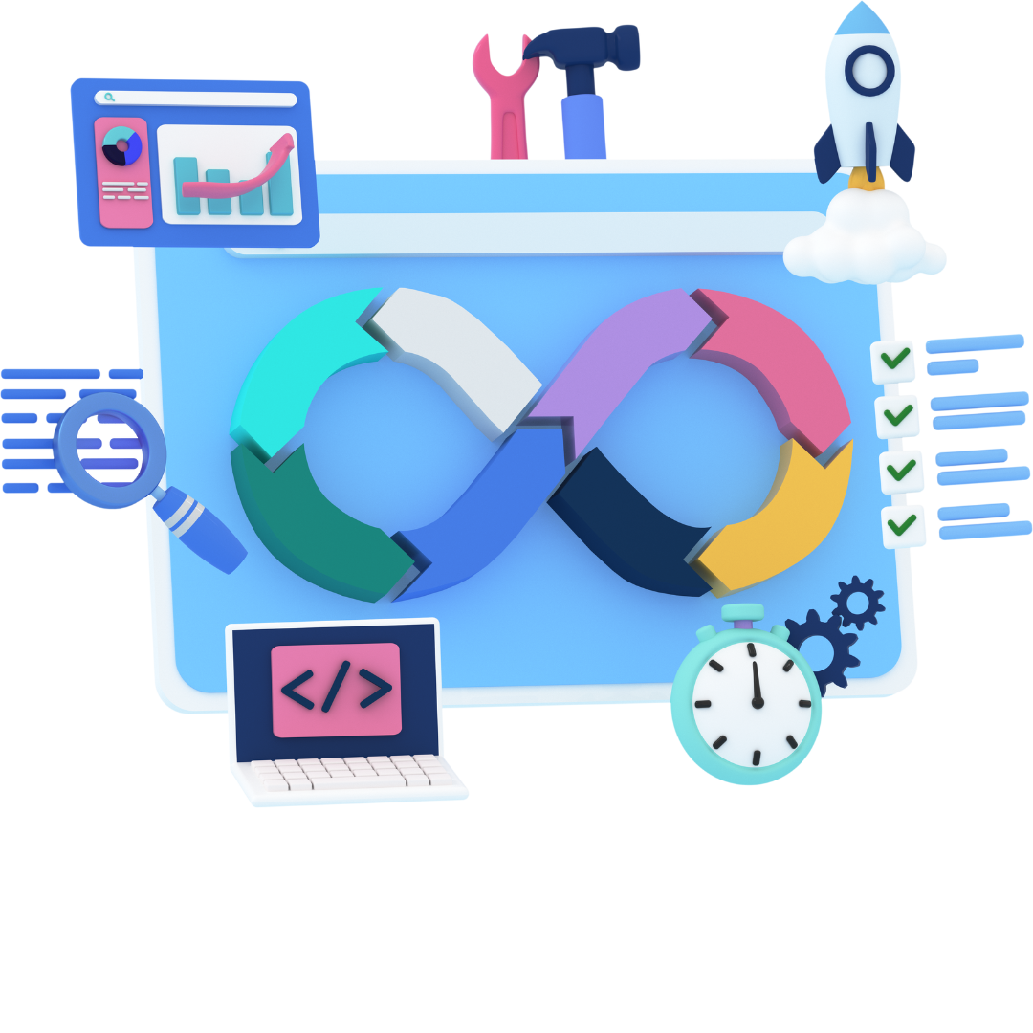
Implementing a full CI/CD Pipeline

Slide 13
SCM – Source Control Management
First Step
All code changes made by dev team are tracked in SCM
All pieces of pipeline need to interact with SCM
Git & GitHub
As an admin you need basic understanding
Version Control System

Slide 14
Remote Repo vs Local Repo
Remote Repo
GitHub
Local Repo
(Dev A)
Local Repo
(Dev B)
Local Repo
(Dev C)

Slide 15
Local Repo
Local Repository
Working Area
Staging
Committed Files

Slide 16

CI – Continuous Integration
Practice of frequently merging code changes
Code
Feed back
Build
Notify
Fetch
Test

Slide 17
Building and Packaging
Java : Ant, Maven, Gradle
Scala : sbt
NodeJs : npm, Grunt
PHP : Composer
Python : pip, easy_install

Slide 18
Automate Testing
After build, testing will be done
Its up to developers to write good tests
Types of tests
Unit Tests
Integration Tests
Regression Tests
AT (Acceptance Tests) | UAT (User Acceptance Tests)

