Slide 1


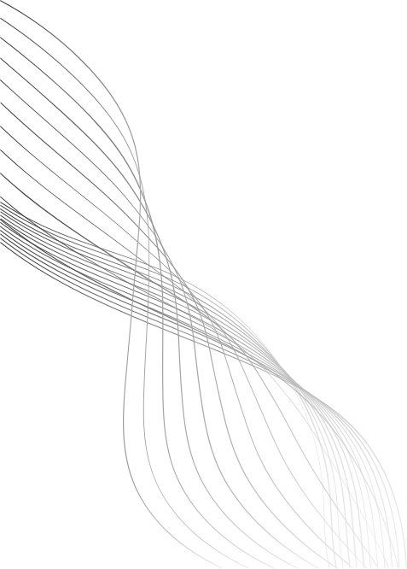
MACHINE LEARNING AND DATA SCIENCE - ENCS5341
Assignment #2
NADEEN JABER 1220044
TASNEEM SHELLEH 1220439
SECTION 2

Slide 2
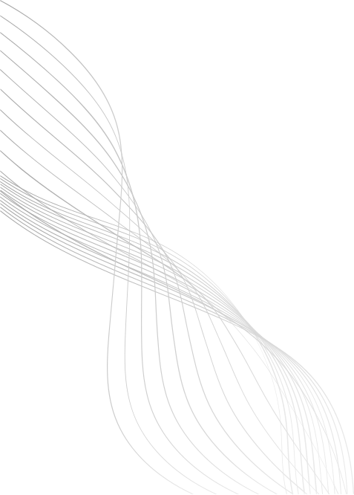
PART 1 – NON-LINEAR REGRESSION

Slide 3
OVERVIEW
part A: Ridge Regression (Polynomial Basis)
We generated 25 noisy samples from the function sin(5πx) and fitted polynomial regression models using different λ values. The goal was to compare how regularization affects overfitting and generalization.
Part B: Non-Linear Regression with RBFs
Using the same dataset from part A, we trained models with Gaussian RBF basis functions using different numbers of RBFs (K = 1, 5, 10, 50). We evaluated how model flexibility changes with K and which configuration generalizes best.

Slide 4
DATA SET
The dataset contains 25 samples with input values Xi ∈ [0,1], generated using np.random.seed() function
Each output is generated from the nonlinear function: y = sin(5𝜋𝑥) + 𝜀, where the noise term 𝜀 ∈ [-0.3,0.3], generated using np.random.uniform(-0.3, 0.3)

Slide 5
PART A: RIDGE REGRESSION IMPLEMENTATION
Polynomial Features: x → [1, x, x², ..., x⁹] (10 features = 9 "degree” + 1 “bias”) to capture non-linear relationships
Ridge Formula: θ = (XᵀX + λI)⁻¹Xᵀy
- θ: Model parameters/weights for each polynomial term
- λ: Regularization strength controlling model complexity
Lambda Values Tested: [0, 0.0001, 0.01, 1, 10]
- High degree polynomial (d=9) with limited data (n=25) suggests overfitting
risk, it typically requires regularization.
- Started with λ = 0 (unregularized), included very small λ (0.0001) to test
minimal regularization, extended to larger values (1, 10) to observe smoothing
effects.

Slide 6
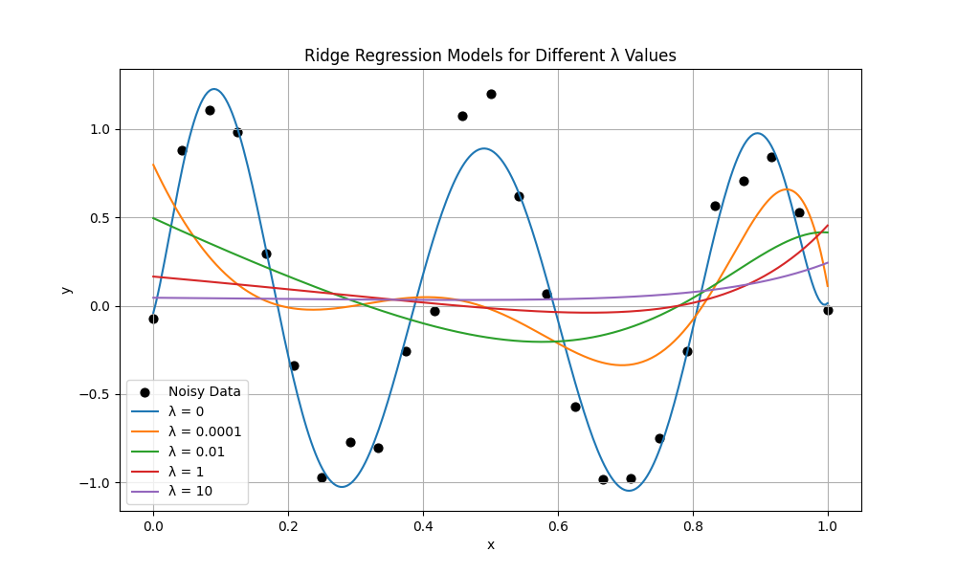
PART A: RIDGE REGRESSION OUTCOME
λ = 0: major overfitting, worst generalization.
λ = 0.0001: Overfitting is reduced, but still present.
λ = 0.01: optimal curve, best generalization.
λ = 1: Too smooth, underfitting.
λ = 10: smoother, underfitting, nearly linear.

Slide 7
PART B: NON-LINEAR REGRESSION WITH RBFS IMPLEMENTATION
Gaussian RBF Basis Functions: φⱼ(x) = exp(-(x - α)²/(2σ²))
- Centers α: K evenly-spaced points in [0,1], K ∈ {1, 5, 10, 50}
- Width σ: Adaptive scaling σ = 1.5 × (1/(K-1))
Design Matrix: Φ (N × K+1) ; N: number of data points, K: number of RBF centers, 1: for the bias (intercept) column
- Column 0: All ones, bias (intercept)
- Columns 1 to K: RBF activations for each center
Training: θ = Φ⁺y (pseudoinverse, no regularization)

Slide 8
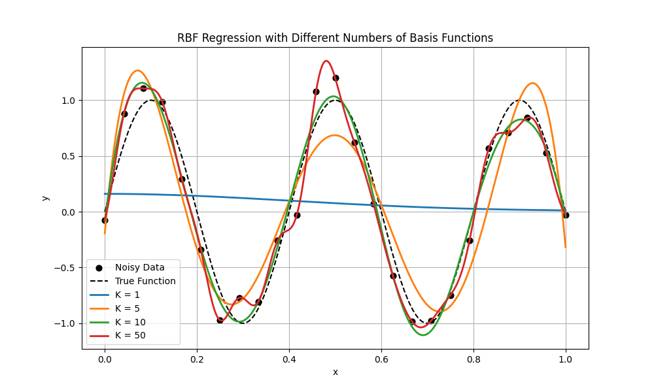
PART B: NON-LINEAR REGRESSION WITH RBFS OUTCOME
K = 1: Severe Underfitting, worst performance, nearly flat line.
K = 5: Underfitting, amplitude too low in some regions.
K = 10: Best generalization performance, optimal balance of flexibility.
K = 50: Overfitting, very close fit to data points.

Slide 9
KEY FINDINGS
part A: Ridge Regression Implementation
Polynomial regression is sensitive to model complexity (degree).
Increasing λ reduces overfitting but too large λ causes underfitting.
A moderate λ produces the smoothest and most reliable predictive curve.
Part B: Non-Linear Regression with RBFs
Increasing K improves the ability to fit nonlinear patterns, but large K causes overfitting, and small K causes underfitting.
RBFs provide smooth, localized control over the function.

Slide 10
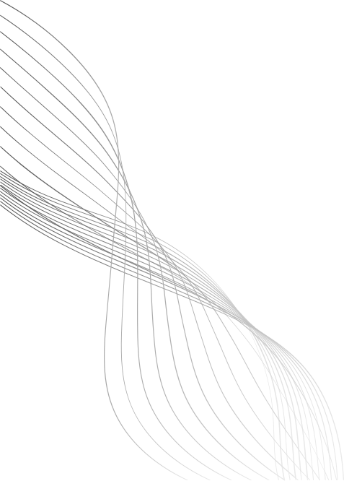
PART2 - CUSTOMER CHURN PREDICTION USING LOGISTIC REGRESSION

Slide 11
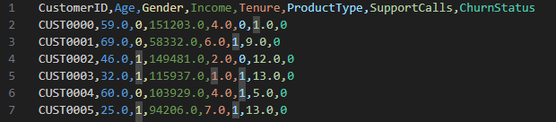
OVERVIEW
Objective: Predict customer churn using Logistic Regression
Dataset:
Total samples: 3,500 customers
Features: Age, Income, Gender, Product Type, Support Calls, Tenure
Target: Churn Status (0 = stay, 1 = Churned)

Slide 12
DATA PREPROCESSING
Preprocessing Steps:
Removed CustomerID
Handled missing values using median imputation
Standardization: Applied StandardScaler to all features
Stratified split to maintain class distribution
Data Split:
Train: 2500 samples
Validation: 500 samples
Test: 500 samples

Slide 13
LOGISTIC REGRESSION MODELS
Linear Logistic Regression: Basic model.
Polynomial Logistic Regression: Degrees 2, 5, 9 to capture non-linear relationships.
All models trained with:
class_weight='balanced' (critical for imbalanced data)
max_iter=2000-5000 for convergence

Slide 14
EVALUATION METRICS
Accuracy
Precision
Recall
F1-like score (used to select best model)
ROC Curve & AUC for model discrimination

Slide 15
RESULTS COMPARISON
Accuracy | f1 | Model | Precision | Recall
81.6% | 0.324 | Linear | 19.3% | 100%
88.2% | 0.416 | poly-2 | 26.6% | 95.5%
94.6% | 0.597 | poly-5 | 44.4% | 90.9%
95.4% | 0.623 | poly-9 | 48.7% | 86.4%
BEST MODEL SELECTED BASED ON F1-LIKE SCORE.

Slide 16
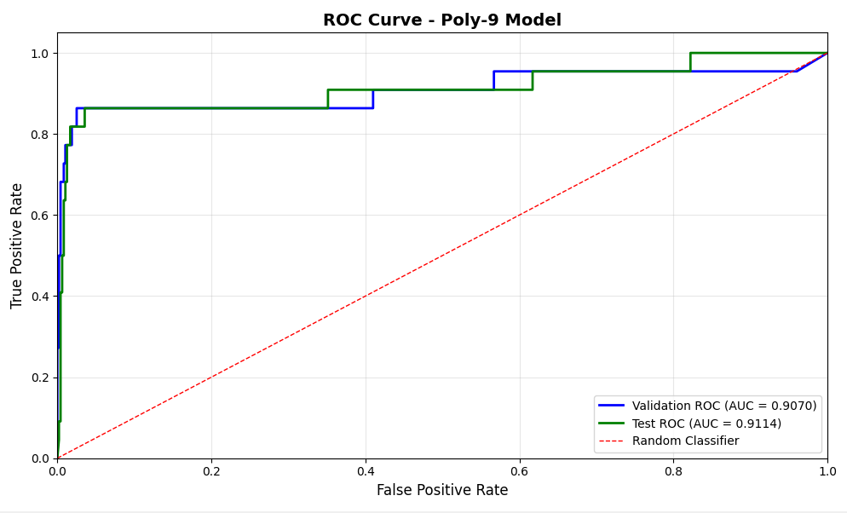
ROC CURVE ANALYSIS

Slide 17
KEY FINDINGS & INSIGHTS
Main Findings:
Class imbalance was critical to address
Without balancing: Models predict all as "No Churn"
With balancing: High recall achieved across all models
Polynomial features improve performance significantly
Linear: 81.6% → Poly-9: 95.4% validation accuracy
Trade-off between complexity and overfitting
Higher degree = Better fit BUT risk of overfitting
Poly-9 optimal for this dataset
Non-linear decision boundaries essential
Customer churn involves complex feature interactions
Simple linear model insufficient

