Slide 1


UEFA DATABASE INSIGHTS AND QUALITY ISSUES
Presented by: Nadeen Ahmed

Slide 2


TABLE OF CONTENTS
1
2
ATOS PAERTNERSHIP
DATA INSIGHTS
3
4
PROBLEM AND SOLUTION
QUALITY ISSUES

Slide 3



ATOS PARTNERSHIP
Atos is the Official Technology Partner for UEFA National Team Football (UNTF) until 2030.
This partnership aims to deliver technological support for UNTF and its competitions and will be fundamental to the organization’s technological evolution.
https://atos.net/en/services/sports-and-major-events/uefa#:~:text=Atos%20is%20the%20Official%20Technology,to%20the%20organization's%20technological%20evolution.

Slide 4


DATABASE OVERVIEW
400 Players
200+ Matches
1000
Player Stats
80
Transfer Records
20 Teams

Slide 5

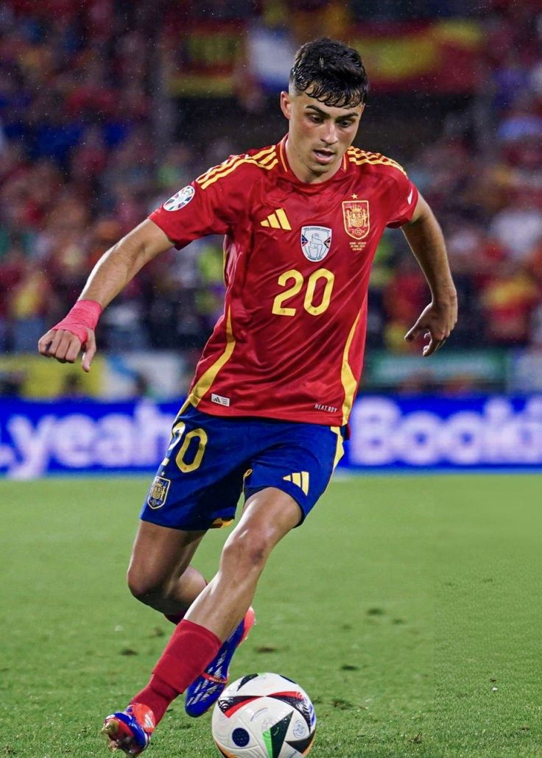
PROBLEM
Building a detailed player profile that includes:
Stats and performance metrics
Milestones
Transfer history

Slide 6

SOLUTION STEPS
DATA MODEL
MATERIALIZED VIEW
IDENTIFYING QUALITY ISSUES
AUDIT LOGS & TRIGGERS

Slide 7

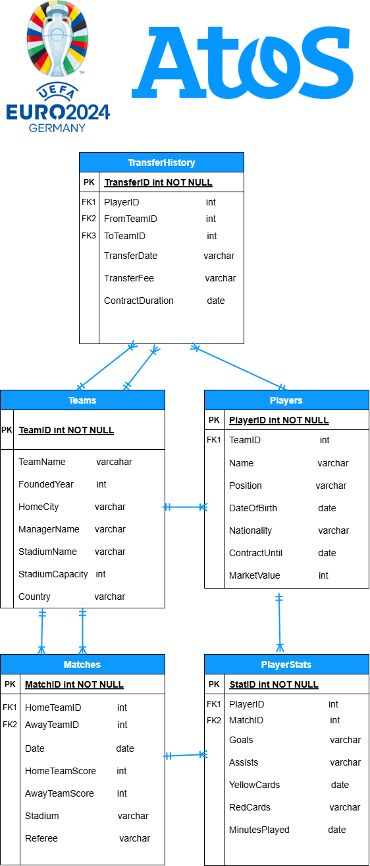
ERD MODEL
Entity relationship diagram

Slide 8

DATA QUALITY ISSUES
Referntial Integrity Issues
Missing Values
Duplicate Player Names
Player with ID = 31 didn’t exist in players table
399 values were missing in the assists column
27 duplicate player names
Goals By Goalkeepers
Early Transfers
Goalkeepers scoring more than 5 goals
Players transferring before contract end date

Slide 9

MATERIALIZED VIEW
Scored 3+ Goals in a Match
Total Goals & Assists
Estimated Matches Played
Average Minutes Played
Played in France or Germany
Age Between 25 and 30

Slide 10

Results
44 Player Profiles
Joined a French Team
Joined neither a French nor a German team
30%
38%
32%
Joined a German Team

Slide 11
8 milliseconds
Execution time for the optimized solution

Slide 12
AUDIT LOGS & TRIGGERS
log_id | team_id | action_type | old_manager_name | new_manager_name | change_date
1 | 1 | UPDATE | Marco Rossi | José Romero | 2024-11-09 13:08:23.849 +0200
2 | 21 | DELETE | Marcell Koller | NULL | 2024-11-09 13:17:36.775 +0200

Slide 13

THANKS!
If you have any questions, Messi knows all the answers
repo link: https://github.com/nadeenahmed/atos_task1_uefa_database

