Slide 1



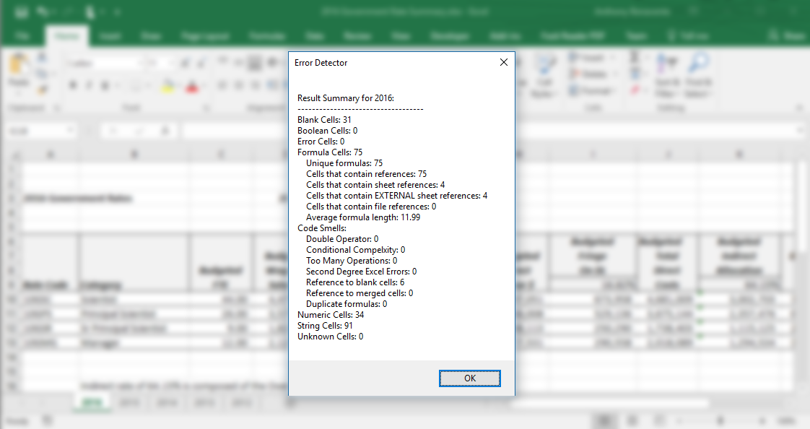



Excel-ent Research: Understanding Spreadsheet Use,
Creation, and Maintenance at
Anthony Benavente (ambenavente1@catamount.wcu.edu) and Nadeen Saleh (nsaleh2012@fau.edu)
PhD Student Mentor: Justin Smith (jssmit11@ncsu.edu)
Problem and Motivation
Spreadsheets are abundant, but little is known about how they are used in practice.
Findings
The resulting survey and interview data identified practices and problems related to the use, creation, and maintenance of spreadsheets.
What practices have helped improve the quality of your spreadsheets?
Population
Practice | Mentions
Look at existing spreadsheets | 11
Participate in training | 7
Use macros | 5
Seek help from colleagues | 5
Document spreadsheets | 5
Organize spreadsheets well | 5
Learn to use pivot tables | 5
Label data using tables | 1
Finalize formulas before formatting | 1
How often do you divide sheets into separate sections?
To better understand how spreadsheets are used, we surveyed and interview ABB employees.
Surveyed 180 respondents across 5 divisions and 26 business units , the typical user...
Uses
2–10 spreadsheets per week
Uses spreadsheets for
3–10 hours per week
Uses 2+ spreadsheets
daily, weekly, monthly, yearly
How often do you test spreadsheets you are given?
Spreadsheet Usage
End-users use a variety of Excel functions in their everyday work.
These functionalities serve a variety
of purposes.
Future Work
Spreadsheet Playground – Web application that enables users to learn different spreadsheet tools interactively.
Company forum – Website allowing users to address Excel problems through coworkers.
Error Detector – Plug-in for Excel that alerts users of poor practice (i.e. referencing error flagged cells).
Inexperienced users are less likely to apply best spreadsheet practices – this includes dividing and testing spreadsheets.
Interviewees frequently requested training in macros.
End-users turn to online resources for immediate help when working with spreadsheets. This includes end-users of all experience types.
This material is based on work supported by the National Science Foundation under Grant No. 1559593.
Our prototype detects code smells that are symptoms of bad practice in Excel programming.

