Slide 1
Exploratory Data Analysis 1st notebook
EDA is the core course of the Graduate Certificate in Data Science for chemistry and biology masters.

Slide 2
Importing Data and Introduction to Statistical Analysis
Day 2 of Exploratory Data Analysis for Scientists

Slide 3

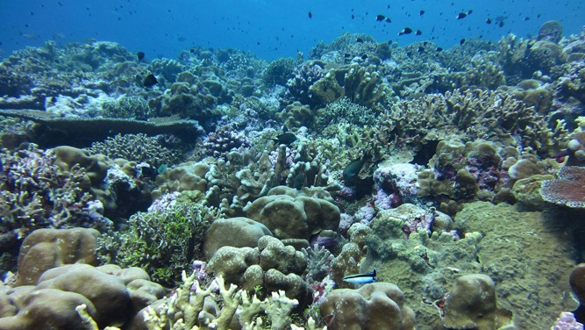
Today you will learn to:
Run R in a jupyter notebook
Import data from a csv file into a data frame
Analyze that data using statistics
Plot the data
Show the relationship between CO₂ concentration and the pH of the ocean
Woods Hole Oceanographic Institution
Notes:
https://www.whoi.edu/press-room/news-release/scientists-identify-how-ocean-acidification-weakens-coral-skeletons/

Slide 4
Jupyter notebook instructions
Install anaconda/jupyter and R
Make a folder called acidification
Download the notebook and the data that we will analyze
Put both into your new folder!
Open notebook through Anaconda and R environment.
Notes:
https://docs.anaconda.com/anaconda/navigator/tutorials/r-lang/

Slide 5
Jupyter notebook R & python
Jupyter notebooks can run R and python (kernels)
We are going to watch movies together through zoom.
Links to re-watch the videos will be available on the course website.

Slide 6

Ocean acidification is from CO₂
Global warming and climate change is an urgent crisis.
Our CO₂ pollution and rising temperatures have a cascading effect on all life and ecosystems.
We must study climate data and talk to people about the crisis.
Ocean acidification is one effect of CO₂ and increased temperature.
Coral reefs are especially sensitive.

Slide 7
Interview with Kaho Tisthammer
https://vimeo.com/426401182/6889b0858c

Slide 8
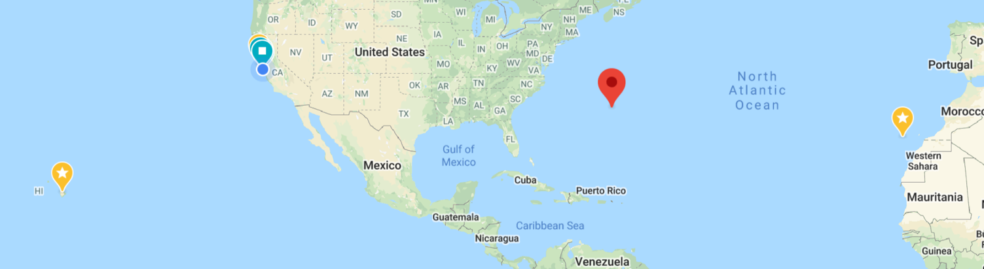
CO₂ and pH near Hawaii
The Environmental Protection Agency (EPA) provides free access to climate data.
The CO₂ and pH has been measured in Hawaii, the Canary Islands and Bermuda.
Let’s review some chemistry to see why atmospheric CO₂ increases ocean acidification (pH).

Slide 9
Chemistry of CO₂ and ocean pH
Video by Nicole Adelstein, SFSU Professor of Chemistry
https://www.dropbox.com/s/yqa1i1oyzae8qfz/pCO2_pH_lecture.mp4

Slide 10
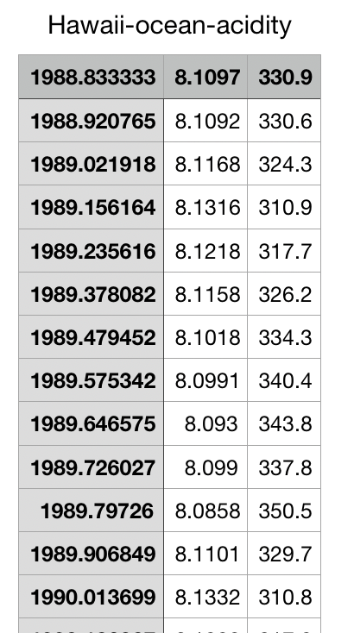
CO₂ and pH near Hawaii
We have cleaned/tidied the data.
You will learn to clean data soon.
The format of our cleaned csv data is show here:
CSV = comma separated variable

Slide 11
CO₂ and pH near Hawaii
We have cleaned/tidied the data.
You will learn to clean data soon.
The format of our cleaned csv data is show here:
CSV = comma separated variable
The CO₂ is measured in micro-atmospheres, a partial pressure of the total atmospheric pressure.
Date, pH, CO2 [mATM]

Slide 12
Importing data
We will use R to import and analyze data.
Video by Pleuni Pennings, SFSU Professor of Biology
https://vimeo.com/427422514/b092393284

Slide 13
Setting up your filesystem
Make a folder for this analysis, maybe called acidification.
Within that folder make another folder called Data
Download and move the Hawaii-ocean-adidity.csv data into your acidification/Data folder.
Your jupyter notebook needs to be in the acidification folder.
Or you can start by having the data and notebook in the same folder.

Slide 14
Scheme to import data:
Identify the structure of the data (set the structure, if you made the data)
Identify the location of the data - its path on your computer
Open that file in the script (generate a pointer to that file's location)
Read each line of the file (or read it all at once)
Save the data into appropriately named variables or a data frame

Slide 15
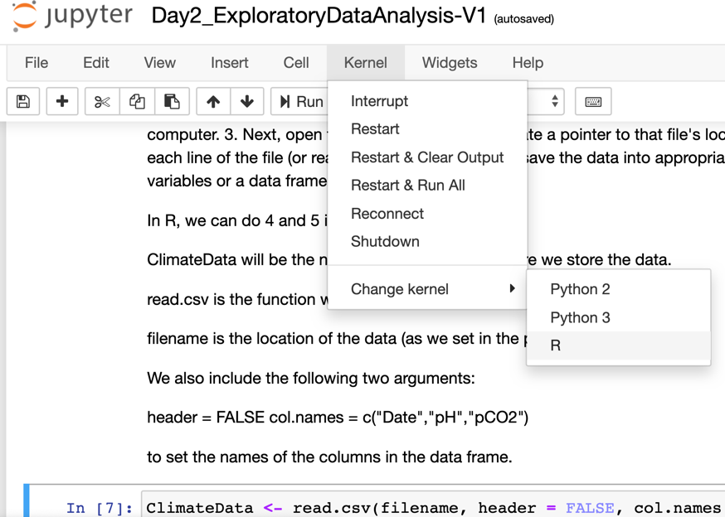
A brief note about kernels
You may have opened your jupyter notebook and the default language was python
To run our code, you need the R kernel.
Use the Kernel tab

Slide 16
Follow along instructions
Import data into dataframe called ClimateData using read.csv
Look at the data using
str(ClimateData)
head(ClimateData)
Summarize the data using
summary(ClimateData$Date)
On which date was the first measurement taken?
Determine the answer and check with your neighbor.

Slide 17
Measuring ocean acificiation
Does our data show ocean acidification?
If so, the pH should change (it should get lower).
One way to see if a number is changing is to calculate the mean and standard deviation.
σ_{pH} = 0.019
Mean pH = 8.091
Min pH = 8.042
The minimum pH is lower than the first standard deviation away from the mean: 8.091 – 8.019 = 8.072 > 8.042

Slide 18
Follow along instructions
Plot the data using plot()
Change the style from points to lines
Change more about the style and keep notes!
The thickness of lines
The colors of lines
Make a scatter plot

