Slide 1
From the margins to the mainstream Are far-right interpretations of Islam normalizing intolerance against Muslims and Migrants?
Liriam Sponholz, Anna-Maria Meuth, Sabrina Zajak
Council of European Studies – 28th Conference, Lisbon, 29th June - 1st July

Slide 2
Research question
whether, how and under what conditions far-right interpretations of Islam as radical change public discourse, thereby pushing for the normalization of intolerance and racism against migrants and Muslims?

Slide 3
Our topic today
whether, how and under what conditions far-right interpretations of migration and Islam were normalized in the German Parliament election campaign 2021 on Facebook?

Slide 4
Normalization
incorporation of fringe ideology into the mainstream
not only of politics, but also of popular culture and other fields
the transformation from word to deed, (from announcement to building a wall or a fence)
an adaptation of mainstream parties to the far-right agenda of right-wing populist Parties
leading to an exclusive focus on migration and refugee policy
Deliberate impoliteness, lies, insults, destructive (eristic) argumentation and intentional breaches of taboos
From the backstage to the frontstage (Wodak, 2020,43; 2018, 323)

Slide 5
Electoral Context
Source: Deutscher Bundestag

Slide 6
Method and Research design
Research question
Method
Research design
Are far-right patterns of interpretation of Migration and Muslims being adapted by other parties and politicians in the election campaign?
Manual and automated content analysis
Identity factors (Origin/nationality, race and ethnicity, religion, gender and sexual orientation)
Posts (n=4,697) on Facebook pages of parties and politicians (n=67) in the last four weeks before the election

Slide 7
Mechanisms of Normalization and its empirical operationalization
An exclusive focus on migration and Islam
Issue salience of migration and Islam on Facebook posts of mainstream parties and the far-right party

Slide 8
Mechanisms of Normalization and its empirical operationalization
An adaptation of mainstream parties to the far-right agenda
Problem definition of migration and Islam on Facebook posts of mainstream parties and the far-right party

Slide 9
Mechanisms of Normalization and its empirical operationalization
Deliberate impoliteness, lies, insults and intentional breaches of taboos
Use of derogatory (group) language, threats and incitement to discrimination, hatred, contempt or violence (Hate Speech, cf. UNO 2020)

Slide 10
Mechanisms of Normalization and its empirical operationalization
From the back stage to the front stage
Differences between the far-right Facebook posts of the top candidates, members of Parliament and non-parliamentary actors

Slide 11
Corpus

Slide 12
There is not an exclusive focus on migration and Islam

Slide 13
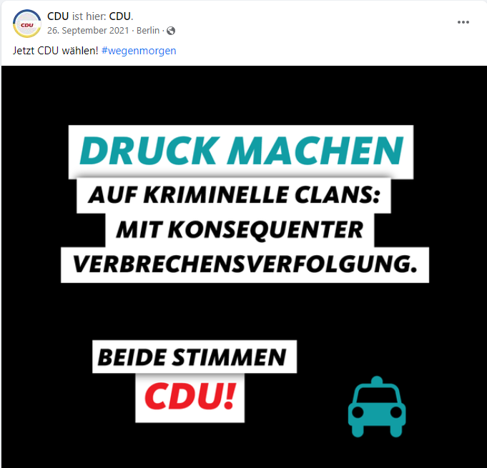
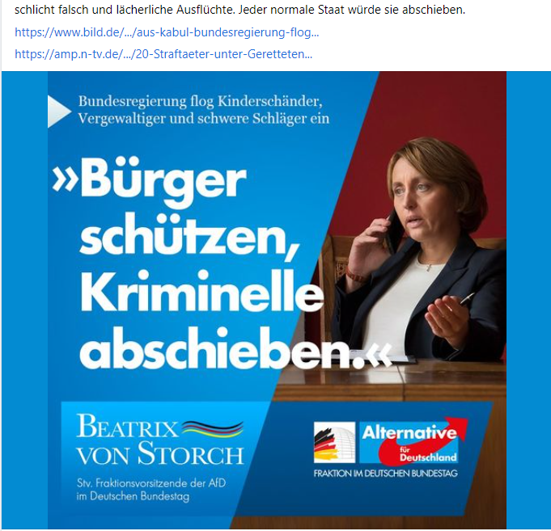
There is an adaptation of mainstream parties to the far-right agenda

Slide 14
Instead of derogatory (group) language and threats, incitement to discrimination, hatred and contempt

Slide 15
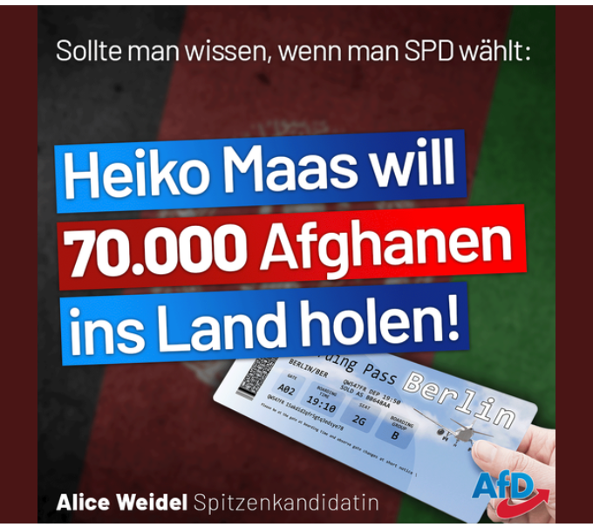

There are differences among far-right Facebook pages

Slide 16
Conclusion and Discussion
In the political communication of parties and politicians on Facebook during
the election campaign to German Parliament in 2021 :
There were substantial differences on issue salience, but a convergence regarding the definition of migration and migrants as a problem that requires action
There was not an exclusive focus on migration and Islam, but there was an adaptation of the mainstream right to the agenda of the far-right
This adaptation does not mean the use of derogatory language, but rather of incitement to hatred, contempt and discrimination
There are differences between the Facebook pages within the far right, but not with clear boundaries between front stage and back stage

