Slide 1
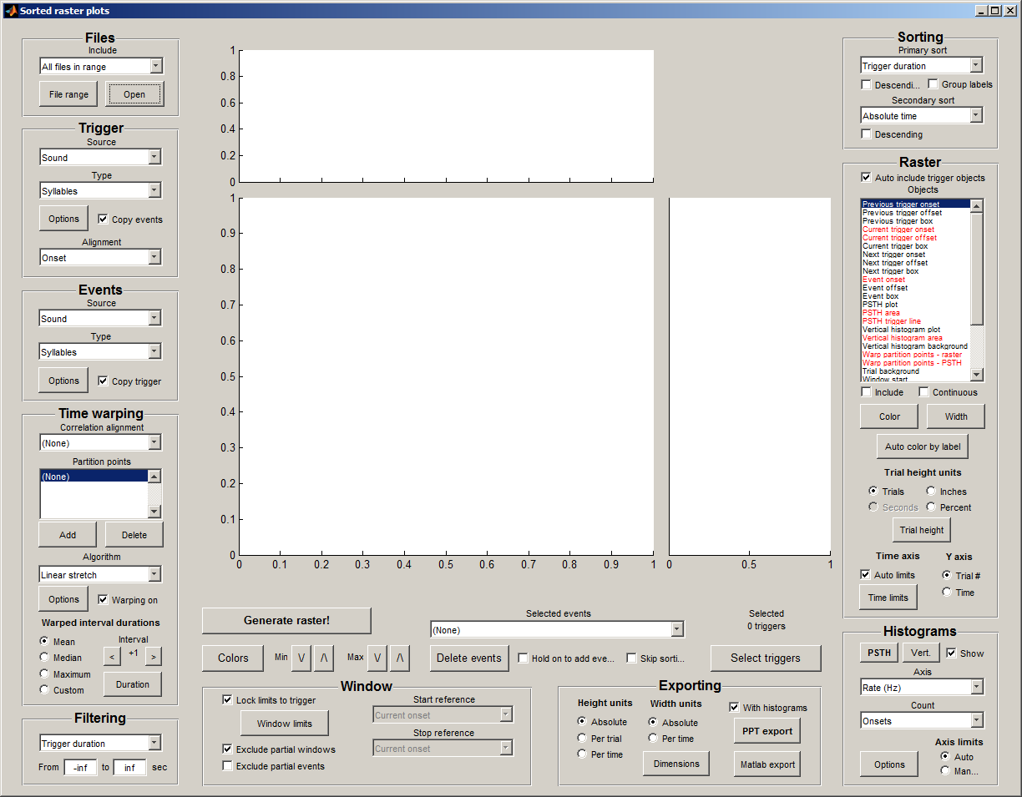
TriggerSyllIncluded
TriggerSyllExcluded
TriggerMotifSequence
TriggerBoutInterval
TriggerBoutMinDuration
TriggerBoutMinSyllCount
TriggerBurstMinFreq
TriggerBurstMinCount
TriggerPauseMinDuration
PrimarySortBy
FileRange
PrimarySortDirection
PrimarySortGroupLabels
SecondarySortDirection
SecondarySortBy
TriggerSource
TriggerType
EventSyllIncluded
EventSyllExcluded
EventMotifSequence
EventBoutInterval
EventBoutMinDuration
EventBoutMinSyllCount
EventBurstMinFreq
EventBurstMinCount
EventPauseMinDuration
Alignment
RasterElements
EventSource
EventType
RasterTrialHeightUnits
RasterTrialHeight
RasterTrialOverlap
RasterInchesPerSec
RasterXLimAuto
FilterByTriggerDuration
FilterByPrevTriggerOnset
FilterByPrevTriggerOffset
FilterByNextTriggerOnset
FilterByNextTriggerOffset
FilterByPrevEventOnset
FilterByPrevEventOffset
FilterByNextEventOnset
FilterByNextEventOffset
FilterByFirstEventOnset
FilterByFirstEventOffset
FilterByLastEventOnset
FilterByLastEventOffset
FilterByNumberOfEvents
FilterByIsInEvent
RasterXLim
RasterYAxis
BackgroundColor
WindowLimits
Hold
SkipSorting
ExportWidthUnits
PsthShow
VerticalHistogramShow
PsthYUnits
VerticalHistogramYUnits
PsthCount
VerticalHistogramCount
HistogramYLimMode
LockLimitsToTrigger
ExcludePartialWindows
StartReference
ExportHeightUnits
ExportPSTHHeight
ExportHistHeight
ExportInterval
ExportResolution
ExportWidth
ExportHeight
PsthBinSize
PsthYLim
PsthSmoothing
VerticalHistogramBinSize
VerticalHistogramYLim
VerticalHistogramSmoothing
ExcludePartialEvents
StopReference

