Slide 1
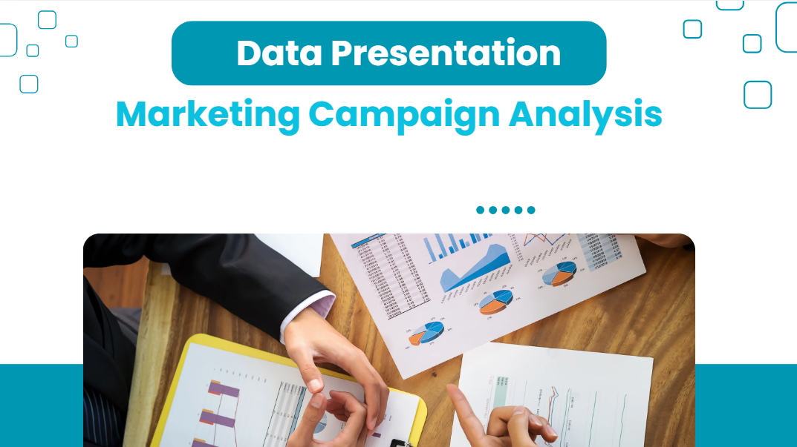
02
03
Data Presentation
Marketing Campaign Analysis

Slide 2
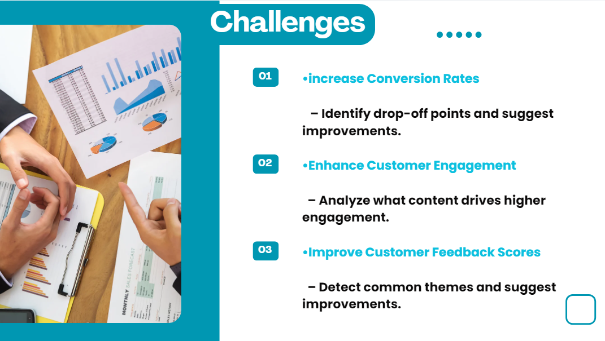
Challenges
increase Conversion Rates
– Identify drop-off points and suggest improvements.
Enhance Customer Engagement
– Analyze what content drives higher engagement.
Improve Customer Feedback Scores
– Detect common themes and suggest improvements.

Slide 3
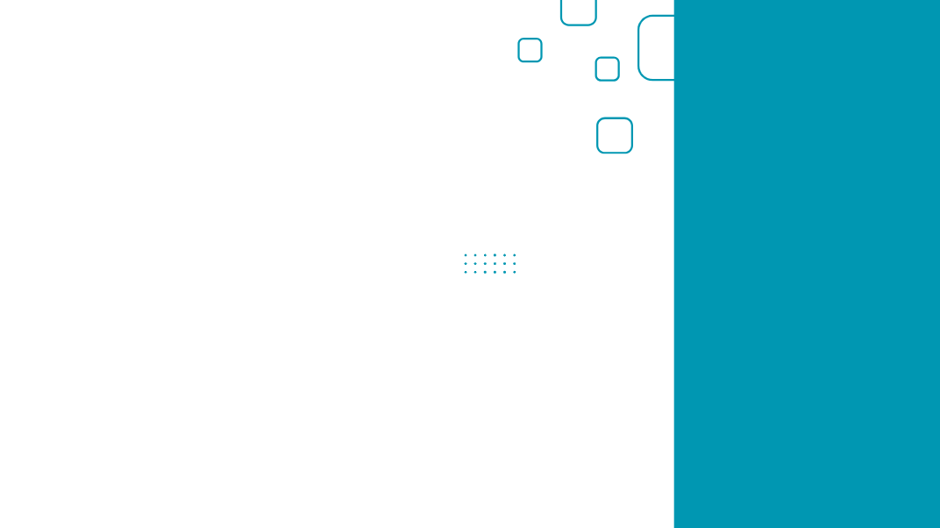
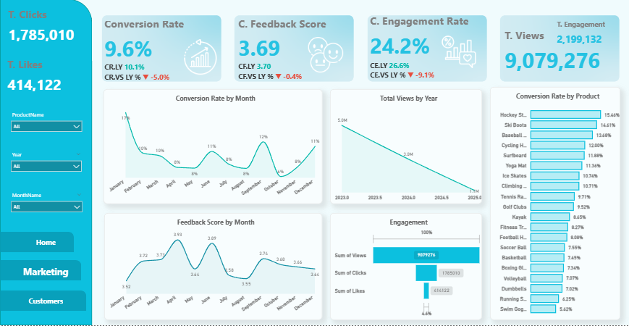
Conversion Rates
•Traffic Freefall: Total annual views dropped from 5.0M (2023) to 1.1M (2025), a staggering ~78% decrease in two years.
•Deceptive Stability: While the 9.6% Conversion Rate looks healthy, it is applied to a shrinking audience, indicating a total failure in new user acquisition.
•Product Performance Gap: Conversion varies wildly from 15.46% (Hockey Stick) to as low as 5.62% (Swim Goggles), showing inconsistent marketing effectiveness.

Slide 4
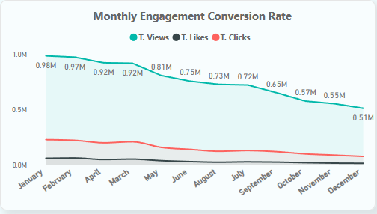
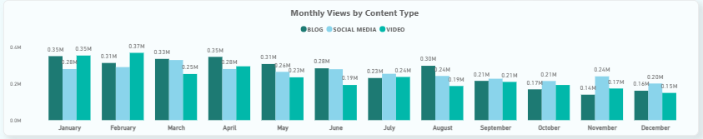
Customer Engagement Rate
Growth Collapse: Total views plummeted by ~48% over the year, dropping from 0.98M in January to 0.51M in December.
​The Advocacy Gap: You have a solid foundation of 840 happy customers (rating 4-5 stars), yet they are "silent fans" who aren't sharing or promoting the content.
​Content Decay: The pillars of your reach—Video and Blogs—saw the steepest decline, with video alone dropping from 0.35M to 0.15M views.
​Regional Mediocrity: Ratings across Europe are "good but not great," ranging from a high of 3.77 in Spain to a low of 3.49 in Switzerland.

Slide 5
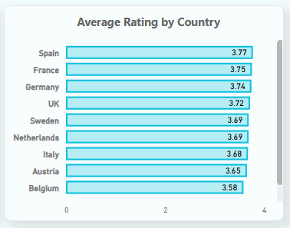
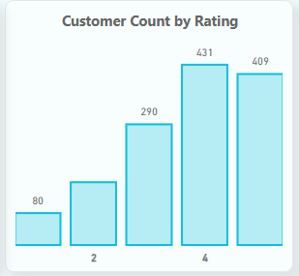
Customer Feedback Score
Reach Collapse: Total Views plummeted from 0.98M in January to 0.51M by December, representing a ~48% loss in visibility.
Video Performance: Dropped by ~57% (from 0.35M to 0.15M), which is the primary driver of the overall reach collapse.
Blog Engagement: Declined by ~54% (from 0.35M to 0.16M), indicating a failure in long-form content strategy.
Social Media: Failed to compensate for the losses, ending the year at a low 0.20M views.

Slide 6
Goals & Action
Goals
Actions
Increase Conversion Rates:
Goal: Identify factors impacting the conversion rate and provide recommendations to improve it.
Insight: Highlight key stages where visitors drop off and suggest improvements to optimize the conversion funnel.
Enhance Customer Engagement:
Goal: Determine which types of content drive the highest engagement.
Insight: Analyze interaction levels with different types of marketing content to inform better content strategies.
Improve Customer Feedback Scores:
Goal: Understand common themes in customer reviews and provide actionable insights.
Insight: Identify recurring positive and negative feedback to guide product and service improvements.
Increase Conversion Rates:
Boost Reach: Turn 840 happy customers into promoters to fix the 48% traffic drop and replace dying long-form content with short-form videos.
Maximize ROI: Shift budget to high-conversion products (15.46%)
Enhance Customer Engagement:
Content Revitalize: Replace failing long-form content with Short-form Video and prioritize Social Media to reverse the 57% view collapse.
Improve Customer Feedback Scores:
Boost Quality: Audit low-rated markets like Switzerland (3.49) and resolve issues for 1-2 star reviewers to stop negative word-of-mouth.
Leverage Success: Survey 840 happy customers to fix the 57% video drop and turn 409 "5-star" ratings into trust-building testimonials.

