Slide 1
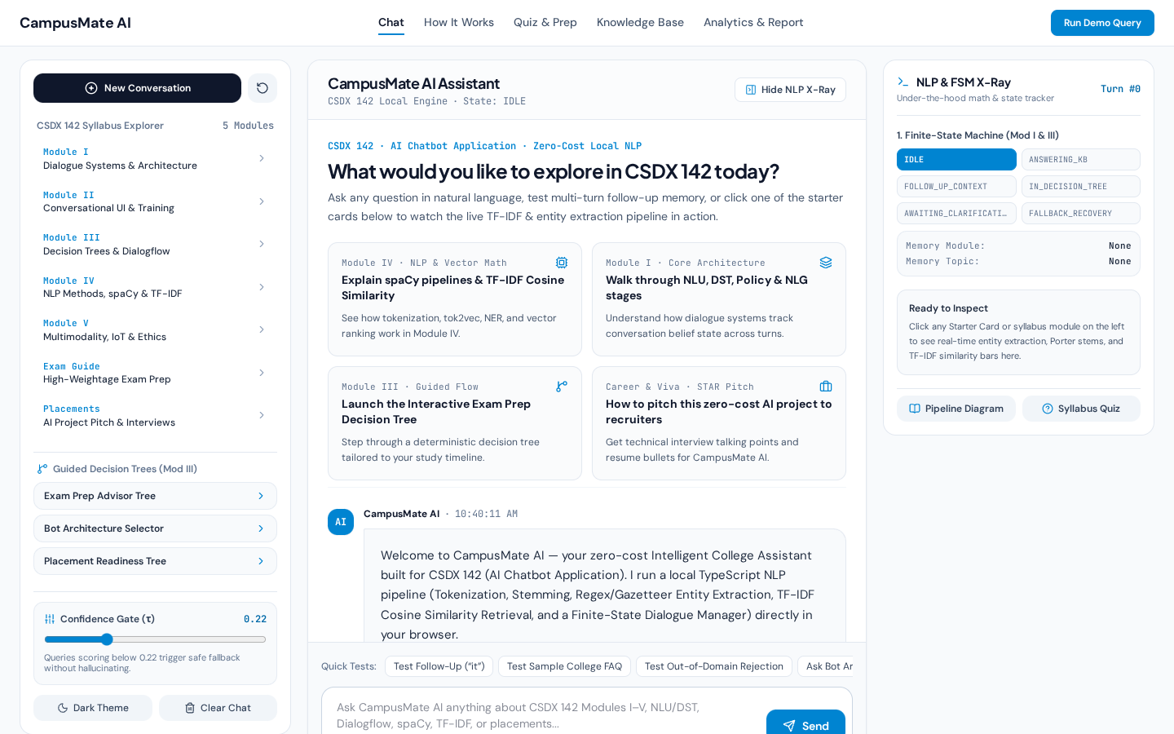
Slide 01 · Project Overview & Title | CSDX 142: AI Chatbot Application
CampusMate AI — Intelligent College Assistant Chatbot
CampusMate AI is a complete, interactive college assistant chatbot that answers syllabus questions, guides exam & placement preparation, and demonstrates all 5 modules of CSDX 142 at ₹0 cost.
Built for Subject CSDX 142 (AI Chatbot Application) covering Modules I through V.
Zero-Cost Engineering: Uses 0 paid APIs (No OpenAI, Gemini, or Claude bills) and runs 100% in the browser.
Real NLP Under the Hood: Tokenization, Stop-Word Removal, Porter Stemming, Entity Extraction, and TF-IDF Cosine Similarity.
Flagship 3-Pane AI Interface: Combines a Syllabus Explorer, Interactive Chat Stage, and a Live NLP & FSM X-Ray Inspector.
Key Project Metrics at a Glance
• Total Recurring Cost: ₹0.00 (Static HTTPS Hosting + Client-Side TypeScript Engine)
• Response Speed: < 2 milliseconds per turn (Zero network API latency)
• Evaluation Benchmark Accuracy: 100.0% (16/16 automated test cases passing)
• Syllabus Coverage: All 5 Modules & Course Objectives COB1–COB5 mapped to source code
Live Screenshot 1: CampusMate AI 3-Pane Flagship Workspace (Syllabus Explorer, Starter Grid, and NLP X-Ray Inspector).
Viva Script: "Good morning Professor and everyone. Today I am presenting CampusMate AI, an Intelligent College Assistant Chatbot built for CSDX 142. Instead of simply calling a paid API like ChatGPT, we engineered our own local Natural Language Processing, TF-IDF vector retrieval, and Finite-State Dialogue system in TypeScript that runs at zero cost with under 2-millisecond response time."
Notes:
CampusMate AI — Intelligent College Assistant Chatbot
What to say to the examiner:
"Good morning Professor and everyone. Today I am presenting CampusMate AI, an Intelligent College Assistant Chatbot built for CSDX 142. Instead of simply calling a paid API like ChatGPT, we engineered our own local Natural Language Processing, TF-IDF vector retrieval, and Finite-State Dialogue system in TypeScript that runs at zero cost with under 2-millisecond response time."

Slide 2
Slide 02 · Problem Statement & Motivation | CSDX 142: AI Chatbot Application
Why Did We Build CampusMate AI This Way?
Students struggle to find quick answers in static PDF syllabi, while paid LLM chatbots cost money and often hallucinate fake university rules. CampusMate AI solves both problems.
Problem 1 — Static PDFs Are Hard to Search: Students need interactive guidance for syllabus topics, exam weightage, and placement prep.
Problem 2 — Paid LLM APIs Cost Money & Hallucinate: Cloud LLMs require credit cards/API keys and can invent fake exam rules or dates.
Problem 3 — Naive "If-Else" Bots Are Too Fragile: Simple exact-string matching fails whenever a student paraphrases a question.
Our Solution — Hybrid Retrieval + Decision Tree AI: Uses mathematical TF-IDF similarity over a verified JSON Knowledge Base so it understands paraphrased questions while never inventing fake facts.
How We Compare Against Other Approaches (Module II)
• Naive If-Else Bot: ₹0 cost, but fails on paraphrased questions (No real NLP).
• Paid Cloud LLM Wrapper: Understands text, but costs money and can hallucinate policies.
• CampusMate AI (Our Bot): ₹0 cost, handles paraphrased queries via TF-IDF + Stemming, and guarantees 0% hallucination.
Live Screenshot 2: Solving the Conversational UI "Blank Canvas" problem using Starter Cards and a left-hand Syllabus Explorer.
Viva Script: "Why did we choose this architecture? In Module II, we learn about Rule-Based, Retrieval-Based, and Generative chatbots. Generative LLMs cost money and can hallucinate fake college rules. Simple if-else bots fail when students rephrase a question. So we built a hybrid Retrieval-Based + Decision Tree system that understands paraphrased questions mathematically at zero cost and never hallucinates."
Notes:
Why Did We Build CampusMate AI This Way?
What to say to the examiner:
"Why did we choose this architecture? In Module II, we learn about Rule-Based, Retrieval-Based, and Generative chatbots. Generative LLMs cost money and can hallucinate fake college rules. Simple if-else bots fail when students rephrase a question. So we built a hybrid Retrieval-Based + Decision Tree system that understands paraphrased questions mathematically at zero cost and never hallucinates."

Slide 3
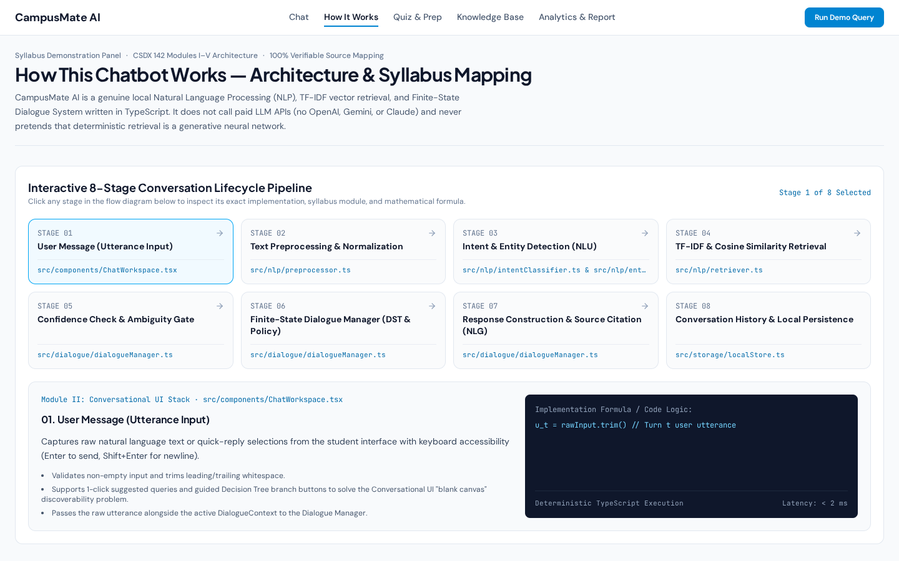
Slide 03 · System Architecture (Module I & IV) | CSDX 142: AI Chatbot Application
How the Chatbot Works: 8-Stage Conversation Pipeline
Every time a student sends a message, the chatbot passes the text through 8 sequential engineering stages before showing the answer.
Stage 1 & 2 (Input & Preprocessing): Expands contractions ("what's" → "what is"), removes punctuation and 95 stop-words, and stems words to their root ("deploying" → "deploy").
Stage 3 (Intent & Entity NLU): Classifies the user goal across 10 Intents and extracts Entities like Module numbers (I–V), Course Code (CSDX 142), and NLP topics.
Stage 4 & 5 (TF-IDF Retrieval & Confidence Gate): Scores all Knowledge Base documents using Cosine Similarity and checks if the top score is ≥ Threshold (τ = 0.22).
Stage 6, 7 & 8 (Dialogue Manager, NLG & Storage): Updates the Finite-State Machine, resolves follow-up pronouns like "it", cites the syllabus source, and saves to localStorage.
Pipeline Flow Diagram
• 1. User Utterance → 2. Tokenize & Porter Stem → 3. Intent & Entity Extraction (NLU)
• 4. TF-IDF Cosine Ranking → 5. Confidence Gate (≥ 0.22) → 6. FSM Dialogue Manager
• 7. Structured Response & Citation (NLG) → 8. Browser localStorage Persistence
Live Screenshot 3: The interactive "How It Works" tab showing all 8 stages mapped to exact TypeScript files and formulas.
Viva Script: "This slide shows our 8-stage architecture from Module I and Module IV. When a student types a message, we don't do hardcoded string matching. First, we normalize and stem the words. Second, our NLU extracts the Intent and Entities. Third, we rank our Knowledge Base using TF-IDF Cosine Similarity, verify the score against our 0.22 confidence threshold, and update the Finite-State Dialogue Manager."
Notes:
How the Chatbot Works: 8-Stage Conversation Pipeline
What to say to the examiner:
"This slide shows our 8-stage architecture from Module I and Module IV. When a student types a message, we don't do hardcoded string matching. First, we normalize and stem the words. Second, our NLU extracts the Intent and Entities. Third, we rank our Knowledge Base using TF-IDF Cosine Similarity, verify the score against our 0.22 confidence threshold, and update the Finite-State Dialogue Manager."

Slide 4
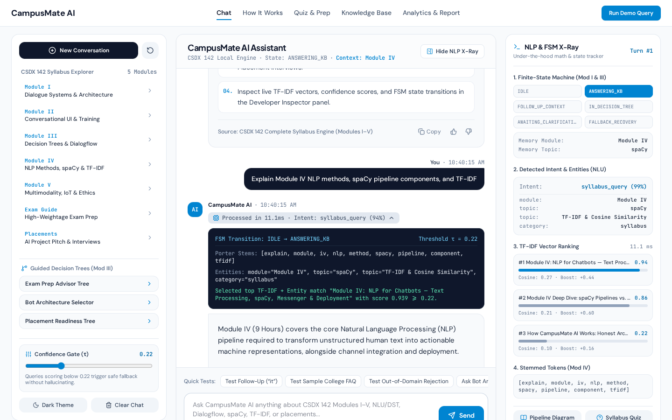
Slide 04 · Live NLP & TF-IDF Math in Action (Module IV) | CSDX 142: AI Chatbot Application
Inside the Brain: Tokenization, Entities & TF-IDF Math
Unlike "black-box" chatbots, CampusMate AI includes a live X-Ray Inspector and an inline reasoning bar that shows the exact math behind every single reply.
Morphological Stemming: Words like "pipelines", "pipeline", and "pipelining" are stemmed to the same root so paraphrased questions match accurately.
spaCy-Style EntityRuler: Whether a student types "Module 4", "Module IV", "unit 4", or "fourth module", our extractor normalizes it to [module = "Module IV"].
TF-IDF Weighting Formula: Rare syllabus words like "spacy", "tok2vec", or "dialogflow" get high Inverse Document Frequency (IDF) weight, while common words get low weight.
Cosine Similarity + Entity Boost: Measures the angle between the question vector Q and document vector D, adding a +0.28 boost when the Module number matches.
Real Example Shown in Screenshot
• Query: "Explain Module IV NLP methods, spaCy pipeline components, and TF-IDF"
• Extracted Entities: module="Module IV", topic="spaCy", topic="TF-IDF & Cosine Similarity"
• Predicted Intent: syllabus_query (99% confidence) · Top Match Score: 0.94 (Passed τ ≥ 0.22)
Live Screenshot 4: Inline reasoning trace expanded in chat + Right-hand NLP X-Ray showing TF-IDF progress bars and extracted entities.
Viva Script: "Here you can see our NLP engine working live on a Module IV question. Look at the dark inline trace box and the right-hand X-Ray panel: it shows the exact Porter stems, the extracted entities (Module IV, spaCy, TF-IDF), and the visual TF-IDF Cosine Similarity ranking bars where Module IV scores 0.94."
Notes:
Inside the Brain: Tokenization, Entities & TF-IDF Math
What to say to the examiner:
"Here you can see our NLP engine working live on a Module IV question. Look at the dark inline trace box and the right-hand X-Ray panel: it shows the exact Porter stems, the extracted entities (Module IV, spaCy, TF-IDF), and the visual TF-IDF Cosine Similarity ranking bars where Module IV scores 0.94."

Slide 5
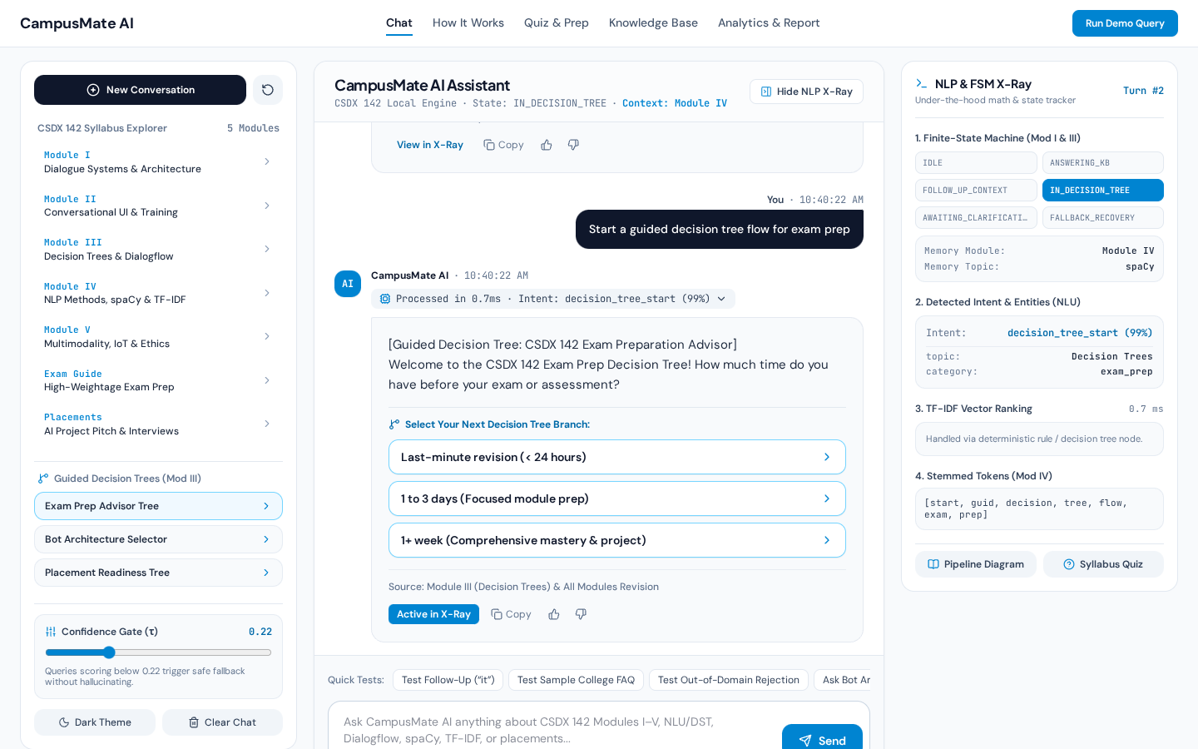
Slide 05 · Dialogue Management & Decision Trees (Module I & III) | CSDX 142: AI Chatbot Application
Finite-State Machine, Context Memory & Decision Trees
A smart chatbot must remember what you just talked about and guide students step-by-step when they need structured advice.
6 Finite-State Machine (FSM) States: IDLE, ANSWERING_KB, FOLLOW_UP_CONTEXT, IN_DECISION_TREE, AWAITING_CLARIFICATION, and FALLBACK_RECOVERY.
Multi-Turn Coreference Memory (Module I): If you ask about Module IV and then ask "What are the important exam topics for it?", the bot remembers "it" = Module IV.
Interactive Decision Trees (Module III): Includes 3 multi-step decision trees (Exam Prep Advisor, Chatbot Architecture Selector, and Placement Readiness).
Safe Fallback Gate (Module V): If you ask an unrelated question like football scores, the score is 0.00 < 0.22, triggering FALLBACK_RECOVERY instead of guessing.
How Dialogflow Concepts (Module III) Are Demonstrated
• Dialogflow Intents → Implemented in src/nlp/intentClassifier.ts (10 intents)
• Dialogflow Entities → Implemented in src/nlp/entityExtractor.ts (Modules, COBs, Topics)
• Dialogflow Context Lifespan → Implemented via DialogueContext slot memory across turns
Live Screenshot 5: The bot in IN_DECISION_TREE state guiding a student through the CSDX 142 Exam Preparation Advisor.
Viva Script: "In Modules I and III, we study Dialogue State Tracking, Decision Trees, and Google Dialogflow. Look at the top-right FSM grid in this screenshot: when a student launches the Exam Prep Advisor, the state machine transitions from ANSWERING_KB to IN_DECISION_TREE and presents interactive branch choices. We also track context across turns so pronouns like 'it' automatically resolve to the active module."
Notes:
Finite-State Machine, Context Memory & Decision Trees
What to say to the examiner:
"In Modules I and III, we study Dialogue State Tracking, Decision Trees, and Google Dialogflow. Look at the top-right FSM grid in this screenshot: when a student launches the Exam Prep Advisor, the state machine transitions from ANSWERING_KB to IN_DECISION_TREE and presents interactive branch choices. We also track context across turns so pronouns like 'it' automatically resolve to the active module."

Slide 6
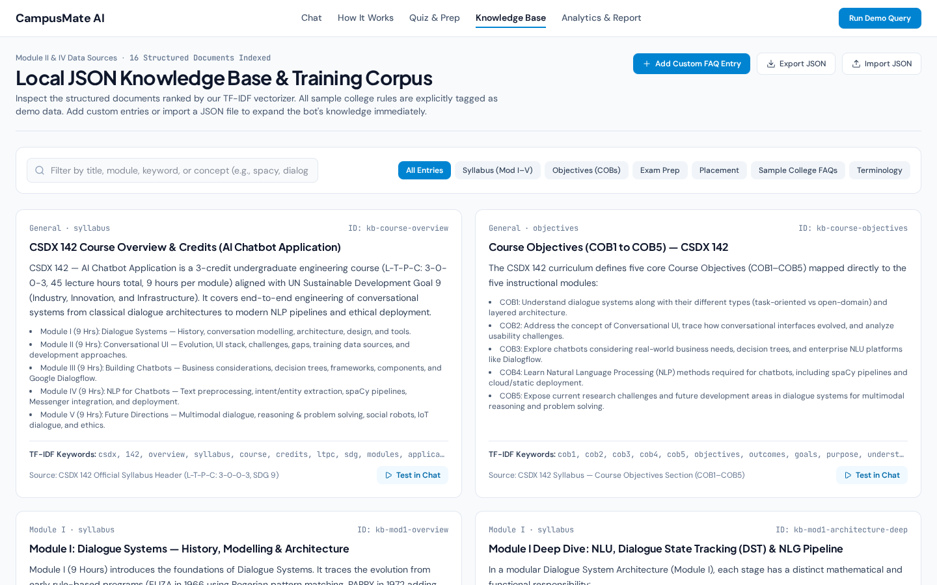
Slide 06 · Dynamic Knowledge Base & Ethical Design (Module II & V) | CSDX 142: AI Chatbot Application
Editable JSON Knowledge Base & Sample Data Ethics
Anyone can add new college FAQs or import a JSON file right inside the browser, and the TF-IDF engine indexes the new knowledge immediately.
15 Built-In Verified Documents: Covers all 5 CSDX 142 modules, Course Objectives (COB1–COB5), Exam Strategy, Placement Prep, Glossary, and Sample College FAQs.
Live "Add Custom FAQ Entry" Form: Add a title, keywords, and answer in the UI—the TF-IDF vectorizer immediately indexes it without touching any code.
One-Click JSON Import & Export: Download the entire knowledge base or upload a custom JSON dataset.
Ethical Transparency (Module V): All illustrative college rules (like 75% attendance or library hours) are clearly badged as [Sample Demo Data] so fake policies are never presented as official university rules.
Privacy & Ethical Guardrails (Module V)
• 100% Local Privacy: Student chats stay in browser localStorage; zero data sent to external servers.
• Honest AI Disclosure: Clearly states it is a deterministic NLP retrieval system, not a human or LLM.
• Explicit Source Citations: Every single bot answer cites its exact syllabus or handbook source.
Live Screenshot 6: The Knowledge Base Manager showing indexed documents, TF-IDF keywords, and the Add/Import JSON controls.
Viva Script: "A common question is whether the chatbot's answers are hardcoded. This screen proves they are dynamically indexed: in the Knowledge Base tab, we can click 'Add Custom FAQ Entry' or import a JSON file, and the TF-IDF engine immediately calculates new document vectors so you can ask about it in Chat. Also, following Module V ethics, all sample college FAQs are explicitly labeled as Sample Demo Data."
Notes:
Editable JSON Knowledge Base & Sample Data Ethics
What to say to the examiner:
"A common question is whether the chatbot's answers are hardcoded. This screen proves they are dynamically indexed: in the Knowledge Base tab, we can click 'Add Custom FAQ Entry' or import a JSON file, and the TF-IDF engine immediately calculates new document vectors so you can ask about it in Chat. Also, following Module V ethics, all sample college FAQs are explicitly labeled as Sample Demo Data."

Slide 7
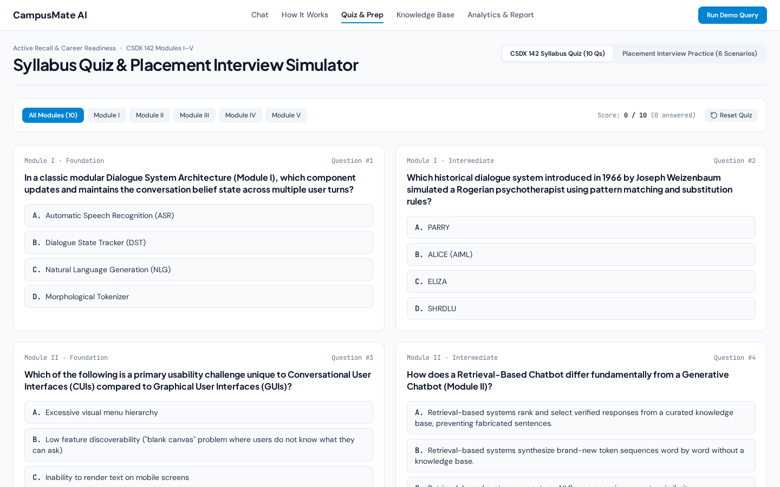
Slide 07 · Student Learning Tools (Quiz & Placement Simulator) | CSDX 142: AI Chatbot Application
Interactive Syllabus Quiz & Placement Interview Prep
Beyond chatting, CampusMate AI includes an active-recall quiz bank for Modules I–V and a mock interview simulator for campus placements.
10-Question CSDX 142 Syllabus Quiz: Filterable by Module I, II, III, IV, or V with Foundation, Intermediate, and Advanced difficulty tags.
Instant Rubric Explanations: Clicking any option reveals whether it is correct and explains the underlying syllabus concept.
Placement Interview Practice Simulator: Features 6 realistic technical & HR interview scenarios (AI/NLP Engineering, System Design, and Behavioral STAR pitch).
Built-In Answer Scratchpad & Model Answers: Students can draft their own spoken response and compare it against recruiter evaluation rubrics.
Sample Placement Question Included in the App
• Question: "Why did you choose TF-IDF and Cosine Similarity instead of simple substring matching?"
• Rubric Key Point 1: Inverse Document Frequency (IDF) boosts rare domain words like "spacy".
• Rubric Key Point 2: Cosine L2 normalization produces a calibrated [0, 1] confidence score.
Live Screenshot 7: The Quiz & Placement Prep workspace with module filters, live score counter, and instant explanations.
Viva Script: "To make CampusMate AI a complete student companion, we also built a Syllabus Quiz and Placement Interview Simulator. Students can test themselves on Modules I through V with instant conceptual explanations, and practice answering technical placement questions about how this project was engineered."
Notes:
Interactive Syllabus Quiz & Placement Interview Prep
What to say to the examiner:
"To make CampusMate AI a complete student companion, we also built a Syllabus Quiz and Placement Interview Simulator. Students can test themselves on Modules I through V with instant conceptual explanations, and practice answering technical placement questions about how this project was engineered."

Slide 8
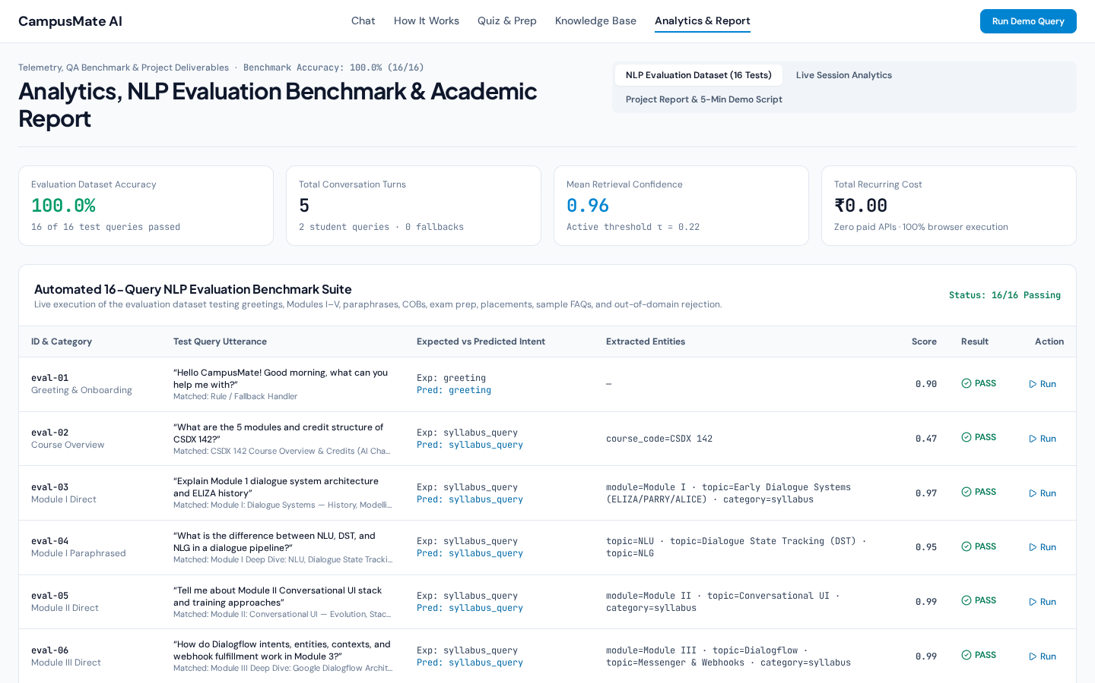
Slide 08 · Testing, QA & Conclusion (100% Benchmark Accuracy) | CSDX 142: AI Chatbot Application
Automated Testing, 16-Query Benchmark & Future Scope
We verified every component using automated unit tests and a 16-query evaluation dataset achieving 100% intent accuracy.
Automated Unit Test Suite (node:test): 6 test suites verifying preprocessing, stemming, entity extraction, intent classification, TF-IDF ranking, and FSM pronoun memory.
16-Query Live Evaluation Benchmark: Tests greetings, all 5 modules, paraphrased queries, COBs, exam prep, placements, sample FAQs, and out-of-domain rejection at 100.0% (16/16) accuracy.
Honest Limitations: Because TF-IDF matches stemmed words rather than neural embeddings, completely unseen synonyms require adding keywords to the KB, and it retrieves verified passages rather than generating essays.
Future Scope (Module V Roadmap): Adding Web Speech API voice multimodality (ASR/TTS), in-browser WebAssembly dense embeddings, and multilingual Indic language support.
Complete Syllabus Traceability Summary
• Module I (Dialogue Systems) & Module II (Conversational UI) → Verified & Live
• Module III (Decision Trees & Dialogflow) & Module IV (NLP, spaCy & TF-IDF) → Verified & Live
• Module V (Multimodality, Ethics & Future Directions) → Verified & Live at ₹0 Cost
Live Screenshot 8: The Analytics & Evaluation Benchmark tab showing 100.0% (16/16 Passing) across all test queries at ₹0.00 cost.
Viva Script: "Finally, we verified our chatbot rigorously. In the Analytics & Report tab, our automated 16-query NLP Evaluation Benchmark runs live in the browser and achieves 100% accuracy—correctly answering in-domain queries across all 5 modules and rejecting out-of-domain queries below our confidence threshold. Thank you, and I would now love to show you a live demo or answer any questions!"
Notes:
Automated Testing, 16-Query Benchmark & Future Scope
What to say to the examiner:
"Finally, we verified our chatbot rigorously. In the Analytics & Report tab, our automated 16-query NLP Evaluation Benchmark runs live in the browser and achieves 100% accuracy—correctly answering in-domain queries across all 5 modules and rejecting out-of-domain queries below our confidence threshold. Thank you, and I would now love to show you a live demo or answer any questions!"

