Slide 1

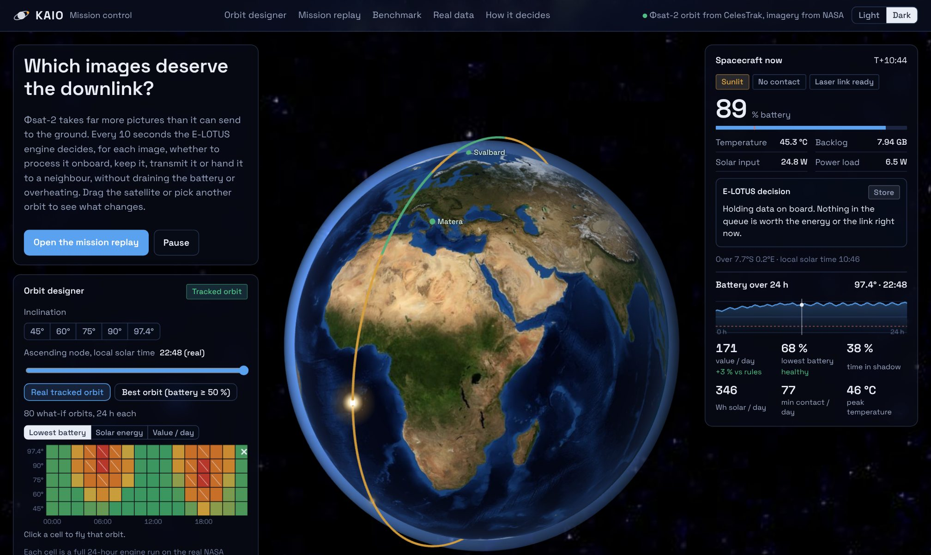
IASTAM 6.0 Technical Challenge · Track 1 · Problem 1 “Process or Transmit?”
Which images deserve the downlink?
Onboard decisions for an Earth-observation satellite, flown on the real orbit of Φsat-2 with real NASA data.
Team KAIO · Nadhem Selmi · Mahmoud Amri
Notes:
Hook: real orbit of Phi-sat-2; far more images than downlink; KAIO decides which ones matter.

Slide 2
Far more data than downlink
≈ 80 GB
≈ 6 GB
35 min
of images produced per day
can be sent in 79 min of ground contact per day
of eclipse every 94-min orbit: no solar power
Every 10 seconds, for every image, within battery, heat, memory and contact limits:
Process
Keep
Transmit
Offload
onboard AI: 50 MB → 1.5 MB; costs energy and heat
store for later; costs memory
during a ground pass
laser link to a neighbour in sunlight
Notes:
Problem 1: process, keep, transmit or offload, under energy, thermal, storage and contact constraints.

Slide 3
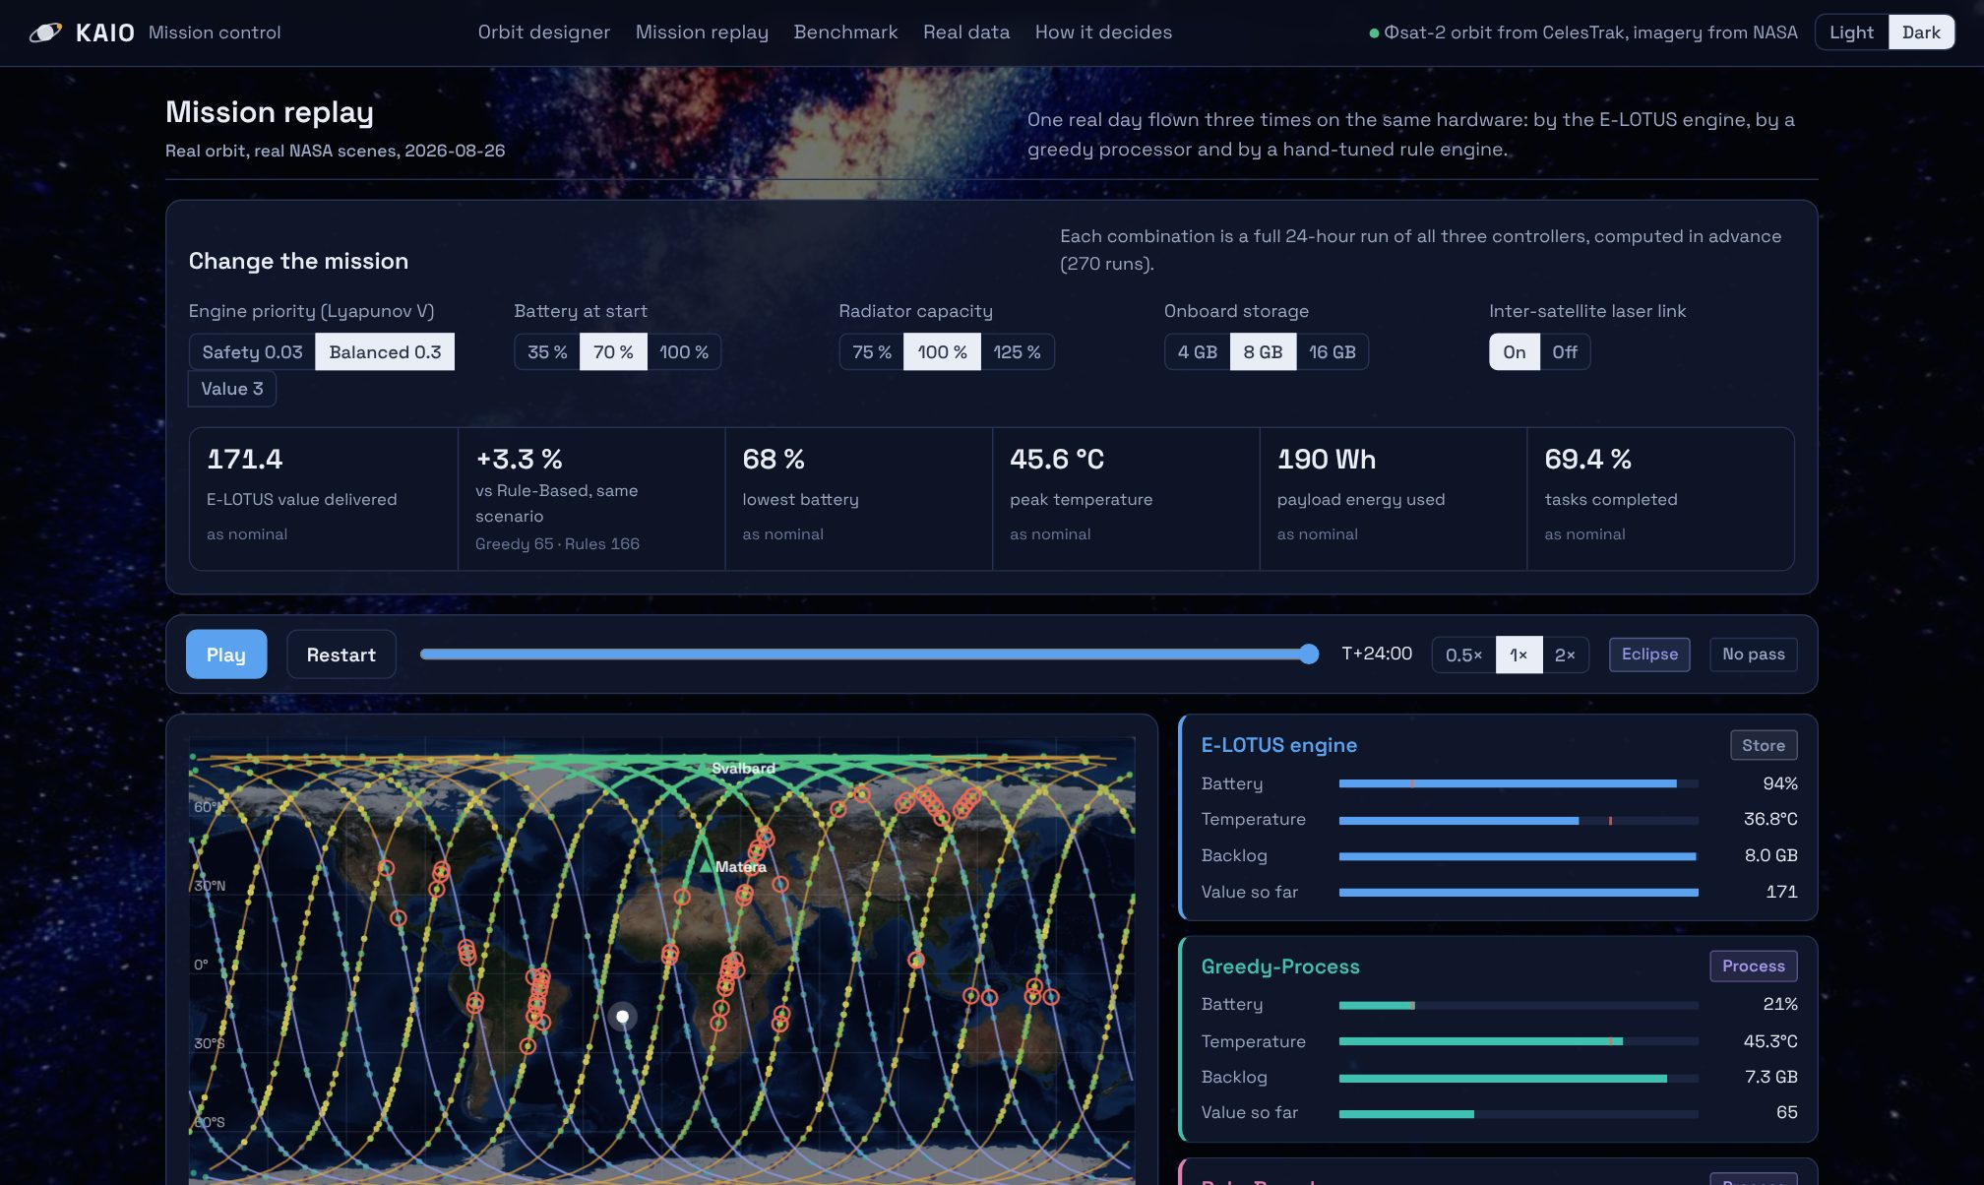
Real orbit, real NASA data
Orbit: Φsat-2 (NORAD 60470) from its CelesTrak TLE, SGP4; RK4 + J2 cross-check within 25 km
Ground stations: KSAT Svalbard and ASI Matera, 10° elevation mask
Earth data: NASA GIBS, 20 days under the real track: VIIRS images, MODIS clouds, FIRMS fires, land mask
57,600 real footprints: each simulated picture is the real scene Φsat-2 flew over at that moment
Simulated: battery, thermal, GPU, radio; every assumption in one file

Slide 4
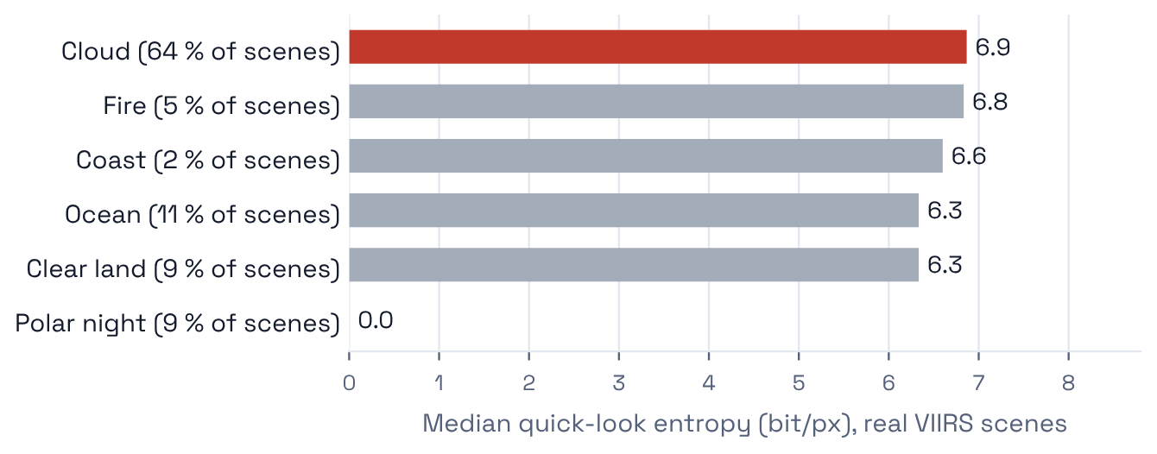
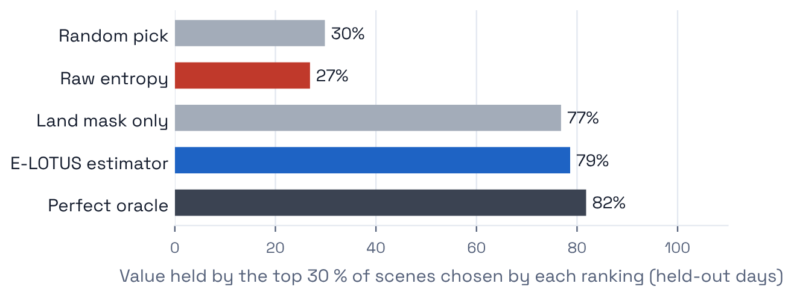
Clouds fool raw entropy
Clouds are the most textured scenes and 64 % of all scenes. Ranking by texture keeps 27 % of the value, worse than random (30 %). Texture × onboard land mask gives 79 %, close to a perfect oracle (82 %).

Slide 5
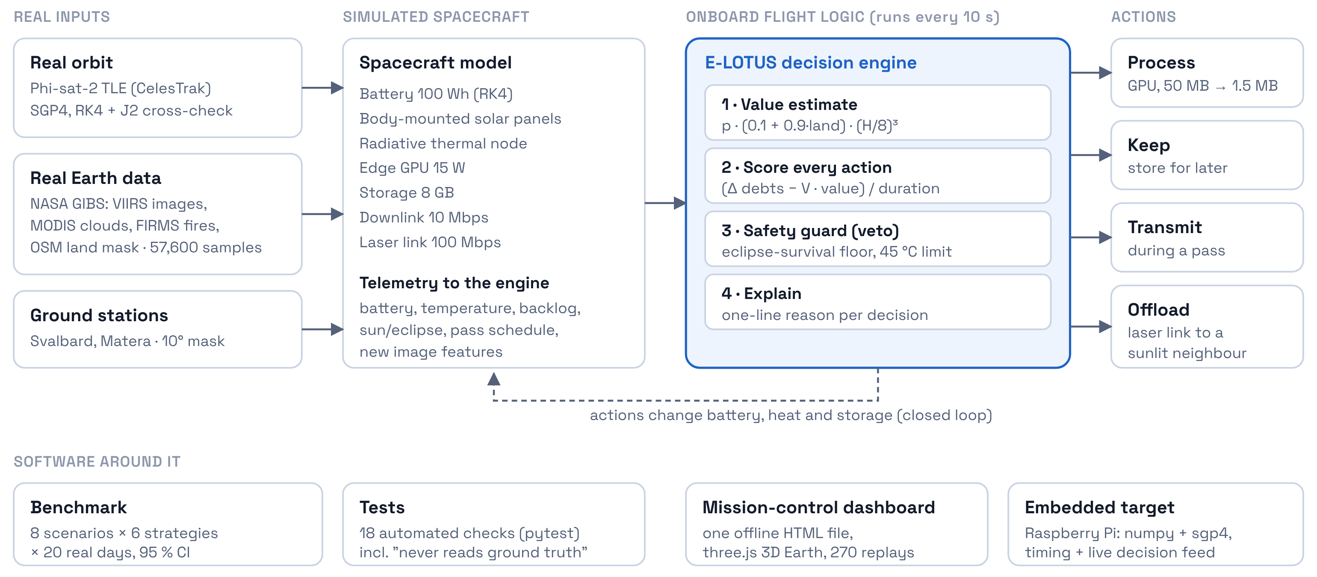
System architecture

Slide 6
How E-LOTUS decides, every 10 seconds
Step 1
Step 2
Step 3
Step 4
Value
Score
Safety guard
Explain
texture × onboard land mask, × 4 for fire alerts
growth of 3 debts (memory, battery, heat) minus V × value, per second
independent veto: survive the next eclipse, stay under 45 °C
every decision logs a reason from onboard data
p·(0.1+0.9·land)·(H/8)³
(ΔL − V·U) / τ
fire alerts: up to 60 °C
auditable by operators
“Process now: est. value 0.68 (optical H 7.5, land 79 %). 20 MB raw → 0.6 MB product, next pass in 476 min; battery 69 Wh after (floor 20), 9.3 °C.”
Drift-plus-penalty from Lyapunov optimisation, used as a principled scoring rule; performance is measured, not claimed as proven.

Slide 7
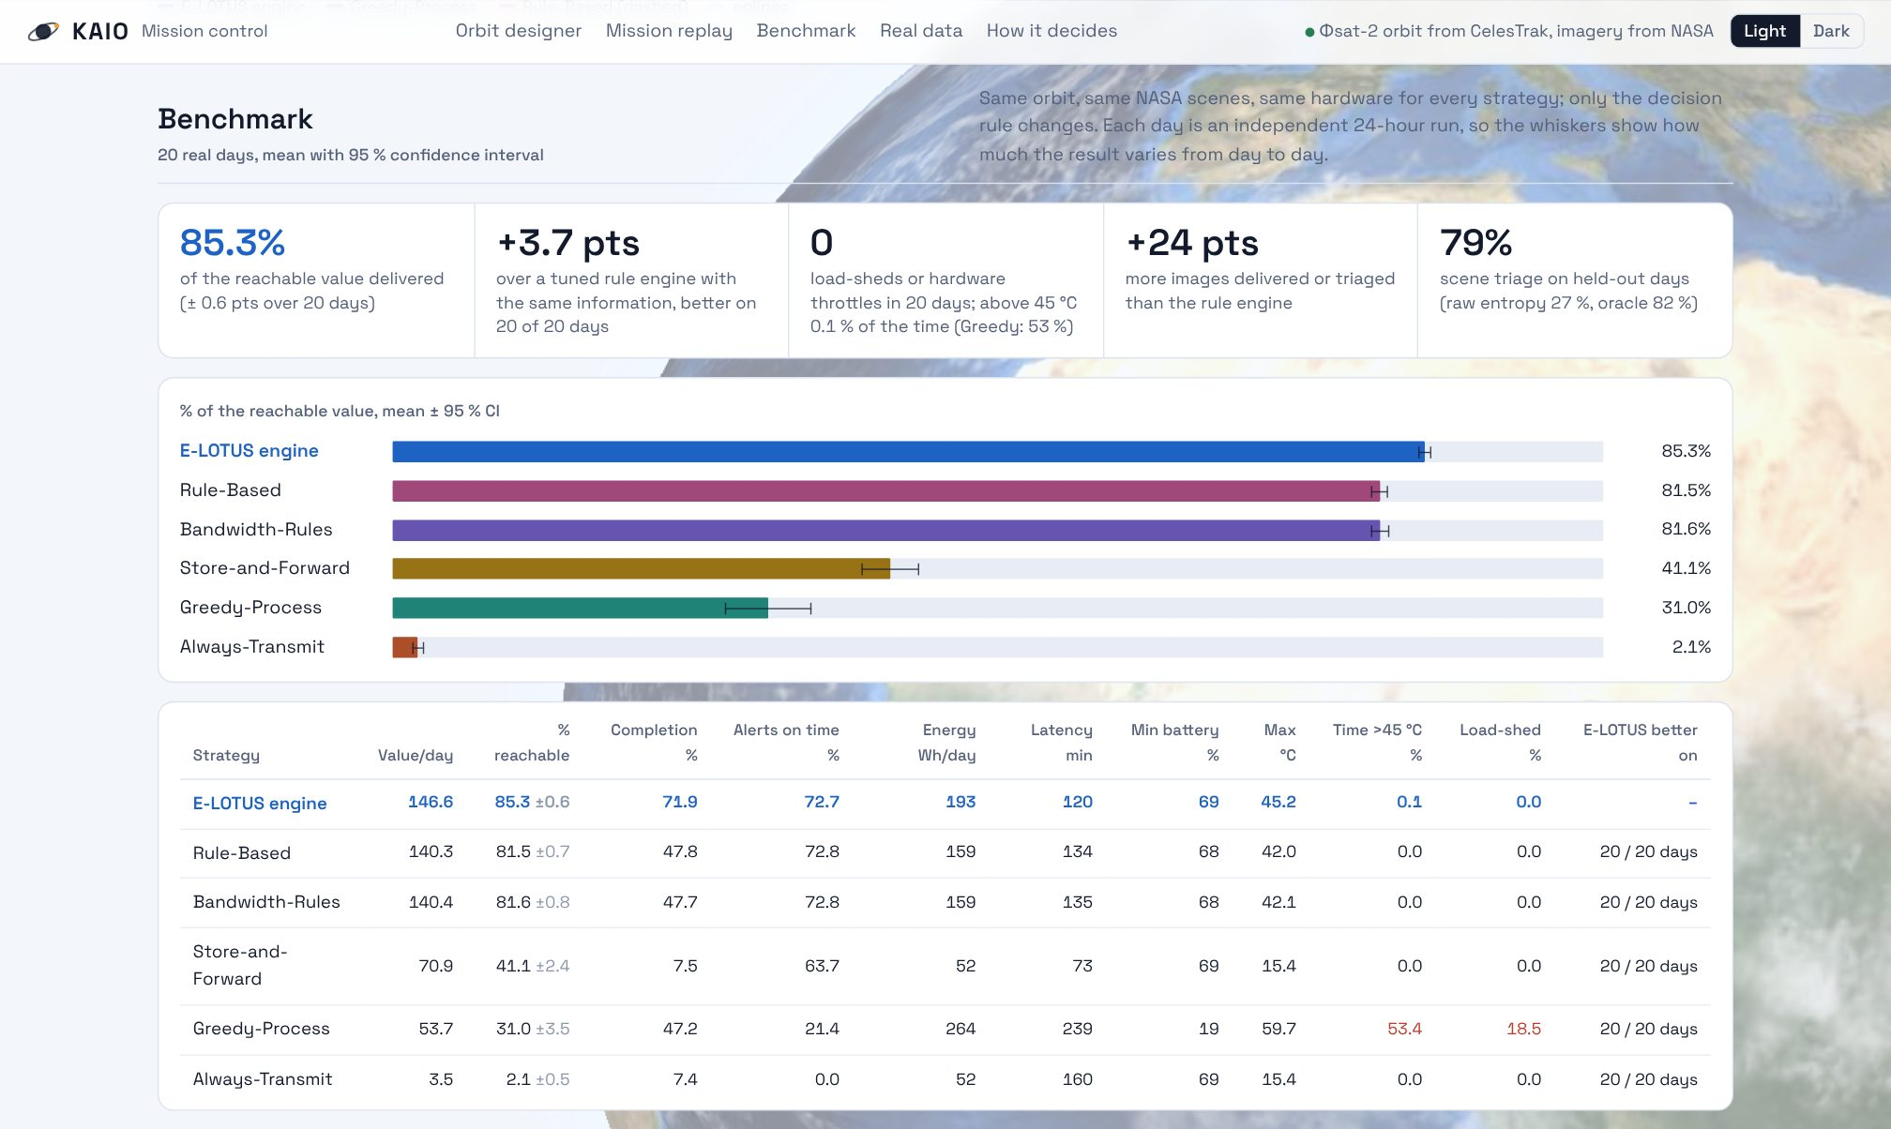
Live demo
Mission-control dashboard: 3D Earth with the real orbit, 80 what-if orbits, 270 pre-computed missions, one offline file
Raspberry Pi: the same flight code runs live, printing each decision, its reason and its compute time
Reproducible: every number is regenerated by scripts from the benchmark

Slide 8
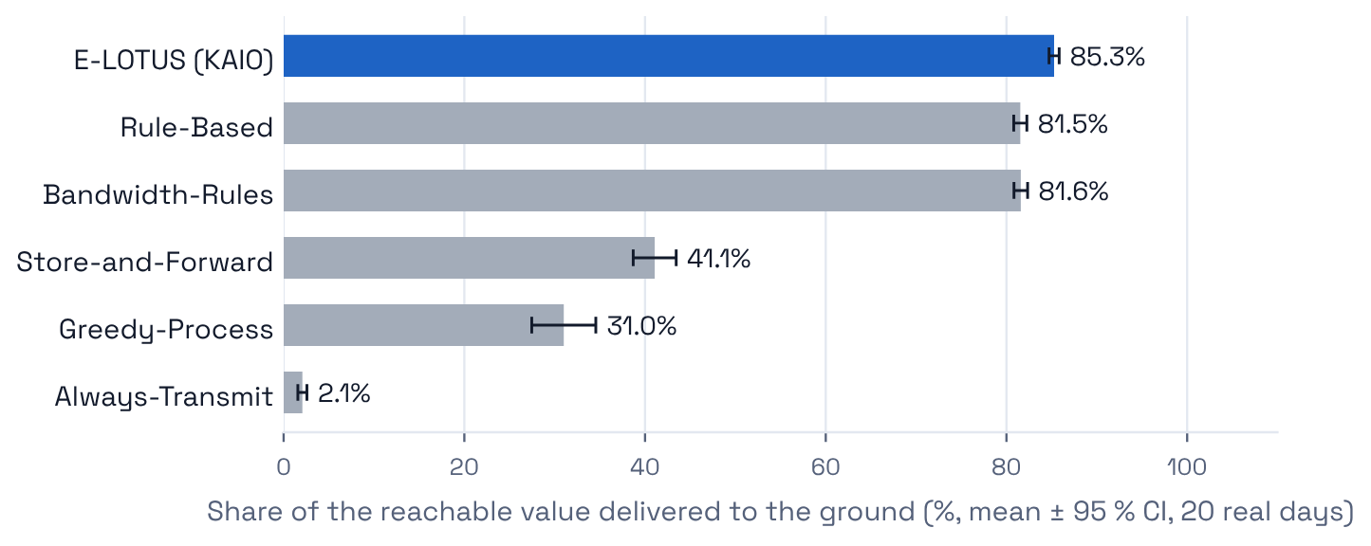
Results: 85.3 % of the reachable value
+3.7 pts
over tuned rules with the same information; better on 20/20 days
+24 pts
more images delivered or triaged (72 % vs 48 %)
0
120 min
20 real days, independent 24-h runs; mean ± 95 % CI. Greedy processing drains the battery to 19 % and sheds the payload 19 % of the time.
load-sheds or throttles; battery ≥ 69 %
mean latency (rules: 134 min)

Slide 9
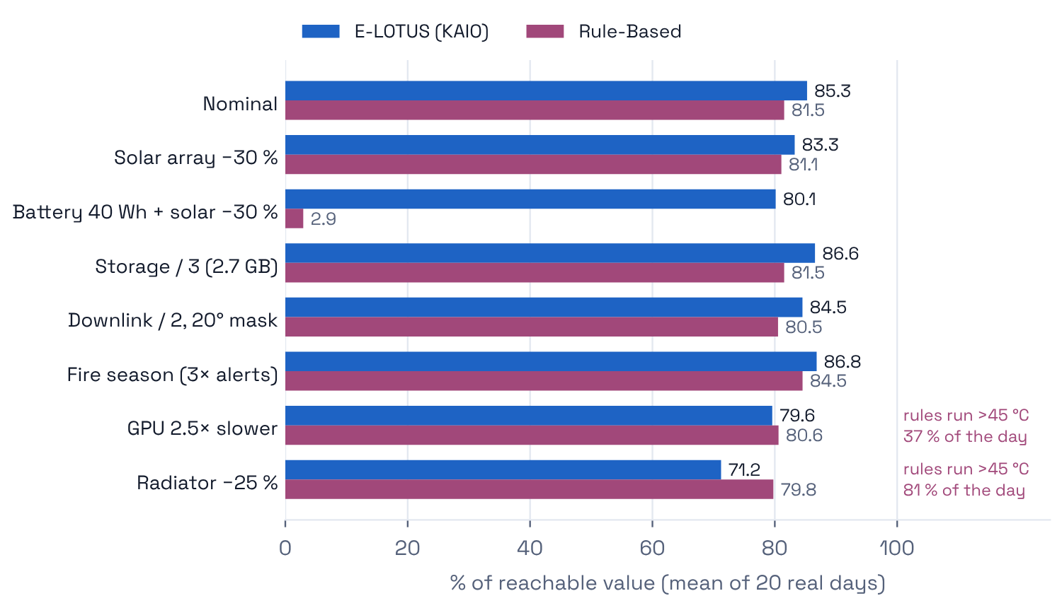
Stress tests: where we win and where we don’t
Wins 6/8: weaker solar array, half the downlink, fire season, less storage; E-LOTUS wins every day
Small battery: the rules' fixed threshold hits the shutdown floor (3 %); E-LOTUS adapts from the orbit (80 %)
Losses 2/8: slower GPU, weaker radiator; the rules only win by running above 45 °C for 37–81 % of the day

Slide 10
Feasible on real hardware
0.16 ms
0.002 %
2 libraries
median decision time (laptop; Pi run pending)
of one CPU core over a full real day
numpy and sgp4; no GPU, no training
Every input already exists on a satellite:
Battery and temperature
Pass schedule
Land mask
Thumbnail entropy
housekeeping sensors
computed on the ground, uplinked
static map, indexed by GNSS position
15 µs per image
Precedent: ESA’s Φsat-1 already discarded cloudy images onboard. KAIO flies the real orbit of its successor.

Slide 11
Method and roadmap
How we built it
Done
engine, safety guard, real-data simulation, benchmark, dashboard, embedded run
Two Phase-2 prototypes merged into one tested package
Review found the old engine above 45 °C 10 % of the time; the safety guard fixed it
18 automated tests, incl. “the engine never reads the ground truth”
1,360 simulations: 8 scenarios × 6 strategies × 20 real days
Same code on a Raspberry Pi
+3 mo
hardware-in-the-loop on a flight-like computer; imperfect forecasts
+6 mo
onboard cloud-screening network replacing the static land map
+12 mo
constellation coordination; CubeSat flight-test partnership

Slide 12
KAIO decides which images deserve the downlink, explains why, and never breaks the spacecraft to do it.
85.3 %
20/20
0
of the reachable value
days better than tuned rules
load-sheds or throttles
Thank you · questions welcome · github.com/<team>/kaio

