Slide 1

OpenCV
Open Source Computer Vision

Slide 2
History
OpenCV was started at Intel 1999 by Gary Bradsky.
OpenCV supports wide variety of programming languages like C++, Python, Java etc.
Available on different platform including Windows, Linux, OS X etc.
OpenCV-Python is the Python API of OpenCV.
It combines the best quality of OpenCV C++ API and Python Language.

Slide 3
What is a program ?

Slide 4
Types of Programming languages
High-level language
Low-level language
Python
C
C++
Perl
Java
Machine languages
Assembly languages

Slide 5
Two kind of program processes:
Interpreters
Compilers

Slide 6
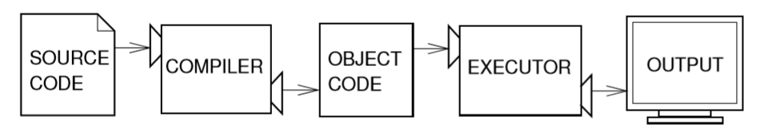
Compilers

Slide 7
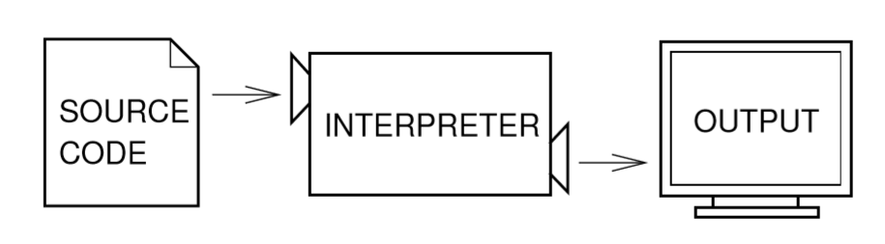
Interpreters

Slide 8
Introduction
Python is :
High-level programming language.
Fast to learn and fast to develop application.
Available for many platforms.
Implement complex logic with very few lines of code.

Slide 9
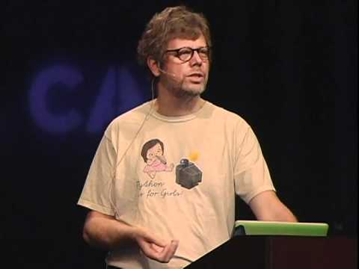
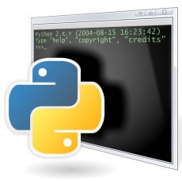
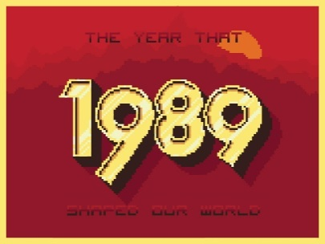
History
Guido van Rossum
At National Research Institute for Mathematics and Computer Science in Netherland.

Slide 10
PYTHON 2 VS. PYTHON 3
Python 2 is legacy, Python 3 is the present and future.
Python 3 was released in 2008.
Python 3 don’t have enough libraries.
That’s why python 2 is present and still ON.

Slide 11
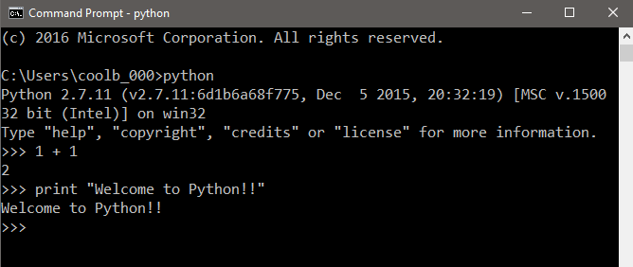
Two ways to use interpreter
1. Interactive Mode :

Slide 12
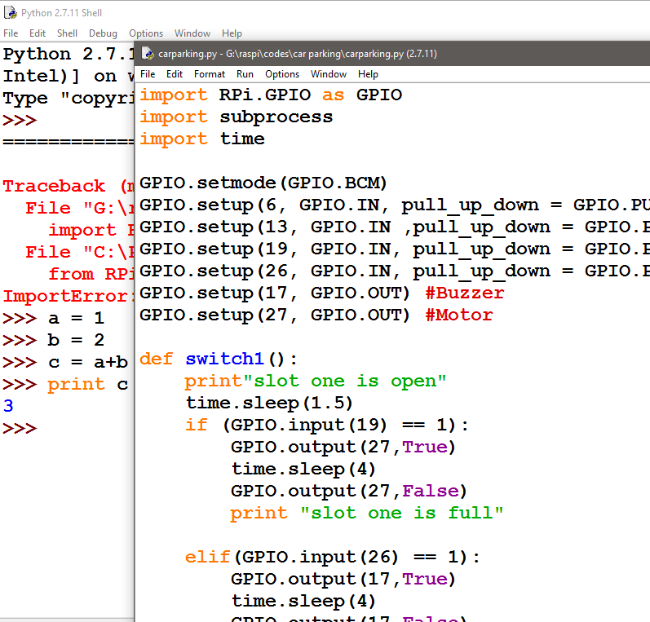
2. Script Mode (IDLE):
Store code in a file ending .py

Slide 13
Arithmetic Operators
Operators | Operations
+ | Addition
- | Subtraction
* | Multiplication
/ | Division
% | Modulus
** | Exponentiation

Slide 14
Number Formatting
Format Specifier | Description
%d | Integer
%F | Floating point number
%s | String
%c | Character
%ld | Long Number
>>> a = 10
>>> print “a=%d” % (a)
a=10

Slide 15
Accepting Input from Keyboard
raw_input
>>> country = raw_input(“Enter the country name :”)
>>> print country

Slide 16
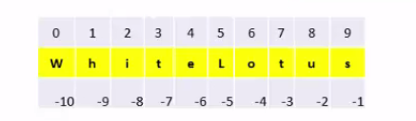
String Slicing

Slide 17
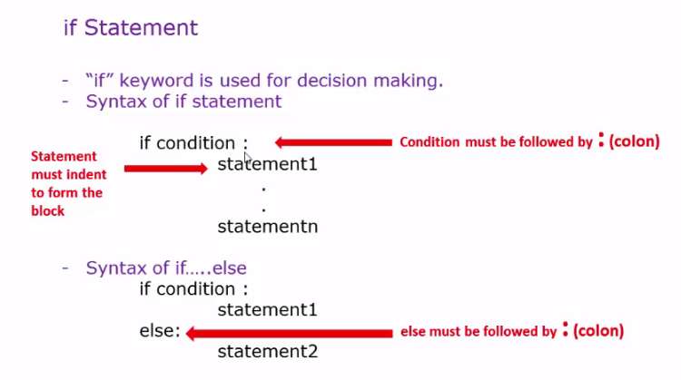
if Statement

Slide 18
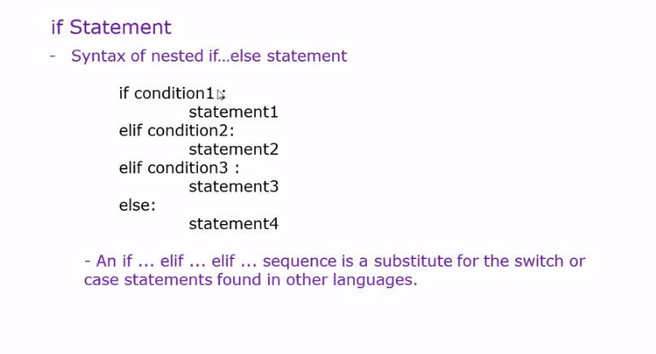
Nested ifelse Statement

Slide 19
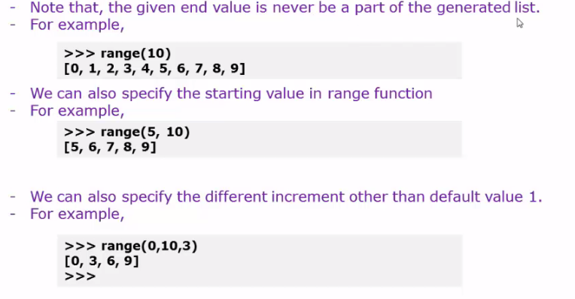
Range Function

Slide 20
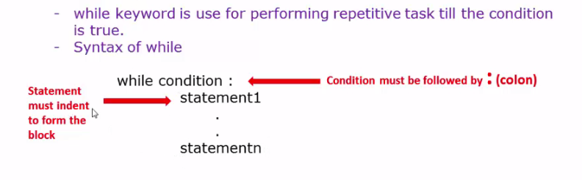
While loop

Slide 21
Data Structures
List
Tuple
Set

Slide 22
Python Lists
List = [‘abcd’ , 786 , 2.23, ‘python’, 70.2]
print List
print List[0]
print List[1:3]
print List[2:]

Slide 23
Methods of List
A= [10,30,40,50]
list.insert(position, element) ex: a.insert(2,20)
list.append(element) ex: a.append(200)
list.remove(element) ex: a.remove(200)
list. reverse() ex: a.reverse()

Slide 24
Nested List
A= [[10,”hello”,20.5],[2,5,6],[7,2]]
>>> a[0]
[10, “hello” , 20.5]
>>> a[1][2]
20.5

Slide 25
Python Tuples
Read only cannot be updated
Tuple=(123, ‘python’,78.12)
print Tuple
print Tuple[:2]

Slide 26
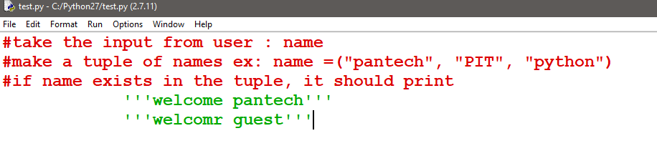
Exercise

Slide 27
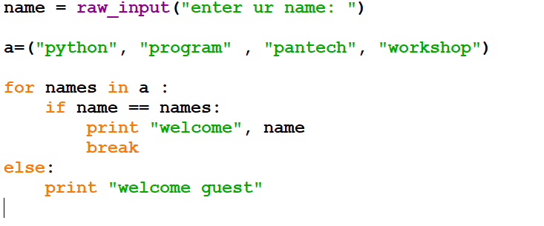
Example:

Slide 28
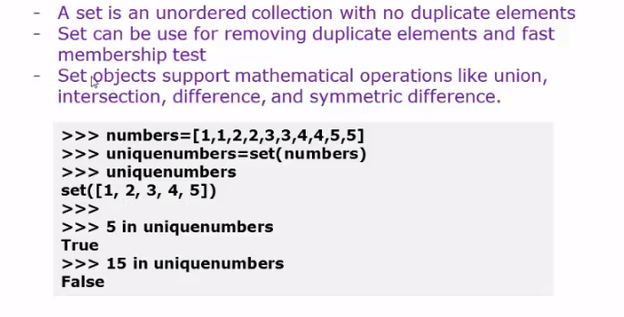
Set

Slide 29
Function
A function is a block of organized, reusable code that is used to perform a single or related tasks.
Python gives in-built functions like print() , you can make your own function also and this are called user-defined-functions
Function blocks begin with the keyword def followed by the function name and parentheses ( ( ) ).

Slide 30
Function without arguments
Function with one argument
Function with two arguments
Keyword Argument

Slide 31
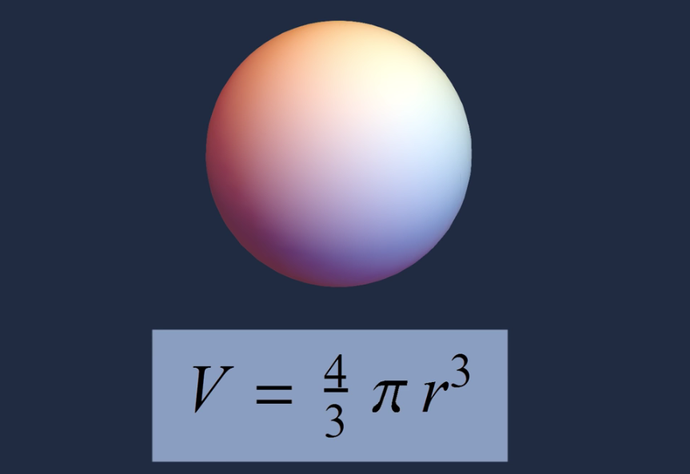
Volume of Sphere

Slide 32
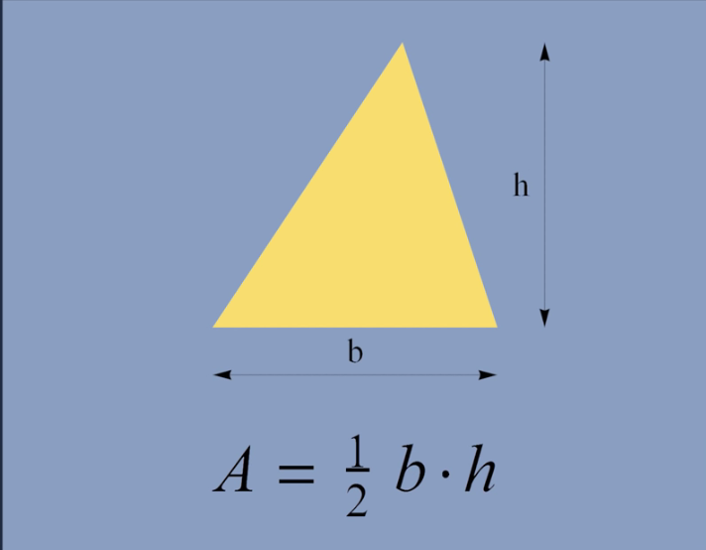
Area of Triangle

Slide 33
Types of arguments
Keywords
Required
Combination of keyword and required, always required should be preferred first
Ex: der g(x=0,y):
return x+y (WRONG WAY)
Ex : def g(y, x=0):
return x+y (Correct way)

Slide 34
Modules
Make your own modules
Use in built Modules
Usage
The import Statement
example :
import module1[, module2[,... moduleN]

Slide 35
Two Libraries
cv2 : OpenCV-Python is a library of Python bindings designed to solve computer vision problems.
NumPy : is a library for the OpenCV-Python, which is a highly optimized library for numerical operations with a MATLAB-style syntax. All the OpenCV array structures are converted to and from Numpy arrays.

Slide 36
TO READ, SHOW AND WRITE A IMAGE
cv2.imread() :
This function is used to read the image
ex: cv2.imread(‘sea.jpg’, 0) # greyscale, color, unchanged(0,1,-1)
cv2.show() :
this function is used to show the frame.
ex: cv2.imshow(‘scenery’, img)
cv2.waitKey()
cv2.destroyAllWindows() or cv2.destroyWindow(‘scenery’)
Ex program:
import numpy
import cv2
img =cv2.imread(‘sea.jpg’,0)
cv2.imshow(‘scenery’, img)
cv2.waitKey(0)
cv2.destroyAllWindows()

Slide 37
cv2.imwrite() :
This function will save the image
ex: cv2.imwrite(‘duplicate.jpg’, img)
Sum-up Program :
import numpy as np
import cv2
img = cv2.imread(‘sea.jpg’,0)
cv2.imshow(‘scenery’, img)
k= waitKey(0)
if k == 27: # escape key
cv2.destroyAllWindows()
if k == ord(‘s’):
cv2.imwrite(‘duplicate.jpg’,img)

Slide 38
Image Properties
img = cv2.imread(‘sea.jpg’)
print img.shape
print img.size
print img.dtype
Crop an image
img = cv2.imread(‘sea.jpg’)
print img.shape
print img.size
print img.dtype
crp=img[720:850,650:700]
cv2.imshow(‘image',crp)

Slide 39
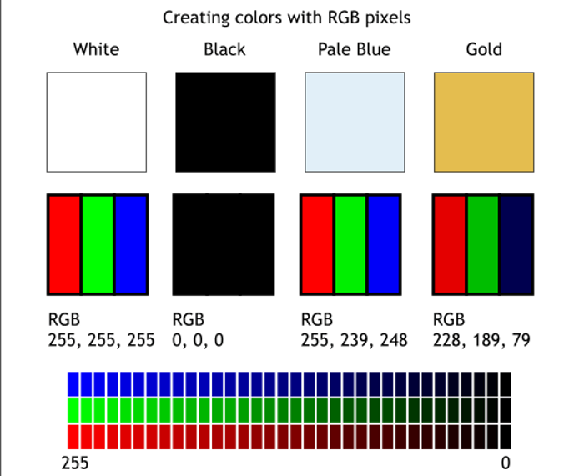

Slide 40
Drawing Functions
cv2.line()
cv2.rectangle()
cv2.circle()
Cv2.putText()
Common arguments :
Image
Color [BGR, tuple (255,0,0)]
Thickness [1 and -1]

Slide 41
LINE
import numpy as np
import cv2
#create a black image
img= np.zeros((512,512,3),np.uint8)
cv2.line(img,(511,20),(511,511),(255,0,0),5)
cv2.imshow('frame',img)
cv2.waitKey(0)

Slide 42
Rectangle
import numpy
import cv2
#create a black image
img= np.zeros((512,512,3),np.uint8)
cv2.rectangle(img,(384,0),(510,128),(0,255,0),3)
cv2.imshow('frame',img)
cv2.waitKey(0)

Slide 43
Circle
import numpy
import cv2
#create a black image
img= np.zeros((512,512,3),np.uint8)
cv2.circle(img,(447,63), 63, (0,0,255), -1)
cv2.imshow('frame',img)
cv2.waitKey(0)

Slide 44
Put Text
import numpy
import cv2
#create a black image
img= np.zeros((512,512,3),np.uint8)
font = cv2.FONT_HERSHEY_SIMPLEX
cv2.putText(img,'OpenCV',(10,500), font,4,(255,255,255),2)
cv2.imshow('frame',img)
cv2.waitKey(0)

Slide 45
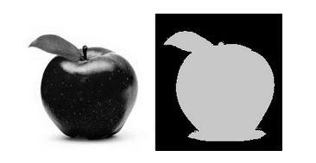

Slide 46
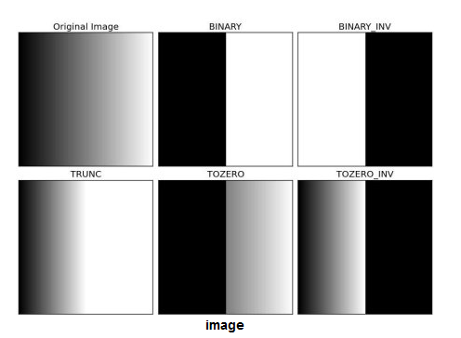

Slide 47
Thresholding
import numpy
import cv2
img = cv2.imread('straw.jpg',0)
ret,thresh1 = cv2.threshold(img,127,255,cv2.THRESH_BINARY)
ret,thresh2 = cv2.threshold(img,127,255,cv2.THRESH_BINARY_INV)
ret,thresh3 = cv2.threshold(img,127,255,cv2.THRESH_TRUNC)
ret,thresh4 = cv2.threshold(img,127,255,cv2.THRESH_TOZERO)
ret,thresh5 = cv2.threshold(img,127,255,cv2.THRESH_TOZERO_INV)

Slide 48
Grayscale Conversion of Video
cv2.cvtColor( frame, cv2.COLOR_BGR2GRAY)
Program :
import numpy
import cv2
cap = cv2.VideoCapture(0)
while True:
ret, frame = cap.read()
gray = cv2.cvtColor( frame, cv2.COLOR_BGR2GRAY)
cv2.imshow(‘greyscale’, gray)
if cv2.waitKey(1) & 0xFF == 27:
break
cap.release()
cv2.destroyAllWindows()

Slide 49
Video
Program :
import numpy
import cv2
cap=cv2.VideoCapture(0)
while True:
ret, frame = cap.read()
cv2.waitKey(1)
cv2.imshow('myVideo',frame)
cap.release()
cv2.destroyAllWindows()

Slide 50
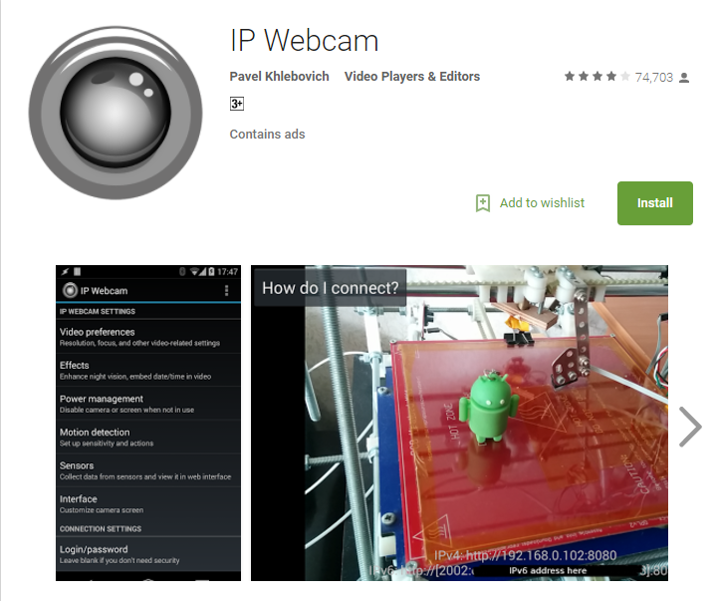
IP WEBCAM

Slide 51
Modules
URLLIB
NUMPY
CV2

Slide 52
import urllib
import cv2
import numpy as np
url="http://192.168.1.29:8080/shot.jpg"
while True:
imgPath=urllib.urlopen(url)
imgNp=np.array(bytearray(imgPath.read()),dtype=np.uint8)
img=cv2.imdecode(imgNp,-1)
cv2.imshow("frame",img)
if ord('q') == cv2.waitKey(10):
exit(0)

