Slide 1
INTERNET OF THINGS (IoT)

Slide 2

Contents
What is IOT
Where is IOT
Why IOT
IOT Market
Attacking IOT
Case Study
Architecture
Conclusion

Slide 3
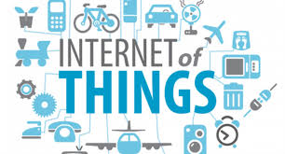
What is IOT?
The Internet of Things (IoT) is the network of physical objects—devices, vehicles, buildings and other items embedded with electronics, software, sensors, and network connectivity—that enables these objects to collect and exchange data.

Slide 4
Various Names
M2M (Machine to Machine)
“Internet of Everything” (Cisco Systems)
“World Size Web” (Bruce Schneier)
“Skynet” (Terminator movie)

Slide 5
What are the “Things” in the IOT?
Could be anything
Physical
Virtual
Internet of Things (IOT) is an integrated part of Future Internet and could be defined as a dynamic global network infrastructure with self configuring capabilities based on standard and interoperable communication protocols where physical and virtual 'things' have identities, physical attributes, and virtual ...

Slide 6
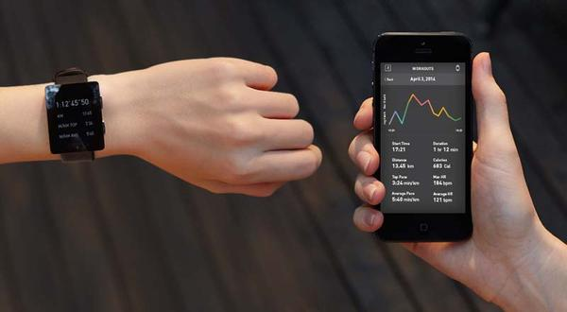
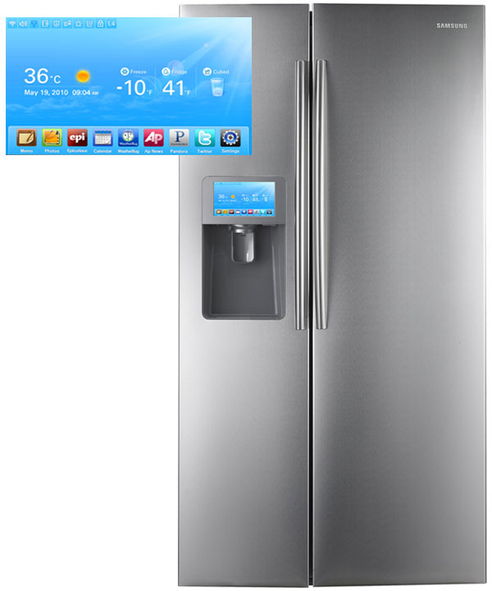
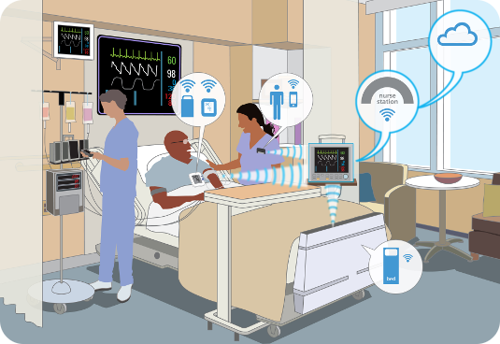
Where is IoT?
It’s everywhere!
Wearable Tech
Smart Appliances
Healthcare

Slide 7
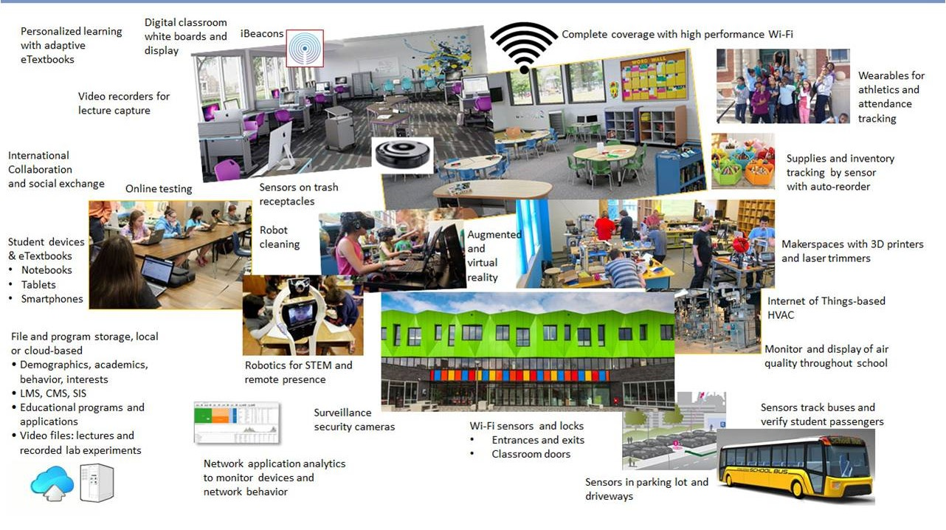
The smart IOT School

Slide 8
Why IOT?
Generate, collect, process and use acquired information to make better decisions
Smart objects: Make things that weren’t meant to talk to each other interact smartly
Gartner says the Internet of Things installed base will grow to 26 Billion units by 2020; I want to be well aligned and prepared for that

Slide 9
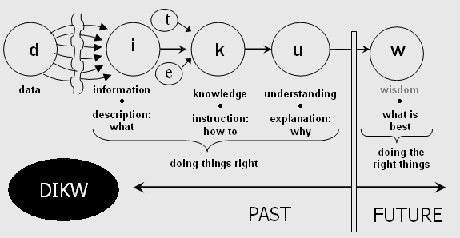
Generate, collect, process and use acquired information to make decisions
DIKW model
Information is inferred from data, in the process of answering interrogative questions (e.g., "who", "what", "where", "how many", "when"), thereby making the data useful for "decisions and/or action".
Knowledge as "synthesis of multiple sources of information over time"

Slide 10
Smart objects: Make things that weren’t meant to talk to each other interact smartly
Phone → Location detection, presence detection → Thermostat
Doorbell activation → CCTV takes picture→ Email + SMS + Tweet
Fire Alarm → Email + SMS
Security System→ CCTV → Email + SMS
Climate control → presence @ home & weather forecast
Hot water tank 1 ← → Hot water tank 2 ← → our presence, weather forecast
Dog→ CCTV + Email
Weather notifications → email

Slide 11

Why we concerned about IOT?
It’s just another computer, right?
All of the same issues we have with access control, vulnerability management, patching, monitoring, etc.
Imagine your network with 1,000,000 more devices
Any compromised device is a foothold on the network

Slide 12

The IOT Market
As of 2013, 9.1 billion IOT units
Expected to grow to 28.1 billion IOT devices by 2020
Revenue growth from $1.9 trillion in 2013 to $7.1 trillion in 2020

Slide 13

Attacking IOT
Default, weak, and hardcoded credentials
Difficult to update firmware and OS
Lack of vendor support for repairing vulnerabilities
Vulnerable web interfaces (SQL injection, XSS)
Coding errors (buffer overflow)
Clear text protocols and unnecessary open ports
DOS / DDOS
Physical theft and tampering

Slide 14
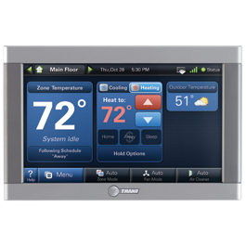
Case Study: Trane
Connected thermostat vulnerabilities detected by Cisco’s Talos group
allowed foothold into network
12 months to publish fixes for 2
vulnerabilities
21 months to publish fix for
1 vulnerability
Device owners may not be
aware of fixes, or have the
skill to install updates

Slide 15
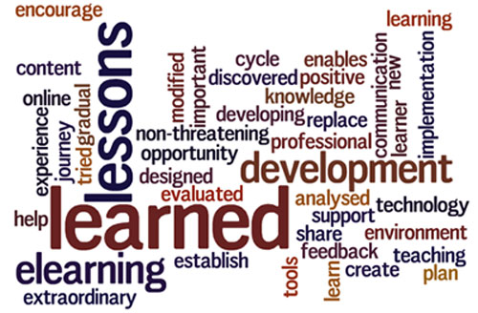
Case Study: Lessons Learned
All software can contain vulnerabilities
Public not informed for months
Vendors may delay or ignore issues
Product lifecycles and end-of-support
Patching IOT devices may not scale in large environments

Slide 16
Threat vs. Opportunity
If misunderstood and misconfigured, IOT poses risk to our data, privacy, and safety
If understood and secured, IOT will enhance communications, lifestyle, and delivery of services

Slide 17
Challenges
Global cooperation
Proprietary and incompatible protocols
Lack of APIs
Example: Common external power supply
Technological challenges
Power usage
Scalability
Security
Communication mechanisms
Ethics, control society, surveillance, consent and data driven life

Slide 18
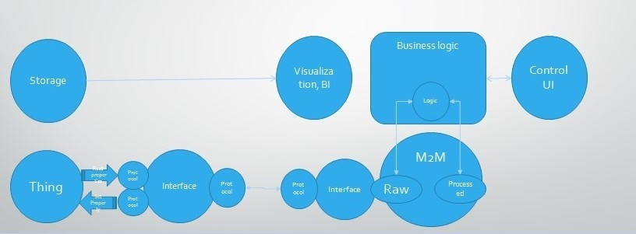
IOT Architecture

Slide 19
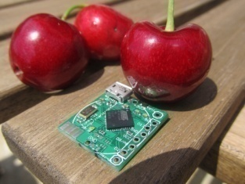
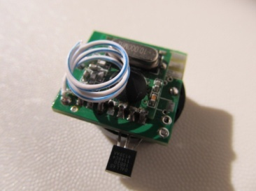
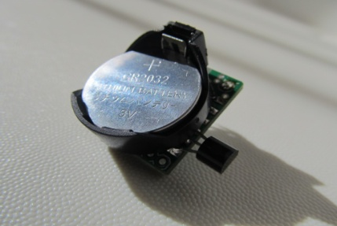
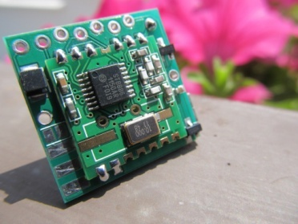
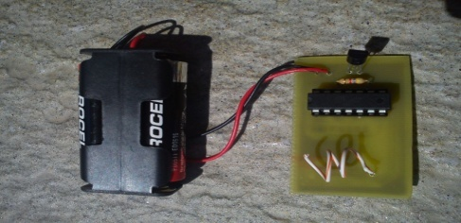
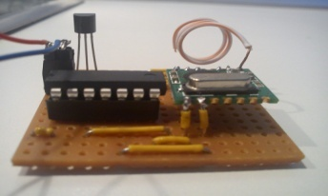
The hardware interface to “things” in Home Automation
The ‘Funky’ project
It is an Arduino-compatible multi purpose micro that is:
Very small: 20×21.2mm (0.78″x0.83″)
Very light: 3 grams
Low power (up to 1 year on coin cell battery)
Wireless capable (RFM12B transceiver)

Slide 20
Conclusion
The future of IOT is virtually unlimited due to advances in technology and consumers' desire to integrate devices such as smart phones with household machines.

Slide 21
Any Queries

Slide 22
References
http://www.utsystem.edu/offices/board-regents/uts165-standards
https://securityintelligence.com/the-importance-of-ipv6-and-the-internet-of-things/
http://www.isaca.org/Knowledge-Center/Research/ResearchDeliverables/Pages/internet-of-things-risk-and-value-considerations.aspx
https://www.owasp.org/images/7/71/Internet_of_Things_Top_Ten_2014-OWASP.pdf
https://www.owasp.org/images/3/36/IoTTestingMethodology.pdf
http://blog.sec-consult.com/2015/11/house-of-keys-industry-wide-https.html
http://blog.trendmicro.com/trendlabs-security-intelligence/high-profile-mobile-apps-at-risk-due-to-three-year-old-vulnerability/#
http://www.rs-online.com/designspark/electronics/knowledge-item/eleven-internet-of-things-iot-protocols-you-need-to-know-about
https://thenewstack.io/tutorial-prototyping-a-sensor-node-and-iot-gateway-with-arduino-and-raspberry-pi-part-1
http://www.business.att.com/content/article/IoT-worldwide_regional_2014-2020-forecast.pdf
http://blog.talosintel.com/2016/02/trane-iot.html
http://krebsonsecurity.com/2016/02/iot-reality-smart-devices-dumb-defaults/
http://www.gsma.com/connectedliving/gsma-iot-security-guidelines-complete-document-set/

Slide 23
Thank You

