Slide 1
LIFI-LIGHT FIDELITY

Slide 2
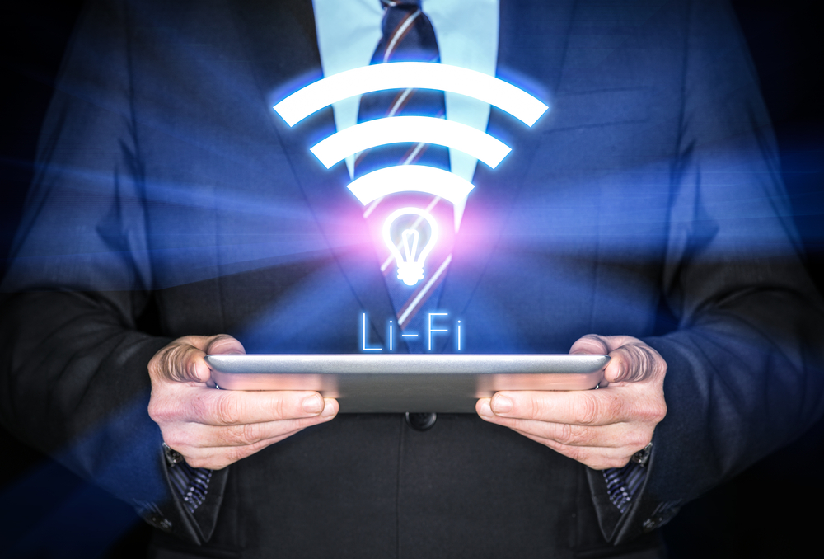

Slide 3

CONTENTS
History
What is Li-Fi?
Why is it required?
Why LIGHT as the medium?
Comparison with Electro Magnetic Spectrum
How it works?
LiFi over WiFi
Applications
Disadvantages
Ideas for more applications of this technology
Rise Krishna Sai Prakasam Group Of Institutions,Ongole

Slide 4
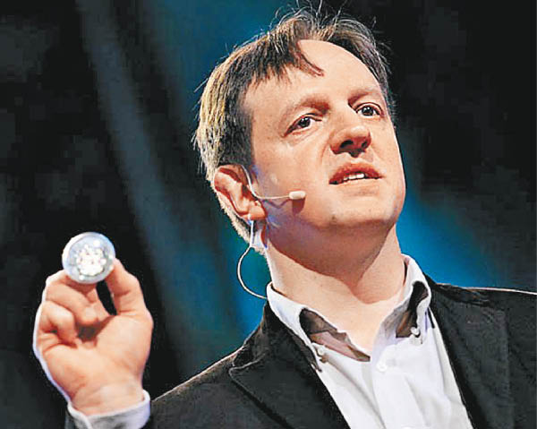

HISTORY
This technology was invented by German Physicist “HARALD HASS”, from the university of Edinburgh,U.K.
He demonstrated it in the year 2012.
Edinburgh University , U.K
Rise Krishna Sai Prakasam Group Of Institutions,Ongole

Slide 5

What is Li-Fi
Light Fidelity (Li-Fi) is a high-speed and fully networked wireless communication technology similar to Wi-Fi. The term was coined by Harald Haas and is a form of visible light communication and a subset of optical wireless communications (OWC) and could be a complement to RF communication (Wi-Fi or cellular networks), or even a replacement in contexts of data broadcasting.
Rise Krishna Sai Prakasam Group Of Institutions,Ongole

Slide 6
Why is it required?
CAPACITY : Spectrum is 10,000 times greater than that of radio frequency.
EFFICIENCY : Highly efficient since LED uses less energy.
AVAILABILITY : It is available everywhere since light is available all round the earth.
SECURITY : Cannot penetrate through walls. Hence cannot be intercepted.
Rise Krishna Sai Prakasam Group Of Institutions,Ongole

Slide 7
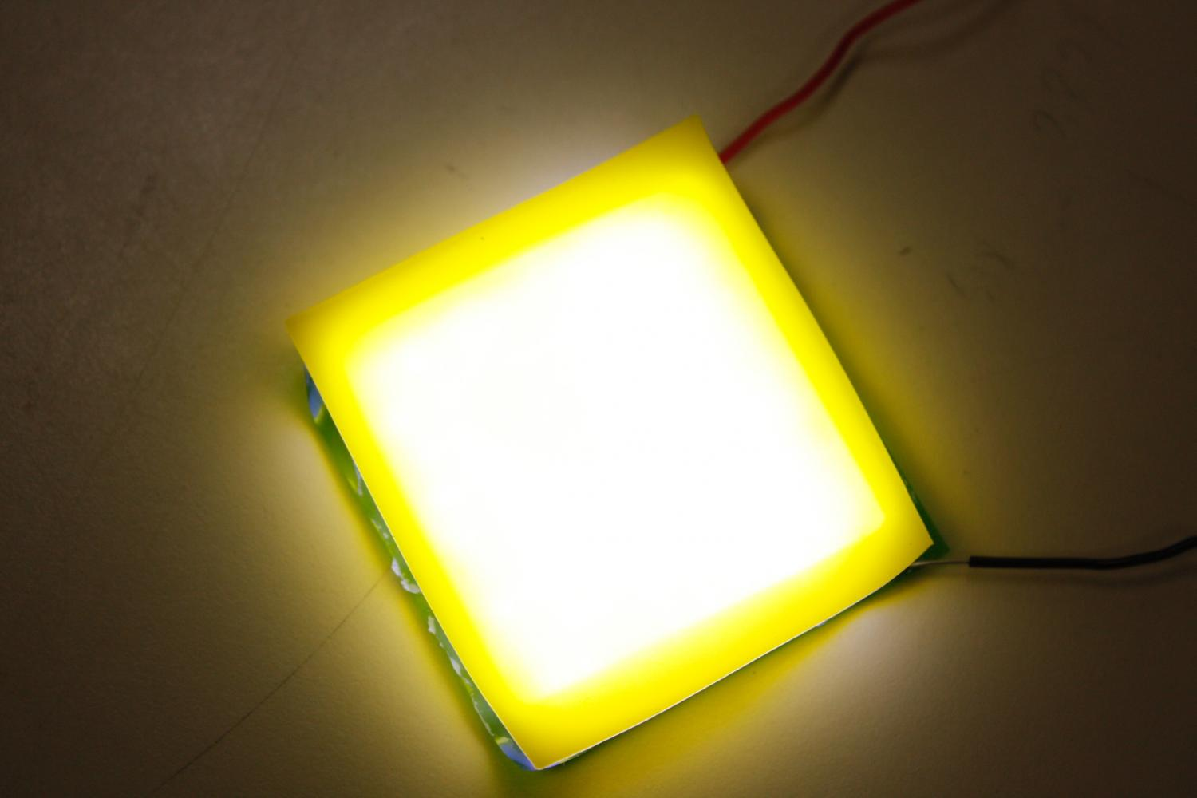

Why LIGHT as the medium?
Light has been around for many millions of years.
Light is a non-harmful medium.
Light is the thing that created life.
Light is a part of the electromagnetic spectrum.
Light is available every where.
Rise Krishna Sai Prakasam Group Of Institutions,Ongole

Slide 8
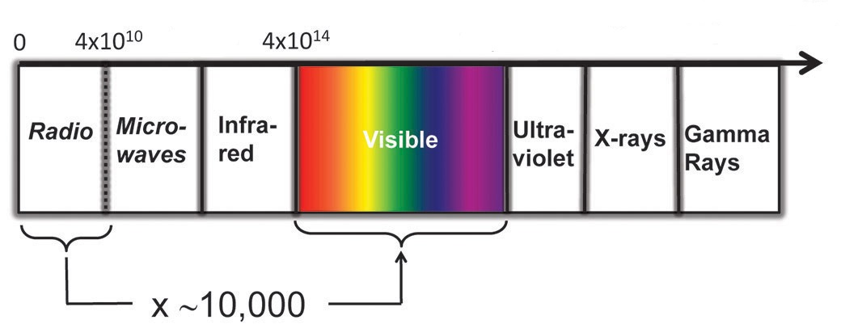
Comparison within E M Spectrum
Gamma rays, X-rays, U V rays are highly dangerous and must be used only with utmost care and under surveillance of higher authorities.
Infrared rays are also exceptional due to eye safety regulations.
Radio waves are already used in Wi-Fi technology which has only shorter range.
Rise Krishna Sai Prakasam Group Of Institutions,Ongole

Slide 9
How it works?
Operational procedure is very simple.
LED varies in intensity that human eye can’t see.
If LED is ON, digital data ‘1’ is transmitted and if LED is OFF, digital data ‘0’ is transmitted.
A controller connected at the backside of these LED’s is used to code data.
Thus we can be able to transfer the data as data is compiled to the machine understandable code (Binary Code).
At last we get the data with a greater speed i.e., >1GbPS .
Rise Krishna Sai Prakasam Group Of Institutions,Ongole

Slide 10
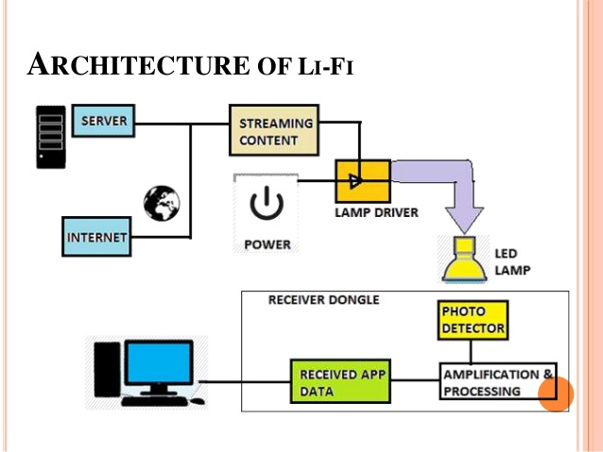
Working
Rise Krishna Sai Prakasam Group Of Institutions,Ongole

Slide 11
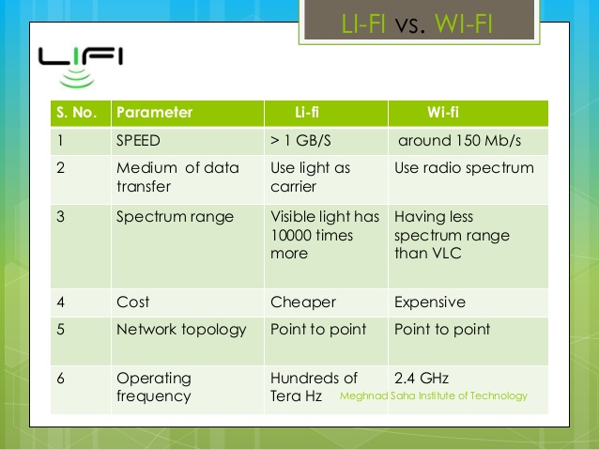


Li-Fi over Wi-Fi
Rise Krishna Sai Prakasam Group Of Institutions,Ongole

Slide 12
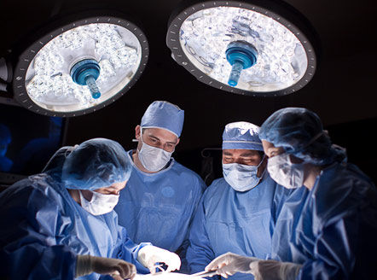
APPLICATIONS
Health sector: Since WIFI is not safe to be used in hospitals and other various health care sectors because it penetrates human body. LIFI can be implemented and well suit in this sector.
Rise Krishna Sai Prakasam Group Of Institutions,Ongole

Slide 13
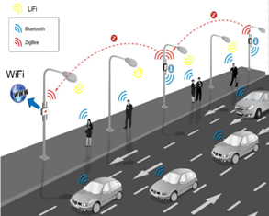
Internet anywhere: street lamps, light of vehicles can be used to access internet anywhere in footpaths, roads, malls, anywhere where light source is available.
Rise Krishna Sai Prakasam Group Of Institutions,Ongole

Slide 14
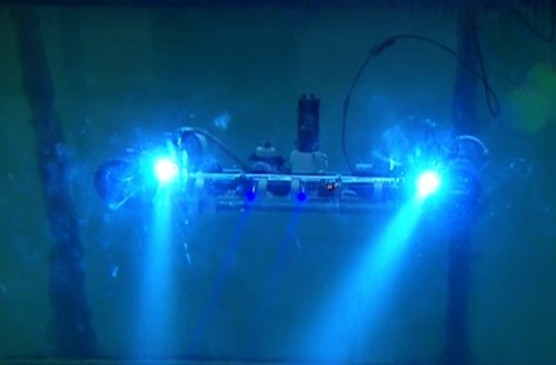
Underwater communications: Since radio waves cannot be used under water because these waves are strongly absorbed by sea water within feet of their transmission and this renders it unusable underwater but LIFI is suitable for underwater communication
Rise Krishna Sai Prakasam Group Of Institutions,Ongole

Slide 15
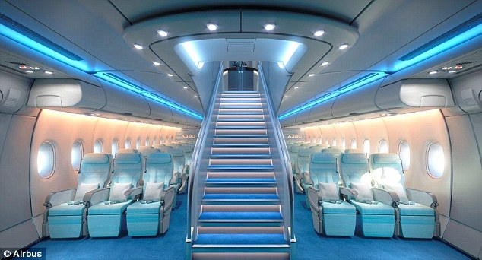
Air Crafts : The whole airways communication is performed on the basis of radio waves. So Wi-Fi usage is strictly prohibited in aircrafts. So Li-Fi is used in these cases that doesn’t trouble the radar signals.
Rise Krishna Sai Prakasam Group Of Institutions,Ongole

Slide 16
DISADVANTAGES
Nothing in this world is perfect and so does LIFI.
These signals cannot penetrate walls. So the person needs wired bulb in that room also.
Only works if there is direct line of sight between source
and receiver.
Used for broadcast and it is difficult to uplink.
Rise Krishna Sai Prakasam Group Of Institutions,Ongole

Slide 17
IDEAS FOR MORE APPLICATIONS :
Instant data transfer between the devices : The high speed transfer of the LED’s can be used to transfer the data between the devices.
Automatic navigation for the visitors.
Navigation System : Since visible light is present everywhere, we can create internal navigation systems for the bigger areas to create automated machinery.
Rise Krishna Sai Prakasam Group Of Institutions,Ongole

Slide 18
CONCLUSION
Hence I conclude that Li-Fi makes a new revolution in the history of internet and even it is the fastest way ever for the transmission of data
Li-Fi is the future of internet
Rise Krishna Sai Prakasam Group Of Institutions,Ongole

Slide 19


Slide 20

ANY QUERIES?

